Slide 1
FIR ,IIR and Delay function in sample Audio Pass through code – Design and Programs 19 Sept 2024

Slide 2
What is DSP ?
Digital Signal Processors (DSP) take real-world signals like voice, audio, video, temperature, pressure, or position that have been digitized and then mathematically manipulate them.
A DSP is designed for performing mathematical functions like "add", "subtract", "multiply" and "divide" very quickly.

Slide 3
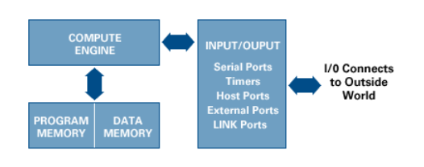
Inside DSP
Program Memory - This is where the instructions or programs that the DSP will execute are stored.
Data Memory - Data memory is where the information to be processed is stored.
Compute Engine - The compute engine is the heart of the DSP. It’s used for executing the instructions from the program memory on the data stored in the data memory.
Input/Output

Slide 4
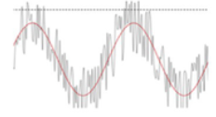
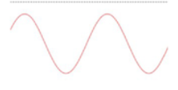
Introduction - Filter
In Signal Processing , the function of a filter is to remove unwanted parts of the signal, such as random noise, or to extract useful parts of the signal, such as the components lying within a certain frequency range.
Raw Signal
FILTER
Filtered Signal

Slide 5
Types of Filter
Digital Filter | Analog Filter
High Accuracy | Less Accuracy –Component Tolerance
Linear Phase( FIR filter) | Non - Linear Phase
No Drift Due to component variations. | Drift Due to component variations.
Easy to simulate and design. | Difficult to simulate and design.
Computation Must be completed in sampling Period – Limits in Real time operation | Analog Filter required at High frequencies and for Anti –Aliasing Filter
Required High Performance ADC,DAC & DSP. | No ADC, DAC or DSP required.
Flexible ,Adaptive Filtering Possible | Adaptive Filters Difficult.

Slide 6
What is an Ideal Filter ?
Ideal Low-Pass Filter (LPF)
Ideal High-Pass Filter (HPF)
Ideal Band-Pass Filter (BPF)
Ideal Band-Reject Filter (BRF)

Slide 7
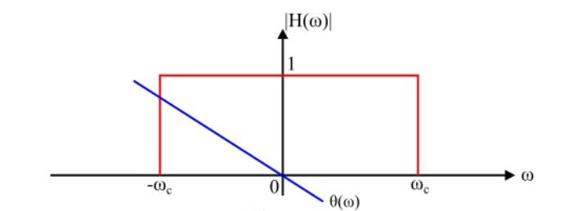
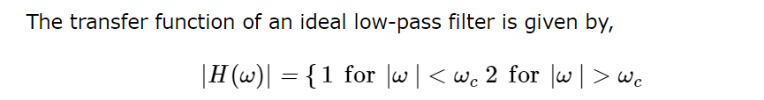
Ideal Filter LPF
It Passes all frequency below a particular cut off frequency, and reject or attenuate other frequency

Slide 8
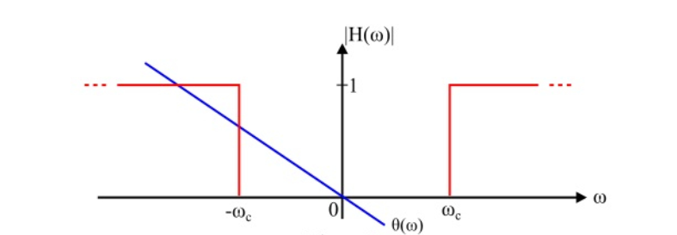
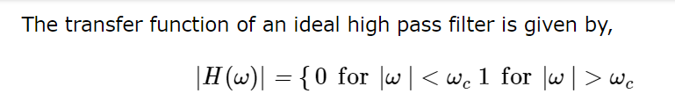
Ideal Filter HPF
It Passes all frequency above particular cut off frequency, and reject or attenuate other frequency

Slide 9
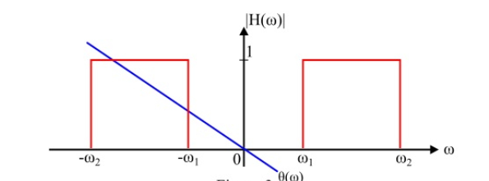
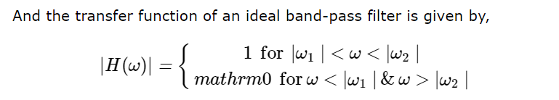
Ideal Filter BPF
It Passes all frequency in a particular band , and reject or attenuate other frequency

Slide 10
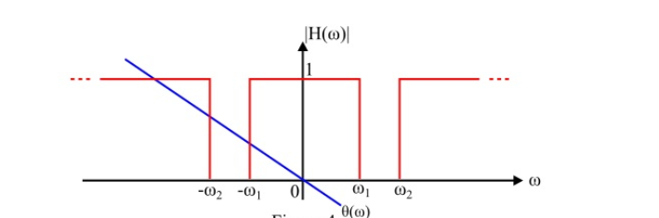
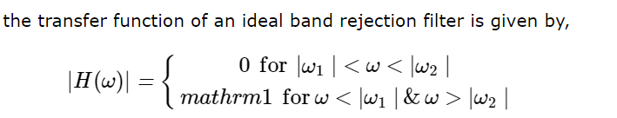
Ideal Filter BRF
It reject or attenuate all frequency in a particular band , passes all other frequencies

Slide 11
FIR
IIR

Slide 12
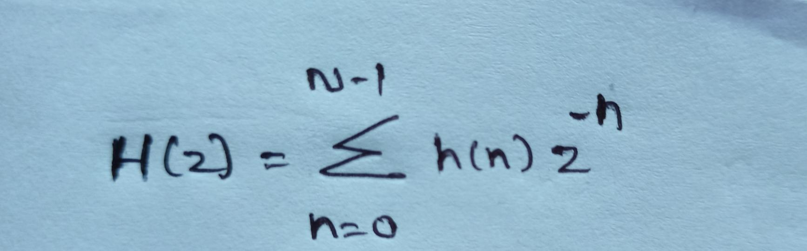
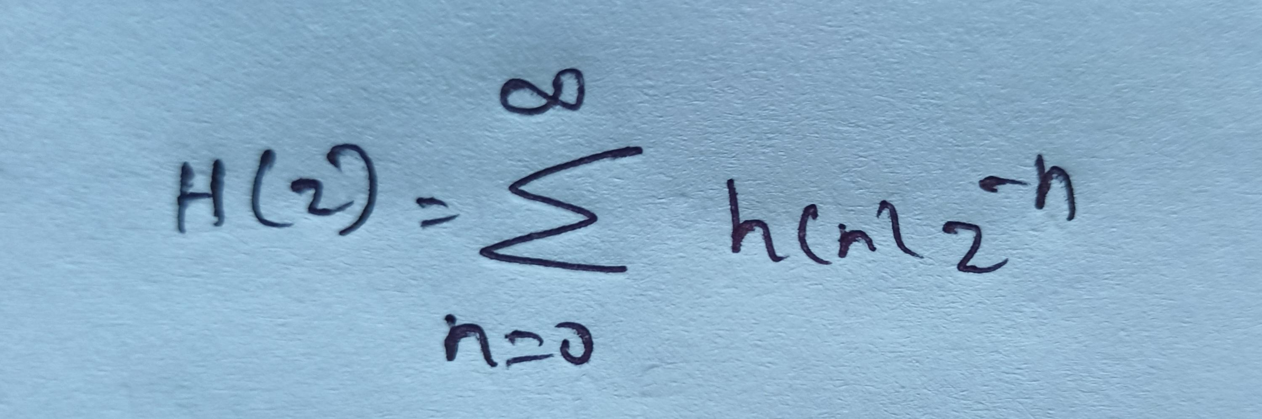
FIR Filter | IIR Filter
Finite Impulse Response Filter | Infinite Impulse Response Filter
The Impulse response h(n) is finite in duration. | The impulse response h(n) is infinite in duration.
Transfer function | Transfer function
Poles and Zeros; All – Zero filters | Poles and Zeros: All pole filter Poles as well as zeros are present
Linear phase response | Non – Linear phase response
It can be realized recursively and non - recursively | Recursive filter

Slide 13
FIR Filter | IIR Filter
Feedback is not required. | Feedback is required.
Less memory requirement. | More Memory.
FIR filters are always stable. | IIR filters are not stable.
Closed loop equations do not exist for designing FIR filters. | It can be designed using closed from equations.
Poles are fixed at the origin. | Poles are placed anywhere inside the unit circle.
More computations [More Multiplications] | Less computations
Less complicated in design procedure | More Complexity
Applications : Used where linear phase characteristics are required. | Applications : Used where sharp cut-off characteristics are required.

Slide 14
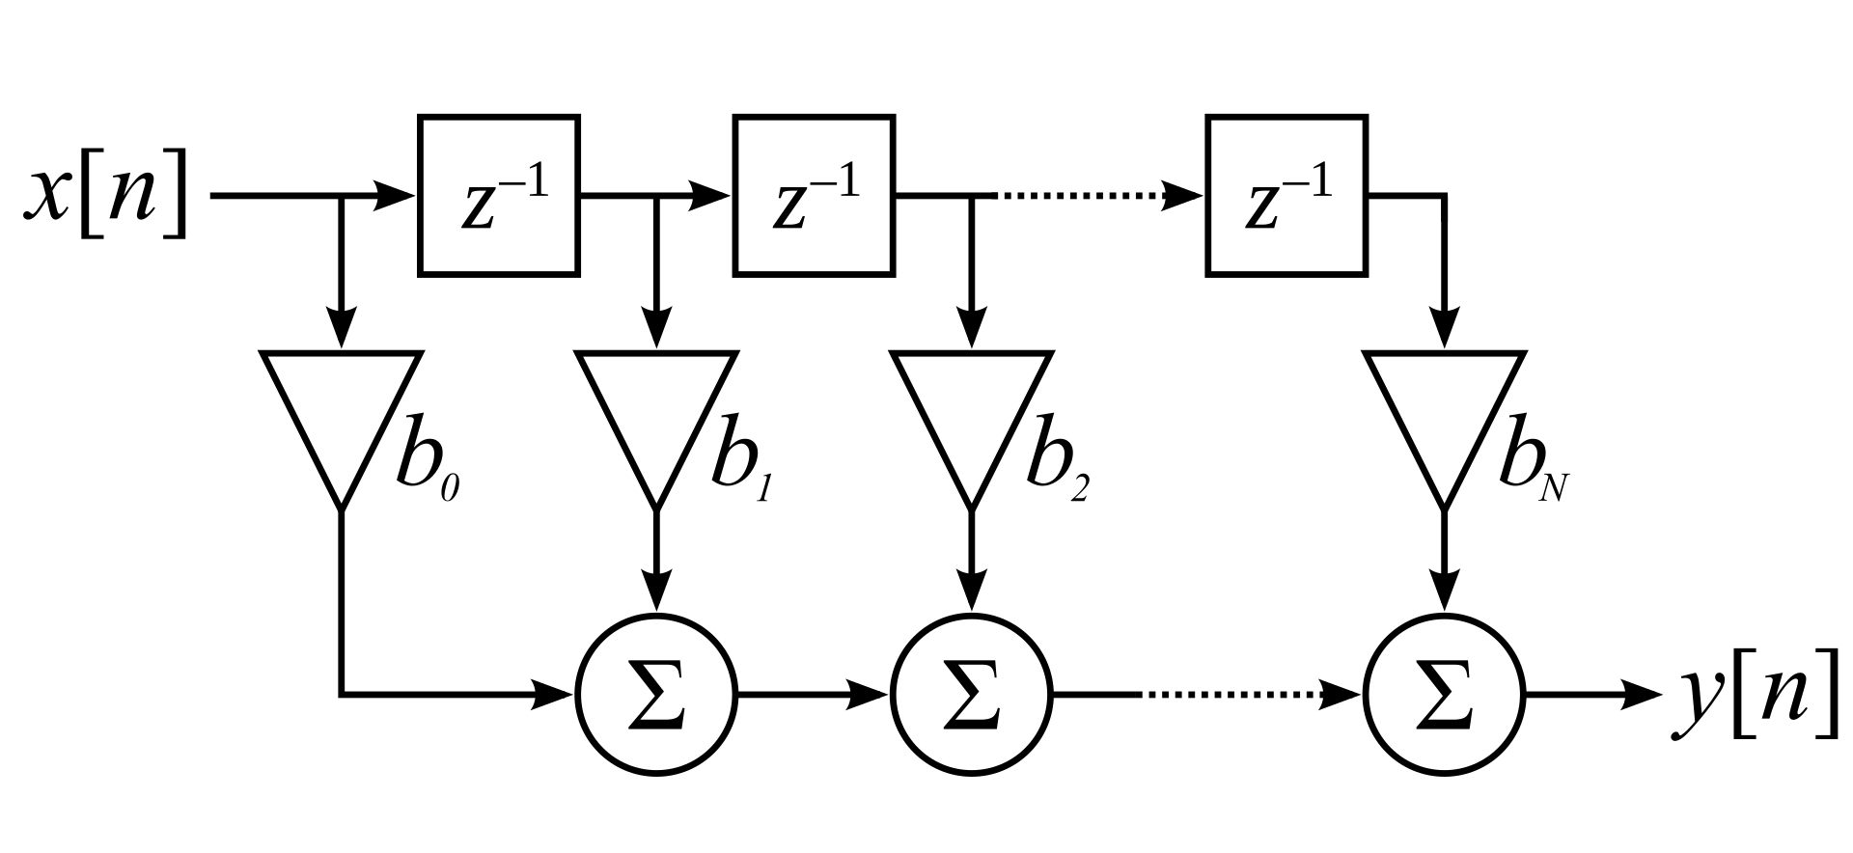
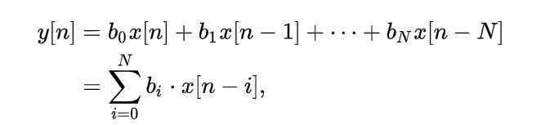
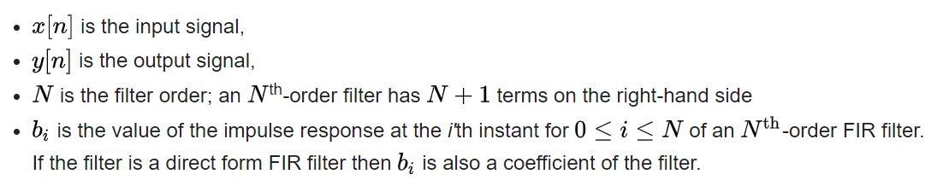
FIR Filter

Slide 15
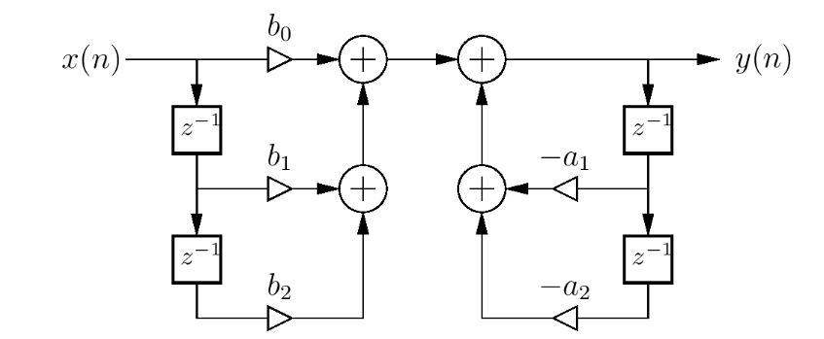
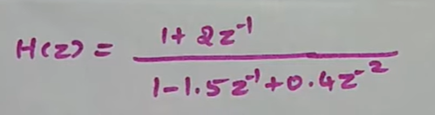
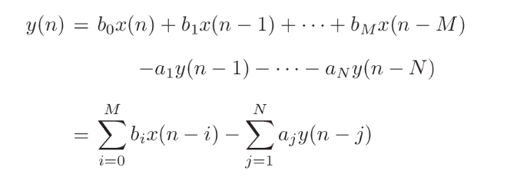
IIR Filter - Direct From – I (2nd Order Digital Filter)
Exercise :
Draw the Direct form – I Structure

Slide 16
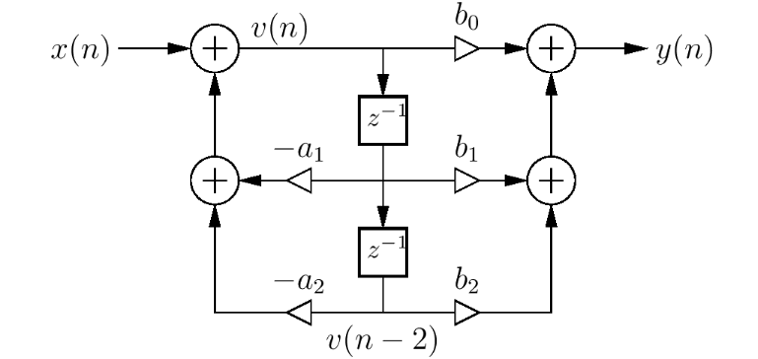
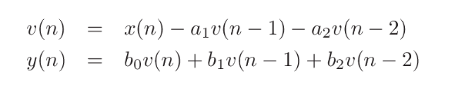
IIR Filter - Direct From – II (2nd Order Digital Filter)
Exercise :
Draw the Direct form – II Structure

Slide 17
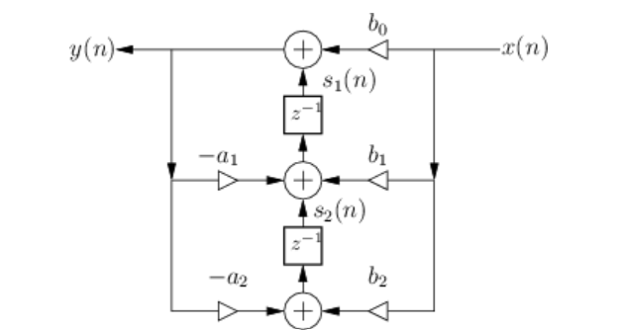
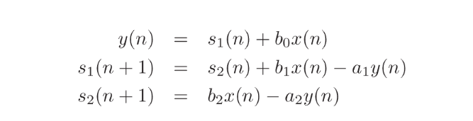
IIR Filter - Transpose Direct From – II (2nd Order Digital Filter)

