Slide 1
ATMOS, DTSX, CrossUpmixing, Command Protocol, Channel Re-order
Oct 2024

Slide 2

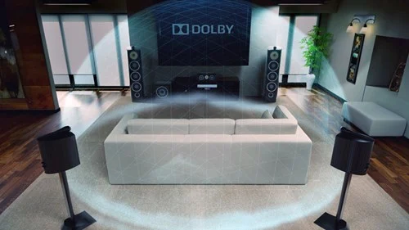
Dolby Atmos Music is an immersive music experience that adds more space, clarity, and depth to your music. Instead of just hearing your music — with Dolby, it feels like you’re inside the song.
©2022 Jasmin Infotech Private Limited
JASMIN CONFIDENTIAL
2

Slide 3
Atmos : It’s really all about the objects, and the ability to place, move, and size those objects within the sound field.
Max channel supported for Soundbar : 16 [9.1.6]
Default up mixing : DAP
Types :
DD - Dolby Digital (.ac3)
DDP - Dolby Digital Plus (.ec3),
MAT - Metadata-enhanced Audio Transmission (TrueHD [.mlp], MAT PCM [.mat])
Supported Devices : Soundbar, AVR, Theatres, Smart TV, Xbox, Streaming services (I.e: Apple TV,Netflix),Laptops, Tablets & Smart Phone …..etc
Note : The Max channel support is applicable for GUL SDK implemented in Jasmin.

Slide 4
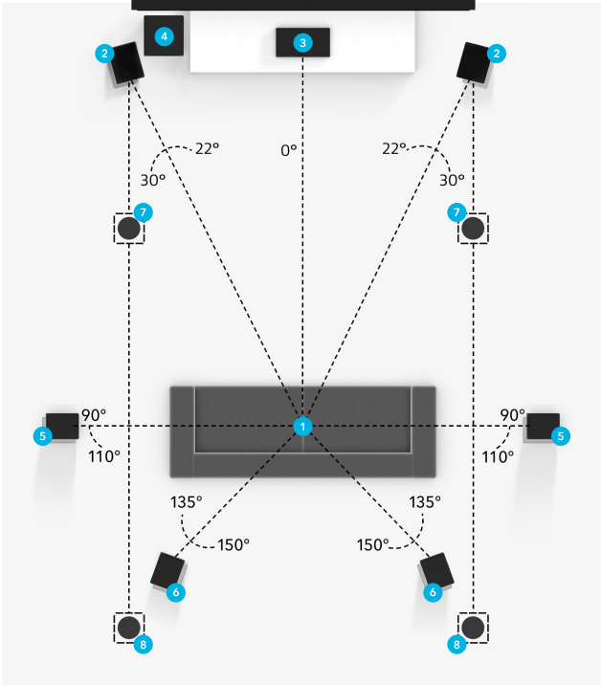
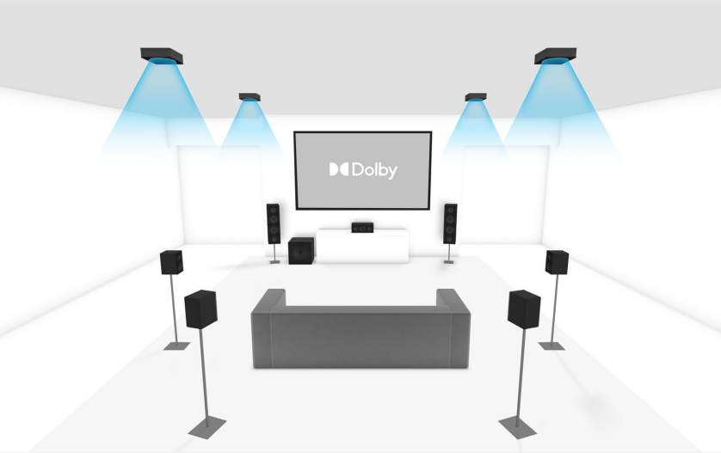
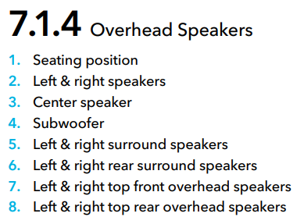

Slide 5
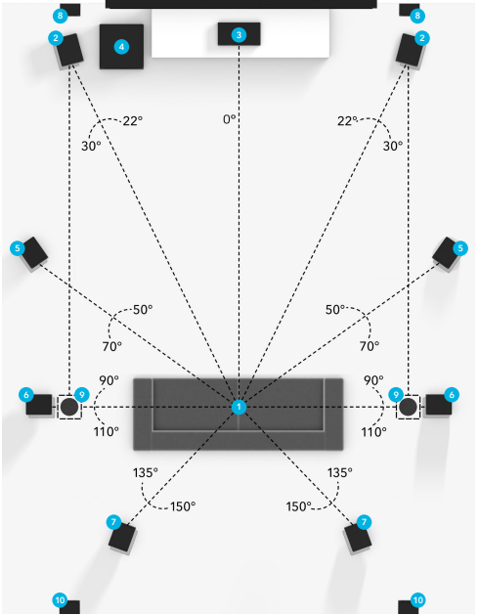
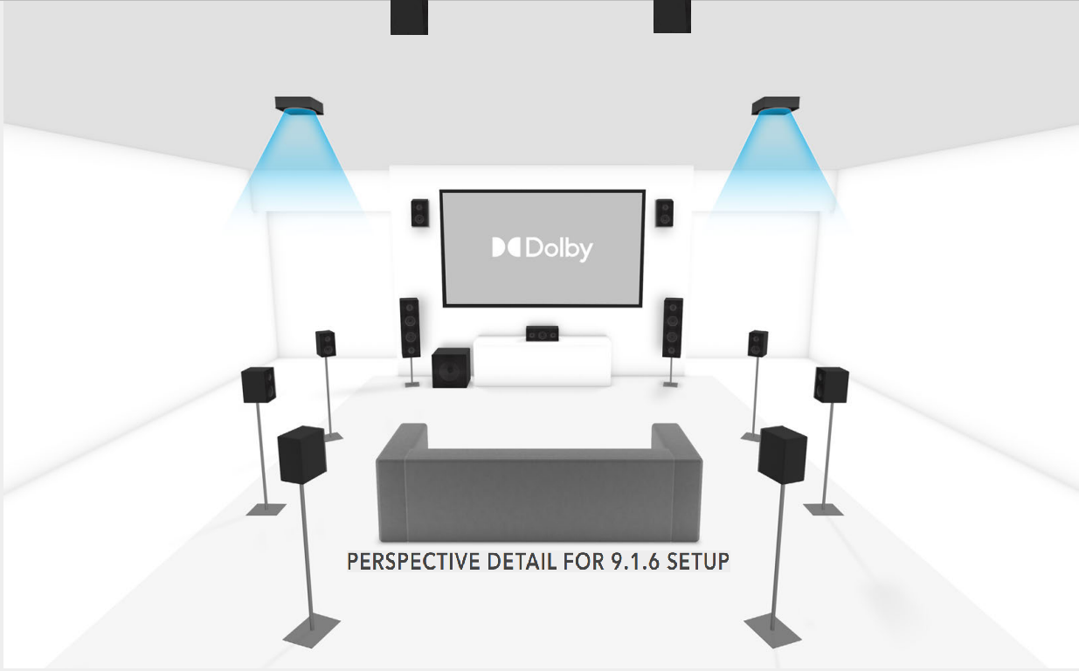
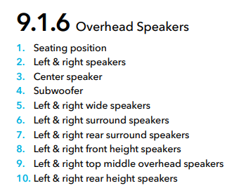

Slide 6



Slide 7
DTS X: Digital Theater Systems with object-based audio.
Max channel supported for Soundbar : 12 [7.1.4]
Default up mixing : NeuralX
Types :
DTS CD/LD [Unformated]
DTS DVD [Formatted]
DTS HD MA
DTS HD HR
DTS LBR
Supported Devices : Theatres, Soundbar, AVR, Smart TV, Xbox Laptops, Tablets & Smart Phone….. etc
Note : The Max channel support is applicable for GUL SDK implemented in Jasmin.

Slide 8
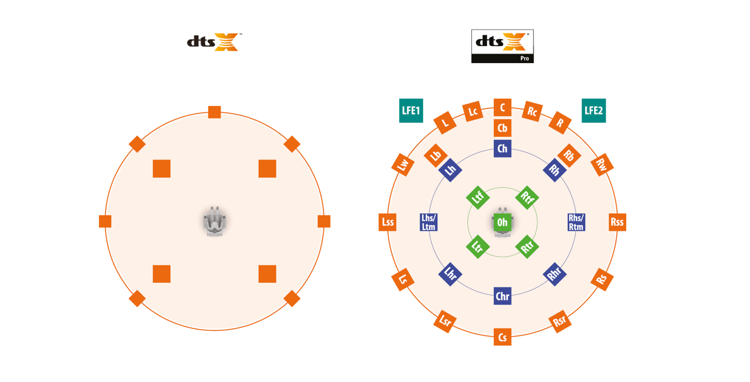
Speaker

Slide 9
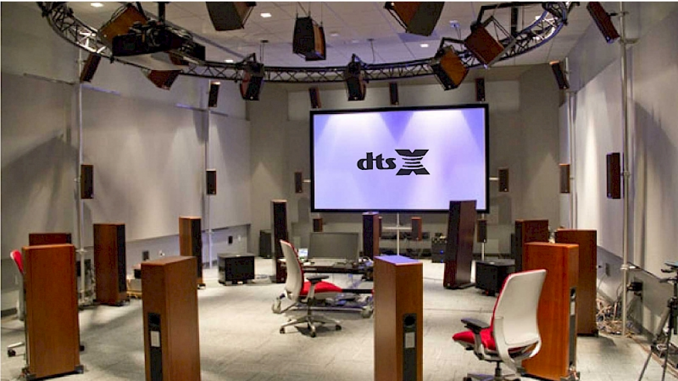

Slide 10
Dolby Vs DTS
Dolby | DTS
bit-rate of 640 kbits/s (kilobits per second) for Blu-ray discs. | higher bit-rates of up to 1.5Mb/s (megabits per second)
DVD discs, it supports a slightly lower bit-rate: up to 448 kbits/s. | DVD discs also have 1.5Mb/s bit-rate, though most have a soundtrack encoded at 754kbps.
In HD formats Dolby Digital Plus supports up to 1.7Mbps. | DTS-HD High Resolution supports up to 6Mb/s.
Dolby Lossless audio - TrueHD | DTS Lossless audio - DTS Master Audio
Dolby Lossy audio – Dolby Digital | DTS Lossy audio - DTS CA

Slide 11
Upmixing
Up-Mixing/Down-Mixing:
Increasing/decreasing the number of channels according to the available speaker setup.
DECODERS | POST PROCESSING
PCM,MCPCM | DAP/OARI NeuralX VirtualX Auro 3D
DD, DDP, TrueHD, MAT
DTS, DTSX
AAC
DECODERS | DEFAULT POST PROCESSING
DD, DDP, TrueHD, MAT | DAP
DTS, DTSX | NeuralX

Slide 12
Example:
Audio Input (En-coded)
Decoder
(DD/DDP/TrueHD/MAT)
(De-coded)
Audio content
Post Processing
(DAP/OARI)
Audio Output
Audio Input (En-coded)
Decoder
(DTS, DTS:X)
(De-coded)
Audio content
Post Processing
(NeuralX/VirtualX
/Trubass)
Audio Output

Slide 13
Cross upmixing
DECODERS | CROSS POST PROCESSING
DD, DDP, TrueHD, MAT | NeuralX, VirtualX
DTSX | DAP

Slide 14
Example:
Audio Input (En-coded)
Decoder
(DD/DDP/TrueHD/MAT)
(De-coded)
Audio content
Post Processing
(NeuralX/VirtualX/
Trubass)
Audio Output
Audio Input (En-coded)
Decoder
(DTS, DTS:X)
(De-coded)
Audio content
Post Processing
(DAP/OARI)
Audio Output

Slide 15
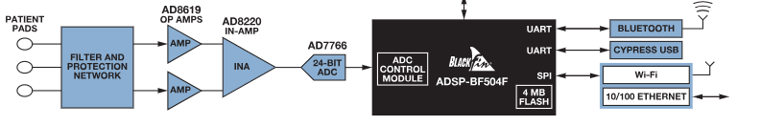
Host Control
GUI
Blackfin
DSP

Slide 16
Command Protocol
User commands ( TTL )
mpause 2000
sendln '0x20000003' //STOP
mpause 2000
sendln '0x20010010'
mpause 2000
sendln '0x20020021'
mpause 2000
sendln '0x20030000'
mpause 2000
sendln '0x20000010' //GDO
mpause 2000
sendln '0x20000006' //SPORT INIT
mpause 2000
sendln '0x20000002' //PLAY
mpause 2000
sendln '0x200 X YYYY'
YYYY – bit 0-15 Parameter values.
X – No of the Parameters (0 - Command).
Soundbar_SDK_On_21569 _Command_Details_Status_Definitions.xlsx

Slide 17
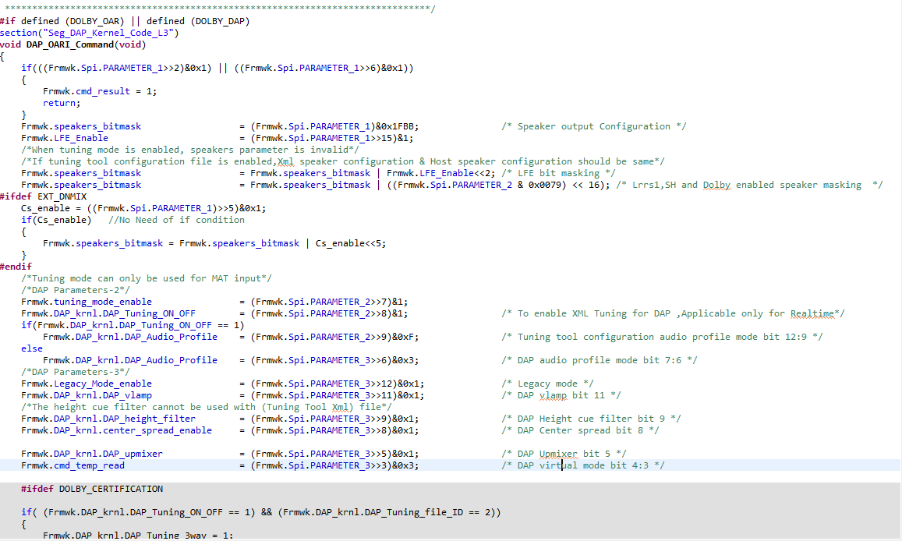
Command Handling

Slide 18
Channel Re-order
Re-ordering the channels
DAP
Channel reorder
L,C,R…... L,R,C,…...

Slide 19
Example:
DAP
L,C,R,Lfe,Ls,Rs,Lsr,Rsr,Ltm,Rtm......
Channel reorder
L,R,C,Lfe,Ls,Rs,Assg1, Assg2,Assg3,Assg4......

Slide 20
Reference:
Soundbar_SDK_On_21569 _Command_Details_Status_Definitions.xlsx
Soundbar_SDK_On_21569_UserGuide_Eval-Melody-8.pdf
9_1_6_mounted_overhead_speaker_setup.pdf (dolby.com)
©2022 Jasmin Infotech Private Limited
JASMIN CONFIDENTIAL
20

Slide 21

©2022 Jasmin Infotech Private Limited
JASMIN CONFIDENTIAL
21

Slide 22
Thank You
©2022 Jasmin Infotech Private Limited
JASMIN CONFIDENTIAL
22

