Slide 1
RootCause Analysis(RCA)
Nov 2024

Slide 2



Audio
Our world is full of sounds. The wind, birds, traffic, buzz of voices, discussions, radio, music, sirens.

Slide 3

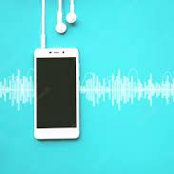
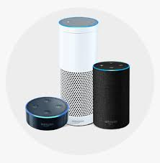
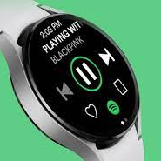
Generation of Audio
PLAYBACK Speaker processing pro-audio
Voice input Audio as UI IOT mobile
Communication Microphone Speaker
Analytics Contextual Awareness Smart devices Big Data IOT,Wearables Medical

Slide 4
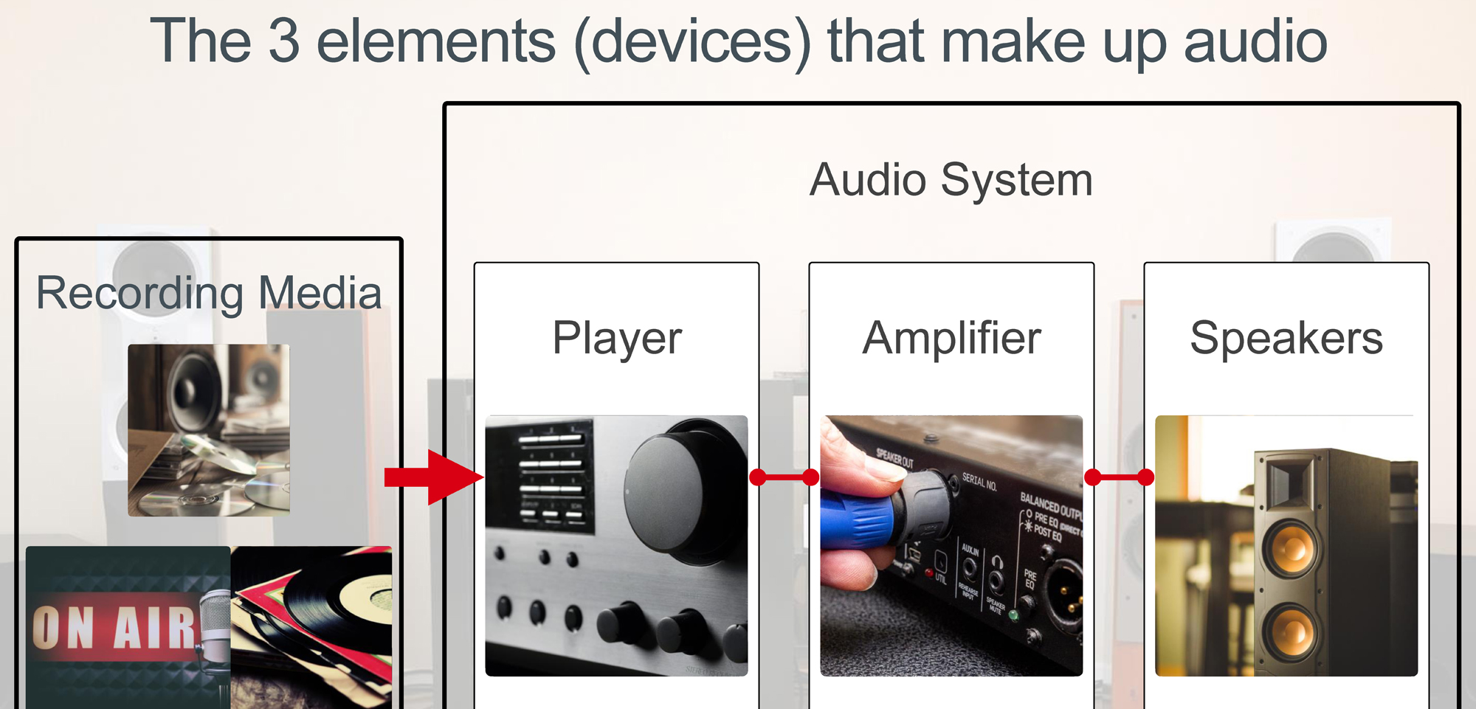
Components

Slide 5
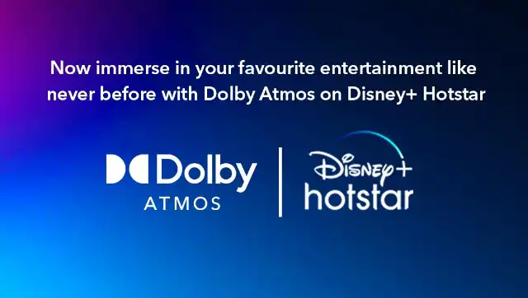
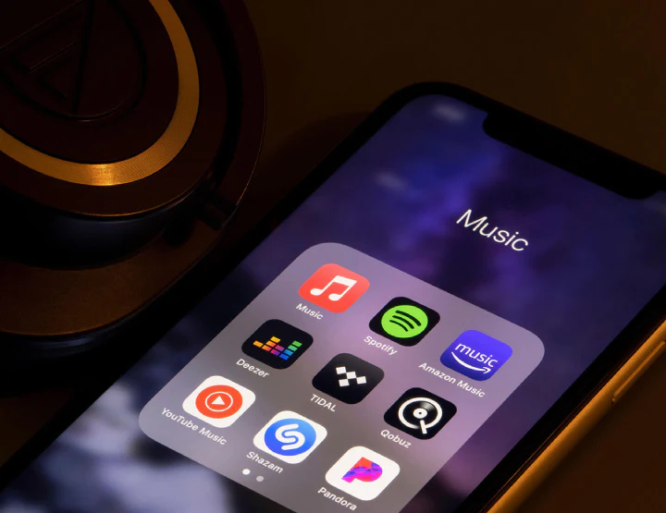

Advancements

Slide 6
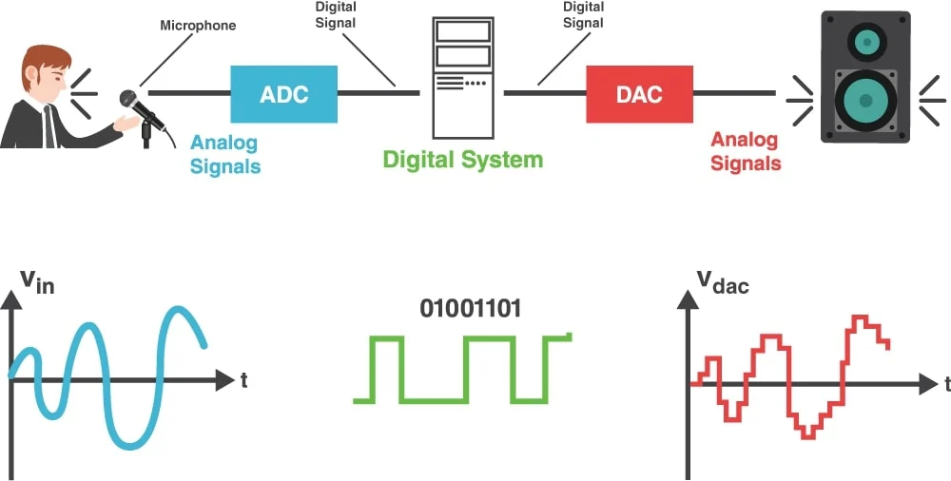
DSP

Slide 7
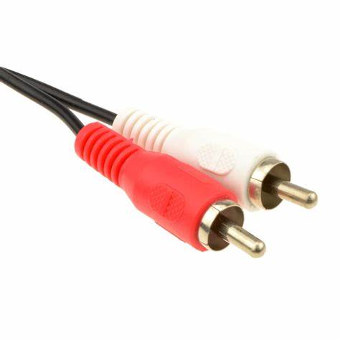
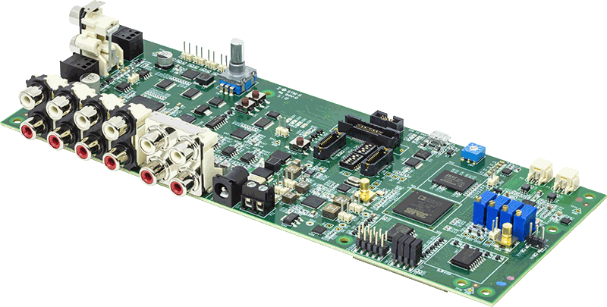
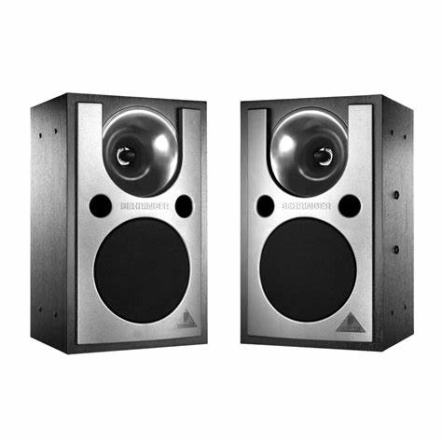
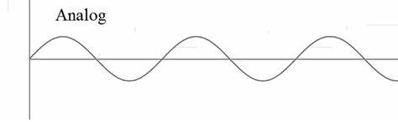
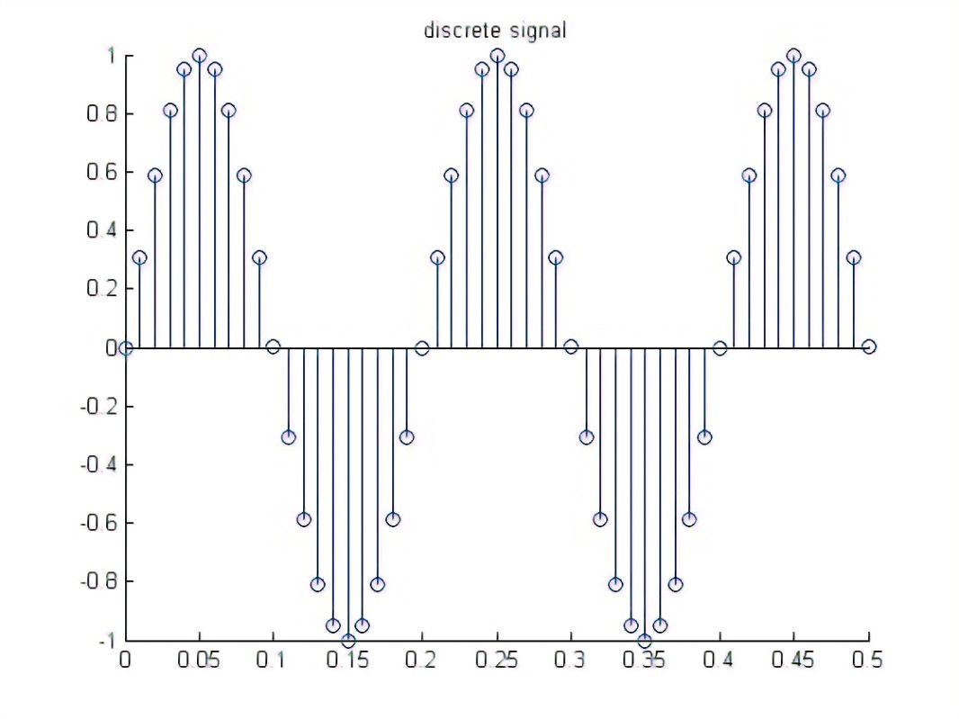

Cont.
Input
Output
ADC
DSP
DAC
Analog signal
Analog to digital converter
Digital Signal
Digital Signal Processing
Digital Signal
Digital to Analog converter
DAI
SPORT
DMA
SPORT
DAI
Analog signal

Slide 8




Compression
Size is reduced.
Removing data so that the resulting compressed file is smaller.
MP3s are typically between 128 kbps and 320 kbps, whilst an uncompressed file is 1,411 kbps.
Compression can be lossy or lossless.

Slide 9
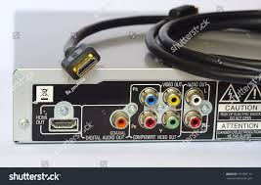
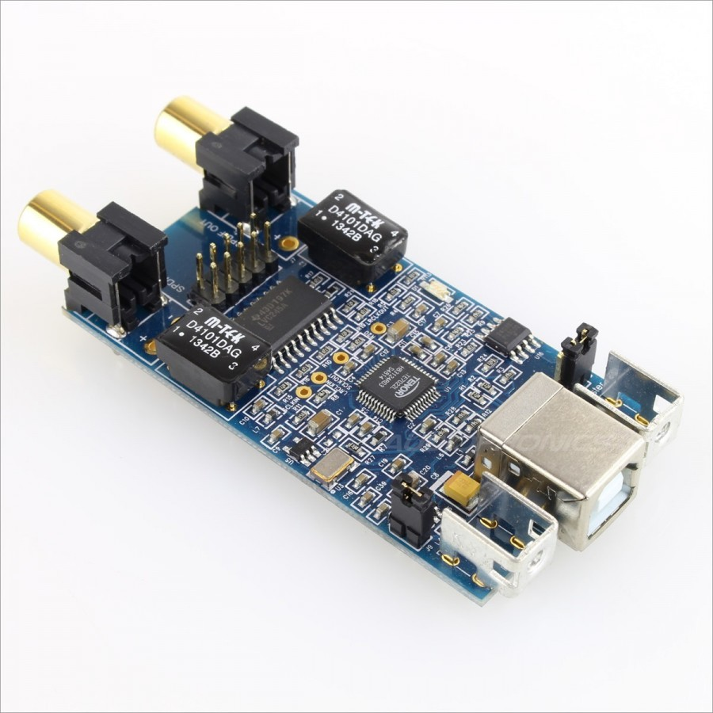
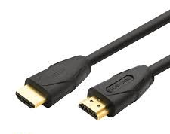
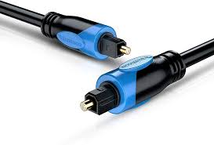
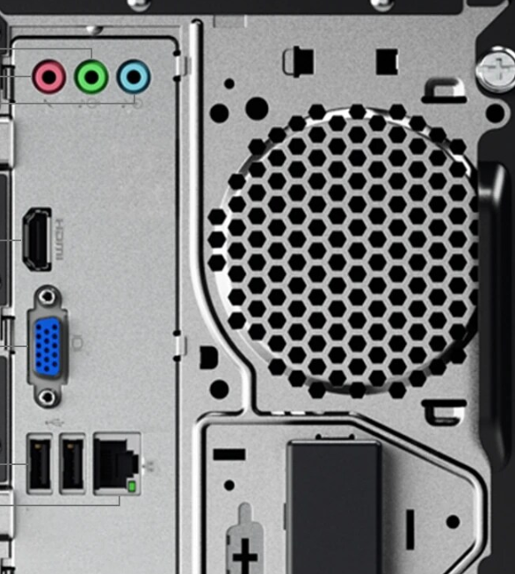
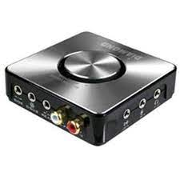
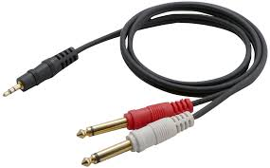
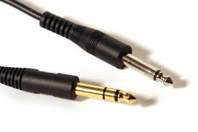
Digtal & Analog Audio Inputs & Outputs

Slide 10
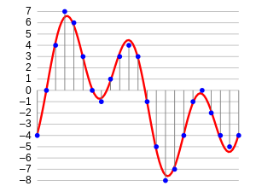
Codec
Audio Codec is a device or program that compress and decompress digital audio data.
The term codec is a combination of coder-decoder.
Non-compression formats
Lossless data compression
Lossy data compression

Slide 11
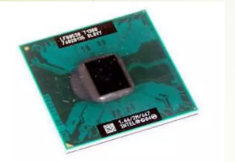
Single Core
Single core on a chip performs single operation at a time.
Receive and process the inputs and provide the output

Slide 12
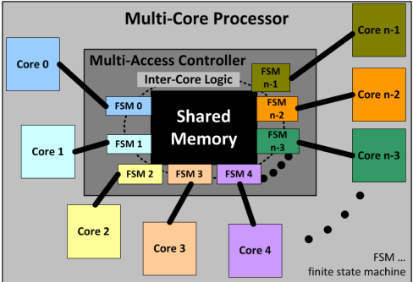
Multi Core
A multi-core processor is an integrated circuit that combines two or more processors to execute numerous tasks at once, minimise power consumption, and boost performance.
The operating system treats each core as a separate processor, and each core can work independently.

Slide 13
Audio Flow (Passthrough)
HDMI
DAI
SPORT
Pack Buffer
DAI
SPORT
Predac Buffer
Customer
PP
CODEC

Slide 14
Audio Flow ( Decoder)
HDMI
DAI
SPORT
Pack Buffer
SPORT
Predac Buffer
Customer
PP
Decoder
DAI
CODEC

Slide 15
Audio Flow ( PostProcessing)
HDMI
DAI
SPORT
Pack Buffer
Predac Buffer
Customer
PP
PostProcessing
Decoder
SPORT
DAI
CODEC

Slide 16
Decoders & PP
PCM
MCPCM
AAC
DD
DDP
TrueHD
MAT
DTSX
DAP
NeuralX
Auro3D

Slide 17
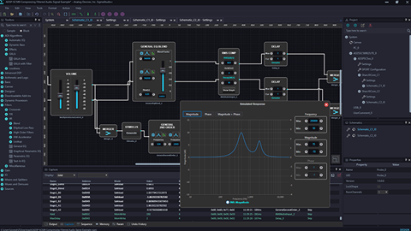
Rapid Audio DSP Project Development
Faster time to market due to user interface (UI) programming features such as – Optimized algorithms (in excess of 100 in existence) – Block and sample processing.
Spectral Domain Processing, FFT/IFFT(standard DFT), Short-Time FFT/iFFT (DFT with Windowing and overlap).
FIR and IIR filters.
Delay modules.
Signal Generators.
Reverberation Effect.
Bit-stream detector for feeding audio bit-stream decoders.

Slide 18
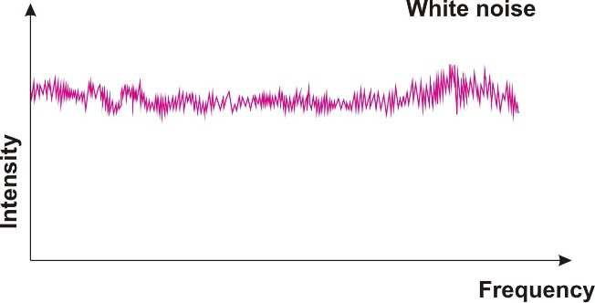
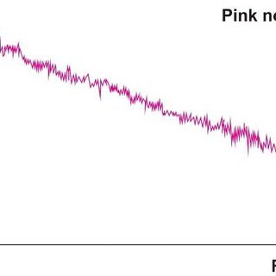
Noise Generator
To test signals for measuring noise figure, frequency response, and other parameters
More power at lower frequencies and less at higher frequencies
white noise contains all frequencies
with equal distribution

Slide 19
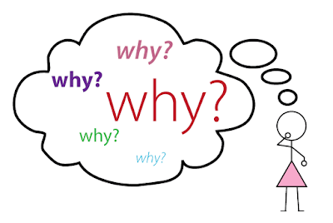
What is RCA
Focuses on asking why a problem happened and then repeating “Why?” four more times until you find the main cause.

Slide 20


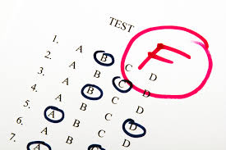
Cont.

Slide 21
RCA Example
[NoiseGenerator] Noise does not output from L & R channels.
S.No | Problem Description | 1st level Root Cause | 2nd level Root Cause | 3rd level Root Cause | 4th level Root Cause | 5th level Root Cause
1 | [NoiseGenerator] Noise does not output from L & R channels. | Data format changes in run time | Floating point operations happens for the fixed output | Data format variable update is not handled properly. | The data format based dB level multiplication is done only for L&R channel | This issue occurs only in L and R channels and not in other channels since the db level multiplication is not done in other channels.

Slide 22
Cont.
[Auro3D] Auro3D Engine doesn't expand the output channels during DTS-HD MA 1.0 stream even though Listening mode is "Auro3D"
S.No | Problem Description | 1st level Root Cause | 2nd level Root Cause | 3rd level Root Cause | 4th level Root Cause | 5th level Root Cause
1 | Auro3D Engine doesn't expand the output channels during DTS-HD MA 1.0 stream even though Listening mode is "Auro3D" | In DTSX case, If Auro is enabled, DTS commands will be updated based on Auro requirement. This update is not handled properly in the DTS kernel | In 1.0 stream case, Input configuration for Auro is updated unexpectedly from DTSX Decoder as 5.1 but the actual content is 1.0. | The wrong input channel configuration for Auro processing causes improper output channels. | DTS command update for Default case and Auro case was not handled properly. | For DTS command update, command initialization was not correct.

Slide 23
Cont.
Bell sound not observed for tuning tool enabled cases
S.No | Problem Description | 1st level Root Cause | 2nd level Root Cause | 3rd level Root Cause | 4th level Root Cause | 5th level Root Cause
1 | Bell sound not observed for tuning tool enabled cases | For pcm/mcpcm + tuning config enabled and dolby decoders + tuning config enabled cases, bell sound is not observed. | For pcm/mcpcm + tuning config enabled and dolby decoders + tuning config enabled cases, it was restricted from channel reorder so customer_pp and timer functions will be skipped. So, bell sound is not observed. | Handling should be done by copying the DAP output to customer_pp buffer and postprocessing routine & timer functions should take place for pcm/mcpcm + tuning config enabled and dolby decoders + tuning config enabled cases. | 256bit key design document need to strenthen.

Slide 24
Cont.
Legacy_Mode_enable_issue
S.No | Problem Description | 1st level Root Cause | 2nd level Root Cause | 3rd level Root Cause | 4th level Root Cause | 5th level Root Cause
1 | Legacy_Mode_enable_ issue | While enabling legacy in TTL, Legacy_mode_enable is enabled/set as 1 in core1 but not enabling in core2. | The legacy value is not updated properly for core2. | Shared variable handling for Legacy_mode_enable variable should be done in core1 and core2. | Shared memory handling is not done properly

Slide 25
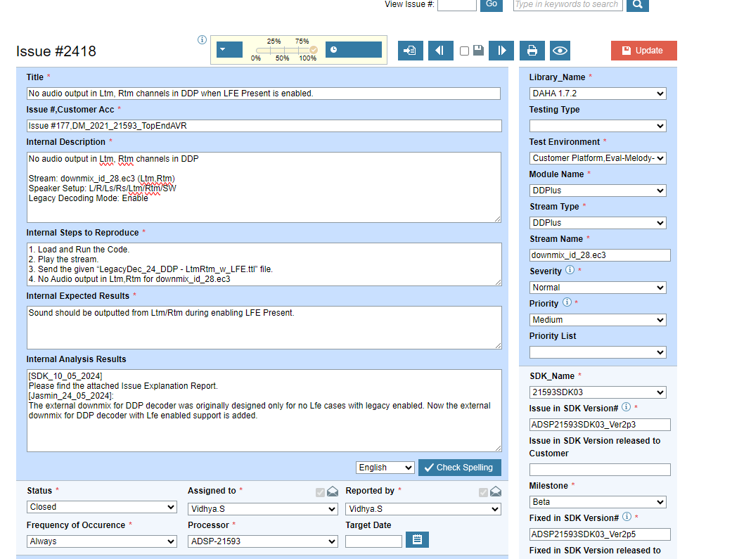
Cont.
Elementool
Issue
Query
Requirement

Slide 26
Task
Simulate an ELT from elementool
Pareto chart design

Slide 27


