Slide 1





Helping you Innovate
Test Plan, Test Report & Bug Report Preparation
www.jasmin-infotech.com
JASMIN CONFIDENTIAL

Slide 2
Agenda
Test Plan
Test Plan Major Components
TestCase Parameters
Test Report
Bug Report

Slide 3
Test Plan
Describing the scope, approach, resources and schedule of intended test activities.
Important aspects like test estimation, test scope, Test Strategy are documented in Test Plan, so it can be reviewed by Management Team and re-used for other projects.
Help people outside the test team such as developers, business managers, customers understand the details of testing.
Test Plan guides our thinking. It is like a rule book.

Slide 4
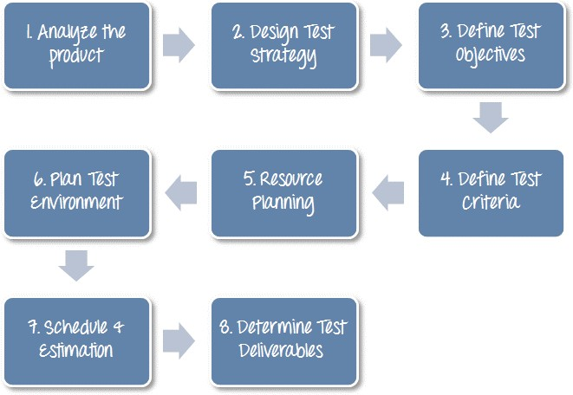
Test Plan Continued…

Slide 5
Test Plan Continued…
Types of Test Plan
Unit Test Plan
Integration Test Plan
System Test Plan
Acceptance Test Plan
Regression Test Plan
Test Plan Template
Summary
Test Summary
“xxxx” Sheet name
Requirement Traceability

Slide 6
Test Case
Test Case
Documentation which specifies set of input values, Pre-conditions, Post-condition, expected result.
Test Case Parameters
Test Case ID
Req.ID
Testing Type
Pre-Requisites
Description/Action
Expected Result
Test Case Complexity
Actual Result
Remarks

Slide 7
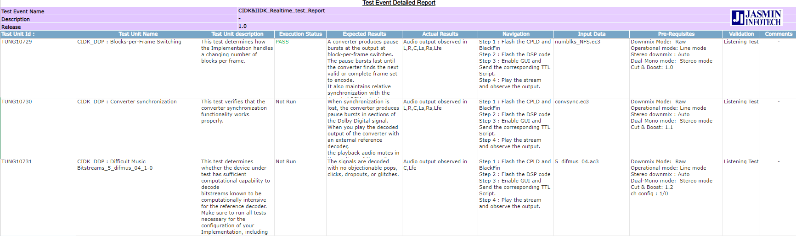
Model Test Case

Slide 8
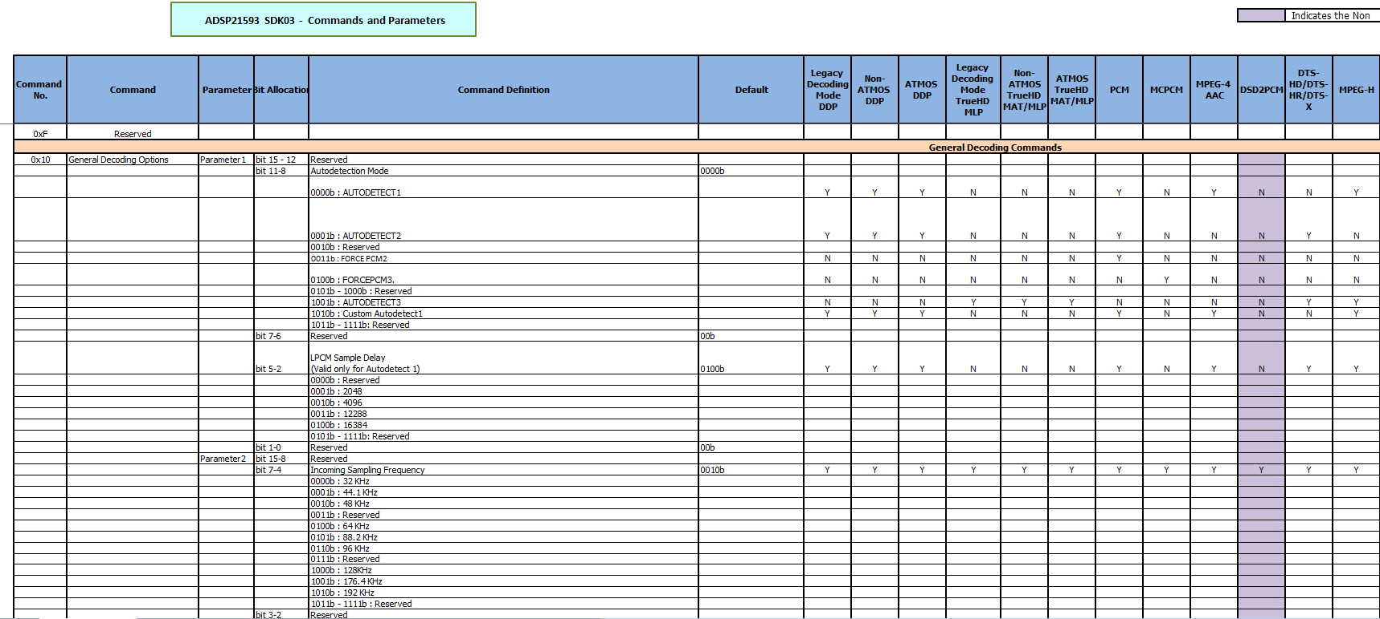
Command Document
©2021 Jasmin Infotech Private Limited
JASMIN CONFIDENTIAL
8

Slide 9
Test Report
Compare the Actual result with Expected result.
Test Report is a document which contains Status of test case.
Test Report Summary contains the status of overall testing.
Important that you communicate the test results and findings to the project stakeholders.
Final decisions can be made for the software release.

Slide 10
Bug Reporting
A Software BUG is a condition in a software product which does not meet a
software requirement or end-user expectation.
Be Specific
Be objective
Be detailed
Reproduce the bug
Review the bug

Slide 11
Bug Template
Bug ID
Project name
Priority & Severity
Affected Version/Component
Summary
Description
Steps to Reproduce
Attachment
Reported By
Assigned to
Status of the bug
Fixed Version

Slide 12
Assessment for Afternoon
Create Test Plan with 5 test cases to validate below mentioned product
5.1 Home Theatre(supports Bluetooth, Aux & USB)
Command protocol will be given and create at least 20 test cases.
Support in code
PCM, MCPCM, Dolby and DTS Decoder.
Maximum configuration of 12 channels.

Slide 13

Jasmin Infotech Pvt. Ltd. 119, Velachery Tambaram Road, Pallikaranai, Chennai 600100, INDIA
Tel: +91 44 6666 9600
Jasmin Infotech Pvt. Ltd.
DG Square,
127, Pallavaram Thoraipakkam Radial Road, Kilkattalai, Chennai 600117, INDIA
Tel: +91 44 6604 9600
Jasmin Infotech Pvt. Ltd. No.23, 2nd Floor,
1st Main Mutthappa Block, Ganga Nagar, RT Nagar, Bengaluru 560032, INDIA
Jasmin Infotech Co Ltd Room 5092, Building 1,
853, Minjing Road, Yangpu District, Shanghai, CHINA
Jasmin Infotech GmbH
Stefan-George-Ring 29,
81929 München, GERMANY
Jasmin Infotech GmbH
Christianstr. 6,
24534, Neumunster 6, GERMANY
Jasmin Infotech Inc.
4040, Moorpark Ave,
Suite 104,
San Jose, CA 95117, USA
Jasmin Infotech Japan
5-27,17, Hiyoshi-Honcho, Kohoku-ku, Yokohama City, JAPAN
©2018 Jasmin Infotech Private Limited
JASMIN CONFIDENTIAL
10

