Slide 1
Audio Precision
APx585

Slide 2
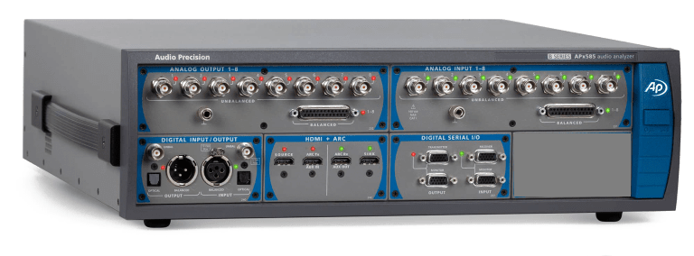
Audio precision Analyzer
An Audio Analyzer is a test and measurement instrument used to objectively quantify the audio performance of electronic and electro-acoustical devices.
Audio quality metrics cover a wide variety of parameters, including level, gain, noise, harmonic and intermodulation distortion, frequency response, relative phase of signals, interchannel crosstalk, and more.
In addition, many manufacturers have requirements for behavior and connectivity of audio devices that require specific tests and confirmations.
APx585 B series

Slide 3
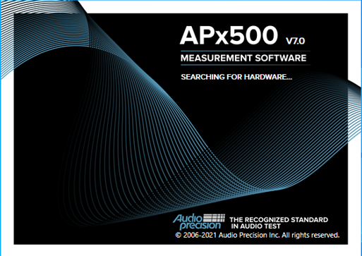
APx500 Measurement Software
APx500 is the measurement software used with Audio Precision APx audio analyzers or with an APx500 Flex Key and a compatible audio interface.
APx500 version 7.0 is a updated release that brings software innovations, improved security, and B Series compatibility to the APx platform.
Open the APx500 V7.0 software available in AP PC

Slide 4
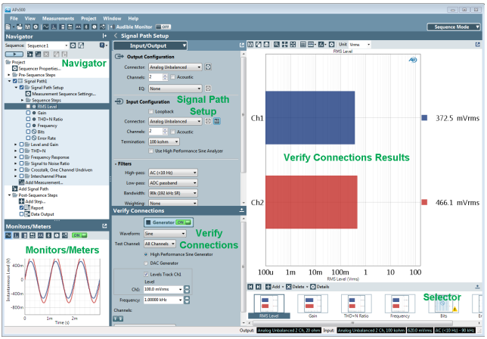
APx500 Measurement Software

Slide 5
The Measurement Navigator
At the left of the APx585 window is the Measurement Navigator panel. Click the button to hide the Navigator; click Show Measurement Navigator to restore it to view.
The Navigator displays the signal paths, measurements and measurement results in your project, organized in a tree structure. Using the Navigator, you can customize signal paths, add or delete measurements or results, create and run automated sequences, and select and customize reports.

Slide 6
Monitors
APx585 provides a number of monitors that display continuous detailed information about the signals at the analyzer's inputs and other data, without changing the primary measurement view.
The monitors are normally docked at the lower left-hand corner of the application window, just below the Navigator. Each monitor can be undocked and moved around the screen.
Types
Scope Monitor
FFT Spectrum Monitor
Meters Monitor
Aux Control Monitor
Metadata Monitor: Status Bits(available for instruments fitted with AES/SPDIF DIO)
Metadata and CEC Monitor: HDMI(available for instruments fitted with HDMI I/O)

Slide 7
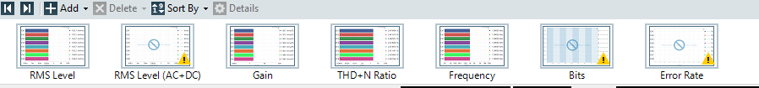
The Selector (filmstrip)
The Selector (also called the filmstrip) runs across the bottom of the Graph panel. The Selector displays "thumbnail" views of all of the current measurement results. Click on a result thumbnail to select it and show it in the Graph panel.

Slide 8

Meters and Bar Graph Displays
Bar graph displays are used for meter results. Meter results (also called single value results) only return one parameter per channel.
Bar graphs provide a simple, clear view for meter results across many channels. APx585 also uses a vertical bar graph display for distortion product measurements, where several parameters are displayed but the view is limited to one channel.
Bar Graph toolbar

Slide 9
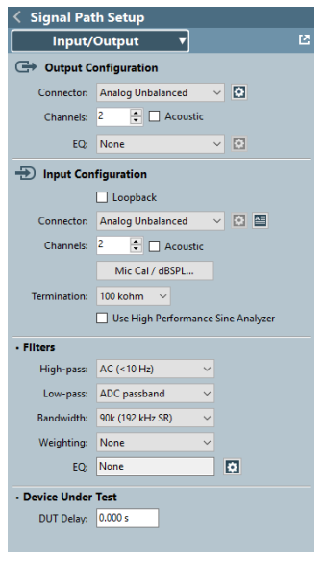
Signal Path Setup
The Signal Path Setup view gives you the tools to select and configure the physical connections between the analyzer and the Device Under Test (DUT) for the current Signal Path.
This is where you choose digital or analog, balanced or unbalanced, specify impedances or communications protocols, set the number of channels in use, name your inputs and outputs and so on.

Slide 10
Output Configuration settings
Signal Path Setup Output Configuration allows you to select generator output connections, formats and configuration settings for the current signal path. The following selections are available:
Analog Unbalanced
Analog Balanced
Digital Unbalanced
Digital Balanced
Digital Optical
HDMI Source
HDMI ARC Tx
Digital Serial
Transducer Interface
ASIO
None (External)

Slide 11
Input Configuration settings
Signal Path Setup Input Configuration allows you to select analyzer input connections, formats and configuration settings for the current signal path. The following selections are available:
Loopback (when available)
Analog custom
Digital Unbalanced
Digital Balanced
Digital Optical
HDMI Sink
HDMI ARC Rx
Digital Serial
Transducer Interface
ASIO
File (Analog Units)
File (Digital Units)

Slide 12
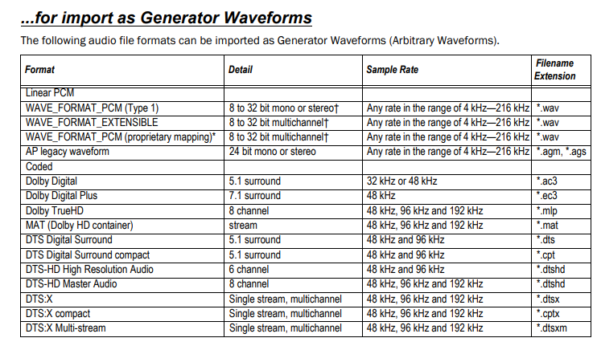
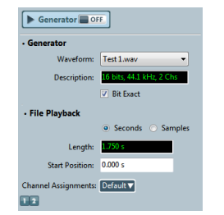
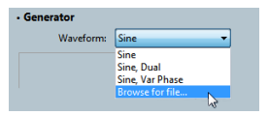
Selecting a Waveform
A measurement that supports generator waveform files displays a Waveform selection list in the Signal Generation panel.
Click the Waveform menu and choose Browse for file... to select an audio file for the generator to use. You can select multiple files.
A selected file becomes the source for that measurement's generator output and is attached to the project file.
Once attached to the project, an audio file is available to all other supported measurements as a selection on the Waveform menu.

Slide 13
The “Big Six” Measurements
Audio engineers agree that there is a small group of measurements that will reveal the key characteristics and performance of almost any audio device. At Audio Precision we talk about the “Big Six” measurements as the benchmark set of audio tests. They are,
Level and Gain
THD+N
Frequency Response
Signal to Noise Ratio
Crosstalk
Phase

Slide 14
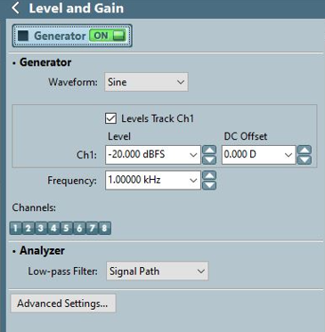
Level & Gain :
The basic level measurement provides the output level or amplitude of an audio device. Depending on the device and your test configuration, the result might be displayed in volts, watts, dBV or other level units. Gain gives the ratio of the DUT output level to its input level,
Navigator > Add measurement > Level and Gain > Add & Close
The Level and Gain measurements provide single value results that show the output level or gain in each DUT channel, as measured at each analyzer input.

Slide 15
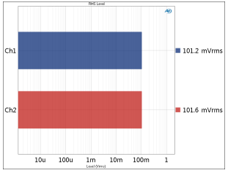
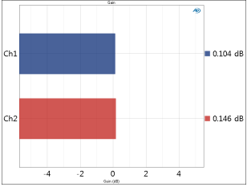
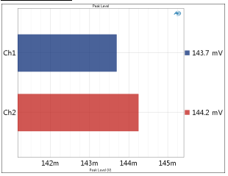
RMS Level
Gain
Peak Level
RMS Level provides a single-value meter result, displaying the rms output level from each DUT channel, as measured at each analyzer input.
The Gain measurement result provides a single-value measurement of the DUT gain for channel, as measured at each analyzer input.
Peak Level provides a single-value meter result, displaying of the peak output level from each DUT channel, as measured at each analyzer input

Slide 16
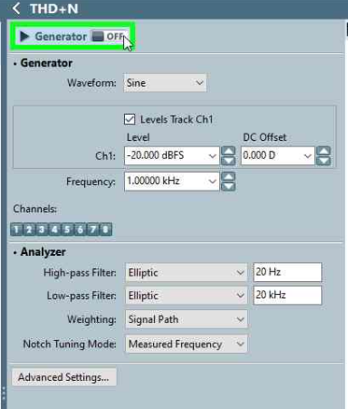
THD+N
THD+N is an abbreviation for total harmonic distortion plus noise. THD+N measurements have been used for many years as a comprehensive single-value statement of an audio device’s overall performance.
Navigator > Add Measurements > THD+N > Add & Close
The THD+N measurement provides single-value results that show the THD+N (total distortion plus noise) in the output signal from each DUT channel, as measured at each analyzer input.
THD+N results available in APx585 are
THD+N Ratio
THD+N Level
THD Ratio
THD Level
Noise Ration
Noise Level
Distortion Product Level
Distortion Protect Ratio

Slide 17
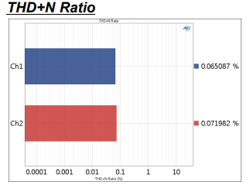
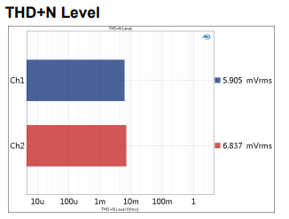
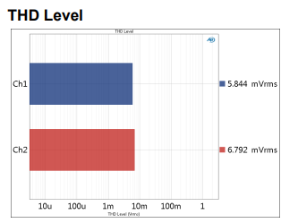
The THD+N Ratio result provides a single-value measurement of the THD+N (total harmonic distortion plus noise) ratio in the output signal from each DUT channel.
The THD Level result provides a single-value measurement of the THD (total harmonic distortion) level in the output signal from each DUT channel
The THD+N Level result provides a single-value measurement of the THD+N (total harmonic distortion plus noise) level in the output signal from each DUT channel

Slide 18
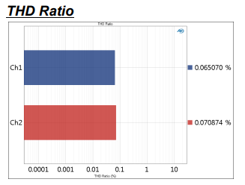
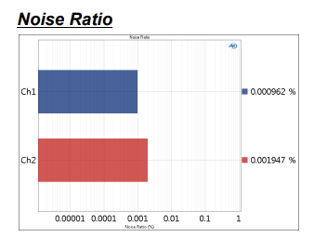
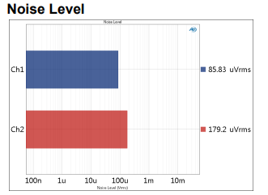
The THD Ratio result provides a single-value measurement of the THD (total harmonic distortion) ratio in the output signal from each DUT channel.
The Noise Ratio result provides a single-value measurement of the Noise ratio in the output signal from each DUT channel.
The Noise Level result provides a single-value measurement of the Noise level in the output signal from each DUT channel

Slide 19
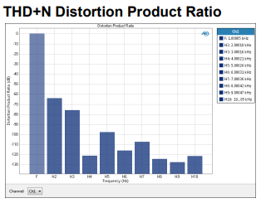
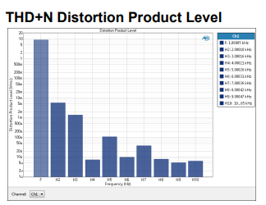
The THD+N Distortion Product Ratio result displays a single-value measurement of the ratio of a distortion product (single harmonic) to the total signal for a selected channel, for the harmonics 2–10. The level displayed in each bar is the rms level of that harmonic tone divided by the rms level of the total signal.
The THD+N Distortion Product Level result displays a single-value measurement of the rms level of distortion products (harmonics) for the harmonics 2–10. The level displayed in each bar is the rms level of that harmonic tone.

Slide 20
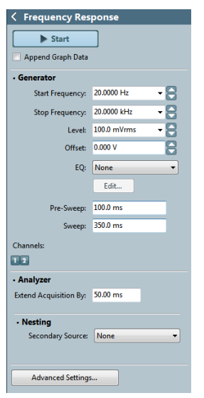
Frequency Response
A frequency response test reveals how a device “responds” across the audible spectrum. For most devices, a “flat” response curve, where all frequencies are passed with the same gain, is desirable
Navigator > Add Measurements > Frequency Response > Add & Close
Frequency Response is a chirp-based measurement, using a brief Farina log-swept sine “chirp” stimulus that moves continuously across a specified range of frequencies. The DUT output is acquired by the analyzer and is mathematically deconvolved to provide a number of results.
Frequency Response results available in APx500 are
Level
Gain
Relative Level
Deviation

Slide 21
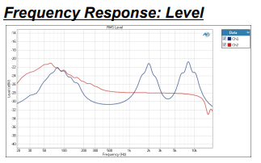
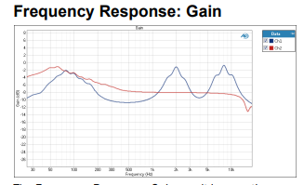
Level result is a continuous sweep measurement that provides a graphical display of the frequency response of each channel. In this result the DUT output level is plotted against frequency.
Gain result is a continuous sweep measurement that provides a graphical display of the frequency response of each channel. In this result the DUT gain is plotted against frequency.

Slide 22
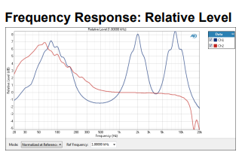
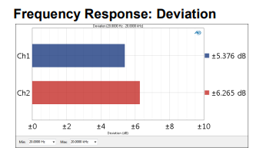
Relative Level result is a continuous sweep measurement that provides a graphical display of the frequency response of each channel. In this result the DUT output level is plotted against frequency, relative to the level at a selected frequency. This enables you to specify the frequency that will be set as 0 dB and view the response in relation to that frequency. A midband frequency such as 1 kHz is often set as the reference frequency, and is the default here
Deviation is a single value result computed from the continuous sweep acquisition. In this result the frequency deviation (the total range of frequency variation) of each channel is displayed as a meter bar. You can specify a minimum and maximum frequency to define the range to be considered in the deviation measurement.

Slide 23
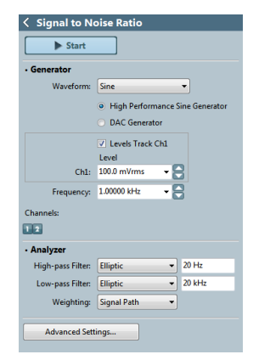
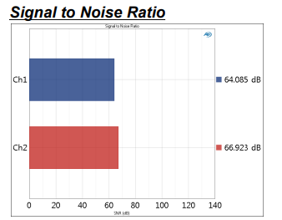
Signal to Noise Ratio
Signal to Noise Ratio or SNR gives a single value that indicates how “noisy” an audio device is. Two measurements are actually required: the first measures the DUT output level (usually at either maximum level or at a nominal operating level); the second measures the residual noise in the device. The signal level is divided by the noise level, and the resulting ratio is usually expressed in decibels
Navigator > Add Measurements > Signal to Noise Ratio > Add & Close
The Signal to Noise Ratio measurement provides a single-value result that shows the signal to noise ratio (SNR) of the output signal from each DUT channel. To use the SNR measurement to produce a dynamic range result, set the initial generator level to produce the maximum level in the DUT
To measure SNR, click Start. The generator is turned on briefly, then off. The results are compared and displayed as meter bars

Slide 24
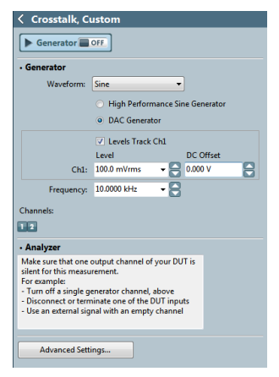
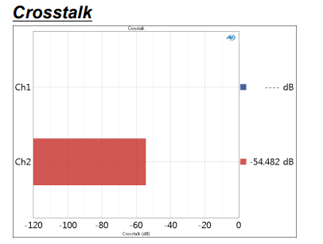
Crosstalk, Custom
Crosstalk is an expression of the degree of signal leakage between DUT channels. Ideally, none of the signal in one channel will appear in a second channel, but in practical devices there is always measurable crosstalk. Crosstalk often varies with frequency.
Navigator > Add Measurements > Crosstalk, Custom > Add & Close
Crosstalk is unwanted leakage or bleed of a signal from one or more channels to other channels within a device. The Crosstalk, Custom measurement result provides a measurement of the crosstalk into one undriven DUT channel, while the other channels are driven. For this measurement, the user must manually turn OFF or interrupt the signal to the undriven channel.

Slide 25
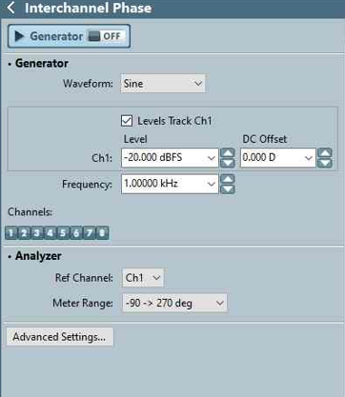
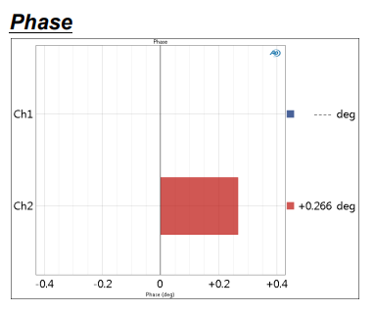
Interchannel Phase
Phase is a measure of the lagging or leading of an alternating current waveform with regards to a reference waveform. Interchannel phase measures the phase relationships between channels in a multichannel device. One channel is chosen as the reference
Navigator > Add Measurements > Interchannel Phase > Add & Close
The Interchannel Phase measurement provides a single-value result that shows the relative phase of the DUT channels at a single frequency. One channel is chosen as the phase reference channel, and the remaining channels are measured against it.

Slide 26
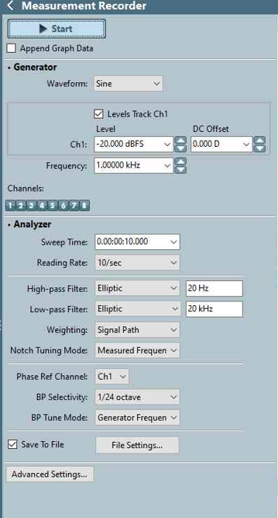
Measurement Recorder
Navigator > Add Measurements > Measurement Recorder > Add & Close
The Measurement Recorder is a general-purpose diagnostic tool that provides a record of a number of measurements versus elapsed time.
The record can be very long (up to one week), providing a means of monitoring the output of a device under test over an extended period of time.
The Measurement Recorder does not require a specific test signal. It can be used with any audio signal within the input range of the analyzer
Measurement Recorder results available in APx500 are:
RMS Level
Frequency
Gain
Phase
DC Level
SINAD
THD Ratio
THD Level
Peak Level
Bandpass Level
THD+N Ratio
THD+N Level

Slide 27
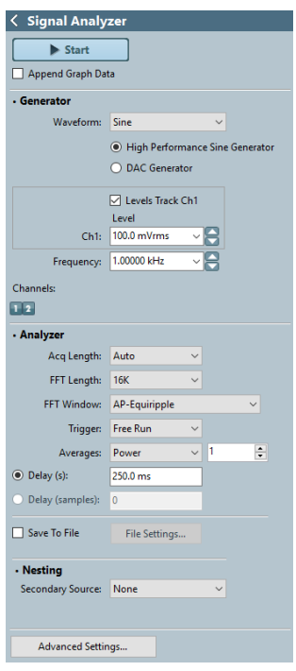
Signal Analyzer
Navigator > Add Measurements > Signal Analyzer > Add & Close
The Signal Analyzer is a general-purpose diagnostic tool that provides a time-domain Scope result view, an FFT Spectrum result view and noise density views.
Signal Analyzer results available in APx500 are:
•Scope
•Amplitude Spectral Density
•FFT Spectrum
•Power Spectral Density
The Signal Analyzer is a general purpose diagnostic tool that uses a high-resolution FFT technique to provide several different display results.

Slide 28
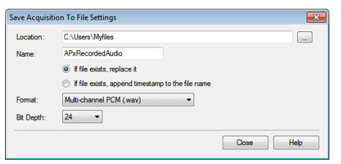
Save to File
Recording Audio to a File
The Measurement Recorder and the Noise Recorder can optionally record acquired audio to a file on disk
Location >Enter or browse to the destination folder here. Name Name >Name the output file here.
Choose from one of these selections:
•If file exists, replace it
•If file exists, append timestamp to the file name
On the Measurement or Noise Recorder panel, check the Save to File checkbox. Click File Settings to specify the file name, location and file format.
Save Acquisition to File Settings dialog
Format > Choose the file format in the Format field. For both analog inputs and digital acquisitions, there are three linear file formats available
Multiple Mono PCM (.wav)
Multi-channel PCM (.wav)
Extensible Multi-channel PCM (.wav)

Slide 29
References:
APx500_Users_Manual.pdf available in APx hardware PC local path @ “D:\APx_7.0\User Documents” or else Please refer following URL for reference https://ap.com
Help file (available with installed software)
Support:
For APx request and usage support contact apx585audioanalyzer@jasmin-infotech.com

Slide 30
Assessment for Afternoon
What are the Six Big measurements?
Which measurement tool is used for measuring latency of the signal?
What are the available I/O options?
List the supported Audio File formats? Specify with sample frequency?

