Slide 1
Realtime Testing

Slide 2
Agenda
What is testing?
Test Levels
Testing Process
Issue Testing
Test Case Preparation
Testing Methods
Tools and Hardware
©2021 Jasmin Infotech Private Limited
JASMIN CONFIDENTIAL
2

Slide 3
What is Testing?
Finding defects
Gaining confidence about the level of Quality
Providing information for decision-making
Preventing defects
To check whether the system met the requirements and be executed successfully in the intended environment.
To check whether the system ‘Fit for the purpose’.
Definitions
“Testing is the process of executing a program with the intention of finding errors” – Myers
“Testing can show the presence of bugs but never their absence” – Dijkstra
©2021 Jasmin Infotech Private Limited
JASMIN CONFIDENTIAL
3

Slide 4
Test Levels
Unit / module Testing
Is the level of software testing where individual unit/ components of software are tested.
The purpose is to validate that each unit of the software .
Integration Testing
Is the level of software testing where individual units are combined and tested as group.
The purpose of this level of testing is to expose faults in the interaction between integrated units.
©2021 Jasmin Infotech Private Limited
JASMIN CONFIDENTIAL
4

Slide 5
Test Levels
System Testing
System Testing is a level of testing that validates the complete and fully integrated software product.
Acceptance Testing
Acceptance testing focuses on the client's use of the system and how it functions as a whole unit, rather than on a specific integration between different aspects.
©2021 Jasmin Infotech Private Limited
JASMIN CONFIDENTIAL
5

Slide 6
Re-Testing
Is the testing of a particular bug after it has been fixed.
The purpose this testing is ensure that issue was fixed
Regression Testing
Is the level of software testing is done to verify that a code changes in the software does not impact the existing functionality of the product.
This is to make sure the product works fine with new functionality, bug fixes or any change in the existing feature.
©2021 Jasmin Infotech Private Limited
JASMIN CONFIDENTIAL
6

Slide 7
Testing Process
Requirement analysis
Test Case creation
Test Case execution
Defect logging
Re-testing
Regression testing
©2021 Jasmin Infotech Private Limited
JASMIN CONFIDENTIAL
7

Slide 8
Test evaluation methods
Listening Testing
Evaluate those test case by Listening to verify any unexpected glitches, pops, mute or noisy output observed in output.
Performance Testing
Evaluate those test case by use Spectra lab to analyzing Frequency level, dB level, noise floor, SNR, THD+N and mutes etc,.
©2021 Jasmin Infotech Private Limited
JASMIN CONFIDENTIAL
8

Slide 9
Pumping Utilities
Foobar
Used for Pumping “.wav” streams
MPCHC
Used for Pumping DTSHD ".dtshd" streams
DOLBY HDMI TOOL
Used for pumping DTSHD Stream.
DTSHD HDMI TOOL (Linux)
Used for pumping Dolby ".ac3,.ec3,.mat,.mlp.wav" Stream.
©2021 Jasmin Infotech Private Limited
JASMIN CONFIDENTIAL
9

Slide 10
Recording and Analysing
Used for Recording and Analysing the audio output.
Used for Recording and Analysing the audio output.
It is used for Recording Digital and Analog audio output.
Audacity (Tool)
It is used for Recording and Analysing the both digital & analog and I2S data line output.
SpectraPlus (Tool)
Sound Card (External Hardware)
APx (Equipment)
©2021 Jasmin Infotech Private Limited
JASMIN CONFIDENTIAL
10

Slide 11

Audacity
©2021 Jasmin Infotech Private Limited
JASMIN CONFIDENTIAL
11

Slide 12
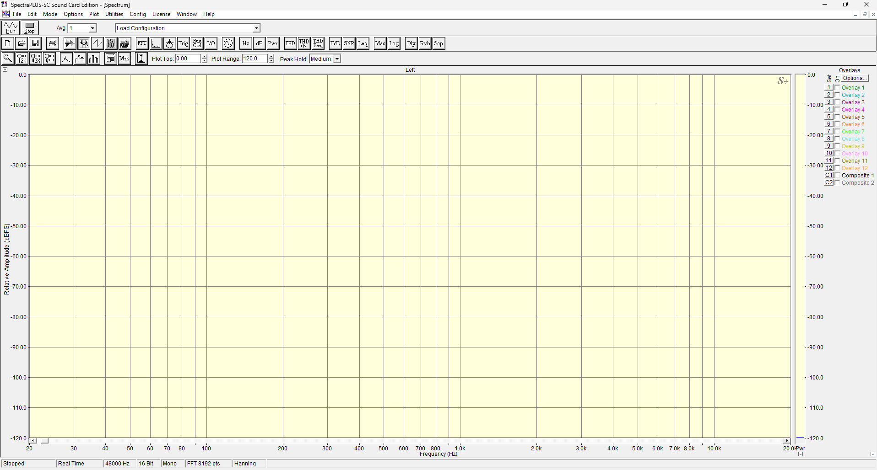
Spectra Plus
©2021 Jasmin Infotech Private Limited
JASMIN CONFIDENTIAL
12

Slide 13
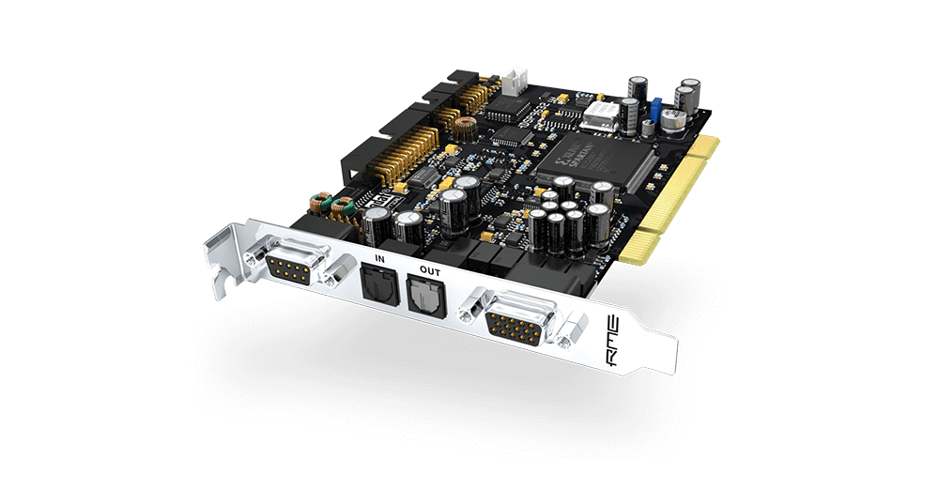
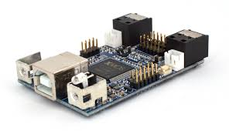
External I/O cards
Balanced stereo analog in- and output, 24-Bit/192kHz, > 110 dB SNR
Optional analog expansion boards with 4 balanced in- or outputs
All analog I/Os capable of 192 kHz, constant number of available channels
1 ADAT digital I/O, supporting 96 kHz S/MUX operation
1 SPDIF digital I/O, 192 kHz-capable
1 Breakout cable for coaxial SPDIF*
Up to 16 I/Os can be used simultaneously!
1 Stereo headphone output, parallel to the analog out, additional level settings
HDSP 9632
Multi-channel USB audio interface (up to 24x24)
Wide range of digital IO format depending on the loaded firmware: TOSLINK, ADAT, S/PDIF (coax), I2S, TDM, DSD and PDM data formats
Native support up to 32bit / 384kHz
PDM to I2S converter for up to 16 MEMS microphones
Multichannel DSD (up to 8ch) support
USB 2.0 High speed and Audio class 2.0 device / Asynchronous USB synchronization
OS compatible: Win/Mac/Linux 2.0/Android/Ios (with Camera kit dongle)
Toslink (optical) and SPDIF (coax) transmitter and receiver
Flexible board powering option: USB powered or External DC input power

Slide 14
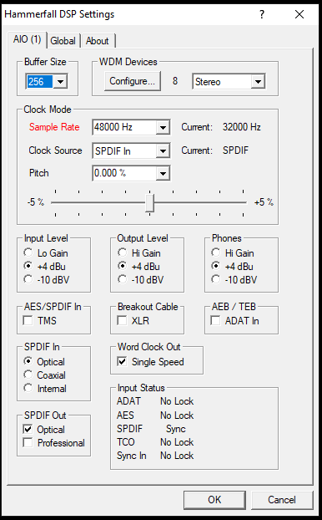
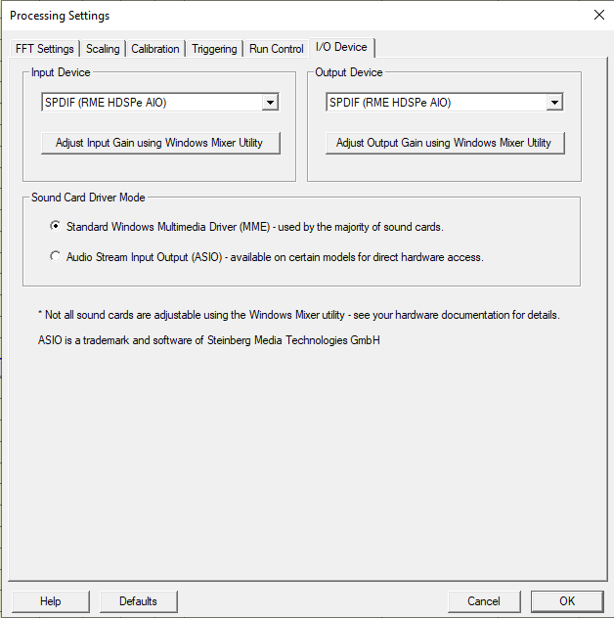
External I/O cards

Slide 15

External I/O cards

Slide 16
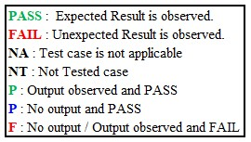
Test Execution
Testing procedure
Flash the BlackFin
Flash / Load the DSP code
Open GUI and Select Com port
Send the corresponding TTL script
Play the stream
Observe the DSP output.
Based on the output update the status as PASS or FAIL
©2021 Jasmin Infotech Private Limited
JASMIN CONFIDENTIAL
16

Slide 17
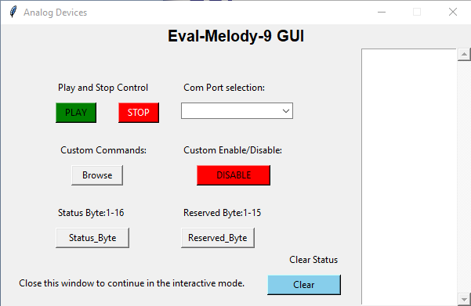
GUI
©2021 Jasmin Infotech Private Limited
JASMIN CONFIDENTIAL
17

Slide 18
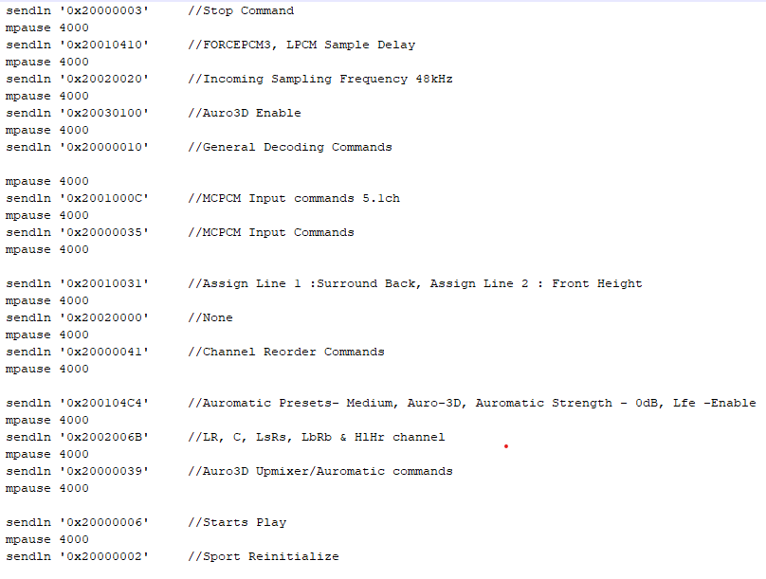
Model TTL
©2021 Jasmin Infotech Private Limited
JASMIN CONFIDENTIAL
18

Slide 19
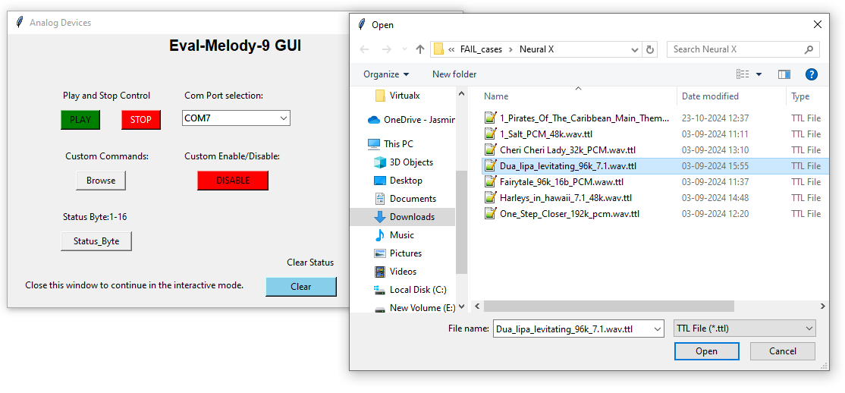
GUI

Slide 20
Hardware Required for Real Time testing
Eval Melody Board
Power Adapter
Emulator
Speakers
HDMI Cables, Analog Cables and Optical cable
USB cable
DB25 Connector
TV, BD Player and Required Disc.
PC or Laptop
External Optical Module
©2021 Jasmin Infotech Private Limited
JASMIN CONFIDENTIAL
20

Slide 21
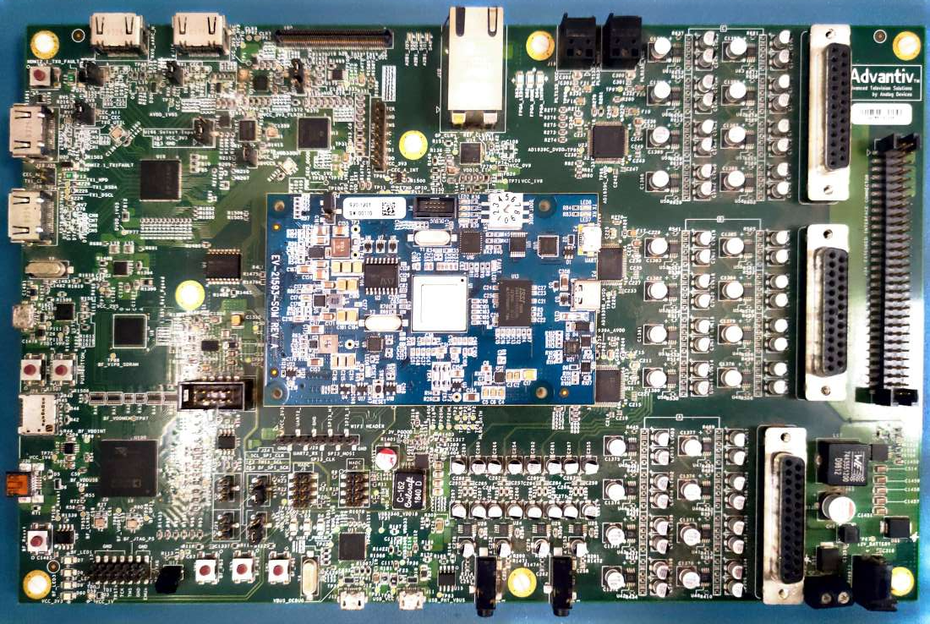
Eval Melody AVR9 Board
©2021 Jasmin Infotech Private Limited
JASMIN CONFIDENTIAL
21

Slide 22
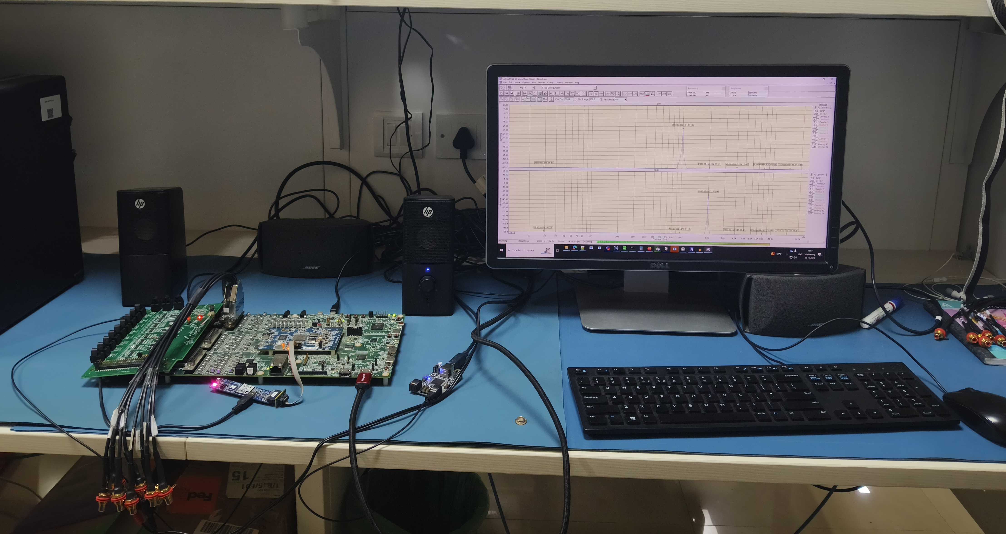
Realtime Performance Test Environment

Slide 23
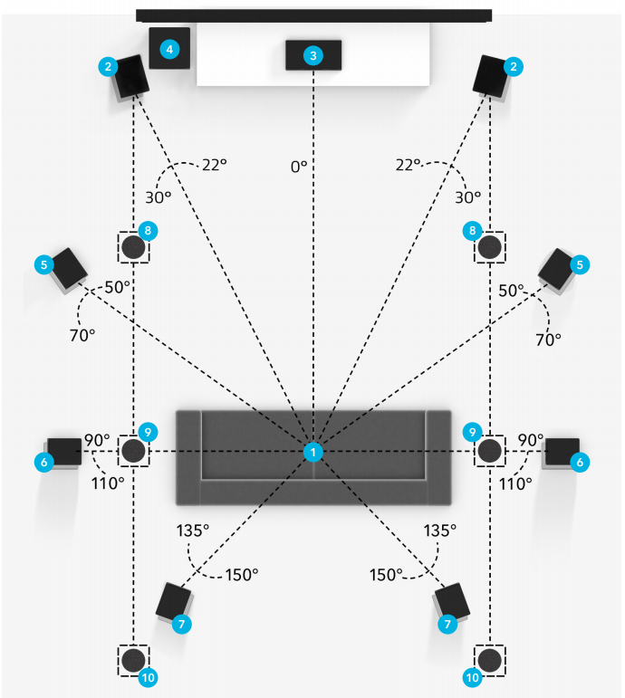
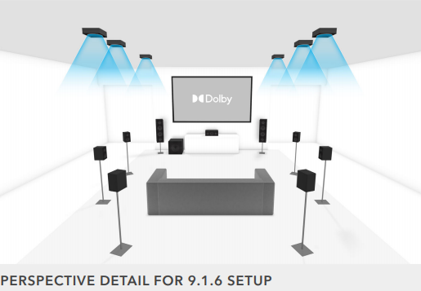
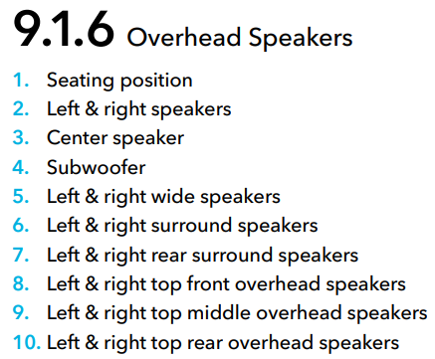
9.1.6 Speaker Setup - Dolby
©2021 Jasmin Infotech Private Limited
JASMIN CONFIDENTIAL
23

Slide 24
Assessment for afternoon
Testing handson will be given for 2 pair at a time.
©2021 Jasmin Infotech Private Limited
JASMIN CONFIDENTIAL
24

Slide 25

Jasmin Infotech Pvt. Ltd.
119, Velachery Tambaram Road, Pallikaranai,
Chennai 600100, INDIA
Tel: +91 44 6666 9600
Jasmin Infotech Pvt. Ltd.
DG Square,
127, Pallavaram Thoraipakkam Radial Road, Kilkattalai,
Chennai 600117, INDIA
Tel: +91 44 6604 9600
Jasmin Infotech Pvt. Ltd.
No.23, 2nd Floor,
1st Main Mutthappa Block,
Ganga Nagar, RT Nagar,
Bengaluru 560032, INDIA
Jasmin Infotech Co Ltd
Room 5092, Building 1,
853, Minjing Road,
Yangpu District, Shanghai,
CHINA
Jasmin Infotech GmbH
Stefan-George-Ring 29,
81929 München,
GERMANY
Jasmin Infotech GmbH
Christianstr. 6,
24534, Neumunster 6,
GERMANY
Jasmin Infotech Inc.
4040, Moorpark Ave,
Suite 104,
San Jose, CA 95117, USA
Jasmin Infotech Japan
5-27,17, Hiyoshi-Honcho,
Kohoku-ku, Yokohama City,
JAPAN
©2021 Jasmin Infotech Private Limited
JASMIN CONFIDENTIAL
25

