Slide 1
Processing Elements

Slide 2
Processing Elements - Overview
Two Processing Elements:
- PEx (Primary Processing Element)
- PEy (Secondary Processing Element)
Each Processing Element consist of,
- Data Registers
- ALU (Arithmetic Logic Unit)
- Multiplier
- Shifter

Slide 3
Data Formats. The units support 32-bit fixed and floating point single precision IEEE 32-bit and extended precision IEEE 40-bit.
Arithmetic/logic unit. The ALU performs arithmetic and logic operations on fixed-point and floating-point data.
Multiplier. The multiplier performs floating-point and fixed-point multiplication and executes fixed-point multiply/add and multiply/subtract operations.
Barrel Shifter. The barrel shifter performs bit shifts, bit, bit field, and bit stream manipulation on 32-bit operands. The shifter can also derive exponents

Slide 4
Processing Elements – Overview (Cont’d)

Slide 5
Universal Registers (Ureg)
Register Type | Register(s) | Function
Dreg | R0 – R15 | Processing element X register file locations, fixed-point
 | F0 – F15 | Processing element X register file locations, floating-point
cdreg | S0 – S15 | Processing element Y register file locations, fixed-point
 | SF0 – SF15 | Processing element Y register file locations, floating-point
Program Sequencer | PC | Program counter (read-only)
 | PCSTK | Top of PC stack
 | PCSTKP | PC stack pointer
 | FADDR | Fetch address (read-only)
 | DADDR | Decode address (read-only)
 | LADDR | Loop termination address, code; top of loop address stack
 | CURLCNTR | Current loop counter; top of loop count stack
 | LCNTR | Loop count for next nested counter-controlled loop
Data Address Generators | I0 – I7 | DAG1 index registers
 | M0 – M7 | DAG1 modify registers
 | L0 – L7 | DAG1 length registers
 | B0 – B7 | DAG1 base registers
 | I8 – I15 | DAG2 index registers
 | M8 – M15 | DAG2 modify registers
 | L8 – L15 | DAG2 length registers
 | B8 – B15 | DAG2 base registers

Slide 6
Universal Registers (Ureg)
Register Type | Register(s) | Function
Timer | TPERIOD | Timer period
 | TCOUNT | Timer counter
sreg | MODE1 | Mode control & status
 | MODE2 | Mode control & status
 | IRPTL | Interrupt latch
 | IMASK | Interrupt mask
 | IMASKP | Interrupt mask pointer (for nesting)
 | MMASK | Mode mask
 | FLAGS | Flag pins input/output state
 | LIRPTL | Link Port interrupt latch, mask, and pointer
 | ASTATx | Element x arithmetic status flags, bit test flag, etc.
 | STKYx | Element x sticky arithmetic status flags, stack status flags, and so on.
 | USTAT1 | User status register 1
 | USTAT3 | User status register 3
 | csreg | ASTATy Element y arithmetic status flags, bit test flag, etc.
 | STKYy | Element y sticky arithmetic status flags, stack status flags, and so on.
 | USTAT2 | User status register 2
 | USTAT4 | User status register 4

Slide 7
Data Registers
Two set of Data Registers.
R0 – R15 / f0 – f15 (Primary Data Registers)
S0 – S15 (Secondary Data Registers)
r0=r1+r2, r0=dm(i0,m0), r0=pm(i8,m8); /* r0 is loaded from i0*/ r0=r1+r2, r0=pm(i8,m8); /* r0 is loaded from i8 */
Multiplier Registers.
MRF Register (Foreground)
MFB Register (Background)

Slide 8
Computational Modes
Mode1 Register:
- Controls the Operating modes of Processing
Elements.
The following Mode1 Bit Control the Computational Modes.
1. Floating Point Data format (RND32)
2. Rounding Mode (TRUNC)
3. ALU Saturation (ALUSAT)
4. Short word Sign Extension (SSE)
5. Secondary Processing Element (PEy).

Slide 9
Computational Modes
Floating Point Data format (RND32)
Bit16, rounds floating-point data to 32 bits (if 1)or rounds to 40 bits (if 0)
Rounding Mode (TRUNC)
Bit15, rounds results with round-to-zero (if 1) or round-to-nearest (if 0).
ALU Saturation (ALUSAT)
Bit13, saturates results on positive or negative fixed-point overflows (if 1) or returns unsaturated results (if 0).
Short word Sign Extension (SSE)
Bit 14, sign extends short word 16-bit data (if 1) or zero-fill the upper 16 bits (if 0).
Secondary Processing Element (PEy)
Bit21, enables computations in PEy (SIMD mode) (if 1) or disables PEy (SISD mode) (if 0)

Slide 10
Arithmetic Logic Unit (ALU)
ALU Performs the following operations,
Floating-point addition, subtraction, add/subtract, average
Fixed-point addition, subtraction, add/subtract, average
Floating-point manipulation: binary log, scale, mantissa
Fixed-point add with carry, subtract with borrow, increment,decrement
Logical And, Or, Xor, Not
Functions: ABS, PASS, MIN, MAX, CLIP, COMPARE
Format conversion
Reciprocal and reciprocal square root primitives

Slide 11
ALU Status Flag
ALU operations update seven status flags in the processing element’s arithmetic status (ASTATx and ASTATy) registers.
ALU result zero or floating-point underflow, bit 0 (AZ)
ALU overflow, bit 1 (AV)
ALU result negative, bit 2 (AN)
ALU fixed-point carry, bit 3 (AC)
ALU X input sign for ABS, MANT operations, bit 4 (AS)
ALU floating-point invalid operation, bit 5 (AI)
Last ALU operation was a floating-point operation, bit 10 (AF)
Compare accumulation register results of last eight compare operations,
bits 31-24 (CACC)

Slide 12
Fixed-to-Float Conversion Instructions
The ALU supports conversion between floating and fixed point as shown in the following example.
Fn = FLOAT Rx; /* floating-point */
Rn = FIX Fx; /* fixed-point */
Fixed-to-Float Conversion Instructions with Scaling
The ALU supports conversion between floating- and fixed-point by using a scaling factor as shown in the following example.
Fn = FLOAT Rx by 31; /* floating-point [-1.0 to 1.0] */
Rn = FIX Fx by 31 /* fixed-point 1.31 format */

Slide 13
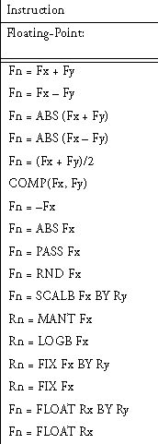
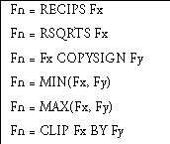
ALU Instructions

Slide 14
Multiplier
Multiplier Performs the following operations,
Floating-point multiplication
Fixed-point multiplication
Fixed-point multiply/accumulate with addition, rounding optional
Fixed-point multiply/accumulate with subtraction, rounding
optional
Rounding multiplier result register
Saturating multiplier result register
Clearing multiplier result register

Slide 15
Multiplier Instructions

Slide 16
Barrel Shifter
The shifter performs bit-wise operations on 32-bit fixed-point operands.
Shifter operations include:
Shifts and rotates from off-scale left to off-scale right
Bit manipulation operations, including bit set, clear, toggle, and test
Bit field manipulation operations, including extract and deposit
Fixed-point/floating-point conversion operations, including exponent
extract, number of leading 1s or 0s

Slide 17
Multifunction Computation
Supports multiple parallel (multifunction) computations by using the parallel data paths within its computational units.
Complete in a single cycle.
Combine parallel operation of the multiplier and the ALU or dual ALU functions.

Slide 18
Multifunction Computation

Slide 19
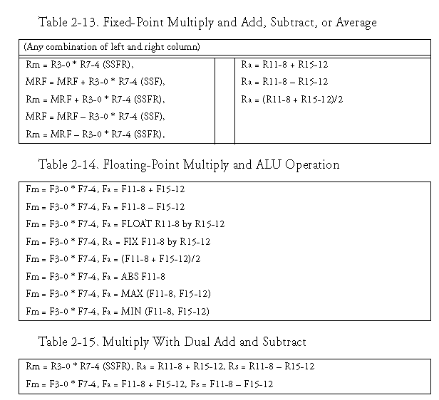
Multifunction Computation

Slide 20
Secondary Processing Elements
Supports SIMD (Single Instruction Multiple Data)
To perform SIMD, enable the PEy bit in MODE1 Register

Slide 21
Secondary Processing Elements

Slide 22
Thank U

