Slide 1
Audio Framework (Autodetection, Buffer flow, Data flow)
Mukeshkumar M
Ajithprabhu ST

Slide 2
Audio Framework Basic Flow
Wait for next data from receiver
NO
Check
Valid
DAI
SPORT
Rx
DMA
Rx Buffer
Auto Detection
HDMI
YES
Predac
Buffer
Post
Processing
Pack
Buffer
Decoder
DMA
Tx Buffer
SPORT
Tx
DAI
CODEC
Audio O/P

Slide 3
Realtime Framework – Buffer Flow
SINGLECORE
Auto Detection
Decoder
Rx DMA
Processing buffer
TX DMA
Pack Buffer
Post Decoder
Customer PP
Processing buffer
Processing buffer
Predac Buffer
3
3

Slide 4
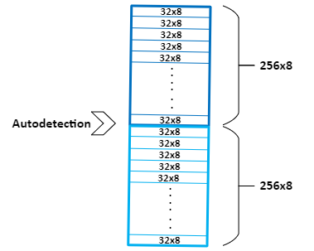
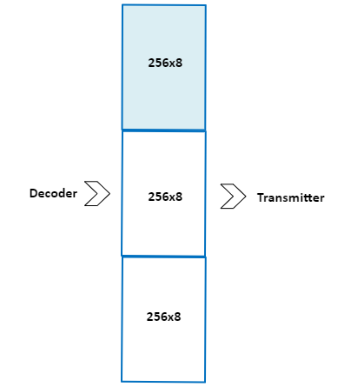
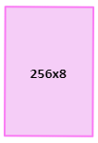
Realtime Framework – Buffer Flow
Pack Buffer:
Is an input buffer which receives the samples from Auto detection.
Pack buffer size in the framework will be Sample block * No of input channels * No of Halfs.
The sample block and Number of Half's will vary based on decoders.
This works in a circular fashion.
When the Pack is filled, This will be sent to next flow i.e, Decoding
Predac Buffer:
Is an output buffer which gets the output samples from the decoder.
Predac buffer size in the framework will be Sample block * No of Output channels * No of half
Factors like the Number of Cores and decoder latency decides the Number of Half.
This works in a circular fashion.
When the Predac is filled, This will be sent to next flow i.e, Transmitter.
Processing Buffer:
Is an internal buffer used to store the intermediate results.
Size of the buffer is usually sample block * No of input channels
This can be reused in the audio chain
Pack Buffer
Predac Buffer
Processing Buffer
<number>

Slide 5
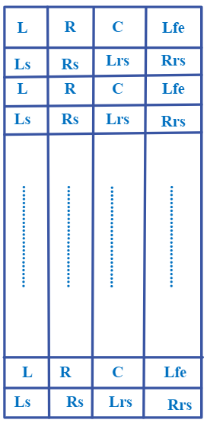
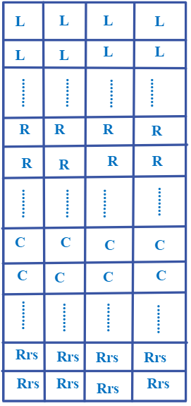
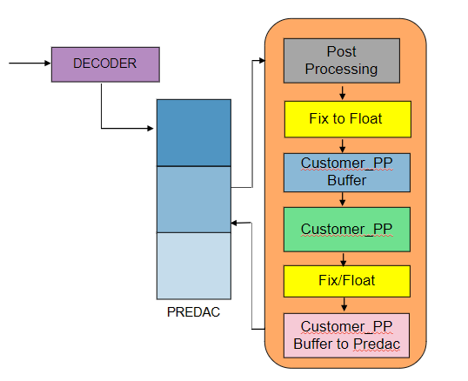
Realtime Framework – Data Flow
Input / Output Data flow of the audio framework includes
Sample block : 256 , 128
Bit Rate : 24 bit / 32 bit
Data Format : Floating / Fixed
Data Organization:
Block based - Processes data in larger chunks or blocks.
Interleaved - Combines multiple channels into a single stream.
When Factors copying the Data between buffers
Source and Destination Buffer pointers
No of samples to be copied
Buffer Stride
Circular Pointer update :
Whenever a data copied to or from a circular buffer, the respective read and write pointers to be updated for the next processing
Empty Space and Filled Space checking:
This is to check a valid sample is available to process and enough space is available to fill data
Interleaved format
Block based format

