Slide 1
DAI, SPORT, PCG - Peripherals usage and configuration

Slide 2
BASIC FLOW
NO
Check
Valid
DAI
SPORT
Rx
DMA
Rx Buffer
Auto Detection
HDMI
YES
Post
Processing
Predac
Buffer
Pack
Buffer
Decoder
DMA
Tx Buffer
SPORT
Tx
DAI
CODEC
Audio O/P

Slide 3
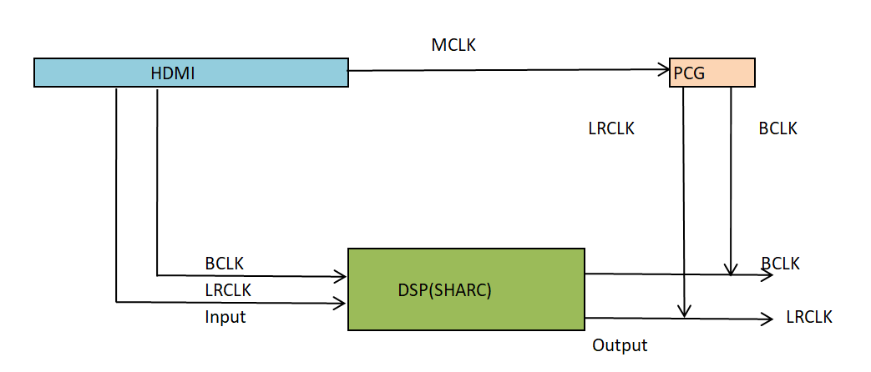
DAI - Digital Audio Interface
The Digital Audio Interfaces (DAIn) are comprised of groups of identical peripherals and their respective Signal Routing Units (SRUn).
The SRU connects inputs and outputs of the DAI peripherals with each other and to the external pins
This SDK supports up to 8 channels input through 4 physical I2S channels, where each I2S data line carries two channels of audio.
All required clocks including bit clock, frame sync, and MCLK should be provided from the audio source, and the input data should be synchronized to those clock signals

Slide 4
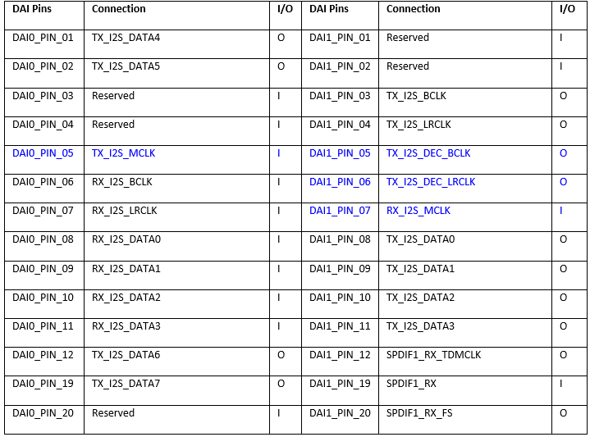
DAI Pin Assignment

Slide 5
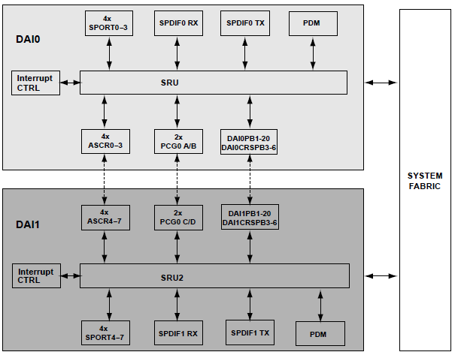
SRU

Slide 6
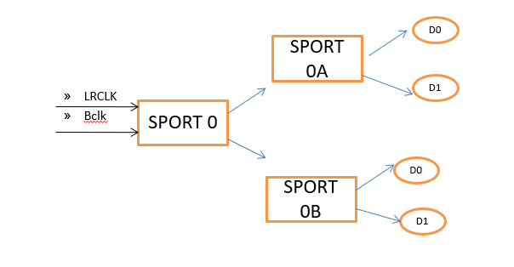
SPORT
The processors feature eight synchronous serial ports (SPORTs)
SPORT 0 to 7
DAI 0 GROUP SPORT 0 to 3
DAI1 GROUP SPORT 4 to 7
SPORT
SPORT0 Group | SPORT1 Group
SPORT 0 | SPORT 4
SPORT 1 | SPORT 5
SPORT 2 | SPORT 6
SPORT 3 | SPORT 7

Slide 7
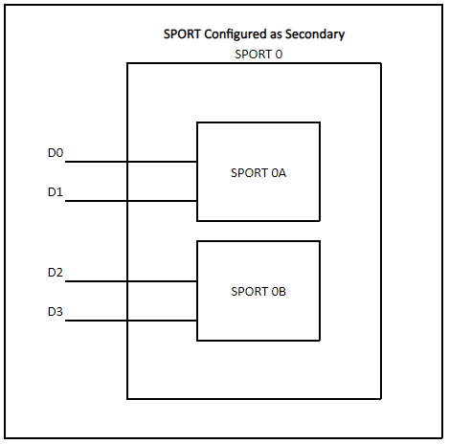
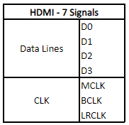

Slide 8
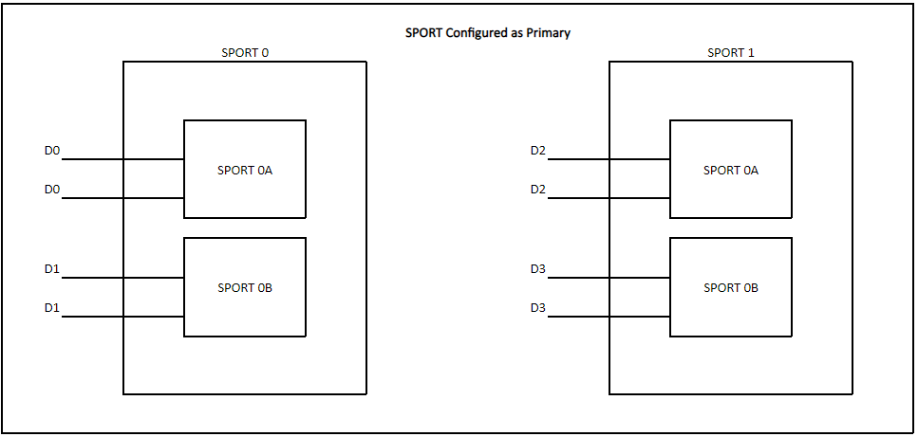

Slide 9
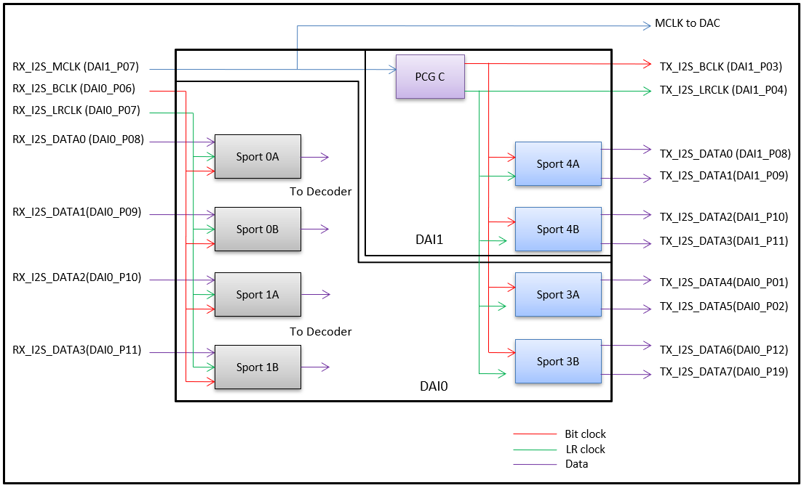
SPORT
This SDK SPORT I/P to 16 channels output. PCG is used to derive the required output bit clock and frame sync.
The MCLK received from the source is used to generate the bit clock and frame sync for audio output.
There are four PCG units per DAI.
PCGA, PCGB, PCGE, and PCGF belong to DAI0;
PCGC, PCGD, PCGG, and PCGH belong to DAI1.

Slide 10
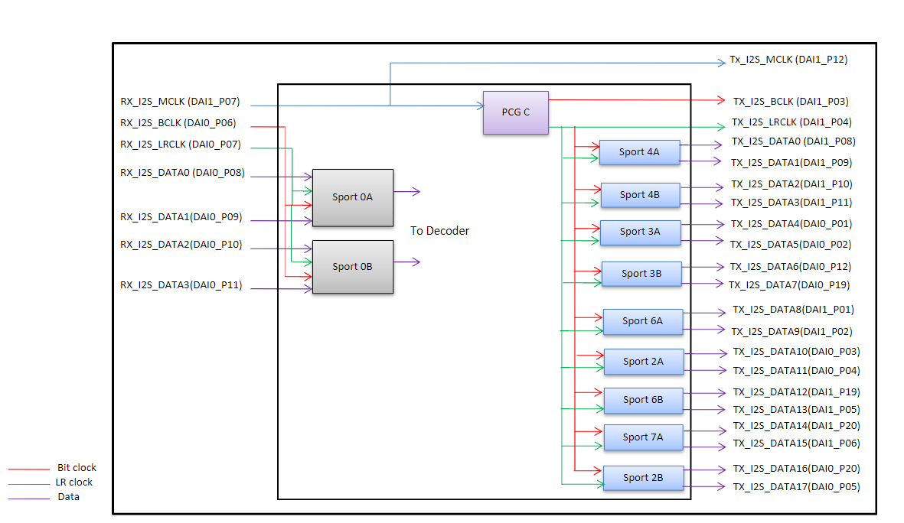
I2S

Slide 11
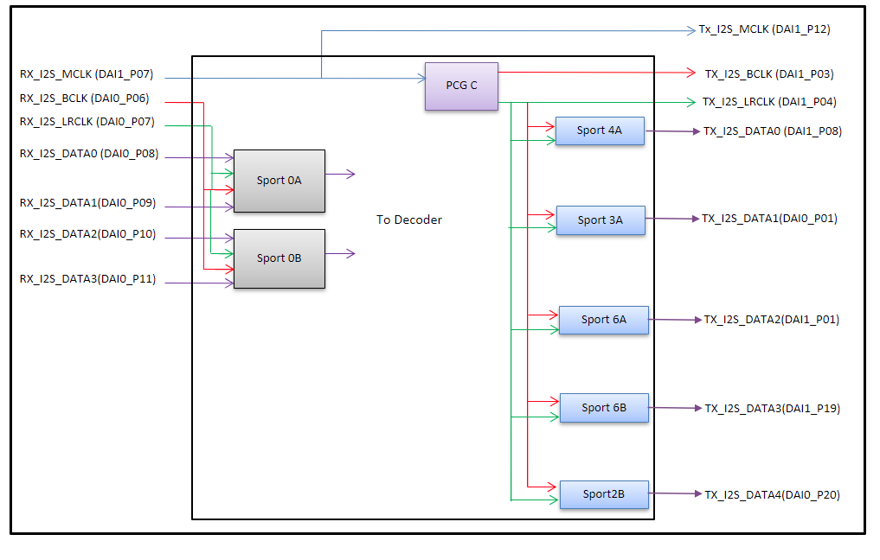
TDM

Slide 12
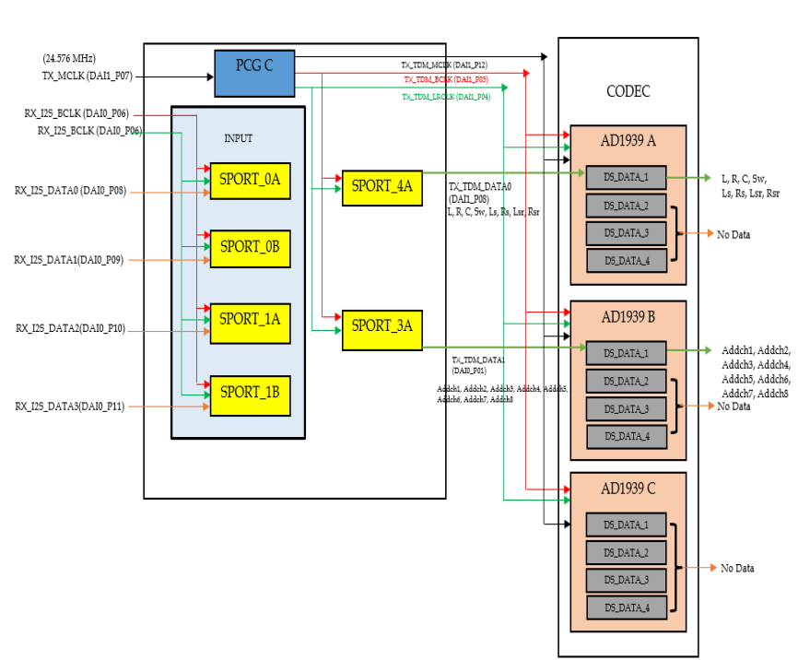

Slide 13
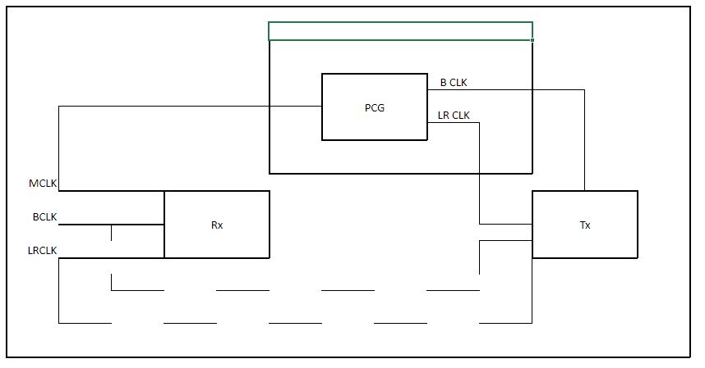

PCG
DIV = MCLK/FS CLK
24.576MHz/48K
BCLK = 64 * FS CLK.

Slide 14
Debugging Tips
Probe the I/P & O/P clocks
Verify Interrupt is generating for Rx and Tx Handler function.
Plot the DMA buffers content
DAI to DAI routing
SPORT to SPORT routing

Slide 15


