Slide 1
What is Optimization?

Slide 2
The action of making the best or most effective use of a situation or resource.
For Example:
1.The mode of transport that you choose to reach your destination.
2.Drawing the star

Slide 3
Code Optimization
Optimization is a program transformation technique, which tries to improve the code by making it consume less resources (i.e. CPU, Memory) and deliver high speed.
What is CPU?
What is memory?
What is Efficiency?

Slide 4
Code Transformation
Calculate the area of Circle
Sum of two numbers
Perform Arithmetic operation of two numbers

Slide 5
Techniques to follow:
The output must not changed
Optimization should increase the speed of the program and if possible, the program should demand less number of resources.
Optimization should itself be fast and should not delay the overall compiling process.

Slide 6
Mobile phones and Laptops Specs
RAM
A computer with more memory (RAM) will be capable of storing more programs that are currently running in memory.
Processor
The overall speed or clock speed of the computer and how fast it is capable of processing data is managed by the computer processor (CPU).

Slide 7
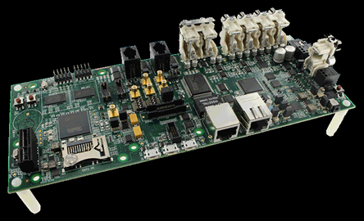
ADSP-SC587 SPEC
500 MHz per core-dual core
5Mbits/640KB L1 memory/core with parity
- Optional cache/SRAM mode
32-bit, 40-bit & 64-bit floating point support
Advanced Hardware Accelerators FFT/iFFT ( 5usec per 1K-pt FFT)
FIR/IIR and SINC Filters, ASRC

Slide 8
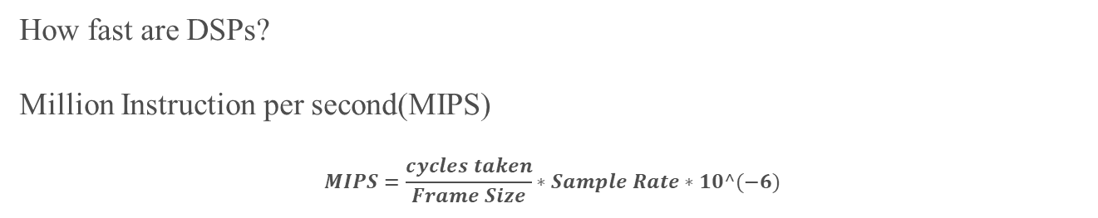
MIPS
How fast are DSPs?
Million Instruction per second(MIPS)
$$MIPS=\frac{cycles taken}{Frame Size}∗Sample Rate∗10^(−6)$$
SET_TIMER() & CALCULATE_MIPS() are cycles measurement modules in SHARC DSP processor which need to be inserted before and after the module for which the MIPS is required.
Eg:
int main()
{
int a=5,b=6;
SET_TIMER(); //start timer
add();
CALCULATE_MIPS(); //stop timer
}
int add(int a,int b)
{
return a+b;
}

Slide 9
Memory
Data Memory
Data memory is used for temporarily storing and keeping the immediate results and variables
Program Memory
Program memory is normally used for storing program code, i.e. instructions.

Slide 10
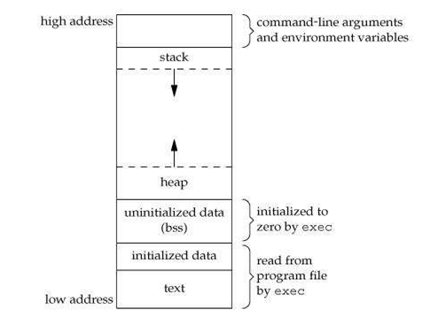
A typical memory representation of C program consists of following sections.
1. Text segment 2. Initialized data segment 3. Uninitialized data segment 4. Stack 5. Heap
#include <stdio.h>
int global = 10; /* initialized global variable stored in DS*/
int main(void)
{
static int i = 100; /* Initialized static variable stored in DS*/
return 0;
}

Slide 11
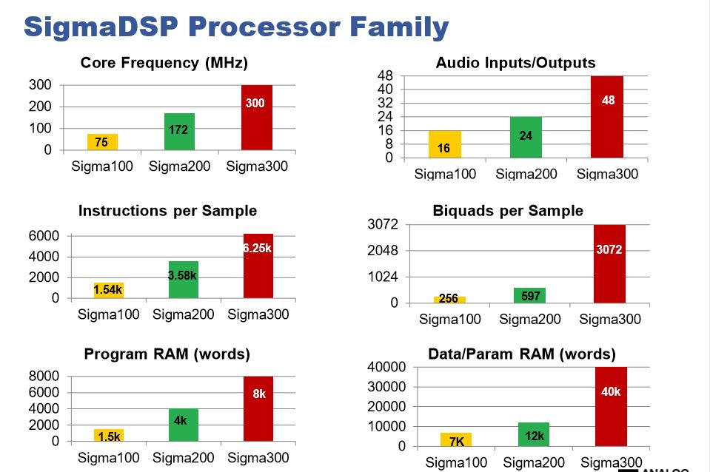
Sigma DSP Processor

Slide 12
Why need to optimize?
When the application exceeds the limitations (memory, MIPS) of the processor, the application may not be run in a expected time.
This will lead to lack in the performance of the system and the system may not be a real time system.
MIPS optimization
When your application consumes more cycles compare to the processor cycles , we need to do MIPS optimization.
Memory optimization
Code memory
Data memory

Slide 13
Rules for Optimization
First rule of optimization: Don't do it.
Understand the processor architecture, compiler options, optimization switches, SIMD, etc.
Find the place where the cycles are high
Do the Loop unrolling, loop jamming, removing the dead code,etc.
Change the logical functions of the program
Asm code conversion
Finally find the point at where to stop

Slide 14
Compiler optimizations
Smart selection of compilation options can yield a dramatic code performance improvement.
Turning on optimization flags makes the compiler attempt to improve the performance.
Compiler optimizations
-O0 –no optimization
-O1 –local optimization, register allocation
-O2 –local/limited global optimization
-O3 –aggressive global optimization
-Munroll – loop unrolling
-Mvect - vectorization
-Minline – function inlining
From CCES,
Properties->C/C++ build->settings->cross core SHARC C/C++ compiler-> General -> Optimization (set Optimize for code/size to 100)

Slide 15
SIMD
Single instruction multiple data (SIMD) mode allows the processors to execute the same instruction in both processing elements, but each processing element operates on different data.
Using Shadow register next instruction are executed parallely to produce the result.
This will lead to reduce the half of the cycles taken.
Ex:
for (i=0;i<256;i++)
{
C[i]=a[i]+b[i];
}
for (i=0;i<128;i+2)
{
C[i]=a[i]+b[i]; // c[i+1]=a[i+1]+b[i+1];
}

Slide 16
Hardware Math Accelerators
- A high performance accelerator is available to improve the overall computation power of the DSP processors.
- FFT/IFFT
- FIR/IIR filter
- Math functions(sqrt,log,rand,exp)
Parallel load
- The DSP performance can be increased by an increased parallelism in the instructions execution.
It is possible to load or store multiple data in each memory in a single cycle
{ [X0X1X2X3] = DM0(P0), [Y0Y1Y2Y3] = DM1(P1) };
Code Scheduling
Optimization is not just rewriting the code to the instructions that correspond to processor architecture. In case of using processor with pipelining there is the need to plan the execution of the code so that each instruction, if possible, work with the already calculated operands, i.e. the instructions have to be rearranged in a way that maximizes the performance by reducing the pipeline stalls.

Slide 17
INLINING
gcc and a few other compilers are capable of inlining small functions at higher optimization levels automatically.
If necessary, C functions can be recoded as macros to obtain similar speedup on compilers with no inlining capability.
This should be done after the code is completely debugged.
Before: After:
int foo(a, b)
{
a = a - b;
b++;
a = a * b;
return a;
}
#define foo(a, b) (((a)-(b)) * ((b)+1))

Slide 18
Loop Unrolling
Loop unrolling is another technique to exploit parallelism between loop iterations.
Let us have the following code:
#define N 3 short i; short a[N], b[N]; long long s = 0; // 64-bit accumulator for(i=0; i < N; i++)
{
s += a[i] * b[i];
}
Since N is known at the compile-time to be the constant and it is a small number, it is more efficient to rewrite the cycle as follows:
s += a[0] * b[0]; s += a[1] * b[1]; s += a[2] * b[2];

Slide 19
Before:
for (int i=0;i<1000;i+=1)
{ a[i] = b[i] + c[i];
}
After:
for (int i=0;i<1000;i+=2)
{
a[i] = b[i] + c[i];
a[i+1] = b[i+1] + c[i+1];
}
Before:
int a[10][10];
for (i=0;i<10;i++)
{
for (j=0;j<10;j++)
{
a[i][j] = a[i][j] *2;
}
}
After:
int a[10][10];
for (i=0;i<10;i++)
{
a[i][0]=a[i][0]*2; a[i][1]=a[i][1]*2; a[i][2]=a[i][2]*2; a[i][3]=a[i][3]*2; a[i][4]=a[i][4]*2; a[i][5]=a[i][5]*2; a[i][6]=a[i][6]*2; a[i][7]=a[i][7]*2; a[i][8]=a[i][8]*2; a[i][9]=a[i][9]*2;
}

Slide 20
Loop Jamming
Before:
for (i = 0; i < MAX; i++){ for ( j = 0; j < MAX; j++) a[i][j] = 0.0;
}
for ( i = 0; i < MAX; i++)
a[i][i] = 1.0;
After:
for ( i = 0; i < MAX; i++)
{
for ( j = 0; j < MAX; j++)
a[i][j] = 0.0;
a[i][i] = 1.0;
}
Early loop breaking
Before:
found = false;
for(i=0;i<10000;i++)
{ if( list[i] == -99 )
found = true;
}
if( found )
printf(“…”);
After:
found = false;
for(i=0; i<10000; i++)
{
if( list[i] == -99 )
found = true;
break;
printf(“ found”);
}
if ( found ) printf(“…”);

Slide 21
Loop Collapsing
Some nested loops can be collapsed into a single-nested loop to reduce loop overhead and improve run-time performance.
Example:
In the code fragment below, the double-nested loop on i and j can be collapsed into a single-nested loop.
int a[100][300];
for (i = 0; i < 300; i++)
for (j = 0; j < 100; j++)
a[j][i] = 0;
Here is the code fragment after the loop has been collapsed.
int a[100][300];
int *p = &a[0][0];
for (i = 0; i < 30000; i++)
*p++ = 0;

Slide 22
Dead Code Elimination
Dead code elimination is a compiler optimization to remove code which does not affect the program results.
Induction Variable Elimination
Some loops contain two or more induction variables that can be combined into one induction variable.
int a[SIZE];
int b[SIZE];
void f (void)
{
int i1;
for (i1 = 0; i1 < SIZE; i1++)
a[i1] = b[i1];
return;
}
int a[SIZE]; int b[SIZE];
void f (void) {
int i1, i2, i3;
for (i1 = 0, i2 = 0, i3 = 0; i1 < SIZE; i1++)
a[i2++] = b[i3++];
return;
}

Slide 23
Branch Elimination
Eliminate a branch to a branch.
In the code fragment below, the branch to L1 and then to L2 can be replaced with a single branch to L2.
goto L1;
/* other code */
L1:
goto L2
goto L2;
/* other code */
L2:
Your code

Slide 24
If inside a loops
Original code : c= 0 ; for (i=0; i<999; i++) { if (a > B) c++ ; } Modified code for speed optimization: c= 0 ; for (i=0; i<999; i++) { c += (a > B) ; }

Slide 25
Instruction Combining
At the source code level, combine two statements into one statement.
In the code fragment below, the two post-increment statements can be combined into one statement.
int i;
void f (void)
{
i++; i++;
}
int i;
void f (void)
{
i += 2;
}

Slide 26
Look-up tables
In some cases, the results can be computed in compile-time and stored in memory as constants. This is quite common practice in case of digital filter coefficients calculation.

Slide 27
Code Optimization
Code optimization is any method of code modification to improve code quality and efficiency.
A program may be optimized so that it becomes a smaller size, consumes less memory, executes more rapidly, or performs fewer input/output operations.

Slide 28
Code Optimization-Peephole
Peephole optimization is a type of Code Optimization performed on a small part of the code.
It is performed on the very small set of instructions in a segment of code.
It basically works on the theory of replacement in which a part of code is replaced by shorter and faster code without change in output.
Objectives of Peephole Optimization:
To improve performance.
To reduce memory footprint.
To reduce code size.

Slide 29
Peephole Optimization Techniques:
1.Redundant load and store elimination:
In this technique the redundancy is eliminated.
Initial code:
y = x + 5;
i = y;
z = i;
w = z * 3;
Optimized code:
y = x + 5;
w = y * 3;
2.Constant folding:
The code that can be simplified by user itself, is simplified.
Initial code:
x = 2 * 3;
Optimized code:
x = 6;

Slide 30
3.Strength Reduction:
The operators that consume higher execution time are replaced by the operators consuming less execution time.
Initial code:
y = x * 2;
Optimized code:
y = x + x; or y = x << 1;
Initial code:
y = x / 2;
Optimized code:
y = x >> 1;
Initial code:
x = w % 8;
y = pow(x, 2.0);
z = y * 33;
for (i = 0; i < MAX; i++) {
h = 14 * i;
printf("%d", h);
}
Initial code:
x = w & 7; /* bit-and cheaper than remainder */ y = x * x; /* mult is cheaper than power-of */
z = (y << 5) + y; /* shift & add cheaper than mult */
for (i = h = 0; i < MAX; i++)
{
printf("%d", h);
h += 14; /* addition cheaper than mult */
}

Slide 31
4.Unreachable code
Unreachable code is a part of the program code that is never accessed because of programming constructs.
void add_ten(int x) {
return x + 10;
printf(“value of x is %d”, x);
}

Slide 32
Thank you

