Slide 1
Title : Host Communication Protocol
26 Mar 2025

Slide 2
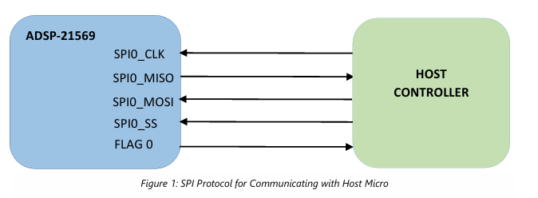
SPI Communication Physical Layout

Slide 3
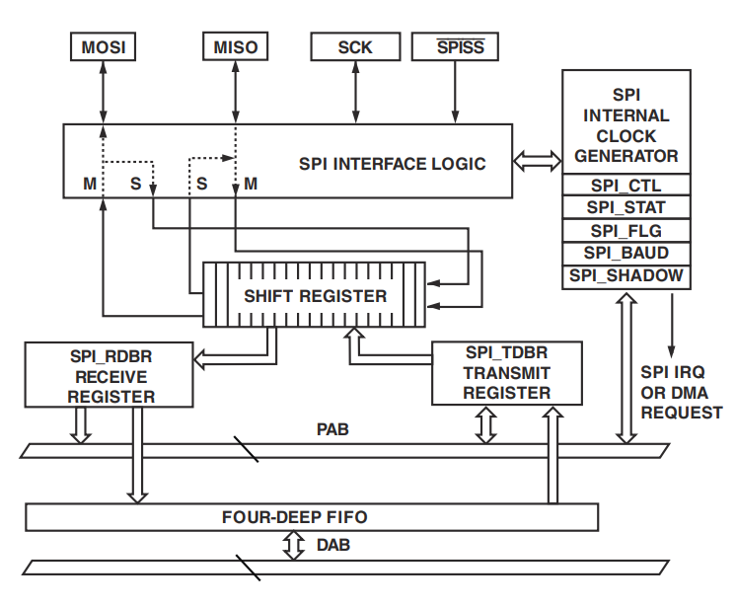
BF-524 – SPI Master
The following steps to be followed to Configure SPI Master in BF-524 processor.
Pin Mux Configuration to be done for the required SPI device.
Selected SPI DMA need to be secured using SPU (SystemProtectionUnit)
The following configuration need to be configured in SPI_CTL MMR Register and should be same as SPI Slave Config.
CPHA – Clock Phase
CPOL – Clock Polarity
SPI_BAUD MMR register used to configure the SPI Clock Speed.
SPI_FLG MMR register need to configured and this is for SlaveSelect.
SPI Clock Frequency = (Peripheral Clock Frequency SCLK)/(2*SPI_BAUD)
Peripheral Clock Frequency = 100Mhz.

Slide 4
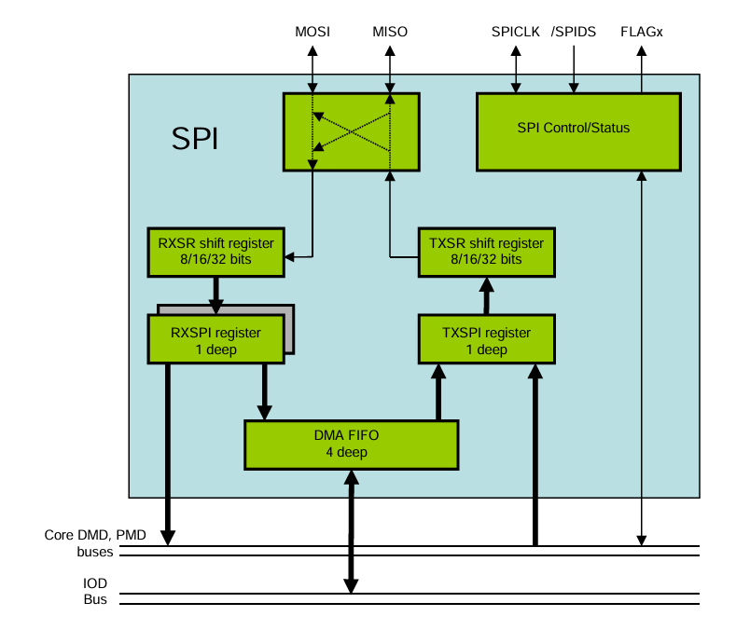
ADSP-21569/21593 – SPI Slave
The following steps to be followed to Configure SPI device in SHARC processor.
Pin Mux Configuration to be done for the required SPI device.
Selected SPI DMA need to be secured using SPU (SystemProtectionUnit).
The following configuration should be same as SPI Master Configuration and it is configured in SPI_CTL MMR Register.
CPHA – Clock Phase
CPOL – Clock Polarity
SPI_CLK MMR register will not configured and ignored for SLAVE devices.

Slide 5
FLAG0 is used as interrupt to Host micro
Memory Buffer is defined in the ADSP-21569/ADSP-21593.
ADSP Periodically update the STATUS and RESERVED Bytes by Comparing its previous value. If any changes found, the DSP will make the FLAG0 pin status as HIGH to raise interrupt in HOST micro.
Example:-
If Stream Type is switched from PCM to DD, the STATUS_BYTE1 will be updated as 0x8002 from0x8001, and the FLAG0 pin.
Host
ADSP-21569
FLG0

Slide 6
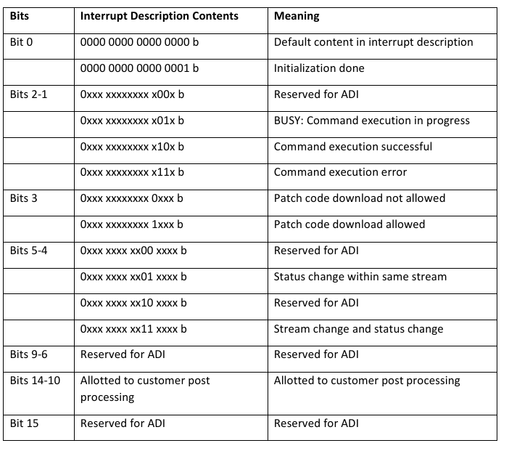
Interrupt_Description (Frmwk.Spi.INTR_DESC_LOCN – Variable in DSP)

Slide 7
Command and Status Handling in ADSP-21569
Command Buffer Location | Name | Variable in ADSP21569/21593
0x0 | Command Register | Frmwk.Spi.COMMAND_BYTE
0x1 | Parameter#1 | Frmwk.Spi.PARAMETER_1
0x2 | Parameter#2 | Frmwk.Spi.PARAMETER_2
0x3 | Parameter#3 | Frmwk.Spi.PARAMETER_3
0x4 | Parameter#4 | Frmwk.Spi.PARAMETER_4
0x5 | Parameter#5 | Frmwk.Spi.PARAMETER_5
... | ... | ...
0x1E | Parameter#30 | Frmwk.Spi.PARAMETER_30
0x1F | Parameter#31 | Frmwk.Spi.PARAMETER_31
0x20 | Status#1 | Frmwk.Spi.STATUS_BYTE1
0x21 | Status#2 | Frmwk.Spi.STATUS_BYTE2
0x22 | Status#3 | Frmwk.Spi.STATUS_BYTE3
0x23 | Status#4 | Frmwk.Spi.STATUS_BYTE4
0x24 | Status#5 | Frmwk.Spi.STATUS_BYTE5
0x25 | Status#6 | Frmwk.Spi.STATUS_BYTE6
... | ... | ...
0x2E | Status#15 | Frmwk.Spi.STATUS_BYTE15
0x2F | Status#16 | Frmwk.Spi.STATUS_BYTE16
Command Buffer Location | Name | Variable in ADSP21569/21593
0x30 | Reserved | Frmwk.Spi.RESERVED_BYTE1
0x31 | Reserved | Frmwk.Spi.RESERVED_BYTE2
0x32 | Reserved | Frmwk.Spi.RESERVED_BYTE3
0x33 | Reserved | Frmwk.Spi.RESERVED_BYTE4
0x34 | Reserved | Frmwk.Spi.RESERVED_BYTE5
0x35 | Reserved | Frmwk.Spi.RESERVED_BYTE6
... | ... | ...
0x3E | Reserved | Frmwk.Spi.RESERVED_BYTE15
0x3F | Interrupt Description | Frmwk.Spi.INTR_DESC_LOCN

Slide 8
Command and Status bit Allocation – 32bit
31 | 30 | 29 | 28 | 27 | 26 | 25 | 24 | 23 | 22 | 21 | 20 | 19 | 18 | 17 | 16 | 15 | 14 | 13 | 12 | 11 | 10 | 9 | 8 | 7 | 6 | 5 | 4 | 3 | 2 | 1 | 0
Reserved |  | Read/Write | Reserved |  |  |  |  |  |  | Address |  |  |  |  |  | Data
Example:-
SPI Write (from Host to DSP):
Mute Command – 0x20000003 [29th bit - Write]
Parameter_1 – 0x20010410 [29th bit - Write]
SPI Read (Command from Host to DSP followed by dummy Zero to Readback the DSP status):
Parameter#1 – 0x00010000 [29th bit - Read]
StatusByte#1 – 0x00200000 [29th bit - Read]

Slide 9
References
Connecting SHARC® and Blackfin® Processors over SPI Application Note (EE-340)
ADI_SoundBar_SDK_Host_Interface_ Protocol_Guide_EVAL-MELODY-8.pdf
ADSP-21569 Datasheet and Product Info | Analog Devices
ADSP-BF524 Datasheet and Product Info | Analog Devices

Slide 10






India, Germany, Japan, USA & China
+91 44 6666 9600
www.jasmin-infotech.com
THANK YOU!

