Slide 1
System Programming using C
Chapter 1 : Building an Executable

Slide 2
Contents
QEMU
Build Setup
Hello World! Bare metal application ARM
C Startup Code
Linking Process
Linker Script
Linking Hello World! Program
Map File
Object file, Symbol Table.
Map File Interpretation
Building Libraries
Static Library
Dynamic Library

Slide 3
QEMU
The module is designed with QEMU emulator as the prime development environment.
An emulator is a computer program or hardware equipment that can simulate/imitate one computer system by using another system.
QEMU can be used to emulate an ARM machine, it is a powerful virtualization & emulation tool that works with a variety of architectures.
The code that is written can boot on the real ARM device.
Why QEMU?
We don’t have to do software flashing / download process.
No additional hardware is required.
We have tools to inspect the state of the emulated hardware.
This module uses the Ubuntu based system for development. But QEMU supports wide range of systems.
QEMU emulator have support for Texas Instruments platform, that contains Stellaris LM3S6965 Microcontroller.
We will write and debug bare metal ARM software for Stellaris LM3S6965 Microcontroller in our example code to understand the module.
"Module3_SystemProgramming_Using_C/BareMetal_LM3S6965" contains the source code files.

Slide 4
Build Setup
QEMU:
To Install QEMU run following command in ubuntu Terminal:
sudo apt-get install qemu-system-arm
gcc-arm-none-eabi:
We cannot use the common gcc compiler to build code that executes on an ARM core, instead we need a cross-compiler.
It simply runs on one platform & compiles executables for another platform.
We’re using Linux on the x86-64 platform, & we want executable for ARM platform, so a cross compiler is the used for that.
For ARM platform gcc-arm-none-eabi toolchain is required.
To install it run the below command on terminal:
sudo apt-get install gcc-arm-none-eabi

Slide 5
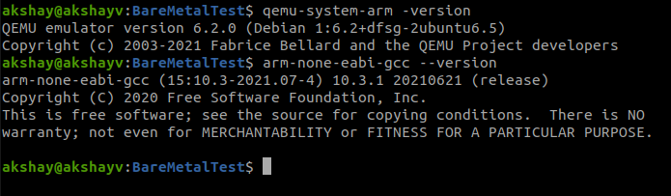
Build Setup contd..
We can verify the installation using commands:
gdb-multiarch:
GDB is a source-level debugger, capable of breaking programs at any specific line, displaying variable values, and determining where errors occurred.
But GDB is platfrom specific..
To debug our bare-metal program we can use GDB Multiarch.
To install run the below command:
sudo apt-get install gdb-multiarch
Stellaris®LM3S6965 Microcontroller Datasheet:
Directory: Module3_SystemProgramming_Using_C/BareMetal_ARM926EJ-S contains all the source code and documentation for LM3D6965 Microcontroller.

Slide 6
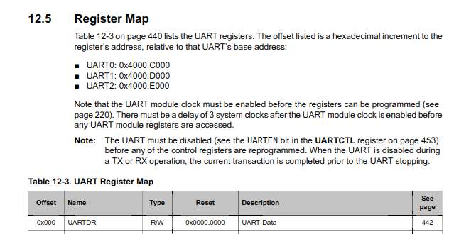
Hello world for bare metal ARM
LM3D6965 core has three UART serial ports.
From the Registor map of LM3D6965 from the datasheet the address we can find the UART0 is mapped: 0x4000C000
The UART0 particularly can be used as a terminal when using the "-nographic" or “-serial stdio” with QEMU.

Slide 7
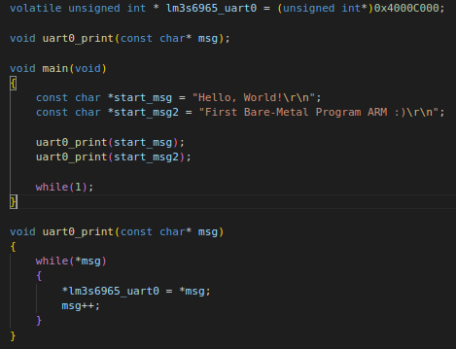
Hello world! for bare metal ARM contd..
The code just outputs start_msg & start_msg2 buffers through the device’s UART0.
The volatile keyword is necessary to instruct the compiler that the memory pointed by lm3s6965_uart0 can change so don’t optimize.
The unsigned int type enforces 32-bits read and write access.
Now lets compile the code following command:
arm-none-eabi-gcc -c -mcpu=cortex-m3 -g main.c -o main.o
-mcpu flag indicates the processor platform for which the code is compiled.
Main.c - Implements the "Hello World!" Program.

Slide 8
C Startup Code
When developing bare metal applications it is required to supply some functions that we normally take for granted when developing code for mainstream OS’s.
To write a bare metal program we must understand the startup sequence of the processor.
The ARM Cortex M3 architecture begins to execute code at a determined address, that could be 0x0 the initial value of the Stack Pointer.
Startup code runs before the main() function starts its execution.
What is actually needed to start the execution of the main function?
All uninitialized variables are zero. These are stored in the .bss section of the final elf file.
All initialized variables are actually initialized. These are stored in the .data section of the final elf file.
All static objects are initialized, they may need to get their constructors called if they are not trivial. Function pointers to these static initialization routines are stored in the .init_array section.
The stack pointer is correctly set during startup.
Some other machine dependent features like enabling access to the floating point coprocessor (VFP coprocessor on most ARM microcontroller architectures etc.).

Slide 9
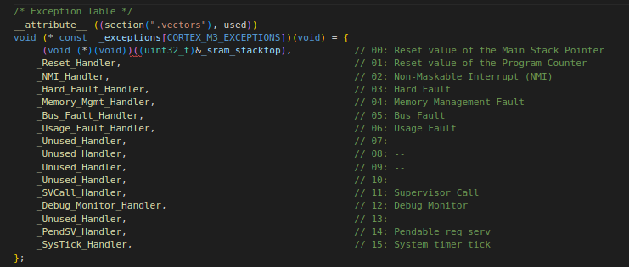
C Startup Code contd..
Default startup code is given in the assembly language for the target processor.
It makes sense, however, reimplementing this code in C, for the purposes of creating a more generic code that can be used for multiple devices.
The Startup code does the following tasks:
Vector table for the NVIC (Nested Vectored Interrupt Controller):
Define the vector table for the NVIC.
Upon an exception or interrupt it looks up the address of the corresponding ISR.
This table contains:
The Stack pointer & Program Counter initial value.
The reset vector
All exception vectors
All external interrupt vectors.
Fault handlers.
When a system reset occurs, execution starts from the reset vector.
The processor loads the value of the MSP (main stack pointer) with the highest ram address (defined by the linker as __StackTop).
The __StackTop variable is actually defined in the linker script.
_sram_stacktop = ORIGIN(SRAM) + LENGTH(SRAM);

Slide 10
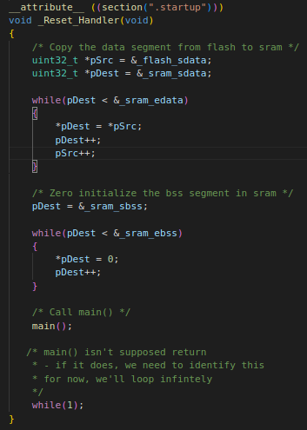
C Startup Code contd..
Initialize the .data section :
This section is defined in the linker script with different VMA (Virtual address) and LMA (Load address).
Since it has to be loaded to Flash, but used from RAM when the execution starts.
To make sure that all C code can use the initialized data within the .data section, it has to be copied over from Flash to RAM by the startup code.
To accomplish this it uses the following symbols defined by the linker: _flash_sdata, _sram_sdata and _sram_edata.
Initialize the .bss section to zero:
It uses the symbols _sram_sbss and _sram_ebss to obtain the address range that should be set to zero.
These symbols are defined in the linker script.
_Reset_Handler:
When a reset occurs it will start executing the code at the address indicated by the _Reset_Handler function pointer.
This is where we setup and call main().
We'll create a separate section .startup so this resides immediately after the vector table

Slide 11
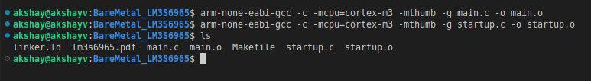
C Startup Code contd..
"Startup.c" file contains source code for C Startup.
Compile the Startup Code using command:
arm-none-eabi-gcc -c -mcpu=cortex-m3 -mthumb -g startup.c -o startup.o

Slide 12
Linking Process
What is linker?
We say “compilation” when referring to the process by which source code is built into an executable file.
In previous steps we compiled the C code: 'main.c' & assembly code : startup.s. Both those compilation created the object files main.o & startup.o.
Linking process comes after the compilation.
Whether we use an IDE or GCC from the command line, compilation and linking will happen together as both are invoked with the same command.
A linker takes one or more object files, adds external libraries & links it all into an executable file.
Each object file is likely to make reference to functions that are hold in other object files, and resolving those dependencies is done by linker.
Linker scripts tell the linker how to do the job.

Slide 13
Linker Script
Anatomy of a Linker Script:
A linker script hold four things:
Memory layout:
The information of what and where the memory is available “flash”, and “ram” any specific memory available with the cpu (Eg : Core Coupled SRAM, Secondary SRAM etc.)
Section definitions:
Defines which part of a program should go where Data & Code.
Options:
Commands to specify architecture, entry point of application if needed
Symbols:
Variables to insert into the program at link time

Slide 14
Linker Script : Memory Layout
To allocate program space, the linker must know how much memory is available & at what addresses that memory exists.
This is defined in MEMORY definition in the linker script.
The syntax for MEMORY :
name :
Is a name we want to use for the region. Names do not carry meaning, so we are free to use anything we want.
Often “flash” & “ram” as region names.
(attr) :
Are attributes for the region:
writable (w), readable (r), or executable (x).
Flash is (rx),
RAM is rw.
These attributes describe the properties of the memory, not set it.
origin :
Is the start address of the memory region.
len :
Is the size of the memory region, in bytes.
Syntax :
MEMORY { name [(attr)] : ORIGIN = origin, LENGTH = len … }
TI LM3S6965 Memory Map
Memory | Start Address | Size
Flash | 0x00000000 | 256 Kbytes
SRAM | 0x20000000 | 64 Kbytes
This memory map gives us:
MEMORY { FLASH (rx) : ORIGIN = 0x00000000, LENGTH = 256K SRAM (rw) : ORIGIN = 0x20000000, LENGTH = 64K }

Slide 15
Linker Script : Section Definitions
Code & data are bucketed into sections, which are contiguous blocks of memory.
We name those sections as:
.text - code & constants
.bss - uninitialized data
.stack - our stack
.data - initialized data
.text Section:
The code segment, it usually called .text.
It contains the executable code, which means it’s read-only and has a known size.
This section goes in FLASH. The syntax is:
This defines a section named .text & adds it to the FLASH.
We also need to tell the linker what to put in this section.
This is done by listing all of the sections from input object files we want in .text.
SECTIONS { .text : { } > FLASH }

Slide 16
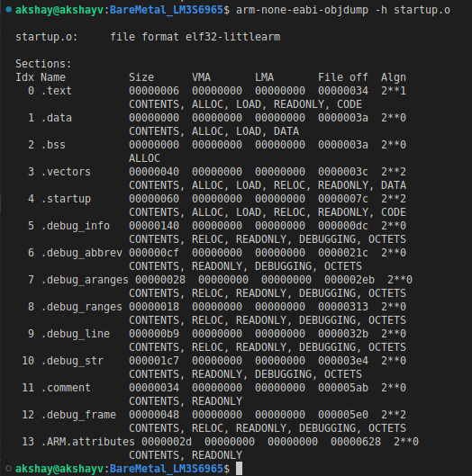
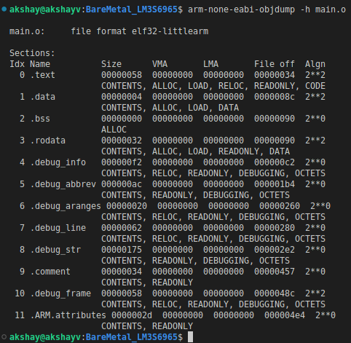
Linker Script : Memory Layout
.text Section contd.. :
To find the sections are in object file, we need to look at objdump.
To display summary information from the section headers of the object file.
Run the below command on both startup.o & main.o:
arm-none-eabi-objdump -h main.o
arm-none-eabi-objdump -h startup.o
We see that each symbol has a section.

Slide 17
Linker Script : Memory Layout
.text Section contd.. :
To add all of our functions in the .text section in linker script, we use the syntax: <filename>(<section>)
Filename : The name of the input file whose symbols we want to include in the section.
Section : The name of the input sections
We want following sections from out files, we can use wildcard * to include from all input files:
.vector input section, It contains functions we want to keep at the very start of our .text section
.text
.startup
. rodata (segment for constant data)
.=ALIGN(4);
This means: insert padding bytes,
until current location becomes aligned on 4-byte boundary.
We will talk about this concept in future chapters.
Finally the .text section looks like :
.text : {
KEEP(*(.vectors))
*(.startup)
*(.text)
*(.rodata)
. = ALIGN(4);
} > FLASH

Slide 18
Linker Script : Memory Layout
.bss Section :
The unitialized data segment, also called as the BSS segment.
This is the section where we put uninitialized static memory.
.bss must be reserved in the memory map, but there is nothing to load as all variables are initialized to zero.
The .bss section also contain *(COMMON).
This is a special input section where the compiler place global uninitialized variables that go beyond scope of file.
int Count; goes there, while static int Count; does not.
This permits the linker to merge multiple definitions into one symbol if they have same name.
We specify that this section is not loaded with use of NOLOAD property.
.bss (NOLOAD):{
. = ALIGN(4);
*(.bss)
*(COMMON)
. = ALIGN(4);
} > SRAM

Slide 19
Linker Script : Memory Layout
.stack Section :
Similar to .bss section we do same with .stack memory, since it is in RAM it is not loaded.
The stack does not hold symbols, we must explicitly reserve space for it by indicating the size.
.data Section:
The .data section hold static variables which have an initial value at start.
Since RAM isn’t persisted when power is off, those sections are loaded from flash.
At startup, the Reset_Handler() copies the data from Flash to RAM before the main function is called.
To make this viable, every section in our linker script needs two addresses:
Load address (LMA):
Is where our Programmer needs to place the section. LMA is the address “at rest” .
Virtual address (VMA) :
The VMA the address during execution i.e. the device is on and the program is running.
STACK_SIZE = 0xFA00; /* 64kB */
.stack (NOLOAD) :
{
. = . + STACK_SIZE;
} > SRAM
.data : {
. = ALIGN(4);
*(.data);
. = ALIGN(4);
} > SRAM AT > FLASH
Syntax:
.data : { *(.data*); } > ram AT > rom /* "> ram" is the VMA, "> rom" is the LMA */

Slide 20
Linker Script : Memory Layout
Variables:
To make section addresses available to code, the linker is able to create symbols & add them to the program.
The syntax is similar to C assignment: symbol = expression;
We need:
_etext - end of code in .text section in FLASH.
_sdata - start of .data section in RAM
_edata - end of .data section in RAM
_sbss - start of .bss section in RAM
_ebss - end of .bss section in RAM
_sram_stacktop - top of stack.
_flash_sdata - Return the absolute LMA of the .data section.
They are straight forward: we can assign symbols to the value of the location counter (.) at the start and at the end of each section definition.
Final Linker Script:
Linker script is now ready. You can find the linker script inside: "linker.ld".

Slide 21
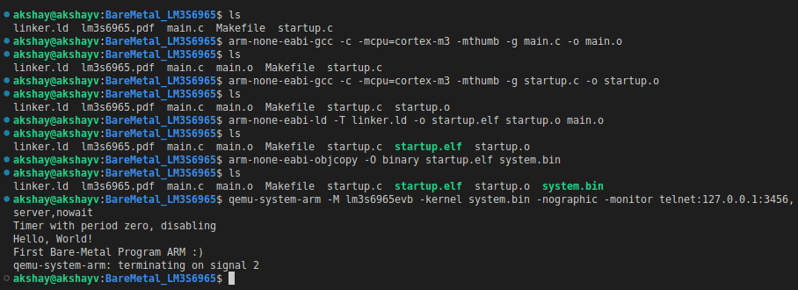
Hello world! for bare metal ARM contd..
Now that we have all the files for building & emulating the first Bear Metal App -> main.c : main application program, startup.c : Startup File & linker.ld : Linker File
We already have compiled objects for main.o & startup.o.
Run the command to create system.elf & system.bin binary image which we can use with QEMU emulator for ARM core.
arm-none-eabi-ld -T linker.ld -o startup.elf startup.o main.o
arm-none-eabi-objcopy -O binary startup.elf system.bin
To run my program in the emulator, the command is:
qemu-system-arm -M lm3s6965evb -kernel system.bin -nographic -monitor telnet:127.0.0.1:3456,server,nowait
UART0 particularly can be used as a terminal when using the -nographic or “-serial stdio” options with QEMU.
The -M option specifies the emulated system
Final Output print's two lines :
Hello, World!
First Bare-Metal Program ARM :)

Slide 22
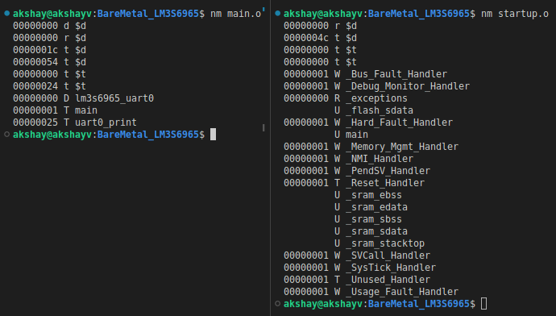
Object File- Symbol Table
In previous section we saw object file (main.o & startup.o) is the real output from the compilation phase.
It's mostly machine code, also contains metadata about the addresses of its functions & variables these are termed as Symbols in an data structure called a symbol table.
The addresses may not be the final address of the symbol in the final executable.
To know the symbols our object files main.o & startup.o contain we can use linux tool nm (read the link to read about tool).
nm - prints the symbol table for a given object file.
Just run following commands in terminal:
nm main.o
nm startup.o
The output is a list (separated by space) of address, type, and symbol name.
Address: are placeholders in object files, and final in executables.
Name: name of function or variable.
Type:
If lowercase, the symbol is usually local.
If uppercase, the symbol is global (external).
"t" The symbol is in the .text section, "U" The symbol is undefined, "D" The symbol is in the initialized data section,
"W" The symbol is a weak symbol

Slide 23
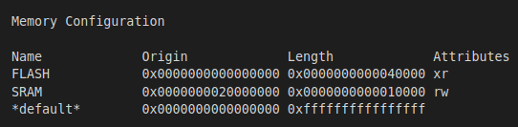
Map File
The map file provides important information that helps in understand and optimize memory.
It is symbol table for whole program.
A map file provides information about the linker / Locate process, including the following:
Where object files are mapped into memory.
How common symbols are allocated.
All archive members included in the link, with a mention of the symbol which caused the archive member to be brought in.
The values assigned to symbols.
How to generate MAP file run the command:
arm-none-eabi-ld -Map output.map -T linker.ld -o output.elf startup.o main.o
-Map = mapfile Print a link map to the file output.map.
This will generate the file "output.map".
Sections in map file:
Memory configuration:
This information in the map file are the actual memory regions, along with location, size and access rights granted to those regions:

Slide 24
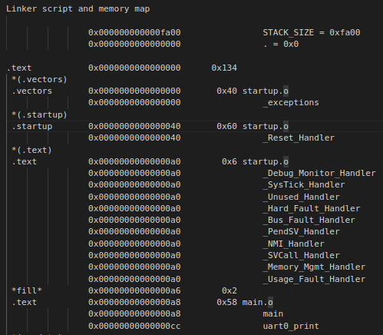
Map File contd..
Linker script and memory map :
It gives information about symbols in program.
In our file it indicates the text area size and its content.
The interrupt vectors (under the section .vectors) are present at the beginning of the executable, defined in startup.c.
These lines give us the address & size of each function.
The address of _exceptions defined under .vector section 0x0000000000000000, coming from startup.o which has a size of 0x40 bytes in the .text area.
The size is 0x40 bytes because _exceptions is an array of void * (size = 4byte) with 16 elements.
In this way, we can locate each function used in the program.

Slide 25
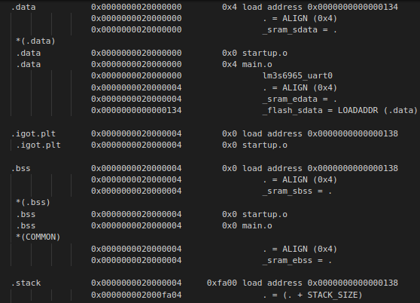
Map File contd..
Initialized variables have to be kept in Flash but they emerge in RAM in the map file, as they are copied into RAM in .data section before entering the main().
Symbols _sram_sdata & _sram_edata keep track of the area used in RAM to keep initialized variables.
These values are stored in Flash starting at load address 0x0000000000000134.
The address of lm3s6965_uart0 defined in main.c is 0x0000000020000000.
Similar way .bss section & .stack are defined in the map file.

Slide 26
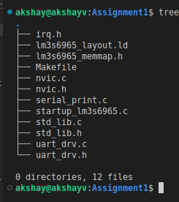
Assignment
Cross compile and execute:
Multiple source files, header files, communication between files, Cross compile and execute program on external target.
Compiler options towards optimization (both space and speed)
We will consider the MCU Stellaris®LM3S6965 Microcontroller.
Consider Dir: Module3_SystemProgramming_Using_C/Chapter1_Building_an_Executable/Assignment1
startup_lm3s6965.c -: Startup File
irq.h -: Interrupt routines
lm3s6965_layout.ld -: Linker script
lm3s6965_memmap.h -: LM3S6965 Memory Map
nvic.c & nvic.h -: Nested Vector Interrupt Controller
serial_print.c -: Routines for serial communication, Initialization and main() code.
uart_drv.c & uart_drv.h -: Uart Driver
std_lib.c & std_lib.h -: Custom memcpy() & memset()

Slide 27
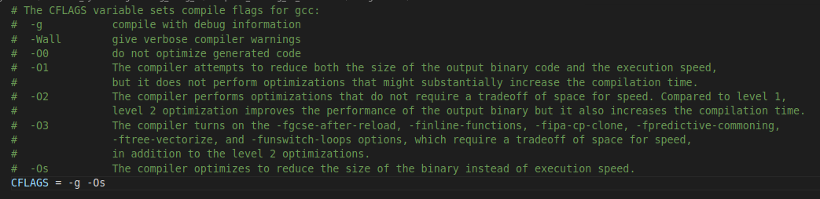
Assignment
Makefile -: To build code and Run the application in QEMU
CFLAGS : You can change the optimizations & add GCC flags to the CFLAGS
Read the comments provided below to enable GCC flags
To Build the code : make all
To run application in QEMU: make run

Slide 28
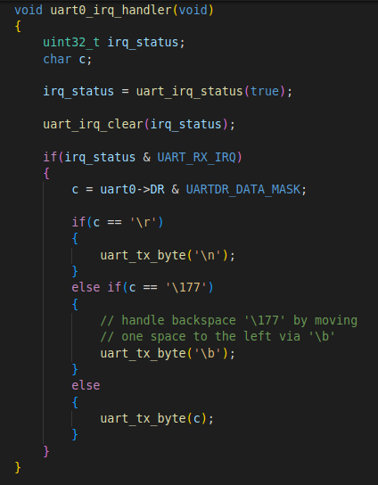
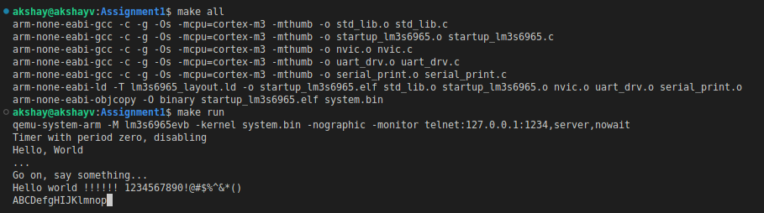
Assignment
Application:
In application the UART_RX_IRQ – Uart Receive Interrupt is enabled.
It reads the byte from UART in uart0_irq_handler() & loops back the Received byte using uart_tx_byte().
In QEMU:
UART0 particularly can be used as a terminal when using the -nographic or
“-serial stdio” options with QEMU.
Output:
When you type a ASCII char here it is loop backed from UART_RX_IRQ to UART_TX

Slide 29

Building libraries
A library is a pre-compiled code that can be reused in an application.
Libraries give reusable functions, data structures, routines that can be reused in the code.
Static libraries:
A Static library or statically-linked library is a set of external functions, variables & routines, which are resolved in a caller at compile-time
Static libraries are collections of object files which are linked into the stand-alone executable program, with the prefix “lib” and ".a" extension
Static libraries are faster than the shared libraries as a set of commonly used object files is put into a single library executable file.
Static libraries are bigger in size, as external programs are built in the executable file.
Example code:
To demonstrate static library creation we have set of code files inside directory:
"Module3_SystemProgramming_Using_C/Chapter1_Building_an_Executable/shared-lib"
calculator.c : Library to perform basic math operation.
print_lib.c : Print the terminal characters in colour.
header.h : Include file with all function prototypes.
main.c : Application code

Slide 30
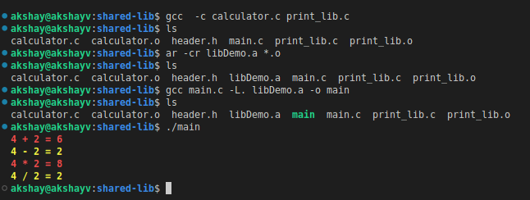
Building libraries contd..
Steps to generate a static c libraries in Linux:
Compile all of our library source code into an object file, GCC do this using command:
gcc -c calculator.c print_lib.c
We use GNU ar command to create final library or archive file:
The archiver, also called ar, is a Unix utility that maintains groups of files as a single archive file.
ar -cr libDemo.a *.o -c : Create the archive.
-r : updates the library with the most recent version of any existing object file.
Now we can compile the main.c :
gcc main.c -L. libDemo.a -o main
-L : flag indicates to the linker that libraries might be found in the current directory (referred to with ‘.’)
Run the main executable.

Slide 31
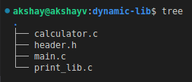
Building libraries contd..
Dynamic libraries:
Also called Shared Libraries.
A shared library or Dynamic Library is loaded dynamically at runtime for each application that needs it.
Dynamic Linking doesn’t require the code to be copied.
It is done by placing name of the library in the binary file.
Actual linking is done when the program is executed, both the binary file & the library are in memory.
Example code:
To demonstrate static library creation we have set of code files inside directory:
"Module3_SystemProgramming_Using_C/Chapter1_Building_an_Executable/dynamic-lib"
calculator.c : Library to perform basic math operation.
print_lib.c : Print the terminal characters in colour.
header.h : Include file with all function prototypes.
main.c : Application code

Slide 32
Building libraries contd..
Steps to generate a dynamic c libraries in Linux:
We need to compile all of our library source code into an object file so we inform GCC to do this using command :
gcc -c -fPIC calculator.c print_lib.c
-fPIC flag generates position-independent code, which accesses all constant addresses stored in the Global Offset Table (GOT).
Create Library file:
It has a format that is specific to the architecture for which the lib is created.
We need to use the compiler to create a library, for this we need to inform compiler that it should create a shared library, not a final program executable file.
This is achieved using the '-shared' flag.
gcc -shared -o libDemo.so *.o
Install Library:
The shared library will not be found at runtime if its directory is not in the variable LD_LIBRARY_PATH.
Type the following command add it:
export LD_LIBRARY_PATH=.:$LD_LIBRARY_PATH
In our example the local directory ('.') is added to the search.
The new path list will be effective only in the shell where you applied the command.

Slide 33
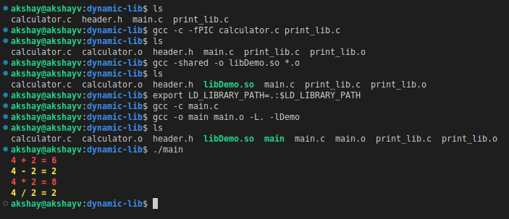
Building libraries contd..
Steps to generate a dynamic c libraries in Linux::
Build the executable:
To create the executable, you first compile the source file:
gcc -c main.c
Then link the created code main.o with the library:
gcc -o main main.o -L. -lDemo
'-L' indicates where the library is to be found
'-l' specifies the library, without the prepending 'lib' and file extension '.so'.
Finally run the executable

