Slide 1
System Programming using C
Chapter 10: Coding Practices

Slide 2
Contents
Coding Guidelines
Naming Conventions
Calling Conventions
Comments
Conditional Compilation
Secure and Safe Coding
Scope
Handling Arrays
Control statement expressions
Functions
Debug Port
Buffer Overflow
Regular cleanup
Develop Optimal Code
Macro vs Functions
Inline functions
Recursion
Memory Overlay
Structure Packing
Optimize for space
Optimize for Performance

Slide 3
Coding guidelines
Coding Standards:
Good software development organizations want their programmers to maintain to some well-defined and standard style of coding called coding standards.
They usually make their own coding standards and guidelines depending on what suits their organization best and based on the types of software they develop.
It is very important for the programmers to maintain the coding standards otherwise the code will be rejected during code review.
Coding best practices and standards vary depending on the industry a specific product is being built for.
The standards required for coding software for luxury automobiles will differ from those for coding software for gaming.
Advantages of implementing Coding Standards:
Offers uniformity to the code created by different engineers.
Enables the creation of reusable code.
Makes it easier to detect errors.
Make code simpler, more readable, and easier to maintain.
Boost programmer efficiency and generates faster results.
Some Coding Standards :
CERT , MISRA. Barr Group's Embedded C Coding Standard

Slide 4
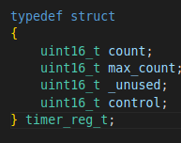
Key considerations while developing code
Naming Conventions:
Modules:
All module names shall consist entirely of lowercase letters, numbers, and underscores. No spaces shall appear within the module’s header and source file names.
All module names shall be unique in their first 8 characters and end with suffices .h and .c for the header and source file names, respectively.
No module’s header file name shall share the name of a header file from the C Standard Library or C++ Standard Library. For example, modules shall not be named “stdio” or “math”.
Any module containing a main() function shall have the word “main” as part of its source file name eg : app_main.c
Data Type Rules:
The names of all new data types, including structures, unions, and enumerations, shall consist only of lowercase characters and internal underscores and end with ‘_t’.
All new structures, unions, and enumerations shall be named via a typedef.
The name of all public data types shall be prefixed with their module name and an underscore.

Slide 5
Key considerations while developing code contd...
Naming Conventions:
Variable Rules:
No variable shall have a name that is a keyword of C, C++, or any other well-known extension of the C programming language, including specifically K&R C and C99. Restricted names include interrupt, inline, restrict, class, true, false, public, private, friend, and protected.
No variable shall have a name that overlaps with a variable name from the C Standard Library (e.g., errno).
No variable shall have a name that begins with an underscore.
No variable name shall be longer than 31 characters.
No variable name shall be shorter than 3 characters, including loop counters.
Each variable’s name shall be descriptive of its purpose.
The names of any global variables shall begin with the letter ‘g’. For example, g_zero_offset.
The names of any pointer variables shall begin with the letter ‘p’. For example, p_led_reg.
The names of any pointer-to-pointer variables shall begin with the letters ‘pp’. For example, pp_vector_table.
The names of all integer variables containing Boolean information (including 0 vs. non-zero) shall begin with the letter ‘b’ and phrased as the question they answer. For example, b_done_yet or b_is_buffer_full.

Slide 6
Key considerations while developing code
Calling Convention:
Calling conventions are a scheme for how functions receive parameters from their caller and how they return a result.
Adhering to calling conventions ensures that your functions won't step on each other's data when using the same registers.
Calling conventions allow us to implement recursive functions and call functions which we cannot see the implementations of.
Certain registers need to have their contents preserved by the caller if the caller wants to ensure that the values in those registers are saved across the function call.
Other registers need to have their contents saved by the callee (the function being called) before using them.
When arguments are pushed onto the stack, eventually they must be popped back off again.
Whichever function, the caller or the callee, is responsible for cleaning the stack must reset the stack pointer to eliminate the passed arguments.

Slide 7
Key considerations while developing code
C Calling Conventions
Keyword | Stack cleanup | Parameter passing
__cdecl | Caller | Pushes parameters on the stack, in reverse order (right to left)
__clrcall | n/a | Load parameters onto CLR expression stack in order (left to right).
__stdcall | Callee | Pushes parameters on the stack, in reverse order (right to left)
__fastcall | Callee | Stored in registers, then pushed on stack
__thiscall | Callee | Pushed on stack; this pointer stored in ECX
__vectorcall | Callee | Stored in registers, then pushed on stack in reverse order (right to left)

Slide 8
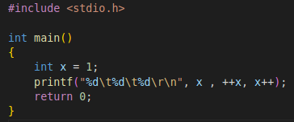

Key considerations while developing code
C Calling Conventions
__cdecl
The default calling convention for C and C++ programs.
Pushes parameters on the stack, in reverse order (right to left)
Because the stack is cleaned up by the caller, it can do vararg functions.
The __cdecl calling convention creates larger executables than __stdcall, because it requires each function call to include stack cleanup code.
Consider the following code : test_calling_convention.c
What do you think the output of program will be?
Output : 1 2 3
Output : 3 3 1
As Calling convention is Right to Left :
X value is assigned to x++ ( Post Increment ), arg value = 1
x++ increments the value of x, new value of x = 2
++x due to pre increment new value of x = 3, arg value = 3
Current X value = 3, arg value = 3

Slide 9
Key considerations while developing code contd...
Comment
A comment is an explanation or description of the source code of the program.
It helps a developer explain logic of the code and improves program readability.
At run-time, a comment is ignored by the compiler.
Types of Comments : There are two ways to add comments in C:
// - Single Line Comment
/*...*/ - Multi-line Comment
Advantages of commenting on a program:
Using comments in a program, the program seems easy to read and maintain.
By using comments to explain the program's working and logic made the program universally accepted as everyone finds it easy to use and understand.
Using comments not only others but you can also understand your code after ages.

Slide 10
Key considerations while developing code contd...
Comment Rules
Acceptable Formats:
Single-line comments in the C++ style (i.e., preceded by //) are a useful and acceptable alternative to traditional C style comments (i.e., /* … */).
Comments shall never contain the preprocessor tokens /*, //, or \.
Code shall never be commented out, even temporarily.
To temporarily disable a block of code, use the preprocessor’s conditional compilation feature (e.g., #if 0 … #endif).
Any line or block of code that exists specifically to increase the level of debug output information shall be surrounded by :
#ifndef NDEBUG …
#endif.

Slide 11
Key considerations while developing code contd...
Comment Rules
Locations and Content
All comments shall be written in clear and complete sentences, with proper spelling and grammar and appropriate punctuation.
The most useful comments generally precede a block of code that performs one step of a larger algorithm.
A blank line shall follow each such code block.
The comments in front of the block should be at the same indentation level.
Avoid explaining the obvious. Assume the reader knows the C programming language.
For example, end-of-line comments should only be used where the meaning of that one line of code may be unclear from the variable and function names and operations alone but where a short comment makes it clear.
Specifically, avoid writing unhelpful and redundant comments,
e.g., “numero <<= 2;
// Shift numero left 2 bits.”.
The number and length of individual comment blocks shall be proportional to the complexity of the code they describe. All assumptions shall be spelled out in comments.
Each module and function shall be commented in a manner suitable for automatic documentation generation, e.g., via Doxygen.

Slide 12
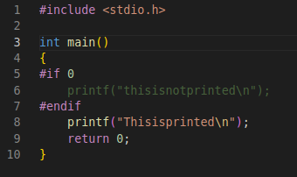
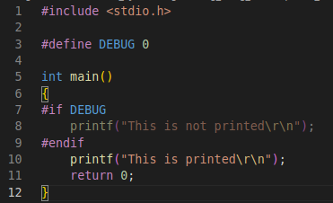

Key considerations while developing code contd...
Conditional Compilation
Conditional compilation provides a way of including or omitting selected lines of source code depending on the values of literals specified by the directives.
In this way, you can create multiple variants of the same program without the need to maintain separate source streams
There are different ways we can use Conditional compilation directives.
#if <condition that can be evaluated by the preprocessor >
…....
#endif

Slide 13
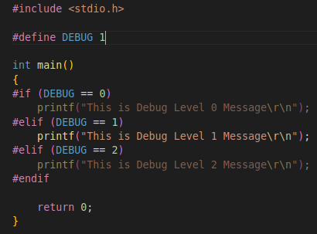
Key considerations while developing code contd...
Conditional Compilation
#else
#if
...
#elif
…
#else
...
#endif
#ifdef means "if defined", and is terminated by an #endif.
#indef means "if not defined".
#undef removes a previously defined definition.
#pragma directive is an implementation-defined directive which allows the various instructions to be given to the compiler.

Slide 14
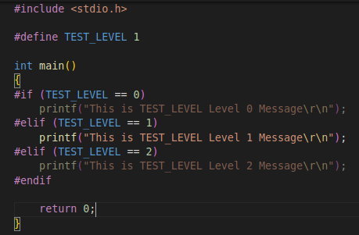
Key considerations while developing code contd...
Conditional Compilation
There are several reasons to use conditional compilation in your program:
Code shall never be commented out, even temporarily.
To temporarily disable a block of code, use the preprocessor’s conditional compilation feature (e.g., #if 0 … #endif).
Your program may require different code depending on which device or architecture you use.
In some cases, library routines may exist in one configuration that do not exist in another.
Conditional compilation allows you to handle such a situation by substituting alternate functions with the unavailable library routines.
Many complex functions require comprehensive test code to verify or validate I/O and proper operation.
Intermediate values may be tested and output as well.
After verification, you may wish to retain the test cases for future reference.
You can include them in conditional blocks you control with a macro. For example:

Slide 15
Secure and Safe Coding
Scope Rules:
Scope = Lifetime
The area under which a variable or function is applicable.
Variables and functions should be declared in the minimum scope from which all references to the identifier are still possible.
When a larger scope than necessary is used, code becomes less readable, harder to maintain, and more likely to reference unintended variables
Scope | Meaning
File Scope | Scope of a Identifier starts at the beginning of the file and ends at the end of the file. It refers to only those Identifiers that are declared outside of all functions. The Identifiers of File scope are visible all over the file Identifiers having file scope are global
Block Scope | Scope of a Identifier begins at opening of the block / ‘{‘ and ends at the end of the block / ‘}’. Identifiers with block scope are local to their block
Function Prototype Scope | Identifiers declared in function prototype are visible within the prototype
Function scope | Function scope begins at the opening of the function and ends with the closing of it. Function scope is applicable to labels only. A label declared is used as a target to goto statement and both goto and label statement must be in same function

Slide 16
Secure and Safe Coding
Scope Rules:
Minimize the scope of variables and functions
The function counter() increments the global variable count and then returns immediately if this variable exceeds a maximum value.
Assuming that the variable count is only accessed from this function, this example does not define count within the minimum possible scope.
The variable count is declared within the scope of the counter() function as a static variable.
The static modifier, when applied to a local variable (one inside of a function), modifies the lifetime (duration) of the variable so that it persists for as long as the program does and does not disappear between invocations of the function.
unsigned int count = 0;
void counter() {
if (count++ > MAX_COUNT) return;
/* ... */
}
void counter() {
static unsigned int count = 0;
if (count++ > MAX_COUNT) return;
/* ... */
}
1
2

Slide 17
Secure and Safe Coding
Scope Rules:
Minimize the scope of variables and functions
The function f() is called only from within the function g(), which is defined in the same compilation unit.
By default, function declarations are extern, meaning that these functions are placed in the global symbol table and are available from other compilation units.
The function f() is declared with internal linkage.
This practice limits the scope of the function declaration to the current compilation unit and prevents the function from being included in the external symbol table.
It also limits cluttering in the global name space and prevents the function from being accidentally or intentionally invoked from another compilation unit
int f(int i) {
/* Function definition */
}
int g(int i) {
int j = f(i);
/* ... */
}
static int f(int i) {
/* Function definition */
}
int g(int i) {
int j = f(i);
/* ... */
}
1
2

Slide 18
Secure and Safe Coding
Handling Array:
Do not form or use out-of-bounds pointers or array subscripts
The function f() attempts to validate the index before using it as an offset to the statically allocated table of integers.
However, the function fails to reject negative index values.
When index is less than zero, the behavior of the addition expression in the return statement of the function is undefined behavior.
One compliant solution is to detect and reject invalid values of index if using them in pointer arithmetic would result in an invalid pointer.
Use an unsigned type to avoid having to check for negative values while still rejecting out-of-bounds positive values of index.
enum { TABLESIZE = 100 };
static int table[ TABLESIZE ];
int *f ( int index )
{
if ( index < TABLESIZE )
{
return table + index;
}
return NULL;
}
1
enum { TABLESIZE = 100 };
static int table[ TABLESIZE ];
int *f ( int index )
{
if (index >= 0 && index < TABLESIZE )
{
return table + index;
}
return NULL;
}
enum { TABLESIZE = 100 };
static int table[ TABLESIZE ];
int *f ( size_t index )
{
if ( index < TABLESIZE )
{
return table + index;
}
return NULL;
}
2
3

Slide 19
Secure and Safe Coding
#include <stddef.h>
#define COLS 5
#define ROWS 7
static int matrix[ROWS][COLS];
void init_matrix(int x){
for (size_t i = 0; i < COLS; i++) {
for (size_t j = 0; j < ROWS; j++){
matrix[ i ] [ j ] = x;
}
}
}
1
Handling Array:
Apparently Accessible Out-of-Range Index
Code example declares matrix to consist of 7 rows and 5 columns in row-major order.
The function init_matrix iterates over all 35 elements in an attempt to initialize each to the value given by the function argument x.
However, because multidimensional arrays are declared in C in row-major order.
The function iterates over the elements in column-major order, and when the value of j reaches the value COLS during the first iteration of the outer loop.
The function attempts to access element matrix[0][5].
Because the type of matrix is int[7][5], the j subscript is out of range, and the access has undefined behavior.
Solution avoids using out-of-range indices by initializing matrix elements in the same row-major order as multidimensional objects are declared in C.
#include <stddef.h>
#define COLS 5
#define ROWS 7
static int matrix[ROWS][COLS];
void init_matrix(int x){
for (size_t i = 0; i < ROWS; i++) {
for (size_t j = 0; j < COLS; j++){
matrix[ i ] [ j ] = x;
}
}
}
2

Slide 20
Secure and Safe Coding
Handling Array:
Null Pointer Arithmetic
This code allocates a block of memory and initializes it with some data.
The data does not belong at the beginning of the block, which is left uninitialized.
Instead, it is placed offset bytes within the block.
The function ensures that the data fits within the allocated block.
This function fails to check if the allocation succeeds
If the allocation fails, then malloc() returns a null pointer.
The null pointer is added to offset and passed as the destination argument to memcpy().
Because a null pointer does not point to a valid object, the result of the pointer arithmetic is undefined behaviour.
Solution ensures that the call to malloc() succeeds
1
#include <string.h>
#include <stdlib.h>
char *init_block(size_t block_size, size_t offset, char *data, size_t data_size)
{
char *buffer = malloc(block_size);
if (data_size > block_size || block_size - data_size < offset)
{
/* Data won't fit in buffer, handle error */
}
memcpy(buffer + offset, data, data_size);
return buffer;
}
#include <string.h>
#include <stdlib.h>
char *init_block(size_t block_size, size_t offset, char *data, size_t data_size)
{
char *buffer = malloc(block_size);
if (NULL == buffer)
{
/* Handle Error if malloc fails */
}
if (data_size > block_size || block_size - data_size < offset)
{
/* Data won't fit in buffer, handle error */
}
memcpy(buffer + offset, data, data_size);
return buffer;
}
2

Slide 21
Secure and Safe Coding
Control statement expressions
Assignment operators shall not be used in expressions that yield a Boolean value
No assignments are permitted in any expression which is considered to have a Boolean value.
This precludes the use of both simple and compound assignment operators in the operands of a Boolean-valued expression.
However, it does not preclude assigning a Boolean value to a variable.
If assignments are required in the operands of a Boolean-valued expression then they must be performed separately outside of those operands.
This helps to avoid getting “=” and “==” confused, and assists the static detection of mistakes.
1,2 Does not follow the rule.
We can use 3 to satisfy the rule.
if ( ( x = y ) != 0 ) /* Boolean by context */
{
foo();
}
1
if ( x = y )
{
foo();
}
2
x = y;
if ( x != 0 )
{
foo();
}
3

Slide 22
Secure and Safe Coding
Floating-point expressions shall not be tested for equality or inequality.
The inherent nature of floating-point types is such that comparisons of equality will often not evaluate to true even when they are expected to.
In addition, the behaviour of such a comparison cannot be predicted before execution, and may well vary from one implementation to another.
For example the result of the test in the following code is unpredictable
Control statement expressions
Tests of a value against zero should be made explicit, unless the operand is effectively Boolean.
Where a data value is to be tested against zero then the test should be made explicit.
The exception to this rule is when data represents a Boolean value, even though in C this will in practice be an integer.
This rule is in the interests of clarity, and makes clear the distinction between integers and logical values.
Not compliant, unless y is effectively Boolean data e.g a flag
Correct way of testing x is non-zero
float32_t x, y;
if ( x == y ) { …. }
float32_t x, y;
if ( ( x <= y ) && ( x >= y ) )
{ …. }
if ( y )
1
float32_t x, y;
if ( x == 0.0f ) { …. }
if ( x != 0 )
2

Slide 23
Secure and Safe Coding
Control statement expressions
Numeric variables being used within a for loop for iteration counting shall not be modified in the body of the loop.
Loop counters shall not be modified in the body of the loop.
However other loop control variables representing logical values may be modified in the loop.
For example a flag to indicate that something has been completed, which is then tested in the for statement.
The controlling expression of a for statement shall not contain any objects of floating type.
The controlling expression may include a loop counter, whose value is tested to determine termination of the loop.
Floating-point variables shall not be used for this purpose.
Rounding and truncation errors can be propagated through the iterations of the loop, causing significant inaccuracies in the loop variable, and possibly giving unexpected results when the test is performed.
flag = 1;
for ( i = 0; (i < 5) && (flag == 1); i++ )
{
/* ... */
flag = 0; /* Compliant - allows early termination of loop */
i = i + 3; /* Not compliant - altering the loop counter */
}

Slide 24
Secure and Safe Coding
Functions Definitions:
Functions shall not call themselves, either directly or indirectly:
This means that recursive function calls cannot be used in safety-related systems.
Recursion carries with it the danger of exceeding available stack space, which can be a serious error.
Unless recursion is very tightly controlled, it is not possible to determine before execution what the worst-case stack usage could be.
Identifiers shall be given for all of the parameters in a function prototype declaration:
Names shall be given for all the parameters in the function declaration for reasons of compatibility, clarity and maintainability.
The identifiers used in the declaration and definition of a function shall be identical.
Functions with no parameters shall be declared and defined with the parameter list void.
All exit paths from a function with non-void return type shall have an explicit return statement with an expression
This expression gives the value that the function returns. The absence of a return with an expression leads to undefined behaviour (and the compiler may not give an error)
If a function returns error information, then that error information shall be tested:
A function (whether it is part of the standard library, a third party library or a user defined function) may provide some means of indicating the occurrence of an error.
The calling program shall check for the indication of an error as soon as the function returns

Slide 25
Secure and Safe Coding
Functions
Functions shall not be defined with a variable number of arguments:
There are a lot of potential problems with this feature.
Users shall not write additional functions that use a variable number of arguments.
This precludes the use of use of stdarg.h, va_arg, va_start and va_end.
Function should be declared explicitly:
The use of function prototype enables the compiler to check the integrity of function definitions & calls.
void MyFunc ( char_t * pBuf, ... ) { // ... }
void example() { fun(); } void fun() { }
void fun(void); void example(void) { fun(); } void fun(void) { }

Slide 26
Secure and Safe Coding
Functions
Functions Parameters should not be reassigned:
Function should not contain too many return:
Having too many returns from function increases the function complexity as flow of execution is broken each time return statement is encountered
int globalVar = 0; void function (int a) { a = globVar; ... }
int globalVar = 0; void function (int a) { int b = globVar; ... }
int fun() { if (condition1) { return 1; } else { if (condition2) { return 0; } else { return 1; } } return 0; }

Slide 27
Secure and Safe Coding
Debug Port:
If left unlocked, the debug port constitutes a significant security vulnerability.
Thus, the security best practice is to lock or disable debug access before a product is released to production.
If you need to debug in production, there are a few things to ensure when doing so;
Debugging does not have an extensive performance hit.
Debugging does not block people from using your application.
Secure data is not exposed to the outside world.
You are getting enough debug information to find and fix the issue as soon as possible.
Specific debugging methods, such as a remote debugger in your IDE or dumping error information to the user, are not considered safe.
If your product is linux based system always disable the serial port & ssh login access usually used in development phase to the device in final image.

Slide 28
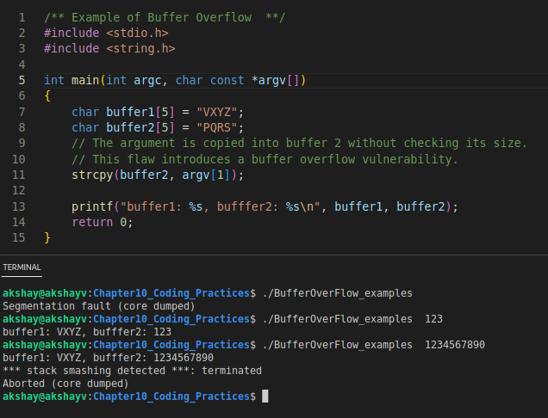
Secure and Safe Coding
Buffer overflow
Buffer overflow is a common security vulnerability in C programming.
A buffer overflow occurs when a program allows input to write data beyond allocated memory.
The attacker can gain control over an entire application or crash a program by exploitation via buffer overflow.
How Buffer Overflow Invites Hackers
Hackers can use buffer overflow errors to cause a program to crash, corrupt the data, or simply steal information.
When a program runs, it uses an area of memory referred to as the ‘stack’.
Variables within the scope of the currently executing function will be stored on the stack.
The address of the function call will also be stored to allow return statements to return to the correct location.
When the function returns to the calling function, the program execution continues from where it left off.
So, if the return address on the stack is modified to point to some alternative malicious instructions, then those instructions will be executed when the function returns.

Slide 29
Secure and Safe Coding
Regular cleanup:
If any dynamic allocation is in the program, the memory should be freed if no longer needed by the programmer.
Use of Garbage Collector:
In computer science, garbage collection (GC) is a form of automatic memory management.
The garbage collector attempts to reclaim memory which was allocated by the program, but is no longer referenced; such memory is called garbage.
Garbage Collection (GC) is a mechanism that provides automatic memory reclamation for unused memory blocks.
The GC engine takes care of recognizing that a particular block of allocated memory (heap) is not used anymore and puts it back into the free memory area.
The Boehm-Demers-Weiser (BDW) GC library, a popular package that allows C and C++ programmers to include automatic memory management into their programs.
This is a garbage collecting storage allocator that is intended to be used as a plug-in replacement for C's malloc.
BWGC The library is freely available on github.

Slide 30
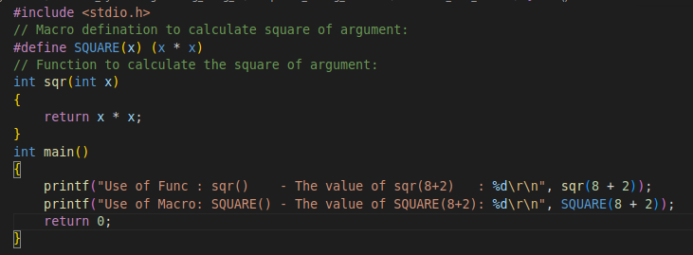

Develop optimal code
Macros vs functions
A macro is a name given to a block of C statements as a pre-processor directive.
Being a pre-processor, the block of code is communicated to the compiler before entering into the actual coding (main () function).
A macro is defined with the pre-processor directive.
Macros are pre-processed which means that all the macros would be processed before your program compiles.
However, functions are not preprocessed but compiled.
In macros no type checking is done, so it may occur some problems for different types of inputs.
In the case of functions, this is not done.
For macros if the inputs are not properly maintained, then it may generate some invalid results
Difficult to debug as they cause simple replacement.
Macro don’t have namespace, so a macro in one section of code can affect other section.
Consider example:​ macro_func_demo.c
The function and macro, we want both will do the same task, but here we can see that the output are not same. ​
The main reason is when we are passing 8 + 2 as function argument, it converts into 10, then calculate 10 * 10 = 100. ​
For macro it is doing 8 + 2 * 8 + 2 = 8 + 16 + 2 = 26.​
​

Slide 31
Develop optimal code
Macros vs functions
If you need to choose between a function and a macro implementation of a library routine, consider the following trade-offs:
Speed versus size
The main benefit of using macros is faster execution time.
During preprocessing, a macro is expanded (replaced by its definition) inline each time it's used.
A function definition occurs only once regardless of how many times it's called.
Macros may increase code size but don't have the overhead associated with function calls.
Function evaluation
A function evaluates to an address; a macro doesn't.
Thus you can't use a macro name in contexts requiring a pointer.
For instance, you can declare a pointer to a function, but not a pointer to a macro.
Type-checking
When you declare a function, the compiler can check the argument types.
Because you can't declare a macro, the compiler can't check macro argument types; although it can check the number of arguments you pass to a macro.

Slide 32
Develop optimal code
Inline Functions
When an inline function is called, a copy of the C/C++ source code for the function is inserted at the point of the call.
This is known as inline function expansion, commonly called function inlining or just inlining.
Inline function expansion can speed up execution by eliminating function call overhead.
This is particularly beneficial for very small functions that are called frequently.
Function inlining involves a tradeoff between execution speed and code size, because the code is duplicated at each function call site.
Large functions that are called in many places are poor candidates for inlining.
Excessive inlining can make the compiler dramatically slower and degrade the performance of generated code.
Inline functions might make it larger:
For example, if a system has 100 inline functions each of which expands to 100 bytes of executable code and is called in 100 places, that's an increase of 1MB. Is that 1MB going to cause problems? Who knows, but it is possible that that last 1MB could cause the system to "thrash," and that could slow things down.
Inline functions might make it smaller:
The compiler often generates more code to push/pop registers/parameters than it would by inline-expanding the function's body.
This happens with very small functions, and it also happens with large functions when the optimizer is able to remove a lot of redundant code through procedural integration — that is, when the optimizer is able to make the large function small.

Slide 33
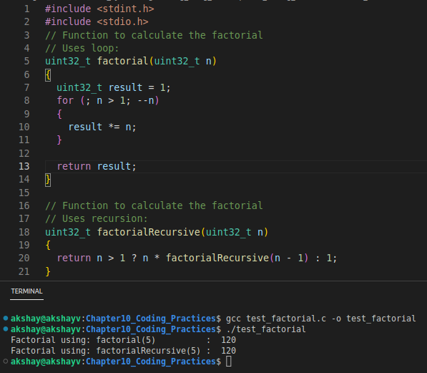
Develop optimal code
Recursion
An algorithmic technique where a function, in order to accomplish a task, calls itself with some part of the task.
The power of recursion evidently lies in the possibility of defining an infinite set of objects by a finite statement.
In the same manner, an infinite number of computations can be described by a finite recursive program, even if this program contains no explicit repetitions.
Recursion carries with it the danger of exceeding available stack space, which can lead to a serious failure.
Unless recursion is very tightly controlled, it is not possible to determine before execution what the worst-case stack usage could be.
That’s why recursive function calls cannot be used in safety-related systems.
Recursive calls should be replaced with loops wherever possible.
The following example demonstrates how this can be applied to the code : test_factorial.c

Slide 34
Develop optimal code
Memory overlay
In a general computing sense, overlaying means "the process of transferring a block of program code or other data into main memory, replacing what is already stored".
Overlaying is a programming method that allows programs to be larger than the computer's main memory.
An embedded system would normally use overlays because of the limitation of physical memory, which is internal memory for a system-on-chip, and the lack of virtual memory facilities.
The concept of overlays is that whenever a process is running it will not use the complete program at the same time, it will use only some part of it.
Then overlays concept says that whatever part you required, you load it and once the part is done, then you just unload it, means just pull it back and get the new part you required and run it.
In memory management, overlays work in the following steps, such as:
The programmer divided the program into many logical sections.
A small portion of the program had to remain in memory at all times, but the remaining sections (or overlays) were loaded only when needed.
The use of overlays allowed programmers to write programs much larger than physical memory, although memory usage depends on the programmer rather than the operating system.

Slide 35
Develop optimal code
Memory overlay
Example of Overlays
The best example of overlays is assembler.
Consider the assembler has 2 passes, 2 pass means at any time it will be doing only one thing, either the 1st pass or the 2nd pass.
This means it will finish 1st pass first and then 2nd pass.
Let's assume that the available main memory size is 150KB and the total code size is 200KB.
Pass 1.......................70KB
Pass 2.......................80KB
Symbol table............30KB
Common routine......20KB
As the total code size is 200KB and the main memory size is 150KB, it is impossible to use 2 passes together.
So, in this case, we should go with the overlays technique.
According to the overlay concept, only one pass will be used, and both the passes always need a symbol table and common routine.
If the overlays driver is 10KB, what minimum partition size is required?
For pass 1 total memory needed is = (70KB + 30KB + 20KB + 10KB) = 130KB.
For pass 2 total memory needed is = (80KB + 30KB + 20KB + 10KB) = 140KB.
So if we have a minimum 140KB size partition, we can run this code very easily.

Slide 36
Develop optimal code
Memory overlay
So overlay is a technique to run a program that is bigger than the size of the physical memory by keeping only those instructions and data that are needed at any given time.
Divide the program into modules in such a way that not all modules need to be in the memory at the same time.
Advantages:
Reduce memory requirement
Reduce time requirement
Disadvantage :
Overlap map must be specified by programmer
Programmer must know memory requirement
Overlapped module must be completely disjoint
Programming design of overlays structure is complex and not possible in all cases

Slide 37
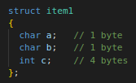
Develop optimal code
Structure Padding
Structure members are assigned to memory addresses in increasing order, with the first component starting at the beginning address of the structure name itself.
Structure padding is a concept in C that adds the one or more empty bytes between the memory addresses to align the data in memory.
The processor does not read 1 byte at a time. It reads 1 word at a time.
What does the 1 word mean?
If we have a 32-bit processor, then the processor reads 4 bytes at a time 1 word = 4 bytes.
If we have a 64-bit processor, then the processor reads 8 bytes at a time, 1 word = 8 bytes.
As we know that structure occupies the contiguous block of memory as shown in diagram.
Consider the 32 bit architecture:
The problem is that in one CPU cycle we can access:
one byte of char a,
one byte of char b,
2 bytes of int c.
We will not face any problem while accessing the char a and char b as both the variables can be accessed in one CPU Cycle.
We will face the problem when we access the int c variable as 2 CPU cycles are required to access the value of the 'c' variable.
Size = 6 bytes
0 | 1 | 2 | 3 | 4 | 5
a | b | c

Slide 38
Develop optimal code
Structure Padding
Suppose we only want to access the variable 'c', which requires two cycles.
The variable 'c' is of 4 bytes, so it can be accessed in one cycle also, but in this scenario, it is utilizing 2 cycles.
This is an unnecessary wastage of CPU cycles.
Due to this reason, the structure padding concept was introduced to save the number of CPU cycles.
How is structure padding done?
To achieve the structure padding, an empty row is created on the left, as shown in the diagram.
The two bytes which are occupied by the 'c' variable on the left are shifted to the right.
So, all the four bytes of 'c' variable are on the right.
Now, the 'c' variable can be accessed in a single CPU cycle.
After structure padding, the total memory occupied by the structure is 8 bytes (1 byte+1 byte+2 bytes+4 bytes).
Although the memory is wasted in this case, the variable can be accessed within a single cycle.
Size = 8 bytes
0 | 1 | 2 | 3 | 4 | 5 | 6 | 7
a | b | Empty |  | c
Structure Padding

Slide 39
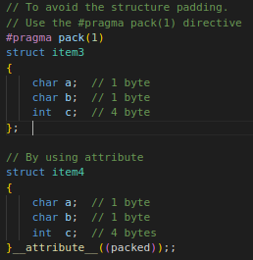
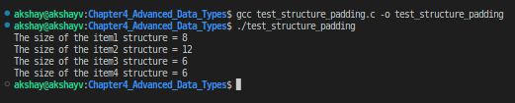
Develop optimal code
Structure Padding
The structural padding is an in-built process that is automatically done by the compiler.
Sometimes it required to avoid the structure padding in C as it makes the size of the structure greater than the size of the structure members.
Structure Packing :
Packing, prevents compiler from doing padding means remove the unallocated space allocated by structure.
We can avoid the structure padding in C in two ways:
Using #pragma pack(1) directive
Using __attribute__((__packed__))
That will allow us to save some memory.
Example Program: Demo for strcut padding:
test_structure_padding.c

Slide 40
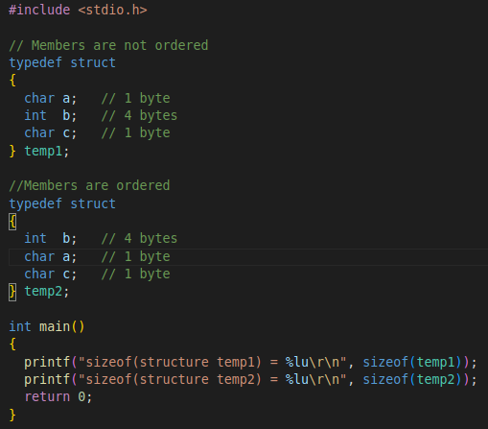

Develop optimal code
Structure Good Practice:
If you don’t want to use the structure packing and still want to reduce the memory wastage, then you need to correctly order the structure.
We need to declare members in decreasing or increasing order of size.
We have given two structures called temp1 (members are not ordered) and temp2 (members are ordered).
We have saved 4 bytes without using the structure packing and just changing the order of the members.
But still, the last two bytes are padded and we cannot avoid that.
We can use this method also to reduce memory wastage.

Slide 41
Develop optimal code
Optimize for space
Avoid use of inline function it is used at many place.
Avoid Standard Library Functions :
One of the best things you can do to reduce the size of your program is to avoid using large standard library routines. Many of the largest are expensive only because they try to handle all possible cases.
It might be possible to implement a subset of the functionality yourself with significantly less code.
For reducing the size we can rely on compiler optimization for size flag -Os optimize for code size.
This uses O2 as the baseline, but disables some optimizations.
For example, it will not inline³ code if that leads to a size increase.
The first time you enable the compiler’s optimization feature your previously working program will suddenly fail.
Perhaps the most notorious of the automatic optimizations is “dead code elimination.”
This optimization eliminates code that the compiler believes to be either redundant or irrelevant.
For example, adding zero to a variable requires no run-time calculation whatsoever.
Never make the mistake of assuming that the optimized program will behave the same as the unoptimized one.

Slide 42
Develop optimal code
Optimize for Performance
Switch Statement
Compilers translate switch statements in different ways.
If case labels are small contiguous integer values, then it creates a jump table.
This is very fast and doesn’t depend on the number of case labels also.
If case labels are longer and not contiguous then it creates comparison tree i.e. if…else statements.
So, in this case, we should keep the most frequent label first and the least frequent label should be at last.
Fast Mathematics
Multiplication and division by power of 2 : Use left shift(<<) for multiplication and right shift(>>) for division.
The bit operations will be much faster than multiplication and division operations.
Multiply by 6 : a= a<<1 + a<<2; Multiply by 7 : a= a<<3 - a; Divide by 8 : a= a>>3; // division by power of 2
Simplifying Expressions: Sometimes we can reduce some operations by simplifying expressions.
a*b + a*b*c + a*b*c*d ---> (a*b)*(1 + c*(1 + d)) L.H.S can be Simplified to R.H.S L.H.S : 6 multiplications and 2 additions R.H.S : 3 multiplications and 2 additions

Slide 43
Develop optimal code
Optimize for Performance
Unroll small loops:
Most of the times Compiler does this automatically, but it is a good habit of writing optimized codes. Matrix updations using this is very advantageous.
Avoid calculations in loop:
We should avoid any calculation which is more or less constant in value. Inner loops should have minimum possible calculations.
#include <stdio.h>
int main(void)
{
int fact[5];
fact[0] = 1;
// Overhead of managing a counter
// just for 4 iterations
// is not a good idea
for (int i = 1; i < 5; ++i) {
fact[i] = fact[i - 1] * i;
}
return 0;
}
#include <stdio.h>
int main(void)
{
int fact[5] = { 1, 1, 2, 6, 24 };
// Here the same work is done
// without counter overhead
return 0;
}
#include <stdio.h>
int main(void)
{
int arr[1000];
int a = 1, b = 5, c = 25, d = 7;
// pre calculating the constant expression
int temp = (((c % d) * a / b) % d);
for (int i = 0; i < 1000; ++i) {
arr[i] = temp * i;
}
return 0;
}
#include <stdio.h>
int main(void)
{
int arr[1000];
int a = 1, b = 5, c = 25, d = 7;
// Calculating a constant expression
// for each iteration is not good.
for (int i = 0; i < 1000; ++i) {
arr[i] = (((c % d) * a / b) % d) * i;
}
return 0;
}

Slide 44
Assignent – Unit Testing
Unit Testing:
It is method of software testing where individual software components are isolated and tested for correctness.
Ideally these tests are able to cover most of not all:
Code Paths
Failure cases of software under test.
When we follow Test Driven Development(TDD), proper use of unit tests the time to stabilize the embedded software is decreased dramatically.
Firmware is will experience less functional , control flow bugs & even fatal issues such as memory leaks and Bootloops.
Unit testing suggests to adopt a "test as you develop code" approach.
If we follow this recommendation as a variety of path.
Each path symbolizes potential errors.
The more code we develop without testing, more path we have to check for errors.
If (condition){
….. Some work.....
}
else if(condition){
….. Some work.....
}
else if(condition){
….. Some work.....
}
else{
….. Some work.....
}

Slide 45
Assignent – Unit Testing
Regression vs Unit Testing:
Regression | Unit Testing
It ensures that code change does not affect the functionality | It is identifying how a certain part of the code performs.
It involves retesting unchanged parts of a software, this shows weather the current changes are working fine with existing functionality | When the test fails it shows the results shows which part of code needs to be fixed.
It comes to play after the development of specific feature is completed by developer. The tester then checks that existing functionality is working fine with new change. | During development phase the developer ensure that the software works as expected by checking individual parts of code.
Testing Techniques: Retest All Regression Test Selection Prioritization of Test Case | Testing Techniques: Black Box Testing / Behavioral testing : Focus on input & outputs of the app. White Box Testing : Aims to improve security, Usability & design, code is visible to tester.

Slide 46
Assignent – Unit Testing
CUnit:
CUnit is a lightweight system for writing, administering, and running unit tests in C.
It provides C programmers a basic testing functionality with a flexible variety of user interfaces.
It is built as a static library that is linked to the user testing code. When compiling use -lcunit to link library with app.
It uses a simple framework for building test structures & provide a rich set of assertions for testing common data types.
It also provide different interfaces for running tests & report results:
Automated : Output to xml file
Basic : Flexible programming interface
Console : Console Interface which is interactive
Curses: GUI Unix interactive
The Detail Documentation for CUint can be found on : https://cunit.sourceforge.net/documentation.html
Installation of CUnit Framework:
libcunit1
libcunit1-doc
libcunit1-dev
sudo apt-get install libcunit1 libcunit1-doc libcunit

Slide 47
Assignent – Unit Testing
CUnit:
Structure:
Individual test cases are packaged into suites.
These are registered with Test Registry.
Suites can have setup and teardown functions which are automatically called before and after running the suite's tests.
General Usage:
Development of application code completed.
Write functions for tests & suite init/cleanup if necessary.
Initialize the test Registry - CU_initialize_registry()
Add suites to the test registry - CU_add_suite()
Add tests to the suites - CU_add_test()
Run tests using an appropriate interface - CU_console_run_tests()
Cleanup the test registry - CU_cleanup_registry()
Test Registry | --------------------------------- | | Suite '1' . . . . Suite 'N' | | --------------- --------------- | | | | Test '11' ... Test '1M' Test 'N1' ... Test 'NM'

Slide 48
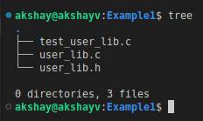
Assignent – Unit Testing
For example consider:
Module3_SystemProgramming_Using_C/Chapter10_Coding_Practices/CUnit_Testing_Example/Example1
user_lib.c & user_lib.h -: User library code developed.
Test_user_lib.c -: User lib test runner.

Slide 49
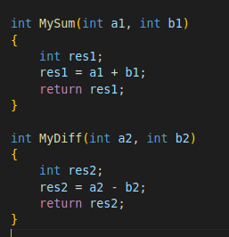
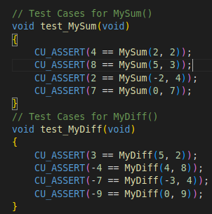
Assignent – Unit Testing
Example Test Cases:
CUnit Assertions -> CUnit provides a set of assertions for testing logical conditions.
CU_ASSERT(int expression) => Assert that expression is TRUE (non-zero)
Test Cases for MySum() & MyDiff():
All the assertions should be TRUE to say the function is Passed.
user_lib.c
User Functions
test_user_lib.c

Slide 50
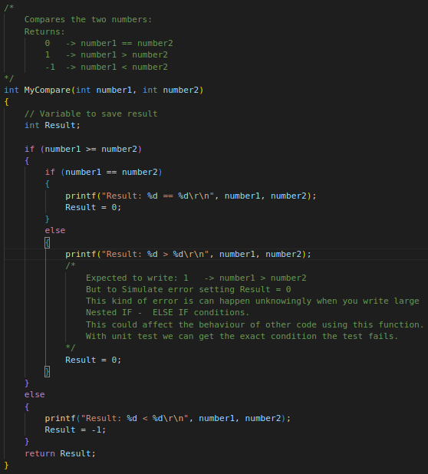
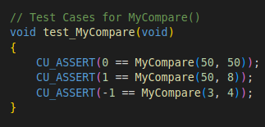
Assignent – Unit Testing
Example Test Cases:
MyCompare():
This I sample function which have Nested If-else conditions.
The Unit test cases should validate that all the paths are evaluated.
Test cases for MyCompare() -:
Test Cases should cover all the possible paths the function has.
It should pass different Input parameters.
It should verify the all outputs that are expected for the input.
test_user_lib.c
user_lib.c

Slide 51
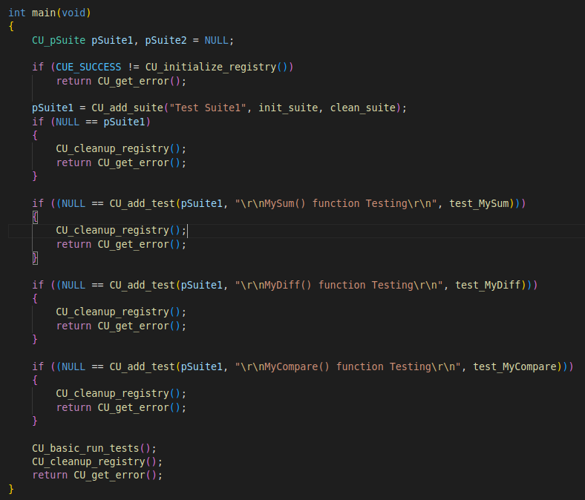
Assignent – Unit Testing
test_user_lib.c
Initialize the test Registry
Add suites to the test registry
Add tests to the suites
Run tests using an appropriate interface
Cleanup the test registry

Slide 52
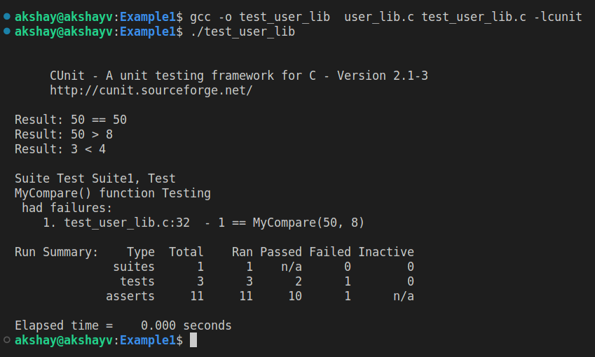
Assignent – Unit Testing
Build The Code: gcc -o test_user_lib user_lib.c test_user_lib.c -lcunit
Test Case Failed : This one is the failure because error we have introduced in MyFunction()
In Similar way by adding all the test cases, the potential error can be found in the developed code.
Printf From user lib
Test Summary

Slide 53
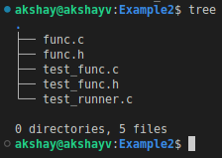
Assignent – Unit Testing
Example2 :
Module3_SystemProgramming_Using_C/Chapter10_Coding_Practices/CUnit_Testing_Example/Example2
Automated Mode:
The automated interface is non-interactive.
Clients initiate a test run, and the results are output to an XML file.
A listing of the registered tests and suites can also be reported to an XML file.
void CU_automated_run_tests(void) : Runs all tests in all registered suites. Test results are output to a file named ROOT-Results.xml.
func.c & func.h -: User Function code developed.
test_func.c & test_func.h -: test cases.
test_runner.c -: Test Runner

Slide 54
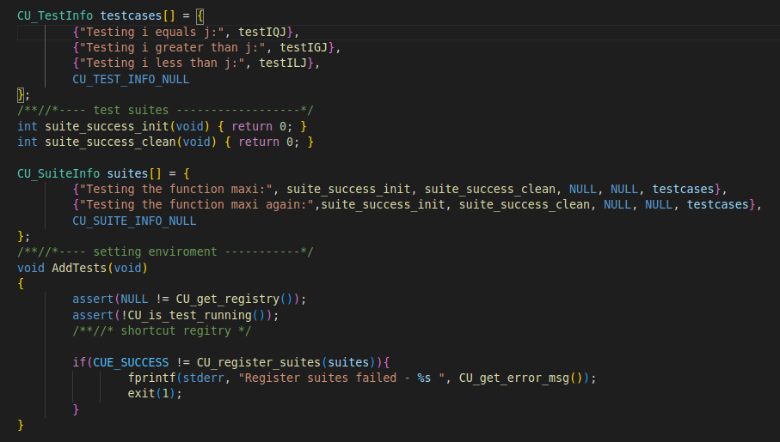
Assignent – Unit Testing
Shortcut Methods for Managing Tests:
For large test structures with many tests and suites, managing test/suite associations and registration is tedious and error-prone.
CUnit provides a special registration system to help manage suites and tests.
It's primary benefit is to centralize the registration of suites and associated tests, and to minimize the amount of error checking code the user needs to write.
Test cases are first grouped into arrays of CU_TestInfo instances
Suite information is then defined in one or more arrays of CU_SuiteInfo instances
All suites defined in a CU_SuiteInfo array can then be registered in a single statement.
test_func.c

Slide 55
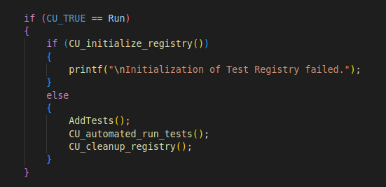
Assignent – Unit Testing
Test Runner Steps:
Initialize test registry.
AddTests() : To add the tests suites all at once
Run the Automated test Mode.
Cleanup the test registry
test_runner.c

Slide 56
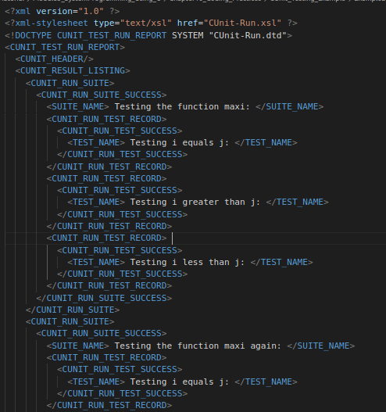
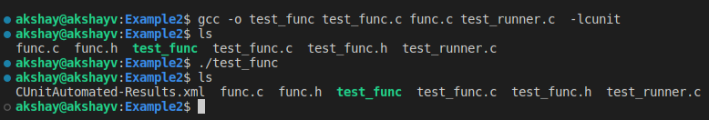
Assignent – Unit Testing
Build & Test:
Compile : gcc -o test_func test_func.c func.c test_runner.c -lcunit
Test:
After running the test CUnitAutomated-Results.xml is generated.
This XML has all the test results.
CUnitAutomated-Results.xml

