Slide 1
System Programming using C
Chapter 1 : Building an Executable

Slide 2
Contents
QEMU
Build Setup
Hello World! Bare metal application ARM
C Startup Code
Linking Process
Linker Script
Linking Hello World! Program
Map File
Object file, Symbol Table.
Map File Interpretation
Building Libraries
Static Library
Dynamic Library

Slide 3
QEMU
The module is designed with QEMU emulator as the prime development environment.
An emulator is a computer program or hardware equipment that can simulate/imitate one computer system by using another system.
QEMU can be used to emulate an ARM machine, it is a powerful virtualization & emulation tool that works with a variety of architectures.
The code that is written can boot on the real ARM device.
Why QEMU?
We don’t have to do software flashing / download process.
No additional hardware is required.
We have tools to inspect the state of the emulated hardware.
This module uses the Ubuntu based system for development. But QEMU supports wide range of systems.
QEMU emulator have support for STMicroelectronics platform, that contains STM32F100RBTx Microcontroller.
We will write and debug bare metal ARM software for STM32F100RBTx Microcontroller in our example code to understand the module.

Slide 4
QEMU
Main Loop:
QEMU is event driven user space process.
Event loops are used for timers, file descriptor monitoring, etc.
QEMU provides a full virtual machine inside the QEMU userspace process.
It provides:
Guest RAM
Ability to execute guest code
Emulated hardware device
Guest:
It is created by running the QEMU program.
It sees the CPU, RAM Disk like running on real machines.
Guest have a vCPU thread per virtual CPU.
When guest shuts down the QEMU process exits.
QEMU
Guest memory (Seen as physical memory by guest)
vCPU#0
Run Guest Code
Device Emulation
vCPU#1
Run Guest Code
Device Emulation
Main Loop
Host I/O Completion
Timers
Deferred Work
Host Kernel

Slide 5
QEMU
QEMU STMicroelectronics STM32 boards Support
The STM32F1 series is based on ARM Cortex-M3 core. The following machines are based on this chip :
stm32vldiscovery STM32VLDISCOVERY board with STM32F100RBT6 microcontroller
Supported devices
ARM Cortex-M3, Cortex M4F
Analog to Digital Converter (ADC)
EXTI interrupt
Serial ports (USART)
SPI controller
System configuration (SYSCFG)
Timer controller (TIMER)

Slide 6
Build Setup
QEMU:
To Install QEMU run following command in ubuntu Terminal:
sudo apt-get install qemu-system-arm
gcc-arm-none-eabi:
We cannot use the common gcc compiler to build code that executes on an ARM core, instead we need a cross-compiler.
It simply runs on one platform & compiles executables for another platform.
We’re using Linux on the x86-64 platform, & we want executable for ARM platform, so a cross compiler is the used for that.
For ARM platform gcc-arm-none-eabi toolchain is required.
To install it run the below command on terminal:
sudo apt-get install gcc-arm-none-eabi

Slide 7
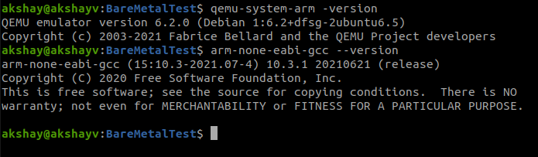
Build Setup contd..
We can verify the installation using commands:
gdb-multiarch:
GDB is a source-level debugger, capable of breaking programs at any specific line, displaying variable values, and determining where errors occurred.
We can debug our bare-metal program using the GDB, the GNU debugger.
To install run the below command:
sudo apt-get install gdb-multiarch

Slide 8
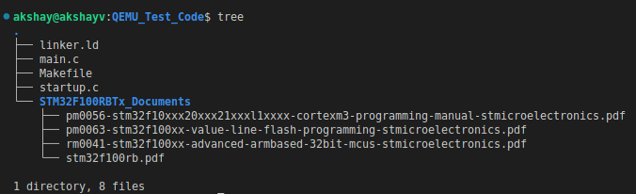
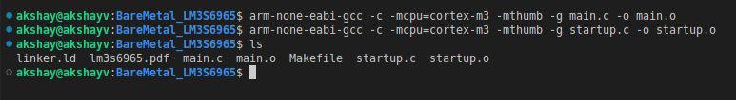
Build The Code - Compile
Now that we have the Build Setup ready let's build the code.
Consider the source code in:
Module3_SystemProgramming_Using_C/Chapter1_Building_an_Executable/QEMU_Test_Code
"main.c" file contains main code.
"startup.c" file contains source code for C Startup.
Compile the main & Startup Code using command:
arm-none-eabi-gcc -c -mcpu=cortex-m3 -mthumb -g startup.c -o startup.o
arm-none-eabi-gcc -c -mcpu=cortex-m3 -mthumb -g main.c -o main.o

Slide 9
Object File
In previous section we saw object file (main.o & startup.o) is the real output from the compilation phase.
The convention for these file names end with .o.
The object code is relocatable, and not executable.
A relocatable file holds code and data suitable for linking with other object files to create an executable file or a shared object file.
Relocatable object files contain a section header table which stores the information about the sections in the program.
Sections represent the smallest indivisible units that can be processed within an ELF file
A section header table contains information describing the file's sections.
Every section has an entry in the table.
Each entry gives information such as the section name and section size.
The layout of a relocatable object file:
ELF Header
Section Header Table
.text
.data
.bss
.rodata
.
Section n

Slide 10
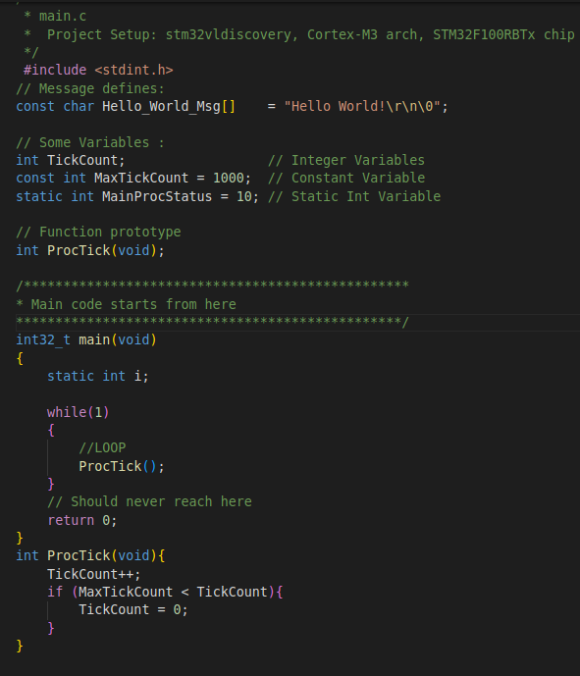
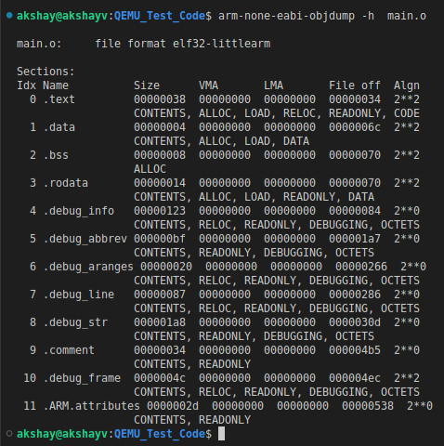
Object File
Consider the main.c that we compiled in previous section
We will use arm-none-eabi-objdump command to display information of object files.
main.c

Slide 11
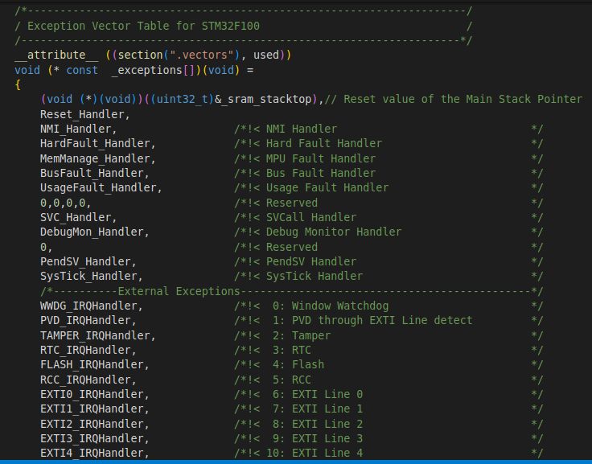
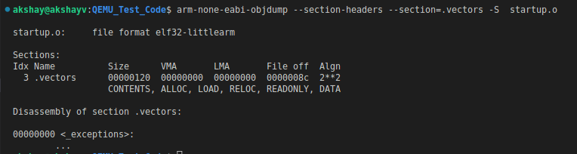
Object File
Consider the startup.c that we compiled in previous section
We can also get the details of specific section in from object file.
The vector table contains the reset value of the stack pointer, and the start addresses, also called exception vectors, for all exception handlers.
We will study the startup.c file upcoming chapters.
startup.c

Slide 12
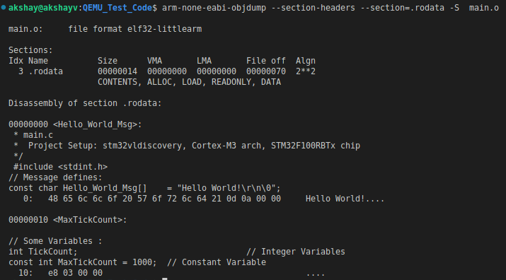
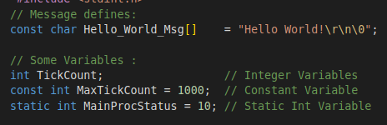
Object File
Consider the main.c that we compiled in previous section
.rodata Section :
Contains all the constant data

Slide 13
Linking Process
What is linker?
We say “compilation” when referring to the process by which source code is built into an executable file.
In previous steps we compiled the C code: 'main.c' & startup.c Both those compilation created the object files main.o & startup.o.
Linking process comes after the compilation.
Whether we use an IDE or GCC from the command line, compilation and linking will happen together as both are invoked with the same command.
A linker takes one or more object files, adds external libraries & links it all into an executable file.
Each object file is likely to make reference to functions that are hold in other object files, and resolving those dependencies is done by linker.
Linker scripts tell the linker how to do the job.
Linker script defines microcontroller specific features like memory sections, memory map, stack location, and size.

Slide 14
Linker Script
Anatomy of a Linker Script:
A linker script hold four things:
Memory layout:
The information of what and where the memory is available “flash”, and “ram” any specific memory available with the cpu (Eg : Core Coupled SRAM, Secondary SRAM etc.)
Section definitions:
Defines which part of a program should go where Data & Code.
Options:
Commands to specify architecture, entry point of application if needed
Symbols:
Variables to insert into the program at link time

Slide 15
Linker Script : Memory Layout
To allocate program space, the linker must know how much memory is available & at what addresses that memory exists.
This is defined in MEMORY definition in the linker script.
The syntax for MEMORY :
name :
Is a name we want to use for the region. Names do not carry meaning, so we are free to use anything we want.
Often “flash” & “ram” as region names.
(attr) :
Are attributes for the region:
writable (w), readable (r), or executable (x).
Flash is (rx),
RAM is rw.
These attributes describe the properties of the memory, not set it.
origin :
Is the start address of the memory region.
len :
Is the size of the memory region, in bytes.
Syntax :
MEMORY { name [(attr)] : ORIGIN = origin, LENGTH = len … }
STM32F100RBTx Memory Map
Memory | Start Address | Size
Flash | 0x08000000 | 128 Kbytes
SRAM | 0x20000000 | 8 Kbytes
This memory map gives us:
MEMORY { FLASH (rx) : ORIGIN = 0x08000000, LENGTH = 128K SRAM (rw) : ORIGIN = 0x20000000, LENGTH = 8K }

Slide 16
Linker Script : Section Definitions
Code & data are bucketed into sections, which are contiguous blocks of memory.
We name those sections as:
.text - code & constants
.bss - uninitialized data
.stack - our stack
.data - initialized data
.text Section:
The code segment, it usually called .text.
It contains the executable code, which means it’s read-only and has a known size.
This section goes in FLASH. The syntax is:
This defines a section named .text & adds it to the FLASH.
We also need to tell the linker what to put in this section.
This is done by listing all of the sections from input object files we want in .text.
SECTIONS { .text : { } > FLASH }

Slide 17
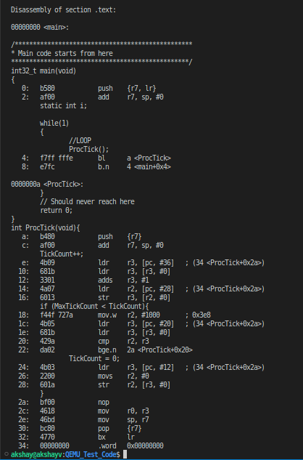
Linker Script : Memory Layout
.text Section contd.. :
To find the sections are in object file, we need to look at objdump.
To display summary contents of .text section .
Run the below command on both startup.o & main.o:
arm-none-eabi-objdump -hS main.o
arm-none-eabi-objdump -hS startup.o
main.o

Slide 18
Linker Script : Memory Layout
.text Section contd.. :
To add all of our functions in the .text section in linker script, we use the syntax: <filename>(<section>)
Filename : The name of the input file whose symbols we want to include in the section.
Section : The name of the input sections
We want following sections from object files, we can use wildcard * to include from all input files:
.vector - It contains functions we want to keep at the very start of our .text section
KEEP will instruct linker to keep specified section, even if no symbols inside it are referenced.
.text
. rodata - segment for constant data
.=ALIGN(4);
This means: insert padding bytes,
until current location becomes aligned on 4-byte boundary.
We will talk about this concept in future chapters.
>FLASH means that sections are located in FLASH memory
Finally the .text section looks like :
.text : {
KEEP(*(.vectors))
*(.text)
*(.rodata)
. = ALIGN(4);
} > FLASH

Slide 19
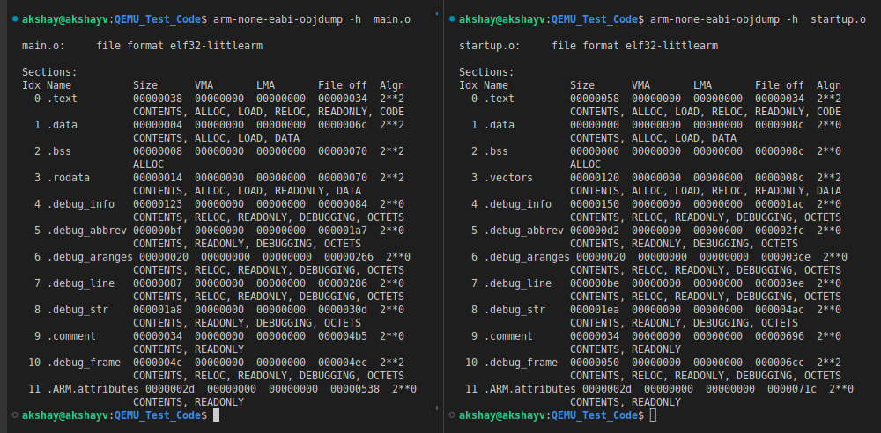
Linker Script : Memory Layout
.text Section contd.. :
Highlighted sections goes into .text section in linker file.

Slide 20
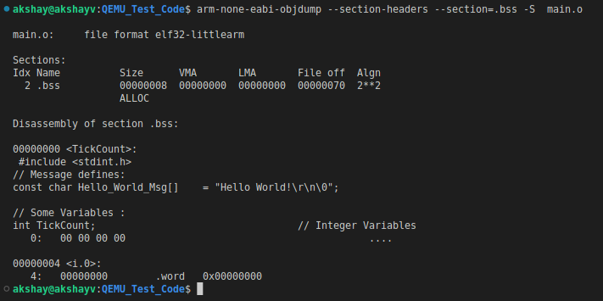
Linker Script : Memory Layout
.bss Section :
The unitialized data segment, also called as the BSS segment.
This is the section where we put uninitialized static memory.
.bss must be reserved in the memory map, but there is nothing to load as all variables are initialized to zero.
The .bss section also contain *(COMMON).
This is a special input section where the compiler place global uninitialized variables that go beyond scope of file.
This permits the linker to merge multiple definitions into one symbol if they have same name.
We specify that this section is not loaded with use of NOLOAD property.
.bss (NOLOAD):{
. = ALIGN(4);
*(.bss)
*(COMMON)
. = ALIGN(4);
} > SRAM

Slide 21
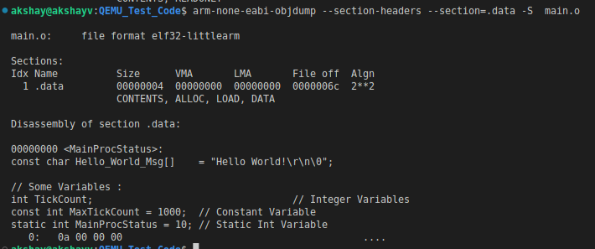
Linker Script : Memory Layout
.data Section:
The .data section hold static variables which have an initial value at start.
Since RAM isn’t persisted when power is off, those sections are loaded from flash.
At startup, the Reset_Handler() copies the data from Flash to RAM before the main function is called.
To make this viable, every section in our linker script needs two addresses:
Load address (LMA):
Is where our Programmer needs to place the section. LMA is the address “at rest” .
Virtual address (VMA) :
The VMA the address during execution i.e. the device is on and the program is running.
.data : {
. = ALIGN(4);
*(.data);
. = ALIGN(4);
} > SRAM AT > FLASH
Syntax:
.data : { *(.data*); } > ram AT > rom /* "> ram" is the VMA, "> rom" is the LMA */

Slide 22
Linker Script : Memory Layout
.stack Section :
Similar to .bss section we do same with .stack memory, since it is in RAM it is not loaded.
The stack does not hold symbols, we must explicitly reserve space for it by indicating the size.
STACK_SIZE = 0x1F40; /* 8kB */
.stack (NOLOAD) :
{
. = . + STACK_SIZE;
} > SRAM

Slide 23
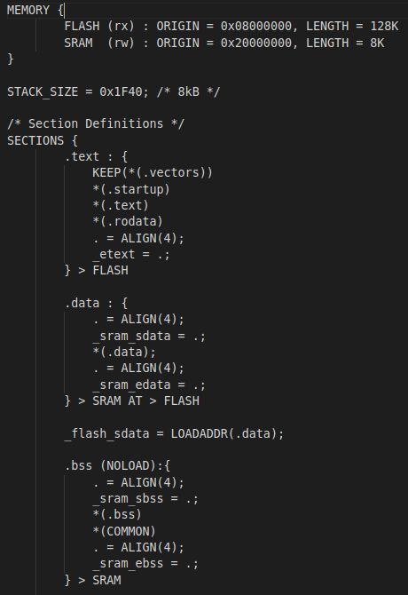
Linker Script : Memory Layout
Variables:
To make section addresses available to code, the linker is able to create symbols & add them to the program.
The syntax is similar to C assignment: symbol = expression;
We need:
_etext - end of code in .text section in FLASH.
_sram_sdata - start of .data section in RAM
_sram_edata - end of .data section in RAM
_sram_sbss - start of .bss section in RAM
_sram_ebss - end of .bss section in RAM
_sram_stacktop - top of stack.
_flash_sdata - Return the absolute LMA of the .data section.
They are straight forward: we can assign symbols to the value of the location counter (.) at the start and at the end of each section definition.
Final Linker Script:
Linker script is now ready. You can find the linker script inside: "linker.ld".

Slide 24
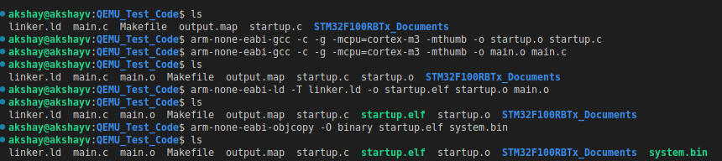
Build The Code - Linking
Now that we have all the files for building & emulating the first Bear Metal App -> main.c : main application program, startup.c : Startup File & linker.ld : Linker File
We already have compiled objects for main.o & startup.o.
Run the command to create system.elf & system.bin binary image which we can use with QEMU emulator for ARM core.
arm-none-eabi-ld -T linker.ld -o startup.elf startup.o main.o
arm-none-eabi-objcopy -O binary startup.elf system.bin
To run my program in the emulator, the command is:
qemu-system-arm -M stm32vldiscovery --cpu cortex-m3 -d unimp,guest_errors -kernel system.bin -serial stdio
UART1 particularly can be used as a terminal when using the -nographic or “-serial stdio” options with QEMU.
The -M option specifies the emulated system

Slide 25
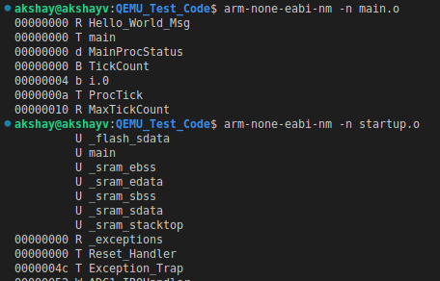
Object File- Symbol Table
In previous section we saw object file (main.o & startup.o) is the real output from the compilation phase.
It's mostly machine code, also contains metadata about the addresses of its functions & variables these are termed as Symbols in an data structure called a symbol table.
The addresses may not be the final address of the symbol in the final executable.
To know the symbols our object files main.o & startup.o contain we can use arm-none-eabi-nm command .
arm-none-eabi-nm - prints the symbol table for a given object file.
Just run following commands in terminal:
arm-none-eabi-nm –n main.o
arm-none-eabi-nm –n startup.o
The output is a list (separated by space) of address, type, and symbol name.
Address: are placeholders in object files, and final in executables.
Name: name of function or variable.
Type:
If lowercase, the symbol is usually local.
If uppercase, the symbol is global (external).
"t" The symbol is in the .text section, "U" The symbol is undefined, "D" The symbol is in the initialized data section,
"W" The symbol is a weak symbol

Slide 26
Object File- Symbol Table
To understand the “relocatable file”, look at the difference between the symbol tables of a relocatable object file and an executable object file.
The relocatable object file has symbols associated with the 00000000 address.
The executable object file has symbols associated with real addresses.
The compiler and assembler generate relocatable object file, the data start at address 0.
The linker then relocates these sections by associating each with a location with in memory (FLASH & RAM).
Flash address starts from 0x08000000
RAM address starts from 0x20000000.

Slide 27
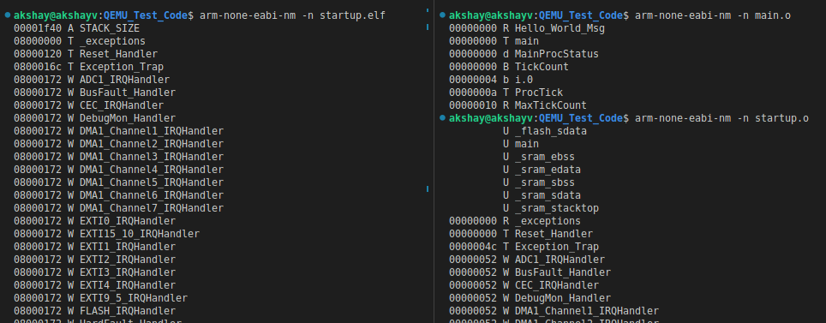
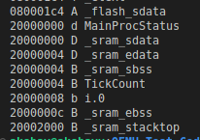
Object File- Symbol Table

Slide 28
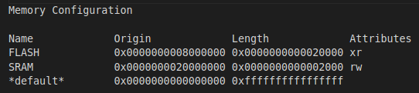
Map File
The map file provides important information that helps in understand and optimize memory.
It is symbol table for whole program.
A map file provides information about the linker / Locate process, including the following:
Where object files are mapped into memory.
How common symbols are allocated.
All archive members included in the link, with a mention of the symbol which caused the archive member to be brought in.
The values assigned to symbols.
How to generate MAP file run the command:
arm-none-eabi-ld -Map output.map -T linker.ld -o startup.elf startup.o main.o
-Map = mapfile Print a link map to the file output.map.
This will generate the file "output.map".
Sections in map file:
Memory configuration:
This information in the map file are the actual memory regions, along with location, size and access rights granted to those regions:

Slide 29
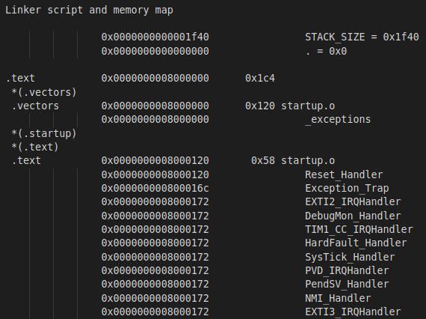

Map File contd..
Linker script and memory map :
It gives information about symbols in program.
In our file it indicates the text area size and its content.
The interrupt vectors (under the section .vectors) are present at the beginning of the executable, defined in startup.c.
These lines give us the address & size of each function.
The address of _exceptions defined under .vector section 0x0000000008000000, coming from startup.o which has a size of 0x120 bytes in the .text area.
The size is 0x120 bytes because _exceptions is an array of void * (size = 4byte) with 72 elements.
In this way, we can locate each function used in the program.

Slide 30
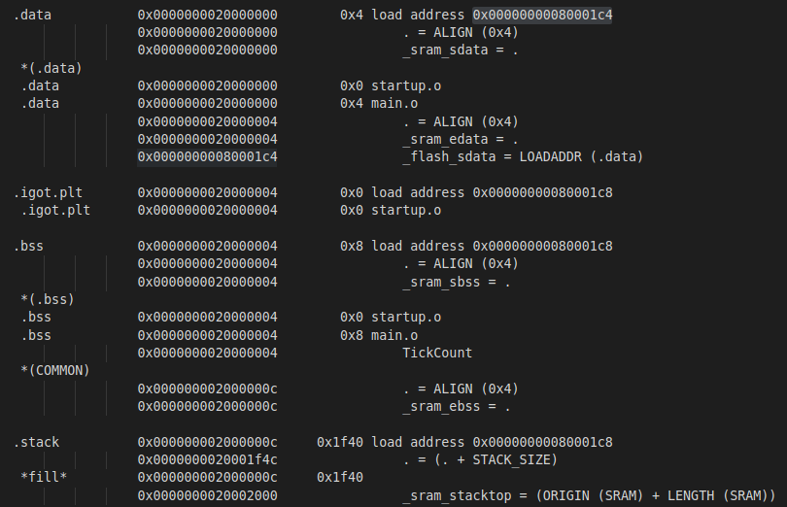
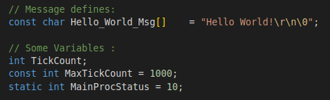
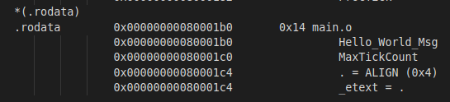
Map File contd..
Initialized variables have to be kept in Flash but they emerge in RAM in the map file, as they are copied into RAM in .data section before entering the main().
Symbols _sram_sdata & _sram_edata keep track of the area used in RAM to keep initialized variables.
These values are stored in Flash starting at load address 0x00000000080001c4.
Similar way .bss section & .stack are defined in the map file.
.rodata all the constant variables goes in this section.
Main.c

Slide 31
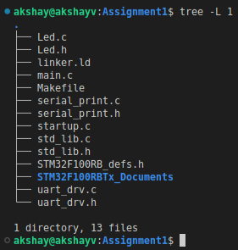
Assignment
Cross compile and execute:
Multiple source files, header files, communication between files, Cross compile and execute program on external target.
Compiler options towards optimization (both space and speed)
Consider Dir: Module3_SystemProgramming_Using_C/Chapter1_Building_an_Executable/Assignment1
startup.c -: Startup File
linker.ld -: Linker script
STM32F100RB_defs.h -: STM32F100RB Memory Map
Led.c & Led.h -: Nested Vector Interrupt Controller
serial_print.c/.h -: Routines for serial communication.
uart_drv.c & uart_drv.h -: Uart Driver
std_lib.c std_lib.h :- Std lib functions
Main.c -: Main code

Slide 32
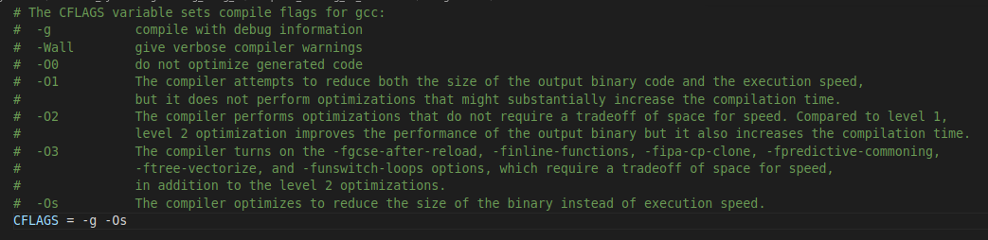
Assignment
Makefile -: To build code and Run the application in QEMU
CFLAGS : You can change the optimizations & add GCC flags to the CFLAGS
Read the comments provided below to enable GCC flags

Slide 33
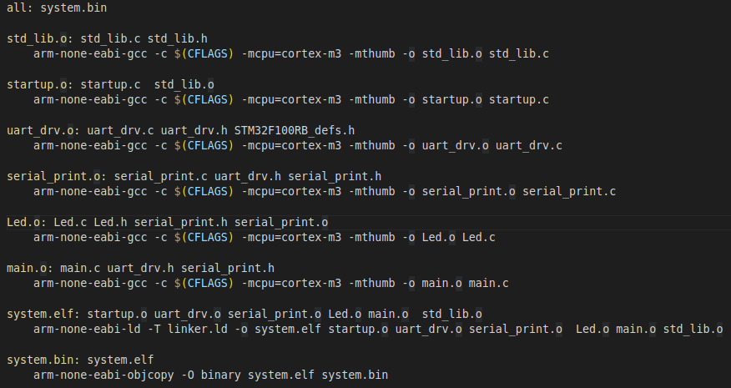
Assignment
Makefile -:
In previous sections we saw commands to compile the code and then linking procecss.
But in big project it is now good idea to compile each file individually
So we can use Makefile to automating software building procedure and other complex tasks with dependencies.
It defines the steps to compile the program.

Slide 34
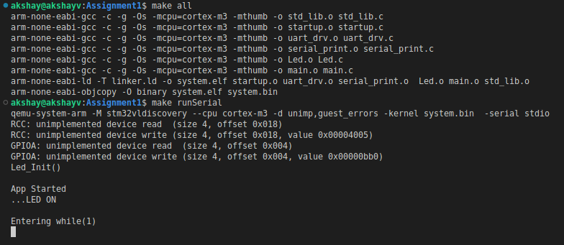
Assignment
Application:
The Application just initialize does some peripheral init.
Write some messages to serial.
QEMU:
We can also add steps to run the binary using QEMU inside Makefile.
Refer :
Output:
To Build the code use comand:
make all
You can see the output it compiles every file.
Finally linking then together.
To Run the code use command:
make runSerial
Final Output of executable file in QEMU

Slide 35

Building libraries
A library is a pre-compiled code that can be reused in an application.
Libraries give reusable functions, data structures, routines that can be reused in the code.
Static libraries:
A Static library or statically-linked library is a set of external functions, variables & routines, which are resolved in a caller at compile-time
Static libraries are collections of object files which are linked into the stand-alone executable program, with the prefix “lib” and ".a" extension
Static libraries are faster than the shared libraries as a set of commonly used object files is put into a single library executable file.
Static libraries are bigger in size, as external programs are built in the executable file.
Example code:
To demonstrate static library creation we have set of code files inside directory:
"Module3_SystemProgramming_Using_C/Chapter1_Building_an_Executable/shared-lib"
calculator.c : Library to perform basic math operation.
print_lib.c : Print the terminal characters in colour.
header.h : Include file with all function prototypes.
main.c : Application code

Slide 36
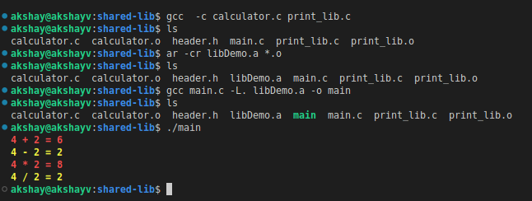
Building libraries contd..
Steps to generate a static c libraries in Linux:
Compile all of our library source code into an object file, GCC do this using command:
gcc -c calculator.c print_lib.c
We use GNU ar command to create final library or archive file:
The archiver, also called ar, is a Unix utility that maintains groups of files as a single archive file.
ar -cr libDemo.a *.o -c : Create the archive.
-r : updates the library with the most recent version of any existing object file.
Now we can compile the main.c :
gcc main.c -L. libDemo.a -o main
-L : flag indicates to the linker that libraries might be found in the current directory (referred to with ‘.’)
Run the main executable.

Slide 37
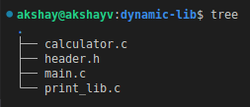
Building libraries contd..
Dynamic libraries:
Also called Shared Libraries.
A shared library or Dynamic Library is loaded dynamically at runtime for each application that needs it.
Dynamic Linking doesn’t require the code to be copied.
It is done by placing name of the library in the binary file.
Actual linking is done when the program is executed, both the binary file & the library are in memory.
Example code:
To demonstrate static library creation we have set of code files inside directory:
"Module3_SystemProgramming_Using_C/Chapter1_Building_an_Executable/dynamic-lib"
calculator.c : Library to perform basic math operation.
print_lib.c : Print the terminal characters in colour.
header.h : Include file with all function prototypes.
main.c : Application code

Slide 38
Building libraries contd..
Steps to generate a dynamic c libraries in Linux:
We need to compile all of our library source code into an object file so we inform GCC to do this using command :
gcc -c -fPIC calculator.c print_lib.c
-fPIC flag generates position-independent code, which accesses all constant addresses stored in the Global Offset Table (GOT).
Create Library file:
It has a format that is specific to the architecture for which the lib is created.
We need to use the compiler to create a library, for this we need to inform compiler that it should create a shared library, not a final program executable file.
This is achieved using the '-shared' flag.
gcc -shared -o libDemo.so *.o
Install Library:
The shared library will not be found at runtime if its directory is not in the variable LD_LIBRARY_PATH.
Type the following command add it:
export LD_LIBRARY_PATH=.:$LD_LIBRARY_PATH
In our example the local directory ('.') is added to the search.
The new path list will be effective only in the shell where you applied the command.

Slide 39
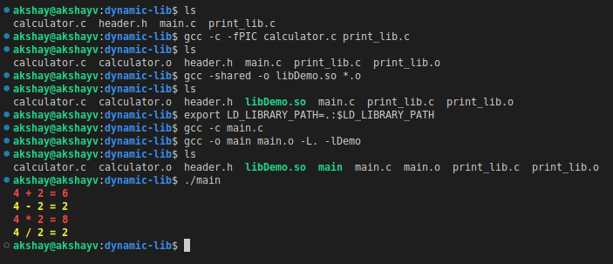
Building libraries contd..
Steps to generate a dynamic c libraries in Linux::
Build the executable:
To create the executable, you first compile the source file:
gcc -c main.c
Then link the created code main.o with the library:
gcc -o main main.o -L. -lDemo
'-L' indicates where the library is to be found
'-l' specifies the library, without the prepending 'lib' and file extension '.so'.
Finally run the executable

