Slide 1
System Programming using C
Chapter 2 : Building an Executable

Slide 2
Contents
Debugging with GDB
Introduction
Operation
Commands
Examples
Debug Commands
Traverse Call stack
Watchpoints
Debug Segmentation fault
Trace
Introduction
Logging vs Tracing
Software Tracing Techniques
Significance of not using printf statements
LTTng
Introduction
Installation
Core Concepts
User Application Demo
Create source files for User app & Tracepoints
Build Source files
LTTng recording session
Log Levels
Lttng API's
Example App

Slide 3
Debugging with GDB
GDB is a debugger for C and C++.
GDB offers extensive facilities for tracing and altering the execution of computer programs.
The user can monitor and modify the values of programs' internal variables, and even call functions independently of the program's normal behavior.
GDB allows you to do things like:
Add breakpoints - Run the program up to a certain point then stop
Print out the values of certain variables at that point.
Step through the program one line at a time and print out the values of each variable after executing each line.
GDB is by default typically compiled to target the same architecture as the host system.
the host architecture: where the GDB program itself is run
the target architecture: where the program being debugged is run
In embedded engineering, we often want to target a foreign architecture eg, the embedded device, connected to some debug probe.
For example if target device is ARM cortex-m3 processor.
We need a version of GDB that supports the target architecture of the program being debugged.
gdb-multiarch - contains a version of GDB which supports multiple target architectures.

Slide 4
Debugging with gdb contd...
GDB Operation:
Compile with the "-g" option when usisng GCC to compile the code.
It generates added information in the object code so the debugger can match a line of source code with the step of execution.
Do not use compiler optimization directive such as "-O" or "-O2" which rearrange computing operations to gain speed as this reordering will not match the order of execution in the source code and it may be impossible to follow.
control+c: Stop execution. It can stop program anywhere, in your source or a C library or anywhere.
To start GDB session use command: gdb ./<Program Name to debug>
GDB command completion: Use TAB key
Press TAB twice to see all available options if more than one option is available or type
GDB Commands:
Start and Stop:
Start and Stop | Description
run r run command-line-arguments run < infile > outfile | Start program execution from the beginning of the program. The command break main will get you started. Also allows basic I/O redirection.
continue c c [ignore-count] | Continue execution to next break point. [ignore-count] - Igonre number of counts breakpoint hits
kill | Stop program execution.
quit q | Exit GDB debugger.

Slide 5
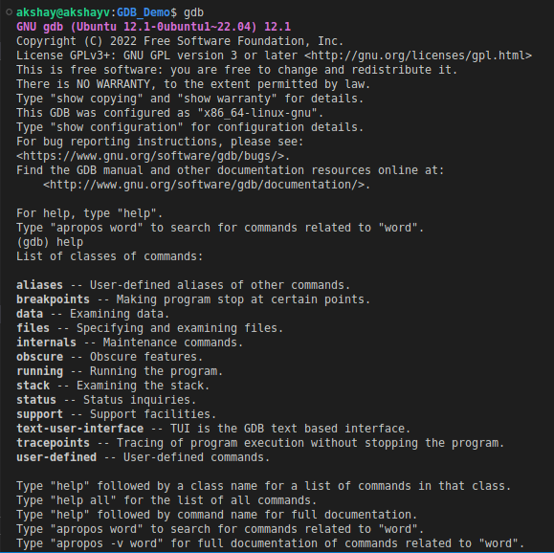
Debugging with gdb contd...
GDB Commands:
Help & Info Commands :
Will provide some help and info regarding the commands and usage :
Command | Description
help | List gdb command topics.
help topic-classes | List gdb command within class.
help command | Command description. eg help show to list the show commands
apropos search-word | Search for commands and command topics containing search-word.
info args i args | List program command line arguments
info breakpoints | List breakpoints
info break | List breakpoint numbers.
info break breakpoint-number | List info about specific breakpoint.
info watchpoints | List breakpoints
info registers | List registers in use
info threads | List threads in use
info set | List set-able option

Slide 6
Debugging with gdb contd...
GDB Commands:
Breakpoint and Watch:
Break and Watch | Description
break funtion-name break line-number break ClassName::functionName | Suspend program at specified function of line number.
break filename:function | Don't specify path, just the file name and function name.
break filename:line-number | Don't specify path, just the file name and line number. break Directory/Path/filename.cpp:62
break *address | Suspend processing at an instruction address. Used when you do not have source.
break line-number if condition | Where condition is an expression. i.e. x > 10 Suspend when boolean expression is true.
break line thread thread-number | Break in thread at specified line number. Use info threads to display thread numbers.
tbreak | Temporary break. Break once only. Break is then removed. See "break" above for options.
watch condition | Suspend processing when condition is met. i.e. x > 100
clear clear function clear line-number | Delete breakpoints as identified by command option. Delete all breakpoints in function Delete breakpoints at a given line
delete d | Delete all breakpoints, watchpoints, or catchpoints.
delete breakpoint-number delete range | Delete the breakpoints, watchpoints, or catchpoints of the breakpoint ranges specified as arguments.
disable breakpoint-number-or-range enable breakpoint-number-or-range | Does not delete breakpoints. Just enables/disables them. Example: Show breakpoints: info break Disable: disable 2-8
enable breakpoint-number once | Enables once
continue c | Continue executing until next break point/watchpoint.
continue number | Continue but ignore current breakpoint number times. Usefull for breakpoints within a loop.
finish | Continue to end of function.

Slide 7
Debugging with gdb contd...
GDB Commands:
Stack:
Stack | Description
backtrace bt bt inner-function-nesting-depth bt -outer-function-nesting-depth | Show trace of where you are currently. Which functions you are in. Prints stack backtrace.
backtrace full | Print values of local variables.
frame frame number f number | Show current stack frame (function where you are stopped) Select frame number. (can also user up/down to navigate frames)
up down up number down number | Move up a single frame (element in the call stack) Move down a single frame Move up/down the specified number of frames in the stack.
info frame | List address, language, address of arguments/local variables and which registers were saved in frame.
info args info locals info catch | Info arguments of selected frame, local variables and exception handlers.

Slide 8
Debugging with gdb contd...
GDB Commands:
Line Execution:
Use to execute code line by line.
Step into/over a function.
Run program till line number.
Line Execution | Description
step s step number-of-steps-to-perform | Step to next line of code. Will step into a function.
next n next number | Execute next line of code. Will not enter functions.
until until line-number | Continue processing until you reach a specified line number. Also: function name, address, filename:function or filename:line-number.
info signals info handle handle SIGNAL-NAME option | Perform the following option when signal recieved: nostop, stop, print, noprint, pass/noignore or nopass/ignore
where | Shows current line number and which function you are in.
Source Code | Description
list l list line-number list function list - list start#,end# list filename:function | List source code. To print lines from a source file.
set listsize count show listsize | Number of lines listed when list command given.
Source Code Commands:
To print lines from a source file during the debug session

Slide 9

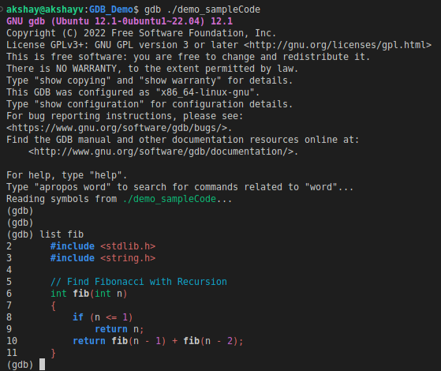
Debugging with gdb - Examples
Consider sample program : demo_sampleCode.c
The program : Prints n-th Fibonacci Number
Compile the code with command:
gcc demo_sampleCode.c -g -o demo_sampleCode
Start a GDB Session with comand:
gdb --args ./demo_sampleCode 9
Source Code Command:
To view the source code we can uses list command:
To view fib() function use command: list fib
This is where we type commands:
(gdb) < Type Commands >

Slide 10
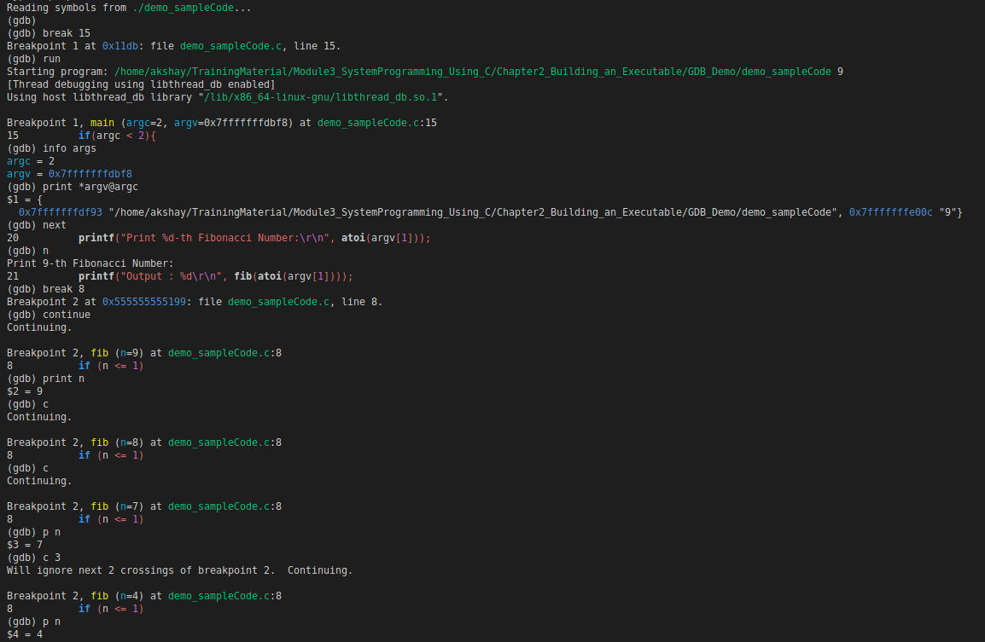
Debugging with gdb - Examples
Break Point at line 15
Run – start program
Code reach Breakpoint 1
info args : to get details about arguents to program
print *argv@argc : print arguments
1
Fig: shows some gdb commands that can be used to debug the example program
2
3
4
1. "next" or "n" : Execute next line
2. break 8 : add breakpoint at line 8
3. "continue" or "c" : Execute untill next breakpoint
4. "print n" or "p n" : Print value at variable n
5. c 3 : ignore break point 3 times
5

Slide 11
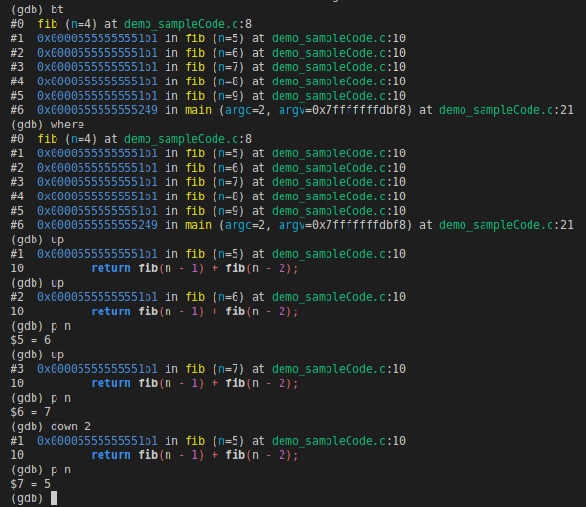
Debugging with gdb - Examples
bt : Show trace of where you are currently. Which functions you are in. Prints stack backtrace.
where : Print out the call stack including files and line numbers.
Helpful to see the function calling sequence of how execution got here, and if you ever get lost in the call stack.
Code is currently in fib (n = 4), you can see complete call sequence from main()
1
GDB – Traverse Call Stack
1. up : Go up the stack i.e. go to the line that called the function you are currently in.
2. up
3. p n : print value on n (After 2 up commands code is currently in fib( n = 6) function )
4. down 2 : Go down the stack 2 frames
5. p n : print value on n (After 1 up command and down 2 frames code is currently in
fib( n =5) function )
2
3
4
5

Slide 12
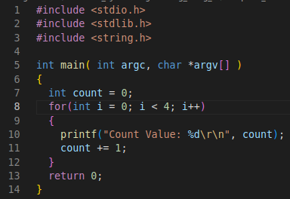
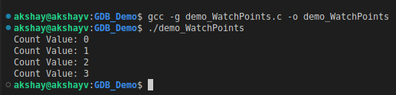
Debugging with gdb - Examples
GDB - Watchpoints
Consider the following source code: demo_WatchPoints.c
With GDB we are able to set a watchpoint on a variable in order to break a program when a variable changes.
Use display to automatically print how variables change throughout the program’s execution.

Slide 13
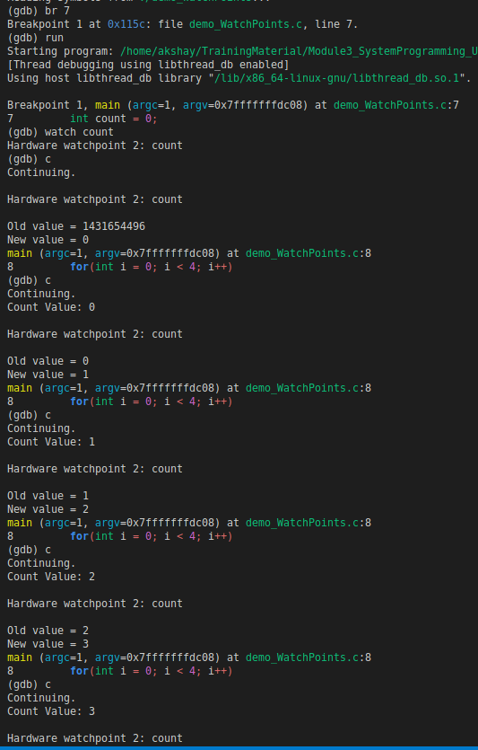
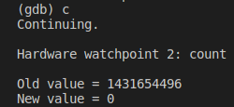
Debugging with gdb - Examples
Add breakpoint at Line 7
watch count : we want to print out value of count when it changes. So we add a watchpoint
We added watchpoint at Line 7:
int count = 0;
Before declaring the variable count there was random value at memory assigned to count.
After continuing the value got initialized to 0.
When count = 1 :
Prints out: Count Value = 1
After:
count += 1;
Value of count incremented to 2.

Slide 14
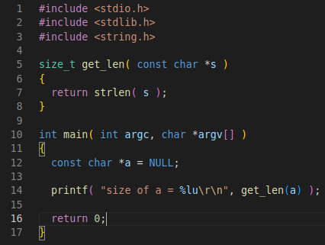

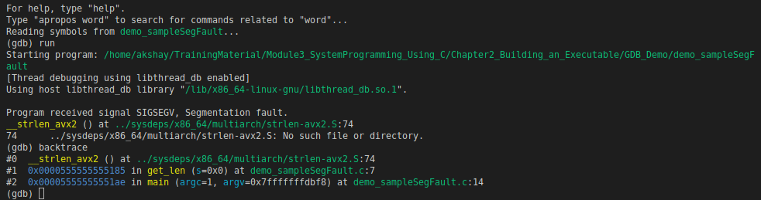
Debugging with gdb contd...
Consider the following source code: demo_sampleSegFault.c
Compile the code with below:
gcc demo_sampleSegFault.c -g -o demo_sampleSegFault
-g flag in order to include appropriate debug information on the binary generated, thus making it possible to inspect it using GDB.
When we execute the program, generates a segmentation fault
GDB can be used to inspect the problem.
Get backtrace
The problem is present in line 7, and occurs when calling the strlen(), because its argument, s, is NULL

Slide 15
Trace
Tracing is a technique used to understand what goes on in a running software system.
The piece of software used for tracing is called a tracer, which is conceptually similar to a tape recorder.
When recording, specific instrumentation points placed in the software source code generate events that are saved on a giant tape: a trace file.
You can record user application and operating system events at the same time, opening the possibility of resolving a wide range of problems that would otherwise be extremely challenging.
In software engineering, tracing involves a specialized use of logging to record information about a program's execution.
This information is typically used by programmers for debugging purposes.
This information is used both during development cycles and after the release of the software.
Tracing is often compared to logging.
However, tracers and loggers are two different tools, serving two different purposes.

Slide 16
Trace
Logging vs Tracing
Logging | Tracing
Consumed primarily by system administrators | Consumed primarily by developers
Logs "high level" information | Logs "low level" information & events that occur much more frequently than log messages
Must not be too "noisy" (containing many duplicate events or information that is not helpful for its intended audience) | Can be noisy
A standards-based output format is often desirable, sometimes even required | Few limitations on output format
Log messages are often localized | Localization is rarely a concern
Addition of new types of events, as well as new event messages, need not be agile | Addition of new tracing messages must be agile

Slide 17
Trace
Software Tracing Techniques:
Tracing macros.
Output to debugger.
Windows software trace preprocessor (aka WPP).
FreeBSD and SmartOS tracing with DTrace - traces the kernel and the userland.
Linux kernel tracing with ftrace.
Linux system-level and user-level tracing with kernel markers and LTTng.
Linux application tracing with UST - part of the same project as LTTng.
Linux C/C++ application tracing with cwrap.
Tracing with GNU Debugger's trace command.
In this module we will go into details of Tracing with LTTng.

Slide 18
Significance of not using printf statements
A common way to do debugging, before true debuggers were available, was to instrument the code – add strategically placed printf() calls
Thus progress through the code could be observed.
There might also be some kind of pause – a breakpoint really – where the code would be stopped, pending a keystroke or some such user response.
A common downside of using printf() calls for debugging was memory.
The code for this function is quite complex and is really overkill for this usage.
Nowadays, that is likely to be less of a problem, but the time taken to execute a call is more likely to be an issue.
Not only is the amount of time very likely to be an issue, but the fact that it is very non-deterministic.
Thus the use of trace tools is very effective for larger systems.
It can offer highly-customizable tracing a profiling capabilities for single core and multicore designs running Linux, Nucleus or on bare metal.

Slide 19
LTTng
The Linux Trace Toolkit: next generation is an open source software toolkit which you can use to trace the Linux kernel, user applications, and user libraries at the same time.
LTTng consists of:
Kernel modules to trace the Linux kernel.
Shared libraries to trace C/C++ user applications.
Daemons and a command-line tool, lttng, to control the LTTng tracers.
LTTng is currently available on major desktop and server Linux distributions.
The main interface for tracing control is a single command-line tool named lttng.
The latter can create several recording sessions, enable and disable recording event rules on the fly, filter events efficiently with custom user expressions, start and stop tracing, and much more.
In this Module we will focus on User Space applications.

Slide 20
LTTng - Installation
LTTng is a set of software components which interact to instrument the Linux kernel and user applications, and to control tracing.
Those components are bundled into the following packages:
LTTng-tools
Libraries and command-line interface to control tracing.
LTTng-modules
Linux kernel modules to instrument and trace the kernel.
LTTng-UST
Libraries and Java/Python packages to instrument and trace user applications.
We will only need LTTng-tools & LTTng-UST to use the user space LTTng tracer.
Install the following dependencies of LTTng-tools and LTTng-UST:
libuuid -> sudo apt-get install uuid-dev
Popt -> sudo apt-get install libpopt-dev
Userspace RCU -> sudo apt-get install liburcu-dev
Libxml2 -> sudo apt-get install libxml2 numactl -> sudo apt-get install libnuma-dev

Slide 21
LTTng - Installation
Download, build, and install the latest LTTng-tools 2.13:
wget https://lttng.org/files/lttng-tools/lttng-tools-latest-2.13.tar.bz2 && tar -xf lttng-tools-latest-2.13.tar.bz2 && cd lttng-tools-2.13.* && ./configure && make && sudo make install && sudo ldconfig
Download, build, and install the latest LTTng-UST 2.13:
wget https://lttng.org/files/lttng-ust/lttng-ust-latest-2.13.tar.bz2 && tar -xf lttng-ust-latest-2.13.tar.bz2 && cd lttng-ust-2.13.* && ./configure --disable-numa && make && sudo make install && sudo ldconfig
View and analyze the recorded events:
Babeltrace 2 -> sudo apt-get install babeltrace2
By default, LTTng-UST libraries are installed to /usr/local/lib append the path to LD_LIBRARY_PATH:
export LD_LIBRARY_PATH=$LD_LIBRARY_PATH:/usr/local/lib

Slide 22
LTTng – Core Concepts
Core Concepts:
From a user’s perspective, the LTTng system is built on a few concepts, or objects, on which the lttng command-line tool operates by sending commands to the session daemon (through liblttng-ctl).
The core concepts of LTTng are:
Instrumentation point, event rule, and event
Trigger
Recording session
Tracing domain
Channel and ring buffer
Recording event rule and event record

Slide 23
LTTng – Core Concepts
Instrumentation point:
An instrumentation point is a point, within a piece of software, which, when executed, creates an LTTng event.
LTTng offers various types of instrumentation depending on the tracing domain:
Linux kernel
LTTng tracepoint
Linux kernel system call
Linux kprobe
Linux user space probe
Linux kretprobe
User space
LTTng tracepoint
A statically defined point in the source code of a C/C++ application/library using the LTTng-UST macros.

Slide 24
LTTng – Core Concepts
Event Rule & event:
An event rule is a set of conditions to match a set of events.
When LTTng creates an event E, an event rule ER is said to match E when E satisfies all the conditions of ER.
When an event rule matches an event, LTTng emits the event, therefore attempting to execute one or more actions.
As of LTTng 2.13, there are two places where you can find an event rule:
Recording event rule
A specific type of event rule of which the action is to record the matched event as an event record.
“Event rule matches” trigger condition (since LTTng 2.13)
When the event rule of the trigger condition matches an event, LTTng can execute user-defined actions such as sending an LTTng notification, starting a recording session, and more.
For LTTng to emit an event E, E must satisfy all the basic conditions of an event rule ER, that is:
The instrumentation point from which LTTng creates E has a specific type.
A pattern matches the name of E while another pattern doesn’t.
The log level of the instrumentation point from which LTTng creates E is at least as severe as some value, or is exactly some value.
The fields of the payload of E and the current context fields satisfy a filter expression.

Slide 25
LTTng – Core Concepts
Trigger
A trigger associates a condition to one or more actions.
When the condition of a trigger is satisfied, LTTng attempts to execute its actions.
As of LTTng 2.13, the available trigger conditions and actions are:
Conditions
The consumed buffer size of a given recording session becomes greater than some value.
The buffer usage of a given channel becomes greater than some value.
The buffer usage of a given channel becomes less than some value.
There’s an ongoing recording session rotation.
A recording session rotation becomes completed.
An event rule matches an event.
Actions
Send a notification to a user application.
Start a given recording session.
Stop a given recording session.
Archive the current trace chunk of a given recording session (rotate).
Take a snapshot of a given recording session.

Slide 26
LTTng – Core Concepts
Recording session
A recording session is a stateful dialogue between you and a session daemon for everything related to event recording.
Everything that you do when you control LTTng tracers to record events happens within a recording session. In particular, a recording session:
Has its own name, unique for a given session daemon.
Has its own set of trace files, if any.
Has its own state of activity (started or stopped).
An active recording session is an implicit recording event rule condition.
Has its own mode (local, network streaming, snapshot, or live).
Has its own channels to which are attached their own recording event rules.
Has its own process attribute inclusion sets.
LTTng offers four recording session modes:
Local mode : Write the trace data to the local file system.
Network streaming mode : Send the trace data over the network to a listening relay daemon.
Snapshot mode : Only write the trace data to the local file system or send it to a listening relay daemon when LTTng takes a snapshot.
Live mode : Send the trace data over the network to a listening relay daemon for live reading.

Slide 27
LTTng – Core Concepts
Tracing domain
A tracing domain identifies a type of LTTng tracer.
A tracing domain has its own properties and features.
There are currently five available tracing domains:
Linux kernel
User space
java.util.logging (JUL)
Log4j
Python
It is must specify a tracing domain to target a type of LTTng tracer when using some lttng commands to avoid ambiguity.
We need to specify a tracing domain when you create an event rule because linux kernal & user space tracing domains could have tracepoints sharing the same name.

Slide 28
LTTng – Core Concepts
Channel and ring buffer
A channel is an object which is responsible for a set of ring buffers.
Each ring buffer is divided into multiple sub-buffers.
When a recording event rule matches an event, LTTng can record it to one or more sub-buffers of one or more channels.
When you create a channel, you set its final attributes, that is:
Its buffering scheme.
What to do when there’s no space left for a new event record because all sub-buffers are full.
The size of each ring buffer and how many sub-buffers a ring buffer has.
The size of each trace file LTTng writes for this channel and the maximum count of trace files.
The periods of its read, switch, and monitor timers.
For a user space channel: the value of its blocking timeout.
A channel is always associated to a tracing domain.
A channel owns recording event rules.

Slide 29
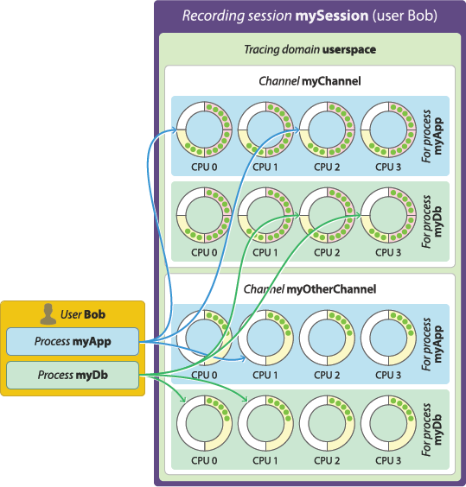
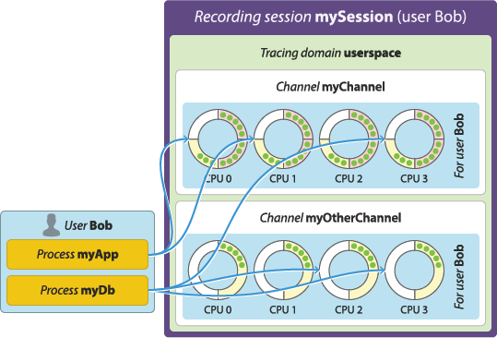
LTTng – Core Concepts
Buffering scheme
A channel has at least one ring buffer per CPU.
LTTng always records an event to the ring buffer dedicated to the CPU which emits it.
The buffering scheme of a user space channel determines what has its own set of per-CPU ring buffers.
Per-user buffering : Allocate one set of ring buffers—one per CPU—shared by all the instrumented processes of.
Per-process buffering : Allocate one set of ring buffers—one per CPU—for each instrumented process of.
Per-process buffering scheme
Per-user buffering scheme
https://lttng.org/docs/v2.13/images/per-process-buffering.png
https://lttng.org/docs/v2.13/images/per-user-buffering.png

Slide 30
LTTng – Core Concepts
Buffering scheme
The per-process buffering scheme tends to consume more memory than the per-user option because systems generally have more instrumented processes than Unix users running instrumented processes.
However, the per-process buffering scheme ensures that one process having a high event throughput won’t fill all the shared sub-buffers of the same Unix user, only its own.
The buffering scheme of a Linux kernel channel is always to allocate a single set of ring buffers for the whole system.
Event record loss mode
When LTTng emits an event, LTTng can record it to a specific, available sub-buffer within the ring buffers of specific channels.
When there’s no space left in a sub-buffer, the tracer marks it as consumable and another, available sub-buffer starts receiving the following event records.
The available event record loss modes are:
Discard mode
Drop the newest event records until a sub-buffer becomes available.
Overwrite mode
Clear the sub-buffer containing the oldest event records and start writing the newest event records there.

Slide 31
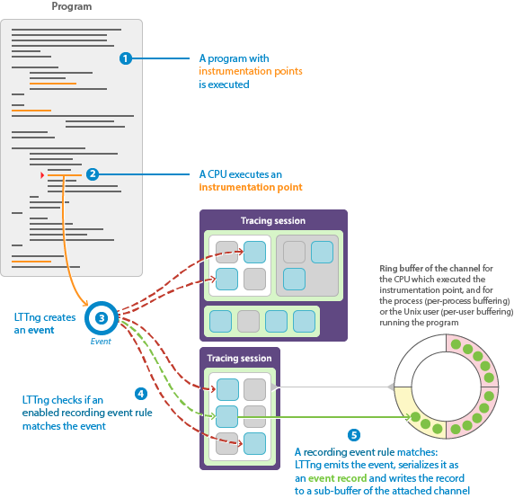
LTTng – Core Concepts
Recording event rule and event record
A recording event rule is a specific type of event rule of which the action is to serialize and record the matched event as an event record.
You always attach a recording event rule to a channel, which belongs to a recording session, when you create it.
When a recording event rule ER matches an event E, LTTng attempts to serialize and record E to one of the available sub-buffers of the channel to which E is attached.
https://lttng.org/docs/v2.13/images/event-rule.png

Slide 32
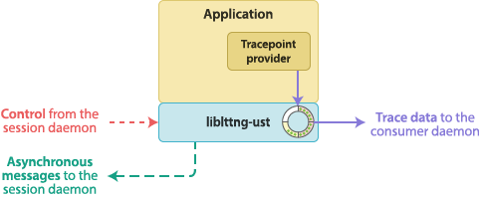
LTTng Tracing – User Application
The high level procedure to instrument a C or C++ user application with the LTTng user space tracing library, liblttng-ust, is:
Create the source files of a tracepoint provider package.
Add tracepoints to the source code of the application.
Build and link a tracepoint provider package and the user application.
All the Source code for this example is inside : Chapter2_Building_an_Executable/LTTng_Demo/Hello_World
Create the source files of a tracepoint provider package
A tracepoint provider is a set of compiled functions which provide tracepoints to an application, the type of instrumentation point which LTTng-UST provides.
Those functions can make LTTng emit events with user-defined fields (Passing values) and serialize those events as event records to one or more LTTng-UST channel sub-buffers.
The lttng_ust_tracepoint() macro, which you insert in the source code of a user application, calls those functions.
Its source files are:
One or more tracepoint provider header (.h).
A tracepoint provider package source (.c).
https://lttng.org/docs/v2.13/images/ust-app.png

Slide 33
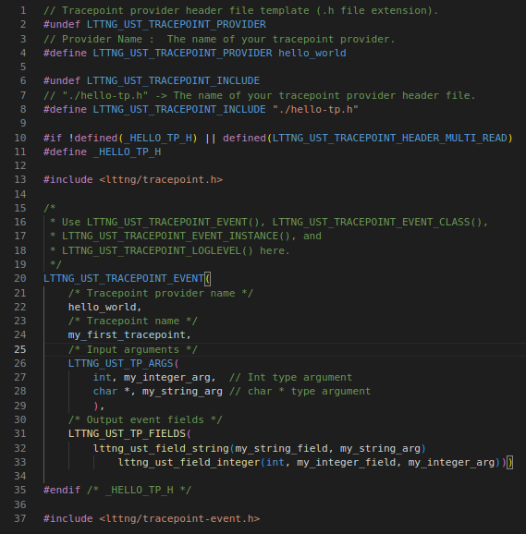
LTTng Tracing – User Application
Create a tracepoint provider header file template
Consider the File: hello-tp.h
provider_name : the name of your tracepoint provider.
"./hello-tp.h" :The name of your tracepoint provider header file.
tracepoint definition:
Its input arguments LTTNG_UST_TP_ARGS()
They’re the macro parameters that the lttng_ust_tracepoint() macro accepts for this particular tracepoint in the source code of the user application.
Those arguments can be used in the argument expressions of the output fields defined in LTTNG_UST_TP_FIELDS().
Its output event fields LTTNG_UST_TP_FIELDS()
They’re the macro contains the output fields of the tracepoint, that is, the actual data that can be recorded in the payload of an event emitted by this tracepoint.
A lttng_ust_field_*() macro specifies the type, size, and byte order of one event field.
Each lttng_ust_field_*() macro takes an argument expression parameter.
1
2
3

Slide 34

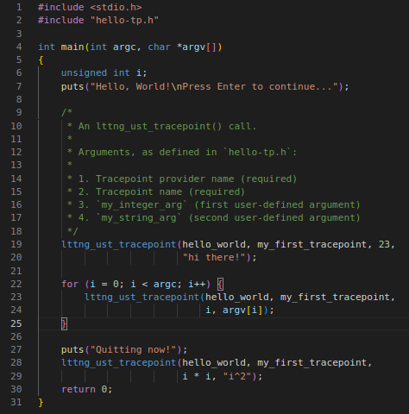
LTTng Tracing – User Application
Create a tracepoint provider package source file
A tracepoint provider package source file is a C source file which includes a tracepoint provider header file to expand its macros into event serialization and other functions.
Consider the File: hello-tp.c
Add tracepoints to the source code of an application
Consider the File: hello.c
Once you create a tracepoint provider header file, use the lttng_ust_tracepoint() macro in the source code of your application to insert the tracepoints that this header defines.
The lttng_ust_tracepoint() macro takes at least two parameters:
The tracepoint provider name and the tracepoint name.
The corresponding tracepoint definition defines the other parameters.
The demo user app does following things:
User app first insert the first tracepoint in app .
User app inserts the all the arguments passed to user app to tracepoint along with argument number.
User inserts a message entry to the tracepoint.
1
2
3

Slide 35
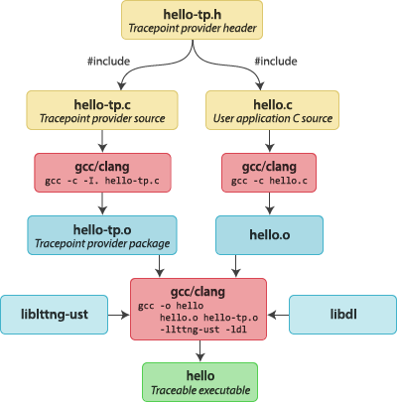

LTTng - User Application
Record user application events
This section walks you through a simple example to record the events of a Hello world program written in C.
All the Source code is inside directory: Chapter2_Building_an_Executable/LTTng_Demo/Hello_World
Create the traceable user application:
hello-tp.h - The tracepoint provider header file, which defines the tracepoints and the events they can generate.
hello-tp.c - The tracepoint provider package source file.
hello.c - The Hello World application source file:
Build the application :
The tracepoint provider package: gcc -c -I. hello-tp.c
The application: gcc -c hello.c
Link the application with the tracepoint provider package, liblttng-ust and libdl :
gcc -o hello hello.o hello-tp.o -llttng-ust -ldl
Run the application with a few arguments:
./hello world 1 2 3 4 5
Credits: https://lttng.org/docs/v2.13/#doc-building-from-source

Slide 36
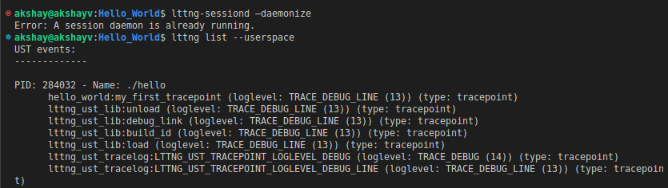
LTTng - User Application
Record user application events:
LTTng Start Trace session:
Start an LTTng session daemon: lttng-sessiond –daemonize
Note: A session daemon might already be running, for example as a service that the service manager of your distribution started.
List the available user space tracepoints: lttng list –userspace
In output we see the hello_world:my_first_tracepoint tracepoint listed under the ./hello process.

Slide 37

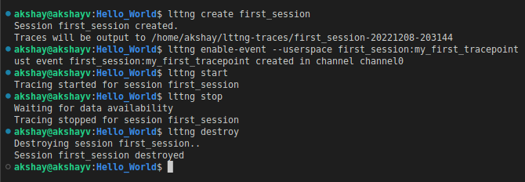
LTTng - User Application
Create a recording session: lttng create <session name>
Create a recording event rule which matches user space tracepoint events named hello_world:my_first_tracepoint:
lttng enable-event –userspace hello_world:my_first_tracepoint
Start recording: lttng start
Go back to the running hello application and press Enter.
The program executes all lttng_ust_tracepoint() instrumentation points, emitting events as the event rule you created matches them, and exits.
Stop recording: lttng stop
Destroy the current recording session: lttng destroy
4
1
2
3
5
6

Slide 38
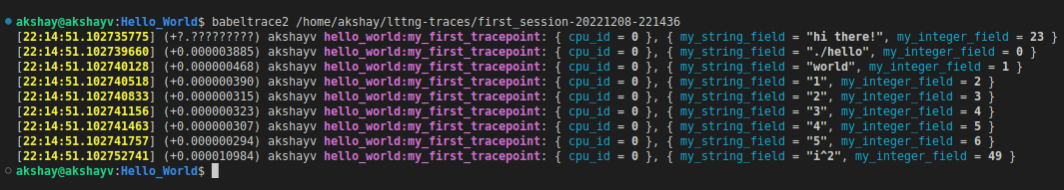
LTTng - User Application
View and analyze the recorded events
Once the step Record user application events is completed we can analyze the traces.
We will use the babeltrace2 command-line tool to read the trace.
By Default the traces are saved in directory : /home/<user>/lttng-traces.
Use command to read the traces: babeltrace2 ~/lttng-traces/<path to trace directory >
Event record fields

Slide 39
LTTng – Log Level
Assign a log level to a tracepoint definition
Assign a log level to a tracepoint definition with the LTTNG_UST_TRACEPOINT_LOGLEVEL() macro.
Assigning different levels of severity to tracepoint definitions can be useful:
When you create a recording event rule, you can target tracepoints having a log level at least as severe as a specific value.
The concept of log levels is similar to the levels found in typical logging frameworks, where the given by the functions are used: debug(), info(), warn(), error(), and so on.
The syntax of the LTTNG_UST_TRACEPOINT_LOGLEVEL() macro is:
LTTNG_UST_TRACEPOINT_LOGLEVEL(provider_name, tracepoint_name, log_level)
Where :
provider_name : the tracepoint provider name.
tracepoint_name : the tracepoint name.
log_level : the log level to assign to the tracepoint definition named tracepoint_name in the provider_name tracepoint provider.
While creating a recording event rule matching any user space event from the my_app tracepoint provider and with a log level range (default channel).
lttng enable-event --userspace my_app:'<trace point name>' --loglevel=INFO

Slide 40
LTTng – API's
lttng_ust_tracef()
It is a small LTTng-UST API designed for quick, printf(3)-like instrumentation without the burden of creating and building a tracepoint provider package.
To use lttng_ust_tracef() in your application:
In the C or C++ source files where you need to use lttng_ust_tracef(), include <lttng/tracef.h>:
#include <lttng/tracef.h>
In the source code of the application, use lttng_ust_tracef() like you would use printf:
lttng_ust_tracef("my message: %d (%s)", my_integer, my_string);
Link your application with liblttng-ust:
gcc -o app app.c -llttng-ust
Create a recording event rule which matches user space events named lttng_ust_tracef:*:
lttng enable-event --userspace 'lttng_ust_tracef:*'
lttng_ust_tracef() is useful for some quick prototyping and debugging, but you shouldn’t consider it for any permanent and serious applicative instrumentation.

Slide 41
LTTng – API's
lttng_ust_tracelog()
API is very similar to lttng_ust_tracef(), with the difference that it accepts an additional log level parameter.
The goal of lttng_ust_tracelog() is to ease the migration from logging to tracing.
To use lttng_ust_tracelog() in your application:
In the C or C++ source files where you need to use tracelog(), include <lttng/tracelog.h>:
#include <lttng/tracelog.h>
In the source code of the application, use lttng_ust_tracelog() like you would use printf(3), except for the first parameter which is the log level:
tracelog(LTTNG_UST_TRACEPOINT_LOGLEVEL_WARNING, "my message: %d (%s)", my_integer, my_string);
Link your application with liblttng-ust:
gcc -o app app.c -llttng-ust
Create a recording event rule which matches user space tracepoint events named lttng_ust_tracelog:* and with some minimum level of severity:
lttng enable-event --userspace 'lttng_ust_tracelog:*' --loglevel=WARNING

Slide 42
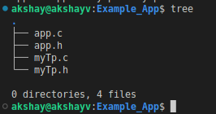
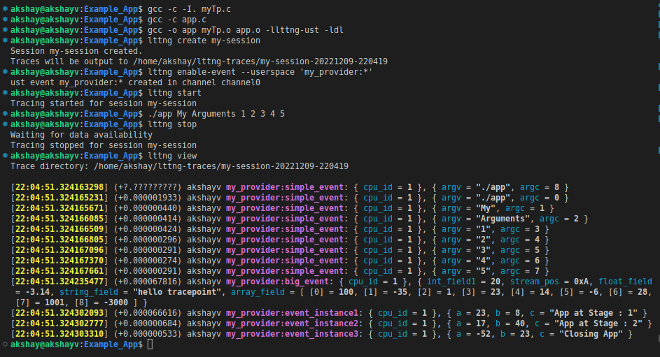
LTTng – Example
This example shows the features we saw in the previous sections.
The static linking method is chosen here to link the application with the tracepoint provider.
This App shows demo of how to use tracepoint events in the user app.
Follow the command sequence to build and run example.

Slide 43
Assignment- Disassembly of C code
Assembler:
An assembler is a program that interprets software programs written in assembly language into machine language, code & instructions that can be executed by computer.
Assembler is also referred as compiler of assembly language.
Each assembly language Is designed for specific processors architecture.
Assembling is performed using a simple one-to-one mapping from assembly code to machine code.
Disassembler:
It is a program that converts machine language instruction into assembly language instructions.
In simple terms it converts performs the inverse of operations performed by assembler.
Also known as reverse engineering.
Assembler
Assembly Code
Machine Code
Disassembler
Machine Code
Assembly Code

Slide 44

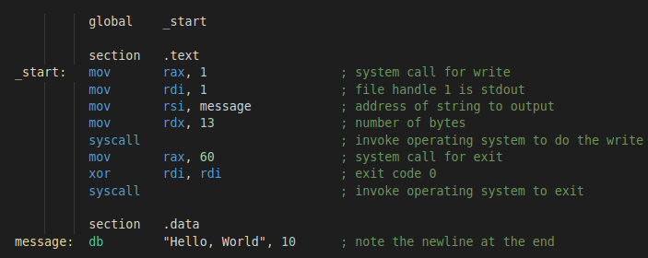
Assignment
NASM:
The Netwide Assembler (NASM), an assembler for the x86 CPU architecture portable to nearly every modern platform, and with code generation for many platforms old and new.
We can write both standalone programs & programs that integrate with C.
To install NASM : sudo apt-get install nasm
Assembly language is complex, we need to read more details about the NASM on: https://www.nasm.us/doc/
In this module we will use the x86_64 GNU/Linux PC.
Let's Run the simple Hello World Program: sample1.asm
Build code : nasm -felf64 sample1.asm && ld sample1.o -o sample1
LABELS
INSTRUCTIONS
OPERANDS
SECTIONS

Slide 45
Assignment
NASM:
Few Instructions:
Operands:
Register Operands:
It refers to data stored in registers.
In x86-64 architecture there are 16 registers R0 – R15.
8 Registers have alternate names.
Instruction | Description
mov x,y | x= y
add x ,y | x= x + y
sub x ,y | X = x - y
inc x | x = x + 1
dec x | x = x - 1
syscall n | Invoke OS Routine n
db | Declares bytes that will be in memory when program runs
R0 | R1 | R2 | R3 | R4 | R5 | R6 | R7 | R8 | R9 | R10 | R11 | R12 | R13 | R14 | R15
aka | aka | aka | aka | aka | aka | aka | aka
RAX | RCX | RDX | RBX | RSP | RBP | RSI | RDI

Slide 46
Assignment
Operands:
Memory Operands:
[ number ]
[ reg ]
[ reg + reg*scale ] scale is 1, 2, 4, or 8 only
[ reg + number ]
[ reg + reg*scale + number ]
Number is called the displacement.
Plain register is called Base
Register with the scale is called index.
Examples:
[50] ; displacement only [rbp] ; base register only [rcx + rsi*4] ; base + index * scale [rbp + rdx] ; scale is 1 [rbx - 4] ; displacement is -4 [rax + rdi*8 + 50] ; all four components [rbx + count] ; uses the address of the variable 'count' as the displacement
Operands:
Immediate Operands:
200 - decimal 0200 - still decimal - the leading 0 does not make it octal 0200d - explicitly decimal - d suffix 0d200 - also decimal - 0d prefex 0c8h - hex - h suffix, but leading 0 is required because c8h looks like a var 0xc8 - hex - the classic 0x prefix 0hc8 - hex - for some reason NASM likes 0h 310q - octal - q suffix 0q310 - octal - 0q prefix 11001000b - binary - b suffix 0b1100_1000 - binary - 0b prefix, and by the way, underscores are allowed

Slide 47
Assignment
Defining Data:
db 0xAA ; A Byte 0xAA
db 0xAA 0x55 0xCC ; Three Bytes
db 'a',0x55 ; character constants are OK
db 'hello',13,10,'$' ; so are string constants
dw 0x1234 ; 0x34 0x12
dw 'a' ; 0x61 0x00 (it's just a number)
dw 'abc' ; 0x61 0x62 0x63 0x00 (string)
dd 0x12345678 ; 0x78 0x56 0x34 0x12
dd 1.234567e20 ; floating-point constant
dt 1.234567e20 ; extended-precision float
To reserve space without initilizing:
buf: resb 64 ; reserve 64 bytes wordvar: resw 1 ; reserve a word realarray: resq 40 ; array of 40 reals
Calling Conventions:
When we integrate the asm & C program we must follow calling conventions:
From Left to Right, we can pass parameters that can fit in registers.
The order in which registers are allocated are:
For integers & Pointers: rdi, rsi, rdx, rcx, r8, r9
For Floating point : xmm0, xmm1, xmm3.
Additional parameters are pushed on stack and are to be removed by caller.
After parameters are pushed to stack call instruction is made.
When called function gets control , the stack pointer rsp is return address, the first memory parameter is at [rsp+8].

Slide 48
Assignment
Using Assembly in C:
All code for a single application can be written in the same source language.
The source language is usually a high-level language such as C or C++.
However, in some situations we might need lower-level control than that provided by C.
Calling assembly functions from C lets you write standalone assembly code in a separate source file.
This code is assembled separately to the C code, and then integrated at link time.
Mixing Assembly and C:
In Following situations we can use assembly functions into C code:
If you want to make use of existing assembly code, but the rest of your project is in C.
If you want to manually write critical functions directly in assembly code that can produce better optimized code than compiling C code.
If you want to interface directly with device hardware and if this is easier in low-level assembly code than high-level C.

Slide 49
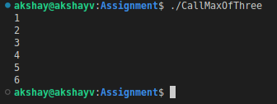
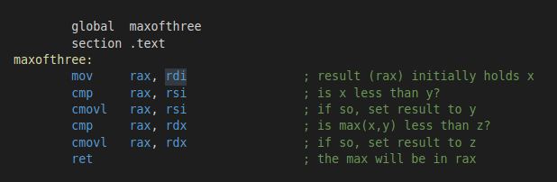
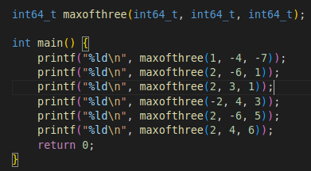
Assignment
Mixing C & Assembly Language:
Consider the Example : MaxOfThree.asm & CallMaxOfThree.c
Build the code : nasm -felf64 MaxOfThree.asm && gcc CallMaxOfThree.c MaxOfThree.o -o CallMaxOfThree
Output
MaxOfThree.asm
The function has following defination:
int64_t maxofthree(int64_t x, int64_t y, int64_t z)
Based on Calling Conventions:
The three parameters are already been passed in:
rdi, rsi & rdx In result value is in rax it needs to be returned.
CallMaxOfThree.c
The main() code that uses the function maxofthree from MaxOfThree.asm

Slide 50
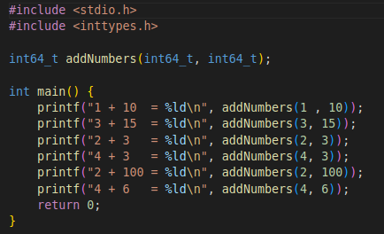
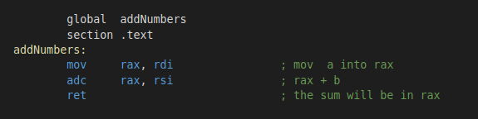
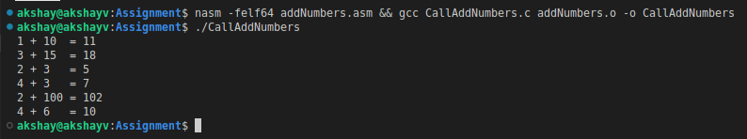
Assignment
Mixing C & Assembly Language:
Consider the Example : addNumbers.asm & CallAddNumbers.c
Build the code : nasm -felf64 addNumbers.asm && gcc CallAddNumbers.c addNumbers.o -o CallAddNumbers

Slide 51
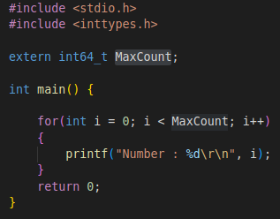

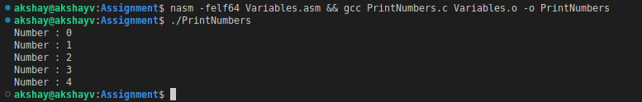
Assignment
Mixing C & Assembly Language:
Using Variable from ASM in C:
Consider the Example : Variables.asm & PrintNumbers.c
Build the code : nasm -felf64 Variables.asm && gcc PrintNumbers.c Variables.o -o PrintNumbers

Slide 52
Assignment
Using Intrinsics:
Compiler Intrinsics also called as built-in functions , are special functions with implementations that are known to the compiler.
These Intrinsics enable you to easily incorporate domain-specific operations in C source code without resorting to complex implementations in assembly language.
Using compiler intrinsics, you can achieve more complete coverage of target architecture instructions than you might get from the instruction selection of the compiler.
They are like the library fuctions, except they're built in to the compiler.
They may be faster than regular library functions, the compiler knows more about them so it can optimize better or handle a smaller input range than the library functions.
Intrinsics also expose processor-specific functionality so you can use them as an intermediate between standard C and assembly language.
Consider The Example: gcc_intrinsics_demo.c
Build the code: gcc gcc_intrinsics_demo.c -o gcc_intrinsics_demo

Slide 53
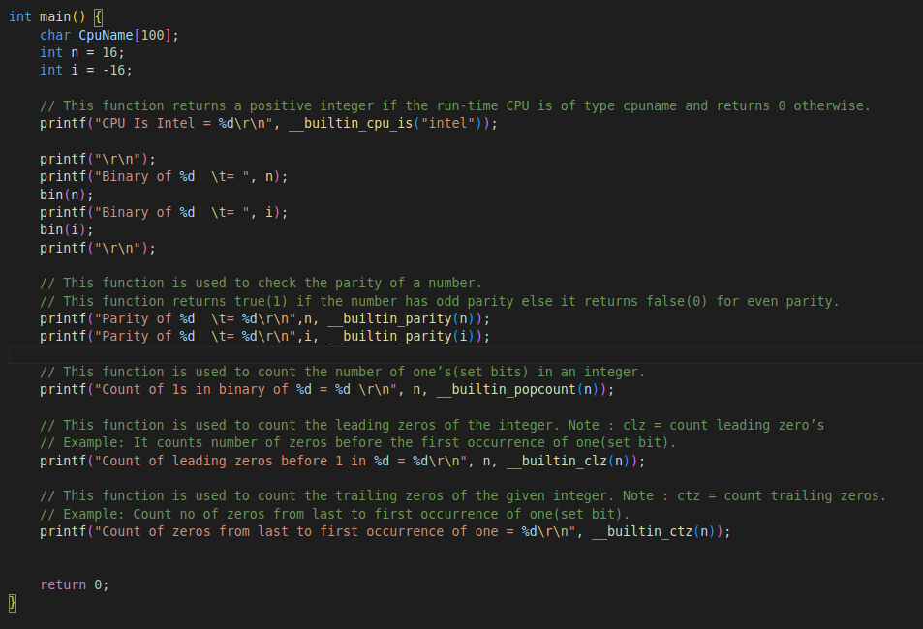
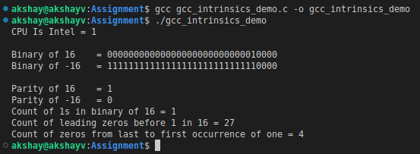
Assignment
Using Intrinsics:

