Slide 1
System Programming using C
Chapter 3 : Memory Management

Slide 2
Contents
Memory Architecture
Text Segment
Initialized Data Segment
Uninitialized Data Segment
Stack
Heap
Memory Allocation
Stack vs Heap Memory Area
Static Memory Allocation
Dynamic Memory Allocation
Fragmentation
Memory Leaks
Dangling Pointers
DMA Access
MMIO Access
Memory Profiling and analysis
Static Code Analysis
Splint
Memory Profiling
Valgrind

Slide 3
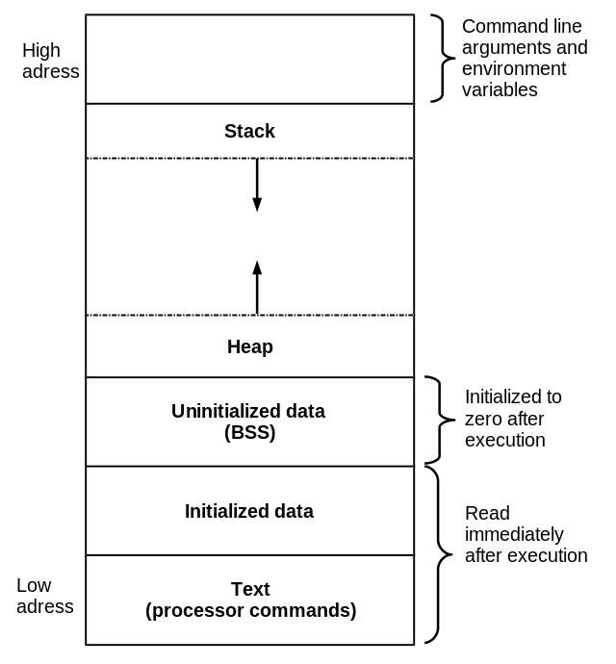
Memory Architecture
Once a C program is compiled, a binary executable file is created.
On execution of program, this binary executable file loads into RAM.
As access time for secondary storage is longer than RAM, computers access instructions from RAM.
Though RAM is faster, programmers should utilize it efficiently as it has a limited storage capacity and is expensive.
The memory layout of C program helps programmers to decide the amount of memory used by the program for execution.
A typical memory representation of a C program comprises of the following sections:
Text segment (Instructions or Processor commands)
Initialized data segment
Uninitialized data segment (bss)
Stack
Heap
Credits : <https://upload.wikimedia.org/wikipedia/commons/thumb/6/6e/C-memlayout.svg/640px-C-memlayout.svg.png>

Slide 4
Text Segment
Text segment, also called as a code segment or simply as text.
The compiled program is converted to executable binary file, it contains instructions, these instructions / processor commands get stored in the Text segment.
Text segment is placed below the heap or stack area, this prevents heaps and stack overflows from overwriting it.
Text segment is read-only area, this prevents a program from accidentally modifying its instructions.

Slide 5
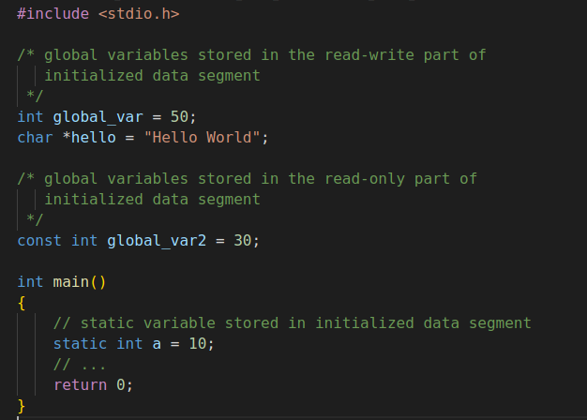
Initialized Data Segment
Initialized data segment, simply called the Data Segment.
Data segment is an area of the virtual address space of a program.
It comprise all the constants, global and static variables.
These are initialized at the time of variable declaration in the program.
These variable values can be change during program execution.
This memory area has read-write permission.
Further it is classified into the read-write & read-only areas.
const variable goes under the read-only area.
All other variables in this segment come in the read-write area.

Slide 6
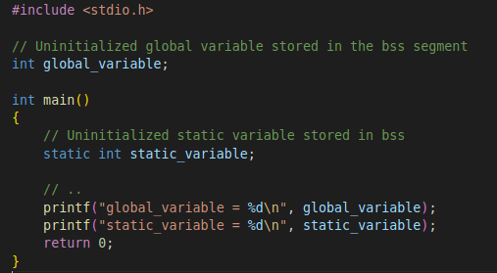

Uninitialized data segment (bss)
Uninitialized data segment alsocalled the “bss” segment.
The kernel initializes the Data from this segment to arithmetic 0 before the program starts executing.
Uninitialized data starts at the end of the initialized data segment.
It comprises all uninitialized global variables and static variables.
This data segment has read-write permissions.

Slide 7
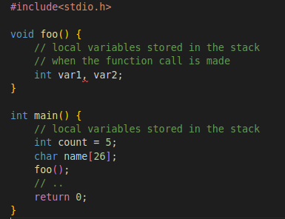
Stack
The stack area is traditionally above the heap area and grows in the downward direction (opposite to heap).
On x86 based computer, it grows toward address zero.
On some other architectures, it grows in the opposite direction.
The stack is LIFO ( last-in-first-out ) data structure.
A “stack pointer(SP)” register points the top of the stack.
Each time a new value is "pushed" onto stack, SP is adjusted.
A stack frame is a set of values pushed for a function call.
A stack frame comprises values of local variables, parameters passed to a function, some of the machine registers & return address.
For each function call new stack frame is created.

Slide 8
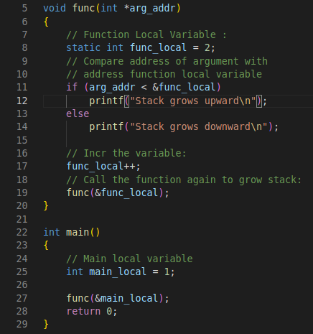
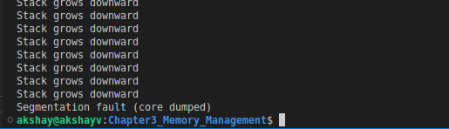
Stack
How stack looks ?
Consider Program: stack_growth_example.c
main_local - local variable inside main.
func() - has its own local variable func_local.
Call the func() from main().
Compare addresses of two local variable.
If address of func()’s local variable is greater than main’s local variable, the stack grows upward (addresses increase).
Inside func() increment the function local variable and call the func() recursively.
This will eventually grow the stack and cause the stack overflow and finally core dump.
Lets use GDB debugger to see how the stack looks.

Slide 9
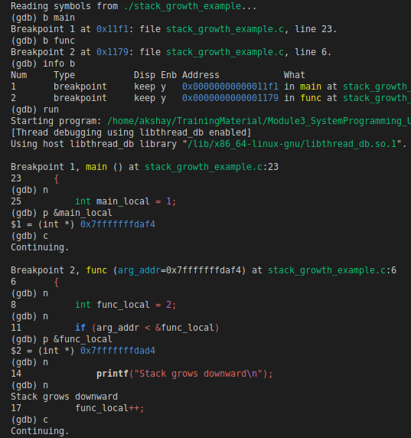
Stack
How stack looks ?
Run GDB debugger with command:
gdb ./stack_growth_example
Add breakpoint in main & func
p &main_local : address of main_local
P &func_local : address of func_local
You can see
&func_local < &main_local
This shows Stack growing downward

Slide 10
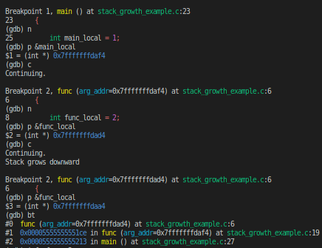
Stack
We can also use below commands to analyze the stack :​
It can be useful, for eg in analysis of stack overflow
backtrace lists the functions on the stack. ​
select-frame n it is variant of frame command, it does not display the new frame after selecting it. ​
info frame allows to print different stack frames to be selected
Frame 0 or #0 => The #0 line is followed by all functions that made calls up to the current function, in reverse order.​
The first function to run in program is main, is last in the output #2.​

Slide 11
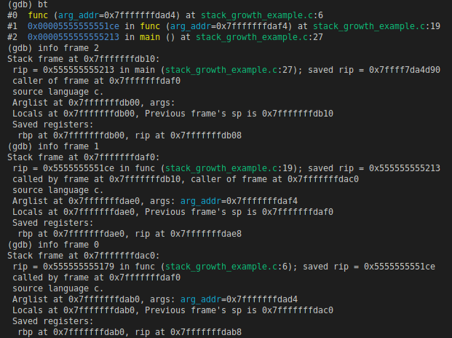
Stack
(gdb) info frame 0
Stack frame at 0x7fffffffdac0: This 0x7fffffffdac0 is the stack address allocated by your current program
rip = 0x555555555179 in func (stack_growth_example.c:6); saved rip = 0x5555555551ce
0x555555555179 it is the address of called function, 0x5555555551ce is the address of the code calling the function, namely: 0x5555555551ce : call 0x555555555179
called by frame at 0x7fffffffdaf0
source language c.
Arglist at 0x7fffffffdab0, args: arg_addr=0x7fffffffdad4
arglist is the address 0x7fffffffdab0 of the function parameter in the stack
Locals at 0x7fffffffdab0,
Address of local variables.
Previous frame's sp is 0x7fffffffdac0
This is where the caller frame´s stack pointer point to, at the moment of calling, it is also the start memory address of called stack frame.
Saved registers:
rbp at 0x7fffffffdab0, rip at 0x7fffffffdab8
These two addresses are on the callee stack, for two saved registers.
rbp: is to stash the value of the stack pointer at the start of the function.
rip : it contains the address of the next instruction to execute. When the instruction is executed, the eip will be pointing to the next instruction in the memory.
In our case rbp is 8 smaller than eip, this is because we have a argument arg_addr which takes 4 bytes

Slide 12
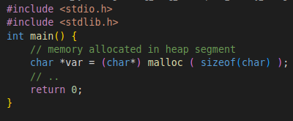
Heap
Heap is the area where dynamic memory allocation takes place.
Heap generally begins at the end of bss segment.
It grows and shrink in the opposite direction of the Stack.
It is managed by functions like malloc / new, free / delete, which use the brk and sbrk system calls to adjust it’s size.
Heap data segment is used among modules loading dynamically and all the shared libraries in a program.
The allocation to the heap area occurs when:
Memory size is dynamically allocated at run-time.
Scope is not limited. (variables referenced from several places).
Memory size is large.

Slide 13
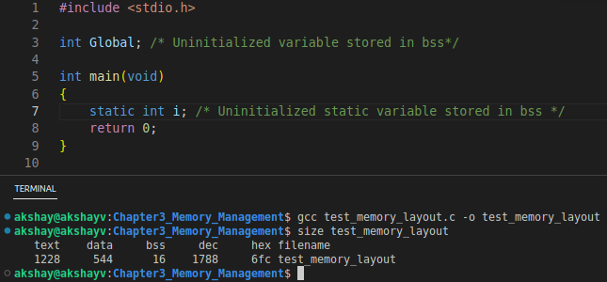
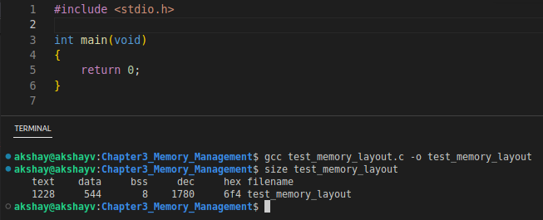
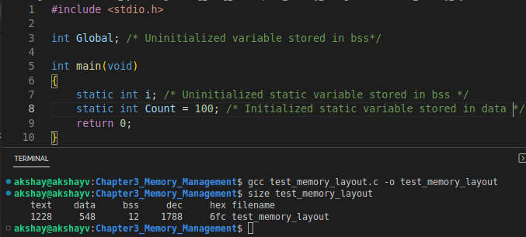
Examples for Memory layout
The linux command size reports the size (in bytes) for the text, data, and bss segments.
simple program
simple C program
simple C program
simple C program

Slide 14
Memory Allocation
Memory allocation is a method by which computer programs and services are assigned with physical or virtual memory space.
The memory allocation is either before or at the time of program execution.
In C memory is allocated in :
Stack memory
Heap memory
When memory is allocated at compile time it is stored in stack area.
When memory is allocated at runtime it is stored in heap area.
Types of memory allocations:
Compile-time or Static Memory Allocation
Run-time or Dynamic Memory Allocation

Slide 15
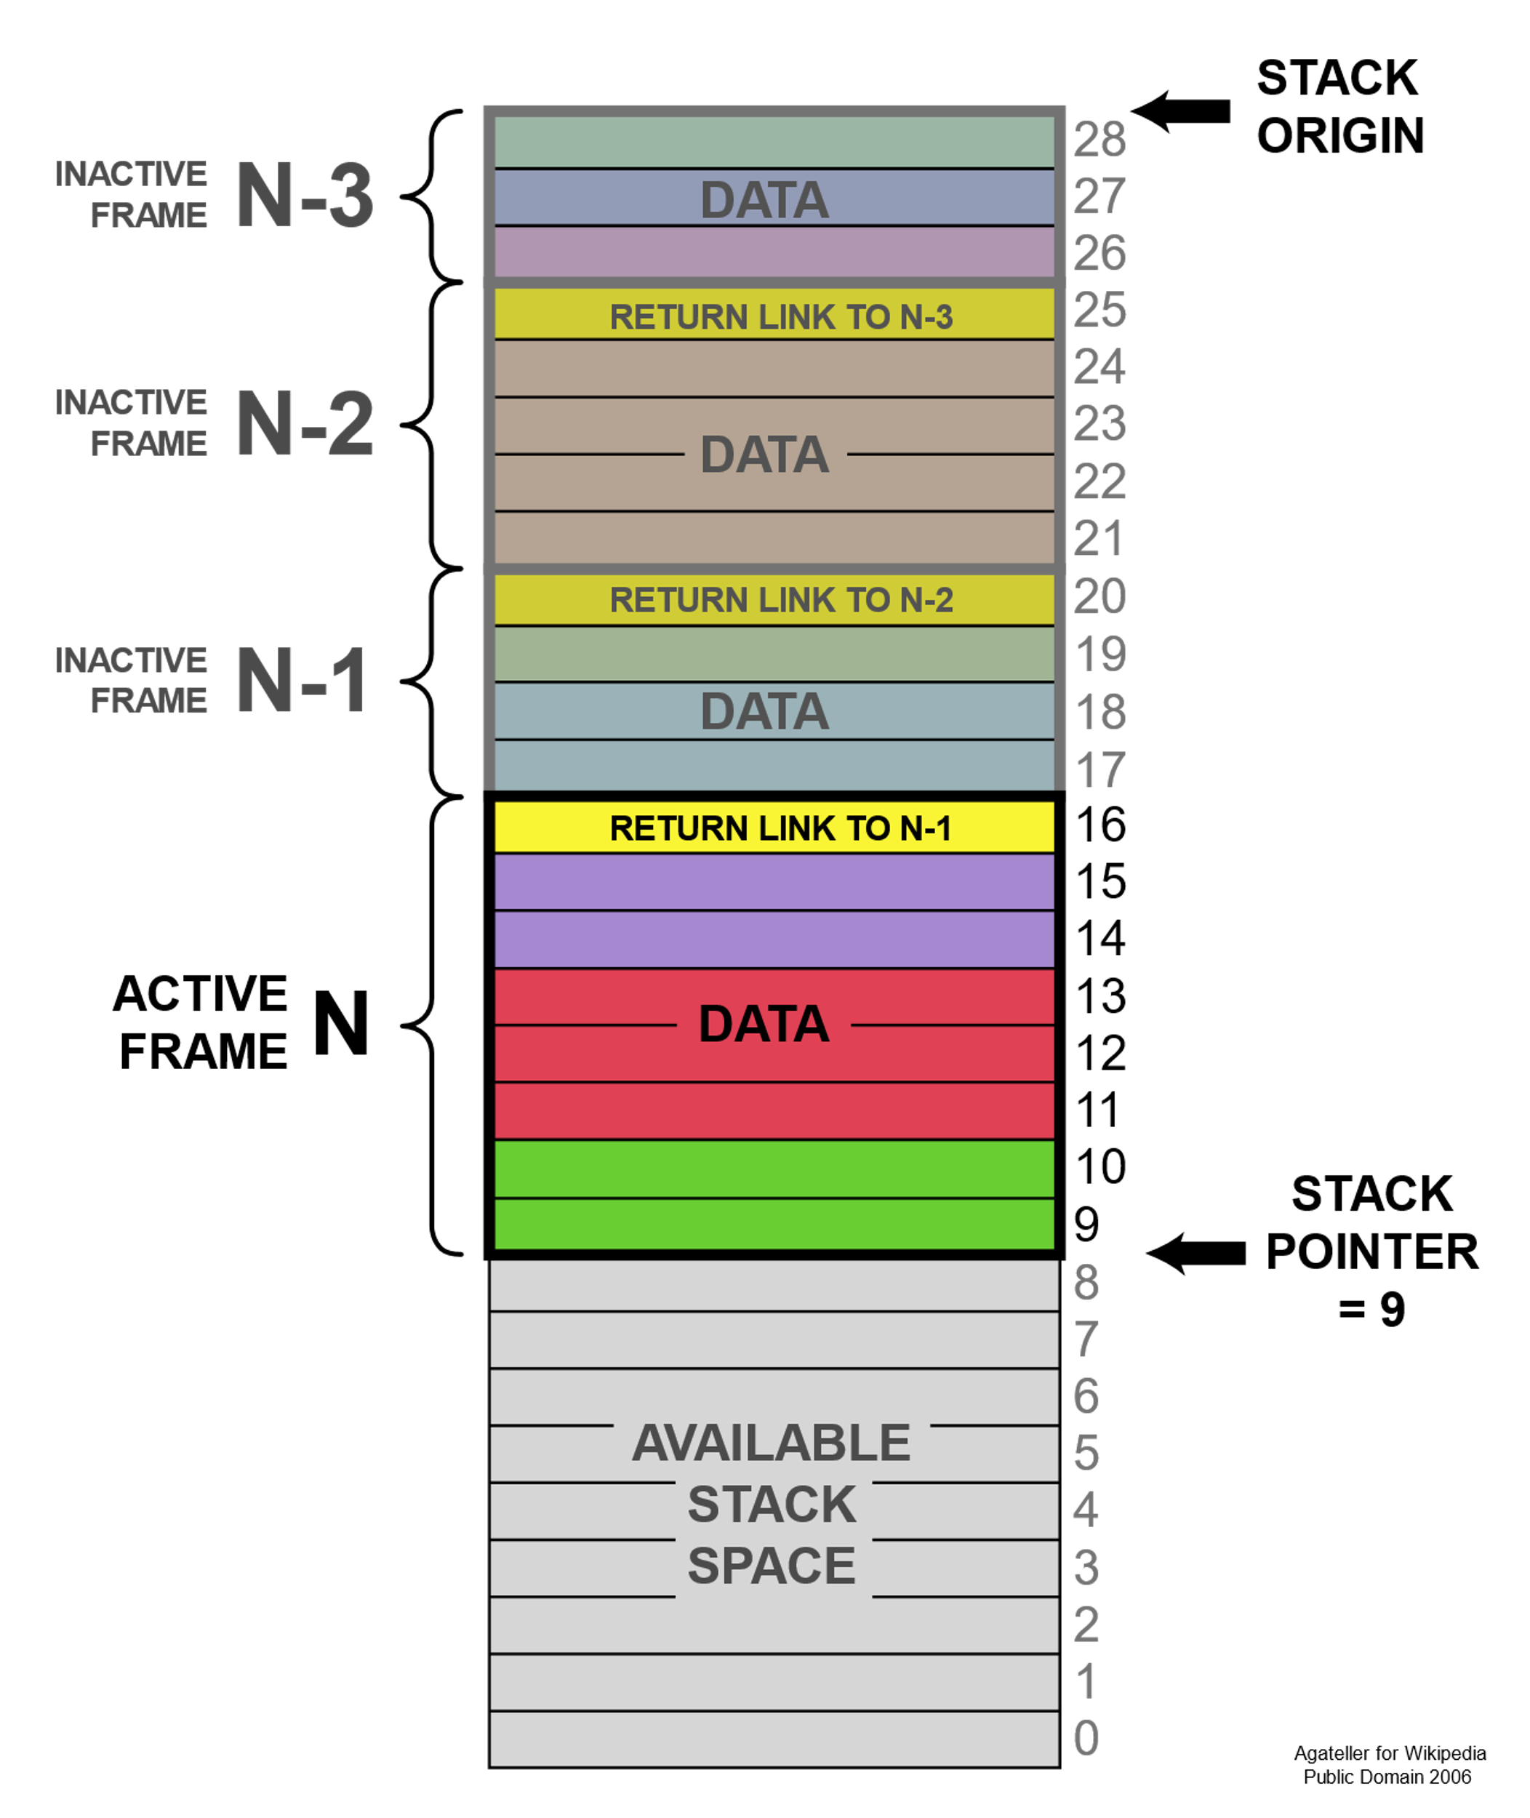
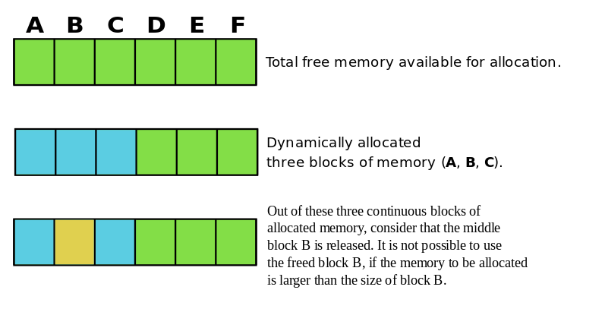
Stack memory area
Heap memory area
A stack is a linear data structure.
Access time is fast.
Space is managed efficiently by OS, so memory will never be fragmented.
Variables cannot be resized.
Memory allocated in a contiguous block.
Allocation & deallocation done by compiler.
You should use the stack when you work with relatively small variables that required until the function using them is alive.
Heap is a hierarchical data structure.
Access time is slow compared to stack.
Heap Space not used efficiently. Memory can be fragmented as frequent blocks of memory are first allocated and then freed.
Variables can be resized.
Memory is allocated in any random order.
Allocation & deallocation is manually done by the programmer.
You should use heap only when we require to allocate a large block of memory.
Credits: https://en.wikipedia.org/wiki/Memory_management#/media/File:External_Fragmentation.svg
Credits:
https://en.wikipedia.org/wiki/Stack-based_memory_allocation

Slide 16
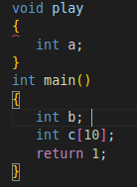
Static Memory Allocation
In static memory allocation – the fixed amount of memory is allocated during the compile time of a program.
All the variables in the program are statically allocated.
There is no memory reusability
Scope of allocated memory remains from start to end of the program.
In this scheme of memory allocation, execution is faster than dynamic memory allocation.

Slide 17
Dynamic Memory Allocation
In Dynamic Memory Allocation - we allocate / deallocate a block of memory during the runtime.
The memory is allocated in the heap area.
Due to frequent allocation and deallocation the heap can become fragmented.
There will be sections of used and unused memory in the allocated space on the heap.
C provides following functions defined under <stdlib.h> header file for dynamic memory allocation:
Function | Description
malloc | Allocates the specified number of bytes
realloc | Increases or decreases the size of the pre specified block of memory, moving the block if required
calloc | Allocates the specified number of bytes and initializes them to zero
free | Deallocate the specified block of memory

Slide 18
malloc()
It is used to allocate a memory block in the heap area of the memory of some specified size (in bytes).
Syntax:
(data-type *)malloc(size-in-bytes);
To create an array of integers is simple:
int arr[50];
The size of array is fixed at compile time. If we wish to allocate a similar array dynamically, following code can be used:
int *arr = malloc(50 * sizeof(int));
This calculates the number of bytes that fifty integers occupy in memory, it requests that many bytes from malloc() and assigns it to a pointer named arr.
If the space is insufficient, memory allocation fails and returns a NULL pointer.
It is good programming practice to check for successful allocation:
int *arr = malloc(50 * sizeof(int)); if (arr == NULL) { fprintf(stderr, "malloc() failed\r\n"); return -1; }

Slide 19
free()
When we don’t need the dynamic memory, it must call free() to return the memory it occupied to the free the block.
free(arr);
calloc()
It is used to allocate a memory block in the heap area of the memory of some specified size (in bytes).
Each block is initialized with a default value ‘0’.
Syntax:
(data-type*)calloc(n, element-size);
here, n is the no. of elements and element-size is the size of each element.
int *arr = calloc(10, sizeof(int));

Slide 20
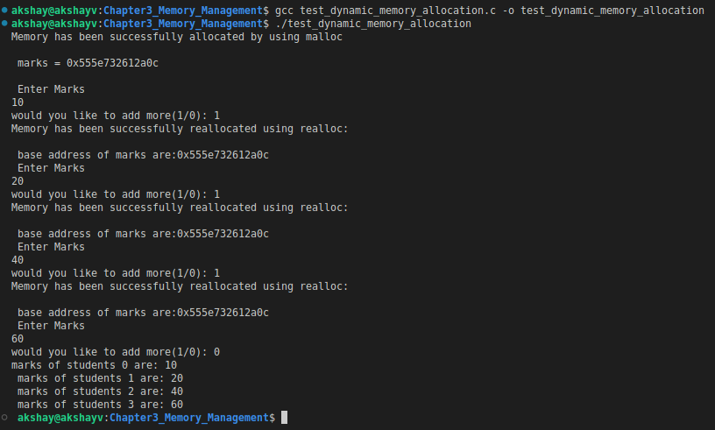
realloc()
Using realloc we can resize the amount of memory a pointer points which was previously allocated.
If there is pointer acting as an array of size {10} and we want to change array size to {100}, we can use realloc().
int *array = malloc(3 * sizeof(int)); array[0] = 1; array[1] = 2;
array[2] = 3; array = realloc(array, 4 * sizeof(int)); array[3] = 4;
Example : Build & run the example code - test_dynamic_memory_allocation.c

Slide 21
Fragmentation
Consider that there is a 10K heap.
Area of 3K is requested:
#define K (1024)
char *ptr1
ptr1 = malloc(3*K);
Then, a further 4K is requested:
ptr2 = malloc(4*K);
Now 3K of memory freed.
After sometime, the first memory allocation, pointed by ptr1, is deallocated:
free(ptr1);
Now we have 6K of memory free in two 3K blocks.
Now a new 4K allocation request is issued:
ptr3 = malloc(4*K);
This allocation will fail – NULL pointer is returned to ptr3, even though 6K of memory is available, there is no 4K contiguous block of memory available. This is called memory fragmentation.
In Fragmentation the storage space is used inefficiently, this reduce the capacity or performance and even both.
Fragmentation can lead to storage space being "wasted".
When a program starts, there are large and contiguous free memory areas.
After some time with use, the long contiguous areas become fragmented into smaller and smaller contiguous regions.
After some time with use, it is impossible for program to allocate large contiguous blocks of memory.
Types of fragmentation:
Internal Fragmentation
External Fragmentation

Slide 22
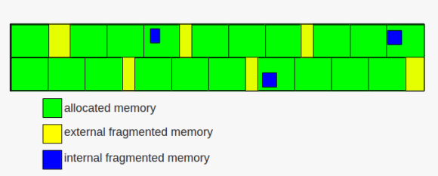
Internal Fragmentation
External Fragmentation
Internal fragmentation occur when the memory splits into mounted-sized blocks.
Whenever a program request for the memory, the mounted-sized block is allotted to the program.
When the memory allotted to the program is larger than the memory requested, then the difference between allotted and requested memory is called internal fragmentation.
This is because we have fixed the sizes of the memory blocks.
If we use dynamic partitioning for allocating space to the program we can avoid this problem.
In dynamic partitioning, the program is allocated only that amount of space which is required by the program.
In external fragmentation, we have total space available that is needed by a program but still we are not able to allocate the memory because that space is not contiguous.
This is because we are allocating memory contiguously.
Paging & segmentation(non-contiguous memory allocation) can be used to avoid this problem, memory is allocated non-contiguously.
Credits:
https://commons.wikimedia.org/wiki/Category:Fragmentation_(computing)#/media/File:%E0%A6%AE%E0%A7%87%E0%A6%AE%E0%A6%B0%E0%A6%BF_%E0%A6%AB%E0%A7%8D%E0%A6%B0%E0%A6%BE%E0%A6%97%E0%A6%AE%E0%A7%87%E0%A6%A8%E0%A7%8D%E0%A6%9F%E0%A7%87%E0%A6%B6%E0%A6%A8.png

Slide 23
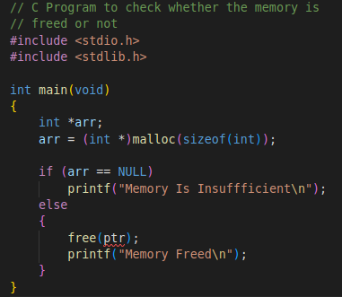
Memory Leak
Memory leak is when programmers create a memory in heap area and forget to delete it after use.
This reduces the performance of the computer by reducing the amount of available memory.
In worst case, all the available memory may be allocated and all or part of the system or device stops working, the application fails, or the system slows down.
As a program executes, it needs extra memory and makes an additional request.
When an application no longer needs the requested memory or the application closes it should explicitly release the allocated memory.
A programmer should never assume that all the operations are undone when the program exits.
We will study tool Valgrind to identify memory leaks in the program in upcoming topics.

Slide 24
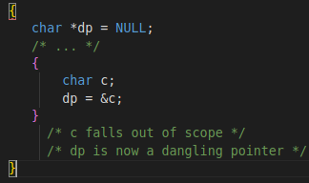
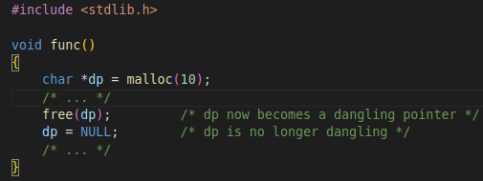
Dangling pointer
Dangling pointer does not reference a valid object.
Dangling pointers emerge during object destruction.
When the incoming reference of an object is deleted or deallocated, without modifying the value of the pointer, the pointer will still point to the memory location that was deallocated.
The system can reallocate the previously freed memory.
Now if program dereferences the dangling pointer, unpredictable behavior may result, as the memory may contain completely different data.
Seconds case if program writes to memory referenced by a dangling pointer, corruption of data may result.
This can leading to subtle bugs that are extremely difficult to find.
Example :
We should reset the pointer to null after freeing its reference

Slide 25
Direct Memory Access (DMA)
Using Direct Memory Access (DMA) controller we can move of blocks of data without burdening the CPU from :
Peripheral to memory.
Memory to peripheral.
Memory to memory.
The process is managed by DMA controller (DMAC).
In DMA the CPU first initiates the transfer of data.
It does other tasks while the transfer is in progress.
Finally it receives an interrupt from the DMA controller (DMAC) when the transfer is completed.
If we have to transfer data stream of 20kB/s can make a CPU without a DMA be so busy that is miss the timing constraints for the application.
RAM
CPU
FLASH
SPI
UART
Peripherals
no-DMA CPU
In no-DMA CPU architecture, the CPU does all the work of fetching instructions (code) from flash, executing the decoded instructions, and move data to and from peripherals and memory.
For eg: UART data receiver that gets a stream of data that the CPU has to transfer to a local buffer so as not to lose any data packet.
This generates large number of interrupts per second being fired by different peripherals ADC, UART, SPI etc.
The CPU has to shuffle everything and lose more and more time by switching between these interrupts and main tasks.

Slide 26
Direct Memory Access (DMA) contd..
On an event, the peripheral sends a request signal to the DMA Controller.
DMA controller serves the request depending on the channel priorities.
When the DMA Controller accesses the peripheral, an Ack is sent to the peripheral by the DMA Controller.
The peripheral releases its request when it gets the Ack from the DMA Controller.
When the request is de-asserted by the peripheral, the DMA Controller releases the Ack.
For more requests, the peripheral can initiate the next transaction.
Here are a handful of possible scenarios when DMA can be used:
UART data reception from a serial device to a local buffer.
ADC circular buffer conversions when we have multiple channels with sensors connected.
SPI external Flash memory interfacing for high-speed data logging.
SPI camera, high speed ADC interfacing.
Local buffer to Local buffer data transfer.
Memory
DMA
ADC
Channel
RX
Sensor
Request Transfer
With the use of the DMA unit we can direct the data from the ADC peripheral directly to the memory while the CPU doing other tasks.

Slide 27
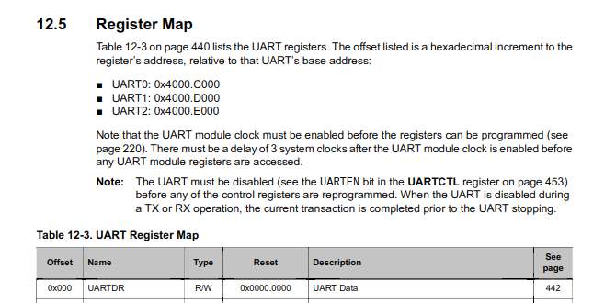
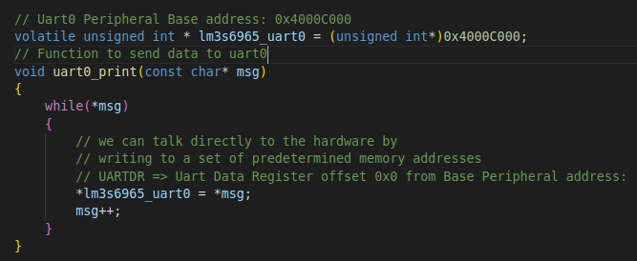
Memory Mapped Input Output (MMIO)
The CPU cannot do anything by itself.
CPU needs to be linked with peripherals, memory, or IO devices. This linking is called Interfacing.
Memory-mapped I/O (MMIO) and Port-mapped I/O (PMIO) are two methods of performing input/output (I/O) between the CPU and peripheral devices in a computer.
Memory-mapped I/O use the same address space to address both I/O devices & main memory.
The registers of the I/O devices & memory are mapped to address values.
Each device monitors the CPU's address bus & responds to any CPU access of an address assigned to that device by connecting the data bus to the desired device's hardware register.
Consider example below: When we want to send data over UART in bare metal application we can directly write data to UART Data register at the address of register ie : PERIPHERAL_BASE_ADDRESS + REG_OFSET.

Slide 28
Static Code Analysis
Static program analysis of a computer program is done without executing them.
The analysis is performed by an automated tool, with human analysis typically being called program comprehension, program understanding or code review.
The automated tool will scan all source code to check for vulnerabilities while validating the code.
The analysis is performed on some version of a source code, and, in some cases, on some form of object code.
This helps developers to understand the code base and ensure it is compliant, safe, and secure.
Static analysis is generally used in finding coding issues such as:
Security vulnerabilities
Coding standard violations : e.g.: C Coding Standard - SEI CERT
Undefined values
Programming errors
Syntax violations
The static analysis is useful for addressing vulnerability in application code for e.g : buffer overflows.

Slide 29
Static Code Analysis
How is static analysis done:
When code is written, a static code analyzer should be used to look over the code.
It will check against characterized coding rules from standards or custom predefined rules.
When the code is gone through the static code analyzer, the analyzer will have recognized whether the code follows the set guidelines.
In some cases it possible for the tool to flag false positives, so somebody should go through & excuse any.
When false positives are deferred, developers can begin to fix any obvious errors, starting from the most critical ones.
When the code issues are settled, the code can continue on toward testing through execution.
Types of static analysis
Control analysis – centers around the control flow in a calling structure. For instance, a control flow could be a method, process, function or in a subroutine.
Data analysis -- ensures characterized data is appropriately utilized while also making sure data objects are appropriately operating.
Fault & failure analysis -- analyzes faults & failures
Interface analysis – confirms simulations to check the code & ensures the interface fits into the model & simulation.

Slide 30
Static Code Analysis
Benefits of Static Analysis:
Implementation
Static analysis can be put into practice early in the software development lifecycle (SDLC), it will give more time to fix the errors discovered by the tool.
Static analysis can detect the exact line of code that’s been found to be vulnerable.
Security
Security is major concern and by adopting static analysis tools you can cut uncertainty of security vulnerabilities in your application, which will ensure that you are delivering a secure & reliable software.
Automation
Automation can save time and energy which means you can invest efforts in some other aspects of development lifecycle, this ensures faster software release.
Define rules to assist developers
Developers work on projects without knowledge about security while they code.
Static code analyzers help you characterize project specific rules.
This ensure all developers follow them without any manual intervention or sidetracking.

Slide 31
Static Code Analysis
Tools for Static Analysis:
PC-lint Plus - Support for coding Standards such as MISRA, AUTOSAR, and CERT C
SonarQube
Sparse - tool designed to find possible coding faults in the Linux kernel.
Lint
Splint - An open-source tool statically analyze C programs for coding mistakes & security vulnerabilities.
Cpplint
And the list goes on you can select the tools based on variety of factors like industrial standards supported , license/ Opensource , Programming Language supported etc.

Slide 32
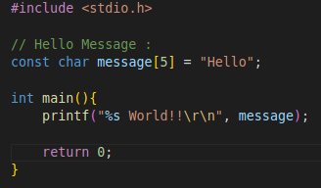
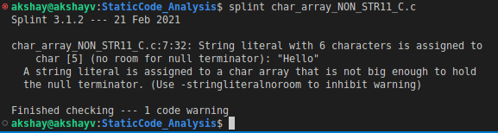

Static Code Analysis - Splint
SPLINT - Secure Programming Lint
Splint is a tool for statically analyzing C programs for coding mistakes & security vulnerabilities.
With minimal effort, Splint can be used as a better lint.
If some efforts are invested adding annotations to programs, Splint can perform strong checking than that can be done by any standard lint.
Check manual pages (man splint) for complete details of the splint.
Install the SPlint using: sudo apt-get install splint
To do static analysys run the command :
splint <filename.c>
Examples for static analysis using SPlint:
Program : char_array_NON_STR11_C.c -
Example code not compliant with STR11-C.
Run static analysis with :
splint char_array_NON_STR11_C.c
Example initializes an array of characters, but a string literal defines one more character (counting the terminating '\0') than the array can hold:
The size of the array message[5] is 5, although the size of the string is 6. Any use of the array as a null-terminated byte string can result in a vulnerability, as it is not properly null-terminated.
After execution you can see the output of program:

Slide 33
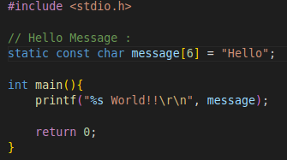
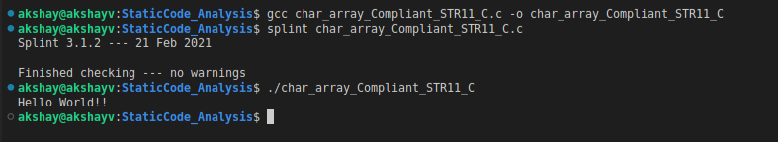
Static Code Analysis - Splint
After addressing the issues pointed by Splint.
Consider the program: char_array_Compliant_STR11_C.c
Splint shows no warnings and output of program is also correct.

Slide 34
Static Code Analysis – Splint
Statically Detecting Likely Bufferer Overflow Vulnerabilities
A buffer, is a region of memory which has certain boundaries in context with the program variable that references this memory.
For eg: char Buffer [20]
"Buffer" represents an array of 10 bytes where:
Buffer [0] - is the left boundary.
Buffer [19] - is the right boundary.
A buffer overflow happens when the data (meant to be written into buffer) gets written past the left or the right boundary of the buffer.
The data is written to a portion of memory which does not belong to the variable.
If Buffer overflows are left undetected, can produce unexpected results or cause your program to crash.
For eg:
char Buffer[20]; Buffer[20] = 'a';
Please note that index 0 to index 19 can used to refer these 20 bytes of buffer.
But we used index 20 store the value ‘a’.
This is the point where buffer overrun happened because data was written beyond the right boundary of the buffer.

Slide 35
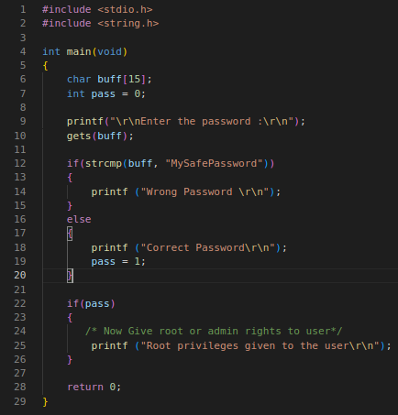
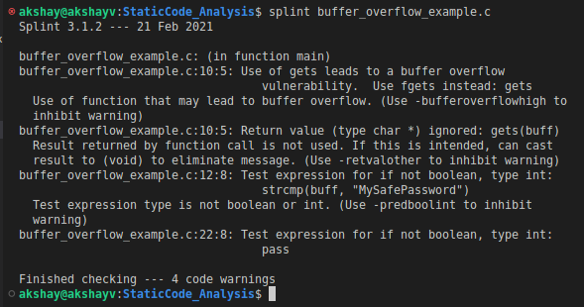
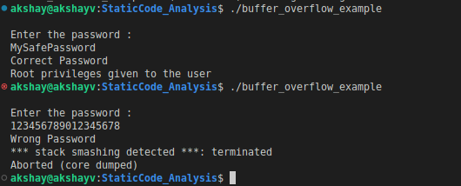
Static Code Analysis – Splint
Consider example : buffer_overflow_example.c
The program accepts the password from user.
Imagine a scenario where the assailant comes to know about a buffer over flow in program and he/she takes advantage of it.
What if it is undetected & this code is deployed in ATM machine? Very bad consciences can be faced.
Splint analysis below shows 4 warnings.
Assignment : resolve these warnings.

Slide 36
Memory Profiling
Run-time memory errors and leaks are the most difficult errors to locate & the most important to correct.
These symptoms of incorrect memory use are unpredictable & typically appear far from the root of the error.
These errors often remain undetected until they are triggered by a random event.
The program can appear to work correctly when in fact it's only working by chance.
Memory Profiling analyzes memory usage & detects memory leaks.
In this module, we introduce Valgrind tool: Memcheck
Valgrind:
Valgrind is a tool for profiling & debugging Linux programs. It is useful to automatically detect memory management & threading errors, making programs more stable & robust.
It consists of a core, that provides a synthetic CPU in software & a series of debugging and profiling tools.
Memcheck tool
Memcheck tool adds extra instrumentation code around most instructions, which keeps track of the addressability & validity.
Memcheck changes the standard C memory allocator with its own implementation, this also includes memory guards around all allocated blocks.
The Memcheck may detect & warn the following issues:
Potential memory leaks.
Use of uninitialized memory
Reading/writing in illegal sections
Reading/writing memory after it has been released

Slide 37
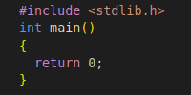
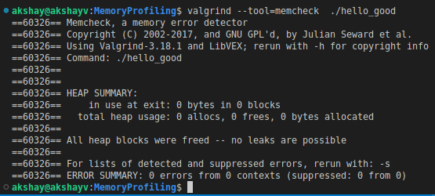
Valgrind - Memcheck
How to use Memcheck tool:
Compile program with the flag -g, it generates debug information, we can see line numbers in the output.
To test the program with valgrind memcheck tool:
Use command : valgrind --tool=memcheck <program name>
Consider simple program with no errors: hello_good.c
Compile code with:
gcc -Wall -g hello_good.c -o hello_good
To use valgrind:
valgrind --tool=memcheck ./hello_good
This example does not have any error Valgrind can detect with Memcheck.
Thus Valgrind-Memcheck, reported zero errors.

Slide 38
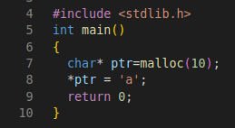
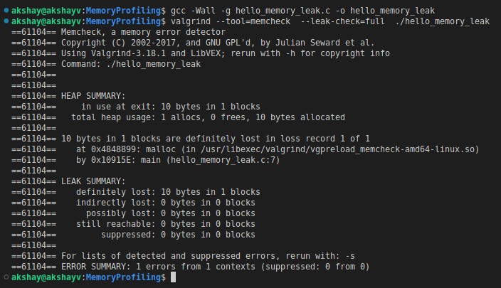
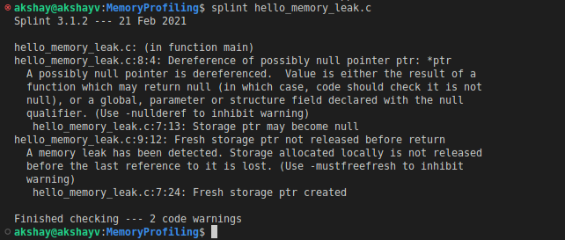
Valgrind - Memcheck
Memory Leak in Code:
Consider the program: hello_memory_leak.c
We introduce memory leak into the code with a malloc in the main code.
We will allocate 10bytes of memory to ptr using malloc.
We didn’t free the allocated memory.
Compile the code:
gcc -Wall -g hello_memory_leak.c -o hello_memory_leak
Test with valgrind
valgrind --tool=memcheck --leak-check=full ./hello_memory_leak
Valgrind tells about a memory leak of 10 bytes in output.
Note : We can also use Static analysis to detect memory leak with Splint tool

Slide 39
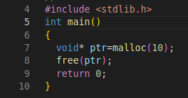
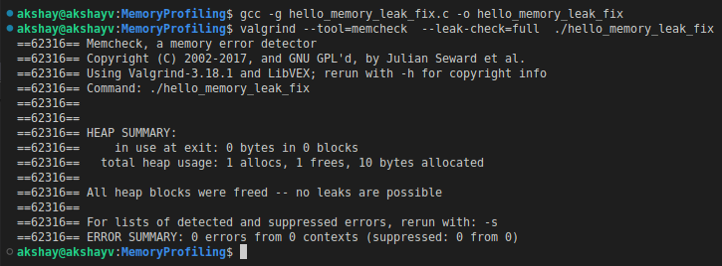
Valgrind - Memcheck
Memory Leak in Code Fix:
When we use malloc for dynamic memory allocation.
We should take care that we free the alocated memory before exiting the block/program.
Consider the program: hello_memory_leak_fix.c
Compile with:
gcc -g hello_memory_leak_fix.c -o hello_memory_leak_fix
To use valgrind:
valgrind --tool=memcheck --leak-check=full ./hello_memory_leak_fix
Valgrind output also shows no errors and all the allocated memory is freed.

Slide 40
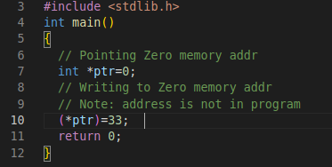
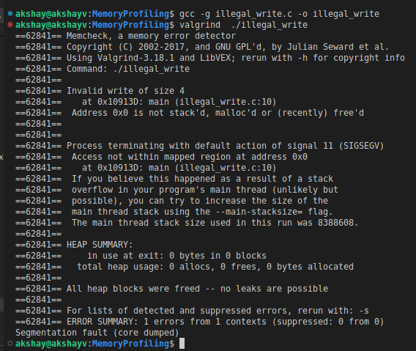
Valgrind - Memcheck
Illegal read/write
One of the problems detected is warning about the code that it is reading or writing illegal positions from a program.
The example consists of an illegal writing on the zero memory address.
Illegal access is produced by writing a memory address that is not a part of program and releasing the alarm Memcheck:
Consider the program: illegal_write.c
Valgrind reports an Invalid write of size 4 for this issue in the main code.

Slide 41
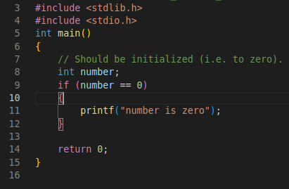
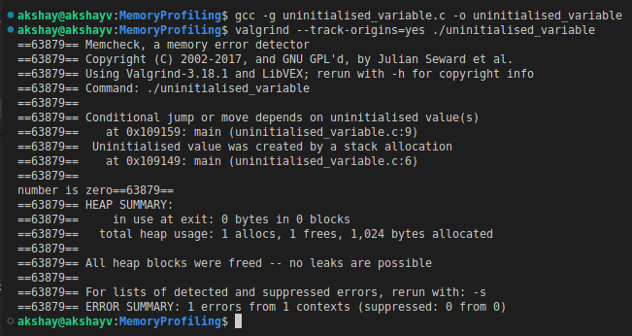
Valgrind - Memcheck
Uninitialised variables:
Valgrind can detect issues caused by uninitialised variables.
For example:
Consider program: uninitialised_variable.c
Compile:
gcc -g uninitialised_variable.c -o uninitialised_variable
Test with Valgrind:
valgrind --track-origins=yes ./uninitialised_variable
Valgrind shows the following error in output:
Similary there are may use issues that valgrind can report.
To read more about valgrind read Valgrind(1) - Linux man page
:

