Slide 1
System Programming using C
Chapter 4: Advanced data types

Slide 2
Contents
Typedef
Typecast
Structure
Structure Padding
Structure Packing
Union
Structure vs. Union
Processor Endianness
Variable Length Array (VLA)
Flexible Array Members (FAM)

Slide 3
Typedef
Keyword typedef can be used to give a type a new name.
It is used to provide meaningful names to already existing variables in the program.
Syntax: typedef <existing name> <alias name>
Existing name: name of an existing variable.
Alias name: name given to the existing variable by a developer.
Example:
typedef char BYTE;
Once an alias name ‘BYTE’ is given to a pre-defined term ‘char’, the identifier ‘BYTE’ can be used as an abbreviation for the same.
BYTE b1, b2;
This will declare the variables b1 & b2 of char data type.

Slide 4
Typecast
Converting the data type from one form to another is known as type casting or the type conversion.
Programmer can initiate a data type of int and make it work like another data type like char or float for one single operation.
Syntax: (type name) expression
Types of typecasting:
Implicit Type casting:
Type conversion is performed automatically by the compiler you are working on without the programmer’s intervention.
int x = 10;
printf (“%c”, x); // it is implicitly converted from int to char
Explicit Type casting:
Type of conversion that happens due to human intervention.
A developer will perform it by posing the type of the variable.
int x = 10;
printf (“%c”, (char)x); /* it is explicitly converted from int to char
Rules to be followed while doing a type conversion:
All the character types must be converted to integer types.
All the integer types to be converted to float.
All the float types to be converted to a double.

Slide 5
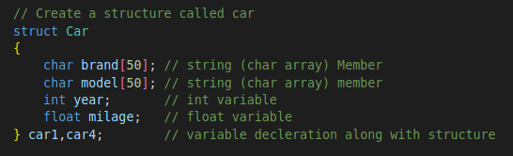
Structure
Structure stores the different types of elements.
A structure can contain many different data types (int, float, char, nested strcutures).
Each variable in the structure is known as a member of the structure.
The struct keyword is used to define structure.
Syntax:
struct structure_name { data_type member1; data_type memeberN; };
Declaration of Structure variables:
struct structure_name { data_type member1; data_type memeberN; }struct_var1,struct_var2;
Or
struct structure_name struct_var1, struct_var2;

Slide 6
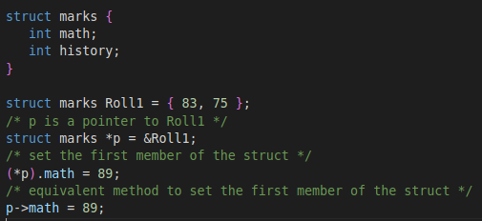
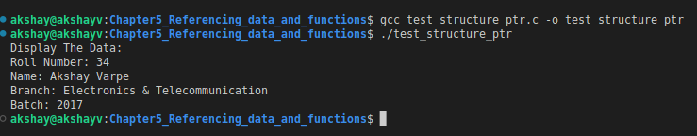
Pointers to Structures
A structure pointer is defined as the pointer which points to the address of the memory block that stores a structure.
Complex data structures like Linked lists, trees, graphs, etc. are created with the help of structure pointers.
The structure pointer tells the address of a structure in memory by pointing the variable to the structure variable.
The Members of struct can be accessed in two ways:
With the help of (*) asterisk or indirection operator and (.) dot operator.
With the help of ( -> ) Arrow operator.
Example Program: Usage of Structure Ptr test_structure_ptr.c

Slide 7
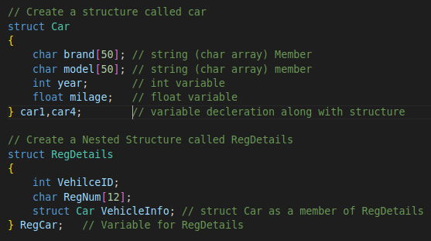
Structure contd..
Array of Structures:
We can define array of structures using syntax:
struct < struct name > <array name>[array size];
For example :
Consider the above structure, to declare the array we use:
struct Car CarList[5]; // Array of 5 Structures
To assign values:
CarList[0] = {"BMW", "X5", 1999, 15.3};
CarList[1] = {"Ford", "Mustang", 1969, 10.6};
To get milage vale from structure CarList[1]
float milageCar1 = CarList[1].milage;
Nested Structures:
A structure inside another structure is known as nested structure.
For example:
We can access the items using (.) dot operator.
To get milage of structure variable RegCar:
float milageCar1 = RegCar.VehicleInfo.milage;

Slide 8
Structure contd..
Copying Structures:
Structure is treated like a value which occupies given number of bytes.
To copy structure along with all members we can use simple assignment operator
For example: Consider structure Car
struct Car carCopy, car1;
car1 = {"BMW", "X5", 1999, 15.3};
To Copy car1 to carCopy structure:
carCopy = car1;
To copy using pointer:
struct Car *carPtr1, *carPtr2;
carPtr1 = &car1;
carPtr2 = &carCopy;
*carPtr2 = *carPtr1;

Slide 9
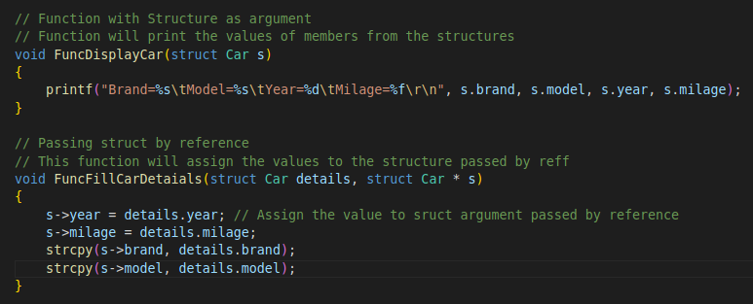
Structure contd..
Passing structure to function:
We can pass structure to function as a value or as a reference.
Consider the following functions that have structures as parameters.
struct Car car1 ;
struct Car car2 = {"BMW", "X5", 1999, 15.3};
FuncFillCarDetaials(car2, &car1);
FuncDisplayCar(car1);

Slide 10
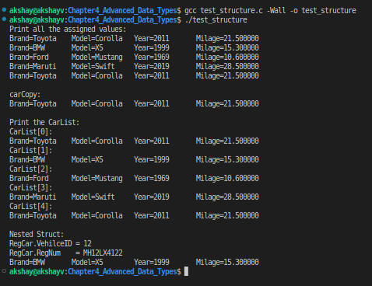
Structure contd..
Example program : test_structure.c shows how to use the structure.
Note: Read the comments in the code carefully.
The code perform demonstrate following operations:
Assign value to structure
How to use string as structure member.
Structure variable declaration
Copy Structure
Structure array operations
Pass structure to function
Pass structure to function by reference
Return the structure from function
Nested Structure

Slide 11
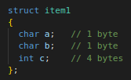
Structure Padding
Structure members are assigned to memory addresses in incremental order.
The first member starts at the beginning address of the structure name itself.
Structure padding is a concept in C that adds the one or more empty bytes between the memory addresses to align the data in memory.
The processor does not read 1 byte at a time. It reads 1 word at a time.
What does the 1 word mean?
If we have a 32-bit processor, then the processor reads 4 bytes at a time 1 word = 4 bytes.
If we have a 64-bit processor, then the processor reads 8 bytes at a time, 1 word = 8 bytes.
As we know that structure occupies the contiguous block of memory as shown in diagram.
Consider the 32 bit architecture:
The problem is that in one CPU cycle we can access:
one byte of char a,
one byte of char b,
2 bytes of int c.
We will not face any problem while accessing the char a and char b as both the variables can be accessed in one CPU Cycle.
We will face the problem when we access the int c variable as 2 CPU cycles are required to access the value of the 'c' variable.
Size = 6 bytes
0 | 1 | 2 | 3 | 4 | 5
a | b | c

Slide 12
Structure Padding contd..
Suppose we only want to access the variable 'c', which requires two cycles.
The variable 'c' is of 4 bytes, so it can be accessed in one cycle also, but in this scenario, it is utilizing 2 cycles.
This is an unnecessary wastage of CPU cycles.
Due to this reason, the structure padding concept was introduced to save the number of CPU cycles.
How is structure padding done?
To achieve the structure padding, an empty row is created on the left, as shown in the diagram.
The two bytes which are occupied by the 'c' variable on the left are shifted to the right.
So, all the four bytes of 'c' variable are on the right.
Now, the 'c' variable can be accessed in a single CPU cycle.
After structure padding, the total memory occupied by the structure is 8 bytes (1 byte+1 byte+2 bytes+4 bytes).
Although the memory is wasted in this case, the variable can be accessed within a single cycle.
Size = 8 bytes
0 | 1 | 2 | 3 | 4 | 5 | 6 | 7
a | b | Empty |  | c
Structure Padding

Slide 13
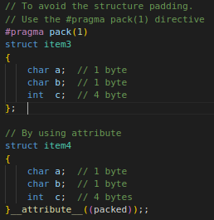
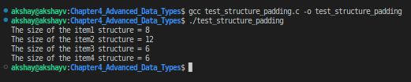
Structure Padding contd..
The structural padding is an in-built process that is automatically done by the compiler.
Sometimes it required to avoid the structure padding in C as it makes the size of the structure greater than the size of the structure members.
Structure Packing :
Structure Packing, prevents compiler from doing padding means remove the unallocated space allocated by structure.
We can avoid the structure padding in C in two ways:
Using #pragma pack(1) directive
Using __attribute__((__packed__))
Example Program: Demo for strcut padding:
test_structure_padding.c

Slide 14
Union
Syntax:
union unionName { data_type member1; data_type memeberN; };
Example:
union Data { int i; // 1 byte float f; // 4 bytes char str[20]; // 20 bytes } data;
Union is a user-defined data type in C, which stores a collection of different kinds of data, just like a structure.
To access any member of a union, we use the member access operator (.).
With unions, only one member can contain a value at any given time.
Unions provide an efficient way of using the same memory location for multiple-purpose.
The memory occupied by a union is large enough to hold the largest member of the union.
Consider the example union data:
Size of union = 20, as the max space is occupied by the char str[20] i.e. 20bytes.

Slide 15
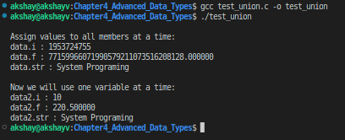
Union contd..
Example Program: test_union.c shows how to use the union.
Assign values to all member at once:
Here, we can see that the values of i and f members of union got corrupted.
Final value str assigned to the variable has occupied the memory location.
Hence the value of str member is getting printed very well.
Use one variable at a time:
Here, all the members are getting printed very well because one member is being used at a time.

Slide 16
Struct vs Union
Struct
Union
Compiler allocates memory to each member separately. Size of struct is equal to the sum of sizes of its members.
Each member is assigned a unique storage area.
Altering the value of member will not affect other members of structure.
Individual member can be accessed at a time.
Several members of structure can initialize at once.
Compiler allocates the memory considering the size of largest member in union. Size of union is equal to size of largest member in union.
Memory allocated is shared by all the members.
Altering the value of member will affect other member values.
Only one member can be accessed at a time.
Only the one member of union can be initialized.

Slide 17
Processor Endianness
Endianness is a term that describes the order in which a sequence of bytes is stored in computer memory.
Types of Endianness:
Little endian:
Last byte of binary representation of the multibyte data-type is stored first.
X86 processor and most of the ARM Cortex-M3 based microcontrollers use the little-endian format.
Big endian:
First byte of binary representation of the multibyte data-type is stored first.
Motorola 6800 / 6801 processors use the big-endian format.
Example:
Integer is stored as 4bytes. will be stored as following:
int x = 0x01234567;
Little Endian
Address | Data
0x100 | 0x67
0x101 | 0x45
0x102 | 0x23
0x103 | 0x01
Big Endian
Address | Data
0x100 | 0x01
0x101 | 0x23
0x102 | 0x45
0x103 | 0x67

Slide 18
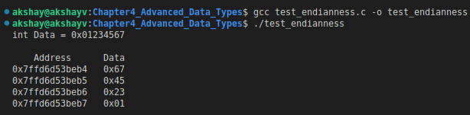
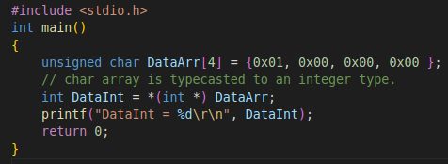

Processor Endianness contd..
Most of the times compiler takes care of endianness.
When we perform bit-wise operation on integer then compiler automatically handles the endianness.
However, endianness becomes an issue in following cases:
Writing raw bytes of data to a file in one processor and you send it to a system that uses different endian processor.
Send bytes of data over network as a serialized steam of data from one endian processor system to other endian processor system.
In network communication, TCP/IP suites are defined to be big-endian.
Sometimes it matters when you are using type casting, below program is an example.
Consider the example in image:
A char array is typecasted to an integer type.
On little endian machine we get:
DataInt = 1
On Big endian machine we get:
DataInt = 16777216
Example Program: To find Endianness of system
test_endianness.c
Example Program:
test_endianness_issue.c

Slide 19

Processor Endianness contd..
Sometimes you may need to convert the endianness of data.
Using the union we change the endianness of data:
Example program:
test_change_endianness_union.c

Slide 20
Processor Endianness contd..
Network Byte Order:
Network stacks & communication have a defined endianness, to allow two nodes with different endianness to communicate.
In network communication, TCP/IP suites are big-endian.
Any 16-bit / 32-bit value within the layers headers like IP address, checksum, packet length is to be transferred with MSB byte first.
For example : the consider the little endian node wants to talk with big endian node:
Little endian node:
Would convert the IP address 192.168.0.1 to the little endian integer 0x0100A8C0.
The byte transmission will be in order 01 00 A8 C0
Big endian node:
Would receive the bytes in order 01 00 A8 C0
This will reconstruct the bytes to big endian integer as 0x0100A8C0
The IP address will be misinterpret as 1.0.168.192
For a stack to be portable it is must to decide whether to do this reordering during compile time.
To do these conversions sockets provide macros to convert to & from the host to network byte order.

Slide 21
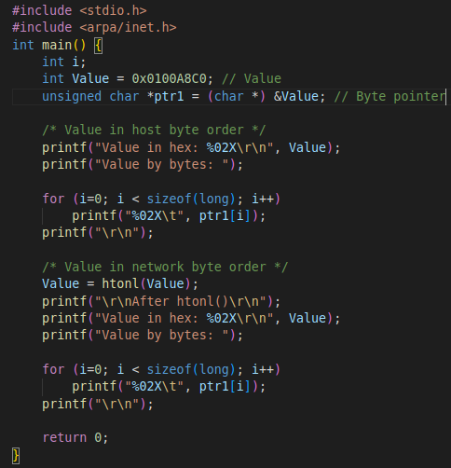
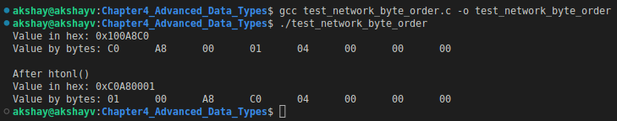
Processor Endianness contd..
Network Byte Order:
To do these conversions sockets provide macros to convert to & from the host to network byte order.
Consider the Example:
test_network_byte_order.c
It shows how the int Value with value 0x0100A8C0 (hex) is stored.
Output observations:
- When the code is executed on little endian CPU check the byte order we get LSB 0xC0 in the lowest address ptr1[0].
- After use of htonl() to convert the host to network order we get the MSB 0x01 in the lowest address ptr1[0].
- But if you print the Value after conversion you get a meaningless number.
Macro | Description
htons() | Host to network short - Reorder bytes of 16-bit unsigned value from processor to network order.
htonl() | Host to network long - Reorder bytes of 32-bit unsigned value from processor to network order.
ntohs() | Network to host short - Reorder bytes of 16-bit unsigned value from network to processor order.
ntohl() | Network to host long - Reorder bytes of 32-bit unsigned value from network to processor order.

Slide 22
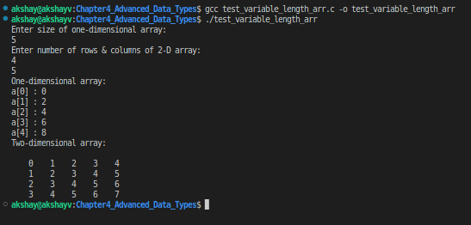
Variable Length Array (VLA)
Is an array data structure whose length is determined at run time (instead of at compile time).
In C, the VLA is said to have a variably modified type that depends on a value.
Variable length arrays is a feature where we can allocate an auto array (on stack) of variable size.
C supports variable sized arrays from C99 standard.
Example:
One Dimensional Array:
int n =10;
// Array size will depend on value of n, in this case size = 10
int arr[ n ];
Two Dimensional Array
int row = 3, col = 3;
int arr[ row ][ col ]; // Size = 9
Example Program: Demo for usage of Variable length array.
test_variable_length_arr.c

Slide 23
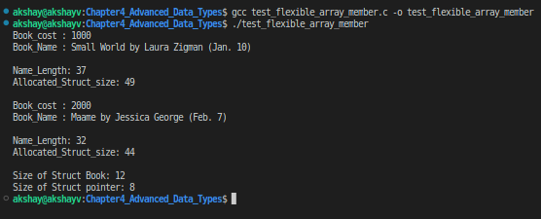
Flexible Array Members (FAM)
Flexible Array Member(FAM) is a feature introduced in the C99 standard of the C programming language.
For the structures in C programming language from C99 standard onwards, we can declare an array without a dimension and whose size is flexible in nature.
Such an array inside the structure should preferably be declared as the last member of structure and its size is variable
The structure must contain at least one more named member in addition to the flexible array member.
It is declared with an empty index: datatype arrayName[ ];
Example:
struct User
{
int Id;
int name[]; // Flexible array members
};
The size of structure is = 4 + 0 = 4
Example Program: Usage and memory allocation of Flexible Array members.
test_flexible_array_member.c

