Slide 1
System Programming using C
Chapter 5 : Referencing data and functions

Slide 2
Contents
Various pointers
Pointers Introduction
Pointer to Data Structure
Linked List
Function Pointers
Pointer to Pointer
Void Pointers
Binding of Variables & Functions
What is Binding?
Scope of variables and functions
Static Binding
Dynamic Binding
Assignment

Slide 3
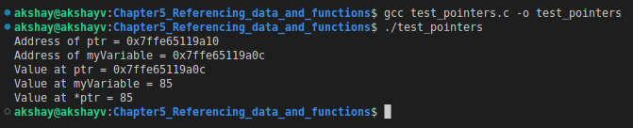
Pointers
A pointer is a variable that stores the memory address of another variable as its value.
A pointer variable points to a data type (like int) of the same type, created with the * operator.
We can get the memory address of a variable with the reference operator &.
Using pointers significantly improves performance for repetitive operations, like traversing iterable data structures. Eg: strings, lookup tables, control tables and tree structures.
Syntax:
<dataType> * <pointerName>;
Example:
int myVariable = 85; // Variable declaration
int *ptr = &myVariable; // Pointer declaration
We can use pointers will all the possible datatypes: char, int, array, structure, float, tree, lists etc.
Example Program: How to use pointer.
test_pointers.c
Variable | Value | Address
myVariable | 85 | 0x7ffe65119a0c
ptr | 0x7ffe65119a0c | 0x7ffe65119a10
*ptr | 85 | --

Slide 4
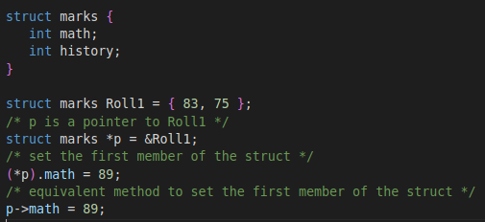
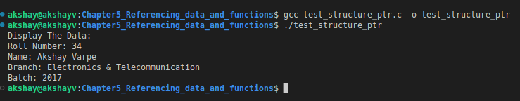
Pointers to Data Structures
A structure pointer is defined as the pointer which points to the address of the memory block that stores a structure.
Complex data structures like Linked lists, trees, graphs, etc. are created with the help of structure pointers.
The structure pointer tells the address of a structure in memory by pointing the variable to the structure variable.
The Members of struct can be accessed in two ways:
With the help of (*) asterisk or indirection operator and (.) dot operator.
With the help of ( -> ) Arrow operator.
Example Program: Usage of Structure Ptr test_structure_ptr.c

Slide 5
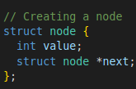
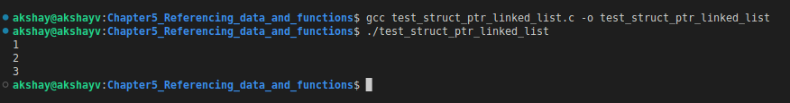
Pointers to Data Structures contd..
Linked List:
One practical use of struct pointers is Linked List.
Consider struct node shown in example.
Member struct node *next is struct ptr.
So we use this member to save address of next node in list.
Let say we have 3 nodes in the list.
node1
int value; | struct node *next;
1
node2
int value; | struct node *next;
2
node3
int value; | struct node *next;
3 | NULL
Example Program: Linked List implementation.
test_struct_ptr_linked_list.c

Slide 6
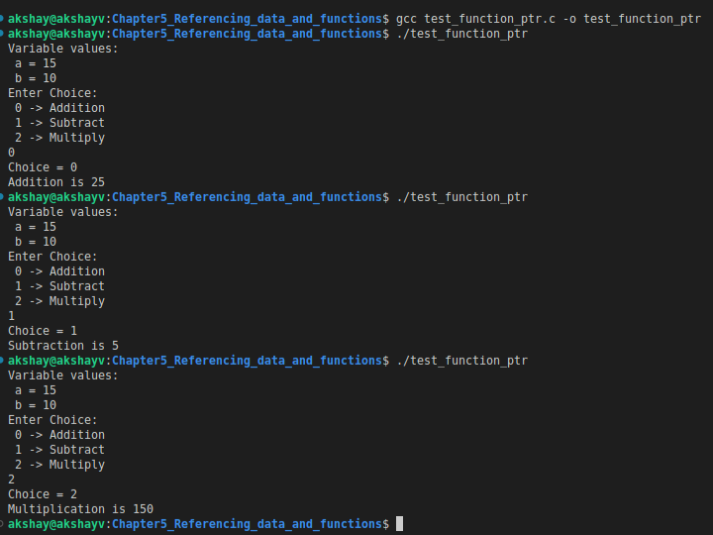
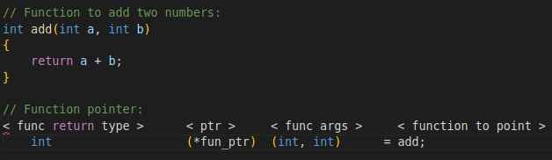
Function pointers
As opposed to referencing a data value, a function pointer points to executable code within memory.
Dereferencing the function pointer yields the referenced function, which can be invoked and passed arguments just as in a normal function call.
Such an invocation is also known as an "indirect" call, because the function is being invoked indirectly through a variable instead of directly through a fixed identifier or address.
Function pointers can be used to simplify code by providing a simple way to select a function to execute based on run-time values.
Syntax:
Example Program: Use of function ptr to execute function based on choice.
test_function_ptr.c

Slide 7
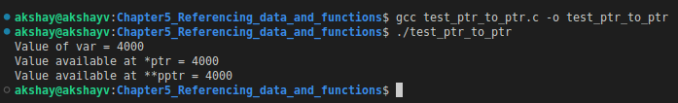
Pointer to Pointer
A pointer to a pointer is a form of multiple indirection, or a chain of pointers.
When we define a pointer to a pointer, the first pointer contains the address of the second pointer, which points to the location that contains the actual value as shown in image.
A variable that is a pointer to a pointer must be declared is done by placing an additional asterisk in front of its name.
When a target value is indirectly pointed to by a pointer to a pointer, accessing that value requires that the asterisk operator be applied twice.
Pointer
Pointer
Variable
Address
Address
Value
int **pptr;
int *ptr;
Example Program: Use of Pointer to Pointer.
test_ptr_to_ptr.c

Slide 8
Void Pointers
#include <stdlib.h>
#include <stdio.h>
int main()
{
// Integer variable
int v = 7;
// Float variable
float w = 7.6;
// void Pointer
void *u;
u = &v; // Pointer to Integer variable
printf("The Integer variable = % d\r\n", *((int *)u));
u = &w; // Pointer to Float variable
printf("The Float variable = % f\r\n", *((float *)u));
return 0;
}
Output:
The Integer variable = 7
The Float variable = 7.600000
A void pointer is a pointer that has no associated data type with it.
A void pointer can hold address of any type and can be typecasted to any type.
In C, malloc() and calloc() functions return void * or generic pointers.
Syntax:
void *name_of_pointer;
One can assign the void pointer with any data type’s address, and then assign the void pointer to any pointer without even performing some sort of explicit typecasting. So, it reduces complications in a code.

Slide 9
Binding of Variables & Functions
A Binding is the attachment of a name (also called an identifier) to a variable types & functions in your program.
Binding refers to the process of converting identifiers into addresses.
Binding is done for each variable and functions.
For functions, it means that matching the call with the right function definition by the compiler.
Binding is intimately connected with scoping, as scope determines which names bind to which objects – at which locations in the program code (statically) and in which one of the possible execution paths (temporally).
It takes place either at compile time or at runtime.
Binding finds the corresponding binding occurrence (declaration/definition) for an applied usage of an identifier.
For Binding there are some points needs to be considered:
Scope of variables should be known.
What will happen if we use same identifier name again?
‘C’ forbids use of same identifier name in the same scope.
Same name can be used in different scope.

Slide 10
Binding of Variables & Functions contd...
Scope :
Scope in any programming language is a region of program where a defined variable/function can have its existence.
Beyond that block / file the variable/function cannot be accessed.
A Block is a set of statements enclosed within left and right braces i.e. ‘{‘ and ‘}’ respectively.
This variable/function has a File Scope, i.e., we can access the anywhere in the same C file but we cannot access outside that C file.
Scope | Place
Local Variable | Inside a function or block.
Global Variable | Outside of all function(can be accessed from anywhere) in the program
Formal Parameters | In the function parameters. Formal parameters are the parameter that are written in the function definition.
Static | Inside a block or function.
Static Global | In all the functions in the C file. But not outside that C file

Slide 11
Binding of Variables & Functions contd...
Binding Time:
At what time a value is assigned an attribute.
There are two types of binding: Static Binding & Dynamic Binding.
Static / Early Binding:
A binding is static if it first occurs before run time and remains unchanged throughout program execution.
Static binding occurs at Compile time.
All the final, static, and private methods are bound at run time.
Program execution is faster
In C, there is only static binding.

Slide 12
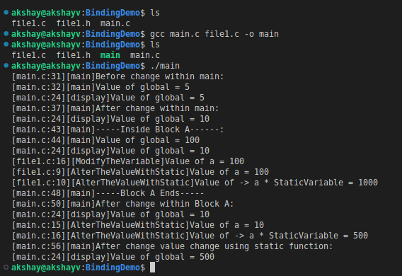
Binding of Variables & Functions contd...
Example Program: Static Binding
Directory "Module3_SystemProgramming_Using_C/Chapter5_Referencing_data_and_functions/StaticBindingDemo " contains source code to demonstrate Static binding with different scope of variables and functions.
Compile the code : gcc main.c file1.c -o main
We have one global variable in main.c :
int global = 5;
fille1.c & file1.h have ModifyTheVariable function to modify a value and is declared into file1.h file
In main.c & file1.c we have static variable & function with same name . As they are in different file scope it is allowed to have same names to the identifiers.
StaticVariable
AlterTheValueWithStatic
In main() we have one code Block A:
Inside Block A we have declared one more int variable : int global = 100;
From output the variable changes are valid only inside the Block A
The Output shown above is formatted as follows:
[<filename>:<Line Number>][Function Name]<Print Message>

Slide 13
Binding of Variables & Functions contd...
Dynamic / Late binding:
A binding is dynamic if it first occurs during execution or can change during execution of the program.
Dynamic binding occurs at Run time.
The compiler doesn’t decide the method to be called.
Based on the type of object, the respective function will be called.
Dynamic binding helps us to handle different objects using a single function name. It also reduces the complexity and helps the developer to debug the code and errors.
In simple words, dynamic binding is just delaying the choice or selection of which function to run until its runtime.
Program execution is slower.
The concept of dynamic programming is implemented with virtual functions.
Virtual Functions:
Virtual functions are special member functions to which calls made through a pointer (or reference) are resolved at run time, based on the object’s type with the pointer.
A function declared in the base class and overridden(redefined) in the child class is called a virtual function.
When we refer derived class object using a pointer or reference to the base, we can call a virtual function for that object and execute the derived class's version of the function.

Slide 14
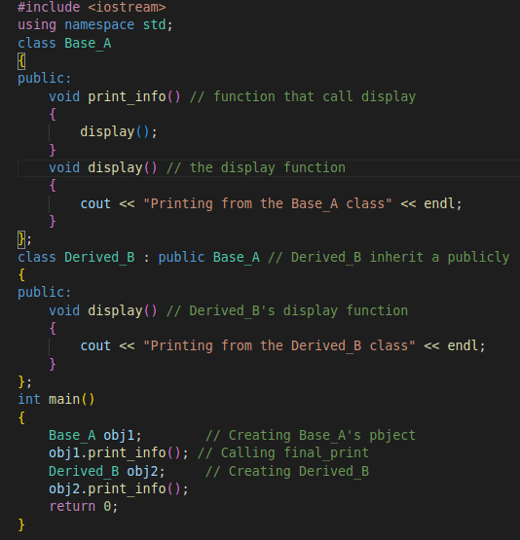
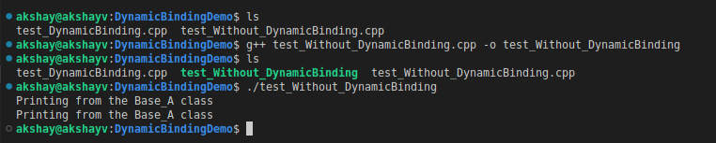
Binding of Variables & Functions contd...
Example Program:
Directory "Module3_SystemProgramming_Using_C/Chapter5_Referencing_data_and_functions/DynamcBindingDemo " contains source code to demonstrate Static binding with different scope of variables and functions.
Consider the program : test_Without_DynamicBinding.cpp
Class Base_A with a function print_info(), and class Derived_B inherits Base_A publicly.
Derived_B also has its print_info() function.
If we make an object of Base_A and call print_info(), it will run of base class whereas, if we make an object of Derived_B and call print_info(), it will run of base only.

Slide 15
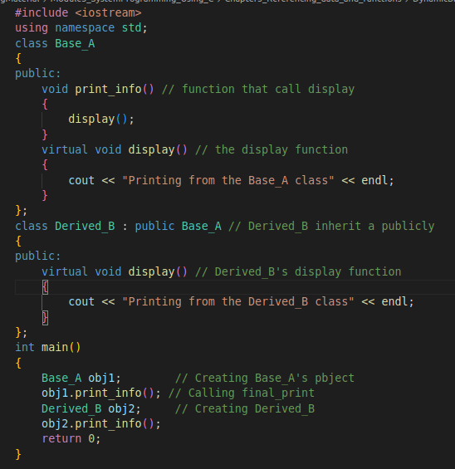
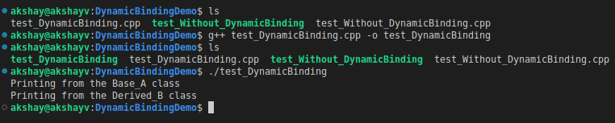
Binding of Variables & Functions contd...
Example Program:
Consider the program : test_DynamicBinding.cpp
Class Base_A with a function print_info(), and class Derived_B inherits Base_A publicly.
Derived_B also has its print_info() function.
Base_A & Derived_B also has its display() function with virtual keyword.
If we make an object of Base_A and call print_info(), it will run of base class, if we make an object of Derived_B and call print_info(), it will run display() of derived class.
This way dynamic binding links the function call with function definition with the help of virtual functions.

Slide 16
Assignment
Timer Driver:
We will consider the MCU Stellaris®LM3S6965 Microcontroller.
For Source Code Consider Dir: Module3_SystemProgramming_Using_C/Chapter5_Referencing_data_and_functions/Assignent
We will use QEMU to emulate ARM CPU for executing the Application.
SysTick Timer:
System Tick Time (SysTick) generates interrupt requests on a regular basis.
For OS based applications, SysTick is used to carry out context switching to support multiple tasking .
For non OS application , the SysTick can be used for time keeping, time measurement, or as an interrupt source for tasks that need to be executed regularly.
Application:
The Application starts the SysTick Timer, registers the function pointer callbacks that are dispatch from the timer IRQ.
The Application run a State Machine to Flash LED ON & OFF based on simulated event generated from the timer callback StateMachineTimerProc() from main.c.
In main.c main_timer_proc() prints the Current state of StateMachine, Also called from SysTick timer IRQ.
StateMachineTimerProc() & main_timer_proc() are registered to the function pointer callback in Systick.c

Slide 17
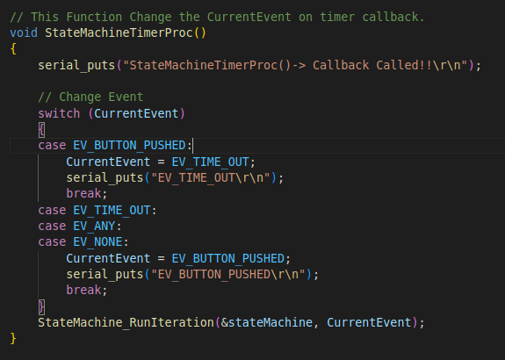

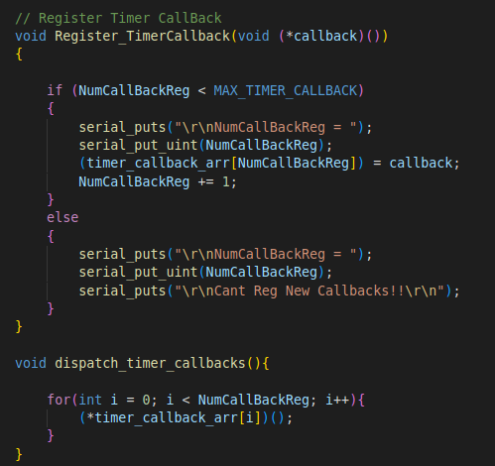
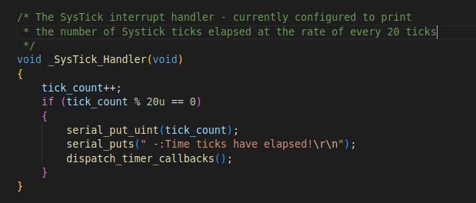
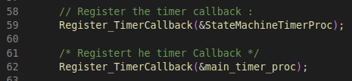
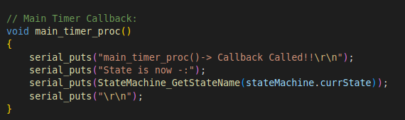
Assignment
Application: How Function Pointer array Callbacks are Registered & Dispatched:
systick.c
Function Pointer Array for timer callbacks
main.c
systick.c
1
main.c
systick.c
2
main.c

Slide 18
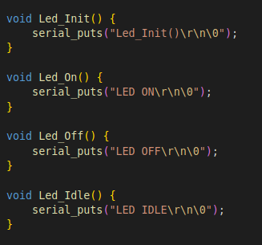
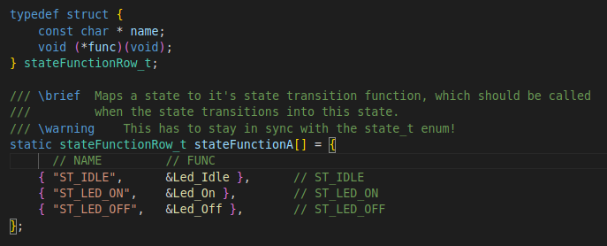
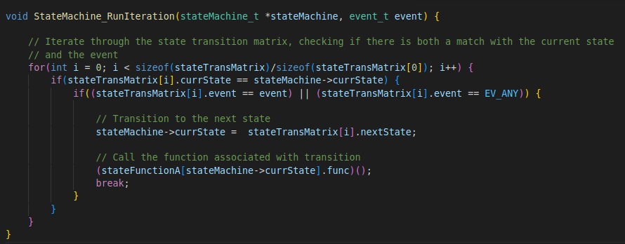
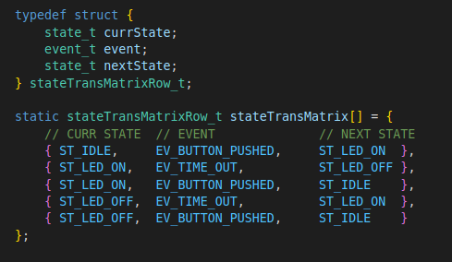
Assignment
Application: StateMachine.c Led.c
StateFunction Structure: it has state name & state function ptr to be called respective state.
Array of sateFunctionRow_t : to hold different states and respective function to be called from Led.c
StateMachine.c
Led.c
StateMachine.c
State Transition matrix : Holds different events and states
Runs the State Machine based on events
StateMachine.c

Slide 19
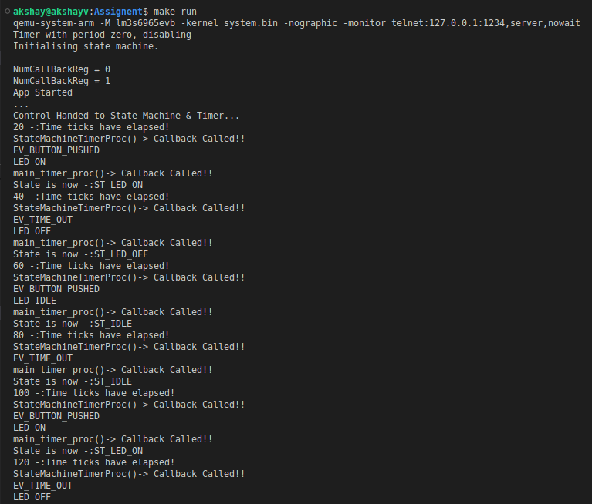
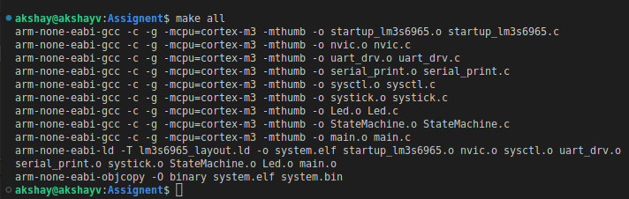
Assignment
Makefile -: To build code and Run the application in QEMU
To Build the code : make all
To run application in QEMU: make run
2 Callbacks Registered
Event Outputs based on event structure and current event

