Slide 1
System Programming using C
Chapter 6: Working with registers

Slide 2
Contents
Bit level operations
Bit level operators
Bitmasks
Accessing Registers
Padding & Packing of data
Bit fields, Structures & Union
Processor Endianness
Bit Endianness
Handling special registers
FIFO
Register Windows
Write only Registers
Data Alignment
Type Qualifiers

Slide 3
Bit level operations
In C programming operations can be performed on a bit level using bitwise operators.
Bitwise operations are contrasted by byte-level operations.
Instead of performing on individual bits, byte-level operators perform on strings of eight bits (known as bytes) at a time.
Reason for this is that a byte is normally the smallest unit of addressable memory.
C provides six operators for bit manipulation:
Operator | Description | Example
& | Binary AND Operator copies a bit to the result if it exists in both operands. | (A & B) = 12, i.e., 0000 1100
| | Binary OR Operator copies a bit if it exists in either operand. | (A | B) = 61, i.e., 0011 1101
^ | Binary XOR Operator copies the bit if it is set in one operand but not both. | (A ^ B) = 49, i.e., 0011 0001
~ | Binary One's Complement Operator is unary and has the effect of 'flipping' bits. | (~A ) = ~(60), i.e,. 1100 0011
<< | Binary Left Shift Operator. The left operands value is moved left by the number of bits specified by the right operand. | A << 2 = 240 i.e., 1111 0000
>> | Binary Right Shift Operator. The left operands value is moved right by the number of bits specified by the right operand. | A >> 2 = 15 i.e., 0000 1111

Slide 4
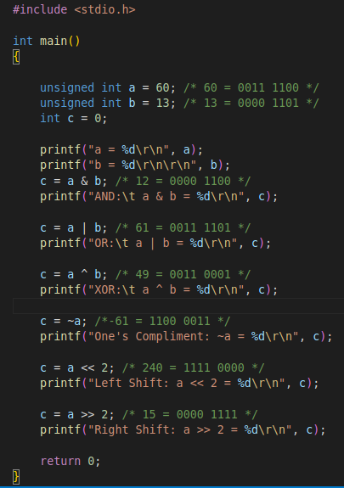
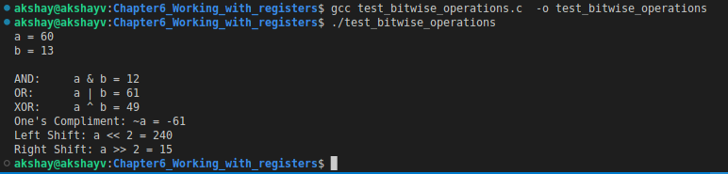
Bit level operations
Consider the Program: test_bitwise_operations.c
The program shows the use of Bit level operators

Slide 5
Bitwise shift operations
The bitwise shift operators move the bit values of a binary object.
The left operand specifies the value to be shifted.
The right operand specifies the number of positions that the bits in the value are to be shifted.
The result is not an lvalue.
Both operands have the same precedence and are left-to-right associative.
Operator << Indicates the bits are to be shifted to the left.
Operator >> Indicates the bits are to be shifted to the Right.
The right operand should not have a negative value or a value that is greater than or equal to the width in bits of the expression being shifted.
The result of bitwise shifts on such values is unpredictable.
If the right operand has the value 0, the result is the value of the left operand.
The << operator fills vacated bits with zeros.

Slide 6
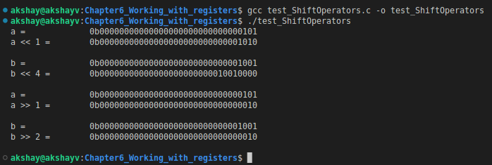


Bitwise shift operations
Consider the example program: test_ShiftOperators.c
It shows how to use the Shift operators.

Slide 7
Bitmasks
In computer science, a bitmask is data that is used for bitwise operations, particularly in a bit field.
Using a mask, multiple bits in a byte, nibble, word, etc. can be set either on or off, or inverted from on to off (or vice versa) in a single bitwise operation.
The idea for bit masking is based on boolean logic.
One of these true/false values is a bit.
Primitives in C (int, float, etc) are made up of some number of bits:
Char – 1 Byte - 8 bits
Int – 4 Bytes - 32 bits
Uint16_t – 2 Bytes - 16 bits
Masking is a general concept in which we keep, change, or remove some part of the information.

Slide 8
Bitmasks
Common Bitmask functions:
Masking bits to 1:
To turn certain bits on, the bitwise OR operation can be used.
When a bit A OR 1 = 1 and A OR 0 = A.
Therefore, to make sure a bit is on, OR can be used with a 1. To leave a bit unchanged, OR is used with a 0.
Example : Masking bits 4,5,6,7 to 1 while leaving bits 0, 1,2,3 unchanged.
Masking bits to 0:
To "masked off" (or masked to 0) than "masked on" (or masked to 1).
When a bit is ANDed with a 0, the result is always 0, i.e. A AND 0 = 0.
To leave the other bits as they were originally, they can be ANDed with 1 as A AND 1 = A
Example: Masking off bits 4,5,6,7 & while leaving bits 0, 1,2,3 unchanged.
 | 10010101 | 10101010
OR | 11110000 | 11110000
= | 11110101 | 11111010
 | 10010101 | 10101010
AND | 00001111 | 00001111
= | 00000101 | 00001010

Slide 9
Bitmasks
Querying the status of a bit:
It is possible to use bitmasks to easily check the state of individual bits regardless of the other bits.
To do this turning off all the other bits using the bitwise AND is done
The value is compared with 0.
If it is equal to 0, then the bit was off, but if the value is any other value, then the bit was on.
Toggling bit values:
To make the bits opposite of what it currently is it calles toggling.
This can be achieved using the XOR (exclusive or) operation.
XOR returns 1 if and only if an odd number of bits are 1.
Therefore, if two corresponding bits are 1, the result will be a 0, but if only one of them is 1, the result will be 1.
If the original bit was 1, it returns 1 XOR 1 = 0.
If the original bit was 0 it returns 0 XOR 1 = 1.
 | 10010101 | 10010101
AND | 00010000 | 00001000
= | 00010000 | 00000000
 | 10011101 | 10010101
XOR | 00001111 | 11111111
= | 10010010 | 01101010

Slide 10
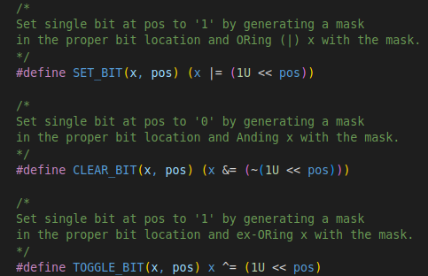
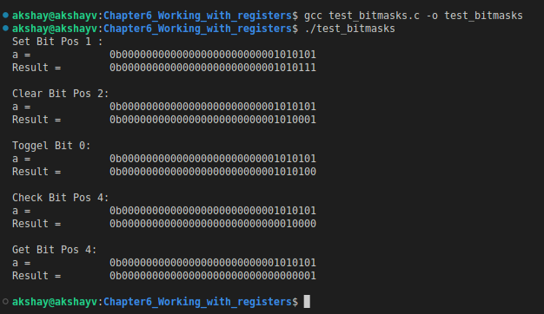
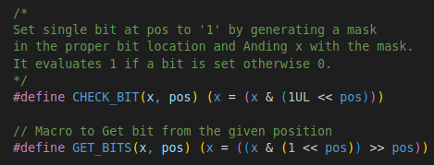
Bitmasks
Consider the example program: test_bitmasks.c
The program shows how to use different bitwise operation to operate in bits.

Slide 11
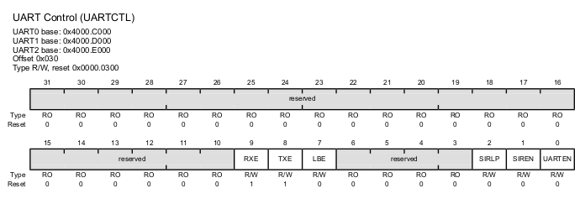
Accessing Registers
Device Registers:
A peripheral device is likely to have a number of internal registers, which may be read from or written to by software.
These normally appear just like memory locations and can, for the most part, be treated in the same way.
Typically a device register will have bit fields – groups of bits that contain or receive specific information.
Such fields may be single bits, groups of bits, or a whole word.
There may also be bits that are unused – reading from them or writing to them normally has no effect.
For example : Consider UART Device Control Register

Slide 12
Accessing Registers
Addressing the Register
Typically when we access registers in C based on memory-mapped IO we use a pointer notation.
It ‘trick’ the compiler into generating the correct load/store operations at the absolute address needed.
For Example : UART0 UARTCTL register:
The peripheral Base Address for UART0 = 0x4000C000
The Register Offset = 0x030
This means UART0 UARTCTL register is located at 0x4000C030
The declaration of the pointer could include an initialization, as:
volatile uint32_t* const Uart0_UARTCTL_reg = ((uint32_t*) 0x4000C030);
#define UART0_UARTCTL_REG (*((volatile uint32_t*) 0x4000C030))

Slide 13
Accessing Registers
Reading the Register
Using the pointer definition from last slide we can read the reg data.
uint32_t UartCTL_Val = UART0_UARTCTL_REG;
Writing to Registers:
Consider we want to want to set following bits in the UARTCTL reg
RXE - bit 9
TXE - bit 8
UARTEN - bit 0
All the Bitwise operators can be used to manipulate the bits.
// Read the value
uint32_t UartCTL = UART0_UARTCTL_REG;
/* Set the bits 9, 8 & 0*/
UartCTL |= (1 << 9); // Set RXE
UartCTL |= (1 << 8); // Set TXE
UartCTL |= (1 << 0); // Set UARTEN
// Write value to register :
UART0_UARTCTL_REG = UartCTL;

Slide 14
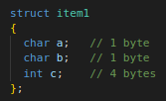
Structure Padding
Structure members are assigned to memory addresses in increasing order, with the first component starting at the beginning address of the structure name itself.
Structure padding is a concept in C that adds the one or more empty bytes between the memory addresses to align the data in memory.
The processor does not read 1 byte at a time. It reads 1 word at a time.
What does the 1 word mean?
If we have a 32-bit processor, then the processor reads 4 bytes at a time 1 word = 4 bytes.
If we have a 64-bit processor, then the processor reads 8 bytes at a time, 1 word = 8 bytes.
As we know that structure occupies the contiguous block of memory as shown in diagram.
Consider the 32 bit architecture:
The problem is that in one CPU cycle we can access:
one byte of char a,
one byte of char b,
2 bytes of int c.
We will not face any problem while accessing the char a and char b as both the variables can be accessed in one CPU Cycle.
We will face the problem when we access the int c variable as 2 CPU cycles are required to access the value of the 'c' variable.
Size = 6 bytes
0 | 1 | 2 | 3 | 4 | 5
a | b | c

Slide 15
Structure Padding contd..
Suppose we only want to access the variable 'c', which requires two cycles.
The variable 'c' is of 4 bytes, so it can be accessed in one cycle also, but in this scenario, it is utilizing 2 cycles.
This is an unnecessary wastage of CPU cycles.
Due to this reason, the structure padding concept was introduced to save the number of CPU cycles.
How is structure padding done?
To achieve the structure padding, an empty row is created on the left, as shown in the diagram.
The two bytes which are occupied by the 'c' variable on the left are shifted to the right.
So, all the four bytes of 'c' variable are on the right.
Now, the 'c' variable can be accessed in a single CPU cycle.
After structure padding, the total memory occupied by the structure is 8 bytes (1 byte+1 byte+2 bytes+4 bytes).
Although the memory is wasted in this case, the variable can be accessed within a single cycle.
Size = 8 bytes
0 | 1 | 2 | 3 | 4 | 5 | 6 | 7
a | b | Empty |  | c
Structure Padding

Slide 16
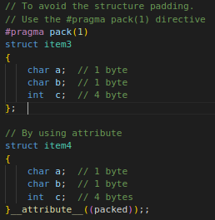
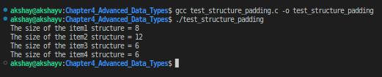
Structure Padding contd..
The structural padding is an in-built process that is automatically done by the compiler.
Sometimes it required to avoid the structure padding in C as it makes the size of the structure greater than the size of the structure members.
Packing :
Packing, prevents compiler from doing padding means remove the unallocated space allocated by structure.
We can avoid the structure padding in C in two ways:
Using #pragma pack(1) directive
Using __attribute__((__packed__))
Example Program: Demo for strcut padding:
test_structure_padding.c

Slide 17
Bit Fields, Structures & Union
Bit Fields :
A bit field is a data structure that consists of one or more adjacent bits which have been allocated for specific purposes, so that any single bit or group of bits within the structure can be set or inspected.
A bit field is most commonly used to represent integral types of known, fixed bit-width, such as single-bit Booleans.
Bit fields can be used to reduce memory consumption when a program requires a number of integer variables which always will have low values.
For example, in many systems storing an integer value requires two bytes (16-bits) of memory; sometimes the values to be stored actually need only one or two bits.
Having a number of these tiny variables share a bit field allows efficient packaging of data in the memory.
In C, we can specify the size (in bits) of the structure and union members.
Declaration of bit-fields in C
Syntax:
struct { data_type member_name : width_of_bit-field; };

Slide 18
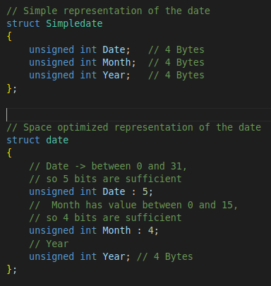
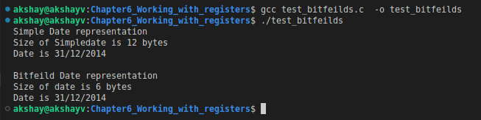
Bit Fields, Structures & Union
Consider the sample program : test_bitfeilds.c
It shows use of bit fields for efficient packaging of data in the memory.

Slide 19
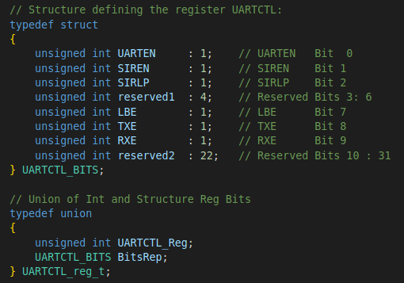


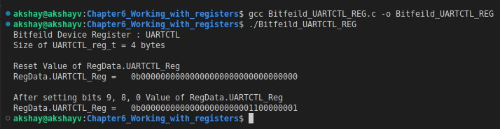
Bit Fields, Structures & Union
Bitfeilds can be used for accessing the device registers in C.
For Example : Bitfeild_UARTCTL_REG.c
The code shows the representation of UARTCTL 32bit register(4 bytes).
We can manipulate bits by accessing the structure fields--->>>
Using the Device register pointer
We can write data to register as below:

Slide 20
Processor Endianness
Endianness is a term that describes the order in which a sequence of bytes is stored in computer memory.
Types of Endianness:
Little endian:
Last byte of binary representation of the multibyte data-type is stored first.
X86 processor and most of the ARM Cortex-M3 based microcontrollers use the little-endian format.
Big endian:
First byte of binary representation of the multibyte data-type is stored first.
Motorola 6800 / 6801 processors use the big-endian format.
Example:
Integer is stored as 4bytes. will be stored as following:
int x = 0x01234567;
Little Endian
Address | Data
0x100 | 0x67
0x101 | 0x45
0x102 | 0x23
0x103 | 0x01
Big Endian
Address | Data
0x100 | 0x01
0x101 | 0x23
0x102 | 0x45
0x103 | 0x67

Slide 21
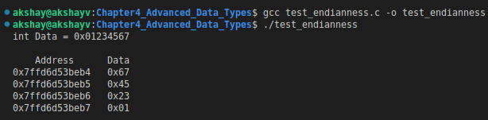
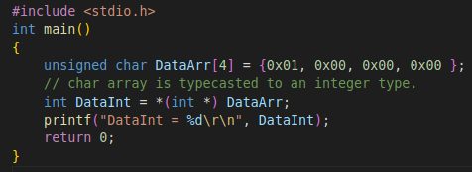

Processor Endianness contd..
Most of the times compiler takes care of endianness.
When we perform bit-wise operation on integer then compiler automatically handles the endianness.
However, endianness becomes an issue in following cases:
Writing raw bytes of data to a file in one processor and you send it to a system that uses different endian processor.
Send bytes of data over network as a serialized steam of data from one endian processor system to other endian processor system.
In network communication, TCP/IP suites are defined to be big-endian.
Sometimes it matters when you are using type casting, below program is an example.
Consider the example in image:
A char array is typecasted to an integer type.
On little endian machine we get:
DataInt = 1
On Big endian machine we get:
DataInt = 16777216
Example Program: To find Endianness of system
test_endianness.c
Example Program:
test_endianness_issue.c

Slide 22

Processor Endianness contd..
Sometimes you may need to convert the endianness of data.
Using the union we change the endianness of data:
Example program:
test_change_endianness_union.c

Slide 23
Bit endianness
In computing, bit numbering is the convention used to identify the bit positions in a binary number.
Bit numbering is a concept similar to endianness, but on a level of bits, not bytes.
The least significant bit (LSB) is the bit position in a binary integer representing the binary 1s place of the integer.
Similarly, the most significant bit (MSB) represents the highest-order place of the binary integer.
The LSB is sometimes referred to as the low-order bit or right-most bit, due to the convention in positional notation of writing less significant digits further to the right.
The MSB is similarly referred to as the high-order bit or left-most bit.
In both cases, the LSB and MSB correlate directly to the least significant digit and most significant digit of a decimal integer.
Bit indexing correlates to the positional notation of the value in base 2.
For this reason, bit index is not affected by how the value is stored on the device, such as the value's byte order.
For Example
Binary (Decimal: 149) | 1 | 0 | 0 | 1 | 0 | 1 | 0 | 1
Bit weight for given bit position n ( 2^{n} ) | 2⁷ | 2⁶ | 2⁵ | 2⁴ | 2³ | 2² | 2¹ | 2⁰
Bit position label | MSB |  |  |  |  |  |  | LSB

Slide 24
Handling special registers
FIFO
A FIFO buffer is a useful way to store data that arrives at a microcontroller peripheral asynchronously but cannot be read immediately.
An example of this is storing bytes that are incoming on a UART.
Buffering the bytes can make it easier for the embedded firmware to handle the incoming data in real time.
A FIFO buffer is a type of data storage that operates on a first-in, first-out basis.
It is a very common construct used in digital systems,
FIFOs can be implemented with software or hardware.
The choice between a software and a hardware solution depends on the application and the features desired.
Enqueue
Dequeue
DATA n | ….. | Data3 | Data2 | Data1
Back
Front

Slide 25
Handling special registers
FIFO
An example of this is storing bytes that are incoming on a UART.
Buffering the bytes can make it easier for the embedded firmware to handle the incoming data in real time.
Many microcontroller designs have limited buffer space for data arriving on the UART.
Using a FIFO in the UART ISR can make it easier to manage incoming data.
Using a FIFO as described above can reduce the real-time requirements for an application, as well as give the application developer more flexibility in handling incoming data.
Because the FIFO buffer stores the data until it can be processed by the application, the application does not need to handle each byte as it arrives.
This can make it easier to develop real-time applications that must process large amounts of data.

Slide 26
Register Windows
In Computer Architecture, the Registers are very fast computer memory which are used to execute programs and operations efficiently.
The sole purpose of having register is fast retrieval of data for processing by CPU.
Register windows are a feature which dedicates registers to a subroutine by dynamically aliasing a subset of internal registers to fixed, programmer-visible registers.
Several sets of registers are provided for the different parts of the program.
Registers are deliberately hidden from the programmer to force several subroutines to share processor resources.
The CPU recognizes the movement from one part of the program to another during a procedure call.
If you consider register organization of RISC CPU, it use an overlapped register window that provides passing of parameters to called procedure and stores the result to the calling procedure.
For each procedure call, the new register window is assigned from register file used by the new procedure.
Each procedure call activates the new register window by increment a pointer and the return statement decrements the pointer which causes the activation of the previous window.
Windows of adjacent procedures have overlapping registers that are shared to provide passing of parameters and storage of results.

Slide 27
Register Windows
There are three classes of registers:–
Global Registers :Available to all functions
Window local registers: Variables local to the function
Window shared registers: Permit data to be shared without actually needing to copy it.
For Example:
Procedure C called procedure D. Therefore, registers R58 to R63 are common to both procedures C and D. Therefore, procedure C stores parameters for procedure D in these registers. Procedure D uses registers R64 to R73 to store the local variables.
When procedure B returns after performing its computation, then the result from registers(R26 to R31) is transferred back to window A.
Registers R10 to R15 are common to procedures A and D also the four windows have a circular organization.
As R0 to R9(i.e. 10 registers) is available all procedures. Therefore, a procedure contains 32 registers while procedure it is active(which includes 10 global ,10 local, 6 low overlapping registers and 6 high overlapping registers) .
R15
R10
Common to D and A
R73
R64
Local to D
R63
R58
Common to C and D
Proc D
R57
R48
Local to C
R47
R42
Common to B and C
Proc C
R41
R32
Local to B
R31
R26
Common to A and B
Proc B
R25
R16
Local to A
R9
R0
Common to All Procedures
R15
R10
Common to A and D
Global Registers
Proc A

Slide 28
Write only Register
A write-only register is a register that can be written to but not read.
In addition to its literal meaning, the term may be applied to a situation when the data written by one circuit can be read only by other circuitry.
The most common occurrence of the latter situation is when a processor writes data to a write-only register of hardware the processor is controlling.
The hardware can read the instruction but the processor cannot.
For instance, a GPU might be carrying out shader (a computer program that calculates the appropriate levels of light, darkness,) processing on the contents of graphics memory.
It can be faster and more efficient for the GPU to take input for the shader process from read-only locations and write the shader output to different write-only locations without having to copy data between the read and write buffers after each iteration.

Slide 29
Alignment
One of the low-level features of C is the ability to specify the precise alignment of objects in memory to take maximum advantage of the hardware architecture.
CPUs read and write memory more efficiently when they store data at an address that's a multiple of the data size.
For example, a 4-byte integer is accessed more efficiently if it's stored at an address that's a multiple of 4.
When data isn't aligned, the CPU does more address calculation work to access the data.
By default, the compiler aligns data based on its size:
char on a 1-byte boundary,
short on a 2-byte boundary,
int, long, and float on a 4-byte boundary,
double on 8-byte boundary, and so on.
The compiler generally aligns data on natural boundaries that are based on the target processor and the size of the data.
Data is aligned on up to 4-byte boundaries on 32-bit processors, and 8-byte boundaries on 64-bit processors.
In some cases, however, you can achieve performance improvements, or memory savings, by specifying a custom alignment for your data structures.

Slide 30
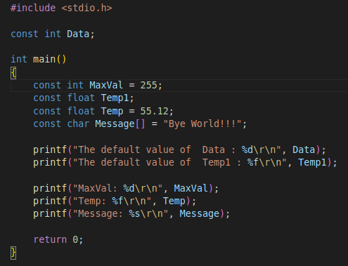
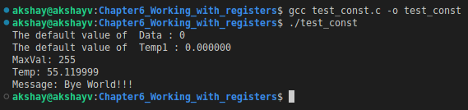
Type Qualifiers
Const:
The const type qualifier is used to create constant variables.
When a variable is created with const keyword, the value of that variable can't be changed once it is defined.
That means once a value is assigned to a constant variable, that value is fixed and cannot be changed throughout the program.
The default value of const variables is 0.
The keyword const is used at the time of variable declaration.
Syntax : const datatype variableName ;
Consider the Example: test_const.c

Slide 31
Type Qualifiers
Volatile:
The volatile keyword is intended to prevent the compiler from applying any optimizations on variables that can change in ways that cannot be determined by the compiler.
Variables declared as volatile are omitted from optimization because their values can be changed by code outside the scope of current code at any time.
The system always reads the current value of a volatile object from the memory location rather than keeping its value in a temporary register at the point it is requested.
Syntax: volatile datatype variableName;
Optimization levels:
If you use a higher optimization level for performance, then this has a higher impact on the other goals such as degraded debug experience, increased code size, and increased build time.
If your optimization goal is code size reduction, then this has an impact on the other goals such as degraded debug experience, slower performance, and increased build time.
Optimization goal | Useful optimization levels
Smaller code size | -Oz
Faster performance | -O2, -O3, -Ofast, -Omax
Better debug experience | -O1
Better correlation between source code and generated code | -O0
Faster compile and build time | -O0
Balanced code size reduction and fast performance | -Os

Slide 32
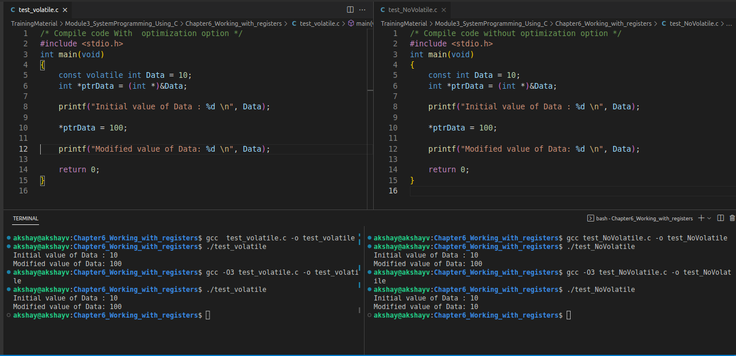
Type Qualifiers
Volatile:
For example consider Program: test_volatile.c & test_NoVolatile.c

Slide 33
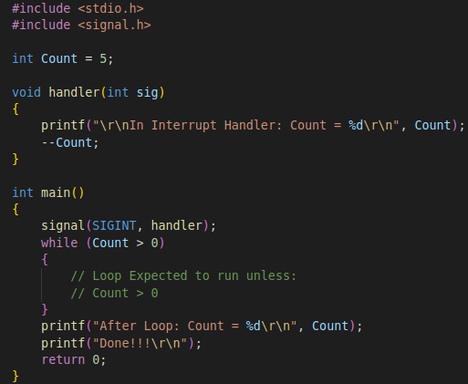
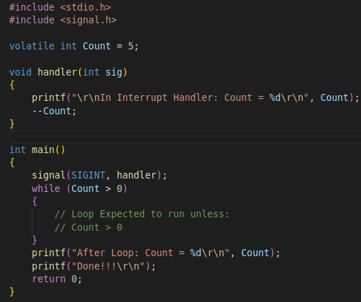
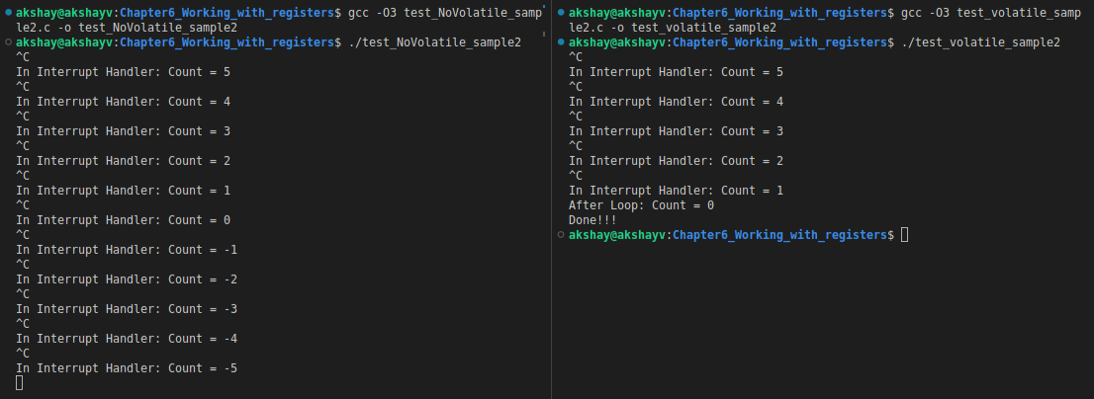
Type Qualifiers
test_NoVolatile_sample2.c
Volatile Keyword with Loops:
Consider the example:
The example uses the SIGINT (Interrupt the process)
SIGINT is the signal sent if we press Ctrl+C.
Inside the SIGINT handler we –Count (decrement).
In main() while loop is expected to run unless Count > 0.
But after applying Compiler optimization –O3 we can see the results below:
test_volatile_sample2.c
Here Compiler optimized the Count so the loop never exit even if the value of Count < 0

Slide 34
Type Qualifiers
restrict:
restrict keyword is mainly used in pointer declarations as a type qualifier for pointers.
It doesn’t add any new functionality. It is only a way for programmer to inform about an optimization that compiler can make.
By adding this type qualifier, a programmer hints to the compiler that for the lifetime of the pointer, no other pointer will be used to access the variable to which it points.
If the compiler knows that there is only one pointer to a memory block, it can produce better optimized code.
The programmer, not the compiler, is responsible for ensuring that the pointers do not point to identical locations.
The compiler can e.g. rearrange the code, first loading all memory locations, then performing the operations before committing the results back to memory.
Since the compiler can rearrange the code more freely, the compiler can generate code that executes faster.

Slide 35
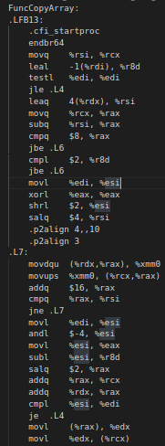
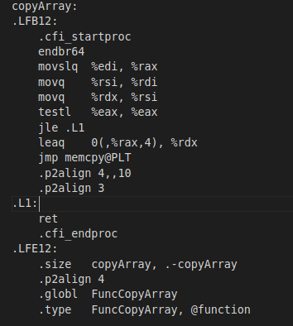
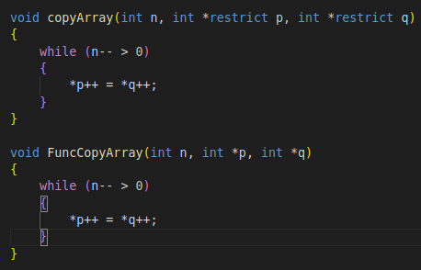
Type Qualifiers
restrict:
Consider the example : test_restrict.c
It has two function which copy the array from source to destination.
We optimize the code with following settings -std=c17 –O3
We can output assembler code file using -S with gcc.
gcc -std=c17 -O3 test_restrict.c -S
From test_restrict.s check the asm code for both
functions
For copyArray() the code is optimised
But for FuncCopyArray()
It it less optimised

