Slide 1
System Programming using C
Chapter 7: Context Management

Slide 2
Contents
Bringing up CPU
Startup Sequence
C Startup Code
Interrupt Vector Table
Requirements of Startup code
Execution Context
What is Execution Context.
Context Switching
Process Control Block
Manage Execution Contexts using ucontext.h
Interrupt Context
How Interrupt context is handled
Processor Modes
Banked Registers
Banked Registers & Processor Modes

Slide 3
Bringing up CPU
Startup sequence
When we reboot our computer, it must start up again, initially without any notion of an operating system.
Somehow, it must load the operating system.
Whatever variant that may be from some permanent storage device that is currently attached to the computer (e.g. a hard disk, a USB dongle, SD card, eMMC etc.)
The CPU starts and fetches instructions into RAM from the BIOS, which is stored in the ROM.
BIOS=Basic Input Output System
Firmware code lives on flash memory
On the motherboard
It is minimum software that system needs
Designed to run as the first code by PC
Identify, test, and initialize system devices
It helps in the functioning of all the input/output devices.
Operation
Init
User-space
Kernel
Linux
Stage 2 Bootloader
LILO, GRUB
Stage 1 Bootloader
Master Boot Record
Powe-up / Reset
System Startup
BIOS / Boot Monitor

Slide 4
Bringing up CPU
Functions of BIOS:
POST (Power On Self Test):
The Power On Self Test happens each time you turn your computer on.
Your computer does so much when it’s turned on and this is just part of that.
It initializes the various hardware devices.
It is an important process to ensure that all the devices operate smoothly without any conflicts.
BIOSes create tables describing the devices in the computer.
The POST first checks the bios and then tests the CMOS RAM.
If there is no problem with this then POST continues to check the CPU, hardware devices such as the Video Card, and the secondary storage devices such as the Hard Drive, Floppy Drives, Zip Drive, or CD/DVD Drives.
If some errors are found then an error message is displayed on the screen or a number of beeps are heard.
These beeps are known as POST beep codes.

Slide 5
Bringing up CPU
Master Boot Record:
The Master Boot Record (MBR) is a special boot sector at the beginning of the disk.
The MBR contains the code that loads the rest of OS, known as bootloader.
Along with the bootloader program, MBR also contains details regarding the partitions of the hard disk. The size of MBR is commonly less than or equal to 512 bytes.
The MBR mainly consists of 3 parts:
Master Boot Code
The MBR begins with the master boot routine that contains a variable loader code.
Users can boot various operating systems from the MBR.
Once the hard disk is booted, MBR passes control to the Operating System that has been registered in the partition table.
Disk Partition Table (DPT)
The disk partition table is located at the first sector of each hard disk and contains locations of the partitions.
The disk partition table is usually 64 bytes long.
It contains a maximum of 4 partitions that can be 16 bytes each.
Identification Code
Identification code is used to identify an MBR and acts as a closing signature.
Its value is AA55 H and may also be written as 55AA H. The identification code is 2 bytes long.
Master Boot Code
1st Partition Table Entry
2nd Partition Table Entry
3rd Partition Table Entry
4th Partition Table Entry
Identification code

Slide 6
Bringing up CPU
Bootloader of Linux
GNU GRUB
GRUB stands for GRand Unified Bootloader.
Its function is to take over from BIOS at boot time, load itself, load the Linux kernel into memory, and then turn over execution to the kernel.
Once the kernel takes over, GRUB has done its job and it is no longer needed.
The GRUB splash screen is often the first thing you see when you boot your computer.
It has a simple menu where you can select some options.
If you have multiple kernel images installed, you can use your keyboard to select the one you want your system to boot with.
By default, the latest kernel image is selected.

Slide 7
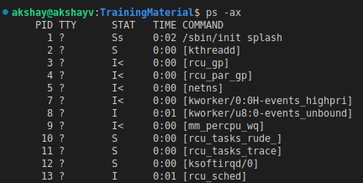
Bringing up CPU
Kernel
The kernel is often referred to as the core of any operating system, Linux included. It has complete control over everything in your system.
In this stage of the boot process, the kernel that was selected by GRUB first mounts the root file system that's specified in the grub.conf file.
Then it executes the /sbin/init program, which is always the first program to be executed.
You can confirm this with its process id (PID), which should always be 1.
The kernel then establishes a temporary root file system using Initial RAM Disk (initrd) until the real file system is mounted.

Slide 8
Bringing up CPU
Init
At this point, your system executes runlevel programs.
At one point it would look for an init file, usually found at /etc/inittab to decide the Linux run level.
Modern Linux systems use systemd to choose a run level instead.
A run-level is used to decide the initial state of the operating system.
These are the available run levels:
Level 0: System Halt.
Level 1: Single user mode.
Level 2: Full multiuser mode without network.
Level 3: Full multiuser mode with network.
Level 4: user definable.
Level 5: Full multiuser mode with network and X display manager.
Level 6: Reboot.
By default most of the LINUX based system boots to runlevel 3 or runlevel 5.
In addition to the standard runlevels, users can modify the preset runlevels or even create new ones according to the requirement.

Slide 9
C Startup Code
Int Bare metal system it is not possible to directly execute C code main(), when the processor comes out of reset.
C programs need some basic pre-requisites to be satisfied.
Before transferring control to C code, the following have to be setup correctly:
Stack
Global variables
Initialized
Uninitialized
Read-only data
The CPU begins to execute code at a determined address, that could be 0x0 the initial value of the Stack Pointer.
Startup code runs before the main() function starts its execution.
What is actually needed to start the execution of the main function?
All uninitialized variables are zero. These are stored in the .bss section of the final elf file.
All initialized variables are actually initialized. These are stored in the .data section of the final elf file.
All static objects are initialized, they may need to get their constructors called if they are not trivial. Function pointers to these static initialization routines are stored in the .init_array section.
The stack pointer is correctly set during startup.
Some other machine dependent features like enabling access to the floating point coprocessor (VFP coprocessor on most ARM microcontroller architectures etc.).

Slide 10
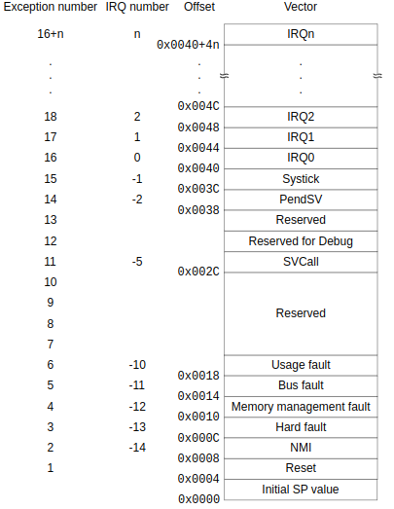
C Startup Code contd..
Default startup code is given in the assembly language for the target processor.
It makes sense, however, reimplementing this code in C, for the purposes of creating a more generic code that can be used for multiple devices.
The Startup code does the following tasks:
Vector table for the NVIC (Nested Vectored Interrupt Controller):
Define the vector table for the NVIC.
Upon an exception or interrupt it looks up the address of the corresponding ISR.
This table contains:
The Stack pointer & Program Counter initial value.
The reset vector
All exception vectors
All external interrupt vectors.
Fault handlers.
When a system reset occurs, execution starts from the reset vector.
The processor loads the value of the MSP (main stack pointer) with the highest ram address (defined by the linker as __StackTop).
The __StackTop variable is actually defined in the linker script.
_sram_stacktop = ORIGIN(SRAM) + LENGTH(SRAM);
Credits: https://documentation-service.arm.com/static/5ea823e69931941038df1b02?token=

Slide 11
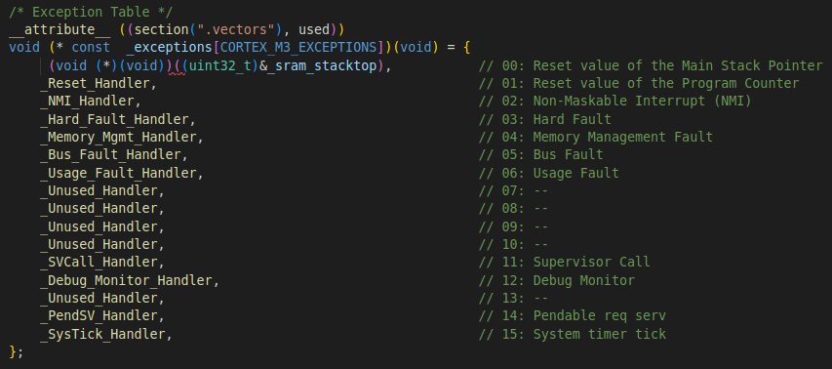
C Startup Code contd..
Vector table for the NVIC (Nested Vectored Interrupt Controller):
The vector table contains the reset value of the stack pointer, and the start addresses, also called exception vectors, for all exception handlers.
The processor handles exceptions using:
Interrupt Service Routines (ISRs): The IRQ interrupts are the exceptions handled by ISRs.
Fault handlers: HardFault, MemManage fault, UsageFault, and BusFault are fault exceptions handled by the fault handlers.
System handlers : NMI, PendSV, SVCall SysTick, and the fault exceptions are all system exceptions that are handled by system handlers.

Slide 12
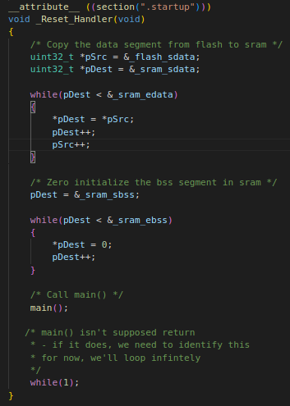
C Startup Code contd..
Initialize the .data section :
This section is defined in the linker script with different VMA (Virtual address) and LMA (Load address).
Since it has to be loaded to Flash, but used from RAM when the execution starts.
To make sure that all C code can use the initialized data within the .data section, it has to be copied over from Flash to RAM by the startup code.
To accomplish this it uses the following symbols defined by the linker: _flash_sdata, _sram_sdata and _sram_edata.
Initialize the .bss section to zero:
It uses the symbols _sram_sbss and _sram_ebss to obtain the address range that should be set to zero.
These symbols are defined in the linker script.
_Reset_Handler:
When a reset occurs it will start executing the code at the address indicated by the _Reset_Handler function pointer.
This is where we setup and call main().
We'll create a separate section .startup so this resides immediately after the vector table
Call Destructors

Slide 13
Execution context
Execution is the process by which a computer reads and acts on the instructions of a computer program.
The context in which execution takes place is crucial. Very few programs execute on a bare machine.
Programs usually contain implicit and explicit assumptions about resources available at the time of execution.
In order for programs and interrupt handlers to work without interference and share the same hardware memory and access to the I/O system.
In a multitasking operating systems running on a digital system with a single CPU/MCU it is required to have some sort of software and hardware facilities to keep track of an executing processes data.
It includes memory page addresses, registers etc and to save and recover them back to the state they were in before they were suspended.
This is achieved by a context switching.
In Linux-based operating systems, a set of data stored in registers is usually saved into a process descriptor in memory to implement switching of context.
An execution context consists of a heap, a stack, code, an instruction pointer, registers etc.
When you're programming in C you only use the heap explicitly
The stack etc. are implicitly used when doing procedure call sand declaring local variables.

Slide 14
Execution context contd...
Context Switching
Context Switching involves storing the context or state of a process so that it can be reloaded when required and execution can be resumed from the same point as earlier.
This is a feature of a multitasking operating system and allows a single CPU to be shared by multiple processes.
When switching is performed in the system, the old running process’s status is stored as registers, and the CPU is assigned to a new process for the execution of its tasks.
While new processes are running in a system, the previous ones must wait in the ready queue.
The old process’s execution begins at that particular point at which another process happened to stop it.
Context Switching Triggers: Here are the triggers that lead to context switches in a system:
Interrupts:
The CPU requests the data to be read from a disk.
In case there are interrupts, the context switching would automatically switch a part of the hardware that needs less time to handle the interrupts.
Multitasking:
Context switching is the characteristic of multitasking.
They allow a process to switch from the CPU to allow another process to run.
When switching a given process, the old state gets saved so as to resume the execution of the process at the very same point in a system.
Kernel/User Switch:
It’s used in the OS when it is switching between the kernel mode and the user mode.

Slide 15
Execution context contd...
Process Table and Process Control Block (PCB)
While creating a process the operating system performs several operations.
To identify the processes, it assigns a process identification number (PID) to each process.
As the operating system supports multi-programming, it needs to keep track of all the processes.
For this task, the process control block (PCB) is used to track the process’s execution status.
Each block of memory contains information about the process state, program counter, stack pointer, status of opened files, scheduling algorithms, etc.
All these information is required and must be saved when the process is switched from one state to another.
When the process makes a transition from one state to another, the operating system must update information in the process’s PCB.
The operating system maintains pointers to each process’s PCB in a process table so that it can access the PCB quickly.
Process Control Block
Stack Pointer
Process State
Process Number (PID)
Program Counter
Registers
Memory Limits
Open File Lists
Misc Accounting & Status Data

Slide 16
Execution context contd...
Manage execution contexts:
We will explore the execution context by means of library ucontext.
The ucontext.h header file defines the ucontext_t type as a structure that can be used to store the execution context of a user-level thread in user space.
Structure ucontext_t holds a pointer tp an execution stack, copy if registers and instruction pointer.
The same header file also defines a small set of functions used to manipulate execution contexts. Read the following manual pages:
ucontext.h
getcontext()
setcontext()
makecontext()
swapcontext()
Using these functions we can capture the current execution context, change it and even start using another context.
We can switch from one execution to another by context switching.
The header files might not be installed on the system so install the header files :
sudo apt-get install linux-headers-$(uname -r)

Slide 17
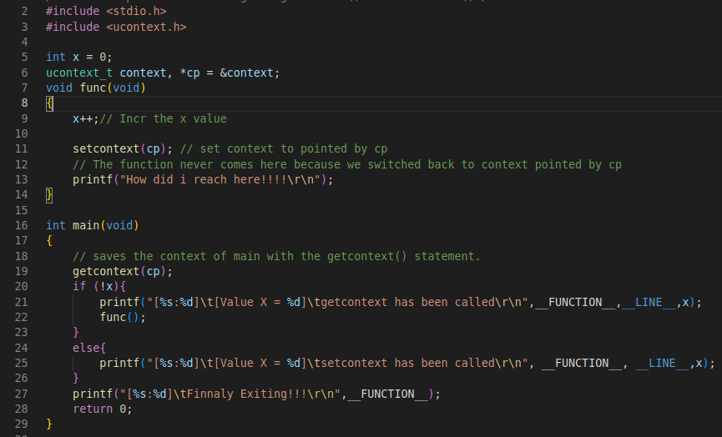
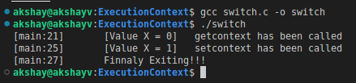
Execution context contd...
Manage execution contexts:
The first lets try to get hold of current execution context and swap one context for another.
Consider the example program: switch.c
This example saves the context in main with the getcontext() statement.
It then returns to that statement from the function func using the setcontext() statement.
Since getcontext() always returns 0 if successful, the program uses the variable x to determine if getcontext() returns as a result of setcontext() or not.

Slide 18
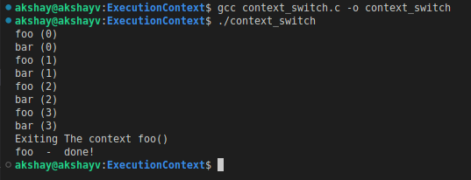
Execution context contd...
Manage execution contexts:
Consider the Program: context_switch.c
Program demonstrate how to create and manipulate execution contexts.
Study the source.
The program handover context to functions foo() & bar() using the swapcontext() function.
This context handover process will continue based on the number of iteration defined in #define N 4.

Slide 19

Execution context contd...
Multithreading in C
Thread -
Is a free unit of execution made inside the context of a process or application that is executed.
At the point when different threads are executing in a process simultaneously, then it is called as multithreading.
The threads are unaware of other threads in a process.
Threads share same global memory (data and heap segments), but each thread has its own stack (automatic variables).
Multithreading -
It allows multiple threads to be created inside a process, executing freely but concurrently sharing the process resources.
Typical process resources are dynamically allocated memory, network connections, open files etc.
Based on hardware, threads can execute in parallel if they are divided to their own CPU core.
C does not have built-in support for multithreading, instead it relies on the OS.
In Linux OS we have POSIX threads.
Process
Thread 1
Thread 2
TIME

Slide 20
Execution context contd...
POSIX threads:
Specifies a set of interfaces (functions, header files) for threaded programming commonly known as POSIX threads, or Pthreads.
The interfaces provided by the Pthread API can be grouped as shown in chart:
Some functions which we will use in demo app:
pthread_create() -: function starts a new thread in the calling process.
It takes 4 arguments:
pthread_t : pointer to thread id, it is an integer used to identify the thread in the system.
attr : Used to set the thread attributes. We can specify the thread attribute's or NULL for default value.
start_routine: C function that the thread will execute
arg: argument that can be passed to start_routine.
pthread_join() -: function waits for the thread specified by thread to terminate. If that thread has already terminated, then pthread_join() returns immediately.
Takes two arguments:
pthread_t
retval : pointer to the status argument passed by the thread as apart of pthread_exit().
Routine Prefix | Functional Group
pthread_ | Thread management API's
pthread_attr_ | Thread attributes objects
pthread_mutex_ | Mutex that deal with synchronization
pthread_mutexattr_ | Mutex attributes objects
pthread_cond_ | Condition variables
pthread_condattr_ | Condition attributes objects
pthread_key_ | Thread-specific data keys
pthread_rwlock_ | Read/write locks
pthread_barrier_ | Synchronization barriers

Slide 21
Execution context contd...
POSIX threads:
Mutex API:
Mutex – Mutual Exclusion Object.
It is a locking mechanism used to synchronize the access to the CPU / Shared resource.
It is created so that multiple thread can take turns sharing the CPU resource, Global Variables or access to file etc.
When the thread wants to access the resource then they can call the mutex lock and proceed with the task.
At any time only one thread can acquire the Mutex.
pthread_mutex_init() -: function initializes the mutex referenced by mutex with attributes specified by attr. If NULL, the default mutex attributes are used.
pthread_mutex_lock() -: Mutex can be locked using this function.
pthread_mutex_unlock() -: Mutex can be released using this function.
To compile the code with GCC for multithreading which use POSIX pthread.h:
We use -lpthread -: the linker find those symbols in the pthread library during the linking stage.

Slide 22
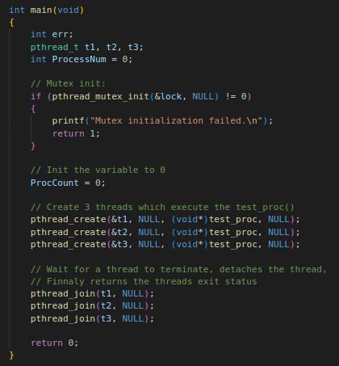
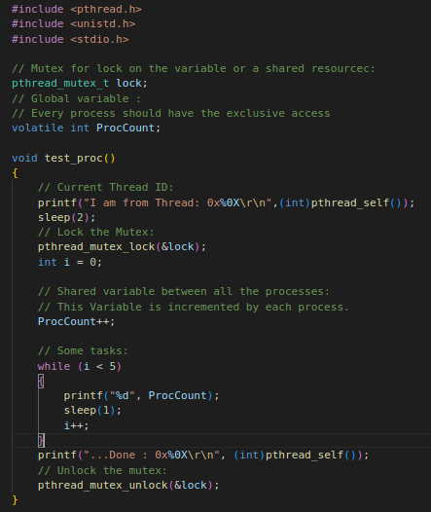
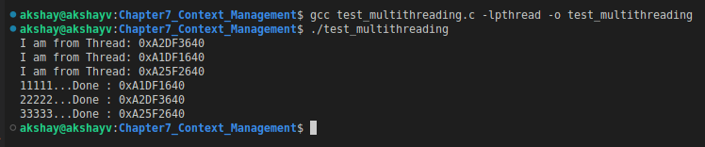
Execution context contd...
POSIX threads:
Consider example program: test_multithreading.c
Output Observation:
You can see we created three threads.
Each thread executes the function test_proc().
As the mutex is locked after entering the function each waits untill the mutex is released.
So this is how each thread can execute and operate on the global variable ProcCount exclusively.

Slide 23
Interrupt Context
When an exception or interrupt occurs, execution transition from user mode to kernel mode where the exception or interrupt is handled.
When the exception or interrupt has been handled execution resumes in user space.
In detail, the following steps must be taken to handle an exception or interrupts.
External event
Time
Process Executing
User Mode
Interrupt
Process Executing
Exception
Save the context of executing process
Select a process to restore and resume.
Restore the context of the selected process.
Resume execution of the selected process.
Kernel Mode
Exception/interrupt Handler
Determine the cause of the exception/interrupt.
Handle the exception/interrupt.

Slide 24
Interrupt Context
Saving context
The exception/interrupt handler uses the same CPU as the currently executing process.
When entering the exception/interrupt handler, the values in all CPU registers to be used by the exception/interrupt handler must be saved to memory.
The saved register values can later restored before resuming execution of the process.
Determine the cause
The handler may have been invoked for a number of reasons.
The handler thus needs to determine the cause of the exception or interrupt.
Information about what caused the exception or interrupt can be stored in dedicated registers or at predefined addresses in memory.
Handle the exception/interrupt
Next, the exception or interrupt needs to be serviced.
For instance, if it was a keyboard interrupt, then the key code of the keypress is obtained and stored somewhere or some other appropriate action is taken.
If it was an arithmetic overflow exception, an error message may be printed or the program may be terminated.

Slide 25
Interrupt Context
Interrupt dispatch
There are two different handlers, __irq_usr and __irq_svc.
The handlers loop around this code until no interrupts remain. If there is an interrupt, the code will branch to do_IRQ that exists in arch/arm/kernel/irq.c.
At this point, the code is the same in all architectures and you call an appropriate handler written in C.
Select a process to resume
The exception/interrupt have now been handled and the kernel.
The kernel may choose to resume the same process that was executing prior to handling the exception/interrupt or resume execution of any other process currently in memory.
Restoring context
The context of the CPU can now be restored for the chosen process by reading and restoring all register values from memory.
Resume
The process selected to be resumed must be resumed at the same point it was stopped.
The address of this instruction was saved by the machine when the interrupt occurred, so it is simply a matter of getting this address and make the CPU continue to execute at this address.

Slide 26
Processor Modes
Many processers run more than a single process simultaneously.
In a multi-process system, each process gets control of the processor and its memory, ports, and I/O devices for a limited “slice” of time.
At the end of its allotted time slice, each process must surrender control and wait idly for its scheduled time-slice to come around again.
Because the processor and its resources can be shared by several active processes, no single process can be allowed to compromise the others.
This means that some system resources must be protected, so that processes can’t interfere with one another.
No user process should be able to reset the processor or put it in a non-responsive state, and no process should be able to change system settings (like exception vectors) that would affect other processes.
To help manage such situations, most processors have different operating modes that allow different levels of “privileged” access to areas of memory, system settings, peripheral devices, and other resources.

Slide 27
Processor Modes
Consider ARM processors that support different processor modes, depending on the architecture version:
Processor mode | Description
User | The basic mode in which application programs run. User mode is the only unprivileged mode, and it has restricted access to system resources. Typically, a processor spends more than 99% of its time in user mode.
FIQ - Fast Interrupt Request | Is entered in response to a fast interrupt request from an external device. It is used to provide faster service for more urgent requests.
IRQ - Interrupt Request | Is entered in response to a normal interrupt request from an external device.
Supervisor | Provides unrestricted access to all system resources. Supervisor mode is entered on reset or power-up, or when software executes a Supervisor Call instruction (SVC).
Abort | Is entered if a program attempts to access a non-existing memory location. Abort mode also offers access to a few private registers that other modes can’t access.
Undefined | Is entered for any instruction-related exceptions, including any attempt to execute an unimplemented instruction.
System | provides unrestricted access to all system resources. Is typically only entered when required to manage a particular resource.
Monitor | Is available in some implementations to change between secure and non-secure states, and for debugging.

Slide 28
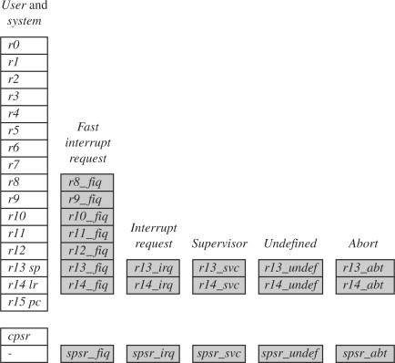
Processor Modes
Registers
ARM processors have 37 registers.
The following registers are available:
Thirty general-purpose, 32-bit registers
The Program Counter (PC)
The Application Program Status Register (APSR)
Saved Program Status Registers (SPSRs).
Of those, 20 registers are hidden from a program at different times.
These are called banked registers.
The shaded blocks in figure are banked registers
The registers are arranged in partially overlapping banks.
There is a different register bank for each processor mode.
The banked registers give rapid context switching for dealing with processor exceptions and privileged operations.

Slide 29
Processor Modes
Fifteen general-purpose registers are visible at any one time, depending on the current processor mode.
These are r0-r12, sp (Stack Pointer), lr (Link Register).
SP
sp (or r13) is the stack pointer. The C and C++ compilers always use sp as the stack pointer.
In Thumb-2 instruction set, sp is strictly defined as the stack pointer, so many instructions that are not useful for stack manipulation are unpredictable if they use sp.
Use of sp as a general purpose register is discouraged.
LR
In User mode, lr (or r14) is used as a link register to store the return address when a subroutine call is made.
It can also be used as a general-purpose register if the return address is stored on the stack.
In the exception handling modes, lr holds the return address for the exception, or a subroutine return address if subroutine calls are executed within an exception.
lr can be used as a general-purpose register if the return address is stored on the stack.

Slide 30
Processor Modes
Program Counter (PC)
The Program Counter is accessed as pc (or r15).
It is incremented by one word (four bytes) for each instruction in ARM state, or by the size of the instruction executed in Thumb state.
Branch instructions load the destination address into pc.
You can also load the PC directly using data operation instructions.
For example, to return from a subroutine, you can copy the link register into the PC using:
Application Program Status Register (APSR)
The APSR holds copies of the Arithmetic Logic Unit (ALU) status flags.
They are used to determine whether conditional instructions are executed or not.

Slide 31
Processor Modes
Current Program Status Register (CPSR)
The CPSR holds:
the APSR flags
the current processor mode
interrupt disable flags
current processor state (ARM, Thumb, ThumbEE, or Jazelle)
execution state bits for the IT (If-Then) instruction block.
The execution state bits control conditional execution in the IT block and are only available on ARMv6T2 and above.
Only the APSR flags are accessible in all modes.
The remaining bits of the CPSR are accessible only in privileged modes, using MSR and MRS instructions.
Saved Program Status Registers (SPSRs)
The SPSRs are used to store the CPSR when an exception is taken.
One SPSR is accessible in each of the exception-handling modes.
User mode and System mode do not have an SPSR because they are not exception handling modes.

Slide 32
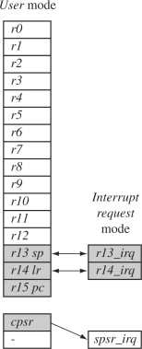
Processor Modes
For example, when the processor is in the interrupt request mode.
The instructions you execute still access registers named r13 and r14.
However, these registers are the banked registers r13_irq and r14_irq.
The user mode registers r13_usr and r14_usr are not affected by the instruction referencing these registers.
A program still has normal access to the other registers r0 to r12.
Figure illustrates what happens when an interrupt forces a mode change.
The figure shows the core changing from user mode to interrupt request mode, which happens when an interrupt request occurs due to an external device raising an interrupt to the processor core.
This change causes user registers r13 and r14 to be banked.
The user registers are replaced with registers r13_irq and r14_irq, respectively.
Note r14_irq contains the return address and r13_irq contains the stack pointer for interrupt request mode.
Fig also shows new register appearing in interrupt request mode: the saved program status register (spsr), which stores the previous mode's cpsr.
You can see in the diagram the cpsr being copied into spsr_irq.
To return back to user mode, a special return instruction is used that instructs the core to restore the original cpsr from the spsr_irq and bank in the user registers r13 and r14.

