Slide 1
System Programming using C
Chapter 8: Linux Fundamentals

Slide 2
Contents
Linux Kernel basics
Introduction to Linux
Linux Architecture
Kernel System Calls
Introduction to Linux Kernel
Loadable Kernel Module
Kernel Modules Directory
Usefull Commands
Linux File System
Introduction
File System Structure
File System Types
Mounting File System
Linux Driver Framework
Introduction
Device Files
Introduction to GPIO Device
Network Sockets
Introduction
Stream Socket Communication
TCP/IP Communication between two programs
Debug Tools
GDB
Introduction
Operation
Commands
Examples
KDB
Introduction
Setup
Commands
Example

Slide 3

Linux Introduction
What Is Linux?
Just like Windows, iOS, and Mac OS, Linux is an operating system.
The most popular platforms on the planet, Android, is powered by the Linux operating system.
The operating system manages the communication between your software and your hardware.
Linux has gained in popularity over the years due it being open source.
Hence, based on a UNIX like design, and ported to more platforms compared to other competing operating systems.
Linux is deployed on a wide variety of computing systems, such as embedded devices, mobile devices, personal computers, servers, mainframes, and supercomputers.
Linux or GNU/Linux?
Linux as an operating system is referred to in some cases as "Linux" and in others as "GNU/Linux."
Linux is the kernel of an operating system.
The wide range of applications that make the operating system useful are the GNU software.
For example, the windowing system, compiler, variety of shells, development tools, editors, utilities, and other applications exist outside of the kernel, many of which are GNU software.
That's the reason many consider "GNU Linux" as appropriate name.

Slide 4
Linux Architecture
Figure Shows fundamental architecture of Linux OS.
User / Application Space :
This is where the user applications are executed.
GNU C Library (glibc):
Provides the core libraries for the GNU system and GNU/Linux systems, as well as many other systems that use Linux as the kernel.
Provides the system call interface that connects to the kernel.
Provides the mechanism to transition between the user-space application and the kernel.
This is important because the kernel and user application occupy different protected address spaces.
Each user-space process occupies its own virtual address space.
The kernel occupies a single address space.
}
User Application
User
Space
GNU C Library (glbc)
System Call Interface
}
Kernel
Kernel
Space
Architecture Dependent Kernel Code
Hardware Platform

Slide 5
Linux Architecture contd...
Kernel Space - System Call Interface
A system call is a method for a computer program to request a service from the kernel of the operating system on which it is running.
The service is generally something that only the kernel has the privilege to do, such as doing I/O.
Programmers don’t normally need to be concerned with system calls because there are functions in the GNU C Library to do virtually everything that system calls do.
The Applications run in an area of memory known as user space. A system call connects to the operating system's kernel, which executes in kernel space.
For example : If the program wants to do device-specific input/output operations then you can just use ioctl().
Why do we need System Calls?
It is must require when a file system wants to create or delete a file.
Network connections require the system calls to sending and receiving data packets.
If you want to read or write a file, you need to system calls.
If you want to access hardware devices, including a printer, scanner, you need a system call.
System calls are used to create and manage new processes.
Types of System Calls:
Process Control
Fork()
Exit()
File Management
Open()
Read()
Device Management
Ioctl()
Read()
Information Maintenance
Getpid()
Alarm()
Communication
Wait()
Write()
Close()
Write()
Sleep()
Pipe()
Mmap()
Shmget()

Slide 6
Linux Architecture contd...
Kernel Space – Kernel
The kernel code, which can be more accurately defined as the architecture-independent kernel code.
This code is common to all of the processor architectures supported by Linux.
Kernel is really nothing more than a resource manager.
Resource being managed is a process, memory, or hardware device, the kernel manages and arbitrates access to the resource between multiple users in both kernel and user space.
Kernel Space - Architecture Dependent Kernel Code
The architecture-dependent code, which forms what is more commonly called a BSP (Board Support Package).
This code serves as the processor and platform-specific code for the given architecture.
The Linux kernel are fairly portable across platforms.
Which means that most of the code runs on all the supported architectures without the need to differentiate among them.

Slide 7
The Linux Kernel
A Kernel represents the core aspect of the Linux distributions for Desktop computers and servers.
It has a monolithic architecture, and the operating system operates entirely in the kernel space.
Linux kernel works as a layer between the software and hardware of a device.
It contains many device drivers that create a communication interface between the hardware and software of a device.
The kernel consists of various modules that can dynamically be loaded and unloaded.
A module can be configured as built-in or loadable.
This kind of architecture would extend the capabilities of the OS and allows easy extensions to the kernel.
It eliminates the tedious task of bringing down and recompiling the whole kernel for little changes.

Slide 8
The Linux Kernel contd..
Advantages of using Kernel Modules:
For small changes / bug fixing we don’t have to rebuild kernel. This saves time and prevents introducing error in rebuilding and reinstalling the base kernel.
It is easier to diagnose system problems.
A bug in a device driver which is bound to kernel can stop the system from booting.
And it can be hard to tell which part of base kernel caused trouble.
If the same device driver is a module, though, the base kernel is up and running before the device driver even gets loaded.
If the system breaks after the kernel is up and running, it's an easy matter to track the problem down to the trouble-making device driver and just not load that device driver until the problem is fixed.
Using modules can save memory, because they are loaded only when the system is actually using them.
Modules are much faster to maintain and debug.
It is possible to try out different parameters or even change the code repeatedly in rapid succession, without waiting for a boot.

Slide 9
The Linux Kernel contd..
Loadable Kernel Modules:
In computing, a loadable kernel module (or LKM) is an object file that contains code to extend the running kernel, or so-called base kernel, of an operating system.
LKMs are typically used to add support for new hardware (as device drivers) and/or filesystems, or for adding system calls.
When the functionality provided by an LKM is no longer required, it can be unloaded in order to free memory and other resources.
If you want to add code to the Linux kernel, the first thing you need to do is to add some source files to the kernel source tree.
There may be situations where you are required to add code to the kernels while it is running, this process is called a loadable kernel module.
Without loadable kernel modules, an operating system would have to include all possible anticipated functionality compiled directly into the base kernel.
Much of that functionality would reside in memory without being used, wasting memory, and would require that users rebuild and reboot the base kernel every time they require new functionality.

Slide 10

The Linux Kernel contd..
Module Location:
Find the information about the system:
We can use command uname to print the system information.
uname -a : Prints all the system information in the following order: Kernel name, network node hostname, kernel release date, kernel version, machine hardware name, hardware platform, operating system
Uname –r : Prints print the kernel release
The code necessary to create a new kernel with new module included, or old modules removed is usually:
/lib/modules/$(uname -r)/kernel
On some distributions the code is found :
/usr/lib/modules/$(uname -r)/kernel
The /usr/lib and /lib directory is where Linux stores object libraries and shared libraries that are necessary to run certain commands, including kernel code.

Slide 11
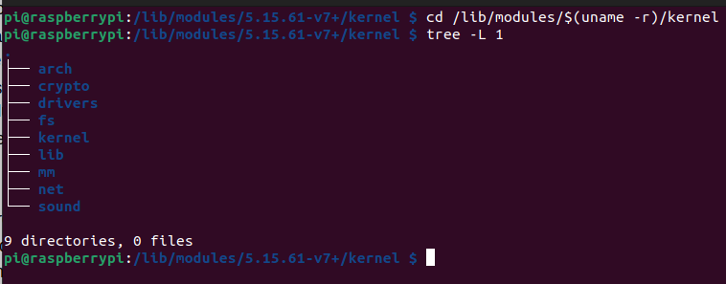
The Linux Kernel contd..
Kernel Modules Subdirectories:

Slide 12
The Linux Kernel contd..
Directory | Description
arch | The arch contains all of the architecture specific kernel code.
mm | This directory contains all of the memory management code.
drivers | All of the system's device drivers live in this directory. They are further sub-divided into classes of device driver: SPI, block, i2c, pwm, video, usb rtc, tty, gpio, gpu,watchdog etc
fs | All of the file system code. This is further sub-divided into directories, one per supported file system, for example ntfs, vfat and ext2.
kernel | The main kernel code. Again, the architecture specific kernel code is in arch/*/kernel.
net | The kernel's networking code.
lib | This directory contains the kernel's library code. The architecture specific library code can be found in arch/*/lib/.
crypto | Device drivers, file system and security all need crypto.
ipc | This directory contains the kernels inter-process communications code.
scripts | This directory contains the scripts (for example awk and tk scripts) that are used when the kernel is configured.

Slide 13
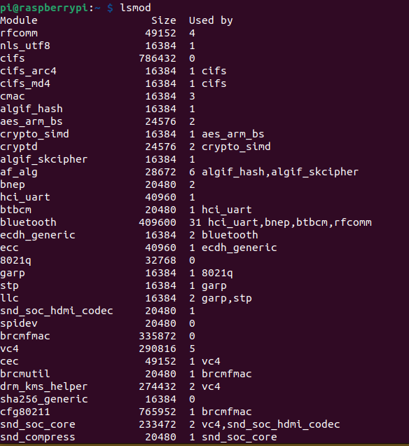
The Linux Kernel contd..
Command lsmod
Show the status of modules in the Linux Kernel.
lsmod is a trivial program which nicely formats the contents of the /proc/modules, showing what kernel modules are currently loaded.
"Module" denotes the name of the module.
"Size" denotes the size of the module (not memory used) in Bytes.
"Used by" shows that number of times the module is currently in use by running programs.

Slide 14
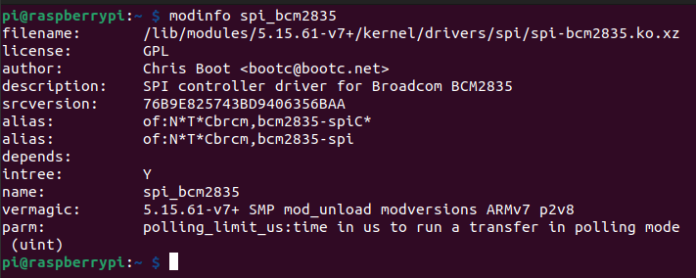
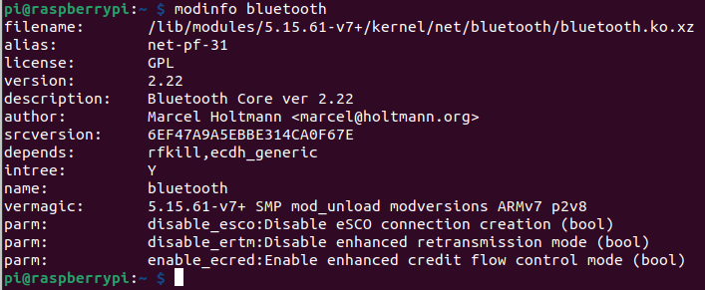
The Linux Kernel contd..
Command modinfo
Show the status of modules in the Linux Kernel.
modinfo extracts information from the Linux Kernel modules given on the command line.
If the module name is not a file name, then the /lib/modules/$(uname -r)directory is searched by default.
Modinfo can understand modules from any of the Linux Kernel architecture.

Slide 15
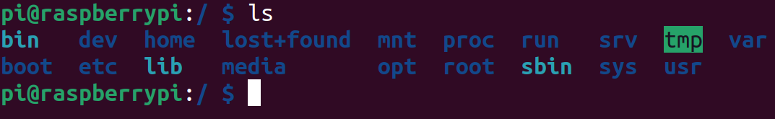
Linux File System
A Linux file system is a structured collection of files on a disk drive or a partition.
A partition is a segment of memory and contains some specific data.
In our machine, there can be various partitions of the memory. Generally, every partition contains a file system.
The general-purpose computer system needs to store data systematically on hard disks (HDD), SSD, eMMC, ,SD Card etc.
Reasons to maintain file system:
Primarily the computer saves data to the RAM storage; it may lose the data if it gets turned off. However, there is non-volatile RAM (Flash RAM and SSD) that is available to maintain the data after the power interruption.
Data storage is preferred on hard drives as compared to standard RAM as RAM costs more than disk space. The hard disks costs are dropping gradually comparatively the RAM.
The Linux file system contains the following sections:
The root directory (/)
A specific data storage format (EXT3, EXT4, BTRFS, XFS and so on)
A partition or logical volume having a particular file system that can be mounted on a specified mount point on a Linux filesystem.

Slide 16
Linux File Hierarchy Structure:
/ (root) | Primary hierarchy root and root directory of the entire file system hierarchy.
/bin | The /bin directory contains user executable files.
/boot | Contains the static bootloader and kernel executable and configuration files required to boot a Linux computer.
/dev | This directory contains the device files for every hardware device attached to the system. These are not device drivers, rather they are files that represent each device on the computer and facilitate access to those devices.
/etc | Contains the local system configuration files for the host computer.
/home | Home directory storage for user files. Each user has a subdirectory in /home.
/lib | Contains shared library files that are required to boot the system.
/media | A place to mount external removable media devices such as USB thumb drives that may be connected to the host.
/mnt | A temporary mountpoint for regular filesystems (as in not removable media) that can be used while the administrator is repairing or working on a filesystem.
/opt | Optional files such as vendor supplied application programs should be located here.
/root | This is not the root (/) filesystem. It is the home directory for the root user.
/sbin | System binary files. These are executables used for system administration.
/usr | These are shareable, read-only files, including executable binaries and libraries, man files, and other types of documentation.
/var | Variable data files are stored here. This can include things like log files, MySQL, and other database files, web server data files, email inboxes, and much more.

Slide 17
Linux Filesystem types
There are three major Linux filesystems: ext2, ext3 and ext4.
ext2
ext2 is suitable for flash drives and USB drives.
A file can be between 16 GB and 2 TB in size.
An ext2 filesystem can be between 2 TB and 32 TB in size.
ext2 filesystems are likely to become corrupt during power failures and computer crashes when data is being saved to the disk.
ext2 filesystems face data fragmentation issues which hinder performance.
ext3
ext3 allows journaling. Journaling creates a separate area of the filesystem where all file changes are tracked. The Journal can then be used in case of a power failure or system crash to restore data.
A directory in ext3 can have up to 32,000 subdirectories.
ext4
A directory can have up to 64,000 subdirectories.
A file can be up to 16 TB in size.
An ext4 filesystem can be up to 1 EB (Exabyte) in size, although most Linux distributions recommend a maximum filesystem size of 100 Tb.
ext4 reduces fragmentation issues and increases performance.
It also provides option to turn off the journaling feature.

Slide 18
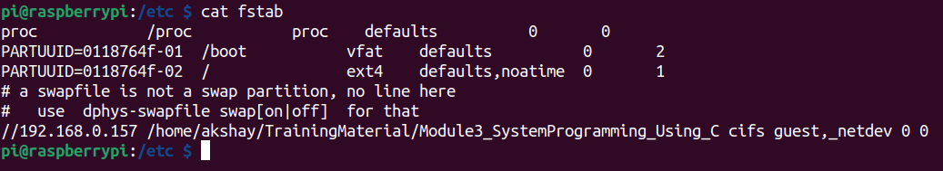
Mounting Filesystem
The filesystem on the disk pack would be logically mounted by the operating system to make the contents available for access by the OS, application programs and users.
A mount point is simply a directory.
For eg: home filesystem is mounted on the directory /home.
The Linux root filesystem is mounted on the root directory (/) very early in the boot sequence.
Other filesystems are mounted later, by the Linux startup programs.
Mounting of filesystems during the startup process is managed by the /etc/fstab configuration file.
The /etc/fstab file is one of the most important files in a Linux-based system, since it stores static information about filesystems, their mountpoints and mount options.
Each line of /etc/fstab contains the necessary settings to mount one partition, drive or network share.
The device file, UUID or label or other means of locating the partition or data source.
The mount point, where the data is to be attached to the filesystem.

Slide 19
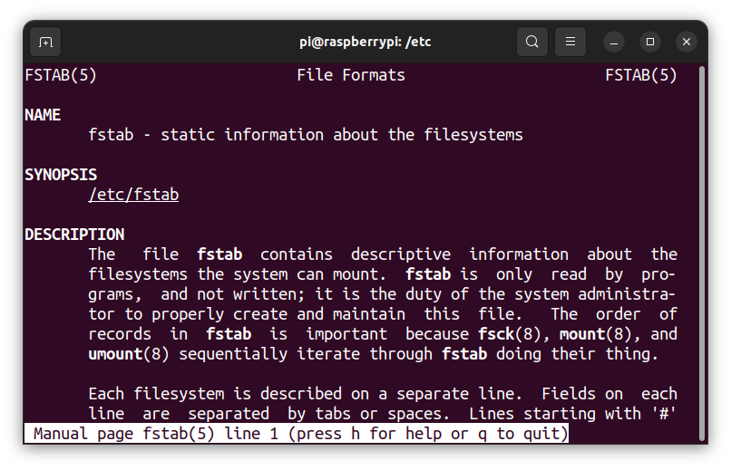
Mounting Filesystem contd..
To read in more details about /etc/fstab go through the linux Manual page.
Use command : man fstab

Slide 20
Linux Driver Framework
In general, any operating system needs a piece of software specific to the device.
This piece of software understands the device functionality and is a middle layer between OS and Hardware.
For Eg: Getting input from a keyboard or displaying it on your screen both require devices.
Linux provides a mechanism to simplify adding these input and output functions.
Linux also provides a large set of tools and utilities to modify and configure how your system and these device drivers interact.
Applications and other programs access everything, even hardware, through files.
The term used for a special file to access hardware is a “device node“.
Device nodes facilitate transparent communication between user space applications and computer hardware.
There are two general kinds of device files :
Character special files
Character devices deliver or accept a stream of characters (bytes) without regard to any other structure.
Some character devices are keyboards and terminals.
Block special files.
A block device is one that stores information in fixed size blocks.
Common block sizes are between 128 bytes and 1k bytes.
Each block may be read independently of the others, so the device allows random access to each block.
Some block devices are hard drives, CD-ROM drives, RAM disks, etc.

Slide 21
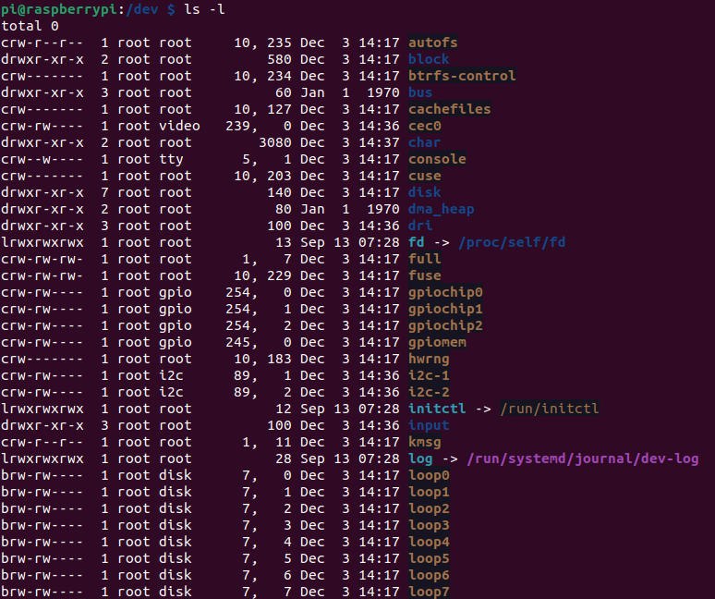
Linux Driver Framework contd...
Device file location
All device files are stored in /dev directory.
Use cd /dev and ls -l command to browse the directory.
A character device is marked with a c as the first letter of the permissions strings.
A block device is marked with a b as the first letter of the permissions strings.

Slide 22

Introduction to chardev GPIO and Libgpiod on the Raspberry PI
chardev GPIO :
We will access GPIO is via the “descriptor-based” character device.
The interface is exposed at /dev/gpiochipN , where N is the chip number.
Libgpiod :
Libgpiod (Library General Purpose Input/Output device) provides both API calls for use in your own programs.
gpiod is a set of tools for interacting with the linux GPIO character device that uses libgpiod library.
Install the tools with: sudo apt-get install gpiod libgpiod-dev libgpiod-do

Slide 23

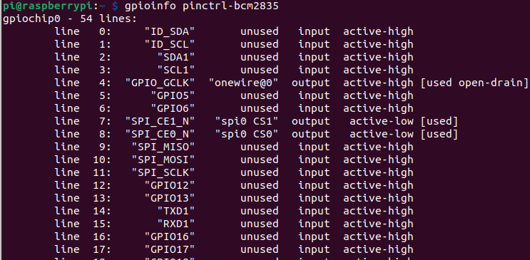
Introduction to chardev GPIO and Libgpiod on the Raspberry PI​ contd...
Following example usage is on a Raspberry PI 3 Model B V1.2.
The following are six user-mode applications to manipulate GPIO:
gpiodetect:
Detect/list GPIO character devices:
gpioinfo:
List all lines of specified gpiochips, their names, consumers,direction, active state and additional flags.
gpioget:
Read values of specified GPIO lines
gpioset:
Set values of specified GPIO lines, potentially keep the lines exported and wait until timeout, user input or signal
gpiofind:
Find the gpiochip name and line offset given the line name
gpiomon:
Wait for events on GPIO lines, specify which events to watch, how many events to process before exiting or if the events should be reported to the console

Slide 24
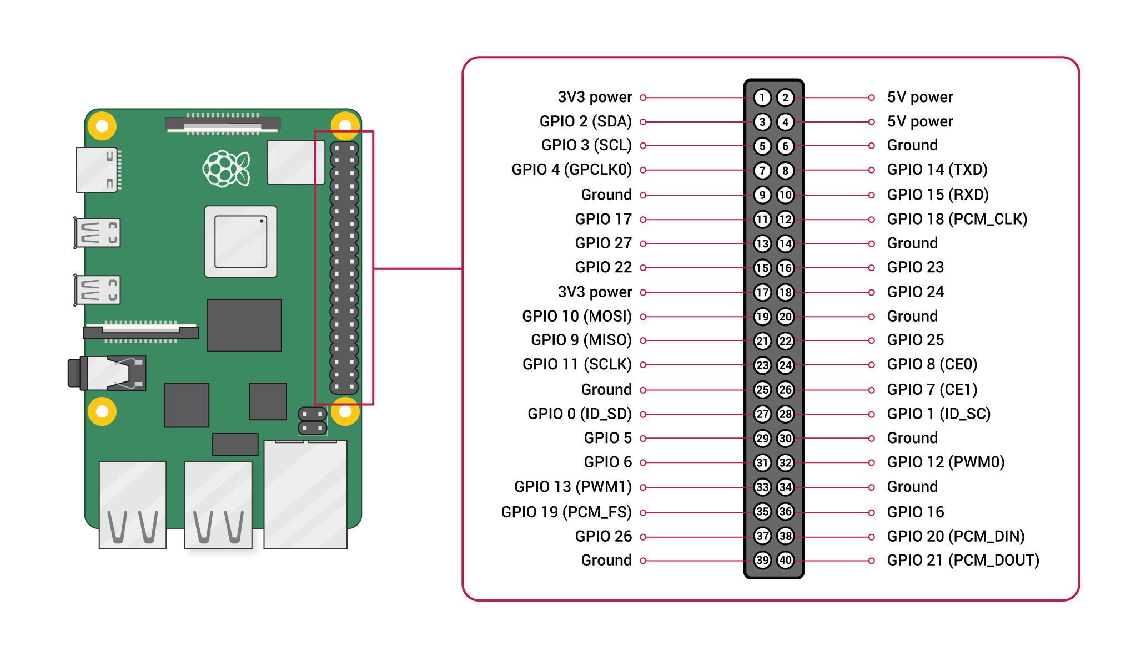

Introduction to chardev GPIO and Libgpiod on the Raspberry PI contd...
gpioget
Consider we want to read input status of GPIO 17.
GPIO 17 is comes under gpiochip0.
Attach a Switch to GPIO 17 pin.
Run the command :
gpioget gpiochip0 17
Try changing the switch state and run the command again.
See the result below:
GPIO Pinout Raspberry -PI

Slide 25

Introduction to chardev GPIO and Libgpiod on the Raspberry PI contd...
gpiomon
Test wait for three rising edge events on a single GPIO 17 line:
Run the following command :
gpiomon --num-events=3 --rising-edge gpiochip0 17
How these tools are working?
All the above tools run from user application.
Character device file: /dev/gpiochip0 has allows access to the GPIO17.
User space
gpiomon, gpioset, gpioget, gpioinfo, gpiodetect, gpiofind
Kernel Space
Character Driver :
/dev/gpiochip0
HW : GPIO 17

Slide 26
Networking sockets
In user space the abstraction of network communication is the socket.
Sockets are a way to enable inter-process communication between programs running on a server, or between programs running on separate servers.
Communication between servers relies on network sockets, which use the Internet Protocol (IP) to encapsulate and handle sending and receiving data.
Network sockets on both clients and servers are referred to by their socket address.
An address is a unique combination of a transport protocol like the Transmission Control Protocol (TCP) or User Datagram Protocol (UDP), an IP address, and a port number.
Different types of sockets that are used for inter-process communication:
Stream sockets, which use TCP as their underlying transport protocol
Datagram sockets, which use UDP as their underlying transport protocol
Unix Domain Sockets, which use local files to send and receive data instead of network interfaces and IP packets.
Stream sockets are connection oriented, which means that packets sent to and received from a network socket are delivered by the host operating system in order for processing by an application.
Network based stream sockets typically use the Transmission Control Protocol (TCP) to encapsulate and transmit data over a network interface.
TCP is designed to be a reliable network protocol that relies on a stateful connection.

Slide 27
Networking sockets contd...
Stream Socket:
Server Process
Client Process
Function Call | Description
socket() | To create a socket
bind() | Used to associate the socket with local address i.e. IP Address, port and address family.
listen() | Ready to receive a connection
connect() | Used by the client application to establish a connection to a server.
accept() | Confirmation, it is like accepting to receive a call from a sender
send() | To send data
read() | To receive data
close() | To close a connection
1
socket()
4
socket()
2
bind()
5
connect()
3
listen()
6
accept()
send()
read()
7
read()
send()
Sockets Facilitate Communication
close()
8
close()

Slide 28
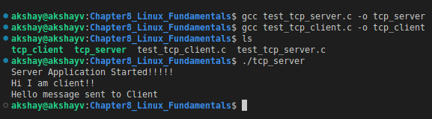
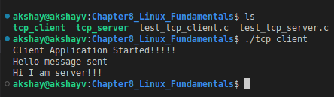
Networking sockets contd...
Example Program:
test_tcp_server.c -:
Listens for socket connection on localhost IP Address: 127.0.0.1 on Port Number : 3456.
Reply's to the client once message is received from client over socket connection.
test_tcp_client.c -:
Connects to Server over localhost IP Address: 127.0.0.1 on Port Number : 3456.
Sends a message to server on connection.
TCP/IP Connection :
127.0.0.1:3456

Slide 29
Debug tools : GDB
GDB is a debugger for C and C++.
GDB offers extensive facilities for tracing and altering the execution of computer programs.
The user can monitor and modify the values of programs' internal variables, and even call functions independently of the program's normal behavior.
GDB allows you to do things like:
Add breakpoints - Run the program up to a certain point then stop
Print out the values of certain variables at that point.
Step through the program one line at a time and print out the values of each variable after executing each line.
GDB is by default typically compiled to target the same architecture as the host system.
the host architecture: where the GDB program itself is run
the target architecture: where the program being debugged is run

Slide 30
Debugging with gdb contd...
GDB Operation:
Compile with the "-g" option when usisng GCC to compile the code.
It generates added information in the object code so the debugger can match a line of source code with the step of execution.
Do not use compiler optimization directive such as "-O" or "-O2" which rearrange computing operations to gain speed as this reordering will not match the order of execution in the source code and it may be impossible to follow.
control+c: Stop execution. It can stop program anywhere, in your source or a C library or anywhere.
To start GDB session use command: gdb ./<Program Name to debug>
GDB command completion: Use TAB key
Press TAB twice to see all available options if more than one option is available or type
GDB Commands:
Start and Stop:
Start and Stop | Description
run r run command-line-arguments run < infile > outfile | Start program execution from the beginning of the program. The command break main will get you started. Also allows basic I/O redirection.
continue c c [ignore-count] | Continue execution to next break point. [ignore-count] - Igonre number of counts breakpoint hits
kill | Stop program execution.
quit q | Exit GDB debugger.

Slide 31
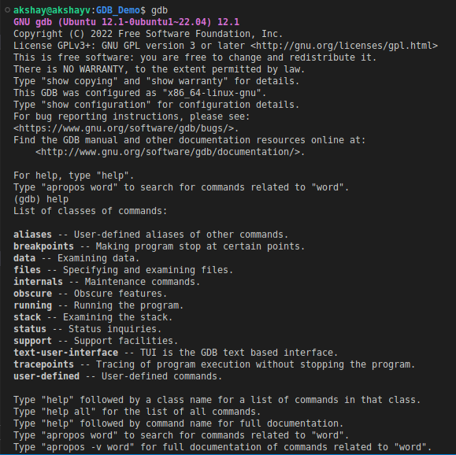
Debugging with gdb contd...
GDB Commands:
Help & Info Commands :
Will provide some help and info regarding the commands and usage :
Command | Description
help | List gdb command topics.
help topic-classes | List gdb command within class.
help command | Command description. eg help show to list the show commands
apropos search-word | Search for commands and command topics containing search-word.
info args i args | List program command line arguments
info breakpoints | List breakpoints
info break | List breakpoint numbers.
info break breakpoint-number | List info about specific breakpoint.
info watchpoints | List breakpoints
info registers | List registers in use
info threads | List threads in use
info set | List set-able option

Slide 32
Debugging with gdb contd...
GDB Commands:
Breakpoint and Watch:
Break and Watch | Description
break funtion-name break line-number break ClassName::functionName | Suspend program at specified function of line number.
break filename:function | Don't specify path, just the file name and function name.
break filename:line-number | Don't specify path, just the file name and line number. break Directory/Path/filename.cpp:62
break *address | Suspend processing at an instruction address. Used when you do not have source.
break line-number if condition | Where condition is an expression. i.e. x > 10 Suspend when boolean expression is true.
break line thread thread-number | Break in thread at specified line number. Use info threads to display thread numbers.
tbreak | Temporary break. Break once only. Break is then removed. See "break" above for options.
watch condition | Suspend processing when condition is met. i.e. x > 100
clear clear function clear line-number | Delete breakpoints as identified by command option. Delete all breakpoints in function Delete breakpoints at a given line
delete d | Delete all breakpoints, watchpoints, or catchpoints.
delete breakpoint-number delete range | Delete the breakpoints, watchpoints, or catchpoints of the breakpoint ranges specified as arguments.
disable breakpoint-number-or-range enable breakpoint-number-or-range | Does not delete breakpoints. Just enables/disables them. Example: Show breakpoints: info break Disable: disable 2-8
enable breakpoint-number once | Enables once
continue c | Continue executing until next break point/watchpoint.
continue number | Continue but ignore current breakpoint number times. Usefull for breakpoints within a loop.
finish | Continue to end of function.

Slide 33
Debugging with gdb contd...
GDB Commands:
Stack:
Stack | Description
backtrace bt bt inner-function-nesting-depth bt -outer-function-nesting-depth | Show trace of where you are currently. Which functions you are in. Prints stack backtrace.
backtrace full | Print values of local variables.
frame frame number f number | Show current stack frame (function where you are stopped) Select frame number. (can also user up/down to navigate frames)
up down up number down number | Move up a single frame (element in the call stack) Move down a single frame Move up/down the specified number of frames in the stack.
info frame | List address, language, address of arguments/local variables and which registers were saved in frame.
info args info locals info catch | Info arguments of selected frame, local variables and exception handlers.

Slide 34
Debugging with gdb contd...
GDB Commands:
Line Execution:
Use to execute code line by line.
Step into/over a function.
Run program till line number.
Line Execution | Description
step s step number-of-steps-to-perform | Step to next line of code. Will step into a function.
next n next number | Execute next line of code. Will not enter functions.
until until line-number | Continue processing until you reach a specified line number. Also: function name, address, filename:function or filename:line-number.
info signals info handle handle SIGNAL-NAME option | Perform the following option when signal recieved: nostop, stop, print, noprint, pass/noignore or nopass/ignore
where | Shows current line number and which function you are in.
Source Code | Description
list l list line-number list function list - list start#,end# list filename:function | List source code. To print lines from a source file.
set listsize count show listsize | Number of lines listed when list command given.
Source Code Commands:
To print lines from a source file during the debug session

Slide 35

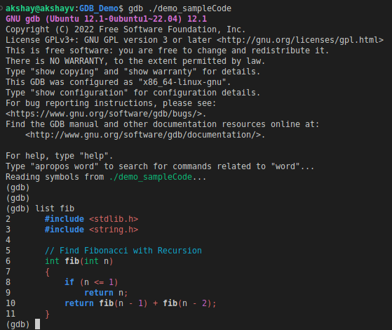
Debugging with gdb - Examples
Consider sample program : demo_sampleCode.c
The program : Prints n-th Fibonacci Number
Compile the code with command:
gcc demo_sampleCode.c -g -o demo_sampleCode
Start a GDB Session with comand:
gdb --args ./demo_sampleCode 9
Source Code Command:
To view the source code we can uses list command:
To view fib() function use command: list fib
This is where we type commands:
(gdb) < Type Commands >

Slide 36
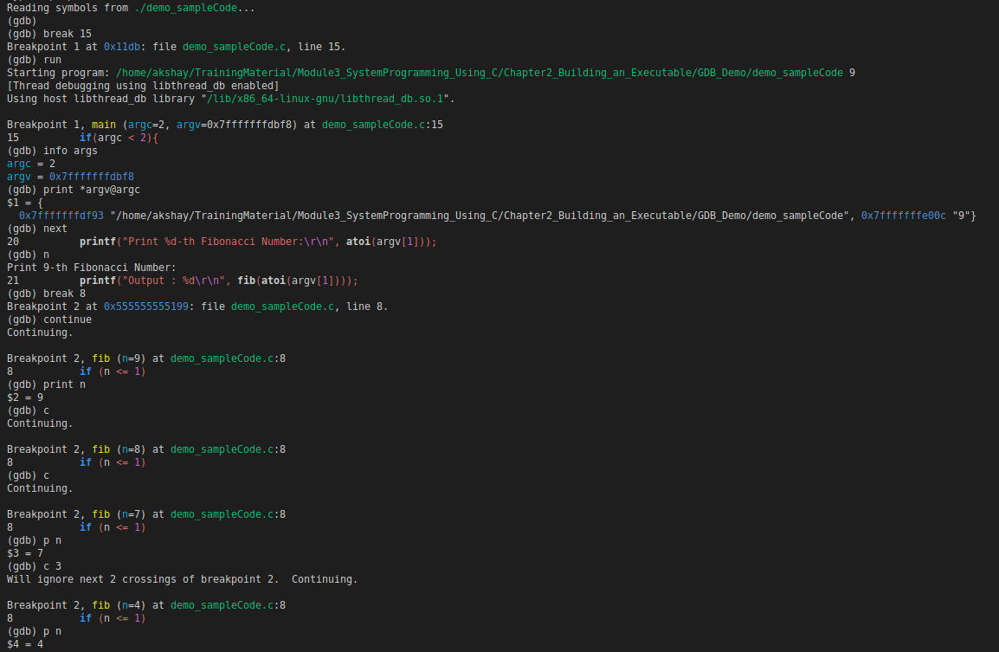
Debugging with gdb - Examples
Break Point at line 15
Run – start program
Code reach Breakpoint 1
info args : to get details about arguents to program
print *argv@argc : print arguments
1
Fig: shows some gdb commands that can be used to debug the example program
2
3
4
1. "next" or "n" : Execute next line
2. break 8 : add breakpoint at line 8
3. "continue" or "c" : Execute untill next breakpoint
4. "print n" or "p n" : Print value at variable n
5. c 3 : ignore break point 3 times
5

Slide 37
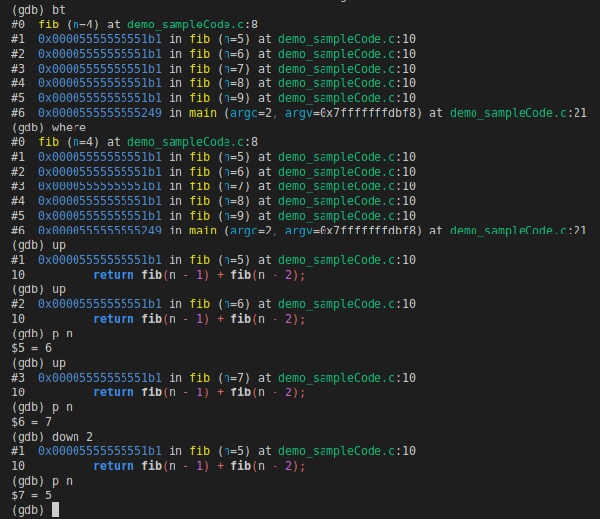
Debugging with gdb - Examples
bt : Show trace of where you are currently. Which functions you are in. Prints stack backtrace.
where : Print out the call stack including files and line numbers.
Helpful to see the function calling sequence of how execution got here, and if you ever get lost in the call stack.
Code is currently in fib (n = 4), you can see complete call sequence from main()
1
GDB – Traverse Call Stack
1. up : Go up the stack i.e. go to the line that called the function you are currently in.
2. up
3. p n : print value on n (After 2 up commands code is currently in fib( n = 6) function )
4. down 2 : Go down the stack 2 frames
5. p n : print value on n (After 1 up command and down 2 frames code is currently in
fib( n =5) function )
2
3
4
5

Slide 38
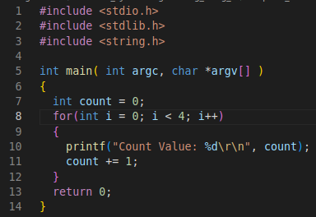
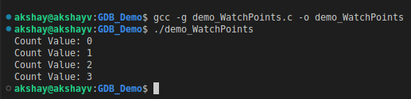
Debugging with gdb - Examples
Consider the following source code: demo_WatchPoints.c
Able to set a watchpoint on a variable in order to break a program when a variable changes.
Use display to automatically print how variables change throughout the program’s execution.

Slide 39
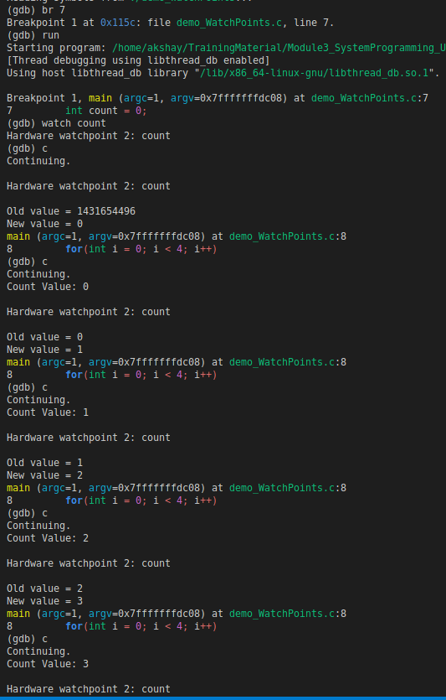
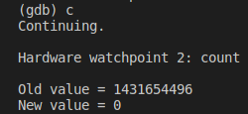
Debugging with gdb - Examples
Add breakpoint at Line 7
watch count : we want to print out value of count when it changes. So we add a watchpoint
We added watchpoint at Line 7:
int count = 0;
Before declaring the variable count there was random value at memory assigned to count.
After continuing the value got initialized to 0.
When count = 1 :
Prints out: Count Value = 1
After:
count += 1;
Value of count incremented to 2.

Slide 40
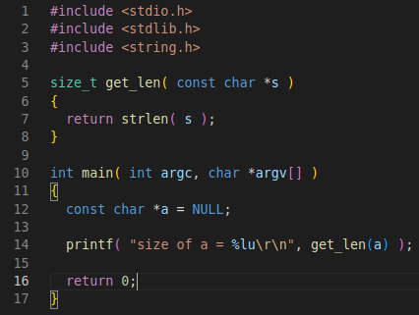

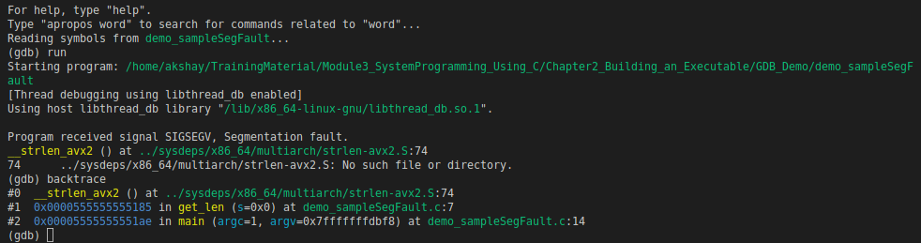
Debugging with gdb contd...
Consider the following source code: demo_sampleSegFault.c
Compile the code with below:
gcc demo_sampleSegFault.c -g -o demo_sampleSegFault
-g flag in order to include appropriate debug information on the binary generated, thus making it possible to inspect it using GDB.
When we execute the program, generates a segmentation fault
GDB can be used to inspect the problem.
Get backtrace
The problem is present in line 7, and occurs when calling the strlen(), because its argument, s, is NULL

Slide 41
Debug tools : KDB
The kernel has two debuggers KDB and KGDB.
The KDB = is kernel debugger is integrated into the kernel and allows full control of the system while a debugging session is in progress.
The KGDB = is kernel GDB server. It allows a second computer to run GDB and debug the kernel.
KDB is simple shell-style interface which you can use on a system with a keyboard or serial console & Host machine.
We can use KDB to inspect:
Memory registers
Process lists
Dmesg - prints the message buffer of the kernel.
Set breakpoints to stop in a certain location or device drivers.
Backtrace any Process
List modules
KDB is not designed as source level debugger.
KDB is mainly focused at doing some analysis to help in development or diagnosing kernel problems.
KGDB is used as a source level debugger for the Linux kernel.

Slide 42
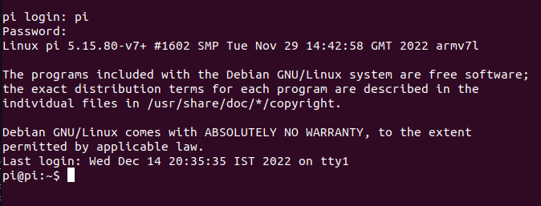
Debug tools : KDB - Setup
Serial Port Enable:
We need to use USB to Serial convertor to UART Pins on Raspberry Pi to connect serially from Host machine.
Enable the serial port on raspberry pi through configuration.
From host machine we can use Screen or Minicom to connect to Pi.
Use command :
screen /dev/ttyXXX 115200
ttyXXX is serial device assigne to USB to Serial Convertor
We will see the Login prompt, login using the correct credentials.
You can see the expected output in fig 1.
SSH Login Enable
Remote access will be required.
It makes easy to transfer files to Raspbery PI.
Follow the document for To enable remote access.
GPIO Pinout Raspberry -PI
1

Slide 43
Debug tools : KDB - Setup
Kernel config options for kdb
To use KDB we must implement shell and add some helper functions into kernel.
We need to recompile the kernel by enabling the following symbols before building the kernel:
CONFIG_FRAME_POINTER=y CONFIG_KGDB=y CONFIG_KGDB_SERIAL_CONSOLE=y CONFIG_KGDB_KDB=y CONFIG_KDB_KEYBOARD=y
To build kernel follow the Rapsberry Pi Documentation : The Linux Kernel
kdb/kgdboc arguments
Using loadable module or built-in
For kernel built-in: Use the kernel boot argument: kgdboc=<tty-device>,[baud] in /boot/cmdline.txt file
For kernel loadable module: Use the command: modprobe kgdboc kgdboc=<tty-device>,[baud]
modprobe kgdboc kgdboc=ttyS0,115200

Slide 44
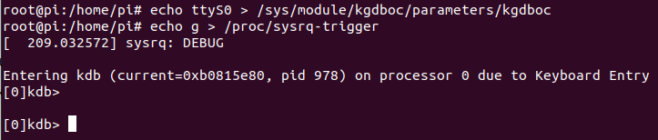
Debug tools : KDB
Using KDB
Ubuntu based Host machine used for demo
Connect using serial to Raspberry Pi as shown >>>
Root Access:
Login as root.
Or use a super user session with command: sudo su
Configure kgdboc at runtime with sysfs
At run time enable or disable kgdboc by echoing a parameters into the sysfs.
Enable kgdboc on ttyS0:
echo ttyS0 > /sys/module/kgdboc/parameters/kgdboc
Disable kgdboc:
echo "" > /sys/module/kgdboc/parameters/kgdboc
Enter the KDB:
We can enter the KDB manually or by waiting for some oops/ fault in kernel.
Manually entering kdb : echo g > /proc/sysrq-trigger
Host Computer: Laptop/ Desktop
USB to Serial
Baudrate : 115200
Connection Info
Raspberry Pi Serial Login
screen /dev/ttyXXX 115200
Screen Terminal Access

Slide 45
Debug tools : KDB
KDB Commands:
Command | Description
lsmod | To show all the loaded modules
ps | To displays the active processes
ps A | To show all the processes
summary | To show kernel version info and memory usage
bt | To get a backtrace of the current process using dump_stack()
dmesg | To view the kernel syslog buffer
go | To continue the system
help | To read the help for different commands
reboot | To reboot device

Slide 46
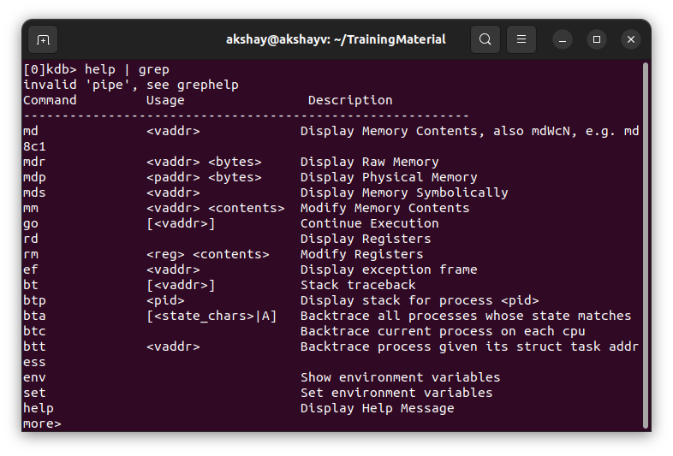
Debug tools : KDB
KDB > help:

Slide 47
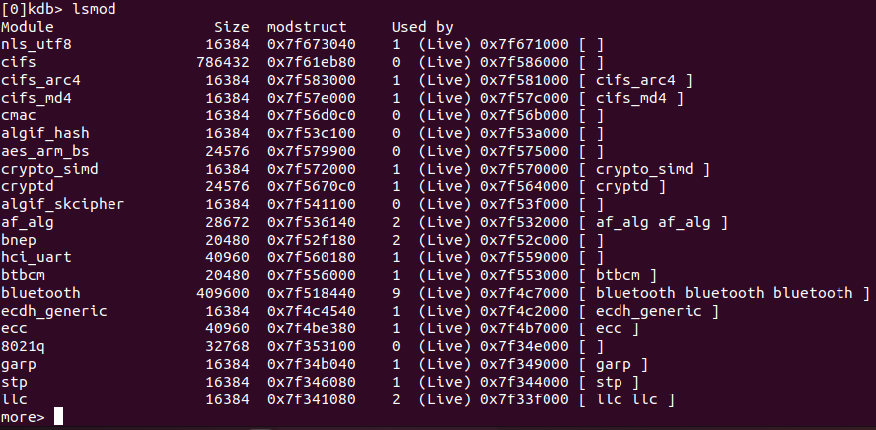
Debug tools : KDB
KDB > lsmod:
This command will show all the loaded modules into kernel

Slide 48
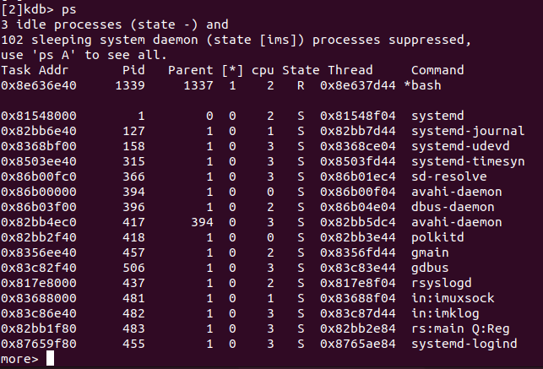
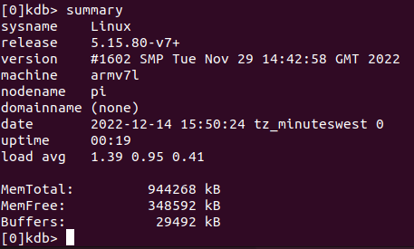
Debug tools : KDB
KDB > ps:
This command will show all active task list
KDB > summary:
To show:
Kernel version info
Memory usage.

Slide 49
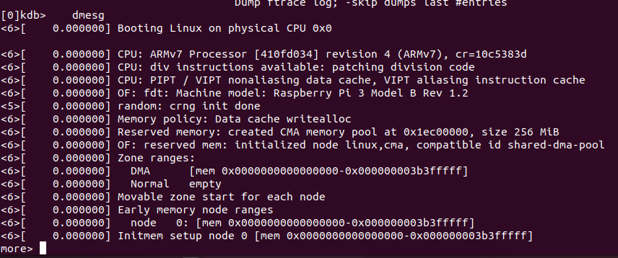
Debug tools : KDB
KDB > dmesg:
To view the kernel syslog buffer.
It prints the message buffer of the kernel.
The output shows all messages produced by the device drivers.
Kernel has own printf kernel API called printk, all those messages can be viewd in the dmesg output

Slide 50
Debug tools : KDB
KDB > demo:
For demo we will follow the steps:
Study the IOCTL System call
Write Simple Device Driver that uses IOCTL system call
Cross Compile setup for driver
How to load / unload device driver
Use KDB to put breakpoint in the device driver
Expected learning :
How to simple write device driver.
Cross compile tools
How to use KDB to debug into kernel space

Slide 51

System Calls : ioctl()
Ioctl() is an abbreviation of input/output control.
It is a system call for device-specific input/output operations and other operations which cannot be expressed by regular system calls.
It takes a parameter specifying a request code; the effect of a call depends completely on the request code.
Request codes are often device-specific.
For instance, a CD-ROM device driver which can instruct a physical device to eject a disc would provide an ioctl request code to do so.
Steps involved in IOCTL:
Create IOCTL command in the driver
Write IOCTL function in the driver
Create IOCTL command in a Userspace application
Use the IOCTL system call in a Userspace
Example Program:
device_driver_ioctl.c : Simple Device driver with IOCTL
test_ioctl_app.c : Test app which usees IOCTL request.

Slide 52

System Calls : ioctl() contd..
Define the ioctl command:
#define “Name of IOCTL” _IOx(num1, num2, argument type)
where IOx can be : “IO“: an ioctl with no parameters “IOW“: an ioctl with write parameters (copy_from_user) “IOR“: an ioctl with read parameters (copy_to_user) “IOWR“: an ioctl with both write and read parameters
num1: is a unique number or character that will differentiate our set of ioctl calls from the other ioctl calls. some times the major number for the device is used here.
num2: is the number that is assigned to the ioctl. This is used to differentiate the commands from one another.
argument type : Type of data.
Command example used in our driver:

Slide 53
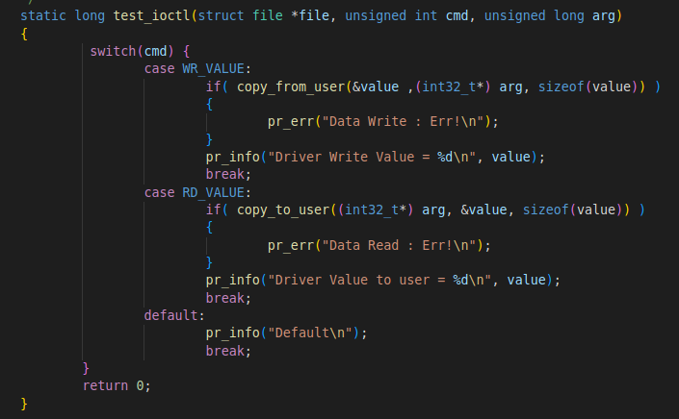
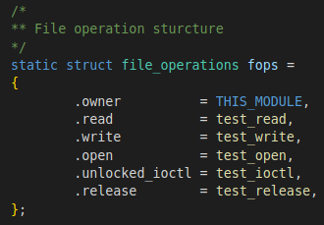
System Calls : ioctl() contd..
Write IOCTL function in the driver:
We need to add the ioctl function to our driver.
The prototype is as shown in image:
"file": the file pointer to the file that was passed by the application. "cmd" : the ioctl command that was called from the userspace. "arg": are the arguments passed from the userspace.
Within function we implement all the commands we defined.
To inform kernel that ioctl call is implemented in test_ioctl():
We make fops poiter unlocked_ioctl point to test_ioctl.

Slide 54
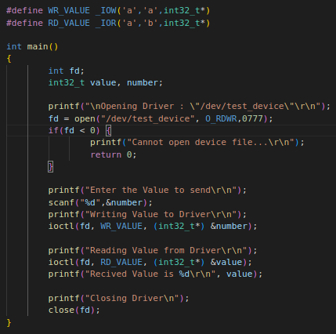
System Calls : ioctl() contd..
Create IOCTL command in a Userspace application :
In test_ioctl_app.c define the ioctl commands:
#define WR_VALUE _IOW('a','a',int32_t*)
#define RD_VALUE _IOR('a','b',int32_t*)
Use IOCTL system call in Userspace:
Open device "/dev/test_device".
Perform write & read calls:
ioctl(fd, WR_VALUE, (int32_t*) &number);
ioctl(fd, RD_VALUE, (int32_t*) &value);

Slide 55
Cross Compile the Device Driver
Make sure you have the Raspberry pi connected to Network.
Connect Raspberry pi via SSH: ssh <pi user name>@<ip address of pi>
Read the kernel version using command: uname –a
Pi on which demo is run has kernel version 5.5.80-v7+
On your host PC download Raspberry pi kernel source code from official RPI linux kernel repo into Chapter8_Linux_Fundamentals/KDB_Demo/ioctl_example dir:
git clone https://github.com/raspberrypi/linux --depth=1
On your host PC install the dependencies required cross compile the kernel:
sudo apt install git bc bison flex libssl-dev make libc6-dev libncurses5-dev
Our RPI is armv7 architecture, we need 32bit toolchain:
sudo apt install crossbuild-essential-armhf
For 64 bit use :
sudo apt install crossbuild-essential-arm64
Go the directory linux: cd linux/
make mrproper
Compile the Kernel:
make KERNEL=kernel7 ARCH=arm CROSS_COMPILE=arm-linux-gnueabihf- bcm2709_defconfig
make ARCH=arm CROSS_COMPILE=arm-linux-gnueabihf- zImage modules dtbs -j 5

Slide 56
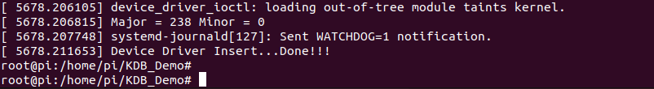
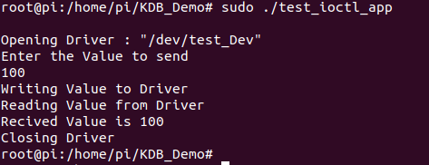

Cross Compile the Device Driver
Compile the driver Run the command : make RPI_build
Copy to the raspberry pi : scp device_driver_ioctl.ko
<pi user name>@<ip address of pi>:<path to save driver>/device_driver_ioctl.ko
Connect to raspberry pi via serial & go to directory where driver is saved.
Load the driver into system using command :
sudo insmod device_driver_ioctl.ko
To check the driver is loaded run command :
sudo dmesg
dmesg is a command
It prints the message buffer of the kernel.
Run the application using command :
sudo ./test_ioctl_app
Again check dmesg to see the log.
To unload the driver use command:
sudo rmmod device_driver_ioctl.ko
Dmesg log after loading driver
Dmesg log after running app

Slide 57
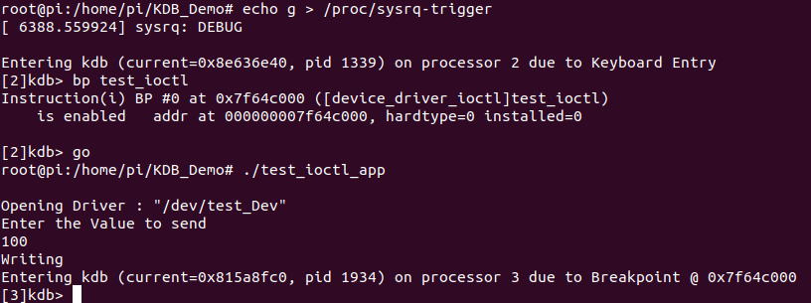

KDB Debug
Now that our driver is up and running let's put breakpoint inside the code from kdb prompt.
Load the driver again if unloaded in previous step
Start the kdb session again
Use breakpoint command:
bp <function name>
We will put breakpoint into test_ioctl() :
bp test_ioctl
Now run command go to resume the kernel execution:
Issue the ioctl call to our driver from the test code.
sudo ./test_ioctl_app
On successful execution when the test_ioctl() function is called by driver, immediately the kdb breakpoint will be triggered and it take you to the kdb prompt
In image you can see the kdb breakpoint is triggered and the kernel is hated at kdb session.
From here you can use other commands to analyze the function call.
If you have reach in kdb due to some oops call or error in kernel operation or due to some kernel panic we can analyze the events that happened that cause the issue.

Slide 58
Debug Tools
There are many other tools that can be used to debug application in user space & kernel space.
User space tools:
Printf statements : commonly used method to debug and logging purpose.
Gporf : Performance analysis tool for Linux applications
Valgrind: Debugging and profiling tools for problems like: memory leek, double freeing
Kernel space debugging:
KGDB :
Kernel space source code debugger. It can be used with GDB debugger to debug remote target device.
We can use the GDB commands to debug the source code.
It can be invoked from the KDB session
Printk() :
It is widely used function to in Linux kernel to debug the kernel source code.
It is possible to specify different log levels.
JTAG Debugger
It is a hardware debugger. It is directly connected to JTAG pins on hardware.
It is used to access the debug modules inside the target CPU.
We can debug the Linux boot sequence, device drivers etc.

