Slide 1
KLH UNIVERSITY / OSSP HACKATHON / PROBLEM 13
BANKER
OS.
Smart resource allocation
using Banker's Algorithm
NITHISH S • SAI SATHWIK • CH. VIVEK
SECTION S7 / GROUP G-13 / 17 OCTOBER 2026
Notes:
Start: Our project is a local resource manager simulator that accepts all matrices from the user and prevents unsafe allocations.

Slide 2
02 / THE CHALLENGE
What we were asked to build
The assigned problem emphasizes deciding whether each request leaves a safe state.
“Build a resource manager that checks resource requests and determines whether the system remains in a safe state.”
01
02
03
User-defined input
Safe state check
Grant or reject
Any valid process/resource dataset
Find one feasible completion sequence
Test each new request before committing
BANKER OS • OSSP HACKATHON 2026
02
Notes:
Do not claim this controls the Linux kernel. The official problem asks for a resource-manager simulator.

Slide 3
03 / THE PROBLEM
Unsafe allocations can stop progress
A system can have free resources and still make an unsafe decision.
WITHOUT SAFETY CHECKS
WITH BANKER OS
Grant resources
just because they
are currently free.
Check the future
completion order
before approving.
BANKER OS • OSSP HACKATHON 2026
03

Slide 4
04 / THE ALGORITHM
Five terms. One safety decision.
AVAILABLE
Resources free now
KEY EQUATION
ALLOCATION
Resources currently held
NEED =
MAXIMUM
Declared upper bound
MAXIMUM − ALLOCATION
NEED
Resources still required
If every process can finish in one order, the state is SAFE.
SAFE SEQUENCE
Order that lets all finish
BANKER OS • OSSP HACKATHON 2026
04

Slide 5
05 / SOLUTION ARCHITECTURE
A visual dashboard. A real C algorithm.
The web interface is only the presentation layer; allocation checks run inside C.
LAYER 1
LAYER 2
LAYER 3
BROWSER UI
→
LOCAL PYTHON API
→
COMPILED C ENGINE
Custom inputs, matrices, actions
Validates JSON, preserves workspace
Safety, grant/deny, rollback
LOCAL-FIRST • NO ONLINE DEPENDENCIES • CUSTOM INPUTS
BANKER OS • OSSP HACKATHON 2026
05

Slide 6
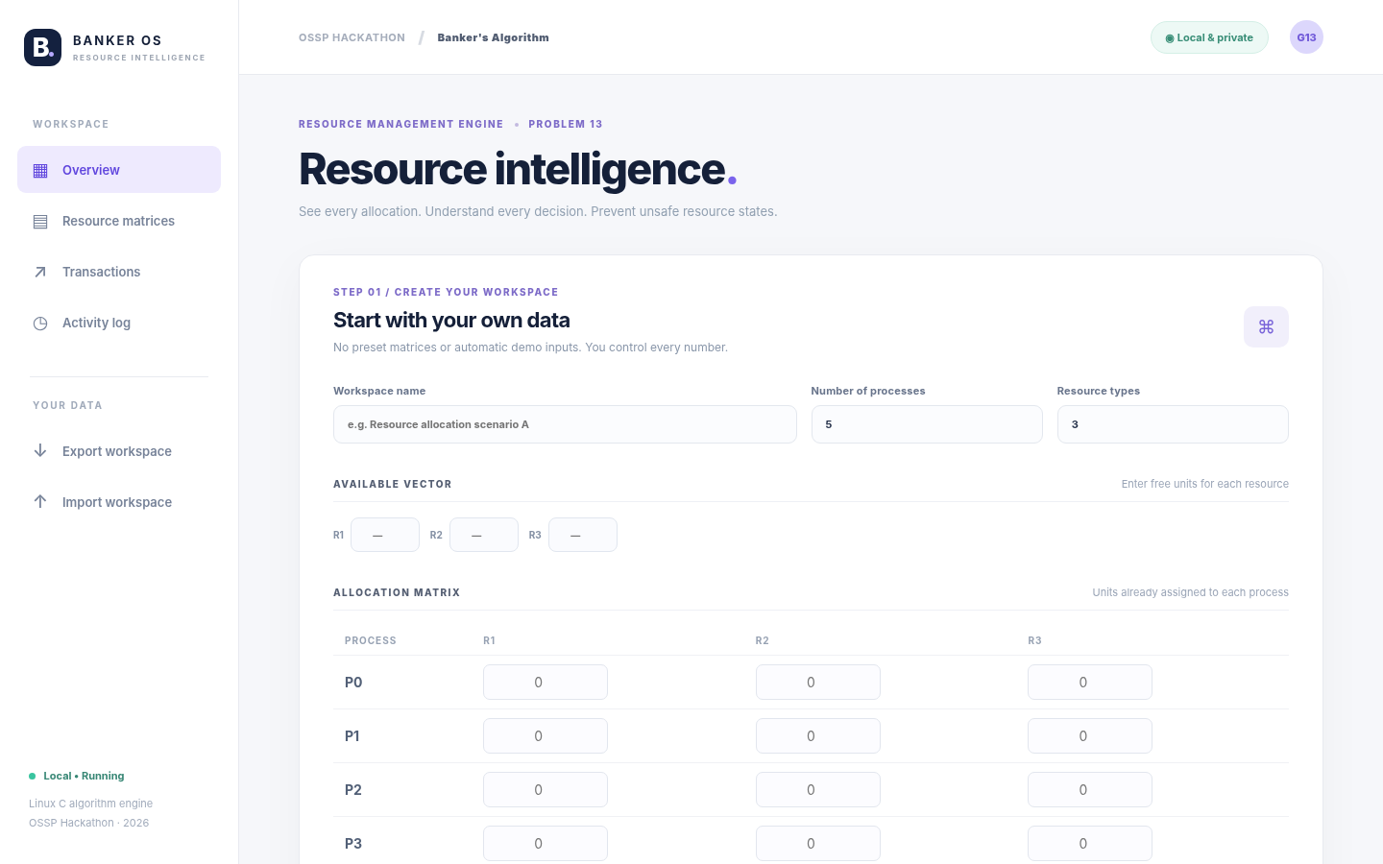
06 / USER EXPERIENCE
Every number comes from the user
Start a new workspace. Enter resources directly into clean tables.
THE INPUTS
Number of processes
Resource types
Available vector
Allocation matrix
Maximum matrix
BANKER OS • OSSP HACKATHON 2026
06

Slide 7
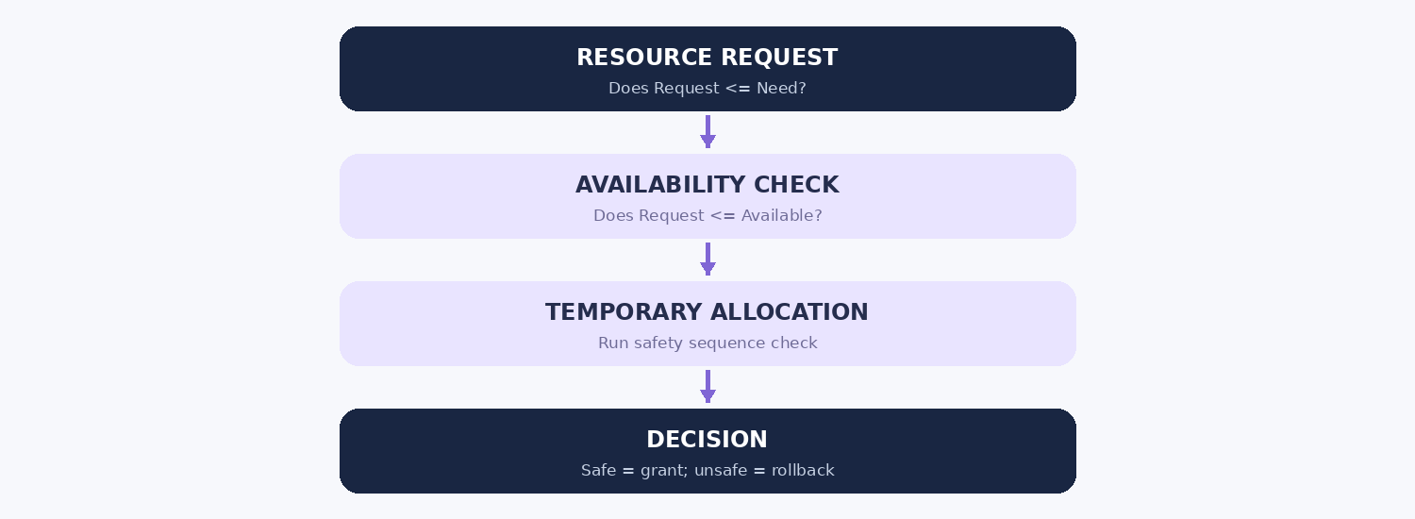
07 / EXECUTION FLOW
How the resource manager decides
A request cannot change state unless the new state is proven safe.
BANKER OS • OSSP HACKATHON 2026
07

Slide 8
08 / TEST DATASET
A transparent five-process example
Representative user-entered data for the demonstration; not a default application state.
PROCESS
ALLOCATION
MAXIMUM
NEED
AVAILABLE
P0
0 1 0
7 5 3
7 4 3
[ 3, 3, 2 ]
P1
2 0 0
3 2 2
1 2 2
P2
3 0 2
9 0 2
6 0 0
TOTAL RESOURCES
P3
2 1 1
2 2 2
0 1 1
[ 10, 5, 7 ]
P4
0 0 2
4 3 3
4 3 1
BANKER OS • OSSP HACKATHON 2026
08

Slide 9
09 / SAFETY VERIFICATION
One complete safe sequence
The engine checks Need <= Work at every step and simulates resource release.
P1
→
P3
→
P4
→
P0
→
P2
[3,3,2]
›
[5,3,2]
›
[7,4,3]
›
[7,4,5]
›
[7,5,5]
›
[10,5,7]
WORK VECTOR AFTER EACH SIMULATED COMPLETION
BANKER OS • OSSP HACKATHON 2026
09

Slide 10
10 / LIVE DECISION
A safe request is approved
Initial state is reset to Available = [3,3,2] before this test.
REQUEST
GRANTED
P1 → [ 1, 0, 2 ]
SAFE
Need P1: [ 1, 2, 2 ]
New Available = [ 2, 3, 0 ]
Available: [ 3, 3, 2 ]
Allocation is committed only after the safety test succeeds.
BANKER OS • OSSP HACKATHON 2026
10

Slide 11
11 / LIVE DECISION
An unsafe request is rolled back
This is an independent test from the original Available = [3,3,2] state.
REQUEST
DENIED
P4 → [ 3, 3, 0 ]
UNSAFE
Tentative Available [ 0, 0, 2 ]
Available stays [ 3, 3, 2 ]
No complete safe sequence
Rollback protects the previously accepted resource state.
BANKER OS • OSSP HACKATHON 2026
11

Slide 12
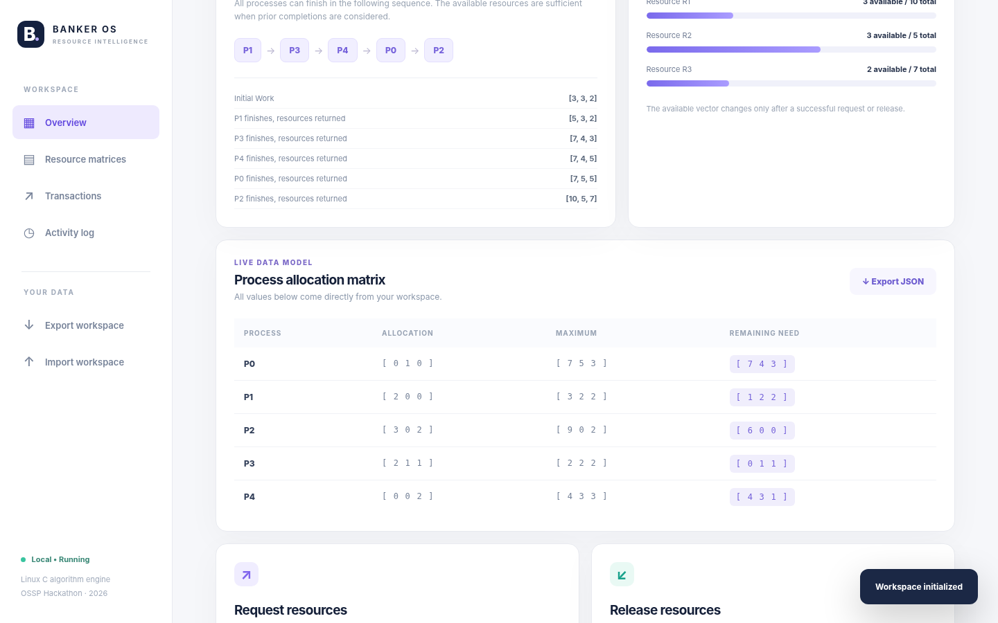
12 / LIVE PRODUCT
Clean, interactive decision dashboard
Current resources and requests remain available until you reset or exit.
BANKER OS • OSSP HACKATHON 2026
12

Slide 13
13 / VERIFICATION
Tested against real allocation cases
All 21 core unit tests passed, including rollback and edge-case checks.
SAFE REQUEST
UNSAFE REQUEST
INSUFFICIENT
P1 [1,0,2]
GRANTED
P4 [3,3,0]
DENIED
P2 [4,0,0]
DENIED
EXCEEDS NEED
RELEASE
RANDOM STATES
P1 [2,0,0]
DENIED
P1 [2,0,0]
SUCCESS
50 seeded sets
CHECKED
Validation includes input bounds, exact rollback, conserved totals, safe sequences, releases and invalid matrices.
BANKER OS • OSSP HACKATHON 2026
13

Slide 14
14 / IMPLEMENTATION
Simple deployment. No online dependencies.
UBUNTU / WSL TERMINAL
C11 core algorithm
make
Local Python server
make web
Responsive HTML/CSS/JS
JSON state persistence
Open http://localhost:8765
C terminal fallback
make test
Unit tests + documentation
BANKER OS • OSSP HACKATHON 2026
14

Slide 15
15 / TEAM EXECUTION
Three presenters. One clear story.
NITHISH S
SAI SATHWIK
CH. VIVEK
2520030346
2520030328
2520030532
Algorithm + live allocation demo
Matrices + test case explanation
Architecture + GitHub + report
Each member should also be able to explain Need = Max − Allocation and what makes a state safe.
BANKER OS • OSSP HACKATHON 2026
15

Slide 16
FINAL MESSAGE
Safer decisions.
Clearer explanations.
CUSTOM INPUTS / BANKER’S SAFETY TEST / LIVE GRANT & ROLLBACK
THANK YOU

