Slide 1
COIMBATORE INSTITUTE OF TECHNOLOGY
DEPARTMENT OF COMPUTER SCIENCE AND ENGINEERING
23CS423-PYTHON PROGRAMMING LABORATORY
PROJECT TITLE:
LEARNQUEST
A Collaborative Coding Platform
TEAM MEMBERS:
NITHIVARSHA TP
2. SANTHIYA P
3. VARSHINI K
4. POOJA GR

Slide 2
AGENDA
Introduction
Problem Statement
Objectives & Scope
Process Flow diagram
Modules
Tools & Technologies Used
Conclusion & Future Scope

Slide 3
INTRODUCTION
LearnQuest is an interactive and gamified learning platform that allows users to engage in coding challenges collaboratively.
It is designed to foster
peer-to-peer learning,
creativity, and
skill development in programming.
Users can
solve challenges,
post their own,
explore themed learning zones.

Slide 4
PROBLEM STATEMENT
Many aspiring programmers lose motivation due to dull, isolated learning experiences.
Traditional platforms often lack creativity, interactivity, and community support, making it hard to stay engaged and grow effectively.
IMPORTANCE OF THE PROJECT
LearnQuest turns coding into an engaging adventure through gamification, collaboration, and creativity.
By making learning fun and community-driven, it helps users stay motivated, build real skills, and enjoy the journey of becoming better coders.

Slide 5
OBJECTIVES
To create a gamified platform that makes coding practice fun and engaging.
To foster collaborative learning through user-generated challenges and peer interaction.
To provide structured learning paths that guide users based on skill level and interests.
To track and reward user progress through badges, leaderboards, and personal reflections.

Slide 6
SCOPES
Development of a web-based platform using React.js, Python (Flask/FastAPI), and MongoDB.
Implementation of core modules: challenge browser, search/filter, challenge creation, and peer submissions.
Integration of gamification elements like badges, leaderboards.
Initial focus on beginner to intermediate level coding challenges, with future scalability for advanced content.

Slide 7
KEY FEATURES
Arena of Quests - A variety of coding challenges categorized by difficulty (Easy, Intermediate, Hard).
Search and Filter Functionality - Users can easily search for challenges using keywords, titles, or tags and filter challenges by difficulty.
Peer-to-Peer Missions - Users can create and post their own coding challenges that encourages collaborative problem-solving through user-submitted content and shared challenges.
Badge and Achievement System - Users earn badges for completing challenges at different difficulty levels which serves as motivation and shows their progress.
Leaderboard - Adds a competitive and social element, motivating users to push their limits.
Interactive User Profiles - Users can track their growth, share their journey, and interact with others in the community.

Slide 8
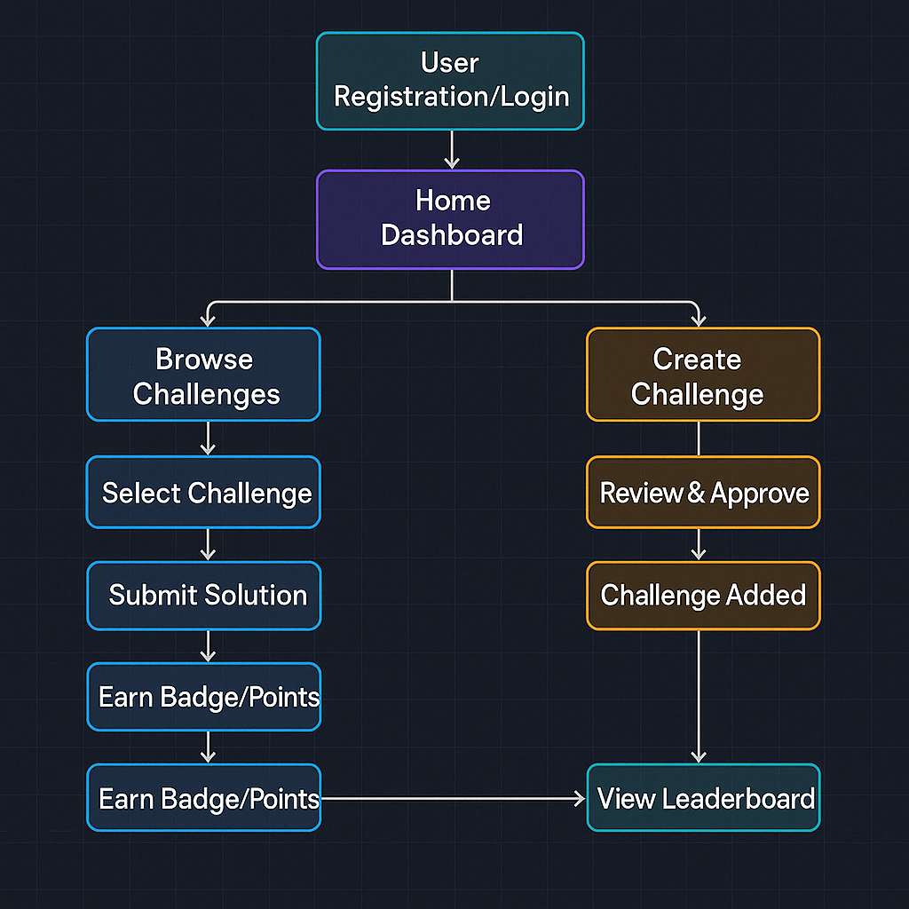
PROCESS FLOW DIAGRAM

Slide 9
MODULES
FRONTEND MODULES:
User Authentication Module
2. Challenge Browsing and Search Module
3. Challenge Creation Module
4. Leaderboard and Progress Tracker Module
BACKEND MODULES:
User Authentication and Session Management
2. Challenge Management System
3. Code Evaluation System
4. Badge and Achievement System
DATABASE MODULES:
User Data Management
2. Challenge Data Storage

Slide 10
TOOLS AND TECHNOLOGY USED
Frontend:
React.js: JavaScript library for building the user interface, providing a dynamic and responsive experience.
2. Tailwind CSS: Utility-first CSS framework for designing a clean, modern, and customizable interface.
3. Axios: To make HTTP requests from the frontend to the backend API.
Backend:
1. Python: The core programming language for the backend logic.
2. Flask / FastAPI: Web frameworks for building RESTful APIs to handle user authentication, challenge management, and data processing.
3. JWT (JSON Web Tokens): For secure user authentication and managing sessions.

Slide 11
TOOLS AND TECH USED
Database:
MongoDB: NoSQL database for storing user data, challenge information, progress tracking, and achievements in a flexible schema.
Version Control:
Git: Version control system to track changes in code and collaborate with the development team.
2. GitHub / GitLab: Repository hosting services for collaboration, code management, and version control.
Testing:
Jest: JavaScript testing framework, used to test frontend components.
2. PyTest / Unittest: Testing libraries for the Python backend to ensure the correct functionality of APIs and logic.

Slide 12
CONCLUSION
LearnQuest is more than just a platform for solving coding problems—it's a gamified, collaborative learning ecosystem designed to make programming both engaging and meaningful.
By combining creative challenge formats, community-driven content, and visual progress tracking, LearnQuest empowers learners to build their skills while having fun.
The integration of peer interaction, achievement-based motivation, and intuitive design ensures that users not only learn how to code but also grow as thinkers, collaborators, and problem solvers.
This project stands as a testament to how technology and gamification can transform traditional learning into an exciting quest for knowledge.

Slide 13
THANK YOU

