Slide 1

SRI MANAKULA VINAYAGAR
ENGINEERING COLLEGE
(An autonomous institutioN)
Data Transmission Using LED and LDR Over a Custom Communication Protocol
PRESENTED BY:
NITHYALAKSHMI S
PRATIBHA P
POOJASRI P
MONICA S

Slide 2
AGENDA
Project Overview
Problem Statement
Literature Review
Methodology
ASCII to Binary Conversion
Main Concepts of the Code
What We Did and How
Applications and Future Scope
Results

Slide 3
Project Overview
Project Title:
Data Transmission Using LED and LDR Over a Custom Communication Protocol
Team Members:
[NITHYALAKSHMI S] – Project Designer and Coder
[MONICA S] – Hardware Assembler
[PRATIBHA P] – Documentation and Research
[POOJASRI P] – Presentation and Visual Design
Introduction:
This project demonstrates a low-cost, simple data transmission system using visible light.
Uses an LED as the transmitter and an LDR as the receiver.
Aims to create a custom communication protocol for data exchange.

Slide 4
Problem Statement
Problem:
RF-based wireless systems face interference, security risks, and EM pollution.
Need for a cleaner, short-range communication system.
Background:
Based on Visible Light Communication (VLC) concepts like Li-Fi.
VLC is secure, efficient, and uses light instead of radio waves.
Inspiration:
“During Diwali, I saw light before hearing sound. That moment reminded me that light travels faster, which sparked this idea.”

Slide 5
Literature Review
Existing Research:
“Complete Data Transmission using Li-Fi Technology” – INCOFT 2022 (IEEE) Achieved high-speed VLC using specialized hardware.
Gaps Identified:
Most systems are costly, complex, and not suited for educational use.
Lack of basic, DIY-friendly VLC implementations.
Research Questions:
Can we create a low-cost VLC system with basic components?
How reliable is it under ambient noise and short-range conditions?
What are the technical limitations?

Slide 6
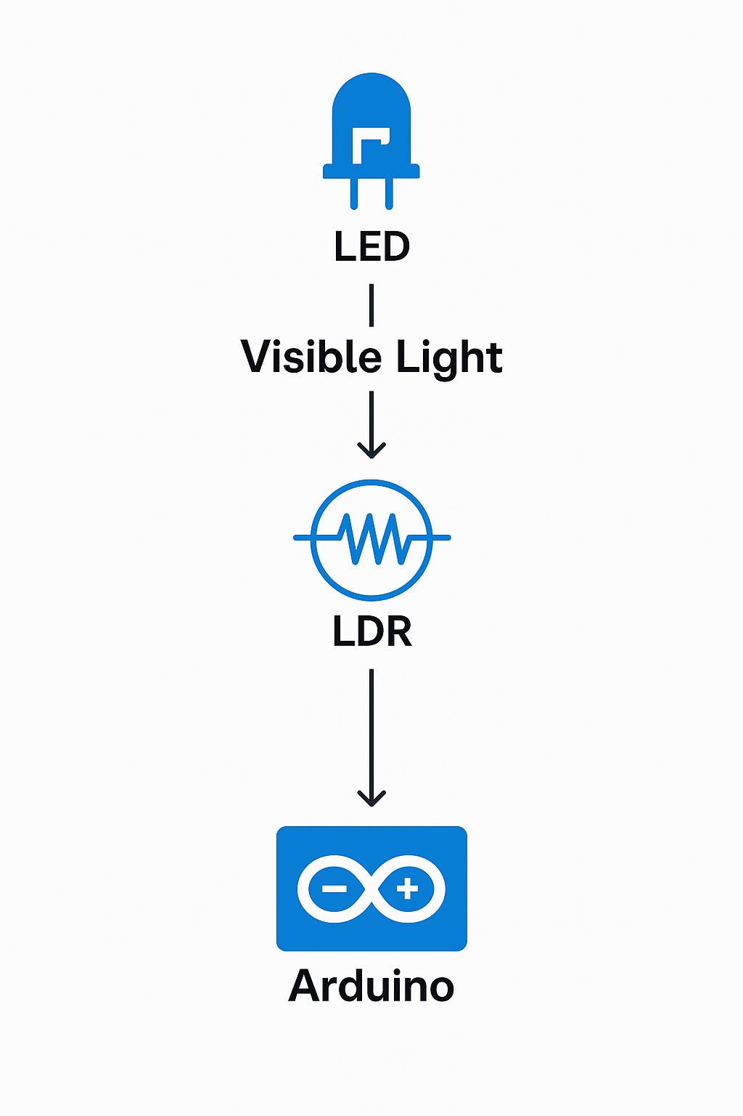
Methodology
Hardware Used:
Arduino Uno, LED, LDR, Resistors
Software Tools:
Arduino IDE
How It Works:
Transmitter converts text to binary.
LED blinks ON/OFF for 1s and 0s.
LDR detects changes in light and reconstructs bits into characters.
Experimental Setup:
LED faces LDR in a fixed short distance.
Low-light environment to reduce noise.
Serial monitor shows decoded characters.

Slide 7
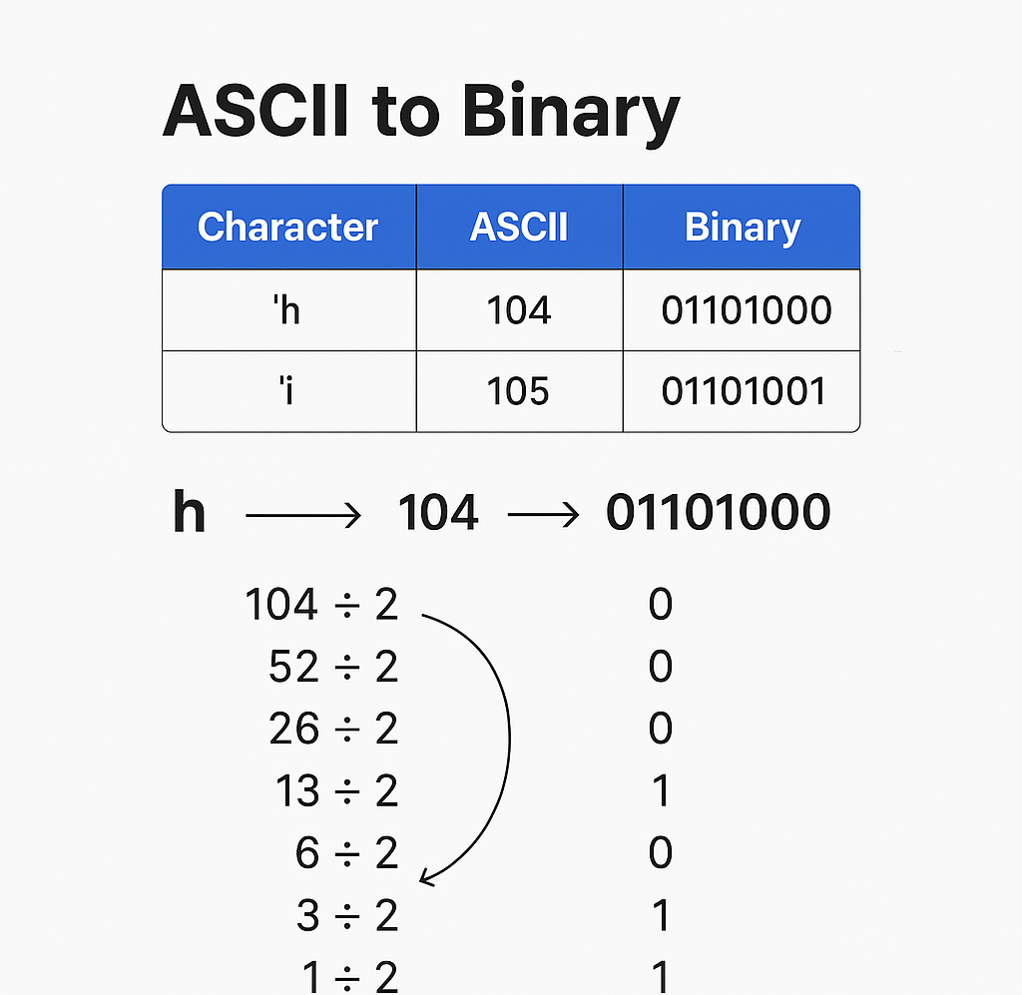
ASCII to Binary Conversion
Step-by-Step Example for 'h':
'h' → ASCII: 104
104 ÷ 2 = 52 remainder 0
52 ÷ 2 = 26 remainder 0
…
Final binary = 01101000 (read remainders from bottom up)
Each of these 8 bits is sent via LED with fixed time intervals.

Slide 8
Main Concepts of the Code
Transmitter (send_byte()):
Each character converted into 8-bit binary.
Sends start bit → 8 data bits → stop bit.
Uses digitalWrite(LED_PIN, HIGH/LOW).
Receiver (get_byte()):
LDR reads analog values using analogRead().
Converts light to digital 1/0 by comparing against THRESHOLD.
Samples signal every PERIOD ms to decode character.
Synchronization is key—both sender and receiver use same PERIOD.

Slide 9
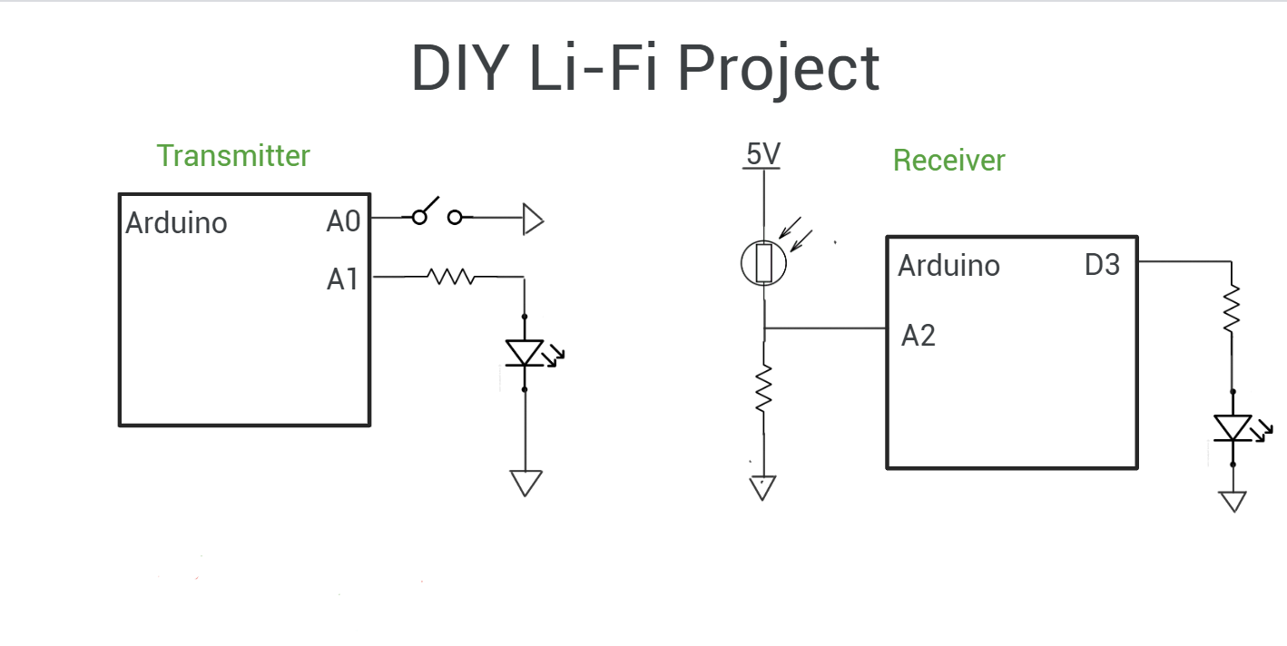
What We Did and How
Hardware Setup:
LED connected to Arduino (A1)
LDR with resistor on A2 (voltage divider circuit)
Software Logic:
Transmitter code sends data via blinking LED.
Receiver reads light changes and decodes to ASCII.
Process Flow:
Character input
Converted to binary
LED blinks ON/OFF
LDR captures pattern
Arduino reconstructs original character

Slide 10

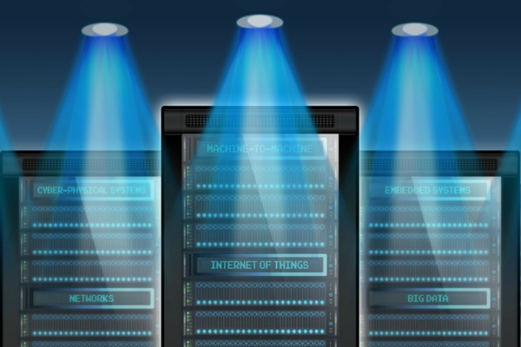
Applications and Future Scope
Applications:
Short-range communication (e.g., hospitals, airplanes)
Educational tool for embedded systems and networking
Simple data transfer in IoT systems
Underwater Communication
Future Enhancements:
Add parity bits for error checking
Use photodiodes or amplifiers for better reception
Support larger messages or files
Turn into a mini Li-Fi prototype

Slide 11
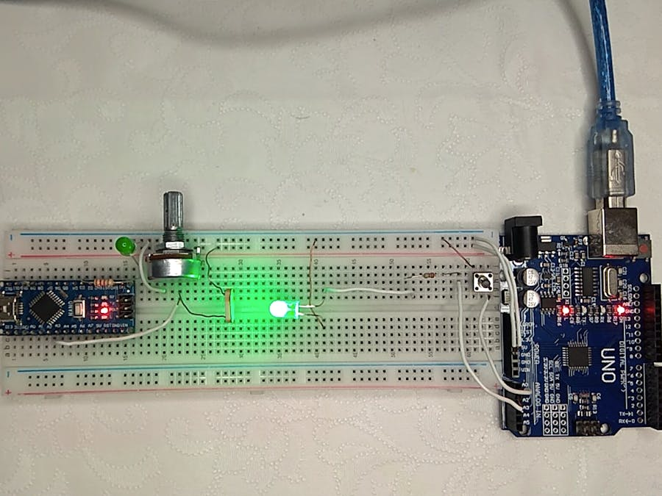
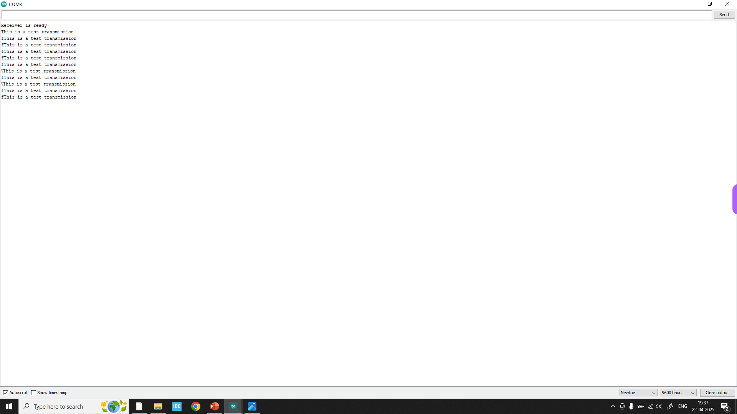
Results

Slide 12


ANY QUERIES

Slide 13
THANK YOU !

