Slide 1


K. RAMAKRISHNAN COLLEGE OF ENGINEERING
(AUTONOMOUS), SAMAYAPURAM - TRICHY
DEPARTMENT OF CSE
CGB1121 – PYTHON PROGRAMMING
FACE DETECTION WITH WEB CAM
PRESENTED BY
SUPERVISOR
S. NITHYASREE
8115U25CS113
S. PREETHA
8115U25CS121
Mr. B. SENTHIL RAJAMANOKAR
Assistant Professor / IT
DATE OF REVIEW: 05/06/2026

Slide 2
INTRODUCTION
Face Detection is a computer vision technique used to identify and locate human faces in images or video frames.
This project uses Python and the OpenCV library to detect faces in real-time via webcam.
Manual monitoring is time-consuming and error-prone — an automated system improves efficiency.
Haar Cascade classifiers are used for accurate, fast face detection.
The application also detects and labels gender (Male / Female) in real-time.
K. RAMAKRISHNAN COLLEGE OF ENGINEERING (AUTONOMOUS)

Slide 3
ABSTRACT
This project presents a Face Detection Application with Webcam developed using Python and OpenCV for real-time image processing. The application detects human faces using a webcam and highlights them with bounding boxes. Haar Cascade classifiers are used to identify faces in video frames accurately.
The system captures frames continuously, converts them to grayscale to improve performance, and detects multiple faces simultaneously. A deep learning model (Caffe-based) is integrated for gender prediction (Male / Female). The project demonstrates practical implementation of computer vision, image processing, and real-time detection using Python.
K. RAMAKRISHNAN COLLEGE OF ENGINEERING (AUTONOMOUS)

Slide 4
ARCHITECTURE DIAGRAM
Webcam
Input
Frame
Capture
Grayscale
Conversion
Haar Cascade
Classifier
Face
Detection
Display
Output
Real-Time Face Detection Pipeline
Faces detected in each frame → Bounding boxes drawn → Gender label displayed → Output rendered on screen in real time
K. RAMAKRISHNAN COLLEGE OF ENGINEERING (AUTONOMOUS)

Slide 5
MODULES USED
1.Window & Webcam Setup
Initializes the application window and activates the webcam using OpenCV.
2.Webcam Control / Frame Selection
Captures live video frames continuously and passes them to the detection module.
3.detect_faces(frame)
Converts frames to grayscale and applies Haar Cascade to detect faces.
4.update_frame()
Core loop — captures, processes, and displays detected faces in real time.
5.Gender Detection Logic
Uses a pre-trained Caffe model to classify detected faces as Male or Female.
6.close() / Exit
Stops the webcam, releases resources, and closes all windows.
K. RAMAKRISHNAN COLLEGE OF ENGINEERING (AUTONOMOUS)

Slide 6
IMPLEMENTATION – KEY CODE
import cv2
gender_net = cv2.dnn.readNet("gender_net.caffemodel", "deploy_gender.prototxt")
gender_list = ['Male', 'Female']
face_cascade = cv2.CascadeClassifier(
cv2.data.haarcascades + 'haarcascade_frontalface_default.xml')
cap = cv2.VideoCapture(0)
while True:
ret, frame = cap.read()
gray = cv2.cvtColor(frame, cv2.COLOR_BGR2GRAY)
faces = face_cascade.detectMultiScale(gray, 1.3, 5)
for (x, y, w, h) in faces:
cv2.rectangle(frame, (x, y), (x+w, y+h), (255, 0, 0), 2)
blob = cv2.dnn.blobFromImage(frame[y:y+h, x:x+w], 1.0, (227, 227),
(78.4, 87.8, 114.9), swapRB=False)
gender_net.setInput(blob)
gender = gender_list[gender_net.forward()[0].argmax()]
cv2.putText(frame, gender, (x, y-10),
cv2.FONT_HERSHEY_SIMPLEX, 0.9, (0,255,0), 2)
cv2.imshow('Face Detection', frame)
if cv2.waitKey(1) & 0xFF == ord('q'):
break
cap.release();
cv2.destroyAllWindows()
K. RAMAKRISHNAN COLLEGE OF ENGINEERING (AUTONOMOUS)

Slide 7
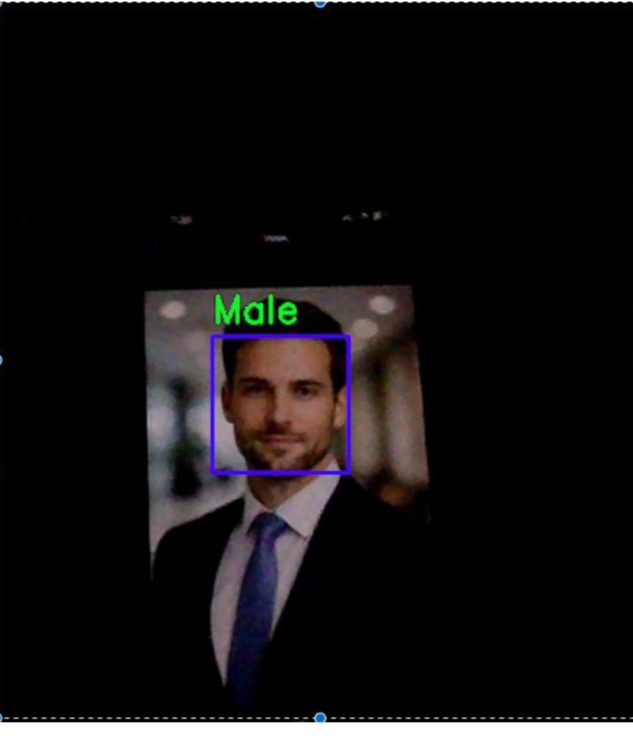
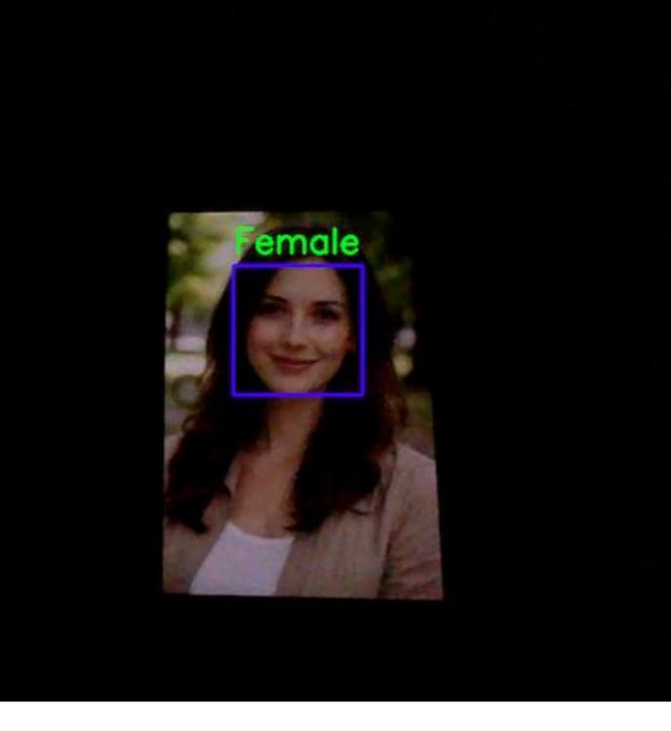
RESULT – OUTPUT
Male
Female
👤
👤
K. RAMAKRISHNAN COLLEGE OF ENGINEERING (AUTONOMOUS)

Slide 8
CONCLUSION
The Face Detection Application with Webcam was successfully developed using Python and OpenCV.
Haar Cascade classifiers enable accurate, real-time face detection from live webcam input.
The integrated gender detection model adds intelligence beyond basic face localization.
The system handles multiple faces simultaneously with smooth real-time performance.
Future enhancements include: face recognition, attendance system integration, mobile/web deployment, emotion detection, and a full GUI.
K. RAMAKRISHNAN COLLEGE OF ENGINEERING (AUTONOMOUS)

