Slide 1
Designing the Next Generation Workspace
Spatial Design and Collaborative Environments
Notes:
Product showcase with high resolution photography.

Slide 2
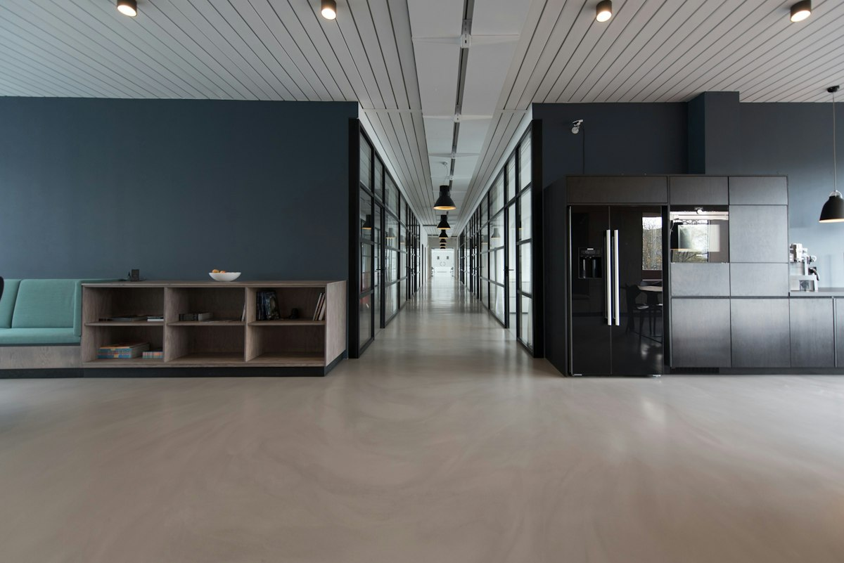
Modern Minimalist Work Environments
Designed for deep collaborative and asynchronous workflows
Acoustic isolation zones paired with open innovation hubs
Energy efficient circadian lighting systems installed throughout
Photo: Unsplash
Notes:
Split layout with curated stock photography.

Slide 3
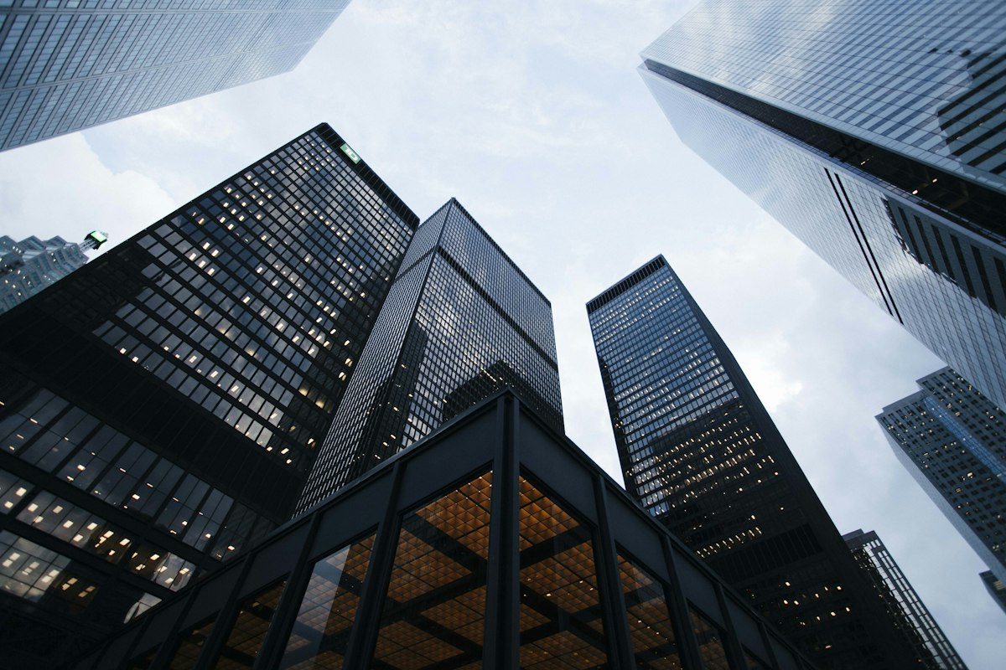
Architectural Vision for 2030
Global headquarters tower
Notes:
Full bleed dramatic hero image with text overlay.

