Slide 1
AetherGuard Forensic: Deepfake Detection System
Piyush (2210992041)
Nishant (2210991988)
Anshul (2210991311)
Subject: IOHE(Industry Oriented Hands-on Experience)
Supervised by : Dr. Rajat Takkar
Chitkara University Institute of Engineering and Technology,
Chitkara University, Punjab

Slide 2

Presentation Outline
Introduction
Problem Statement
Objective
Methodology
System Architecture
Key Features
Technology Stack
Results and Output
Key Findings
Conclusion
Challenges Faced
Future Scope

Slide 3
Introduction
AetherGuard Forensic is an AI-based system developed to detect deepfake content in digital media. With the rapid growth of manipulated images and videos, it has become increasingly difficult to distinguish between real and fake content. This system addresses that challenge by analyzing visual inconsistencies, biometric patterns, and generative artifacts using advanced deep learning models. It supports multiple input types, including images, videos, and live webcam streams, making it a comprehensive solution for modern digital forensics.
The system leverages powerful architectures such as EfficientNet and Vision Transformers to accurately classify media as real, fake, or suspicious. It provides real-time results through an interactive dashboard, enabling users to easily understand and verify content authenticity. By combining artificial intelligence with user-friendly design, AetherGuard Forensic aims to enhance trust, security, and reliability in digital media, making it a practical tool for both individuals and organizations.

Slide 4
Problem Statement
In today’s digital age, the rapid growth of deepfake technology has made it increasingly difficult to distinguish between real and manipulated media. Deepfake images and videos can be easily created using advanced artificial intelligence techniques, leading to serious concerns such as misinformation, identity misuse, and loss of trust in digital platforms. This creates a major challenge for individuals, organizations, and society, as verifying the authenticity of digital content has become more complex than ever before.
With the advancement of artificial intelligence, there is a growing need for intelligent systems that can detect deepfake content accurately and efficiently. However, many existing solutions are either complex, computationally expensive, or not easily accessible to everyday users. AetherGuard Forensic addresses this problem by providing an AI-based system that analyzes digital media using deep learning models to identify manipulated content. It offers a user-friendly interface and real-time detection, helping users verify authenticity and improve trust in digital media.

Slide 5
Objective
The primary objective of AetherGuard Forensic is to develop an AI-based system capable of accurately detecting deepfake content in digital media. The system aims to analyze images, videos, and live webcam inputs to identify whether the content is real, fake, or suspicious. By leveraging advanced deep learning models, it focuses on detecting visual inconsistencies, biometric anomalies, and generative artifacts that are commonly present in manipulated media.
Another key objective is to provide a user-friendly and real-time detection platform that is accessible to a wide range of users. The system is designed to integrate powerful models such as EfficientNet and Vision Transformers to ensure high accuracy and performance. Additionally, it aims to enhance trust, security, and reliability in digital media by offering an efficient, scalable, and easy-to-use solution for deepfake detection in real-world scenarios.

Slide 6
Methodology
The methodology of AetherGuard Forensic follows a structured pipeline for detecting deepfake content. The system accepts input in the form of images, videos, or live webcam streams. Initially, the input data undergoes preprocessing using techniques such as face detection and alignment through MTCNN, followed by normalization and resizing to ensure consistency. This step prepares the data for accurate analysis by removing noise and focusing on relevant features.
After preprocessing, the system extracts meaningful features using deep learning models such as EfficientNet and Vision Transformers. These models analyze visual patterns, textures, and inconsistencies to detect signs of manipulation. The extracted features are then passed through a classification layer that predicts whether the content is real, fake, or suspicious. Finally, the result is displayed on an interactive dashboard in real time, enabling users to easily interpret and verify the authenticity of the media.

Slide 7
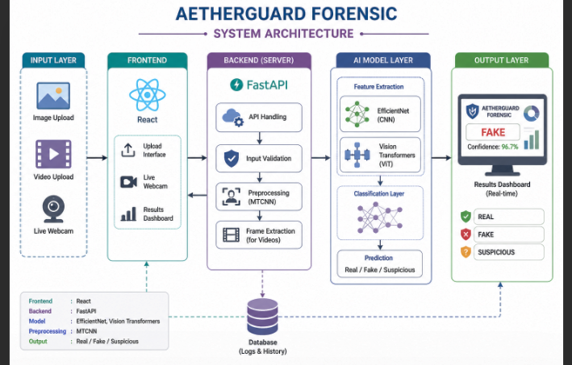
System Architecture
The system follows a pipeline from user input to AI model processing and real-time output.

Slide 8
Key Features & Learnings
Multimodal Detection: Supports images, videos, and live webcam input.
AI-Based Classification: Uses EfficientNet and Vision Transformers for accurate deepfake detection.
Real-Time Analysis: Provides instant results through an interactive dashboard.
Advanced Preprocessing: Uses MTCNN for face detection and alignment.
User-Friendly Interface: Simple and intuitive dashboard for easy usage
Modern Full-Stack Architecture: React frontend with FastAPI backend for efficient processing.
Secure API Communication: Ensures safe and reliable data transfer between frontend and backend

Slide 9
Technology Stack
Frontend:
The frontend is developed using React, providing an interactive and user-friendly dashboard. It allows users to upload images, videos, or use live webcam input and view detection results in real time. HTML, CSS, and JavaScript ensure smooth UI interactions.
Backend:
The backend is built using FastAPI (Python), which handles API requests, processes input data, and communicates with AI models. It ensures fast, scalable, and efficient processing of media inputs.
Data Processing:
Data preprocessing is performed using MTCNN for face detection and alignment. The input media is resized, normalized, and prepared for analysis to improve model accuracy and consistency.
AI Model Integration:
The system uses EfficientNet (CNN) and Vision Transformers (ViT) implemented in PyTorch for feature extraction and classification. These models analyze visual patterns and classify content as real, fake, or suspicious.

Slide 10

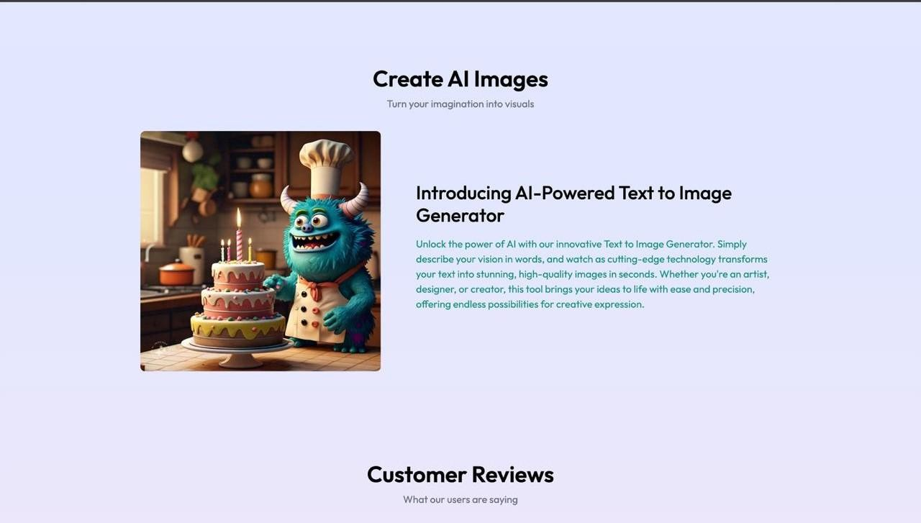

Results and Output

Slide 11


Results and Output

Slide 12
Key Findings
The system successfully detects deepfake content across images, videos, and live webcam inputs.
Deep learning models such as Efficient Net and Vision Transformers achieved high accuracy in identifying manipulated media.
The use of MTCNN preprocessing improved detection performance by focusing on facial features.
The system provides real-time results through an interactive dashboard with fast response time.
The ensemble approach improves reliability and reduces false predictions compared to single-model systems.

Slide 13
Conclusion
The development of AetherGuard Forensic marks a significant step toward addressing the growing challenge of deepfake content in digital media. The system integrates advanced deep learning models such as EfficientNet and Vision Transformers to analyze and classify media as real, fake, or suspicious. By supporting multiple input types including images, videos, and live webcam streams, the platform provides a comprehensive and practical solution for detecting manipulated content.
The system is designed to be efficient, scalable, and user-friendly, offering real-time detection through an interactive dashboard. It enhances trust and authenticity in digital media by enabling users to verify content easily. With its modular architecture and adaptability, AetherGuard Forensic can be extended for large-scale deployment in areas such as cybersecurity, media verification, and digital forensics.

Slide 14
Challenges Faced
Model Accuracy & Generalization: Ensuring reliable detection across diverse deepfake types while minimizing false positives.
Real-Time Processing: Achieving fast inference speed without compromising model performance.
Data Quality & Availability: Limited and imbalanced datasets for real vs deepfake media affected training.
System Integration: Seamless integration of frontend (React), backend (FastAPI), and AI models.
Computational Resources: High processing requirements for deep learning models during training and inference.

Slide 15
Future Scope
Improved Model Accuracy: Enhance detection using larger datasets and advanced hybrid AI models.
Mobile Application Development: Extend the system to Android/iOS for on-the-go deepfake detection.
Cloud Deployment & Scalability: Deploy on cloud platforms for large-scale, real-time processing.
Integration with Social Media Platforms: Enable automatic detection of deepfake content on online platforms.
Real-Time Video Surveillance: Apply the system in security and surveillance systems for live monitoring.

Slide 16


