Slide 1
Capstone Project
Bike sharing demand prediction

Slide 2
Table of Content
Introduction
Reason Behind the Project
Project Description
Dataset Information
Data Summary
Features Analysis
Data Preprocessing
Exploratory Data Analysis
Implementing Algorithms
Challenges
Conclusion

Slide 3
Introduction
Bike sharing systems are a type of bicycle rental service in which the procedure of obtaining a membership, renting a bike, and returning the bike is all done through a network of kiosks located around a city.
People can rent a bike from one location and return it to a different
location on an as-needed basis using these systems.
The purpose of this study is to estimate bike rental demand by combining past bike usage trends with meteorological data. The data set consists of two years' worth of hourly rental data.

Slide 4
Reason Behind the Project
Bike share systems have been growing in popularity across the nations. The concept is simple. There are racks of bikes set up around the city, and people can rent a bike for a short period of time, even if only to get from point A to point B.Covid-19 has had a significant impact on shared mobility and more particularly on the use of shared bikes. As people reassess ground transportation options in the face of the COVID-19 pandemic, many are choosing isolated modes such as sharing bikes over public transportation.

Slide 5
Dataset Information
Currently Rental bikes are introduced in many urban cities for the enhancement of mobility comfort. It is important to make the rental bike available and accessible to the public at the right time as it lessens the waiting time. Eventually, providing the city with a stable supply of rental bikes becomes a major concern. The crucial part is the prediction of bike count required at each hour for the stable supply of rental bikes. The dataset contains weather information (Temperature, Humidity, Windspeed, Visibility, Dewpoint, Solar radiation, Snowfall, Rainfall), the number of bikes rented per hour and date information.

Slide 6
Dataset Summary
Date : year-month-day
Rented Bike count - Count of bikes rented at each hour
Hour - Hour of the day
Temperature-Temperature in Celsius
Humidity - %
Wind speed - m/s
Visibility - 10m
Dew point temperature - Celsius
Solar radiation - MJ/m2
Rainfall - mm
Snowfall - cm
Seasons - Winter, Spring, Summer, Autumn
Holiday - Holiday/No holiday
Functional Day – No Func(Non Functional Hours), Fun(Functional hours)

Slide 7
Data Preprocessing
There were No Missing Values ,No Duplicate ,No null values. Clean data did our most of the preprocessing. The dataset shows hourly rental data for one year (1 December 2017 to 31 November(2018)(365 days).we consider this as a single year data. we converted the "date" column into 3 different column "year", "month", "day". We changed the names of some features for our convenience bike_count', 'Hour', Temperature', 'Humidity', 'Wind_speed', 'Visibility', ‘dew-temp', solar-rad', rainfall ', snowfall ', 'Seasons', 'Holiday', 'Functioning_Day', 'month','weekdays_weekend’,

Slide 8
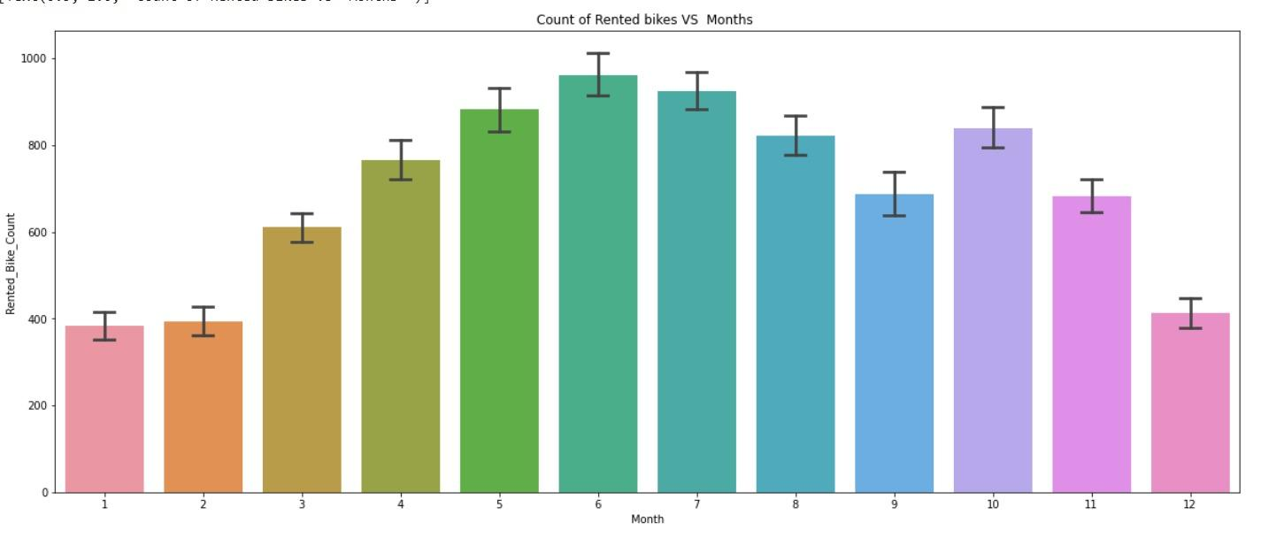
ANALYSIS OF MONTH VARIABLE
e bar plot we can clearly say that from the month 5 to 10 the demand of the rented bike is high as compare to other months.
Above bar plot shows that from the month 5 to 10 the demand of the rented bike is high & month 1 and 2 shows less demand as compare to other months.

Slide 9
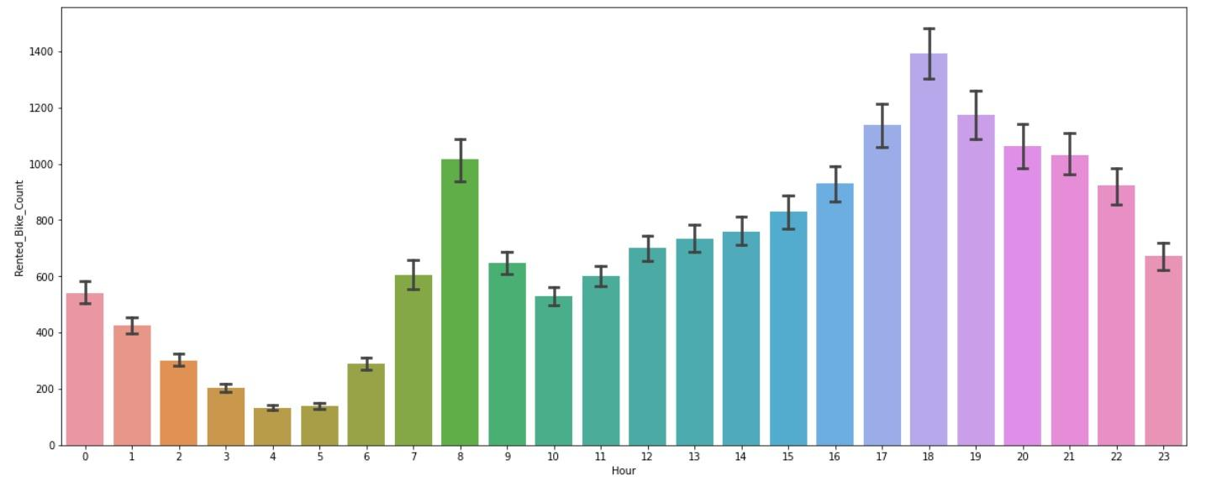
ANALYSIS OF HOUR VARIABLE
In the above plot which shows the use of rented bike according the hours and the data are from all over the year
generally people use rented bikes during their working hour from 7am to 9am and 5pm to 7pm

Slide 10
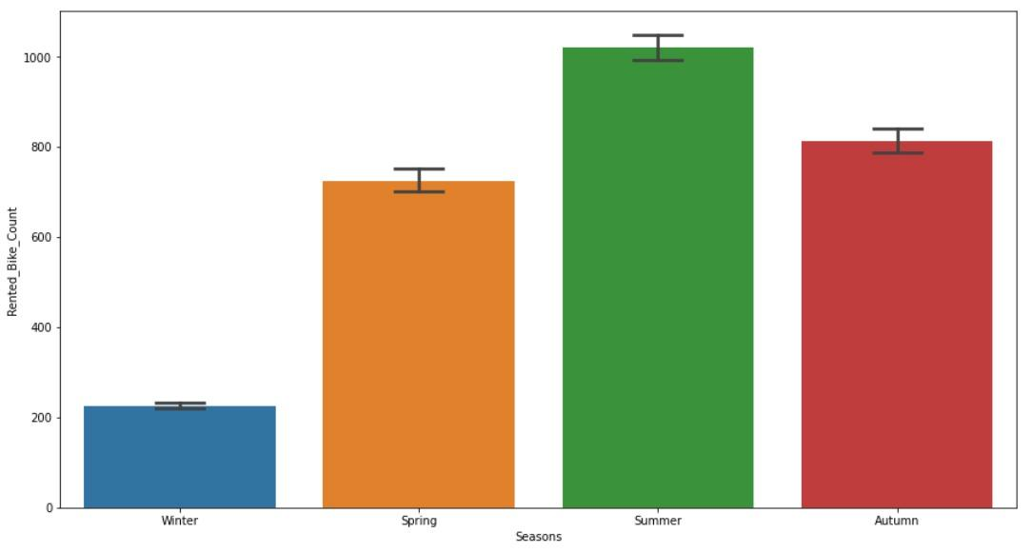
ANALYSIS OF SEASON VARIABLE
Traffic in the summer was too high as compare to the other seasons where as in winter it was too low

Slide 11
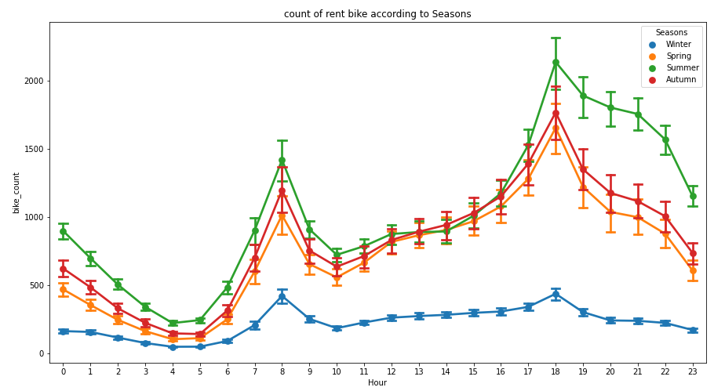
ANALYSIS OF HOURS W.R.T. SEASONS
Hour-8 & Hour-18 were the most demanded hours where as hour-4 showed us most lowest demand

Slide 12
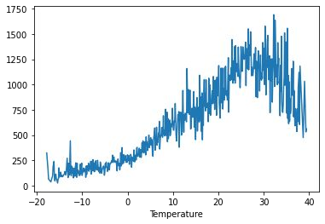
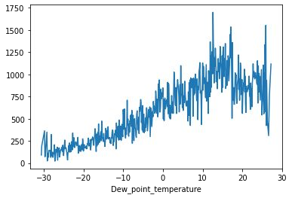
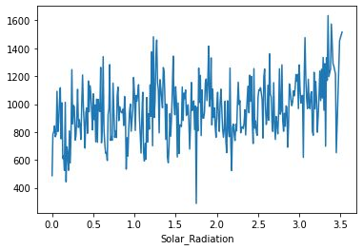
NUMERICAL VS.RENTED BIKE COUNT

Slide 13
NUMERICAL VS.RENTED BIKE COUNT
From the above plot we see that people like to ride bikes when it is pretty hot around 25°C in average
From the above plot of "Dew_point_temperature' is almost same as the 'temperature' there is some similarity present we can check it in our next step
from the above plot we see that, the amount of rented bikes is huge, when there is solar radiation, the counter of rents is around 1000

Slide 14
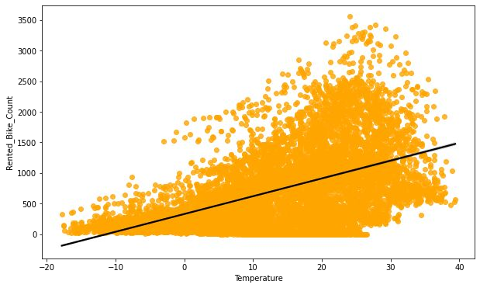
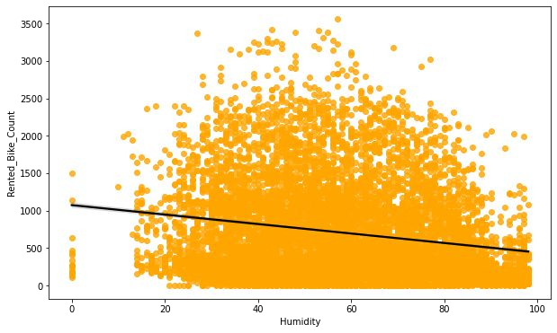
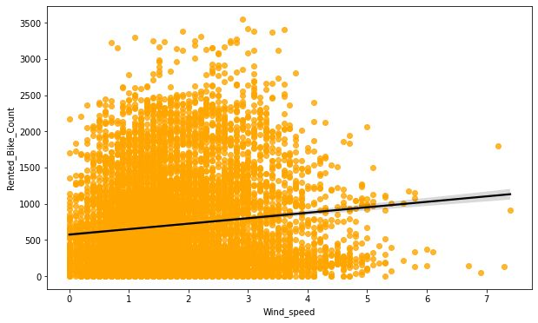
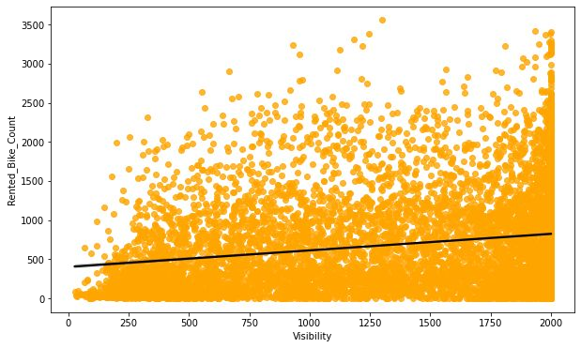
REGRESSION PLOT FOR NUMERICAL VARIABLE

Slide 15
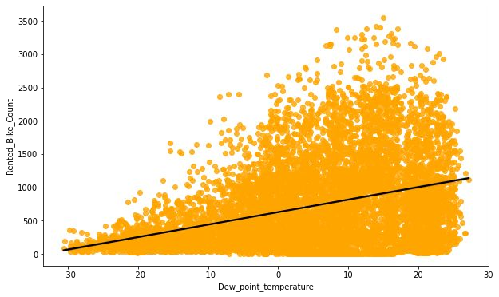
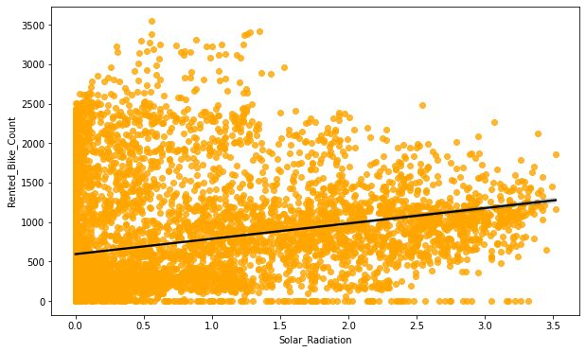
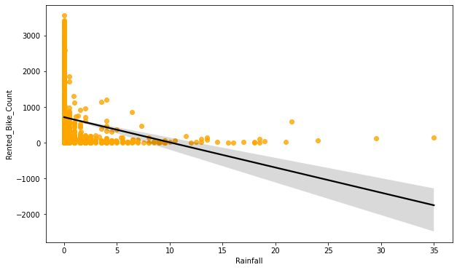
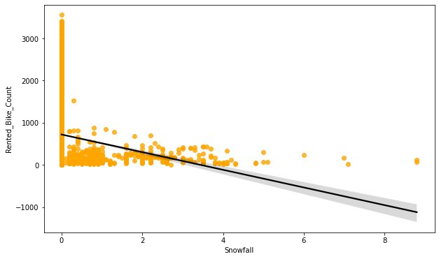
REGRESSION PLOT FOR NUMERICAL VARIABLE

Slide 16
REGRESSION PLOT FOR NUMERICAL VARIABLE
From the above regression plot of all numerical features we see that the columns 'Temperature', 'Wind_speed','Visibility', 'Dew_point_temperature', 'Solar_Radiation' are positively relation to the target variable.
which means the rented bike count increases with increase of these features.
'Rainfall','Snowfall','Humidity' these features are negatively related with the target variable which means the rented bike count decreases when these features increase.

Slide 17
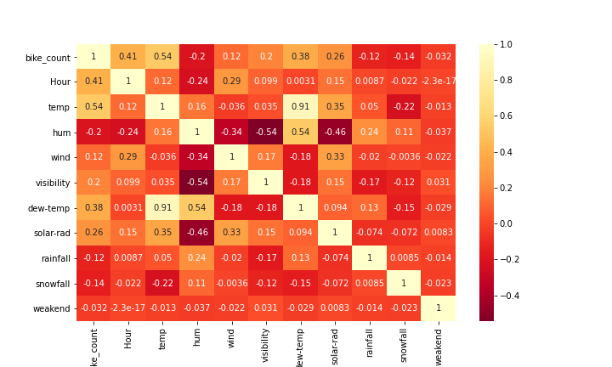
Heatmap
Here We can observe on the heatmap that most positively correlated variables to the rented bike count are:Temperature, DPT( dew point temperature), solar radiation

Slide 18
Algorithms Used
LINEAR REGRESSION
Lasso
DECISION TREE
RANDOM FOREST
GRADIENT BOOSTING
XGBOOST

Slide 19
Implementing Algorithms
LINEAR REGRESSION
MSE : 35.46
RMSE : 5.84
MAE : 4.56
R2_score : 0.77
Score with test data : 0.77
LASSO REGRESSION
MSE : 89.31
RMSE : 9.49
MAE : 7.20
R2_score : 0.41
Score with test data : 0.41
LINEAR REGRESSION performed well with accuracy 77% as compare to LASSO REGRESSION

Slide 20
Implementing Algorithms
DECISION TREE
MSE : 27.10
RMSE : 5.20
MAE : 3.31
R2_score : 0.82
Score with test data : 0.82
Gradient Boosting
MSE : 22.4828
RMSE : 4.7416
MAE : 3.619133
R2_score : 0.85
Score with test data : 0.85
Gradient Boosting gave us accuracy upto 85% which was greater than DECISION TREE

Slide 21
Implementing Algorithms
RANDOM FOREST
MSE : 12.85
RMSE : 3.85
MAE : 2.42
R2_score : 0.91
Score with test data: 0.91
XGBOOSTING
MSE : 11.65
RMSE :3.41
MAE : 2.38
R2_score : 0.91
Score with test data : 0.92
As compare to all of the algorithm XGBOOSTING after a hyperparameter tuning gave us highest accuracy up to 92%

Slide 22
Challenges
Large Dataset to handle.
plotting of Graphs to analyse.
Feature engineering
Feature selection
Optimising the model
Calculation of R2 score.

Slide 23
Conclusion
Month 5th,6th,7th and 10th gave us most of the Traffic of demand
bike rental count is high during working days than non working day.
people are generally prefer to bike at high temperatures, and when little windy
bike rentals counts in Autumn & Summer seasons is highest,
bike rentals counts was lowest in winter season.
There we observed negative relation between humidity and bike count as increasing in humidity lead it to decreases in the number of bike counts
Hour’ of the day holds the most important feature.
Bike rental count is mostly correlated with the time of the day as it is peak at 10 am morning and 8 pm at evening.
We observed that bike rental count is high during working days than non working day.

Slide 24
Conclusion
we implemented 6 machine learning algorithms Linear Regression, Lasso, gradient boost , Decision tree, Random Forest and XGBoost . None of them showed overfitting . XGBOOST model after hyperparameter tuning has given us accuracy upto 92% which is pretty good for prediction and choosing it for deployment. As rental Bike share systems have been growing across the world. our analysis and trained model will surely help to predict demand of the bikes

Slide 25
Thank You.

