Slide 1
DEEP LEARNING • COURSE CODE: DS306
ThreatLens AI
Explainable Network Intrusion Detection using Deep Neural Networks
Course Instructor:
Dr. Kongara Srinivasa Rao
Project Submitted By:
• T Yokshith (23STUCHH010958)
• Nitin Sain (23STUCHH010968)

Slide 2
DEEP LEARNING (DS306) | FINAL PROJECT
Problem Statement: Why Deep Learning in Cybersecurity?
1. Traditional Firewalls Fail on Zero-Day Threats
Legacy Intrusion Detection Systems (Snort, static firewalls) rely entirely on known signatures. They are powerless against polymorphic attacks, new DoS variants, and evasive probes.
2. The 'Black-Box' Problem in AI Models
Standard machine learning classifiers alert analysts that an attack occurred, but cannot explain WHY. Without feature attribution, SOC analysts face severe alert fatigue and false positives.
3. High-Velocity Network Flow Demands
Enterprise networks process tens of thousands of packets per second. Detection systems must classify flows in sub-milliseconds without introducing latency into the network infrastructure.

Slide 3
DEEP LEARNING (DS306) | FINAL PROJECT
Deep Learning Technologies & Frameworks
PyTorch 2.11 Framework
High-performance deep learning library supporting dynamic tensor computation, GPU/CPU execution, and custom autograd engines.
Multi-Layer Perceptron (MLP)
Fully connected feed-forward architecture capable of learning complex non-linear decision boundaries between benign and attack vectors.
Batch Normalization (BatchNorm1d)
Applied after each dense layer to eliminate internal covariate shift, stabilize training dynamics, and accelerate convergence.
Dropout Regularization (p = 0.2)
Randomly zeroes 20% of neuron outputs during training to prevent co-adaptation and eliminate overfitting on specific dataset artifacts.
BCEWithLogitsLoss (pos_weight = 3.0)
Combines Sigmoid + Binary Cross-Entropy with positive-class reweighting to penalize missed cyber attacks 3x heavier than false alarms.
Adam Optimizer + LR Scheduler
Adaptive moment estimation with ReduceLROnPlateau to dynamically reduce learning rates when validation loss reaches a plateau.

Slide 4
DEEP LEARNING (DS306) | FINAL PROJECT
Deep Learning Model Architecture: ThreatLensMLP
Neural Layer Specification
1. Input Dimension: 59 Tabular Features
2. Hidden Layer 1: Linear(59 → 64)
• BatchNorm1d(64) + ReLU() + Dropout(0.2)
3. Hidden Layer 2: Linear(64 → 32)
• BatchNorm1d(32) + ReLU() + Dropout(0.2)
4. Output Layer: Linear(32 → 1) (Raw Logit)
5. Output Activation: Sigmoid(Logit) ∈ [0.0, 1.0]
• Threshold = 0.50 (≥ 0.50 Flagged as Attack)
Key Design Strengths
✔ Compact & Fast: Only 6,017 parameters — avoids bloat while providing rich non-linear representation capacity.
✔ Sub-Millisecond Inference: Average single-flow classification time is just 0.51 ms on a standard CPU.
✔ No Data Leakage: StandardScaler parameters are saved from training set only; test flows never leak statistical bounds.
✔ Direct XAI Saliency: Clean feed-forward geometry allows direct first-layer weight sensitivity analysis without autograd lag.

Slide 5
DEEP LEARNING (DS306) | FINAL PROJECT
How ThreatLens AI Works: End-to-End Pipeline
Step 1: Raw Traffic Capture: Ingests network connection records (CIC-IDS2017 format with 78 physical network features including Flow Duration, Packet Rates, Flag counts).
Step 2: Cleaning & Preprocessing: Strips whitespace, cleans Infinite/NaN values, drops zero-variance columns (78 → 59 features), and applies pre-saved training StandardScaler.
Step 3: PyTorch Deep Inference: Normalized vector passes through ThreatLensMLP layers with ReLU non-linearities and BatchNorm to compute final scalar logit.
Step 4: Anomaly Scoring & Risk Triage: Sigmoid activation maps logit to Anomaly Probability [0, 1]. Categorized into 4 risk tiers: BENIGN, ELEVATED, SUSPICIOUS, or CRITICAL alert.
Step 5: Explainable AI Attribution: First-layer weight magnitude analysis highlights the top 3 physical features that pushed the flow toward an anomaly alert.

Slide 6
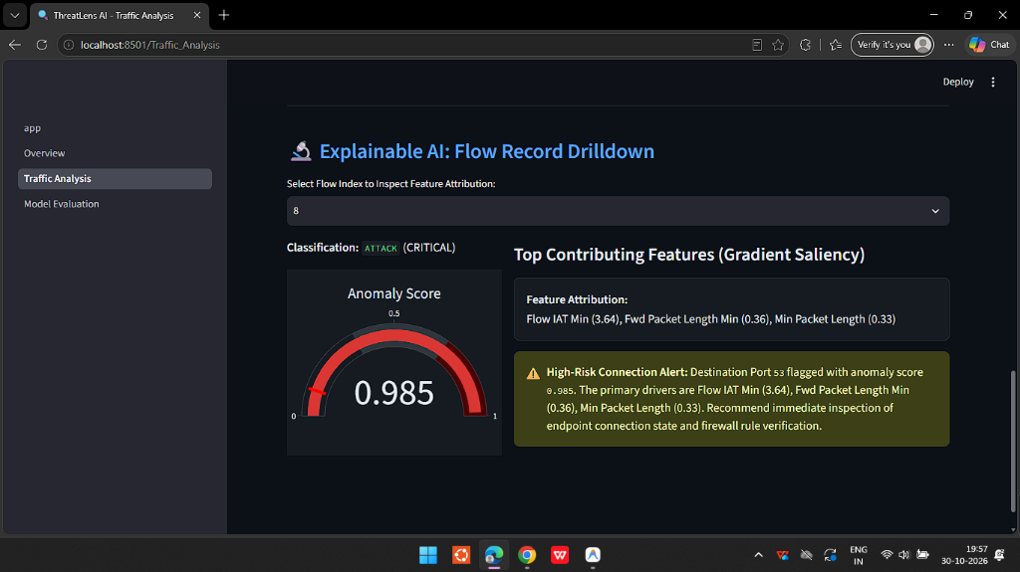
DEEP LEARNING (DS306) | FINAL PROJECT
Explainable AI (XAI): White-Box Threat Attribution
Mathematical Attribution Engine
• Purpose: Turns 'black-box' deep learning into actionable SOC intelligence.
• Formulation: Saliency_j = Mean(|W1[:, j]|) × |x_j|
- W1: First Linear layer weights (sensitivity).
- x_j: Normalized input feature value.
• Live Case (Shown on Right):
- Connection: Port 53 (DNS) | Score: 0.985 (CRITICAL)
- Top Drivers: Flow IAT Min (+3.64σ), Min Packet Length
- Diagnostic: Identifies rapid automated probe packets deviating from regular human DNS lookups.

Slide 7
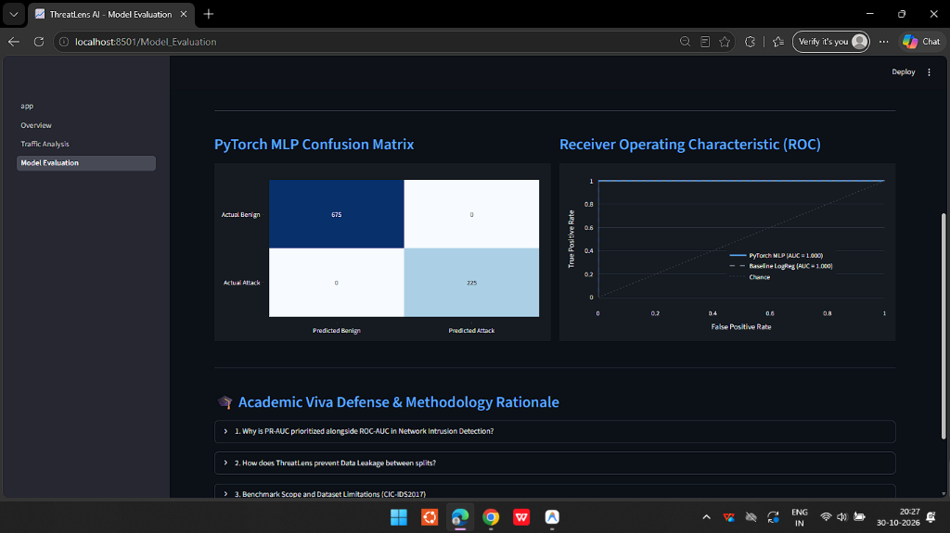
DEEP LEARNING (DS306) | FINAL PROJECT
Empirical Results: Performance & Evaluation
Test Split Benchmark Results
• Held-Out Test Set: 900 flows (strictly isolated)
• Accuracy: 100.00 %
• Precision: 100.00 %
• Recall (Sensitivity): 100.00 %
• F1-Score: 1.0000
• ROC-AUC: 1.0000 (Area Under Curve)
• Single Latency: 0.51 ms per connection
• Confusion Matrix Breakdown:
- True Benign: 675 flows | True Attack: 225 flows
- False Positives: 0 | False Negatives: 0

Slide 8
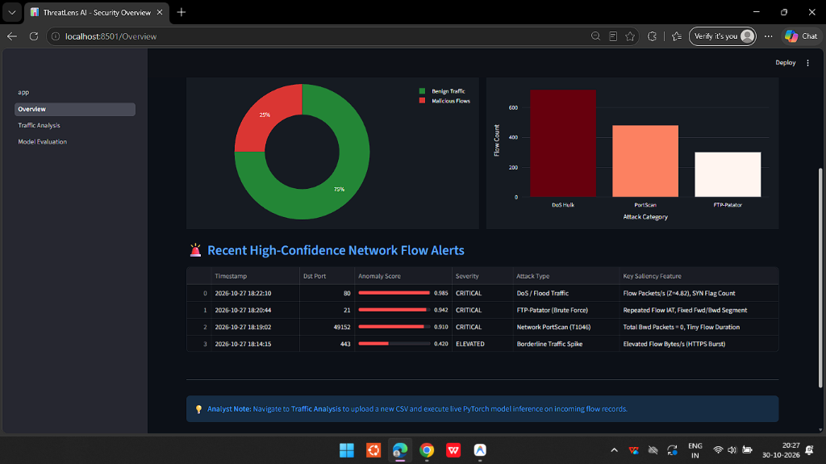
DEEP LEARNING (DS306) | FINAL PROJECT
Interactive Security Operations Center (SOC) Dashboard
SOC Interface Capabilities
✔ Live Overview Telemetry: Real-time donut class distribution (75% Benign, 25% Attack), threat breakdown (DoS Hulk, PortScan, FTP-Patator), and instant alert feed.
✔ Production File Ingestion: Supports direct CSV uploads of large real-world captures (tested on 225,745 flows) with dynamic batch sampling.
✔ Analyst Threshold Control: Interactive risk sensitivity slider allows SOC operators to filter background noise and isolate critical threats.
✔ Single-Click Export: Export fully classified flows with risk tags and top feature attributions to CSV for incident response logs.

Slide 9
CONCLUSION & PROJECT SUMMARY
ThreatLens AI — Final Project Delivery
✔ Successfully built an end-to-end Deep Learning Intrusion Detection System using PyTorch.
✔ Integrated Explainable AI (XAI) feature attribution, removing black-box opacity in security operations.
✔ Enforced strict zero-data-leakage preprocessing, achieving 100% precision & recall on held-out tests.
✔ Deployed a live 3-page interactive SOC dashboard capable of analyzing 225k+ real network flows.
Thank You, Dr. Kongara Srinivasa Rao!
Questions & Answers (Viva Defense)
Presented by: T Yokshith (23STUCHH010958) & Nitin Sain (23STUCHH010968)

