Slide 1
Java Collections
CSX-331

Slide 2
Java 2 Collections
A collection is an object that groups multiple elements into a single unit
Very useful
  store, retrieve and manipulate data
  transmit data from one method to another
  data structures and methods

Slide 3
Collections Framework
Unified architecture for representing and manipulating collections.
A collections framework contains three things
  Interfaces
  Implementations
  Algorithms

Slide 4
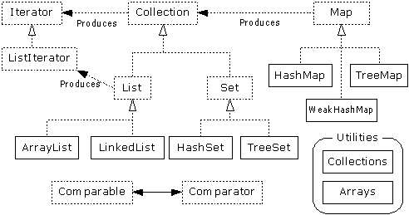
Collections Framework Diagram

Slide 5
Collection Interface
Defines fundamental methods
  int size();
  boolean isEmpty();
  boolean contains(Object element);
  boolean add(Object element); // Optional
  boolean remove(Object element); // Optional
  Iterator iterator();
These methods are enough to define the basic behavior of a collection
Provides an Iterator to step through the elements in the Collection

Slide 6
Iterator Interface
Defines three fundamental methods
  Object next()
  boolean hasNext()
  void remove()
These three methods provide access to the contents of the collection
An Iterator knows position within collection
Each call to next() “reads” an element from the collection
  Then you can use it or remove it

Slide 7
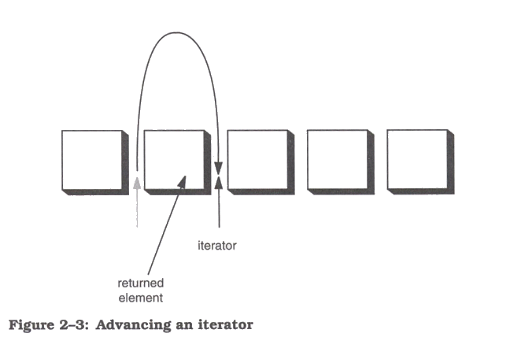
Iterator Position

Slide 8
Example - SimpleCollection
  public class SimpleCollection {
  public static void main(String[] args) {
  Collection c;
  c = new ArrayList();
  System.out.println(c.getClass().getName());
  for (int i=1; i <= 10; i++) {
  c.add(i + " * " + i + " = "+i*i);
  }
  Iterator iter = c.iterator();
  while (iter.hasNext())
  System.out.println(iter.next());
  }
  }

Slide 9
List Interface Context
Collection
List

Slide 10
List Interface
The List interface adds the notion of order to a collection
The user of a list has control over where an element is added in the collection
Lists typically allow duplicate elements
Provides a ListIterator to step through the elements in the list.

Slide 11
ListIterator Interface
Extends the Iterator interface
Defines three fundamental methods
  void add(Object o) - before current position
  boolean hasPrevious()
  Object previous()
The addition of these three methods defines the basic behavior of an ordered list
A ListIterator knows position within list

Slide 12
Iterator Position - next(), previous()

Slide 13
ArrayList and LinkedList Context
Collection
List
ArrayList
LinkedList

Slide 14
List Implementations
ArrayList
  low cost random access
  high cost insert and delete
  array that resizes if need be
LinkedList
  sequential access
  low cost insert and delete
  high cost random access

Slide 15
ArrayList overview
Constant time positional access (it’s an array)
One tuning parameter, the initial capacity
public ArrayList(int initialCapacity) {
super();
if (initialCapacity < 0)
throw new IllegalArgumentException(
"Illegal Capacity: "+initialCapacity);
this.elementData = new Object[initialCapacity];
}

Slide 16
ArrayList methods
The indexed get and set methods of the List interface are appropriate to use since ArrayLists are backed by an array
  Object get(int index)
  Object set(int index, Object element)
Indexed add and remove are provided, but can be costly if used frequently
  void add(int index, Object element)
  Object remove(int index)
May want to resize in one shot if adding many elements
  void ensureCapacity(int minCapacity)

Slide 17
LinkedList overview
Stores each element in a node
Each node stores a link to the next and previous nodes
Insertion and removal are inexpensive
  just update the links in the surrounding nodes
Linear traversal is inexpensive
Random access is expensive
  Start from beginning or end and traverse each node while counting

Slide 18
LinkedList entries
private static class Entry {
Object element;
Entry next;
Entry previous;
Entry(Object element, Entry next, Entry previous) {
this.element = element;
this.next = next;
this.previous = previous;
}
}
private Entry header = new Entry(null, null, null);
public LinkedList() {
header.next = header.previous = header;
}

Slide 19
LinkedList methods
The list is sequential, so access it that way
  ListIterator listIterator()
ListIterator knows about position
  use add() from ListIterator to add at a position
  use remove() from ListIterator to remove at a position
LinkedList knows a few things too
  void addFirst(Object o), void addLast(Object o)
  Object getFirst(), Object getLast()
  Object removeFirst(), Object removeLast()

Slide 20
Set Interface Context
Collection
Set

Slide 21
Set Interface
Same methods as Collection
  different contract - no duplicate entries
Defines two fundamental methods
  boolean add(Object o) - reject duplicates
  Iterator iterator()
Provides an Iterator to step through the elements in the Set
  No guaranteed order in the basic Set interface
  There is a SortedSet interface that extends Set

Slide 22
HashSet and TreeSet Context
Collection
Set
HashSet
TreeSet

Slide 23
HashSet
Find and add elements very quickly
  uses hashing implementation in HashMap
Hashing uses an array of linked lists
  The hashCode() is used to index into the array
  Then equals() is used to determine if element is in the (short) list of elements at that index
No order imposed on elements
The hashCode() method and the equals() method must be compatible
  if two objects are equal, they must have the same hashCode() value

Slide 24
TreeSet
Elements can be inserted in any order
The TreeSet stores them in order
  Red-Black Trees
An iterator always presents them in order
Default order is defined by natural order
  objects implement the Comparable interface
  TreeSet uses compareTo(Object o) to sort
Can use a different Comparator
  provide Comparator to the TreeSet constructor

Slide 25
Map Interface Context
Map

Slide 26
Map Interface
Stores key/value pairs
Maps from the key to the value
Keys are unique
  a single key only appears once in the Map
  a key can map to only one value
Values do not have to be unique

Slide 27
Map methods
Object put(Object key, Object value)
Object get(Object key)
Object remove(Object key)
boolean containsKey(Object key)
boolean containsValue(Object value)
int size()
boolean isEmpty()

Slide 28
Map views
A means of iterating over the keys and values in a Map
Set keySet()
  returns the Set of keys contained in the Map
Collection values()
  returns the Collection of values contained in the Map. This Collection is not a Set, as multiple keys can map to the same value.
Set entrySet()
  returns the Set of key-value pairs contained in the Map. The Map interface provides a small nested interface called Map.Entry that is the type of the elements in this Set.

Slide 29
HashMap and TreeMap Context
Map
HashMap
TreeMap

Slide 30
HashMap and TreeMap
HashMap
  The keys are a set - unique, unordered
  Fast
TreeMap
  The keys are a set - unique, ordered
  Same options for ordering as a TreeSet
    Natural order (Comparable, compareTo(Object))
    Special order (Comparator, compare(Object, Object))

Slide 31
Bulk Operations
In addition to the basic operations, a Collection may provide “bulk” operations
  boolean containsAll(Collection c);
  boolean addAll(Collection c); // Optional
  boolean removeAll(Collection c); // Optional
  boolean retainAll(Collection c); // Optional
  void clear(); // Optional
  Object[] toArray();
  Object[] toArray(Object a[]);

Slide 32
Utilities Context

Slide 33
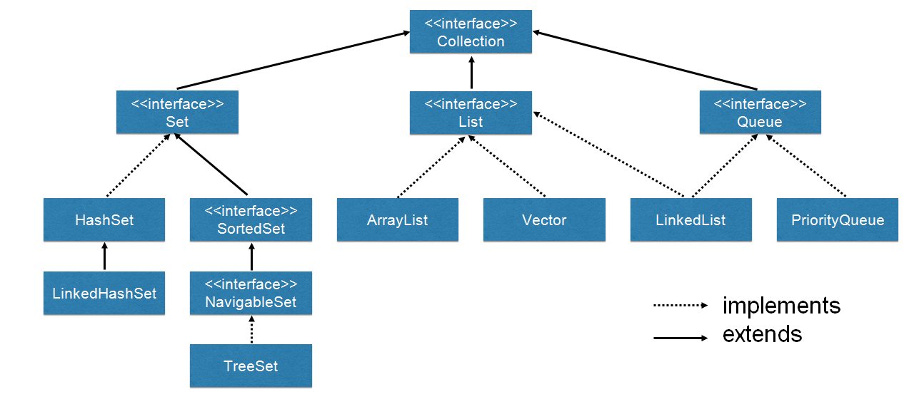
Collection Framework is actually Bigger!

Slide 34
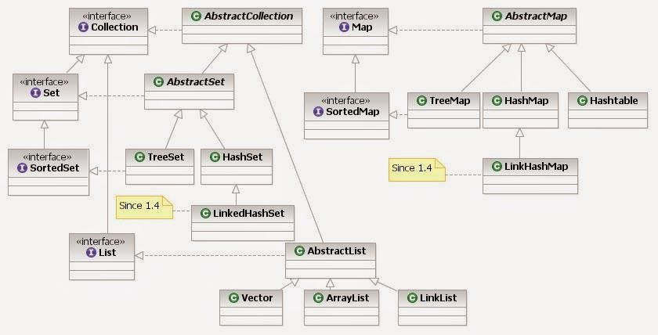
Collection Framework –Even Bigger!

Slide 35
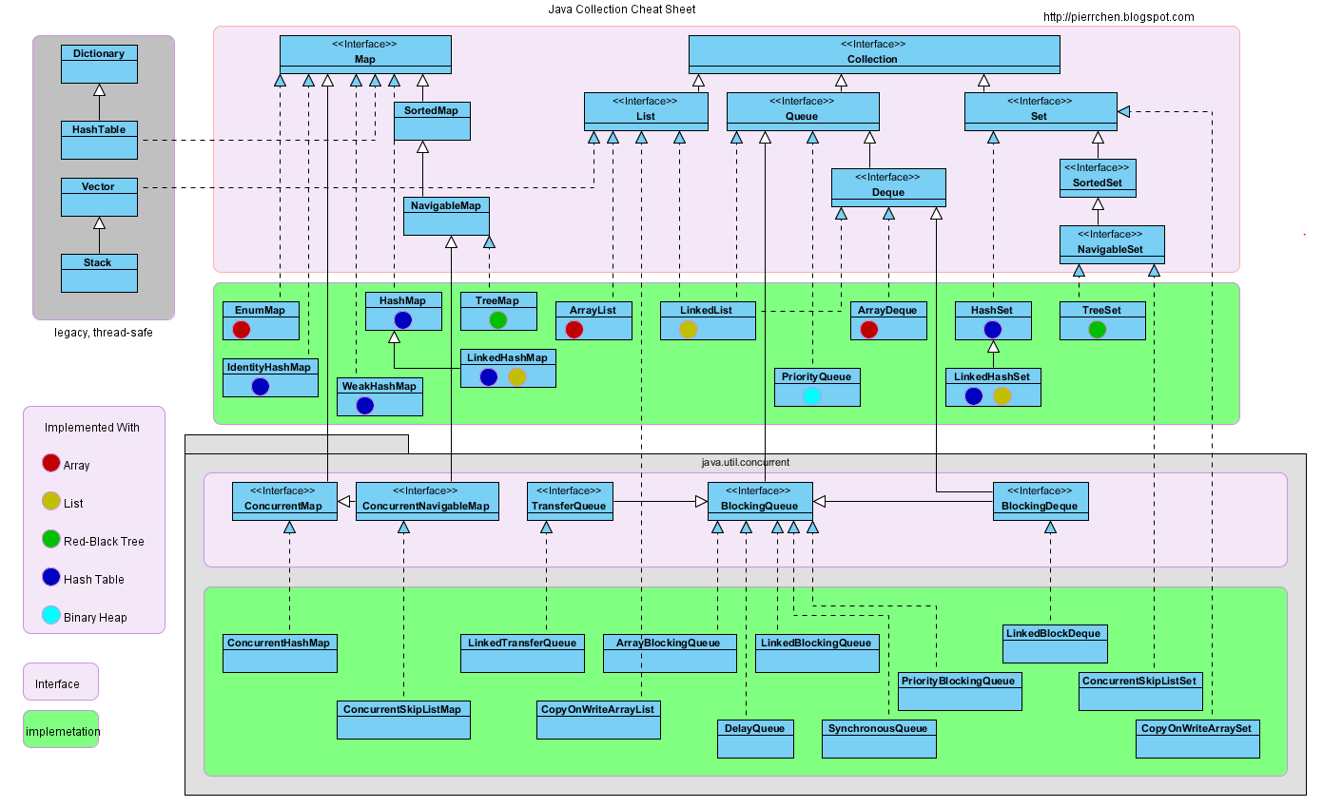
Collection Framework –Even Bigger!

Slide 36
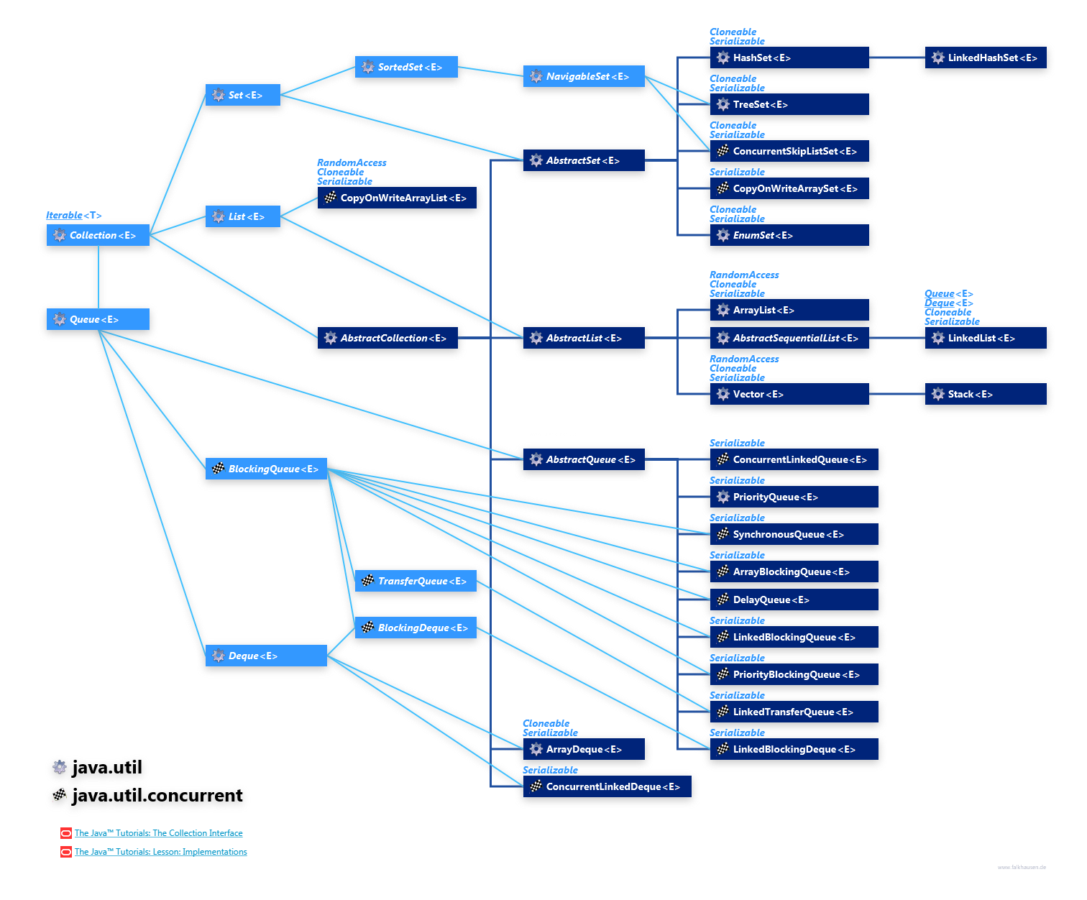

Slide 37
Utilities
The Collections class provides a number of static methods for fundamental algorithms
Most operate on Lists, some on all Collections
  Sort, Search, Shuffle
  Reverse, fill, copy
  Min, max
Wrappers
  synchronized Collections, Lists, Sets, etc
  unmodifiable Collections, Lists, Sets, etc

Slide 38
Legacy classes
Still available
Don’t use for new development
  unless you have to, eg, J2ME, J2EE in some cases
Retrofitted into Collections framework
Hashtable
  use HashMap
Enumeration
  use Collections and Iterators
  if needed, can get an Enumeration with Collections.enumeration(Collection c)

Slide 39
More Legacy classes
Vector
  use ArrayList
Stack
  use LinkedList
BitSet
  use ArrayList of boolean, unless you can’t stand the thought of the wasted space
Properties
  legacies are sometimes hard to walk away from …
  see next few pages

Slide 40
Properties class
Located in java.util package
Special case of Hashtable
  Keys and values are Strings
  Tables can be saved to/loaded from file

Slide 41
System properties
Java VM maintains set of properties that define system environment
  Set when VM is initialized
  Includes information about current user, VM version, Java environment, and OS configuration
Properties prop = System.getProperties();
Enumeration e = prop.propertyNames();
while (e.hasMoreElements()) {
String key = (String) e.nextElement();
System.out.println(key + " value is " +
prop.getProperty(key));
}

