Slide 1
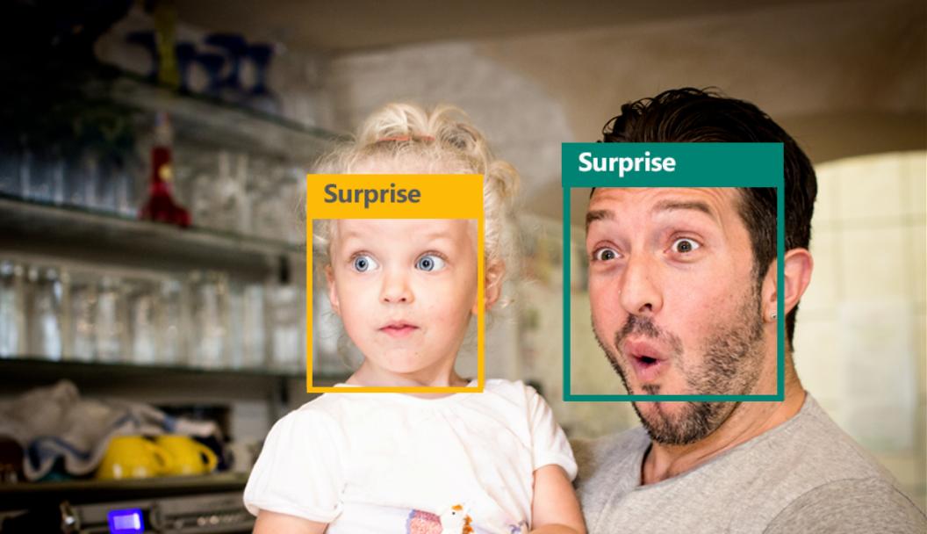
Emotion Recognition for Real-Time Feedback

Slide 2


OBJECTIVE
Performs facial expression analysis in a near real time from a live web cam feed
Light invariant and person independent classification

Slide 3
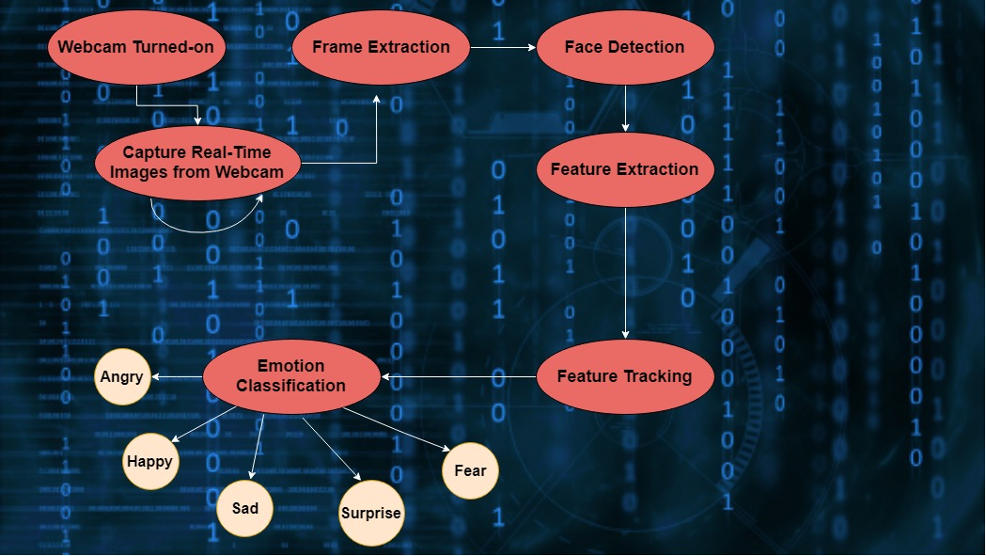
FLOW DIAGRAM

Slide 4
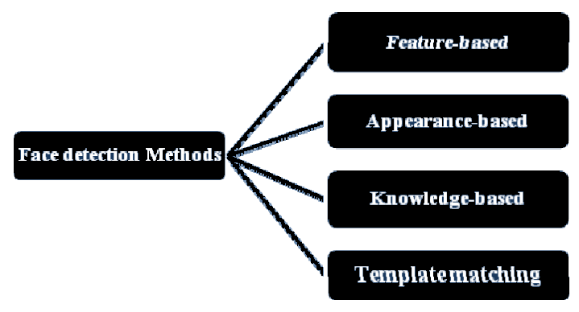
FACE DETECTION
Haar Classifier is used which uses Feature-based face detection

Slide 5
HAAR CLASSIFIER
The Haar Classifier is a machine learning based approach, an algorithm created by Paul Viola and Michael Jones; which are trained from many many positive images (with faces) and negatives images (without faces).
Each window is placed on the picture to calculate a single feature. This feature is a single value obtained by subtracting the sum of pixels under the white part of the window from the sum of the pixels under the black part of the window.
Haar classifier calculates all features , most of them are irrelevant and to discard them we use adaboost and hence it improves classification accuracy

Slide 6
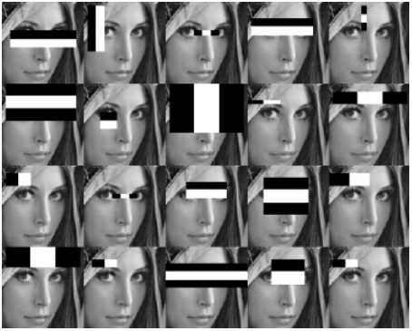
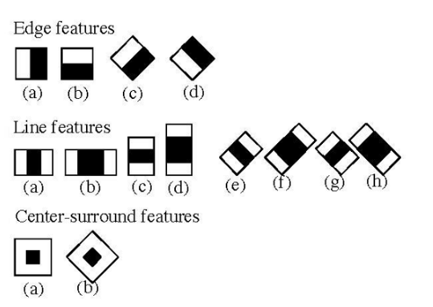
Haar-like features for face detection

Slide 7
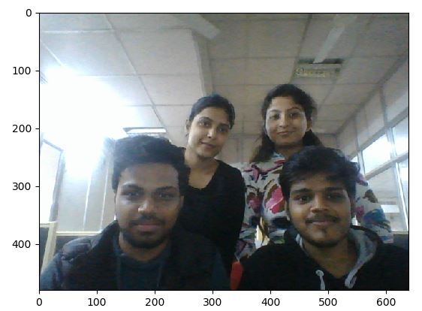
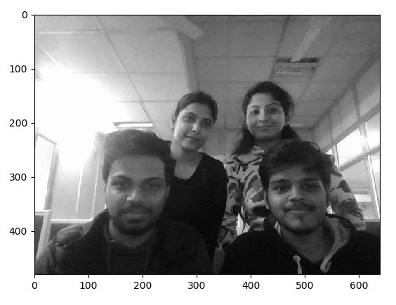
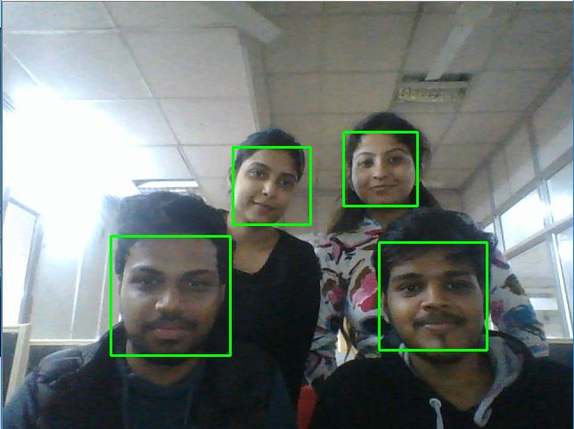
FACE DETECTION FLOW

Slide 8
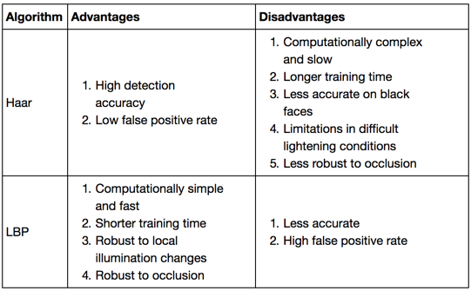
Why Haar Classifier!!!
Local Binary Patterns (LBP) can also be used for face detection

Slide 9
DEPENDENCIES
Open CV(3.2.0)
Python v3.5
Matplotlib 2.0
Data Mining and machine learning algorithms
.

Slide 10



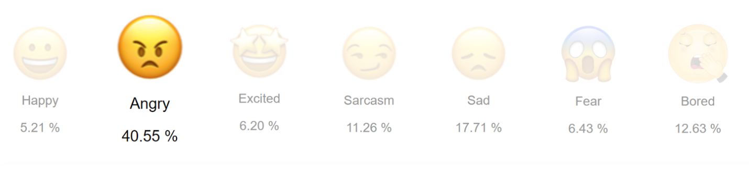
APPLICATIONS

