Slide 1
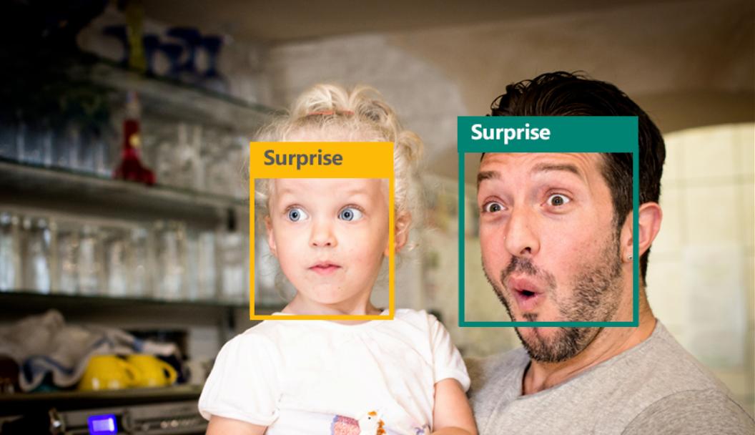
Emotion Recognition for Real-Time Feedback

Slide 2

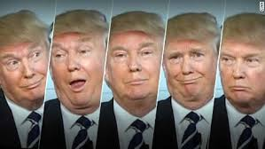
OBJECTIVE
Performs facial expression analysis in a near real time from a live web cam feed
Light invariant and person independent classification

Slide 3
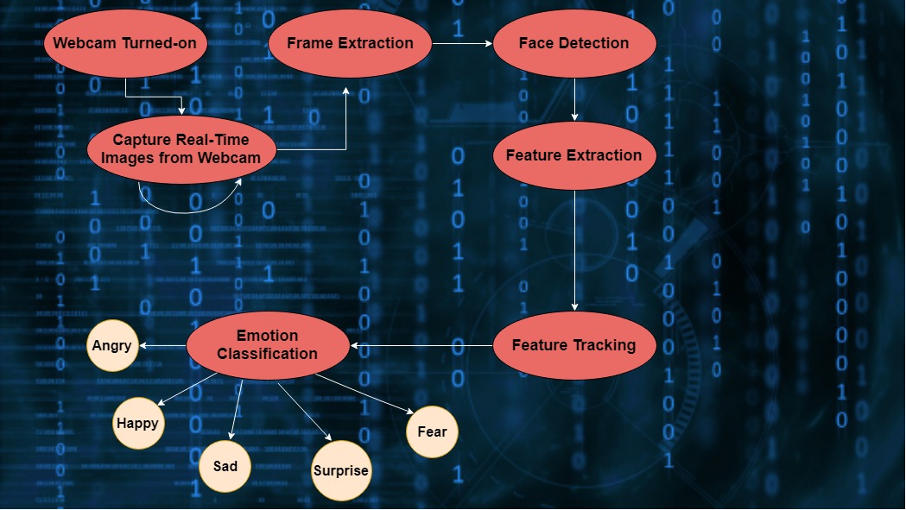
FLOW DIAGRAM

Slide 4
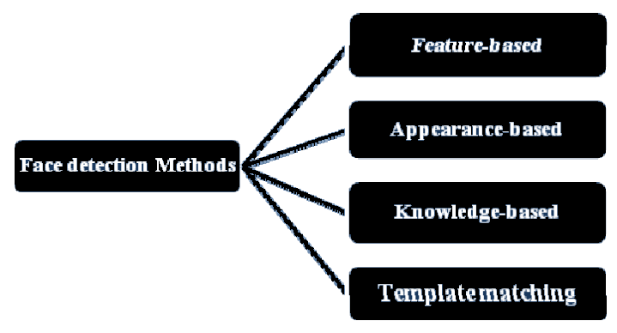
FACE DETECTION
Haar Classifier is used which uses Feature-based face detection

Slide 5
HAAR CLASSIFIER
The Haar Classifier is a machine learning based approach, an algorithm created by Paul Viola and Michael Jones; which are trained from many many positive images (with faces) and negatives images (without faces).
Each window is placed on the picture to calculate a single feature. This feature is a single value obtained by subtracting the sum of pixels under the white part of the window from the sum of the pixels under the black part of the window.
Haar classifier calculates all features , most of them are irrelevant and to discard them we use adaboost and hence it improves classification accuracy

Slide 6
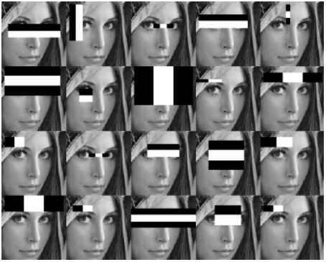
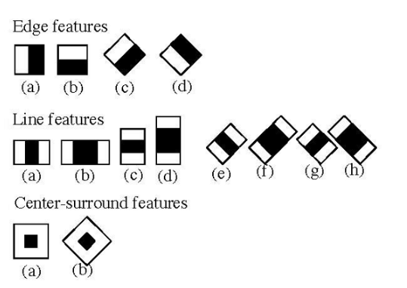
Haar-like features for face detection

Slide 7
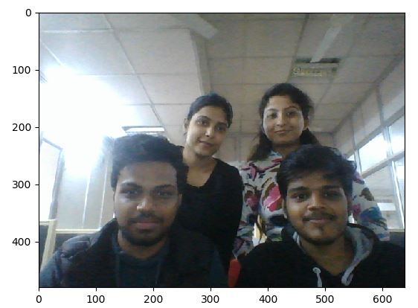
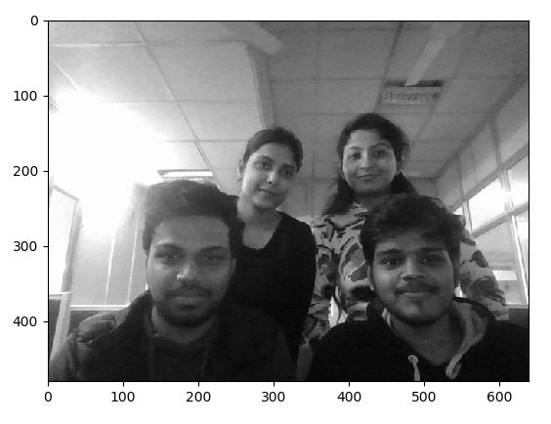
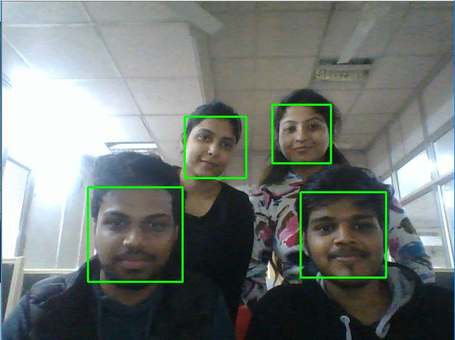
FACE DETECTION FLOW

Slide 8
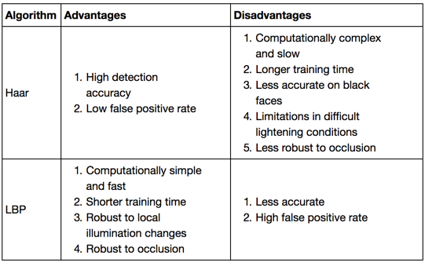
Why Haar Classifier!!!
Local Binary Patterns (LBP) can also be used for face detection

Slide 9
DEPENDENCIES
Open CV(3.2.0)
Python v3.5
Matplotlib 2.0
Data Mining and machine learning algorithms
.

Slide 10


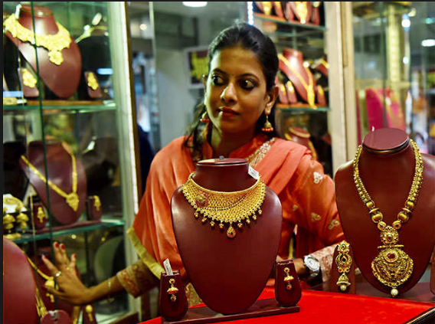
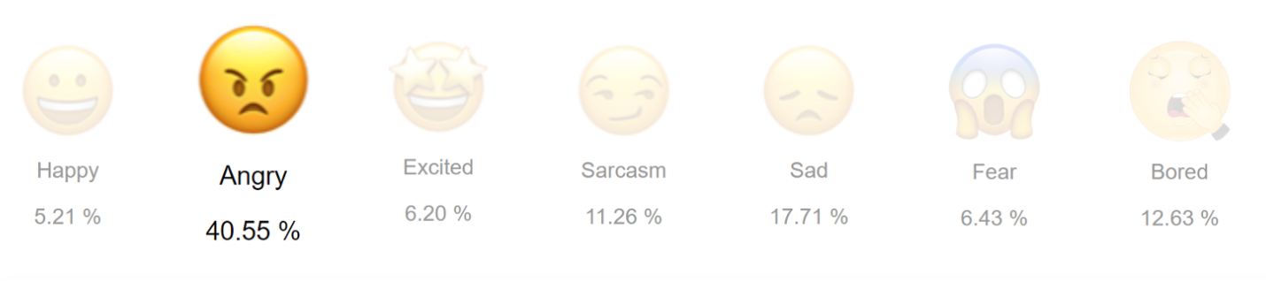
APPLICATIONS

Slide 11
PREVIOUS WORK
Image Captured RGB_TO_GRAY Conversion Real Time Face Detection

Slide 12
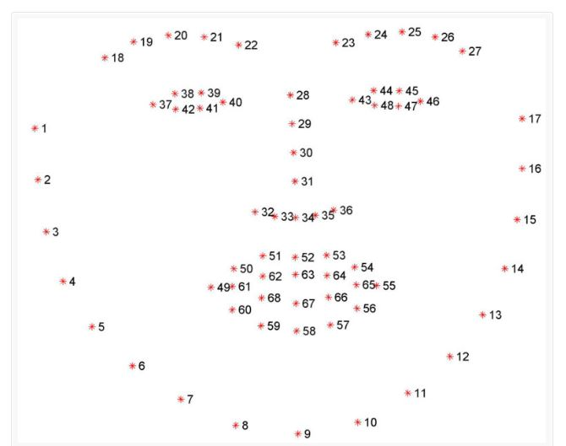
Feature Points (Facial Landmarks)

Slide 13
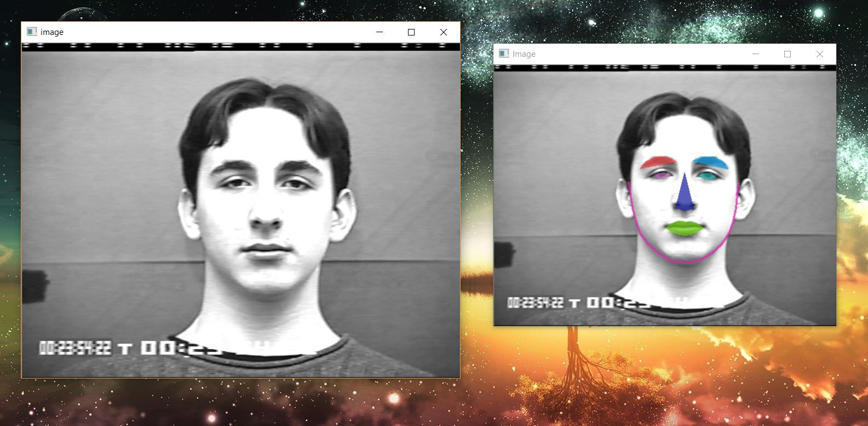
Feature Points Extraction

Slide 14
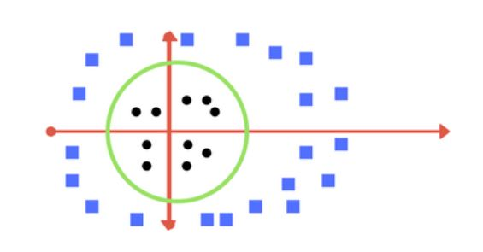
Support Vector Machine (SVM)
A Support Vector Machine (SVM) is a discriminative classifier formally defined by a separating hyperplane.
In other words, given labeled training data (supervised learning), the algorithm outputs an optimal hyperplane which categorizes new examples.

Slide 15
Tuning Parameters
Kernel : A method of using a linear classifier to solve a non linear problem
Regularization : The Regularization parameter tells the SVM optimization how much you want to avoid misclassifying each training example.
Gamma : The gamma parameter defines how far the influence of a single training example reaches, with low values meaning ‘far’ and high values meaning ‘close’

Slide 16
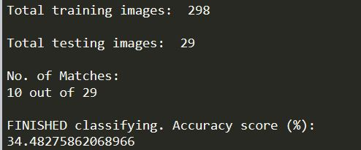
Problems Encountered

Slide 17
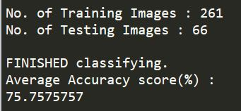
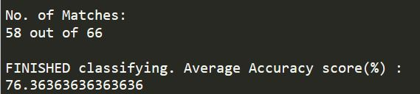
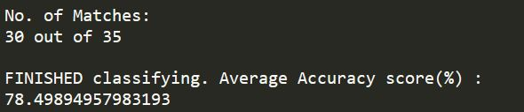
Solution : Sampling Methods
Sampling Method | Accuracy(%) | Observations
Hold out Subsampling | 72-75
Random Subsampling | 74-77
K-Fold Cross Validation | 74-79

Slide 18
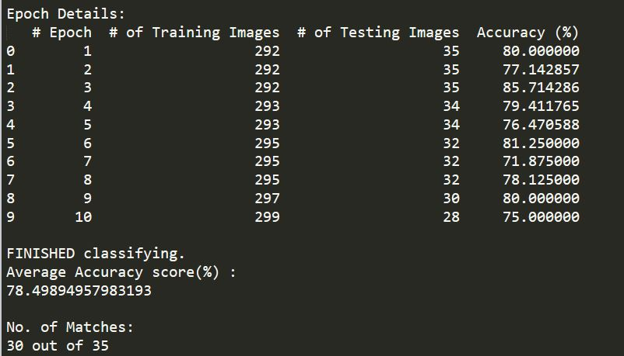
Best Outcome By K-Fold Cross validation

Slide 19
What’s Next?
Facial expression analysis in a near real time from a live web-cam feed.
To present the percentage distribution of the predicted expression.

