Slide 1

PROJECT TITLE
A Project Report
submitted by
PALASH SHAH
HARISH KUMAR
Laser Limbo
TECHNITES - ENGINEER 2014
NATIONAL INSTITUTE OF TECHNOLOGY KARNATAKA SURATHKAL, MANGALORE - 575025

Slide 2
ABSTRACT
“Laser limbo” is a game similar to the real life game named LIMBO. The objective of the game is to pass under a certain height without touching it. The height is generally set by using a rope or a rod. The player can only bend backwards and also cannot bend his knees. If the player touches the rope, he is out.
The game designed by us used Lasers instead of a rope or rod. The laser path was illuminated using a smoke generator.
The game has 4 levels and the person who could pass all the 4 levels was declared as the winner. If a person comes in the path of the laser then a buzzer goes off.
Basic Concept-
The basic concept that is used here is that the resistance of a LDR changes when light falls on the LDR. The resistance of a LDR decreases when light fall on it and it increases when it is kept in dark. The LDR circuit consisted of a LDR and resistor in series.
A voltage of 3.3V is provided across the series combination of the resistor and the LDR.
When the laser beam is incident on the LDR , the resistance of LDR is low and the output of the LDR circuit is high(3.3V).
When the laser beam is not falling on the LDR , the output of the LDR circuit is low, hence when the output of the LDR becomes low, the buzzer goes off for 5 seconds and it again starts from the first level.
The levels could also be changed by pressing a button.

Slide 3
COMPONENTS REQUIRED
1. Texas instruments MSP430G2553 (1 no.)
2. MSP Launchpad (1 no.)
3. Multi-Strand Wire
4. Berg Strip
5. Lasers (4 no.’s)
6. LDR (4 no.’s)
7. Plywood ( 8 ft x 4 ft x 0.5 inch thickness)
8. Stand (2 no’s – approximately 5 feet.)
9. Buzzer (1 no.)
10. Voltage regulator(7833) 3.3V (1 no.)
11. 68K ohms Resistor (4 no.’s)
12. Single Strand Wire

Slide 4
Hardware Setup
The project required a stable base and two wooden stands for the placing the lasers and the LDR sensors.
A wooden plank of dimensions (Dimensions of plank) was used. The two wooden stands were attached to the plank, exactly 150cm apart. (size of L-clamp)-inch 'L'- clamps were used to support the stands.
Two such clamps were used to support each stand.
4 'L' Clamps were also attached to the sides of each of the wooden stands, equidistant from each other in order to support the laser and LDR circuits.
The LDR circuits used were soldered onto a regular circuit board. Small LDR's were used. LDR and 68K ohm resistor are connected in series. The free end of the LDR is connected to 3.3V and the free end of the resistor is connected to ground. Output is tapped from the middle junction.
The circuit diagram for the main circuit is also SHOWN BELOW.
The MSP was fixed onto a 20 PIN IC base which was soldered onto a circuit board, and other connections such as ground and outputs for the lasers were made by bridging the solder with the use of Berg strips.
The 7833 voltage regulator was also soldered onto the board.

Slide 5
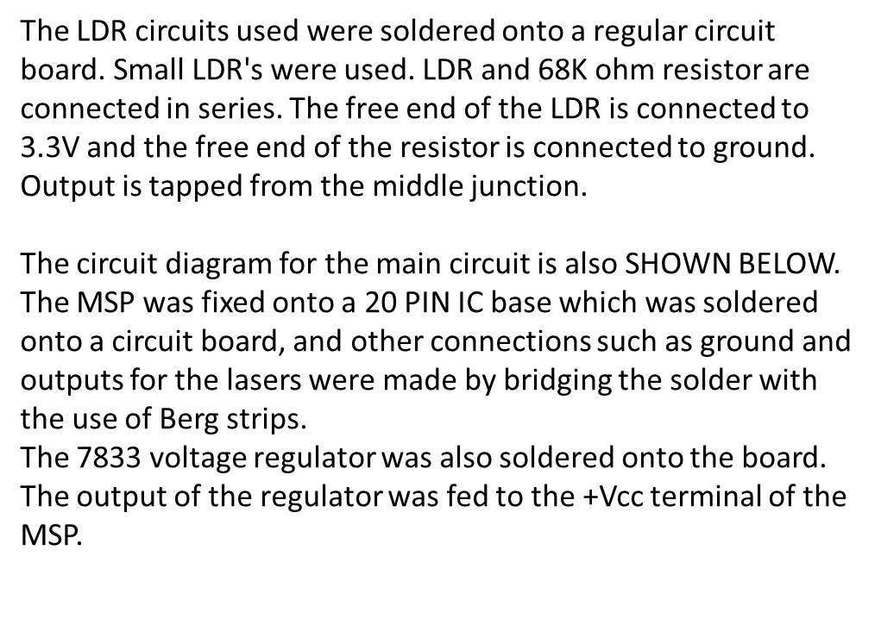
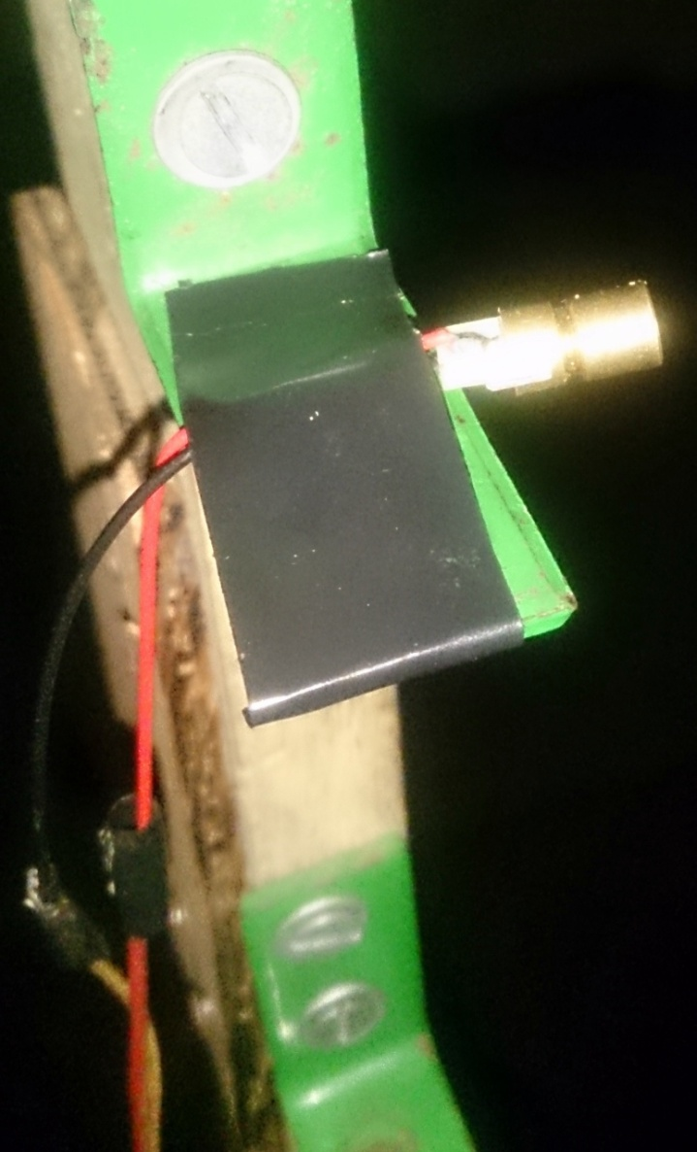
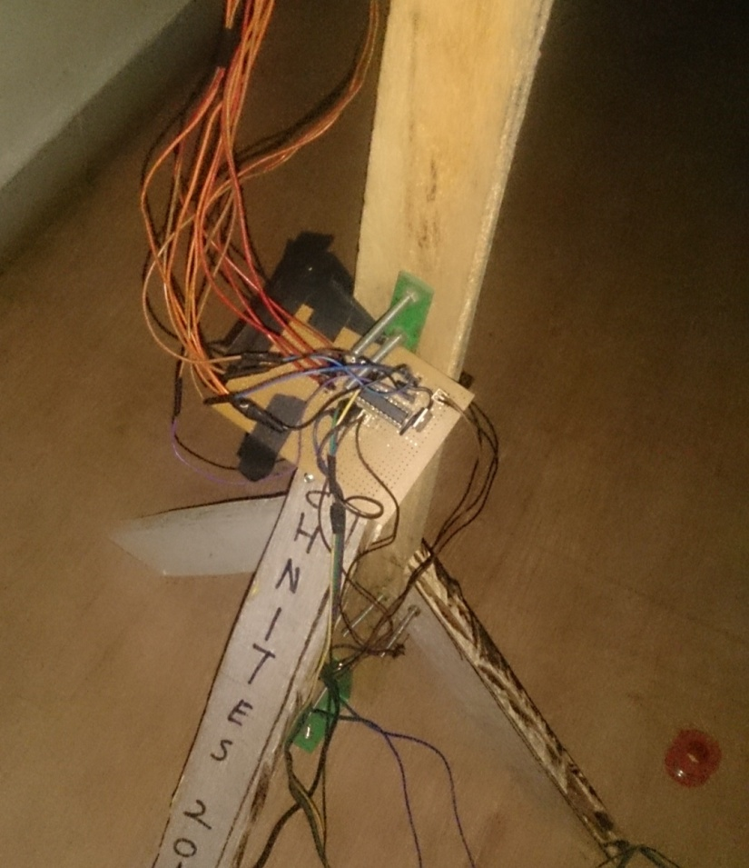

Slide 6
BLOCK DIAGRAM
FOR LASER LIMBO
LDR 1 DETECTOR
LASER 1
LDR 2 DETECTOR
LASER 2
LDR 3 DETECTOR
LASER 3
LDR 4 DETECTOR
LASER 4
P1.0
P1.1
P1.2
P1.3
P1.4
P1.5
P2.0
P2.1
P2.2
RST
P1.7
P1.6
P1.5
P2.5
P2.4
P2.3
MSP430G2553
MICROCONTROLLER
SWITCH
To change levels
BUZZER

Slide 7
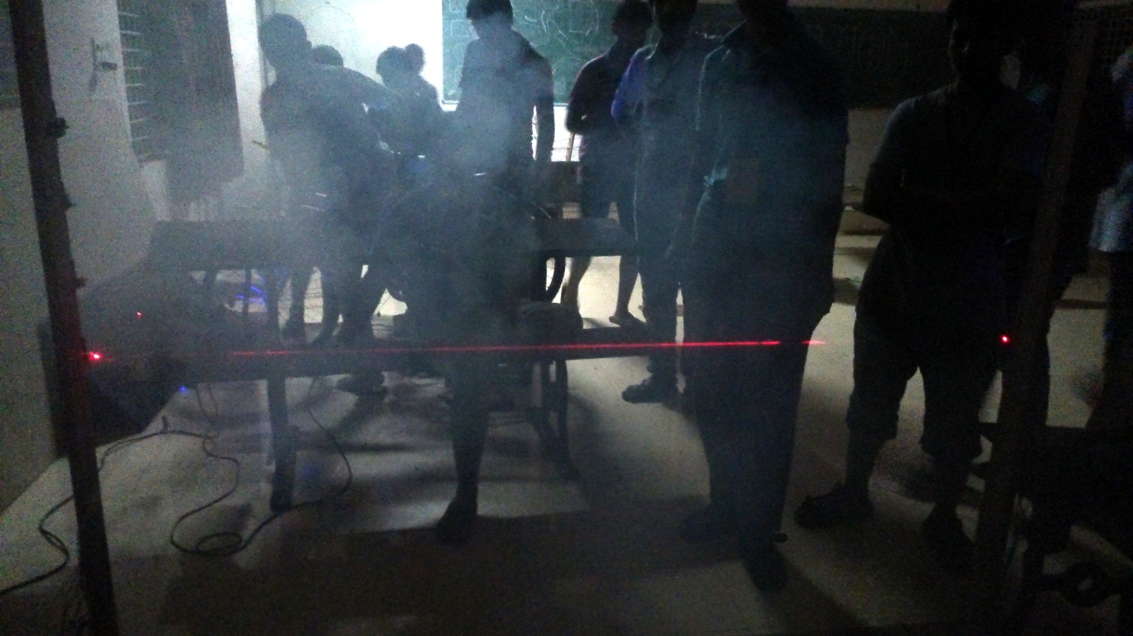
SOFTWARE
The MSP430 series by Texas Instruments is a mixed signal controller. It is essentially a 16 bit CPU designed for low cost, low power consumption.
TI also provides software development tools such as a C/C++ compiler and Integrated development environment, or IDE, which is Eclipse-based Code Composer Studio IDE ("CCS").
The code for Laser Limbo was written, compiled and exported to the MSP using CCS.
The code went through a multitude of changes along the course of the project, and in its final version, the switching and monitoring of lasers and LDR’s was accomplished without the use of an Interrupt sequence.

Slide 8
Problems Faced
The very first problem that we faced while working on the project was with the source code for the MSP.
Since we had 4 lasers , our initial code could not recognize which laser was on at what time.
This problem was overcome by using a flag variable and by using a button input to switch between the levels.
Another problem that we faced was that the input pins of the MSP microcontroller were giving a floating voltage (In between 0 to 3.3V) even if no input was being given. This resulted in the MSP giving erroneous input values.
This problem was overcome by pulling down the input pins in the code itself.
The most difficult problem we faced during this project was the aligning of lasers and LDR’s. The size of the LDR was small, which was a big constraint on the vibration/movement of the stand. Even during the event some lasers went out of alignment and it took us some time to align it again.

Slide 9
Future Plans
We thought of a new game using lasers and LDR’s. The game will mimic the security system for secure areas, as seen in movies.
The game will have a dark room in which a number of lasers are kept at different angles over a distance. The player has to go from one end of the room to the other without touching any of the lasers. The laser path can be seen by spraying deodorant or any other aerosol. The player will be given a deodorant can, using which he can see the path of the laser.
If the player touches any of the lasers , a buzzer will go off and the player loses.

Slide 10
Conclusion
Even though the project idea was simple we faced a number of problems during practical implementation. We were able to overcome these problems with the help of our seniors.
The project was functional from day-1 of engineer.
The event attracted many students, and they had a fun time watching and having a crack at it themselves. Overall, the project was a hit.
We plan on expanding this idea as mentioned in the ‘future plans’ section above.

