Slide 1

Team Details
Case Study No.

Slide 2
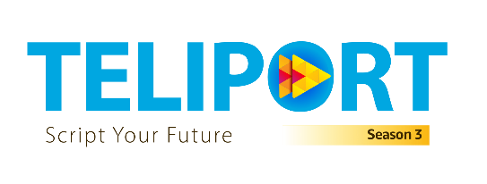


Slide 3
Problem Statement
Design a GenAI-based Digital Twin tool for medical device system design
Automatically generate system architecture from functional requirements
Cover hardware, software, electronics, and enclosure design
Support Class II and Class III medical devices
Ensure compliance with ISO 60601-1, ISO 62366-2, ISO 14971

Slide 4
Key Challenges
Manual system design is time-consuming and error-prone
Difficulty in validating design choices early
Complex regulatory and compliance requirements
Limited what-if analysis in traditional workflows
High cost of design iteration and late-stage changes

Slide 5
Proposed Solution Overview
GenAI-powered Digital Twin for medical devices
Input functional and non-functional requirements
Automatically generate system architecture and modules
Simulate behavior at system, subsystem, and component level
Enable early validation and design optimization

Slide 6
System Architecture
Requirement Ingestion Module (FRs, constraints, regulations)
Knowledge Base (Datasheets, COTS devices, standards)
GenAI Design Engine (RAG + prompt engineering)
Simulation & Digital Twin Engine
Visualization & What-if Analysis Dashboard

Slide 7
Approach & Methodology
Use RAG to fetch relevant medical device references
Bottom-up modeling from components to system level
Top-down validation against requirements
Hybrid simulation: data-driven + physics-based
Continuous feedback loop for refinement

Slide 8
Validation & Compliance
Simulate electrical, mechanical, and functional behavior
Check compliance with medical standards
Log and visualize parameters over time
Snapshot, drill-down, and roll-up views
What-if analysis with runtime parameter changes

Slide 9
Benefits
Reduced design time and development cost
Early detection of design issues
Improved accuracy and reliability
Scalable for future device complexity
Designer-friendly and interactive platform

Slide 10
Conclusion
GenAI + Digital Twin transforms medical device design
Automates architecture generation and validation
Ensures compliance and high-fidelity simulation
Supports innovation and faster go-to-market
Open-source and scalable solution

