Slide 1

SIDDAGANGA INSTITUTE OF TECHNOLOGY,
TUMKUR
Department of Information Science and Engineering
Mini Project Second Review Presentation
on
Banana Leaf Disease Diagnosis and Severity Estimation
By
Rakesh Y G: 1SI24IS076
Pavan B S: 1SI24IS068
Shishir S Gowda: 1SI24IS094
Vathsalya P: 1SI24IS119
UNDER THE GUIDANCE OF
Dr. Jayanna H S
Professor, Dept. of ISE

Slide 2
Outline
OUTLINE
Introduction
Problem statement
Objectives
Literature Survey
Proposed Work
System Architecture/ Block Diagram/ Flow Chart
Requirements
Demonstration of Project
Results and Output Visualization
Work Application
Conclusion
References
Dept. of ISE, SIT, Tumkur
2

Slide 3
Introduction
INTRODUCTION
Bananas are among the world's most cultivated fruit crops and a major source of income for farmers, including in Karnataka.
Leaf diseases such as Sigatoka , Cordana , Pestalotiopsis significantly reduce yield, fruit quality, and farm income.
Manual inspection by farmers is slow, subjective, and often inaccurate, especially in the early stages of infection.
Advances in Deep Learning and Computer Vision enable automated, image-based detection of plant diseases with high accuracy.
This project proposes system that detects the disease, estimates its severity, and visually explains its prediction using Grad-CAM.
The system is designed to provide farmers with an easy-to-use tool for early diagnosis and actionable crop-management recommendations.
Dept. of ISE, SIT, Tumkur
3

Slide 4
Problem Statement
PROBLEM STATEMENT
Banana leaf diseases are difficult to detect manually because inspection is time-consuming and requires expert knowledge. Farmers may not have quick access to experts, which can lead to delayed or incorrect treatment. Therefore, there is a need for an accessible and explainable system that can detect banana leaf diseases at an early stage, estimate their severity, visually explain the prediction, and recommend suitable action.
Dept. of ISE, SIT, Tumkur
4

Slide 5
Objectives
OBJECTIVES
1.To develop a deep-learning model that classifies banana leaf images as healthy or affected by diseases.
2.To estimate disease severity by computing the percentage of leaf area affected and mapping it to Mild/Moderate/Severe categories.
3.To incorporate Explainable AI (Grad-CAM) that visually highlights the regions influencing the model's prediction.
4.To design a recommendation engine that suggests verified crop-management actions based on disease type and severity.
5.To build a Streamlit-based web interface with a dashboard for scan history and disease-progression tracking.
6.To validate every uploaded image (banana leaf / not a banana leaf) before analysis, so that unsuitable images are rejected.
Dept. of ISE, SIT, Tumkur
5

Slide 6
Literature Survey
LITERATURE SURVEY
Authors
Year
Paper Title
Remarks
Kothalawala et al.
2022
Banana Disease Identification Using Machine Learning Based Technologies and Weather-Based Dispersion Analysis (IEEE ICAC, Colombo, Sri Lanka)
Used ML combined with weather-based dispersion analysis to predict disease spread early — good for prevention, but doesn't classify severity or give explainability.
Narayanan et al.
2022
Banana Plant Disease Classification Using Hybrid Convolutional Neural Network (Computational Intelligence & Neuroscience, Hindawi)
Built a hybrid CNN model for banana disease classification with high accuracy — strong on detection, but a "black box" (no explainability), and no severity grading.
Tanwar, Sharma & Aanand
2023
Implementing a Hybrid CNN-SVM Model for Banana Leaf Disease Classification (IEEE RMKMATE, Chennai, India)
Combined CNN (feature extraction) + SVM (classification) to improve accuracy over plain CNN — shows hybrid models outperform others.
Thirumeninathan et al.
2024
Enhancing Banana Cultivation: Disease Identification through CNN and SVM Analysis for Optimal Plant Health (IEEE TQCEBT)
Also used CNN-SVM specifically for banana disease identification, reinforcing this as a mature, reliable approach for the classification step.
Alanazi
2025
A YOLOv10-based Approach for Banana Leaf Disease Detection (Engineering, Technology & Applied Science Research)
Used YOLOv10 for detection and localization — meaning it can point out where on the leaf the disease is, not just classify it.
Dept. of ISE, SIT, Tumkur
6

Slide 7
Literature Survey
OUTCOME OF THE LITERATURE SURVEY
Existing work spans classical ML, hybrid CNN-SVM models, and pure CNN pipelines, with reported accuracies from 90% to 99% depending on dataset size and disease classes.
Hybrid CNN approaches consistently improve on standalone classical ML, but neither severity estimation nor explainability is addressed.
Newer object-detection approaches improve localization of disease regions but still stop at classification/detection, without quantifying affected leaf area.
Very few studies estimate disease severity; most systems output only a disease label and confidence score.
Explainability (e.g., Grad-CAM) is rarely integrated into existing systems, limiting farmer trust.
This motivates an integrated system combining classification, severity estimation and explainable AI in one farmer-friendly application.
Dept. of ISE, SIT, Tumkur
7

Slide 8
Proposed Work : Architecture
ARCHITECTURE OF PROPOSED MODEL/ BLOCK DIAGRAM
Leaf Image Input
Image Quality Check
Image Preprocessing
CNN Disease Classification
Disease Region Segmentation
Not a banana leaf: rejected
Severity Estimation
Grad-CAM Explanation
Recommendation Engine
Farmer Dashboard
Pipeline: Image → Quality Check (banana leaf / not a banana leaf) → Preprocessing → CNN Classification → Segmentation → Severity % → Grad-CAM → Recommendation → Dashboard
Dept. of ISE, SIT, Tumkur
8

Slide 9


Proposed Work : Architecture
ARCHITECTURE AND WORKING OF THE PROPOSED SYSTEM
# | Component | How it works | Output
1 | Leaf Image Input | Farmer uploads a banana leaf photo (smartphone/camera) through the simple, farmer-friendly web interface. | Leaf image
2 | Image Quality Check | Validates every upload as banana leaf / not a banana leaf before analysis; unsuitable images are rejected. | Accepted leaf image, or rejection
3 | Pre-processing (OpenCV, NumPy) | Resizes image to 224 × 224, converts it to a pixel array and applies ResNet-50 preprocessing. | 224 × 224 pixels
4 | CNN Classification (ResNet-50) | 50-layer CNN with skip connections; transfer learning (ImageNet weights). Extracts spots, lesions, discoloration. Classes: Healthy, Black Sigatoka, Panama Disease, Bunchy Top. | Disease class + confidence
5 | Region Segmentation (OpenCV ) | A leaf mask separates leaf from background and a disease mask marks suspected regions by colour. | Leaf mask + disease mask
6 | Severity Estimation | Affected Area % = Diseased Pixels ÷ Total Leaf Pixels × 100. Mild: 0–20%, Moderate: >20–40%, Severe: >40%. | Affected area % + severity level
7 | Grad-CAM Explanation | Uses gradients of the predicted class to build a heatmap overlaid on the leaf, highlighting regions that drove the prediction. | Heatmap overlay
8 | Recommendation Engine | Rule-based (disease × severity): Mild – monitor and prevent; Moderate – increase monitoring and manage; Severe – act immediately, consult expert. | Suggested management action
9 | Farmer Dashboard | Shows image, validation, disease, confidence, severity, segmentation, Grad-CAM and advice; scan history tracks disease progression. | Final results + scan history
Dept. of ISE, SIT, Tumkur
9

Slide 10
Proposed Work : Architecture
DEMONSTRATION OF PROJECT WORK
1. Input
- You give the app a photo of a banana leaf
2. Preprocessing
- The image is cleaned up: resized, noise removed, brightness balanced, made sharper
- So the model sees a clean, clear picture every time
3. Feature Extraction
- The ResNet-50 looks at the image and picks out important details
- Like spots, colour changes, edges and textures — it learns these by itself
4. Feature Maps
- These are the AI's internal notes of "what pattern is where"
- Basically small grids showing where it noticed something important
Dept. of ISE, SIT, Tumkur
10

Slide 11
Proposed Work : Architecture
5. Classification
- The AI compares what it found with what it learned during training
- It decides: Healthy / Brown Spot / Yellow Spot / etc.
- It also gives a confidence score (how sure it is)
6. Explainability (Grad-CAM)
- Shows a heatmap of which parts of the leaf the AI focused on
- Red = most important area
- Helps us trust that it looked at the disease, not the background
7. Output
- The disease name + how confident the AI is
- How much of the leaf is affected (severity: None / Mild / Moderate / Severe)
- 3 pictures saved: cleaned image, affected area highlighted, and the heatmap
Dept. of ISE, SIT, Tumkur
11

Slide 12
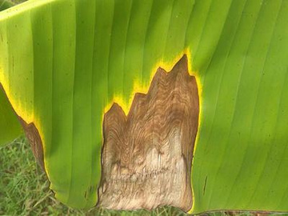
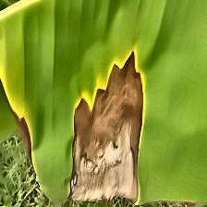
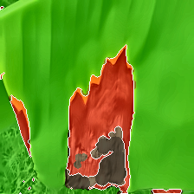
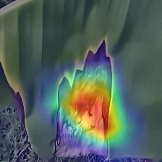
Demonstration
Results and Output Visualization
Image uploaded (input)
Preprocessed image
Severity estimation (infected area segmentation)
Grad-CAM heatmap (explainability)
Dept. of ISE, SIT, Tumkur
12

Slide 13
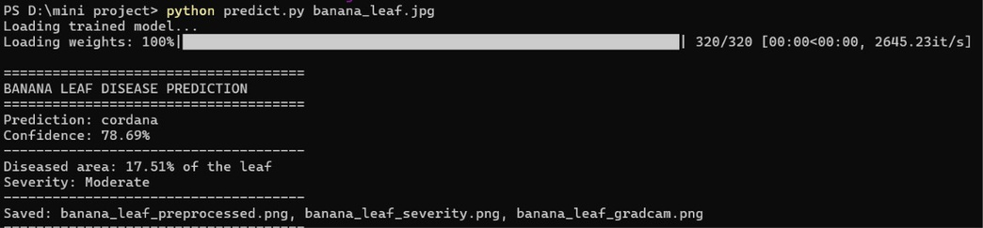
Demonstration
Results
Output containing disease prediction , percentage of diseased area , severity
Dept. of ISE, SIT, Tumkur
13

Slide 14
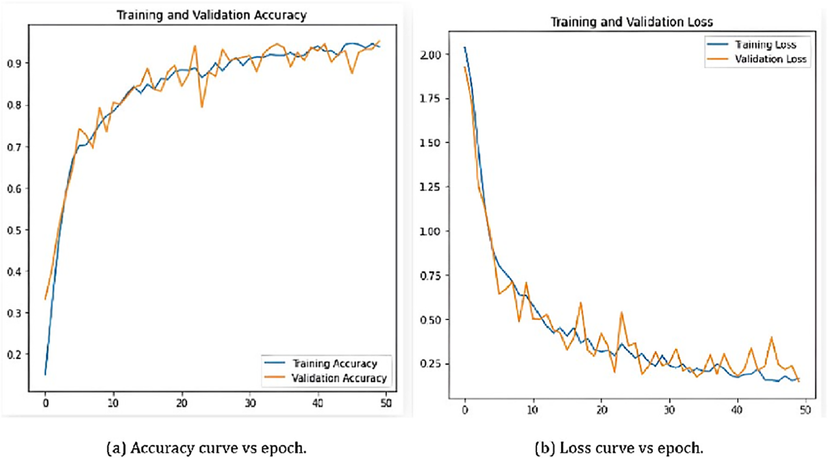
Demonstration
Dept. of ISE, SIT, Tumkur
14

Slide 15
Applications
APPLICATIONS
1.Early disease detection for banana farmers to reduce crop loss and improve yield.
2.Decision-support tool for agricultural extension officers and Krishi Vigyan Kendras.
3.Field-ready diagnosis via a smartphone camera through the web interface.
4.Severity tracking and disease-progression monitoring across large plantations over time.
5.Extensible to other banana-growing regions and adaptable to additional crop diseases.
Dept. of ISE, SIT, Tumkur
15

Slide 16
Requirements
Hardware:
GPU: NVIDIA GPU for accelerated deep learning model training.
Storage: SSD storage for fast dataset loading and saving model checkpoints.
Software & Frameworks:
Python (Core Programming Language)
TensorFlow / Keras (Deep Learning Framework for ResNet50)
OpenCV (Image Processing & Preprocessing)
Dept. of ISE, SIT, Tumkur
16

Slide 17
Limitations & Future Scope
LIMITATIONS AND FUTURE SCOPE
Limitations
HSV colour thresholds can be sensitive to lighting and background conditions.
Leaf-area severity suits spot diseases better than wilt or viral diseases.
Accuracy depends on the quality and variety of the training images.
Future Scope
Test and tune the system on real field images from different plantations.
Expand the dataset with more diseases and growth stages.
Provide a mobile application and regional-language advice for farmers.
Dept. of ISE, SIT, Tumkur
17

Slide 18
Conclusion
CONCLUSION
1.The proposed system automates banana leaf disease detection using deep learning, with ResNet-50 for accurate classification.
2.Beyond classification, it validates the input image, estimates disease severity and provides Grad-CAM visual explanations, improving transparency and farmer trust.
3.A Streamlit-based dashboard with recommendations and scan-history tracking makes the system practical and farmer-friendly.
4.This second review presents the implemented pipeline and its demonstration; further evaluation and field testing follow next.
Dept. of ISE, SIT, Tumkur
18

Slide 19
References
REFERENCES
[1] Kothalawala, M. U., Gaveshith K., M. G., Tharaka, A. H. D. H., Punchihewa, I. A., & Sriyaratna, D. (2022). Banana disease identification using machine learning based technologies and weather-based dispersion analysis. In Proceedings of the 4th International Conference on Advancements in Computing (ICAC), Colombo, Sri Lanka, pp. 234–239. doi: 10.1109/ICAC57685.2022.10025325.
[2] Tanwar, V., Sharma, B., & Aanand, V. (2023). Implementing a hybrid CNN-SVM model for banana leaf disease classification. In Proceedings of the IEEE International Conference on Research Methodologies in Knowledge Management, Artificial Intelligence and Telecommunication Engineering (RMKMATE), Chennai, India. doi: 10.1109/RMKMATE59243.2023.10369215.
[3] Thirumeninathan, V., Vijayalakshmi, S., & Palathara, S. T. (2024). Enhancing banana cultivation: Disease identification through CNN and SVM analysis for optimal plant health. In Proceedings of the International Conference on Trends in Quantum Computing and Emerging Business Technologies (TQCEBT), pp. 1–6. doi: 10.1109/TQCEBT59414.2024.10545264.
[4] Alanazi, R. (2025). A YOLOv10-based approach for banana leaf disease detection. Engineering, Technology & Applied Science Research, vol. 15, no. 3, pp. 23522–23526. doi: 10.48084/etasr.11138.
Dept. of ISE, SIT, Tumkur
19

Slide 20
References
REFERENCES
[5] Narayanan, K. L., Krishnan, R. S., Robinson, Y. H., Julie, E. G., Vimal, S., Saravanan, V., & Kaliappan, M. (2022). Banana plant disease classification using hybrid convolutional neural network. Computational Intelligence and Neuroscience, vol. 2022, article 9153699, pp. 1–13. doi: 10.1155/2022/9153699.
[6] He, K., Zhang, X., Ren, S., & Sun, J. (2016). Deep residual learning for image recognition. In Proceedings of the IEEE Conference on Computer Vision and Pattern Recognition (CVPR), Las Vegas, NV, USA, pp. 770–778. doi: 10.1109/CVPR.2016.90.
[7] Selvaraju, R. R., Cogswell, M., Das, A., Vedantam, R., Parikh, D., & Batra, D. (2017). Grad-CAM: Visual explanations from deep networks via gradient-based localization. In Proceedings of the IEEE International Conference on Computer Vision (ICCV), Venice, Italy, pp. 618–626. doi: 10.1109/ICCV.2017.74.
Dept. of ISE, SIT, Tumkur
20

Slide 21
Thank you, everyone!

