Slide 1






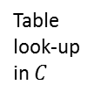


i-th output = $P(w_{t}=i|context)$
softmax
tanh
$$C(w_{t−n+1})$$
$$C(w_{t−2})$$
$$C(w_{t−1})$$
$$……$$
Table
look-up
in $C$
index for $w_{t−n+1}$
index for $w_{t−2}$
index for $w_{t−1}$

