Slide 1
Employee Data Analysis using Excel
STUDENT NAME:NIVETHA.R
REGISTER NO:998904B0A489EAC90314895D07D61570,312208727
DEPARTMENT:B.COM(GENERAL)
COLLEGE:MEENAKSHI COLLEGE FOR WOMEN

Slide 2
PROJECT TITLE
Employee Performance Analysis Based On Specific Department using Excel

Slide 3


AGENDA
Problem Statement
Project Overview
End Users
Our Solution and Proposition
Dataset Description
Modelling Approach
Results and Discussion
Conclusion
3/21/2024 Annual Review

Slide 4

PROBLEM STATEMENT
The Sales Department at XYZ Corporation is experiencing inconsistent employee performance , with some team members exceeding targets while others struggle to meet expectations. Despite training programs and performance , with management initiatives, the department’s overall performance has not improved significantly.

Slide 5

PROJECT OVERVIEW
Analyze employee performance in the Sales Department to identify key factors influencing performance. Inform data-driven decisions to improve department performance and enhance organization competitiveness. Analyze employee-level data on performance metrics, demographics, and job characteristics.

Slide 6

WHO ARE THE END USERS?
HUMAN RESOURCE DEPARTMENTS
MANAGEMENT AND LEADERSHIP
TERM LEADERS AND SUPERVISORS
EMPLOYEES
EXECUTIVE LEADERSHIP
BUSINESS ANALYSIS
RECRUITSERS

Slide 7

PIVOT TABLE-SUMMARYOF EMPLOYEE PERFORMANCE
PIE CHART-FINAL REPORT
OUR SOLUTION AND ITS VALUE PROPOSITION

Slide 8
Dataset Description
EMPLOYEE DATA SET: NAN MUDHALVAN
9 FEATURES IN EXCEL:
EMPLOYEE ID-ALPHANUMBERIC(TEXT)
NAME-ALPHABETICAL(TEXT)
GENDER-ALPHABETICAL(TEXT)
DEPARTMENT-ALPHABETICAL(TEXT)
SALARY-NUMBERICAL
START DATE-ALPHANUMERICAL(TEXT)
FTE-NUMBERICAL
EMPLOYEE TYPE-ALPHABETICAL(TEXT)
EMPLOYEE LOCATION-ALPHABETICAL(TEXT)
3 FEATURES USED:
JOB ROLE-ALPHABETICAL(TEXT)
JOB LEVEL-ALPHABETICAL(TEXT)
NUMBER OF PROMOTION-NUMERICAL

Slide 9

THE "WOW" IN OUR SOLUTION
Seamlessly combine data from various sources(HR system , project management tools, feedback forms) to provide a comprehensive view of performance.
Use AI and machine learning to identify trends, predict performance issues , and recommend targeted intervention.
3/21/2024 Annual Review
9

Slide 10
MODELLING
STEP-1
DOWNLOAD THE EMPLOYEE DATA SET AND OPEN THE EMPLOYEE SATASET IN EXCEL.
STEP-2
SELECT THE ENTIRE DATA AND CLICK ON DATA AND CLICK ON FILTER OPTION.
STEP-3
FILTER FTP FROM A TO Z ORDER.
STEP-4
SELECT THE ENTIRE DATA AND CLICK ON INSERT AND CLICK ON PIVOT TABLE TO CREATE PIVOT TABLE.
10

Slide 11
  STEP-5
  DRAG THE NEEDED DATA AND CREATE A PIVOT TABLE.
  STEP-6
  SELECT THE PIVOT TABLE AND CLICK ON INSERT.
  STEP-7
  NOW CLICK ON THE CHART THAT YOU WANT.
  STEP-8
  THE CHART IS CREATED.

Slide 12
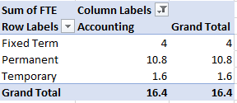
RESULTS
1.TABLE
12

Slide 13
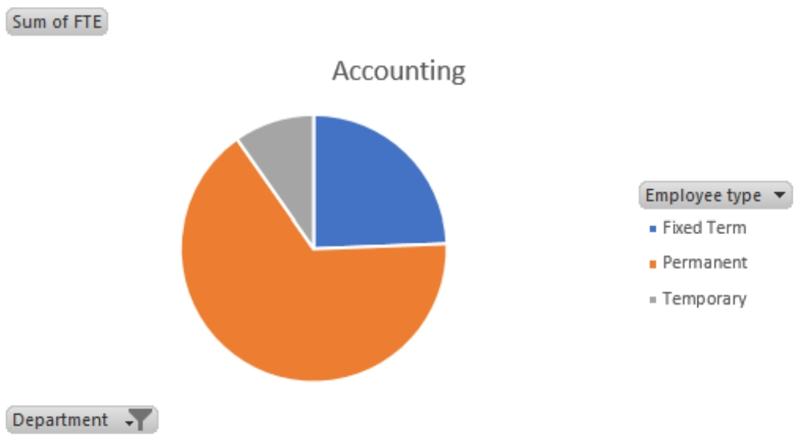
2.PIE CHART

Slide 14
conclusion
The employee performance analysis in the Sales Department revealed valuable insights into the factors driving performance. By leveraging data analytics and visualization, we identified key trends, patterns, and correlations that inform targeted interventions.
Employee tenure and training programs significantly impact sales performance.
Team dynamics and collaboration influence individual performance.

