Slide 1

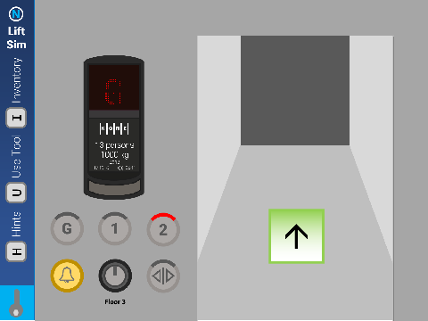
KONE EcoDisc
1996
Coded by NIXE
@NIXE_Hub nixehub.tk

