Slide 1


POLARIS
ALWAYS WITH YOU
Class 1 Group 4:
Ainul Mardhiyyah
Bhavy Mital
Edric
Kwon Inhyuk
Wei Letong
Zhao Lutong

Slide 2

1
Problem Statement

Slide 3
Problems
Problem Statements
In today’s busy world, we send hundreds of messages and emails around everyday, yet we always forget to say small things like “Good Night” to our loved ones because we may consider it trivial. We hide our feelings from them and bury ourselves in piles of work. Although through technology it seems we are more connected to people around us, yet we can’t help but feel less connected to the ones who matter the most.

Slide 4



Problems
NO.1
NO.2
NO.3
Distance
Feelings
Expression
There are cases when we are far away from our families and loved ones
We are connected to many people but there’s still a lack of deeper sense of connectivity with those closest to us
Sometimes we tend to ignore the importance of expression, hence distancing ourselves from our family

Slide 5
2
Stakeholders

Slide 6
Stakeholder
Stakeholder
Constraints
Needs
Working adults*
Students*
*who are living inconveniently far from their family
Busy life
Trivial messages seem unimportant to be sent
Reluctance to express feelings
A hassle free mode of communication for sending trivial messages,
Ability to feel the presence of family.

Slide 7
3
Solution

Slide 8

Solution
Provide a means of communication in a seamless manner, such as tapping a button to invoke some action on the other side, in order to strengthen the sense of one’s presence.
Design a pair of 2 or more night lamps that can play the role of a messenger between multiple parties.
Each lamp will contain RGB LEDs to show different light patterns conveying messages from other lamp(s).
Additional features may include speaker and mic capabilities.

Slide 9
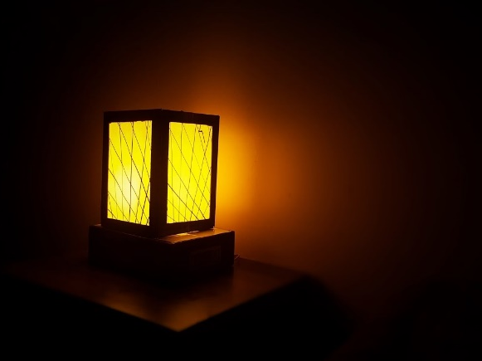
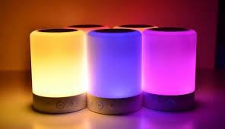
Solution
When one of the lamp detects a tap on top of the device, the other lamp will light up based on the tapping pattern.
Feature:
Tap & Lit
01
Feature:
Emotion & Colors
02
User can choose from a wide variety of emotions through our mobile app. These emotions will then be conveyed to other lamps by change the color of LEDs to represent the respective emotion

Slide 10




Solution
Cloud
Users send emotions (emoji) they want to express from UI on smartphone.
Users can interact (e.g. Tap) with lamps, and the signals will be sent to the cloud.
Lamps will collect the messages sent by users from cloud and changes colors/pattern accordingly.
User A
Lamp A
Lamp B
User B

Slide 11
Solution
Interaction between users and the lamp are detected
Interactions are translated into signals
Behaviors (e.g. blinks, changes colors) are displayed
Users choose the emotions they want to share from UI on mobile phones
Signals are sent to the cloud
Other lamps access data from the cloud
Signals are sent to the clouds

Slide 12
4
Appendix

Slide 13

Work Distribution
App | Cloud | Hardware
Java Program | Database | Schematic
UI | Pull/ Push Request | Prototyping
Pull/Push Request | VoIP | RPi Programming
 |  | Assembly
 |  | Pull/ Push Request
 |  | VoIP
Work allocation:
Letong
Ainul
Inhyuk
Bhavy
Edric
Lutong

Slide 14
Work distribution
70%
Software
30%
Hardware
User Interface
Schematics
Java Program
Prototyping
Cloud (database)
Assembly
Raspberry Pi programming
VoIP

Slide 15
Time line
Week | App/ Cloud | Hardware
6 | Design UI, database, flowchart for Java Program | Design schematic, order components
7 | Start Java Programming | RPi programming and testing components
8 | Finish UI, start Push/ Pull test
9 | Finish Push/ Pull, Java Program | Components arrive, test Push/ Pull, Finish RPi programming
10 | VoIP | Assembly and VoIP
11 | Finishing touch
12
13 | Exhibit

Slide 16
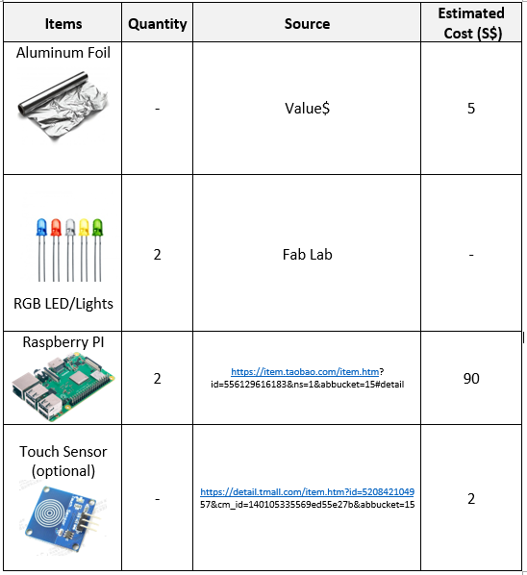
Materials
1
Aluminum foil to make DIY touch sensors
2
RGB LEDs for lights that can change colors
3
Raspberry Pi
4
Further development: Mic and speaker

Slide 17
Thank you

