Slide 1
CCAUTOMA · 1ST AY 2026
FORMAL LANGUAGES & AUTOMATA THEORY
Smart Employee ID Validator
Algorithmic derivation, formal verification, and interactive simulation of an organization-defined automaton
01
02
03
04
05
06
Language
Regex
ε-NFA
DFA
Minimization
Simulator
Anub, Mark Christian T.
Ayson, Rey Noel C.
Dotosme, James Paul B.
LANGUAGE ANALYST · DFA DESIGNER
DOCUMENTATION
PRESENTATION LEAD
Lauzon, Chester Josh C.
Perito, Isiah Thomas A.
Talingting, Ken Ira L.
PROGRAMMER · AUTOMATA OPTIMIZER
TESTER · QA
PROJECT LEADER
Notes:
PRESENTER: Ken — Project Leader
SAY: Good morning, panel. We are Team CCAUTOMA, and this is the Smart Employee ID Validator. On the surface it checks whether a string like EMP-2026-0042 is a valid employee ID. But the real point of the project is how it does that. We start from a formal language, write it as a regular expression, and then let algorithms build the machine for us: Thompson's construction gives an epsilon-NFA, subset construction gives a DFA, Moore's algorithm minimizes it, and the simulator runs it in a GUI. Nobody typed a transition table by hand.
Quick introductions: Mark Anub defined the language and designed the DFA. Rey Ayson handled documentation and diagrams. James Dotosme led the presentation and evidence. Chester Lauzon programmed the system and optimized the automaton. Isiah Perito tested it. I'm Ken Talingting, project leader — I coordinated the work.
EMPHASIS: This is not just a validator — it is a formal language turned into an executable automaton, algorithmically.
TRANSITION: To start, Mark will define exactly which language we are recognizing.

Slide 2
02 · PROBLEM DEFINITION
ANUB — LANGUAGE ANALYST
The Employee ID Language
E
M
P
-
2
0
2
6
-
0
0
4
2
PREFIX EMP
SEP
YEAR YYYY
SEP
NUMBER NNNN
ALPHABET
13
14
10⁸
Σ = { E, M, P, -, 0, 1, …, 9 }
symbols in every valid ID
symbols in the alphabet, |Σ| = 14
valid IDs — 100,000,000
LANGUAGE
L = { w ∈ Σ* | w = EMP-d₁d₂d₃d₄-d₅d₆d₇d₈, d_{i} ∈ {0,…,9} }
|L| is finite, so L is regular.
Notes:
PRESENTER: Mark Anub — Language Analyst / DFA Designer
SAY: Every valid ID follows one pattern: EMP, a hyphen, four digits for the year, another hyphen, and four digits for the number. That's exactly 13 symbols, every time.
Our alphabet Sigma has 14 symbols: the letters E, M and P, the hyphen, and the ten digits. Nothing else. A lowercase e, a space, or an underscore is not in the alphabet at all.
Formally, L is the set of strings over Sigma of the form EMP-d1d2d3d4-d5d6d7d8 where each d is a digit. There are 8 free digit positions with 10 choices each, so the language has exactly 10 to the 8th — one hundred million — strings.
Because L is finite, it is regular. Every finite language is regular, so a DFA for it is guaranteed to exist.
EMPHASIS: Fixed length 13, alphabet of 14, 10^8 strings, finite therefore regular.
IF ASKED — 'Why is it regular?': because it is finite; any finite set of strings can be written as a union of those strings, which is a regular expression.
IF ASKED — 'Why restrict the alphabet?': it makes the automaton's input precise and lets us report characters outside Sigma as a separate error.
TRANSITION: James will now show how we turn this definition into a machine.

Slide 3
03 · CONSTRUCTION
DOTOSME — PRESENTATION LEAD
The Automata Pipeline
01 →
02 →
03 →
04 →
05
Regex AST
Thompson ε-NFA
Subset DFA
Moore minimization
Simulator + GUI
AST
15
Run
26
15
EMP-D⁴-D⁴
DFA states
executable validator
ε-NFA states
minimal states
No hand-written automaton transition table
Notes:
PRESENTER: James Dotosme — Presentation Lead
SAY: Here is the whole technical story on one slide. Each stage takes the output of the stage before it and computes the next one.
We start with the regular expression as a syntax tree. Thompson's construction turns it into an epsilon-NFA with 26 states. Subset construction turns that into a DFA with 15 states. Moore's partition refinement minimizes it — and it stays at 15, which Chester will explain. The final DFA is what the simulator and the GUI actually run.
The key point is the red line: there is no hand-written transition table anywhere in the core validation logic. If we changed the regular expression, every stage would be regenerated.
EMPHASIS: The machine is derived, not hand-coded. 26 → 15 → 15.
IF ASKED — 'Did you check the DFA by hand?': the derivation is algorithmic, and the next slides show how we verified the result formally and with tests.
TRANSITION: Chester will walk through each construction, starting with Thompson's ε-NFA.

Slide 4
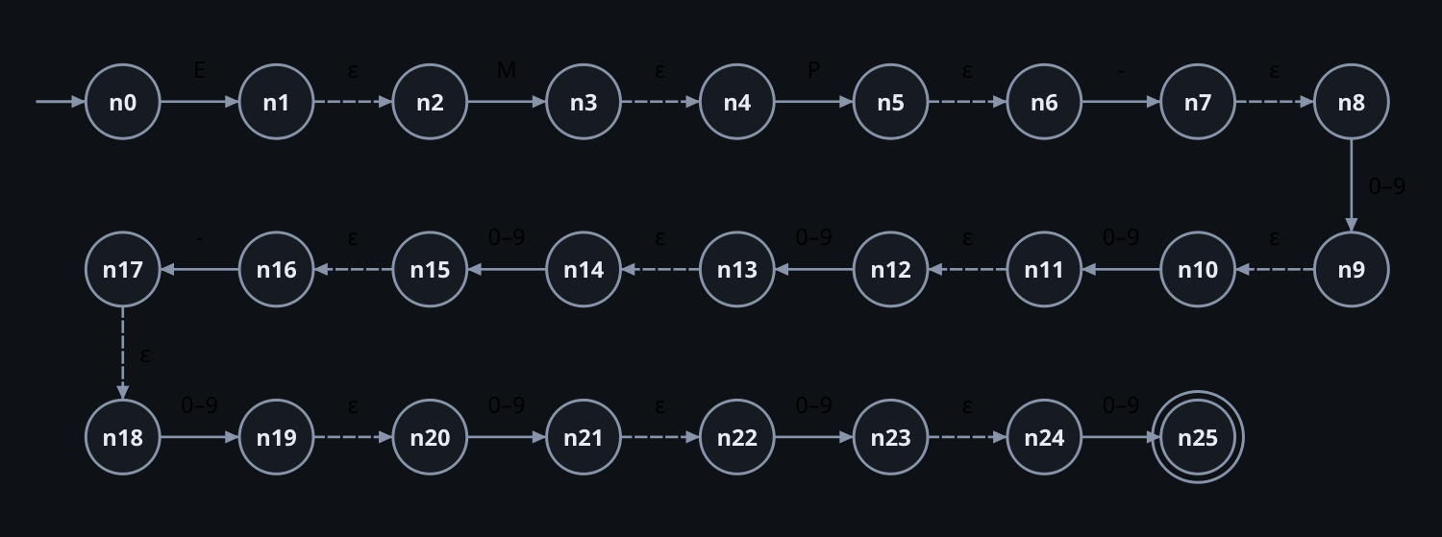
04 · STAGE 2
LAUZON — PROGRAMMER
Thompson’s ε-NFA
01 · REGEX FRAGMENT
EMP-D⁴-D⁴
D = (0 ∪ 1 ∪ … ∪ 9)
02 · CONSTRUCTION
One fragment per symbol; concatenation joins fragments with ε
03 · DIGIT ATOM
26 states · 12 ε-transitions
10 parallel transitions instead of 10 union branches — same language
START N0 · ACCEPTING N25
Notes:
PRESENTER: Chester Lauzon — Programmer / Automata Optimizer
SAY: Thompson's construction works bottom-up on the regex tree. Every symbol becomes a small two-state fragment, and concatenation glues fragments together with epsilon transitions. That's why you see the dashed epsilon arrows between every symbol in the diagram.
One implementation choice: a digit D is formally a union of ten alternatives. Built literally, that would create a lot of extra branch states for every digit position. Instead, we treat the digit class as one atom with 10 parallel transitions between the same two states. The language is exactly the same — it just avoids an unnecessary state explosion.
The result is 26 states, n0 to n25, with 12 epsilon transitions. n0 is the start state and n25 is the only accepting state.
EMPHASIS: The NFA is generated from the regex structure; the digit atom keeps it compact without changing L.
IF ASKED — 'Doesn't collapsing the union change the construction?': no; a union of single symbols and one transition per symbol accept exactly the same strings.
TRANSITION: An NFA can be in several states at once, so next we make it deterministic.

Slide 5
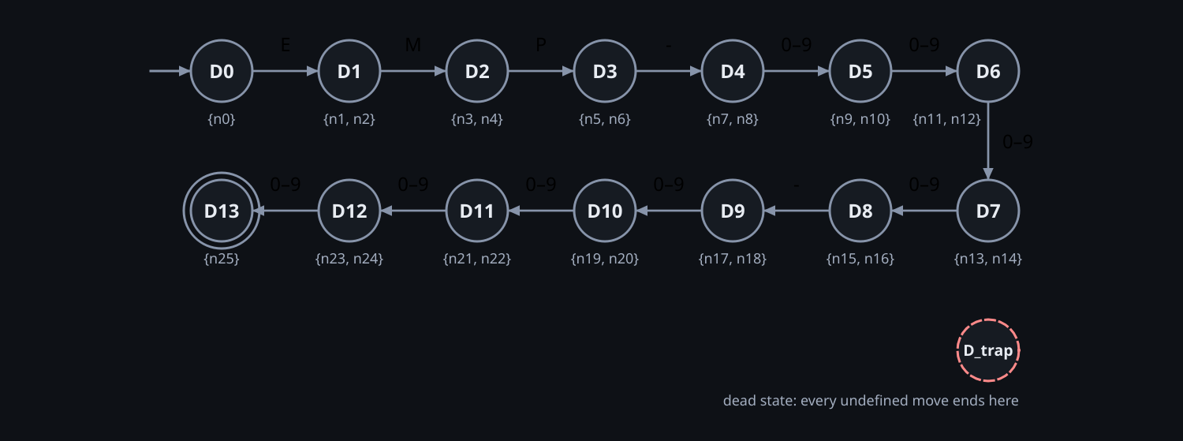
05 · STAGE 3
LAUZON — PROGRAMMER
Subset Construction
01 · FOR EACH SUBSET S, SYMBOL A
ε-closure(move(S, a))
02 · NEW SUBSET
Each new set of NFA states becomes one DFA state
03 · COMPLETE Δ
Every state has a defined transition for every symbol in Σ
15 states · 14 live + D_{trap}
LIVE D0 … D13 · TRAP DTRAP
Notes:
PRESENTER: Chester Lauzon — Programmer / Automata Optimizer
SAY: Rabin–Scott subset construction turns the NFA into a DFA. Each DFA state represents a set of NFA states. We start with the epsilon-closure of n0. Then, for every subset S and every symbol a, we compute move(S, a) and take its epsilon-closure. If that set is new, it becomes a new DFA state.
Running this to completion gives 14 live states, D0 to D13, plus one explicit trap state. Any symbol that is not allowed at a position sends the machine to Dtrap, and Dtrap loops to itself on everything.
That gives us a complete transition function: all 15 states have a defined move for all 14 symbols of Sigma. We never hit an 'undefined' case at runtime.
EMPHASIS: The DFA is computed from the NFA — 14 live states plus one trap, complete over Σ.
IF ASKED — 'Why 15 states?': one state per position read, 0 through 13, plus the trap.
IF ASKED — 'Why an explicit trap state?': it makes δ total, so the simulator can show exactly where an input fails.
TRANSITION: The obvious next question is whether 15 is the smallest possible DFA.

Slide 6
06 · STAGE 4
LAUZON — AUTOMATA OPTIMIZER
Minimization and the No-Merge Proof
SHORTEST ACCEPTING DISTANCE FROM EACH STATE
D0
D1
D2
D3
D4
D5
D6
D7
D8
D9
D10
D11
D12
D13
trap
13
12
11
10
9
8
7
6
5
4
3
2
1
0
∞
MOORE PARTITION REFINEMENT
RESULT
P₀ = { {D13}, {D0, …, D12, Dtrap} }
15 → 15
P₀ → P₁ → … → P₁₃ · 13 rounds
0 merges
d(D_{i}, F) = 13 − i · all distinct
The subset DFA is already minimal; the optimizer verifies minimality.
Notes:
PRESENTER: Chester Lauzon — Programmer / Automata Optimizer
SAY: We minimize with Moore's partition refinement. The first partition splits accepting from non-accepting: D13 on its own, everything else — including the trap — in one block. Then we keep splitting blocks whenever two states go to different blocks on the same symbol. It takes 13 rounds to stabilize, and at the end, zero states have merged. 15 in, 15 out.
Why? Look at the strip. From state D-i, the shortest accepted word has exactly 13 minus i symbols. D0 needs 13, D12 needs 1, D13 needs 0, and the trap can never accept — distance infinity. If two states had different distances, some suffix is accepted from one and not the other. Every state here has a different distance, so every pair is distinguishable.
I want to be clear: zero merges is not a failed optimization. It's the expected mathematical result for this language. The optimizer's job is to prove the DFA is minimal, not just to make it smaller.
EMPHASIS: Unique shortest-accepting distances ⇒ pairwise distinguishable ⇒ already minimal.
IF ASKED — 'Why run minimization if nothing merges?': because without it, minimality is a claim; with it, it's verified — and it would catch redundancy if the regex changed.
TRANSITION: Isiah will show how we verified the minimized DFA accepts the same language.

Slide 7
07 · STAGE 5
PERITO — TESTER / QA
Formal and Empirical Verification
PASS
FORMAL · PRODUCT-AUTOMATON BFS
EMPIRICAL · VS PYTHON RE.FULLMATCH
DFA_{subset} × DFA_{minimal}
41,371
product automaton, explored breadth-first
exhaustive strings, length ≤ 4
15
20,000
reachable state-pairs checked
randomized, mutated and Unicode look-alike inputs
0
0
discrepancies
disagreements
Notes:
PRESENTER: Isiah Perito — Tester / QA
SAY: We verified the result in two independent ways.
On the left is the formal check. We build the product automaton of the subset DFA and the minimized DFA, and explore it with breadth-first search. Each reachable pair of states is checked: if one accepts and the other doesn't, the machines differ. We reached 15 state-pairs and found zero discrepancies. That proves they recognize the same language.
On the right is empirical, differential testing. We compared our automaton against Python's re.fullmatch on 41,371 strings — every string of length 4 or less over the alphabet — plus 20,000 randomized and mutated inputs, including Unicode look-alike characters such as a Cyrillic letter that looks like E. Zero disagreements.
EMPHASIS: The tests don't replace the proof — they back it up from a completely different direction.
IF ASKED — 'How does formal verification differ from differential testing?': BFS over the product automaton covers every reachable state pair, so it is a proof of equivalence between our two DFAs. Differential testing compares against an independent reference on concrete inputs; it can't prove, but it catches mistakes in how we defined the language itself.
TRANSITION: Chester will now show how all of this is organized as software.

Slide 8
08 · IMPLEMENTATION
LAUZON — PROGRAMMER
Software Architecture
Presentation
SimulatePage
TheoryPage
TestsPage
PYSIDE6 GUI
Service
SimulationService
ValidationService
RESULT PACKAGING
Automata core
pipeline.py
simulator.py
minimizer.py
nfa.py
dfa.py
APP.CORE
1
Alphabet filter
2
Automaton traversal
3
Result packaging
Rejects symbols ∉ Σ, with position
app.core.simulator.Run
Structured result for the GUI
Notes:
PRESENTER: Chester Lauzon — Programmer / Automata Optimizer
SAY: The code has three layers. At the bottom is the automata core: nfa.py, dfa.py, minimizer.py, pipeline.py which chains the stages, and simulator.py which runs the result. In the middle, the services — SimulationService and ValidationService — package results for the interface. At the top, the PySide6 pages: Simulate, Theory and Tests.
The GUI never implements automaton logic itself. It only renders structured results from the services.
Every validation goes through the same path. First, an alphabet filter rejects anything outside Sigma and reports the exact symbol and position. Then the automaton traverses the input. Then the result is packaged. That traversal is app.core.simulator.Run — one engine used for batch validation, step-by-step execution and the GUI animation. So the batch validator and the animated simulator can't quietly disagree.
EMPHASIS: One simulation engine is the single source of truth.
IF ASKED — 'How does the GUI stay separate from the automata logic?': the pages only call services and draw what comes back; all decisions happen in app.core.
TRANSITION: James will show what that looks like for a user.

Slide 9
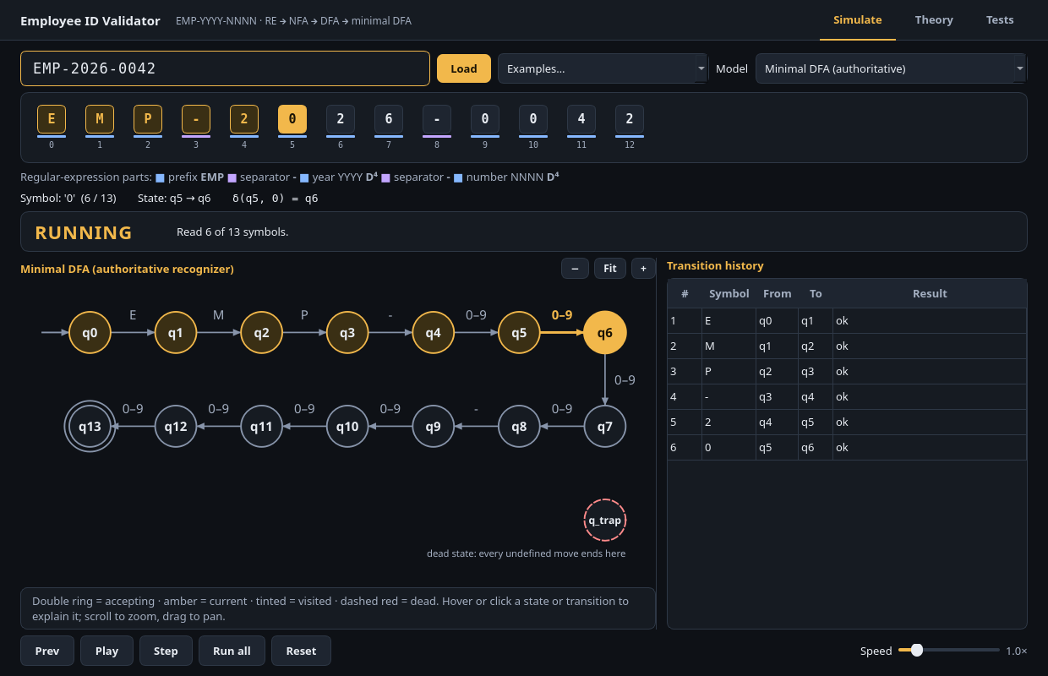
09 · INTERFACE
DOTOSME — PRESENTATION LEAD
The Educational GUI
Built to make automata theory observable
1
2
1
Interactive tape
2
Regex segment indicators
3
3
Active transition
4
4
Visited states
5
Play / pause, step forward and back
KEYBOARD
Space · → · ← · Ctrl+R
5
Notes:
PRESENTER: James Dotosme — Presentation Lead
SAY: This is the Simulate page, mid-run on EMP-2026-0042. Everything on screen comes from the same automaton we just built.
(1) The tape at the top shows each symbol and highlights the one being read. (2) The coloured bars under the tape show which part of the regular expression each symbol belongs to — prefix, separator, year, number. (3) In the diagram, the amber arrow is the transition being taken right now. (4) States already visited stay tinted, so you can see the path so far. (5) The controls let you play, pause, step forward and step backward. Keyboard works too: Space to play or pause, the arrow keys to step, Ctrl+R to reset.
The transition history on the right logs every move, and you can switch the model to the pre-minimization DFA or the ε-NFA.
EMPHASIS: The GUI is designed to make automata theory observable — you can watch δ being applied one symbol at a time.
TRANSITION: Let's run a complete valid ID.

Slide 10
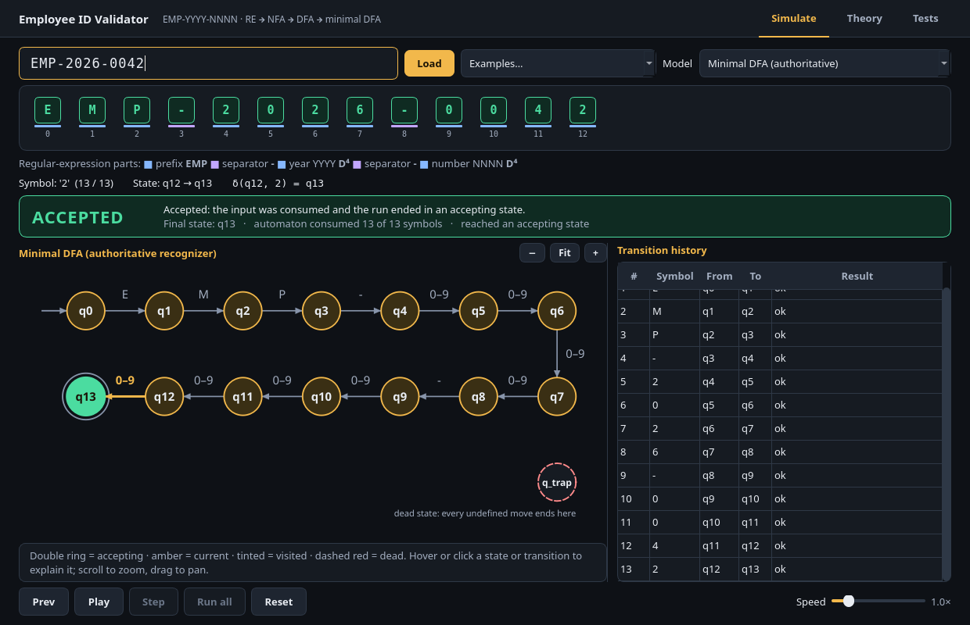
10 · LIVE DEMONSTRATION
DOTOSME — PRESENTATION LEAD
Demo: An Accepted ID
INPUT
EMP-2026-0042
EXECUTION PATH
q0 –E→ q1 –M→ q2 –P→ q3 –‑→ q4
q4 –2→ q5 –0→ q6 –2→ q7 –6→ q8
q8 –‑→ q9 –0→ q10 –0→ q11 –4→ q12 –2→ q13
FINAL STATE Q13 · 13 / 13 SYMBOLS
ACCEPT
Notes:
PRESENTER: James Dotosme — Presentation Lead (live demo)
SAY: (Switch to the app.) I'll type EMP-2026-0042 and press Play. Watch three things: the highlighted symbol on the tape, the amber transition in the diagram, and the state number.
E takes us from q0 to q1, M to q2, P to q3, the hyphen to q4. Then four digits for the year carry us to q8, the second hyphen to q9, and four more digits to q13. After 13 symbols we are in q13 — the double-ringed accepting state — and the banner reads ACCEPTED.
The point of this demo is not the result itself; Python could tell us that in one line. The point is that the DFA we derived on the previous slides is the thing actually running, symbol by symbol.
DEMO TIPS: If the live app has trouble, this slide's screenshot is the fallback. Use Step instead of Play if the panel wants to slow down.
IF ASKED — 'Why not just use Python re?': because the goal is an inspectable, algorithmically derived state machine, not a black-box yes/no.
TRANSITION: Mark and Chester will show what happens when the input is wrong.

Slide 11
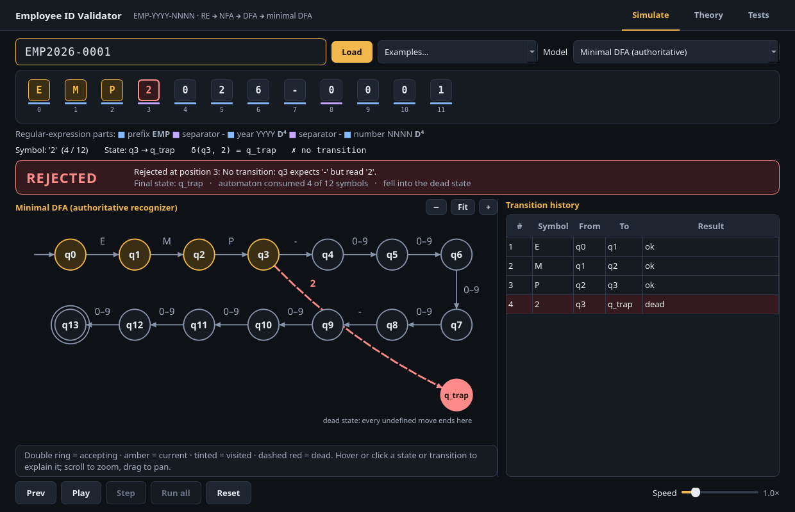
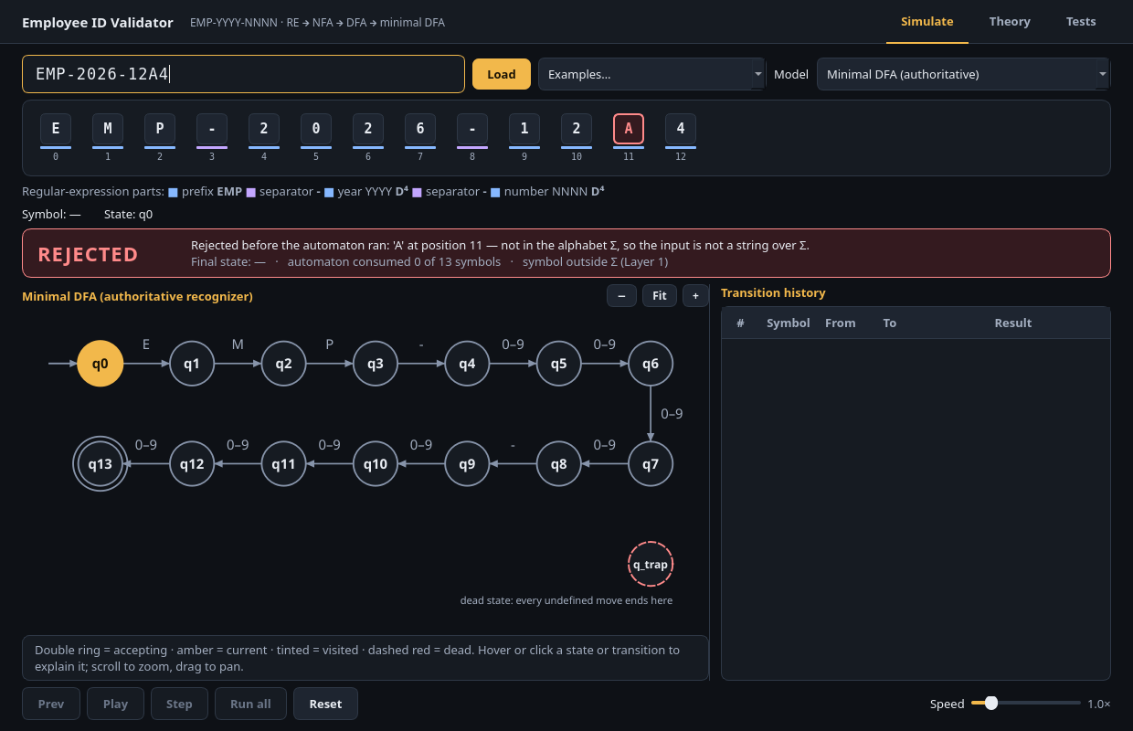
11 · INVALID INPUTS
ANUB + LAUZON
Two Rejection Modes
CASE A · STRUCTURAL REJECTION
CASE B · ALPHABET REJECTION
EMP2026-0001
EMP-2026-12A4
‘2’ ∈ Σ, but q3 only allows ‘-’ → trap state
‘A’ ∉ Σ → rejected before the automaton runs
Notes:
PRESENTER: Mark Anub (language) + Chester Lauzon (implementation)
MARK SAYS: Not every invalid ID fails for the same reason. In Case A, EMP2026-0001, every character is in Sigma — the problem is order. After EMP, the language requires a hyphen, but we read a 2. In Case B, EMP-2026-12A4, the letter A is simply not in our alphabet. That string isn't even a word over Sigma.
CHESTER SAYS: The implementation treats these differently. For Case A, the automaton runs normally: q0, q1, q2, q3, then on '2' there's no valid move from q3, so it goes to the trap state and stays there. The GUI shows the dashed red edge into q_trap. For Case B, the alphabet pre-filter catches 'A' before the automaton runs at all, and reports the exact symbol and its position.
EMPHASIS: Structural rejection happens inside the DFA (trap state); alphabet rejection happens before it (pre-filter).
IF ASKED — 'Why not just let A go to the trap state?': the DFA is defined over Σ, so A has no transition by definition; filtering first keeps δ honest and gives the user a more precise error.
TRANSITION: Isiah will show how we tested these cases and many more.

Slide 12
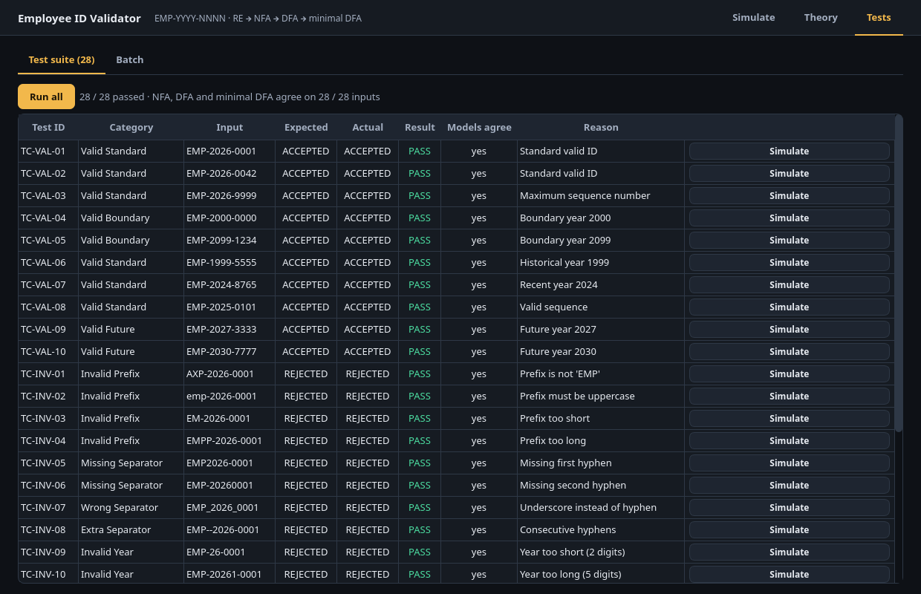
12 · TESTING
PERITO — TESTER / QA
Test Suite and Edge Cases
28
250+
predefined cases
automated tests
10 valid
18 invalid
Unit · Integration · GUI (offscreen)
EDGE CASES COVERED
Boundary years
Prefix errors
Missing / double hyphens
Underscores
Lowercase input
Truncated IDs
Empty string
Whitespace
Notes:
PRESENTER: Isiah Perito — Tester / QA
SAY: Our predefined suite has 28 cases: 10 valid and 18 invalid. You can see them on the Tests page — every one passes, and the NFA, the DFA and the minimal DFA agree on all 28 inputs.
Behind that, the project has more than 250 automated tests, in three groups: unit tests for each core module, integration tests for the full pipeline, and GUI tests that run offscreen.
The invalid cases were chosen to hit the edges: boundary years like 2000 and 2099, wrong or lowercase prefixes, missing, doubled or wrong separators such as underscores, IDs that are too short, the empty string, and whitespace. Each one checks a specific way an ID can be almost right.
EMPHASIS: We test the boundaries, not just the happy path — and all three models must agree.
IF ASKED — 'How do you know the tests are right?': each expected result comes from the language definition, and the differential tests on the previous slide check against an independent reference.
TRANSITION: Rey and Chester will close the technical part with our main engineering decisions.

Slide 13
13 · HIGHLIGHTS
AYSON + LAUZON
Engineering Decisions
01 · LAUZON
02 · LAUZON
Unified simulation engine
Character-class Thompson atom
app.core.simulator.Run drives both GUI stepping and batch validation
Digit unions consolidated without changing language semantics
03 · AYSON
04 · AYSON
Reproducible documentation
Accessibility and motion control
Verification and documentation artifacts regenerate from the implementation
Keyboard navigation and reduced-motion support
Notes:
PRESENTER: Chester Lauzon (cards 1–2) + Rey Ayson — Documentation (cards 3–4)
CHESTER SAYS: Two decisions shaped the code. First, one simulation engine — app.core.simulator.Run — powers both GUI stepping and batch validation, so they can never implement different logic. Second, the character-class Thompson atom: we merge the ten digit alternatives into one atom with ten parallel transitions. It keeps the NFA small without changing the language.
REY SAYS: On the documentation side, our tables and diagrams aren't typed by hand either. The verification and documentation artifacts are regenerated from the implementation, so if the code changes, the documents change with it — and there's a check mode that flags when they're out of date. Finally, accessibility: the simulator can be used fully from the keyboard, and it supports reduced motion for users who don't want animated transitions.
EMPHASIS: The same 'derive, don't hand-type' rule applies to the code, the docs and the diagrams.
IF ASKED — 'How do you keep the documentation accurate?': it is generated from the same objects the program uses.
TRANSITION: Ken will wrap up.

Slide 14
14 · CONCLUSION
TALINGTING — PROJECT LEADER
Language → RE → ε-NFA → DFA → Minimal DFA → Simulation
Thank you — questions and discussion
15-state DFA is minimal
Formal equivalence verified
Working educational GUI
Notes:
PRESENTER: Ken Talingting — Project Leader
SAY: To sum up: we started from a formal definition of employee IDs and derived the whole machine — regex, ε-NFA, DFA, minimal DFA — algorithmically, then ran it in an educational simulator. Three things we can stand behind: the 15-state DFA is minimal, its equivalence is formally verified, and the GUI works and shows the theory step by step.
Each of us owned a piece: Mark the language, Rey the documentation, James the presentation, Chester the implementation and optimization, Isiah the testing, and I coordinated. Thank you — we're happy to take your questions.
Q&A BANK (answer owner in brackets)
• Why is the language regular? [Mark] It is finite — 10^8 strings — and every finite language is regular.
• Why did minimization merge zero states? [Chester] Each live state has a unique shortest accepting distance, 13 − i, and the trap's is ∞, so all states are distinguishable.
• Why run minimization if nothing merges? [Chester] It turns 'we think it's minimal' into a verified result, and it would catch redundancy if the regex changed.
• Why not use Python re directly? [Chester] The goal is an inspectable, algorithmically derived finite-state machine, not a black-box validator. We do use re.fullmatch — as an independent reference in testing.
• Why an explicit trap state? [Chester] It makes δ total over Σ, so every input ends in a defined state and the GUI can show where it failed.
• Why restrict the alphabet? [Mark] The DFA is defined over Σ; symbols outside it are reported separately with their position.
• Why does subset construction produce 15 states? [Chester] One live state per number of symbols read, 0 to 13, plus the trap.
• Formal verification vs differential testing? [Isiah] Product BFS proves the two DFAs equivalent; differential testing checks our language against an independent reference.
• How is the GUI kept separate from automata logic? [Chester] Pages only render results from services; all logic lives in app.core.

