Slide 1
RECOMMENDATION SYSTEM
Mentor Team Members
Anavadhya Mr. Amresh Kumar
Co – Mentor Mr. Azim Khan
Mr. Nitesh Singh
Miss. Preeti Kumari
Mr. Vikram Gowda B S

Slide 2
About Machine Learning
Definition: Machine learning is a branch of artificial intelligence (AI) that enables computers to learn and improve from experience without being explicitly programmed.
Types: It includes supervised learning (learning from labeled data), unsupervised learning (finding patterns in unlabeled data), reinforcement learning (learning from rewards or punishments), and deep learning (using neural networks with multiple layers).
Applications: Widely used in various fields such as image and speech recognition, natural language processing, recommendation systems, predictive analytics, and autonomous vehicles.
Data: Machine learning algorithms require large amounts of data to train effectively, often necessitating preprocessing and feature engineering.
Evaluation: Performance of machine learning models is assessed using metrics like accuracy, precision, recall, F1 score, and area under the ROC curve.
Ethical Considerations: Important considerations include bias, fairness, privacy, and transparency in the deployment and use of machine learning systems.

Slide 3
Recommendation System
Definition: Recommendation systems predict and suggest items (products, content) to users based on preferences or behavior.
Types:
Collaborative Filtering
Content-based Filtering
Hybrid Recommendation Systems
Knowledge-based Recommendation Systems
Process:
Data Collection
Data Preprocessing
Feature Extraction
Model Training
Recommendation Generation
Evaluation

Slide 4
Applications:
E-commerce
Social Media
Music Streaming
News Aggregation
Challenges:
Cold Start Problem
Scalability
Data Sparsity
Diversity and Serendipity
Ethical Considerations:
Fairness and Transparency
User Privacy
User Control

Slide 5
Business Objective
Generate the features from the dataset and use them to recommend the books accordingly to the users.

Slide 6
About the dataset
We have three csv files:- users.csv, Ratings.csv, Books.csv
In users file we have three columns:- User id, Location, Age. Total number of rows are 278858.
in ratings file we have three columns:- User id, ISBN, Book-rating.
In books file we have six columns:- ISBN, Book –Title, Book-Author, Year of Publisher and image url.

Slide 7
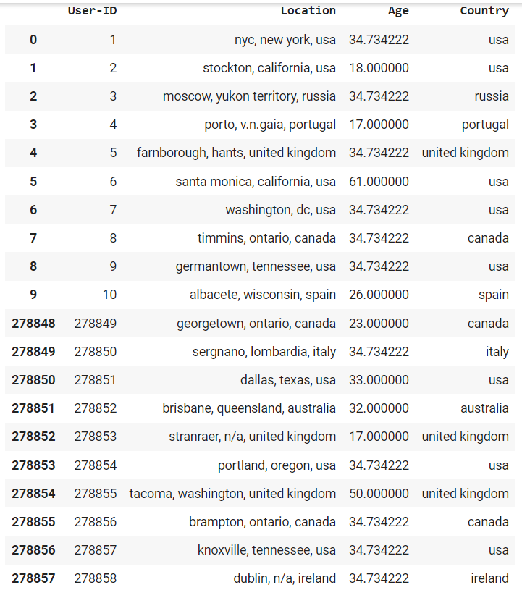
Dataset

Slide 8
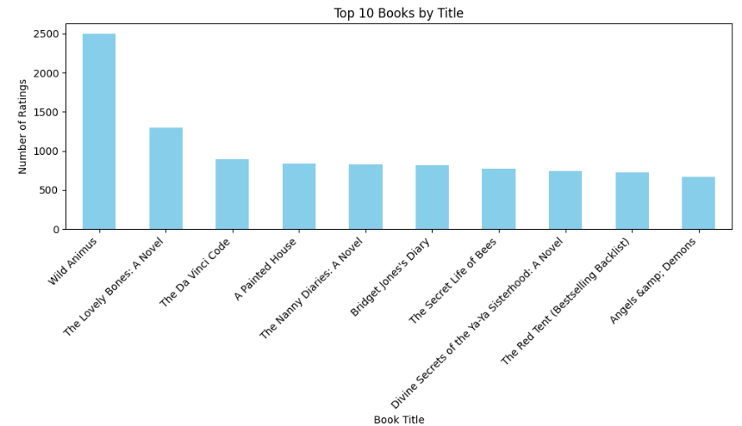
EDA Top 10 Books read by the users

Slide 9
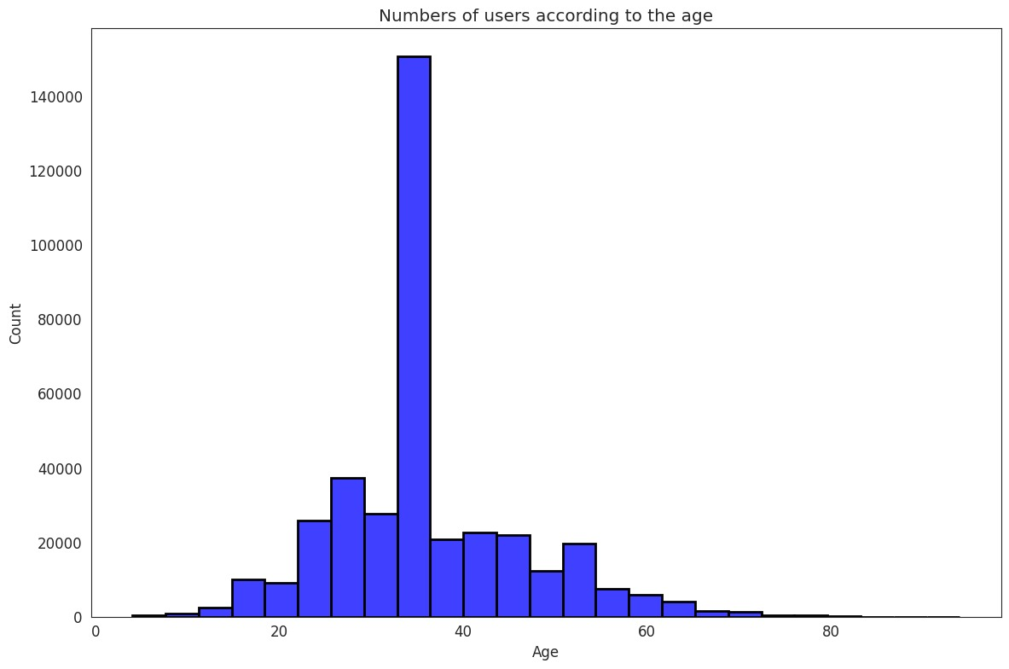
Number of Books read by the users according to Age

Slide 10
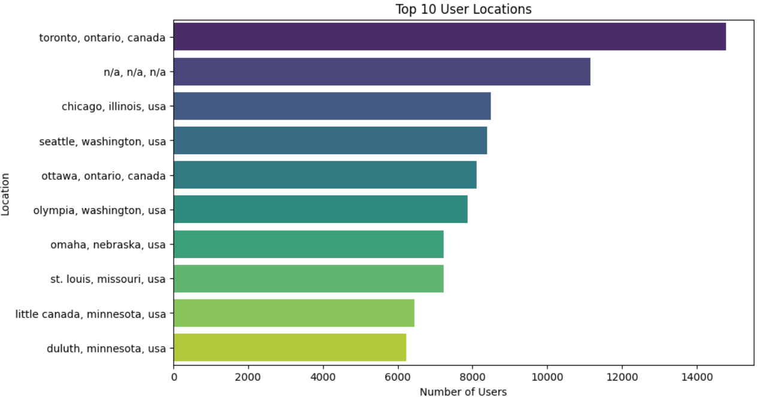
Countries with most readers

Slide 11
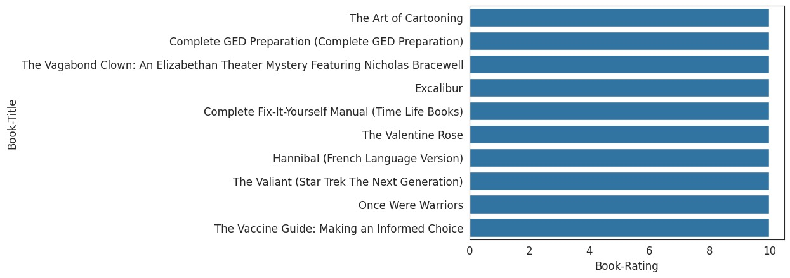
Top 10 Rated books

Slide 12
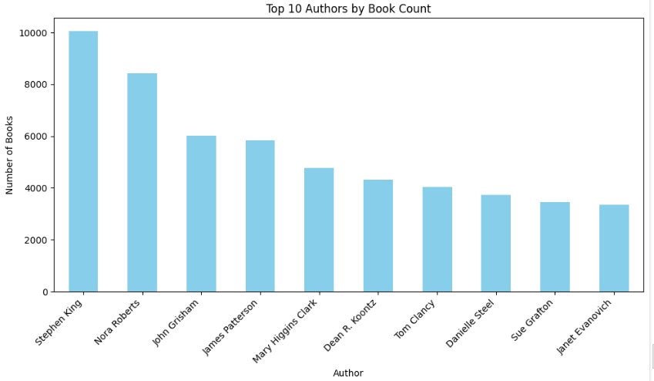
Top Authors by Book count

Slide 13
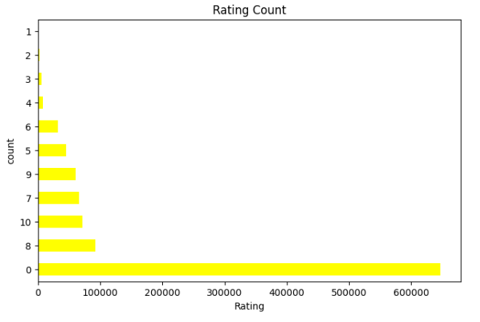
Rating count

Slide 14
Model Building

Slide 15
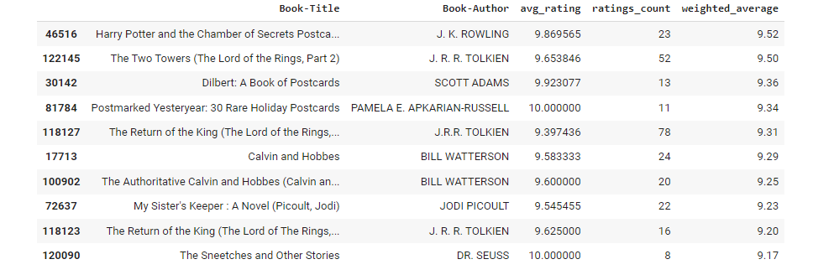
Author based recommender system

Slide 16
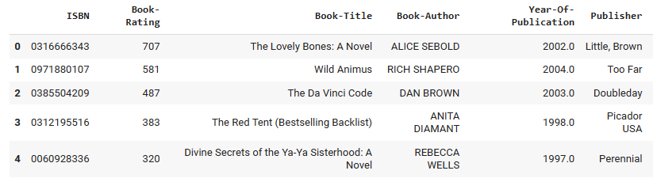
Popularity based recommendation system

Slide 17
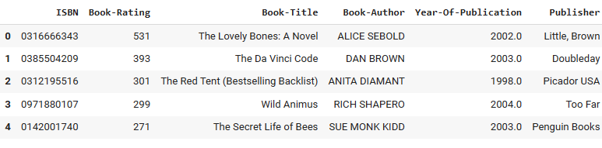
Country-based book recommendation

Slide 18
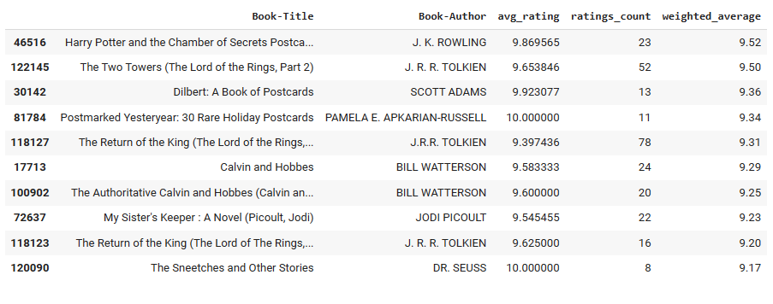
Calculating weighted average rating of the books

Slide 19
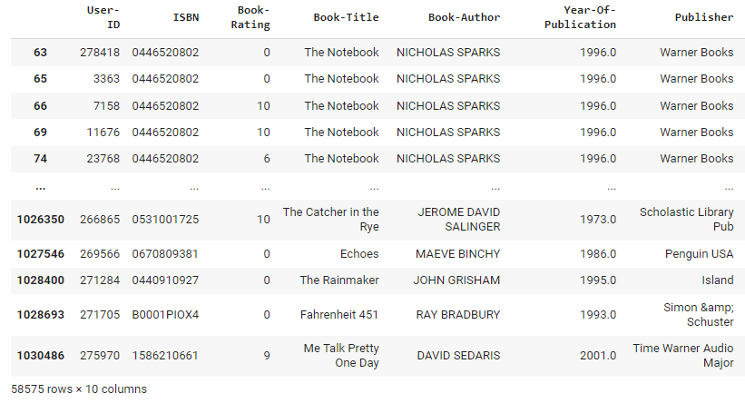
Collaborative Filtering Based Recommendation System

Slide 20

Deployment

Slide 21
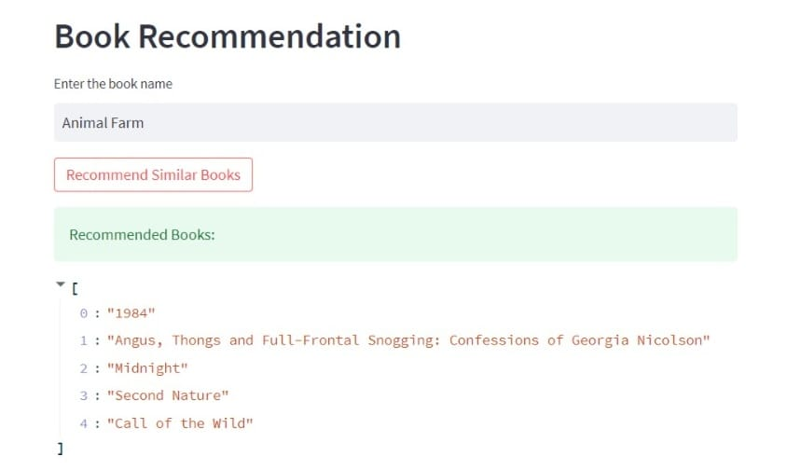

Slide 22
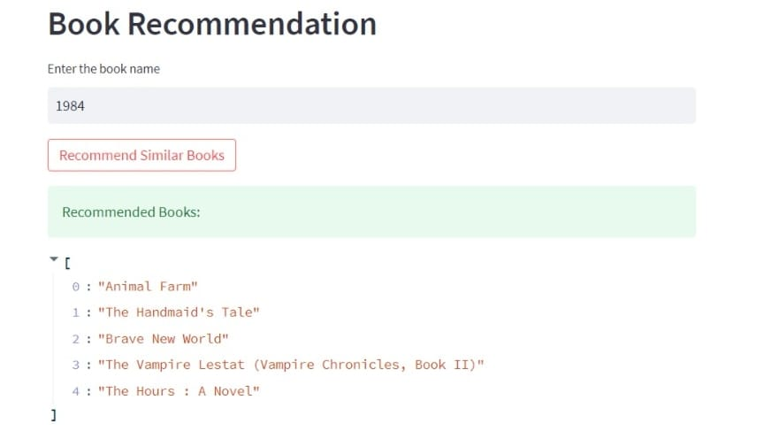

Slide 23
Challenges Faced
We faced some difficulty in uploading the dataset.
As the every team member were belonging to different states, we faced some problems while communicating with each other.
We faced lot of difficulties when we were working on the models.
Deployment part was not easy, we faced lot of problems when we were working on the deployment part.

Slide 24
THANK YOU

