Slide 1
RESUME CLASSIFICATION
Mentor Team Members
Priyanka Bindal Mr. Asif Mallick
Co-mentor Mr. Avinash Pandey
Pallvi B Mr. B S Vikram Gowda
Mr. Manu K
Mr. Nitesh Singh
Mr. Satyavrat Pandey

Slide 2
Business Objective
The document classification solution should significantly reduce the manual human effort in the HRM.
It should achieve a higher level of accuracy and automation with the minimal human intervention

Slide 3
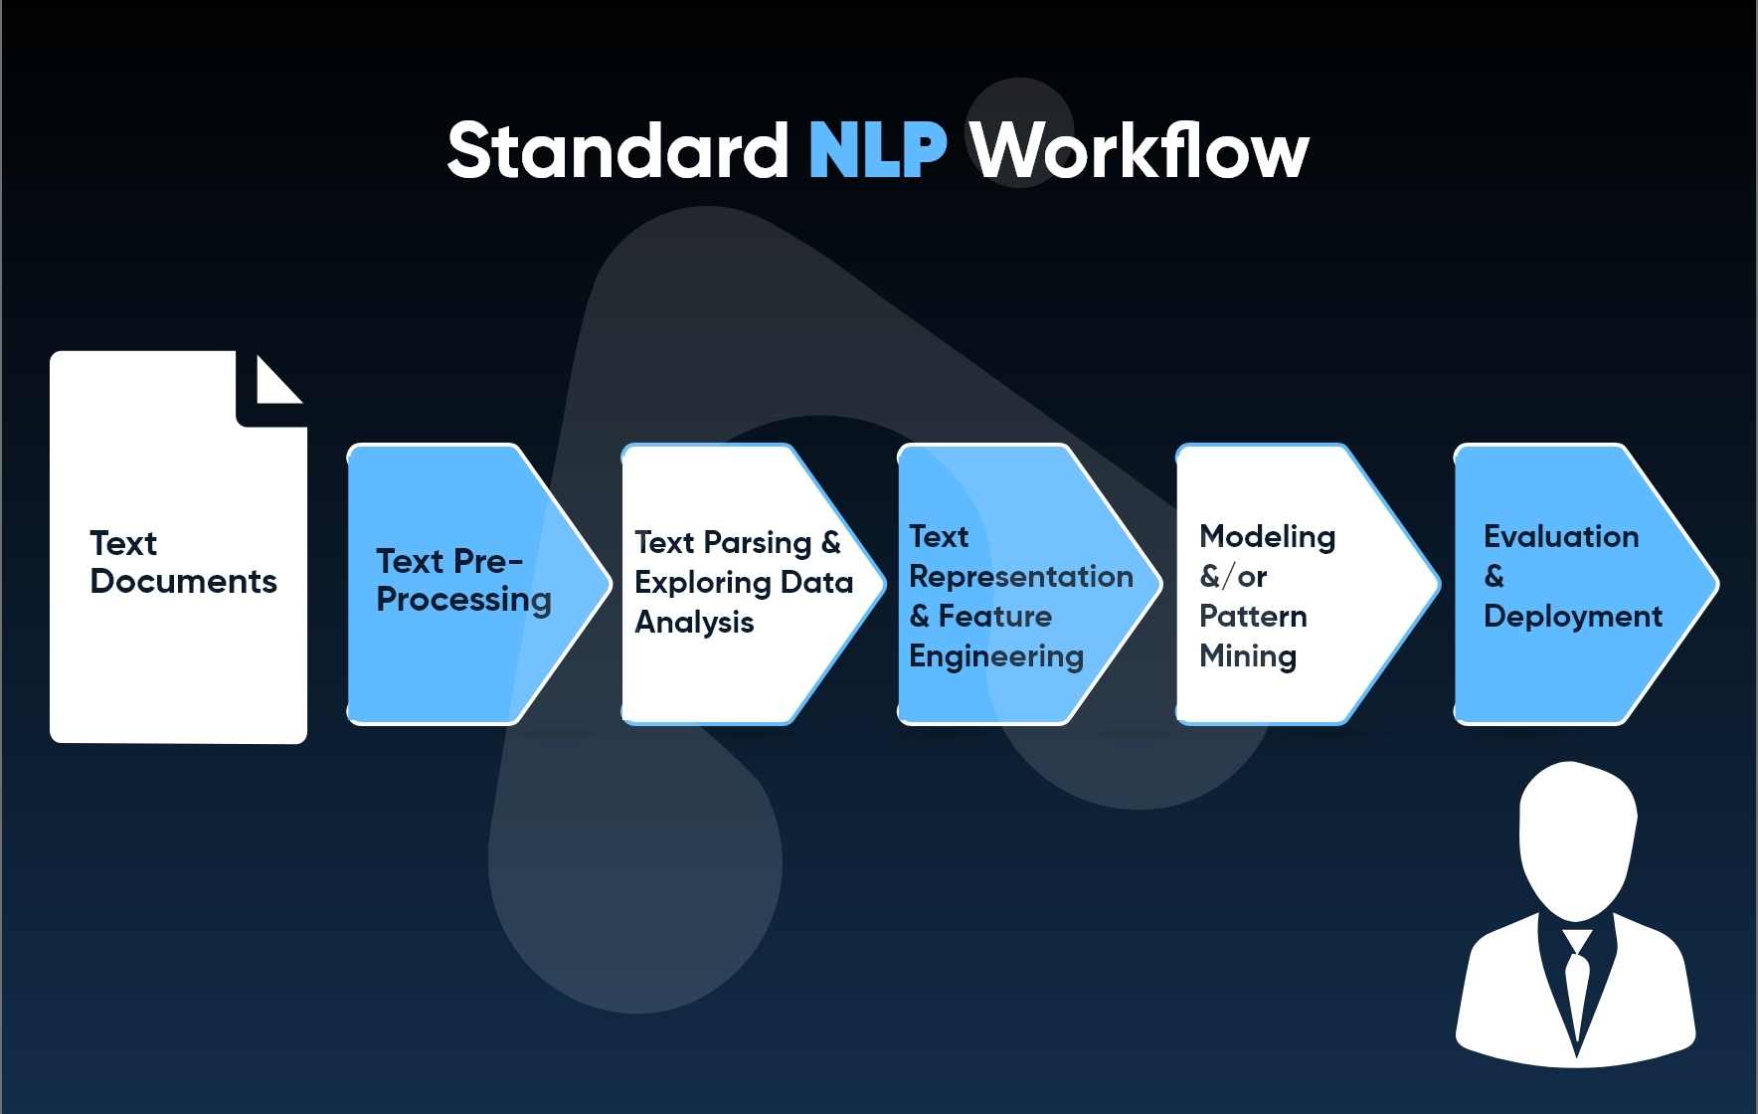
Work flow of the project

Slide 4
About the dataset
There are total 4 types of resumes:- People soft resumes, SQL Developer resumes, Workday resumes, React JS Developer resumes.
There is no null value in the dataset.
There is no duplicate entries present.
There are total 79 resumes.

Slide 5
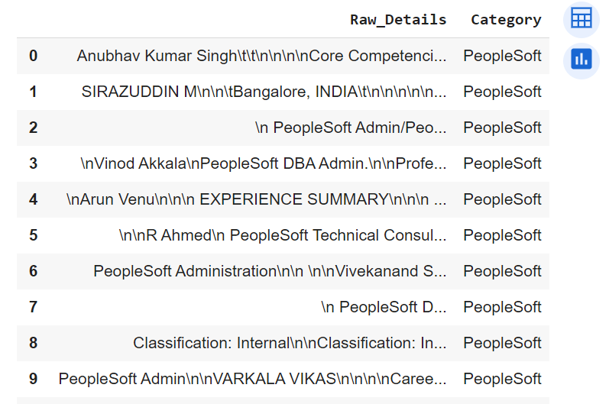
Dataset

Slide 6
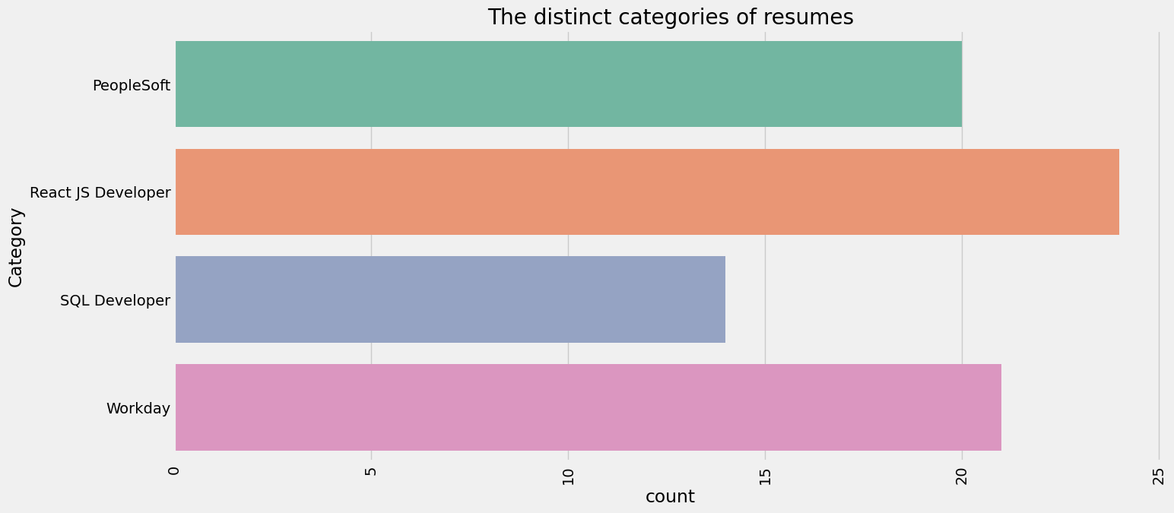
EDA

Slide 7
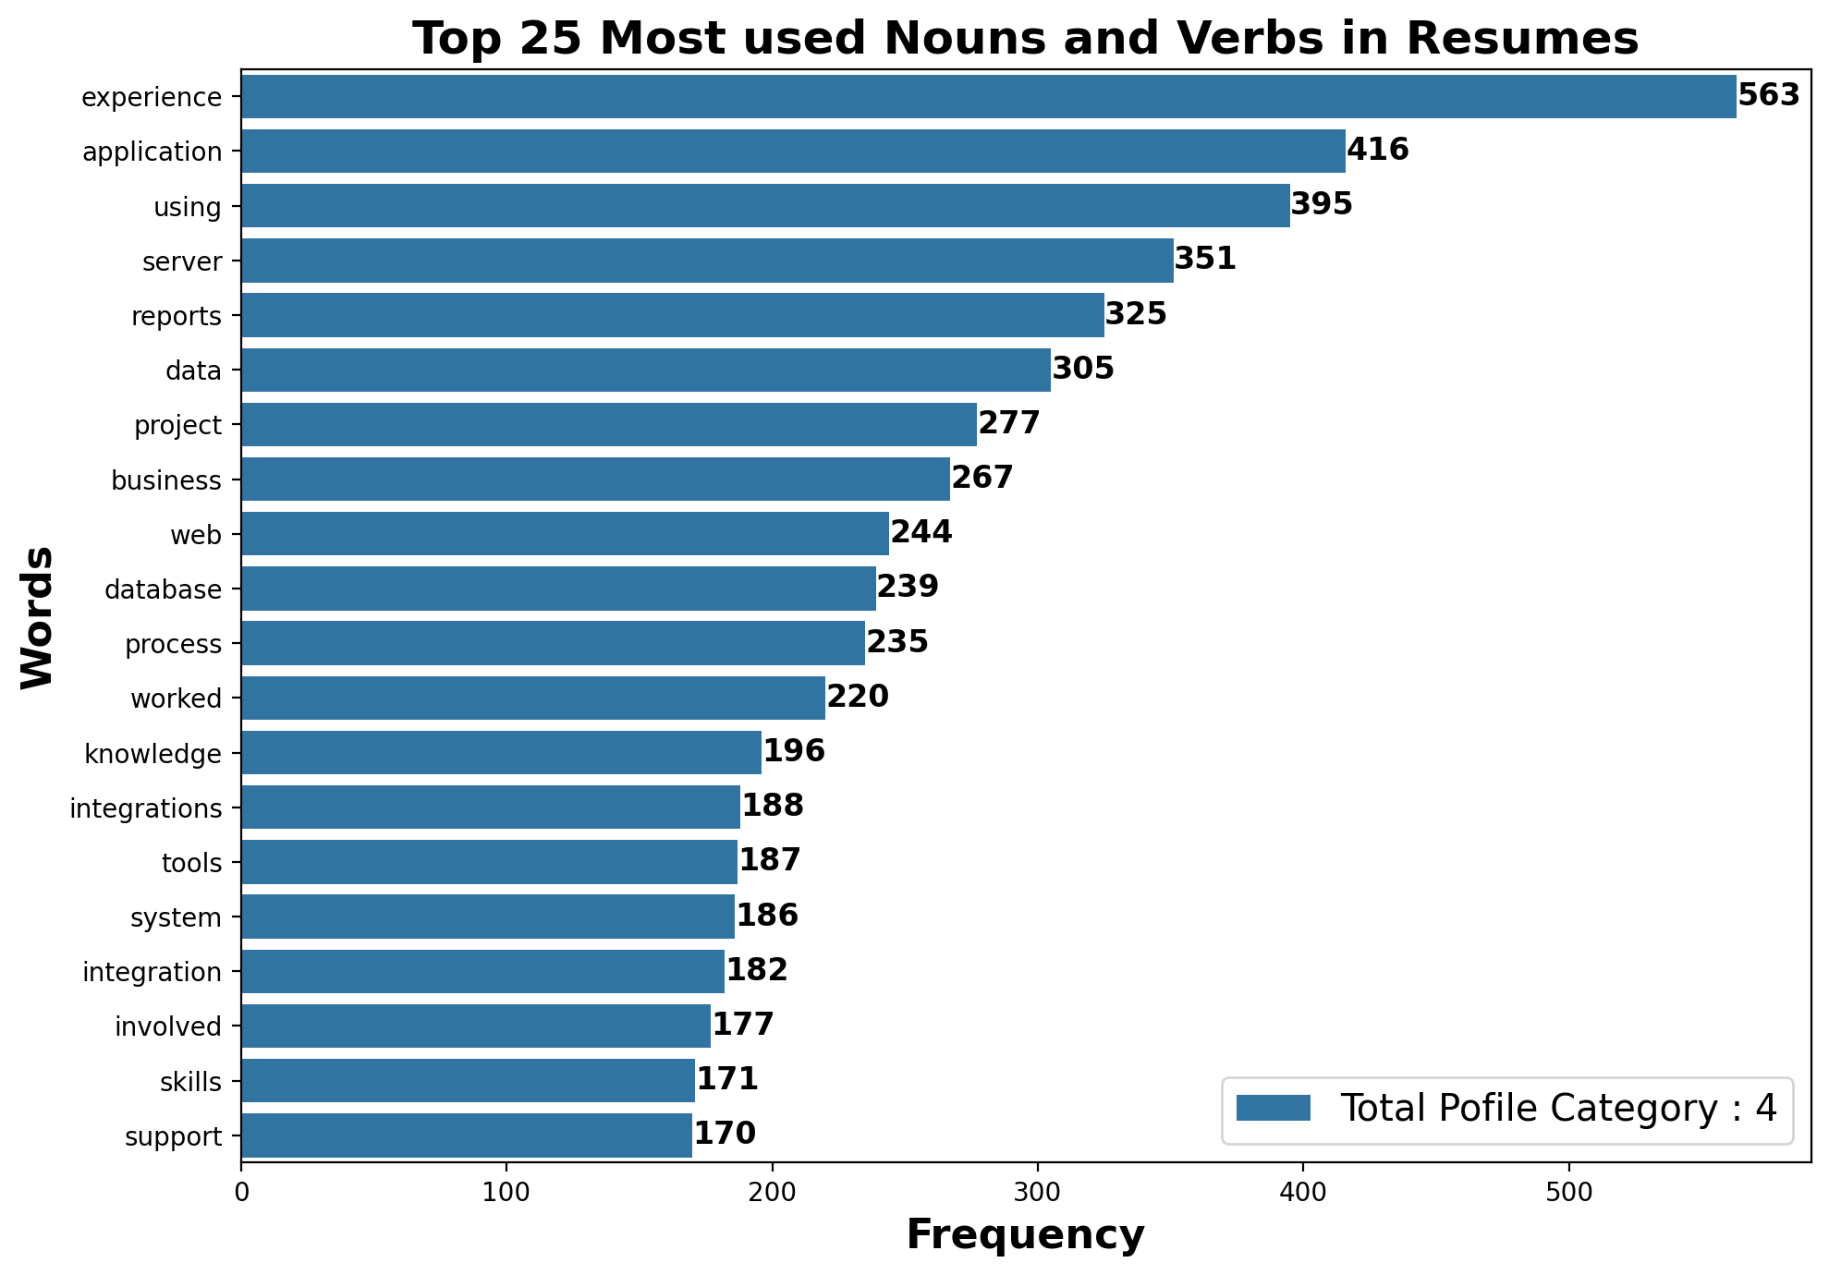

Slide 8
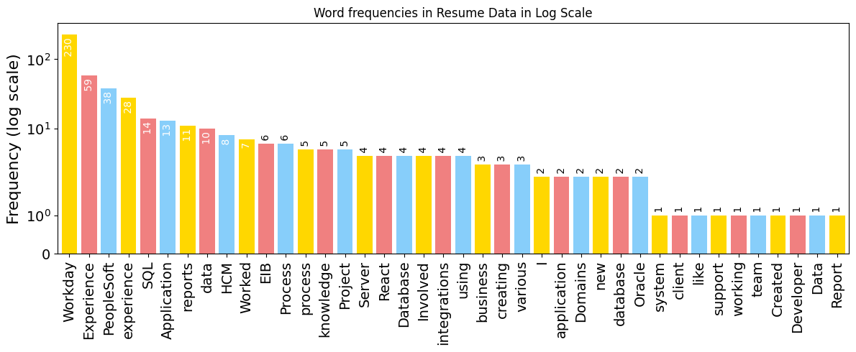

Slide 9
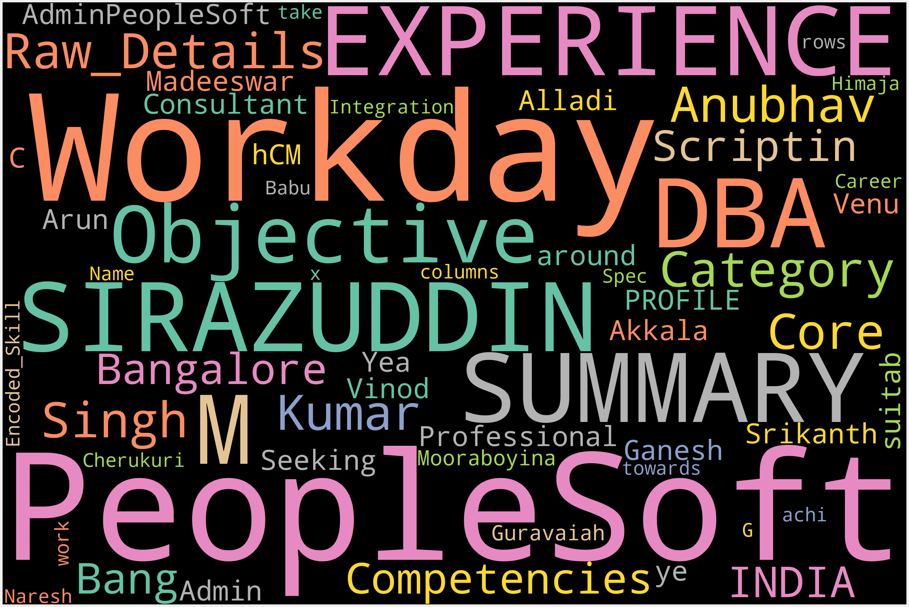
Word Cloud

Slide 10
Model Building
We build model on 9 algorithms which are mentioned below:-
KNN classifier
Decision Tree Classifier
Random Forest Classifier
Logistic Regression
SVM Classifier
Bagging Classifier
AdaBoost Classifier
Gradient Boosting Classifier
Naïve Bayes Classifier

Slide 11
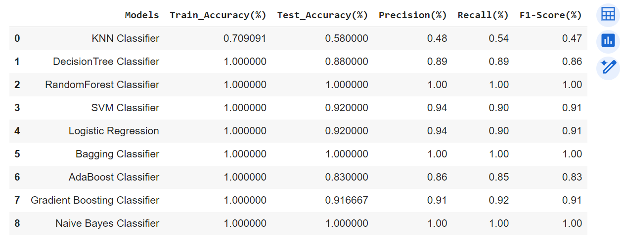

Slide 12
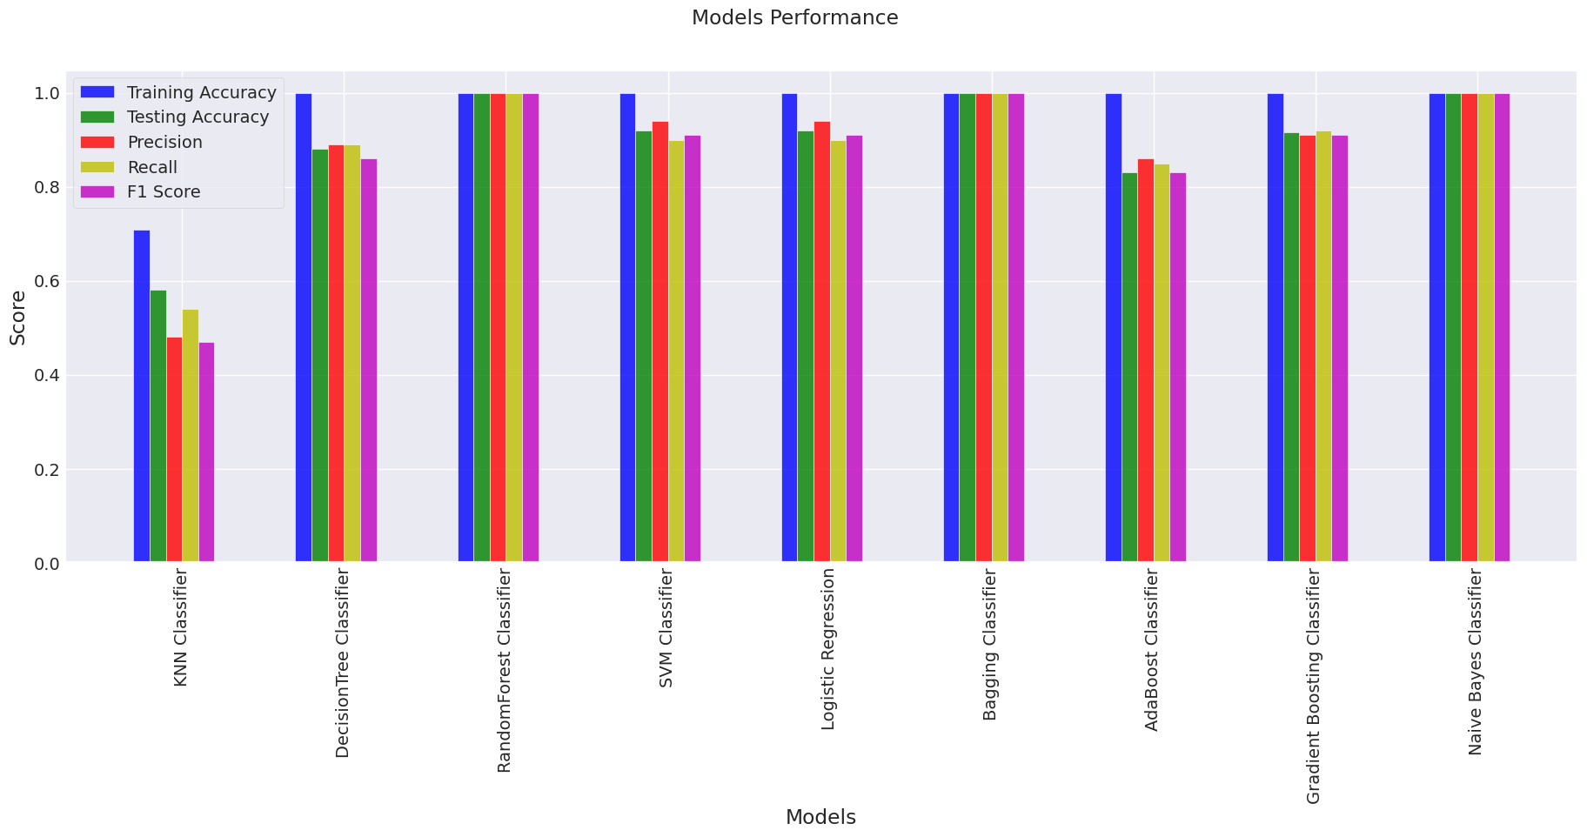

Slide 13
Model Selection
We have selected the Naïve Bayes Classifier on which we are going to do the deployment, as it gives us the best accuracy among the other algorithm.
It is a supervised machine learning algorithm which is commonly applied in use cases involving text classification and sentiment analysis.
It performs well with data sets with high dimensionality.

Slide 14
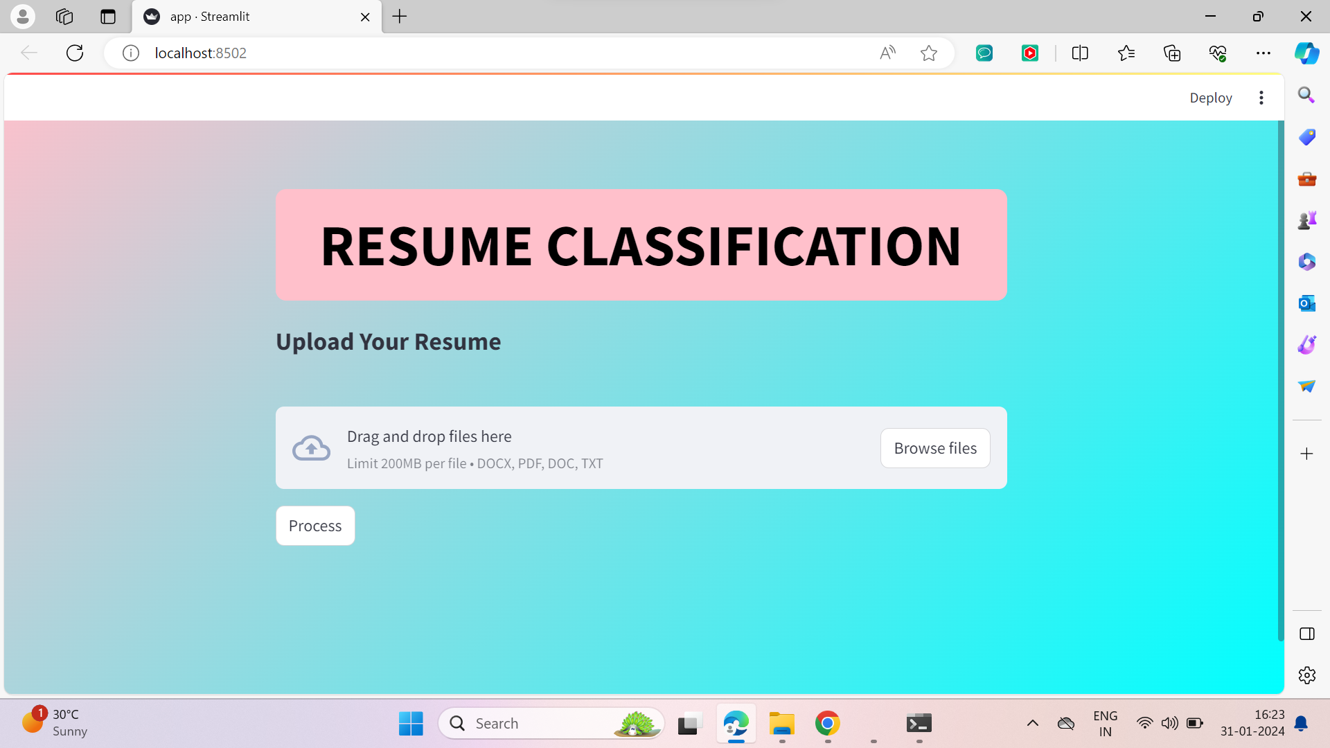
Deployment

Slide 15
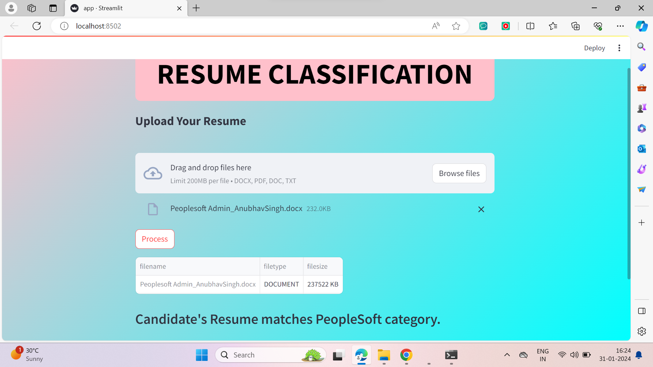

Slide 16
Challenges Faced
We faced some difficulty in uploading the dataset.
As the every team member were belonging to different states, we faced some problems while communicating with each other.
We faced lot of difficulties when we were working on the models.
Deployment part was not easy, we faced lot of problems when we were working on the deployment part.

Slide 17


