Slide 1
Analysis of RILAs
Nathaniel Jones
05/02/2024

Slide 2
Background

Slide 3
Customer Information
60 years old
Retiring in 6 years
$100,000 principal
Looking for additional income in retirement
Goal: find which Allianz product is best for this customer

Slide 4
What is a RILA?
Registered index-linked annuity
Interest paid depends on the performance of an index (S&P 500 in our case)
Rate not guaranteed, unlike traditional fixed annuities!
Introduced somewhat recently (ca. 1990)
Some benefits of participating in equity markets without all drawbacks

Slide 5
Index Advantage+ Annuities
Index Performance
6-year, 3-year, and 1-year terms
10%, 20%, or 30% buffer, various caps & participation rates
Index Precision & Index Dual Precision
Fixed rate if index above threshold, buffered otherwise
Index Guard
Guaranteed to lose no more than 10% in one year
Index Protection
Guaranteed annual return
Terms less than 6 years can be compounded for a total of 6 years

Slide 6
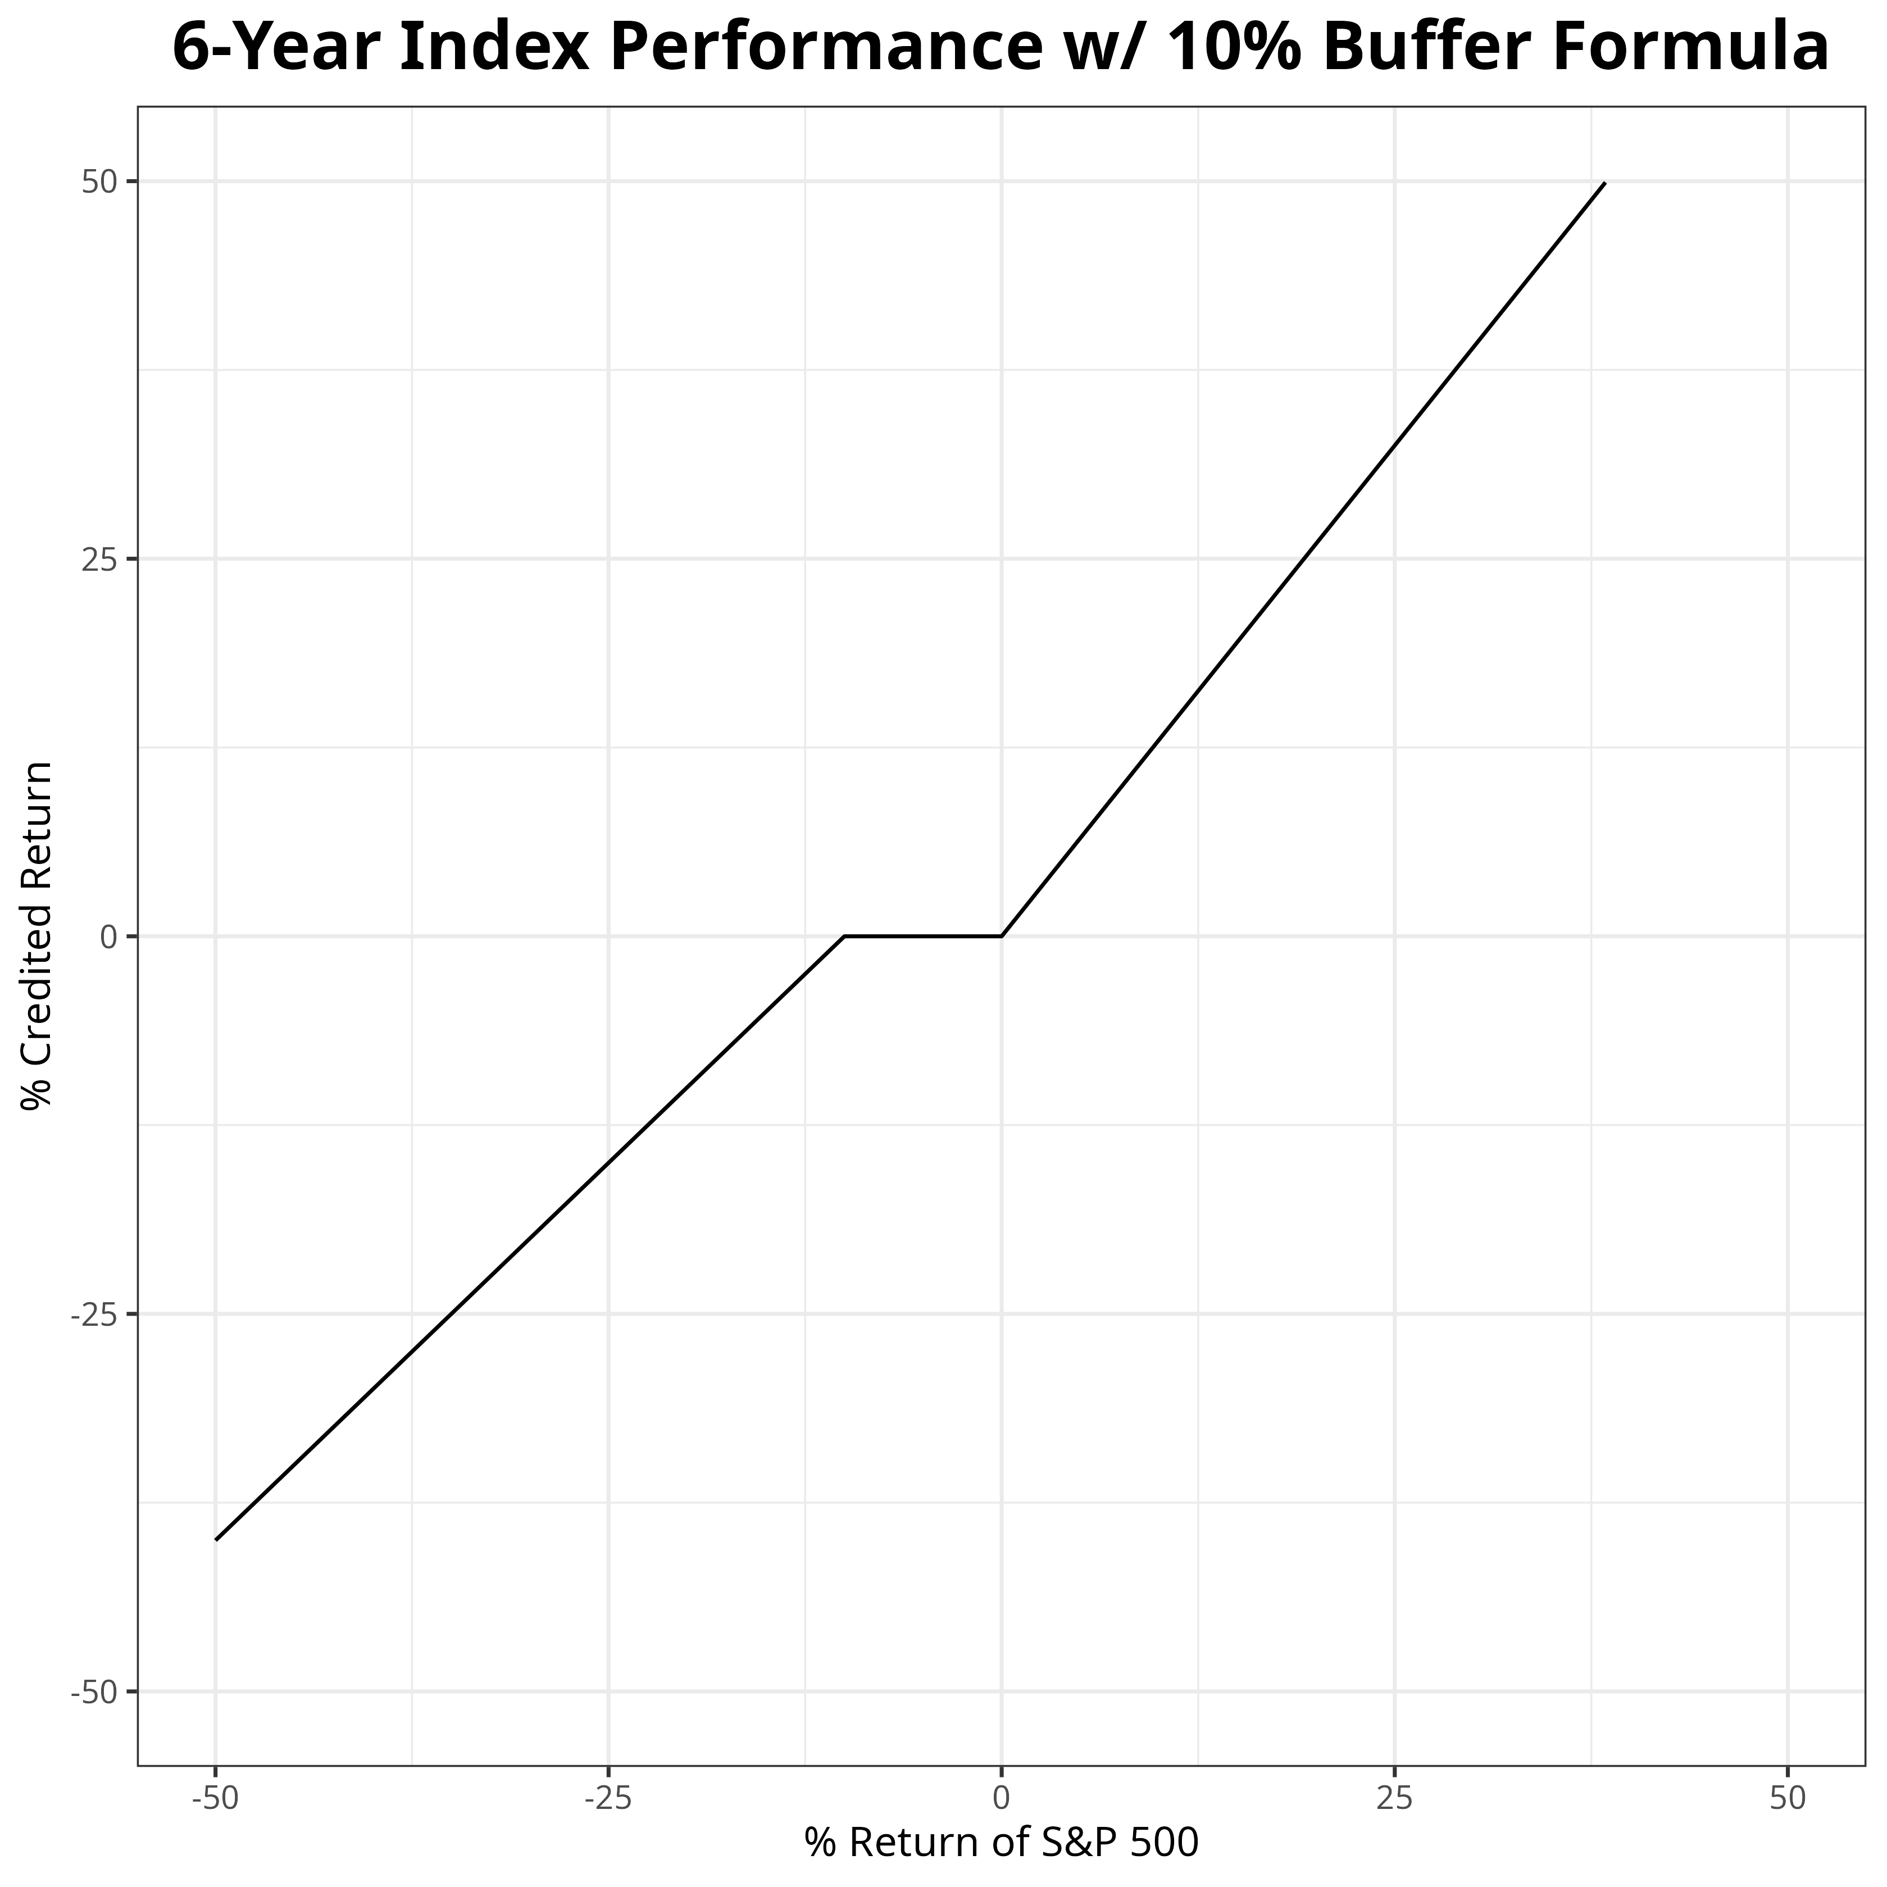
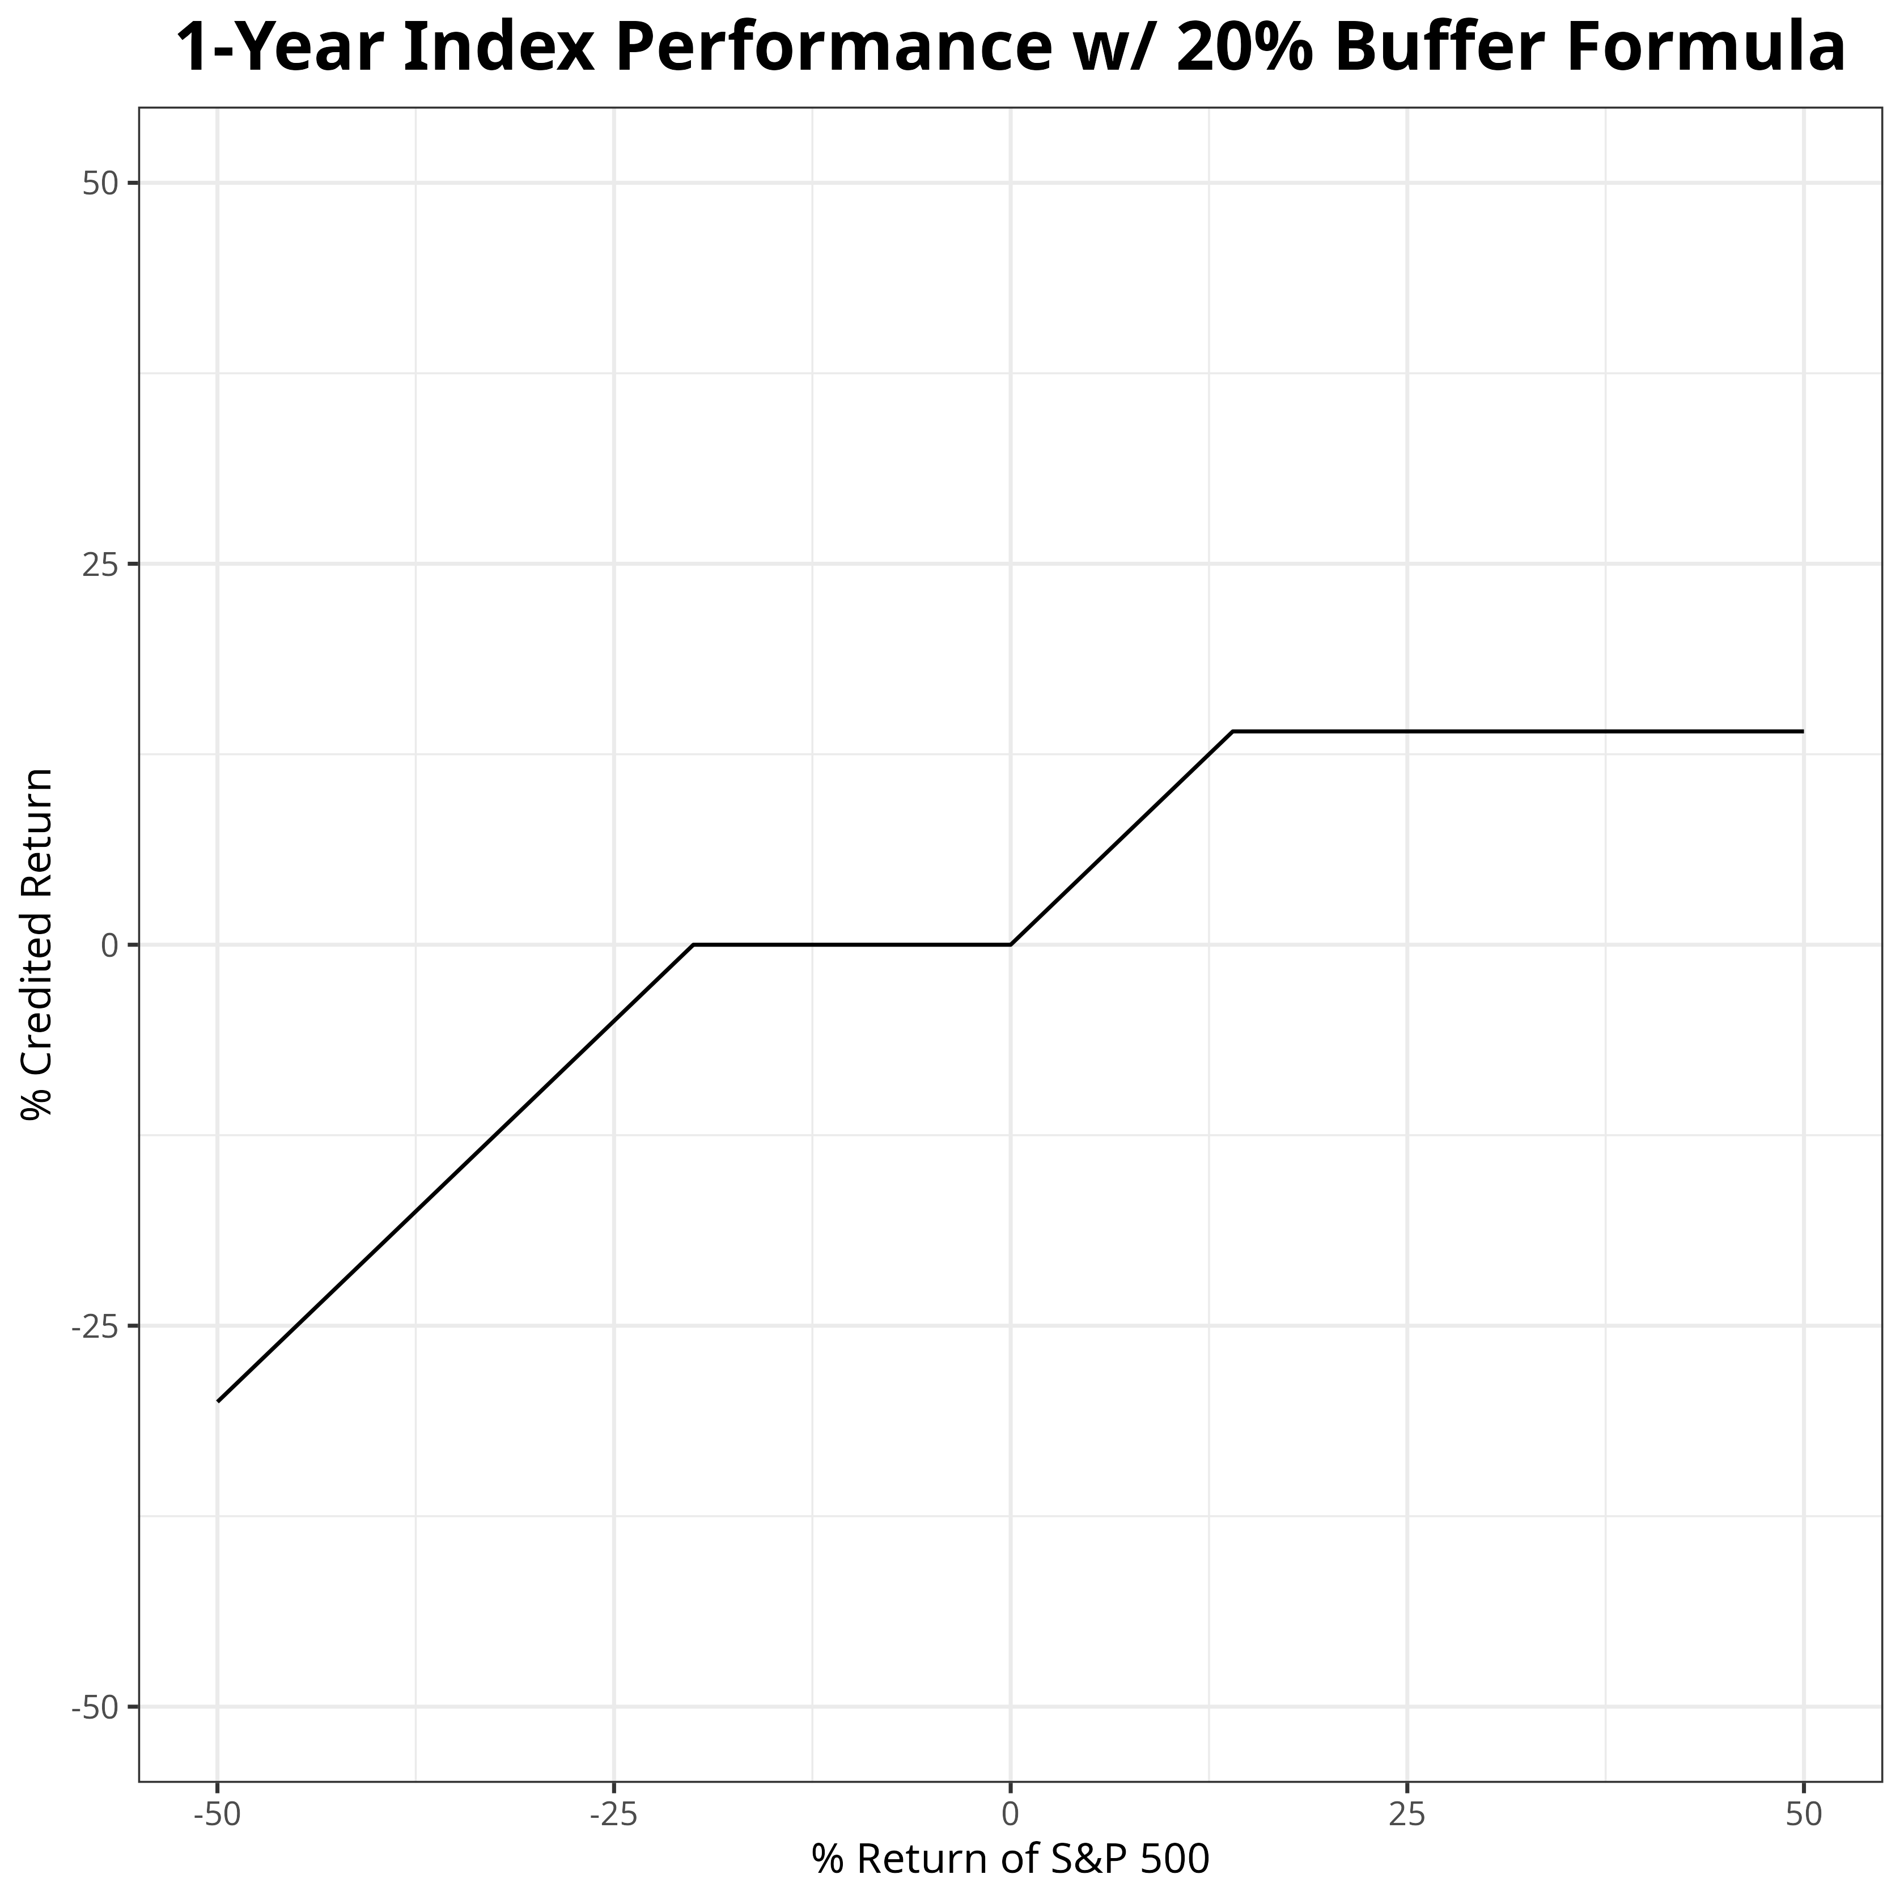
Index Performance Credited Return

Slide 7
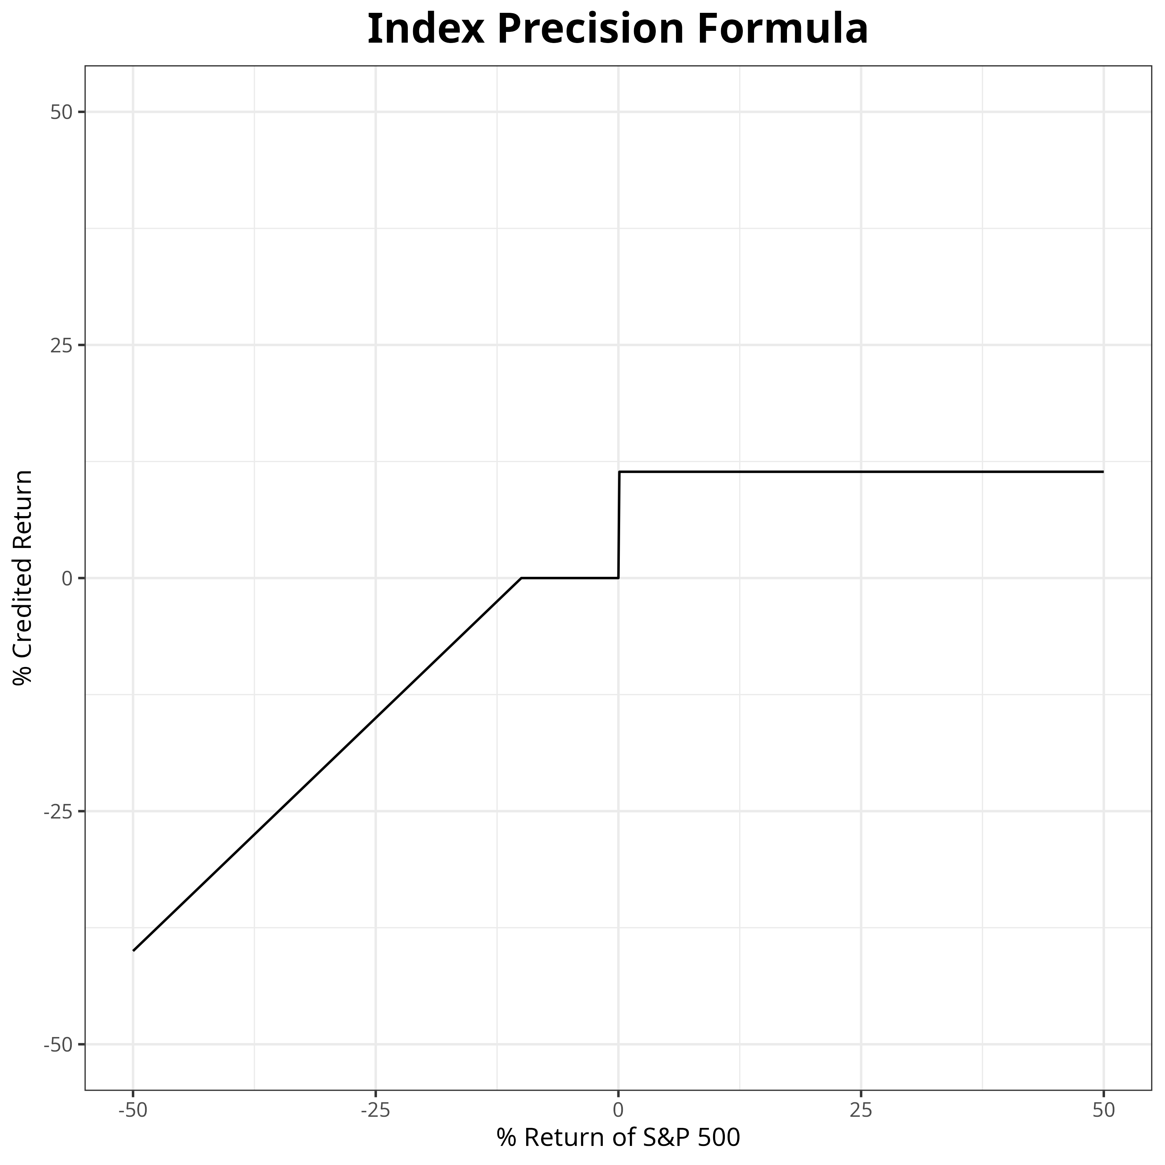
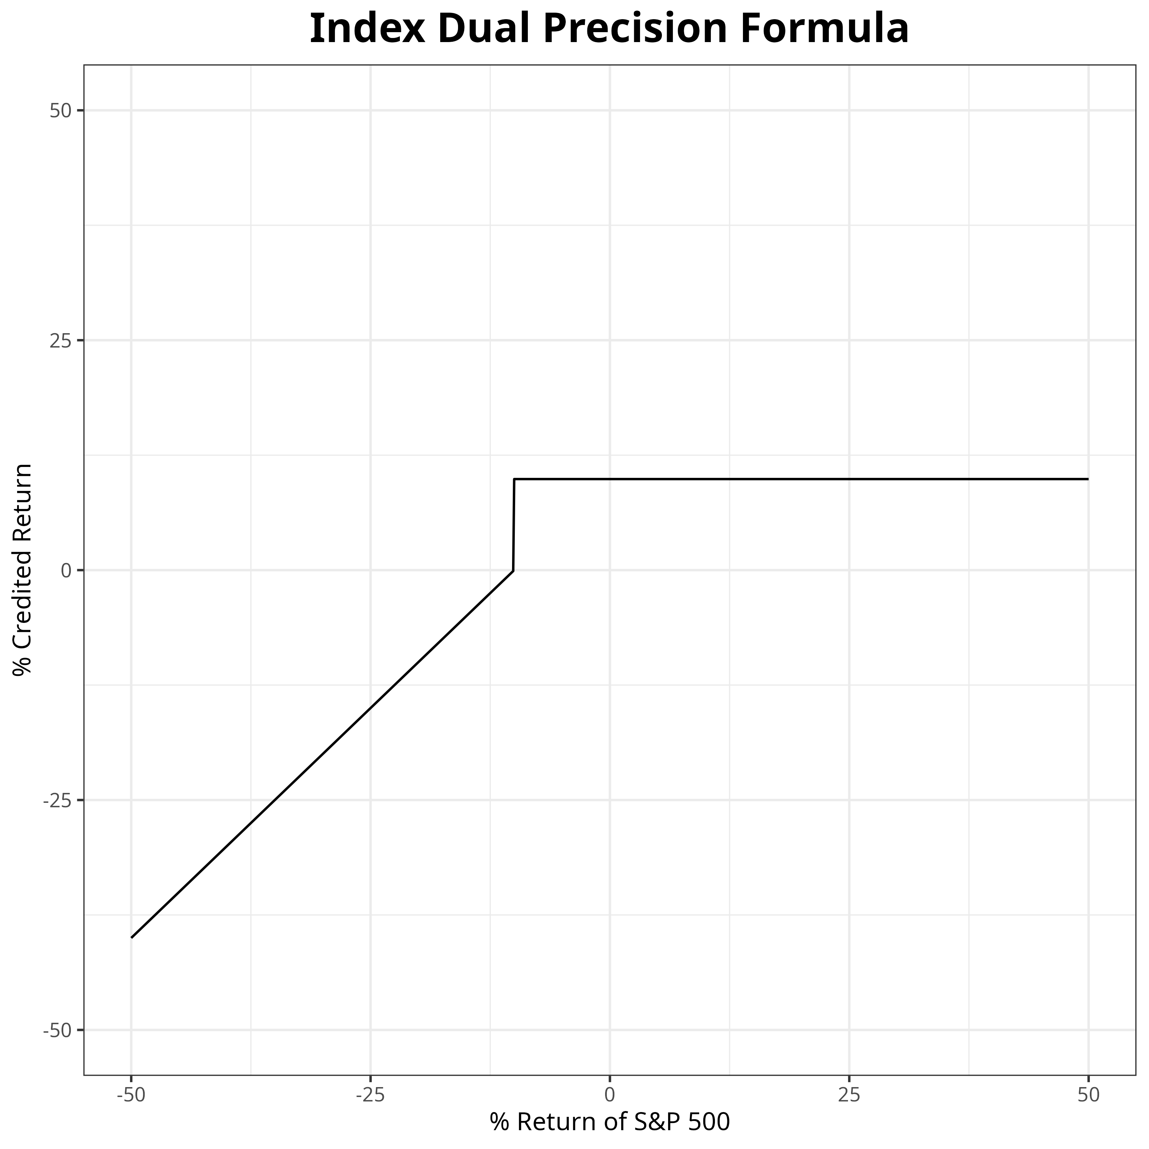
Index Precision and Dual Precision Credited Return

Slide 8
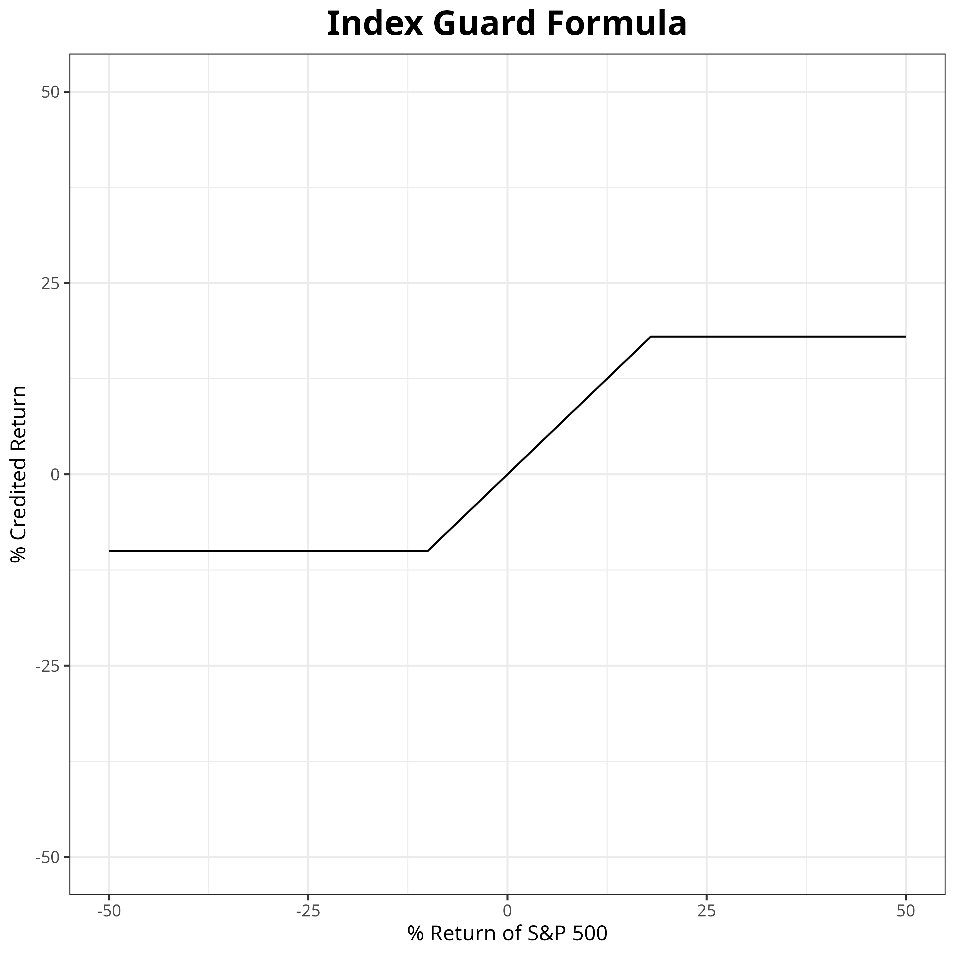
Index Guard Credited Return

Slide 9
Methodology

Slide 10
Overall Procedure
Model S&P 500 index as Geometric Brownian Motion (GBM)
Estimate drift and volatility parameters from historical data
Simulate 100,000 6-year long random walks of GBM using the estimated parameters
Compute credited interest rate for each product for each walk
Perform percentile analysis of distribution of returns for each product

Slide 11
S&P 500 As Geometric Brownian Motion
Parameters estimated from daily closing price of SPY from 2003 to 2023
Values obtained via maximum likelihood estimators
Drift (μ) found to be 0.0966, volatility (σ) found to be 0.1892
100,000 simulations performed for 1,512 steps each via Euler-Maryuama method

Slide 12
Assumptions
Credited rate formulas same from year-to-year
1
No early withdrawals or rate locks
2
Drift and volatility will be constant for the next six years
3
No changes in strategy from year-to-year
4

Slide 13
Results

Slide 14
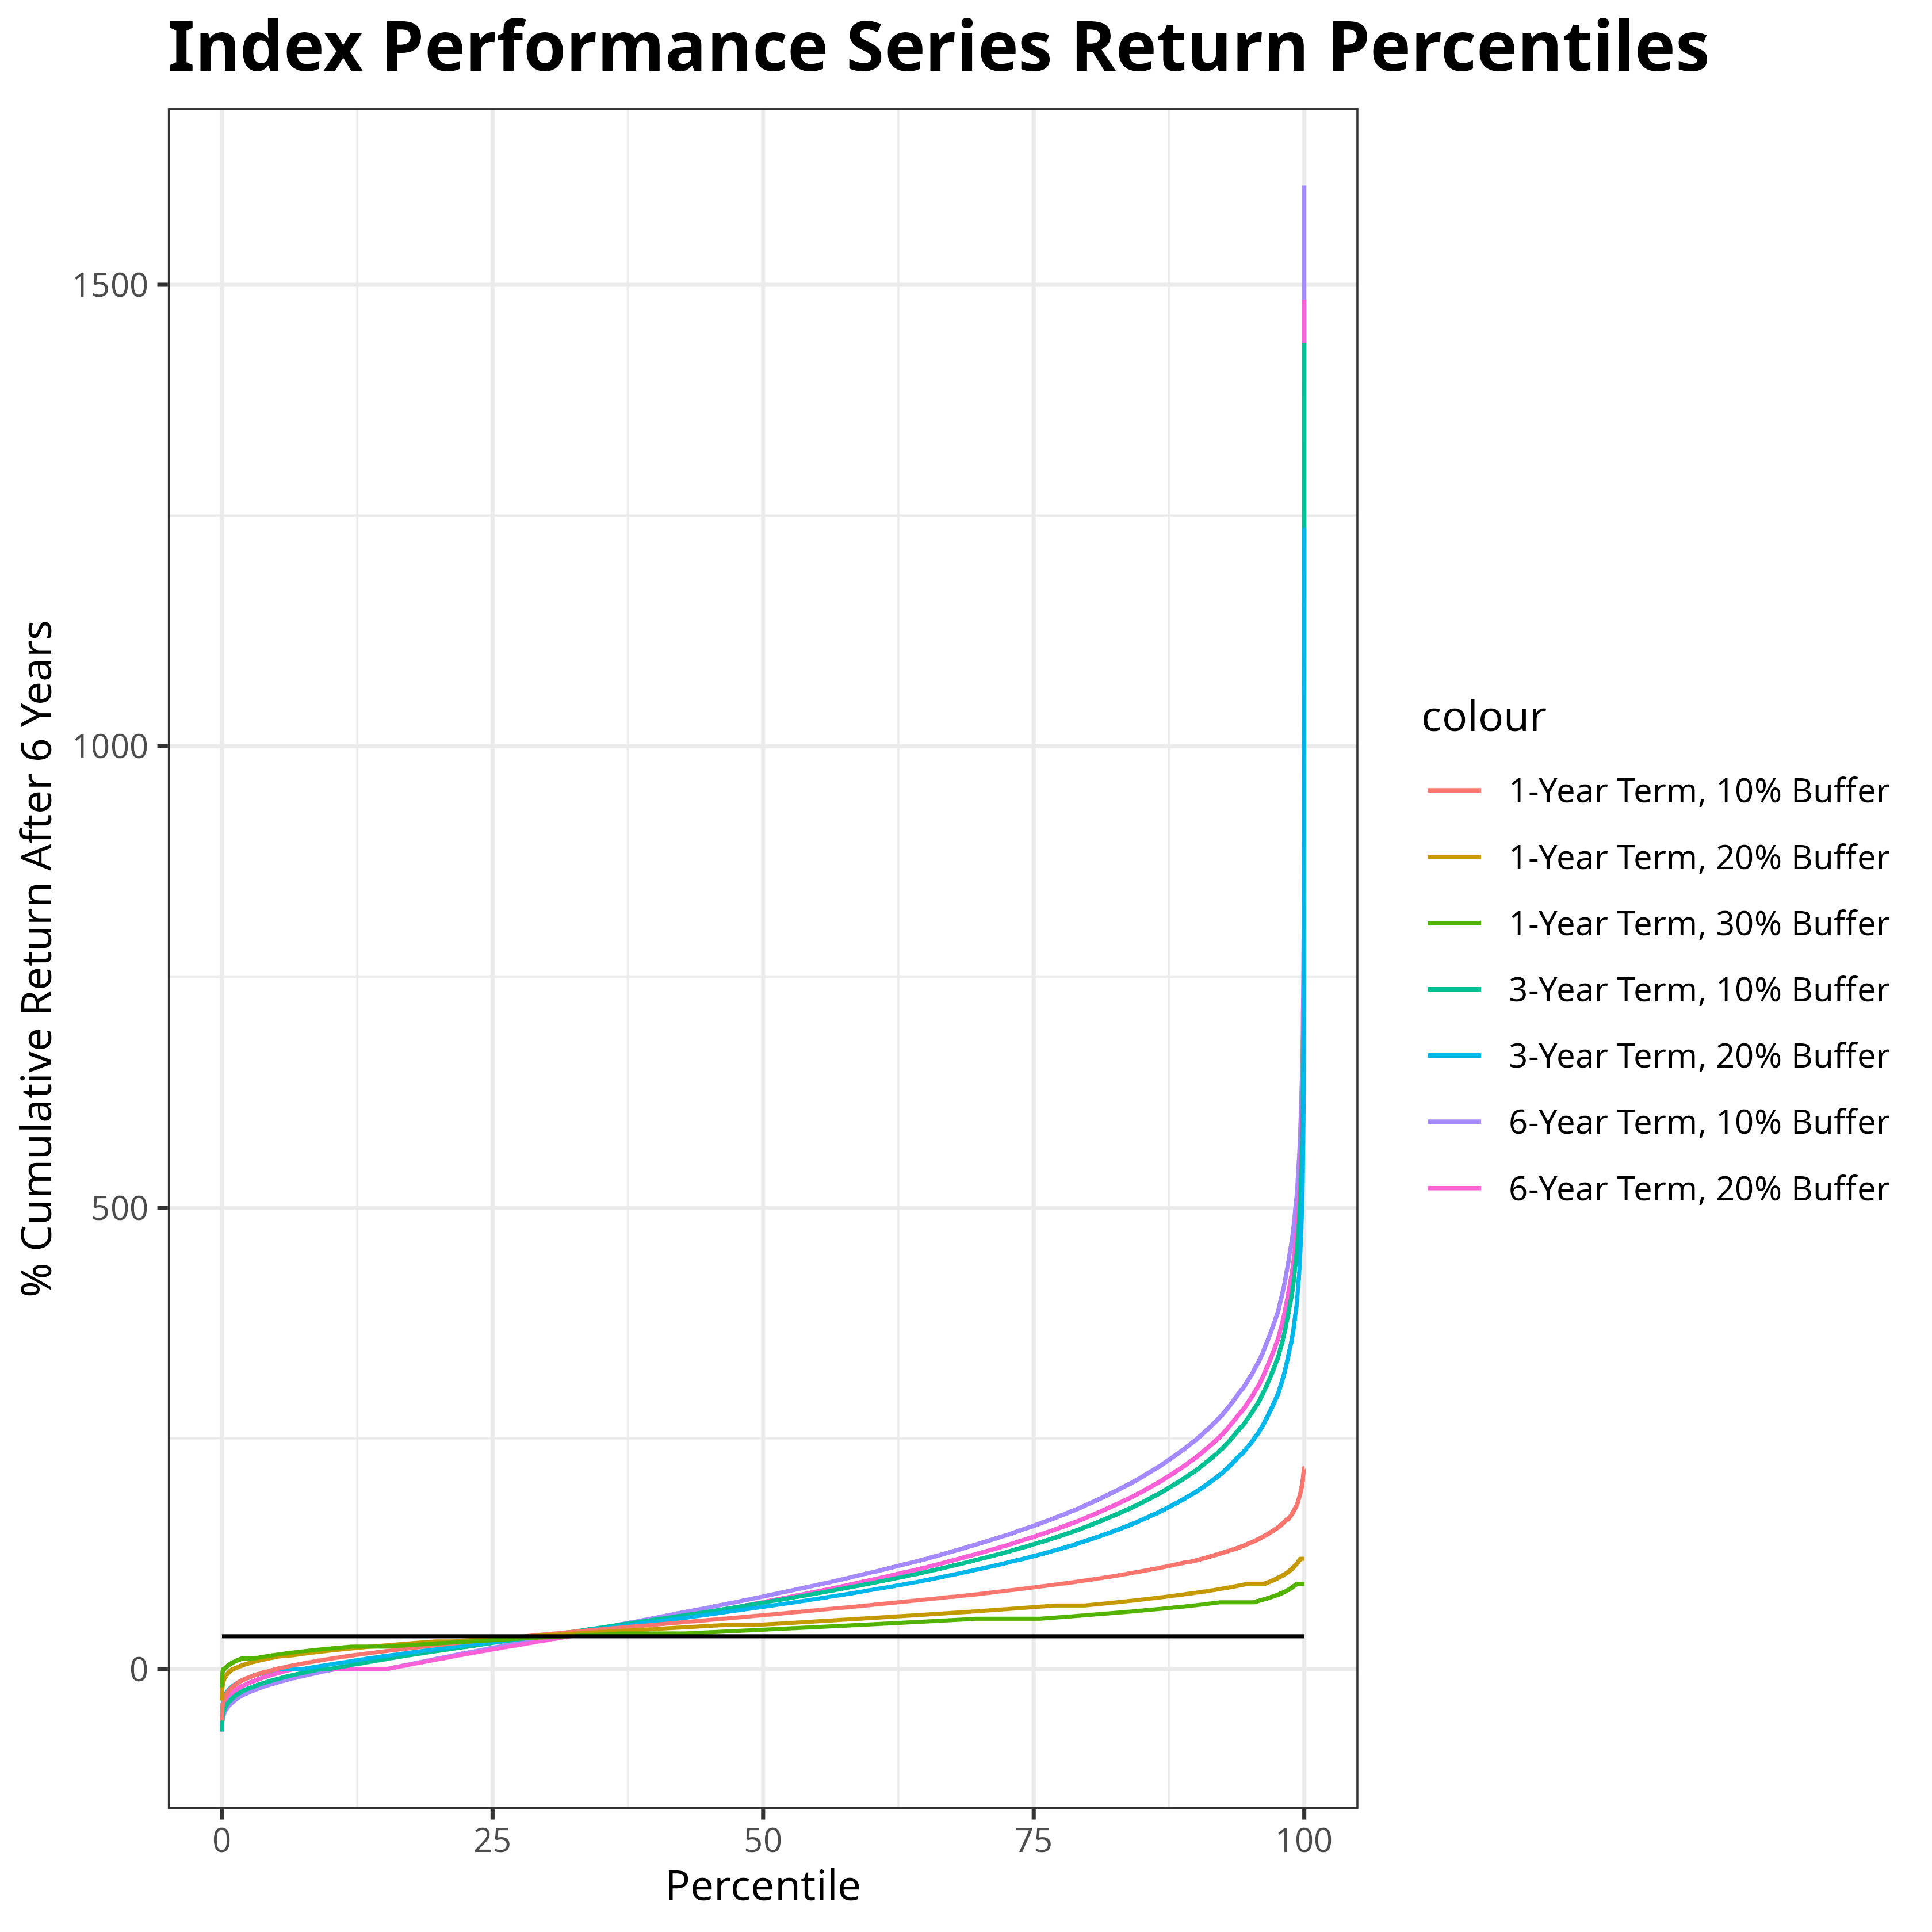
Index Performance Products – Percentiles of Cumulative Returns After 6 Years

Slide 15
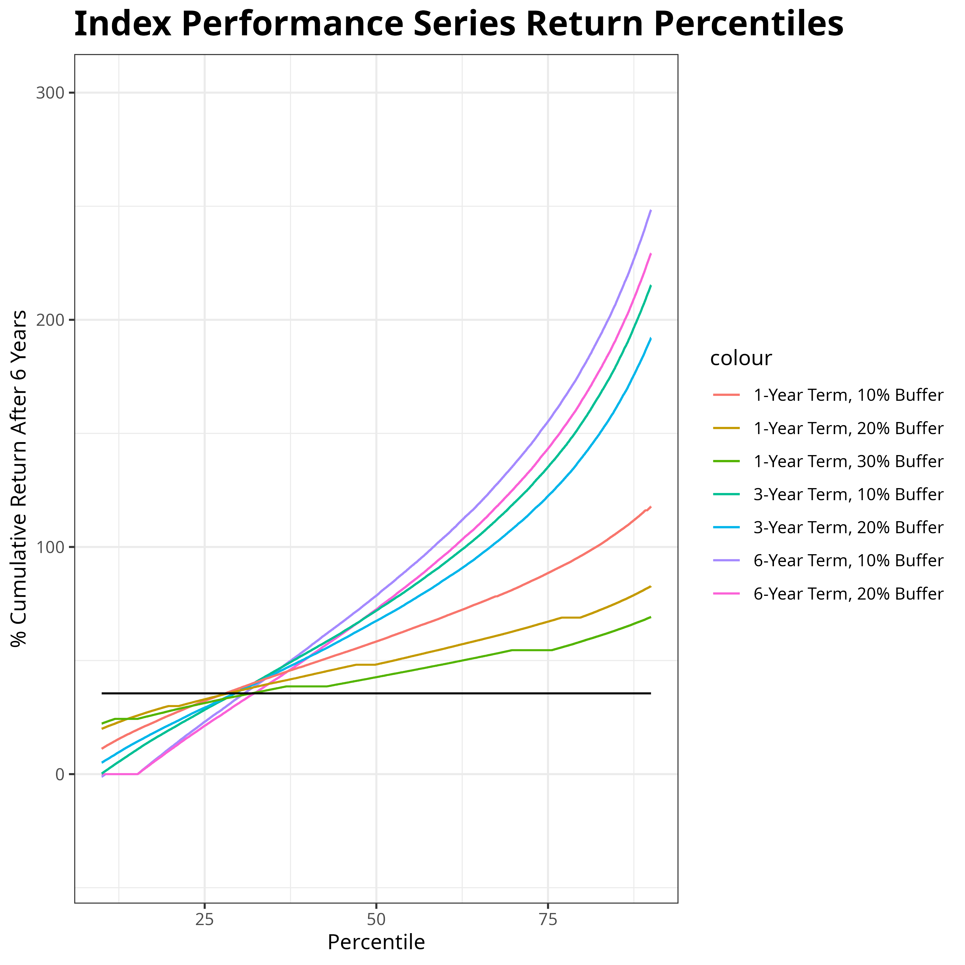
Index Performance Series – Middle 80% of Outcomes

Slide 16
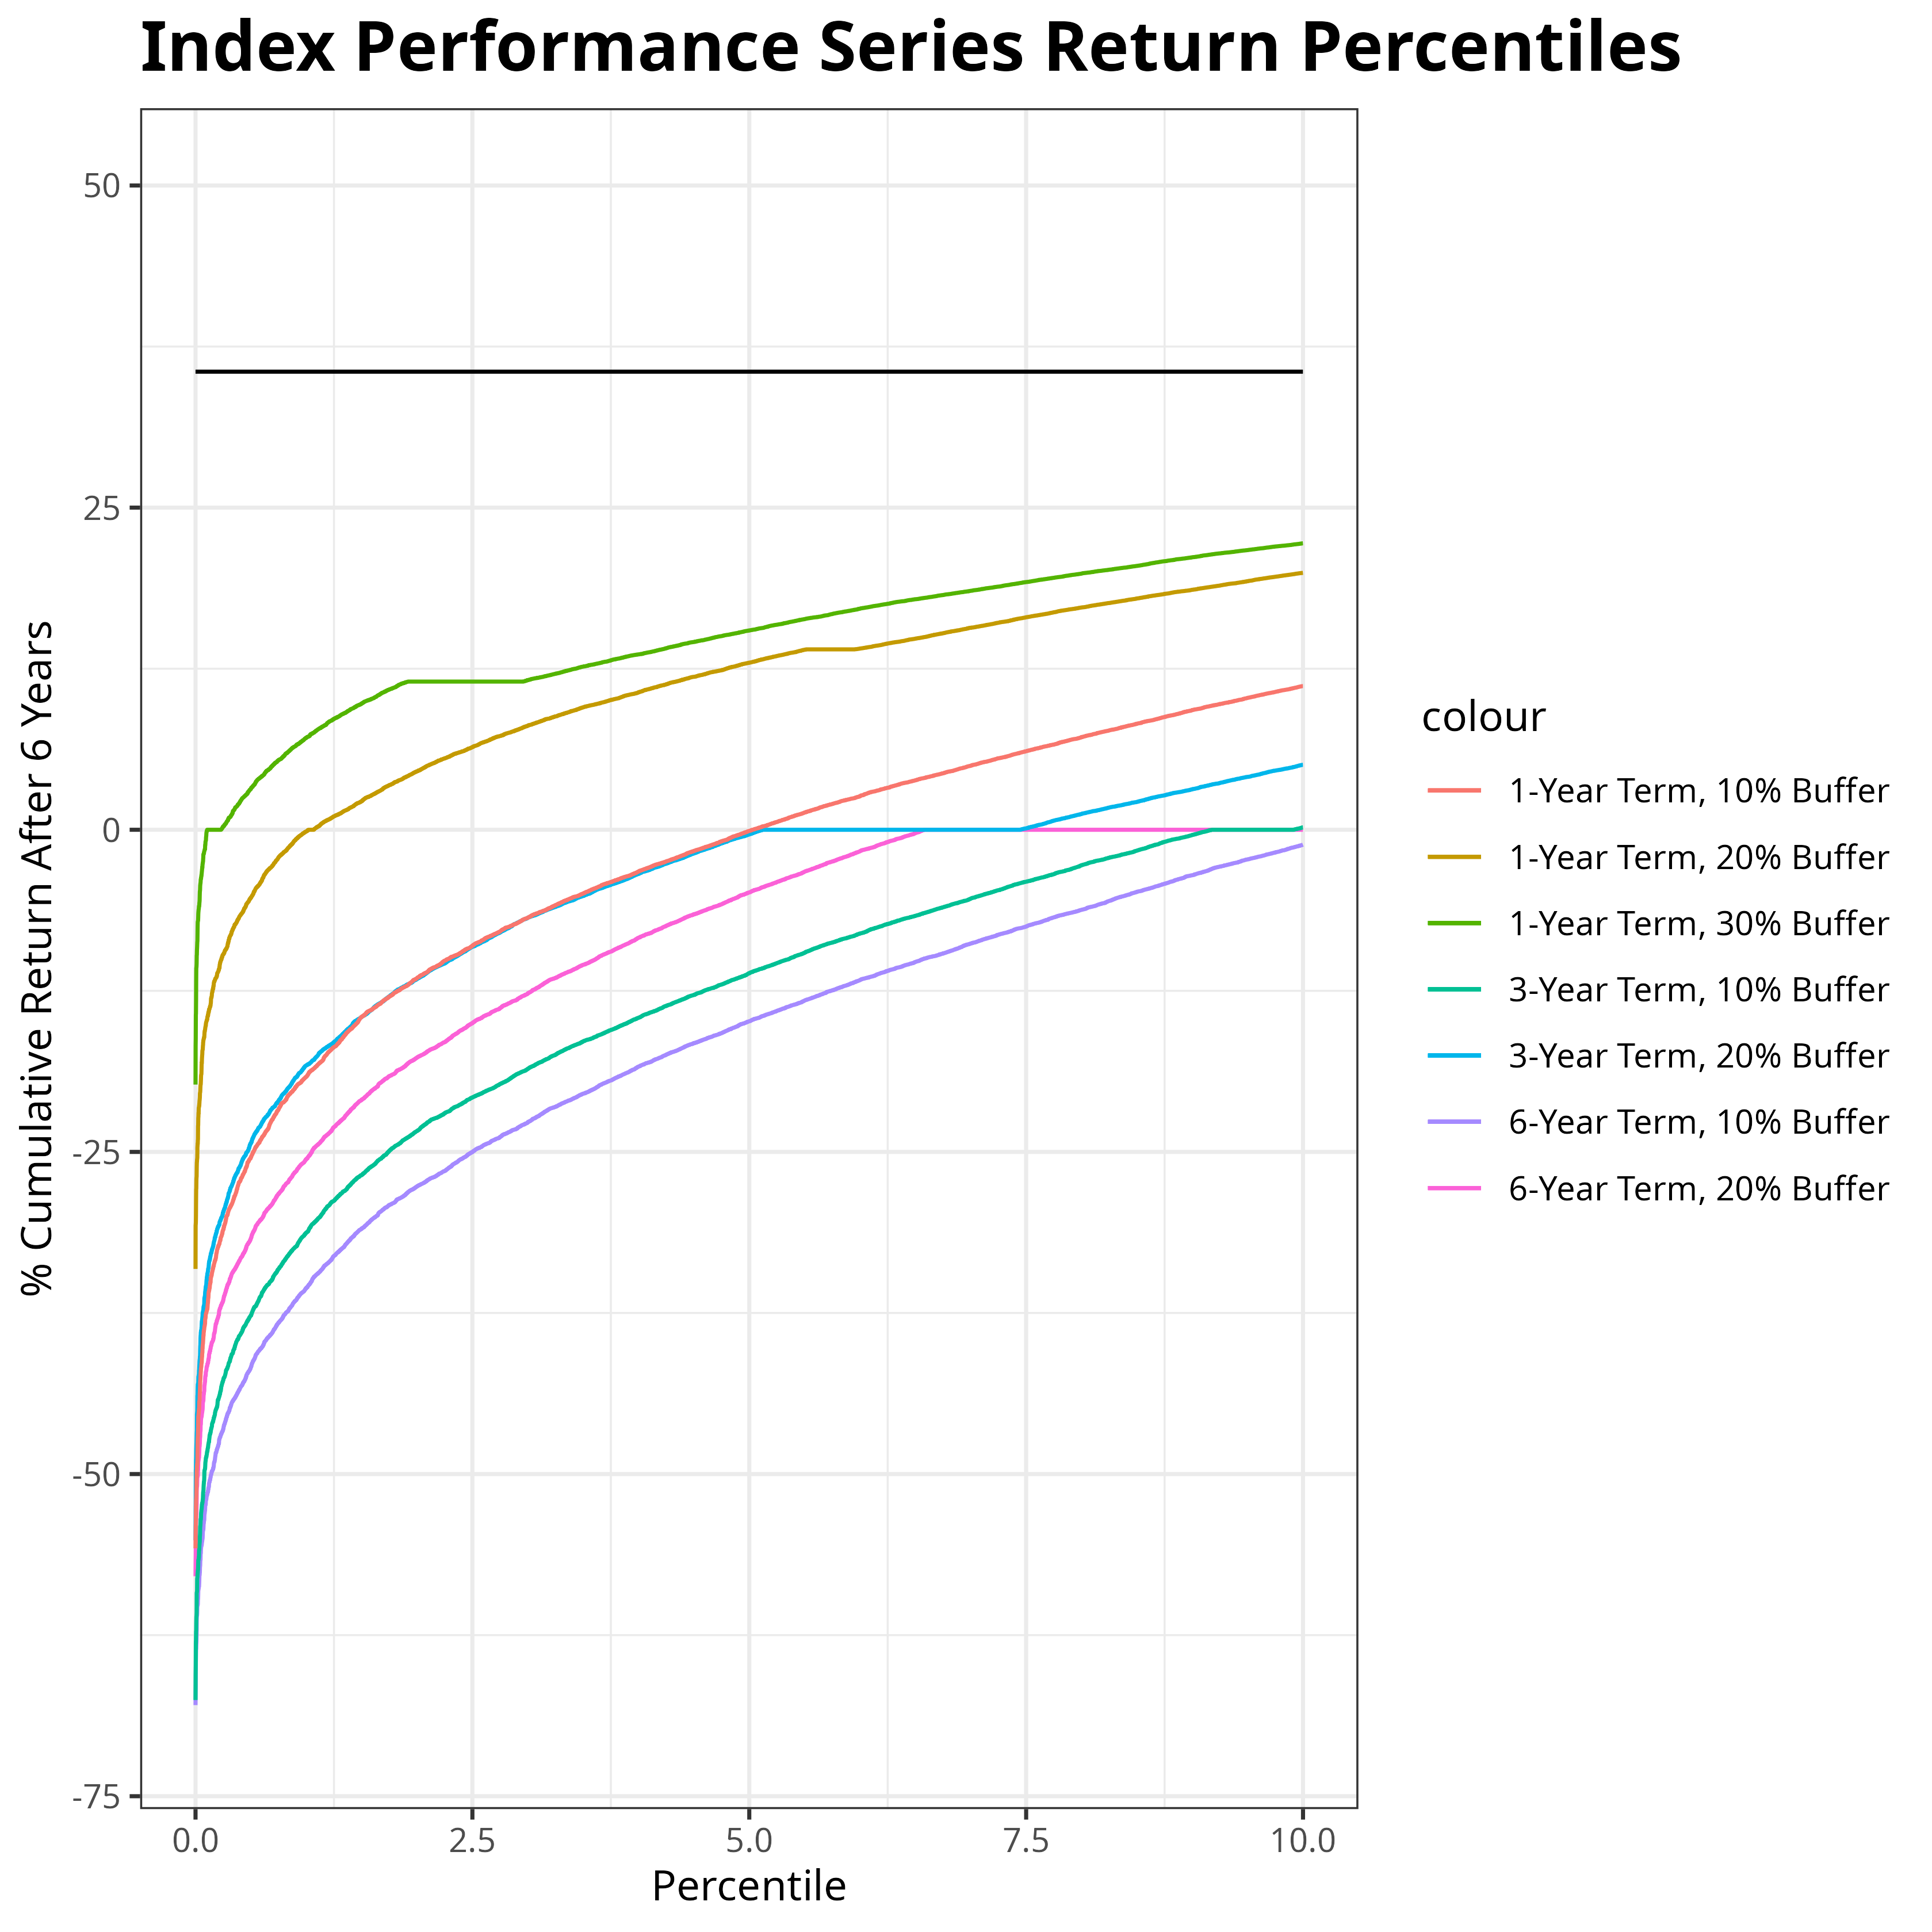
Index Performance Series – Bottom 10% of Outcomes

Slide 17
Index Performance Series – Summary
 | 0.1% Low | 1% Low | 10% Low | Median | Chance to beat fixed annuity
6 Year 10% Buffer | -51.7% | -35.5% | -1.1% | 78.5% | 69.2%
6 Year 20% Buffer | -41.7% | -25.5% | 0.0% | 72.5% | 67.8%
1 Year 10% Buffer | -37.4% | -19.2% | 11.1% | 58.3% | 71.9%
1 Year 20% Buffer | -14.8% | -0.1% | 19.9% | 48.3% | 71.6%
1 Year 30% Buffer | -0.2% | 7.1% | 22.2% | 42.7% | 68.2%

Slide 18
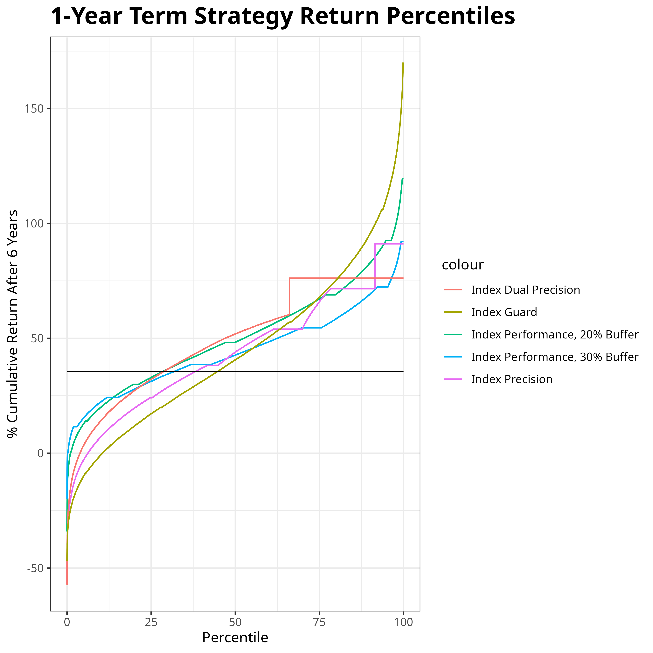
Other Products – Percentiles of Cumulative Returns After 6 Years

Slide 19
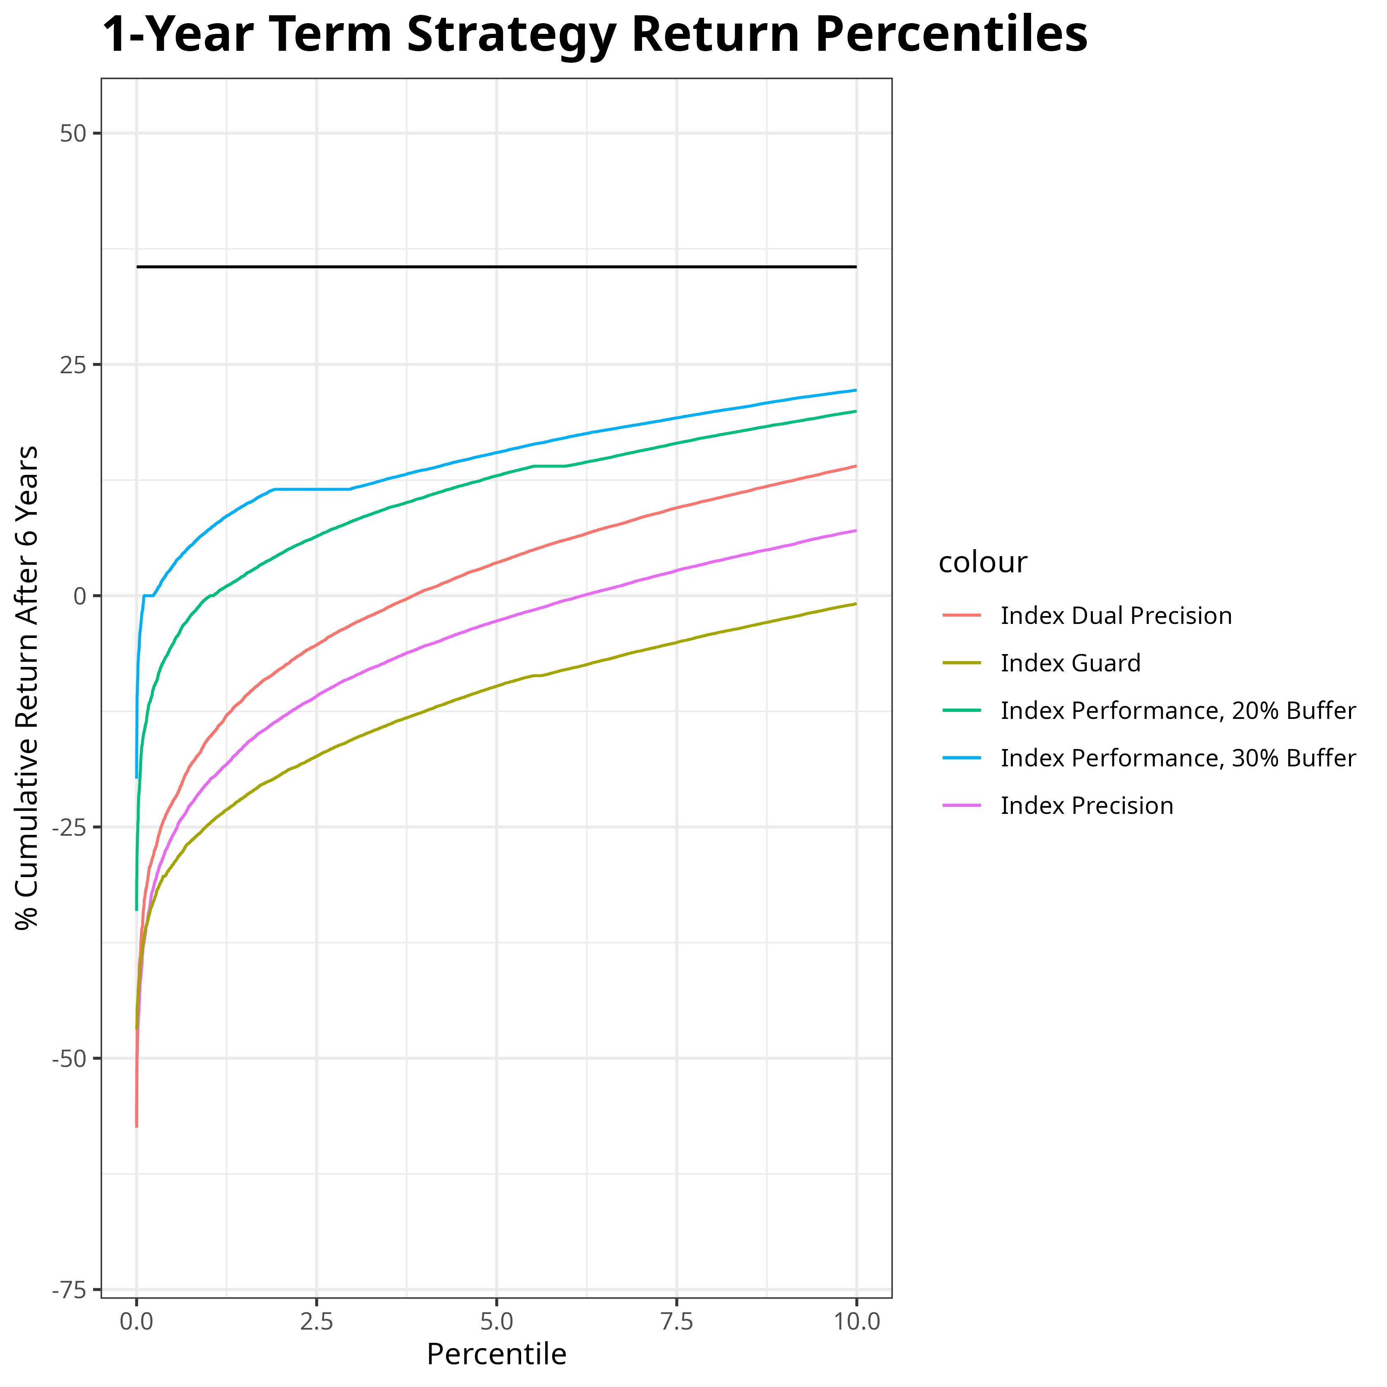
Other Products – Bottom 10% of Outcomes

Slide 20
Other Products - Summary
 | 0.1% Low | 1% Low | 10% Low | Median | Chance to beat fixed annuity
Index Performance 1 Year 20% Buffer | -14.8% | -0.1% | 19.9% | 48.3% | 71.6%
Index Performance 1 Year 30% Buffer | -0.2% | 7.1% | 22.2% | 42.7% | 68.2%
Index Precision | -37.6% | -20.1% | 7.0% | 44.0% | 61.8%
Index Dual Precision | -33.6% | -15.4% | 14.0% | 51.9% | 71.3%
Index Guard | -37.1% | -24.7% | -0.8% | 40.6% | 55.3%

Slide 21
My Recommendation

Slide 22
Index Performance 1-Year Term with 20% Buffer

