Slide 1
Self-Admitted Technical Debt Detection Using NLP
Presented By: Nirav Jadeja, Supriya Patel, Abhishek Singh

Slide 2
Introduction
Methodology
Experimental Results
Critical discussion

Slide 3

What Is Technical Debt ?

Slide 4
Methodology
Data extraction
Filtering
Training the model

Slide 5
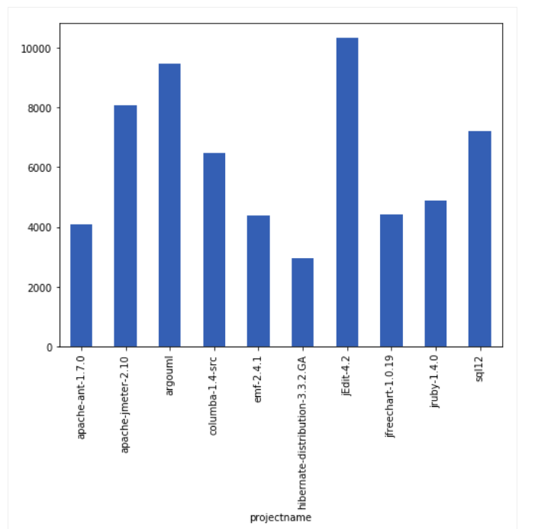
Comment Distribution in Dataset:

Slide 6
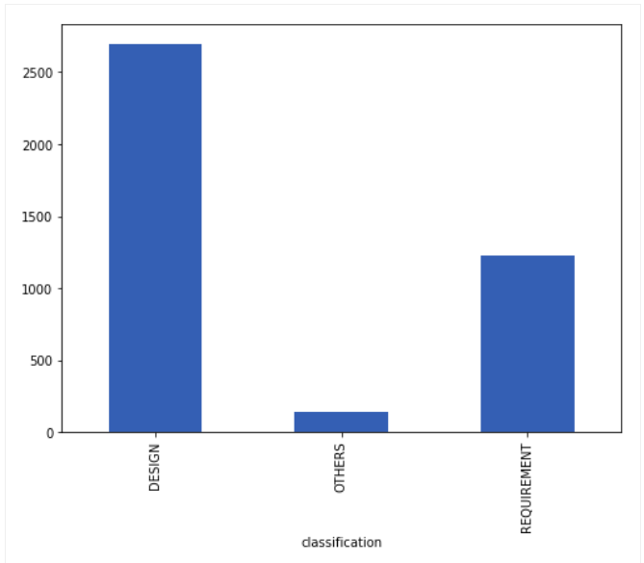
After Filtering Operations:

Slide 7
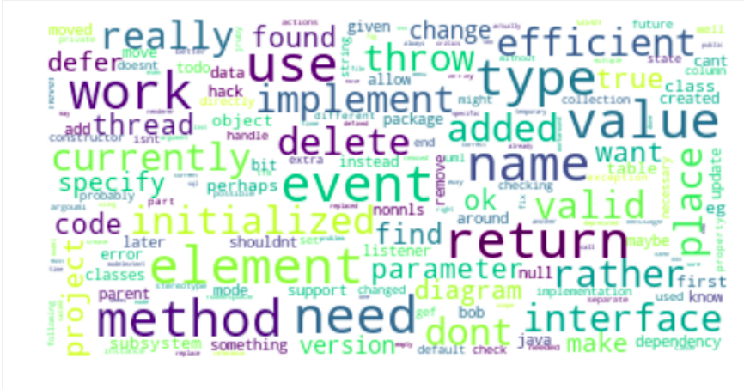
Design Debt Frequent Words

Slide 8
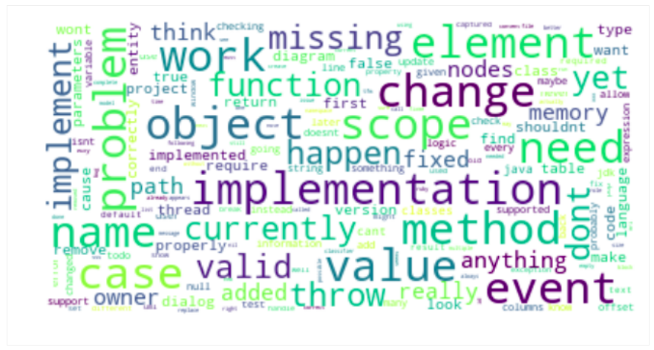
Requirement Debt Frequent Words

Slide 9
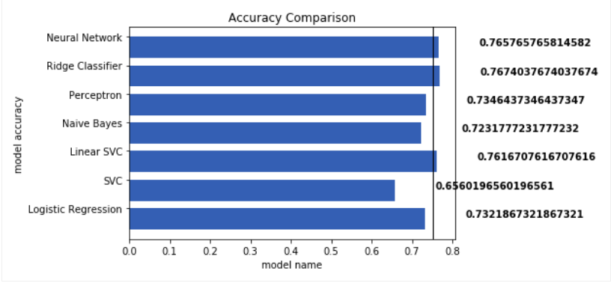
Models vs Accuracy

Slide 10
Overall Summary Of F1 Score, Precision and Accuracy
Algorithms | F1 Measure | Precision | Accuracy
Logistic Regression | 0.6623 | 0.7141 | 73.219
SVC | 0.2641 | 0.2187 | 65.602
Linear SVC | 0.6938 | 0.7782 | 76.167
Naïve Bayes | 0.4006 | 0.5388 | 72.318
Perceptron | 0.6604 | 0.6784 | 73.646
Ridge Classifier | 0.6719 | 0.7826 | 76.740

Slide 11
Critical Discussion:
Low or no comments
Effect on accuracy using Deep Learning?
Focus on removal techniques

Slide 12

Thank you!

