Slide 1
Self-Admitted Technical Debt Detection Using NLP
Presented By: Nirav Jadeja, Supriya Patel, Abhishek Singh
Notes:
Hello Everyone, today, I supriya, nirav and abhsihek are going to present on our topic satd detection using nlp.

Slide 2
Introduction
Methodology
Experimental Results
Critical discussion
Notes:
It starts with a brief introduction about the term td followed by the methodology we are going to use for its detection and the results we obtained and its critical evaluation on our side.

Slide 3
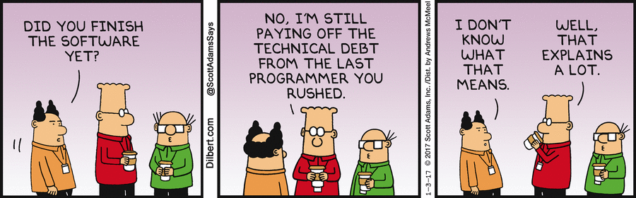
What is Technical Debt ?
Notes:
So, the term td has been defined in many different ways but in simple form we define it to be the shortcuts taken by developers to meet deadlines or the hacks they perform for the time being to be the first one in the market. Its starts with being as small as not defining a functionality in code comment, which may cause someone who does not understand it to change it or remove it. Some of the more serious technical debts are where the person does not fully understand the requirement and instead makes assumptions regarding it. By just fixing a system for time being, u make it fragile, and this approach has been termed as ‘Frankenstein’ approach by many.

Slide 4
Methodology
Data extraction
Filtering
Training the model
Notes:
Hence the aim is to detect such debts which may be self-admitted, and this is done by analysing the source code comments. We select 10 open source projects to extract the comments but instead of manually classifying them, we are using the dataset available to us. Cohen’s Kappa coefficient. Then we filter the comments by removing all the special characters, the license or Javadoc comments as well as the commented source code as all these do not provide any information regarding the td. Once the data is processed, we train multiple models such as logistic regression, neural network, svm, etc. models and we use F1 score as a measure of evaluation by comparing it to some base lines from the literature. Now Nirav will continue with the experimental results. Thank you.

Slide 5
Data Extraction
Source Code Comments From 10 Open Source Projects.
Manual Classification
Notes:
Hence the aim is to detect such debts which may be self-admitted, and this is done by analysing the source code comments. We select 10 open source projects to extract the comments but instead of manually classifying them, we are using the dataset available to us. Cohen’s Kappa coefficient. Then we filter the comments by removing all the special characters, the license or Javadoc comments as well as the commented source code as all these do not provide any information regarding the td. Once the data is processed, we train multiple models such as logistic regression, neural network, svm, etc. models and we use F1 score as a measure of evaluation by comparing it to some base lines from the literature. Now Nirav will continue with the experimental results. Thank you.

Slide 6
Filtering
Removal Of Special Character
Removal of Licence Comments, Commented Source Code
Notes:
Hence the aim is to detect such debts which may be self-admitted, and this is done by analysing the source code comments. We select 10 open source projects to extract the comments but instead of manually classifying them, we are using the dataset available to us. Cohen’s Kappa coefficient. Then we filter the comments by removing all the special characters, the license or Javadoc comments as well as the commented source code as all these do not provide any information regarding the td. Once the data is processed, we train multiple models such as logistic regression, neural network, svm, etc. models and we use F1 score as a measure of evaluation by comparing it to some base lines from the literature. Now Nirav will continue with the experimental results. Thank you.

Slide 7
Training the model
Logistic Regression, Neural Network, SVM, Ridge Classifier, Perceptron, Naïve Bayes
F1 score for evaluation
Notes:
Hence the aim is to detect such debts which may be self-admitted, and this is done by analysing the source code comments. We select 10 open source projects to extract the comments but instead of manually classifying them, we are using the dataset available to us. Cohen’s Kappa coefficient. Then we filter the comments by removing all the special characters, the license or Javadoc comments as well as the commented source code as all these do not provide any information regarding the td. Once the data is processed, we train multiple models such as logistic regression, neural network, svm, etc. models and we use F1 score as a measure of evaluation by comparing it to some base lines from the literature. Now Nirav will continue with the experimental results. Thank you.

Slide 8
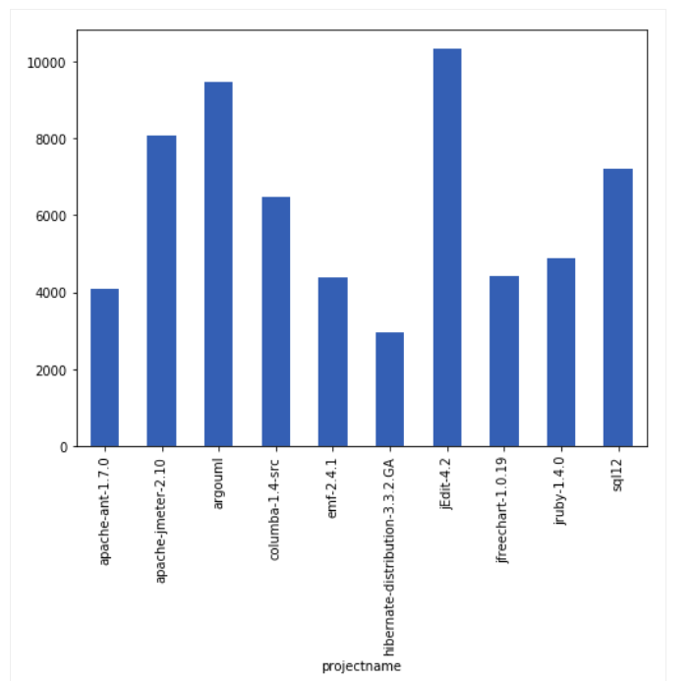
Comment Distribution in Dataset:
https://github.com/maldonado/tse satd data
Notes:
Thank you, so from the graph we can observe that the projects selected have varying amount of code comments to covers a range from approximately 3000 comments in a project to more than 10000 comments. These are then filtered using simple regular expression.

Slide 9
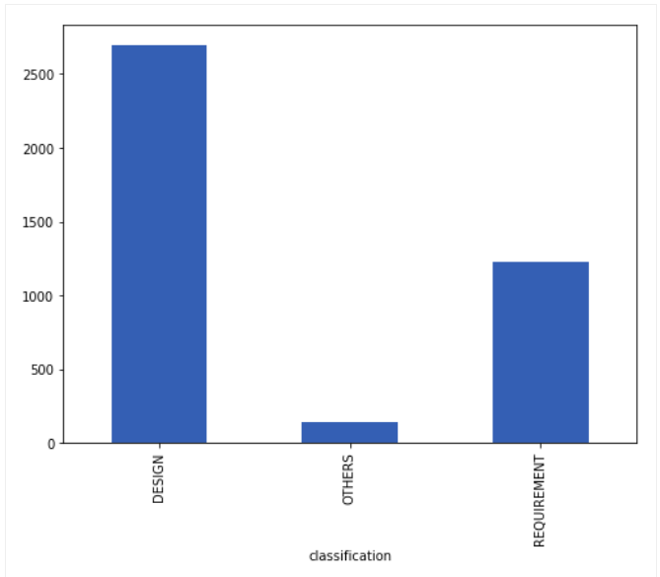
After Filtering Operations:
Notes:
We found several tds in the dataset but as we can see that the most prominent ones are design and requirement debts, so we decided to group other debts into a single category. These debts have certain features which define them, for example comments having words such as “hack” or “method needed” are related to design debts whereas words such as “implementation” “fixme” define requirement debt. These are some of the most frequent words in design and requirement debt.

Slide 10
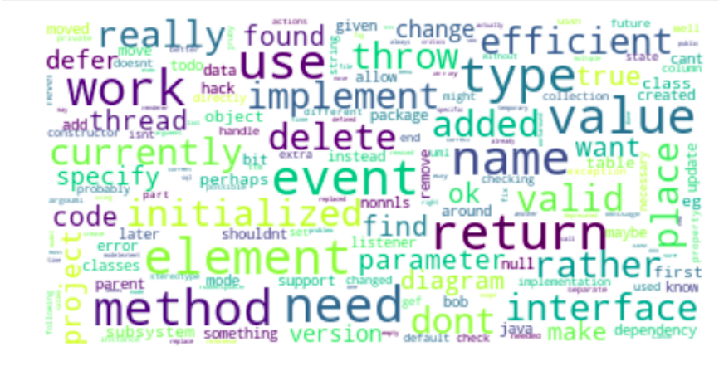
Design Debt Frequent Words

Slide 11
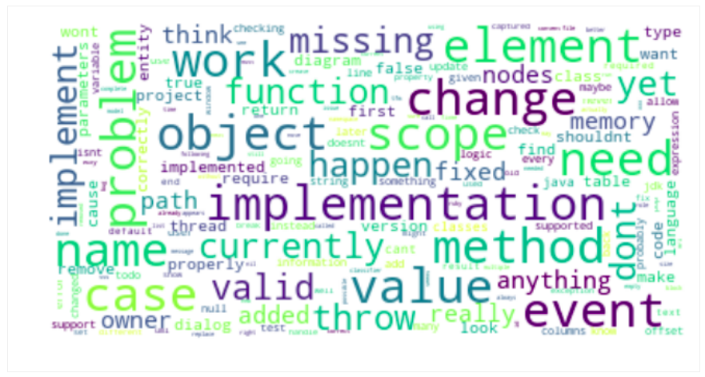
Requirement Debt Frequent Words

Slide 12
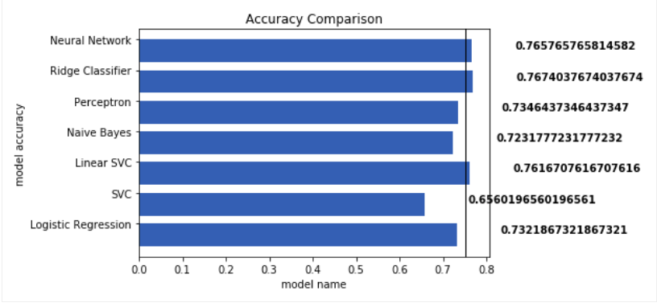
Models vs Accuracy
Notes:
In this project choosing model was the crucial part as it is the case of multi class regression. For this part of implementation, we used sklearn and keras. At first, we went through with several possible algorithms. Among them, neural networks and logistic regression were our first choice. Later on, we tested it on ridge classifier, SVC with linear and RBF (Radial Basis Function) kernel and SVM with stochastic gradient descent (SGD) learning (here, perceptron where loss is perceptron). We made 75% mark as an accuracy benchmark in our case. As we can see, out of 7 only 3 models have just crossed the mark. It also became clear that neural networks are not much effective.

Slide 13
Overall Summary Of F1 Score, Precision and Accuracy
Algorithms | F1 Measure | Precision | Accuracy
Logistic Regression | 0.6623 | 0.7141 | 73.219
SVC | 0.2641 | 0.2187 | 65.602
Linear SVC | 0.6938 | 0.7782 | 76.167
Naïve Bayes | 0.4006 | 0.5388 | 72.318
Perceptron | 0.6604 | 0.6784 | 73.646
Ridge Classifier | 0.6719 | 0.7826 | 76.740
Notes:
Here we provide an overall summary to compare the f1 scores along with precision and accuracy.

Slide 14
Critical Discussion:
Low or no comments
Effect on accuracy using Deep Learning?
Focus on removal techniques
Notes:
Although results show promising f1 measures, one of the current threat to validity that we observed is that a code may have some or no td but if it is not commented properly indicating the issue than it becomes quite difficult to detect any type of td. So, a well commented code is a necessity in order to detect td. Moving further we tried some models such as logistic regression, linear svc, perceptron and also neural network. Even though there is some increase in accuracy, it is not too significant meaning we either need to allow time for some more fine tuning and training or maybe deep learning won’t have a significant effect. The last thing is that this project is the first step and needs to be further carried on for more research into machine learning models and to look into techniques for the removal of technical debt once it has been detected. In the view of our project we refactored our code from scripting to MVC approach.

Slide 15
References
[1] E. S. Maldonado, E. Shihab, and N. Tsantalis, “Using Natural Language Processing to Automatically Detect Self-Admitted Technical Debt,” vol. XX, no. X, pp. 1–20, 2017.
[2] E. Lim and A. Informatics, “A Balancing Act : What Software Practitioners Have to Say about Technical Debt,” pp. 22–28.
[3] N. Zazworka, R. O. Spinola, A. Vetro, F. Shull, and C. Seaman, “A case study on effectively identifying technical debt,” Int. Conf. Eval. Assess. Softw. Eng., pp. 42–47, 2013.
[4] N. Tsantalis and A. Chatzigeogiou, “Identification of extract method refactoring opportunities for the decomposition of methods,” J. Syst. Softw., vol. 84, no. 10, pp. 1757–1782.
[5] N. Tsantalis, D. Mazinanian, and G. P. Krishnan, “Assessing the refactorability of software clones,” IEEE Trans. Softw. Eng., vol. 41, no. 11, pp. 1055–1090, 2015.
[6] N. S. R. Alves, L. F. Ribeiro, V. Caires, T. S. Mendes, and R. O. Spínola, “Towards an Ontology of Terms on Technical Debt,” pp. 1–7, 2014.
[7] E. Maldonado, E. Shihab, and N. Tsantalis, “Replication Package for Using Natural Language Processing to Automatically Detect Self-Admitted Technical Debt,” 2016.
[8] A. Potdar, “An Exploratory Study on Self-Admitted Technical Debt,” 2014.

Slide 16

Thank you!

