Slide 1
CS 340: Computer Systems
Muhammed Can Özdemir
Ahsen Akpınar
Ece Uslu
Nejat Günaydın
Progress Presentation

Slide 2
Dataset details
«Sınıflama» (Classification)
« Eser Adı» (Book Name)
«Yazar» (Author)
«Dil» (Language)
«Konu Başlıkları» (Title of subject)
«Ödünç Sayısı» (Number of borrowing)

Slide 3
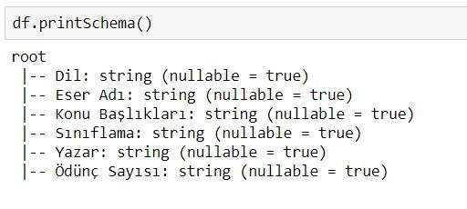
Dataset details
Schema of the Data

Slide 4
What: the problem of interest
Our main interest is to build a program that does similarity analysis for books in the library of İstanbul Şehir University, so that can be used in a more complicated recommendation algorithm.

Slide 5
Why: reason, importance
The system that our university’s library uses doesn’t permit to get details about searchs and access info to each books (with or without user info). As a result, in order to access to more details, there is a need to build (or use) a more data-accessible system that our university’s library has a total control on it.
The reason why we decided to make a program that make similarity analysis between books is to make a starter point to make our own recommendation system so that we have a total control on it.

Slide 6
How: the methodology
What systematic approaches are you going to employ?
First of all, we took our data as an excel file. After that we used xlrd module and each cell read by manually one by one. After that, it converted to spark dataframe. Why we didn't do in pandas and spark? Because, there was a ‘/n’ character in the title of subject column, and when it pass the new row it did not convert csv file, then pandas was tried, and some of cells values gave us the type error so it didn't use. We are making a simalarity anaylzes by using pearson correlation then, we can measure the input values of books similarities with other books.

Slide 7
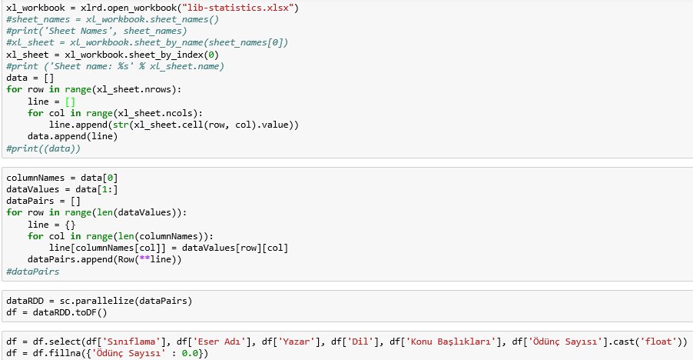
Where: current status
Problem : Dealing With Excel Data

Slide 8
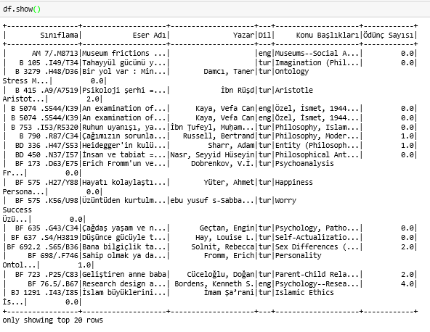
Where: current status
Our Data :

Slide 9
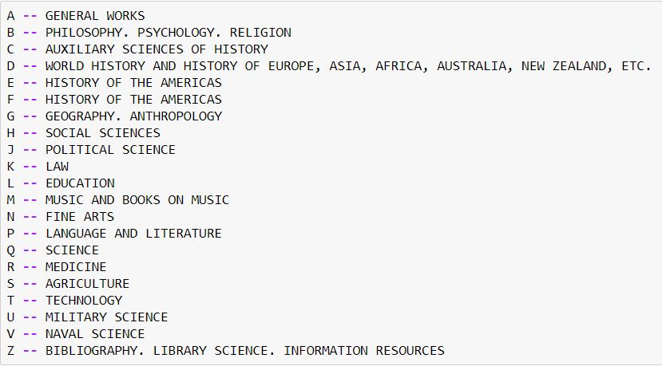
Where: current status
About Column of «Sınıflama»(Classification)

Slide 10
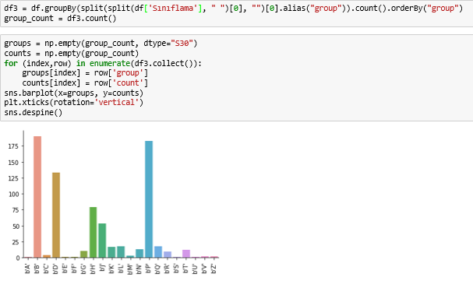
Where: current status
About Column of «Sınıflama»(Classification)

Slide 11
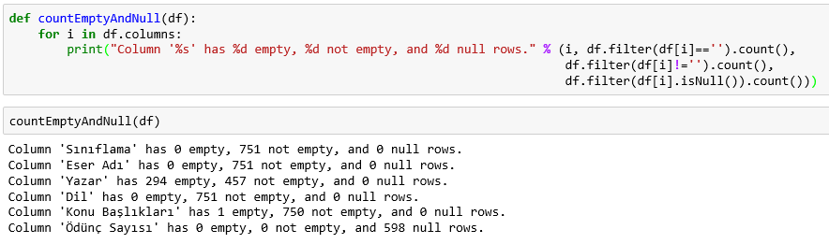
Where: current status
Problem of The Data : Dealing with Null Values

Slide 12
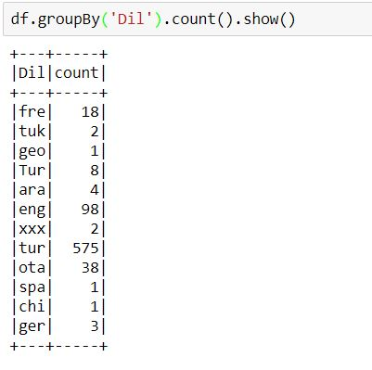
Where: current status
Describe of The Languages

Slide 13
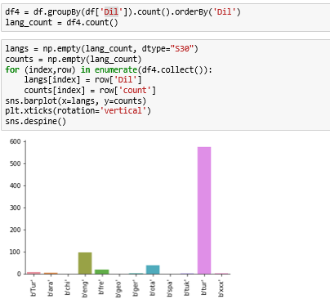
Where: current status
Describe of The Languages

Slide 14
Roadmap
Code to cluster data for input book names according to their Classification, language, and Subject Topics
Plot according to Pearson correlation coefficient

