Slide 1
Threads

Slide 2
Processes
A process has a self-contained execution environment
A process generally has a complete, private set of basic run-time resources
each process has its own memory space.
A program usually contains a single process

Slide 3
Processes
single application may be a set of cooperating processes
Processes may communicate each other using IPC (sockets and pipes)
Java virtual machine run as a single process

Slide 4
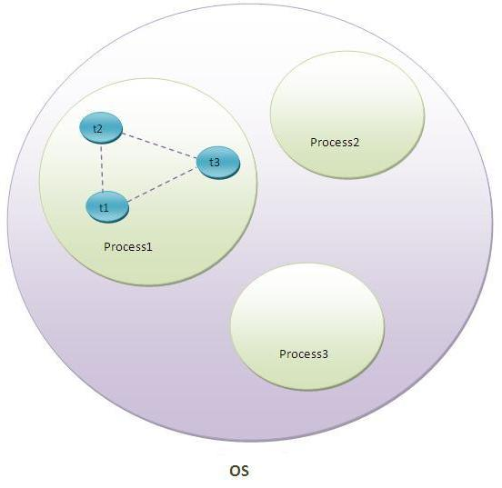
Processes

Slide 5
Threads
sometimes called lightweight processes
Require less resources
Threads exist within a process — every process has at least one
Threads share the process's resources, including memory and open files

Slide 6
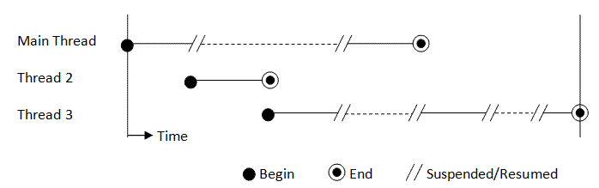
Threads—time slicing

Slide 7
Threads
Single cpu can execute one task at a time
Multiple cpu can execute multiple tasks
Multiple tasks can be executed on single cpu by time slicing
Multitasking is necessary to optimize the usage of the computing resources

Slide 8
Threads --java
Extend a subclass from the superclass Thread
override the run() method to specify the running behavior of the thread
Create an instance and invoke the start() method, which will call-back the run() on a new thread

Slide 9
Threads --java
First method:
Extend a subclass from the superclass Thread
override the run() method to specify the running behavior of the thread
Create an instance and invoke the start() method, which will call-back the run() on a new thread

Slide 10
Threads --java
Thread t = new Thread() { // Create an instance of an anonymous inner class that extends Thread
@Override
public void run() { // Override run() to specify the running behaviors
for (int i = 0; i < 100000; ++i) {
if (stop) break;
tfCount.setText(count + "");
++count;
// Suspend itself and yield control to other threads for the specified milliseconds
// Also provide the necessary delay
try {
sleep(10); // milliseconds
} catch (InterruptedException ex) {}
}
}
};
t.start(); // Start the thread. Call back run() in a new thread

Slide 11
Threads --java
Second method:
Create a class that implements the Runnable interface
provide the implementation to the abstract method run()
Construct a new Thread instance using the constructor with a Runnable object and invoke the start()

Slide 12
Threads --java
// Create an anonymous instance of an anonymous inner class that implements Runnable
// and use the instance as the argument of Thread's constructor.
Thread t = new Thread(new Runnable() {
// Provide implementation to abstract method run() to specify the running behavior
@Override
public void run() {
for (int i = 0; i < 100000; ++i) {
if (stop) break;
tfCount.setText(count + "");
++count;
// Suspend itself and yield control to other threads
// Also provide the necessary delay
try {
Thread.sleep(10); // milliseconds
} catch (InterruptedException ex) {}
}
}
});
t.start(); // call back run() in new thread

Slide 13
Class Thread and run() interface
The class java.lang.Thread has the following constructors:
public Thread();
public Thread(String threadName);
public Thread(Runnable target);
public Thread(Runnable target, String threadName);
The interface java.lang.Runnable declares one abstract method run(), which is used to specify the running behavior of the thread:
public void run();

Slide 14
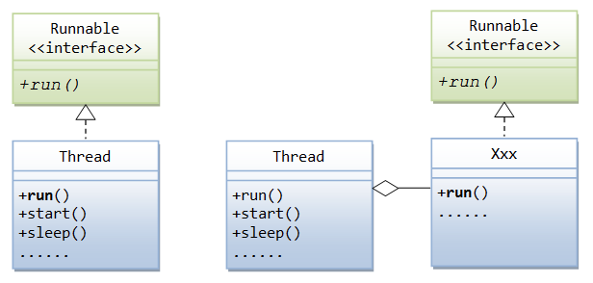
Class Thread and run() interface

Slide 15
Class Thread and run() interface
method run() specifies the running behavior of the thread.
No need do invoke the run() method explicitly
call the start() method of the class Thread.
if a thread is constructed by extending the Thread class, the method start() will call back the overridden run() method in the extended class
if a thread is constructed by providing a Runnable object to the Thread's constructor, the start() method will call back the run() method of the Runnable object

Slide 16
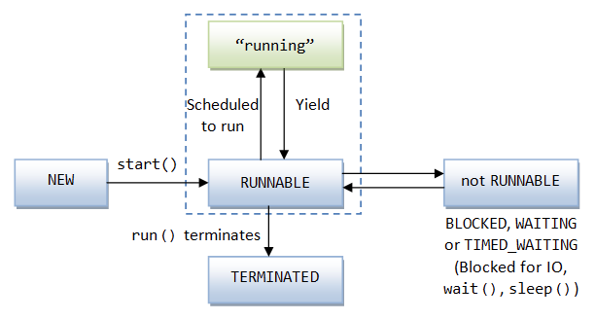
Thread lifecycle

