Slide 1
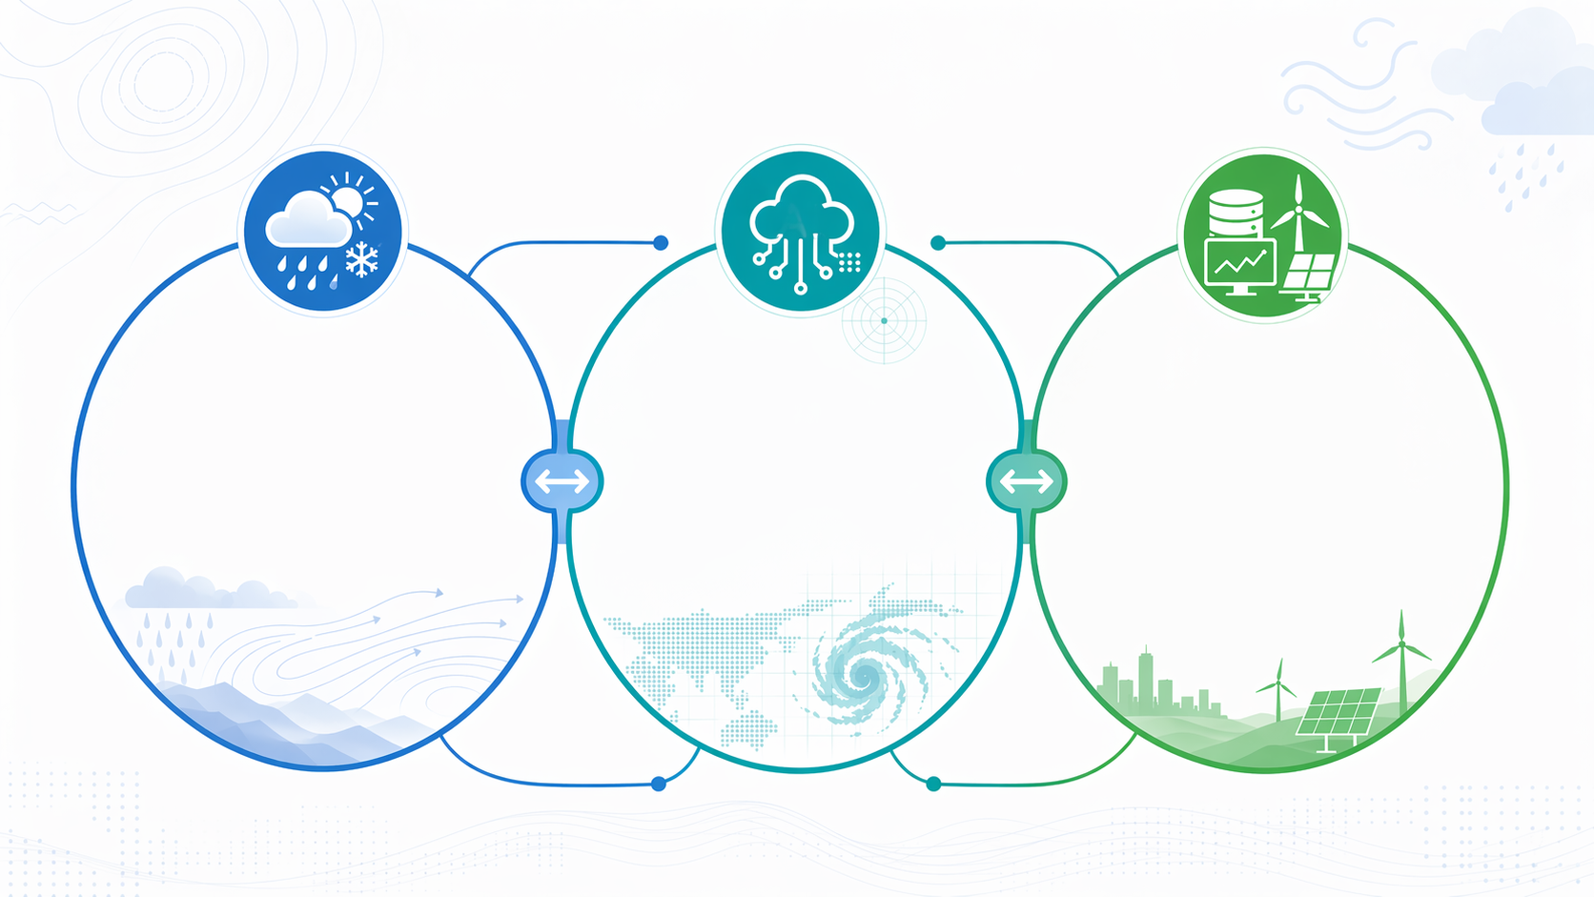
Physical Sciences
AI for Meteorology
Applications
Hydrometeorology,
Ensemble Forecasting, Data Assimilation, Numerical Prediction,
Microphysical Processes …
Short-range & Medium- Weather Global Forecasting, Regional Forecasting, Nowcasting …
Meteorological Datasets, Downscaling, Bias Correction, Extreme Precipitation Forecasting, Typhoon Forecasting, Wind Power Forecasting, Solar Power Forecasting …

