Slide 1
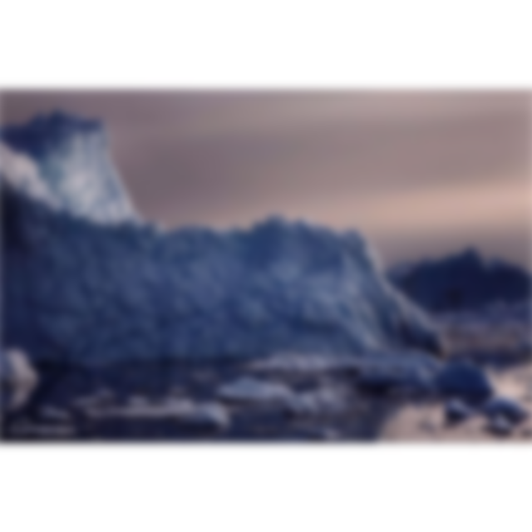
Cultural Iceberg
软网 1603
Presented by 刘康
武雨桐

Slide 2
01
Part ONE
The Culture Iceberg
How can a culture be like an iceberg? Is it because cultures are cool?

Slide 3

Culture Iceberg
If culture is an iceberg, there are some aspects which are visible and can be seen ,and a larger aspect which is hidden beneath the surface.
You can see the top 10%, but 90% of its mass is below the surface.
--Beyond Culture(1976), Edward T. Hall

Slide 4
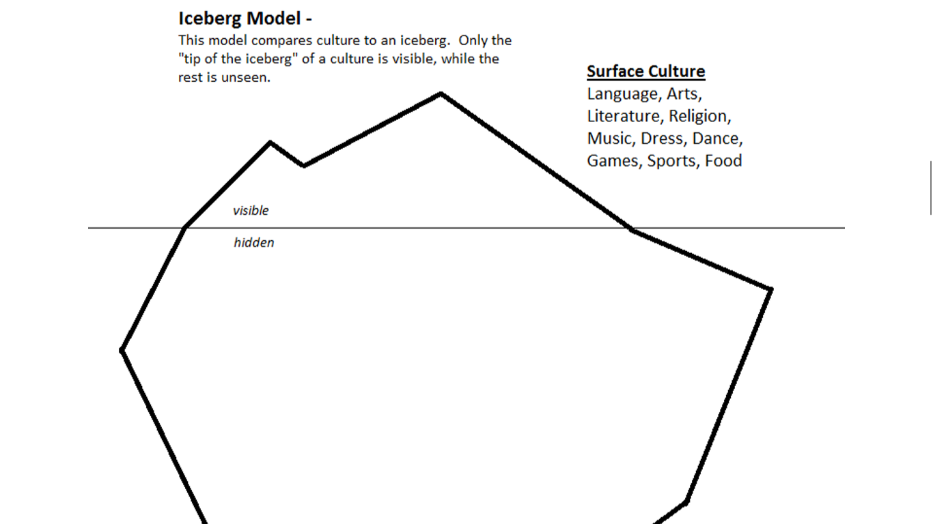

Slide 5
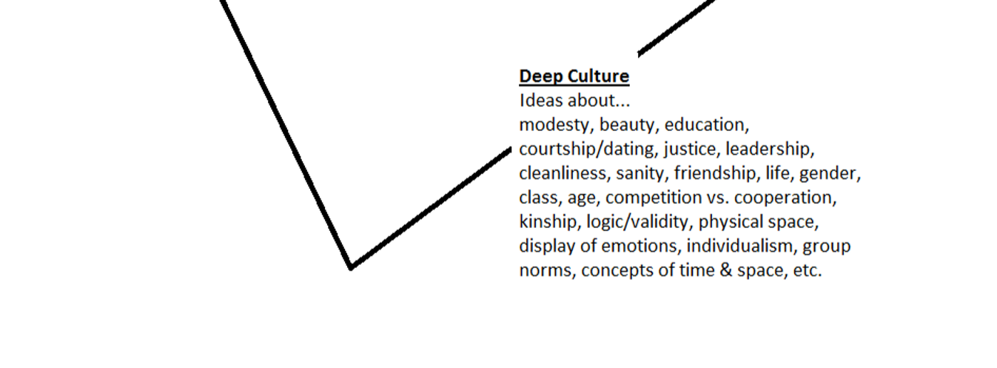
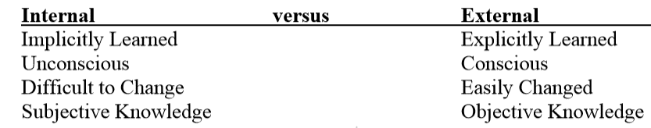

Slide 6
02
Part TWO
Influence on culture
The visible and invisible parts of culture are different, so they have different functions.

Slide 7
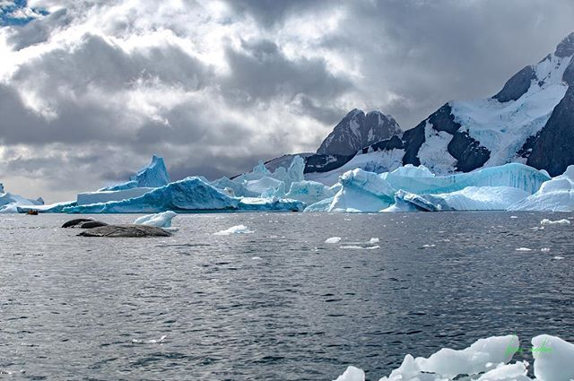
Culture Iceberg
The visible aspects of culture are important parts of how cultures interact and maintain their sense of unity .
-- Christopher Muscato (Northern Colorado University, College of Humanities & Social Sciences)

Slide 8



Slide 9

Once you begin to change these values, people begin to feel like their cultural identity is being threatened.
Invisible aspects
The core of the iceberg. This is where the vast majority of the things that define a culture can be found.
At the core of a culture we find what is often the subconscious parts of culture which people adhere to and believe in without conscious thought.
“
“
The core
Culture Iceberg

Slide 10
03
Part THREE
What we learn
Hall suggests that the only way to learn the internal culture of others is to actively participate in their culture.

Slide 11
What we learn
1
Don’t judge a new culture based only on what we see.
Take the time to get to know individuals from that culture.
2
3
Interact with the new culture.

Slide 12
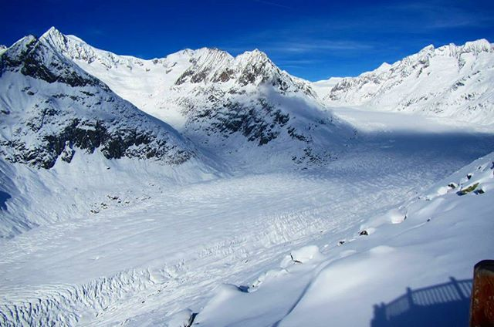
Thank you

