Slide 1
Rough Sets in KDD
Tutorial Notes
Andrzej Skowron
Warsaw University
skowron@mimuw.eud.pl
Ning Zhong
Maebashi Institute of Technolgy
zhong@maebashi-it.ac.jp
Copyright 2000 by A. Skowron & N. Zhong

Slide 2
About the Speakers
Andrzej Skowron received his Ph.D. from Warsaw University. He is a professor in Faculty of Mathematics, Computer Science and Mechanics, Warsaw University, Poland. His research interests include soft computing methods and applications, in particular, reasoning with incomplete information, approximate reasoning, rough sets, rough mereology, granular computing, synthesis and analysis of complex objects, intelligent agents, knowledge discovery and data mining, etc, with over 200 journal and conference publications. He is an editor of several international journals and book series including Fundamenta Informaticae (editor in chief), Data Mining and Knowledge Discovery. He is president of International Rough Set Society. He was an invited speaker at many international conferences, and has served or is currently serving on the program committees of over 40 international conferences and workshops, including ISMIS’97-99 (program chair), RSCTC’98-00 (program chair), RSFDGrC’99 (program chair).

Slide 3
About the Speakers (2)
Ning Zhong received his Ph.D. from the University of Tokyo. He is head of Knowledge Information Systems Laboratory, and an associate professor in Department of Information Engineering, Maebashi Institute of Technology, Japan. His research interests include knowledge discovery and data mining, rough sets and granular-soft computing, intelligent agents and databases, Web-intelligence (WI), knowledge information systems, with over 80 journal and conference publications. He is an editor of Knowledge and Information Systems: an international journal (Springer). He is a member of the advisory board of International Rough Set Society, the Steering Committee of IEEE International Conferences on Data Mining, and PAKDD conferences, the advisory board of BISC/SIGGrC. He has served or is currently serving on the program committees of over 30 international conferences and workshops, including PAKDD’99 (program chair), IAT’99 and 2001 (program chair), RSFDGrC’99 (program chair), and WI’2001(program chair).

Slide 4
Contents
Introduction
Basic Concepts of Rough Sets
A Rough Set Based KDD process
Rough Sets in ILP and GrC
Concluding Remarks (Summary, Advanced Topics, References and Further Readings).

Slide 5
Introduction
Rough set theory was developed by Zdzislaw Pawlak in the early 1980’s.
Representative Publications:
  Z. Pawlak, “Rough Sets”, International Journal of Computer and Information Sciences, Vol.11, 341-356 (1982).
  Z. Pawlak, Rough Sets - Theoretical Aspect of Reasoning about Data, Kluwer Academic Pubilishers (1991).

Slide 6
Introduction (2)
The main goal of the rough set analysis is induction of approximations of concepts.
Rough sets constitutes a sound basis for KDD. It offers mathematical tools to discover patterns hidden in data.
It can be used for feature selection, feature extraction, data reduction, decision rule generation, and pattern extraction (templates, association rules) etc.
identifies partial or total dependencies in data, eliminates redundant data, gives approach to null values, missing data, dynamic data and others.

Slide 7
Introduction (3)
Recent extensions of rough set theory (rough mereology) have developed new methods for decomposition of large data sets, data mining in distributed and multi-agent systems, and granular computing.
This presentation shows how several aspects of the above problems are solved by the (classic) rough set approach, discusses some advanced topics, and gives further research directions.

Slide 8
Basic Concepts of Rough Sets
Information/Decision Systems (Tables)
Indiscernibility
Set Approximation
Reducts and Core
Rough Membership
Dependency of Attributes

Slide 9
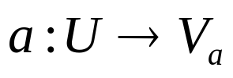


Information Systems/Tables
IS is a pair (U, A)
U is a non-empty finite set of objects.
A is a non-empty finite set of attributes such that for every
is called the value set of a.
Age LEMS
x１ 16-30 50
x2 16-30 0
x3 31-45 1-25
x4 31-45 1-25
x5 46-60 26-49
x6 16-30 26-49
x7 46-60 26-49

Slide 10
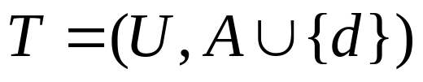

Decision Systems/Tables
Age LEMS Walk
DS:
is the decision attribute (instead of one we can consider more decision attributes).
The elements of A are called the condition attributes.
x１ 16-30 50 yes
x2 16-30 0 no
x3 31-45 1-25 no
x4 31-45 1-25 yes
x5 46-60 26-49 no
x6 16-30 26-49 yes
x7 46-60 26-49 no

Slide 11
Issues in the Decision Table
The same or indiscernible objects may be represented several times.
Some of the attributes may be superfluous.

Slide 12

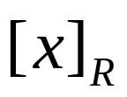


Indiscernibility
The equivalence relation
  A binary relation which is reflexive (xRx for any object x) ,
  symmetric (if xRy then yRx), and
  transitive (if xRy and yRz then xRz).
The equivalence class of an element
consists of all objects such that xRy.

Slide 13


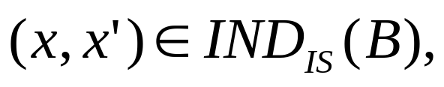

Indiscernibility (2)
Let IS = (U, A) be an information system, then with any there is an associated equivalence relation:
where is called the B-indiscernibility relation.
If then objects x and x’ are indiscernible from each other by attributes from B.
The equivalence classes of the B-indiscernibility relation are denoted by

Slide 14
An Example of Indiscernibility
The non-empty subsets of the condition attributes are {Age}, {LEMS}, and {Age, LEMS}.
IND({Age}) = {{x1,x2,x6}, {x3,x4}, {x5,x7}}
IND({LEMS}) = {{x1}, {x2}, {x3,x4}, {x5,x6,x7}}
IND({Age,LEMS}) = {{x1}, {x2}, {x3,x4}, {x5,x7}, {x6}}.
Age LEMS Walk
x１ 16-30 50 yes
x2 16-30 0 no
x3 31-45 1-25 no
x4 31-45 1-25 yes
x5 46-60 26-49 no
x6 16-30 26-49 yes
x7 46-60 26-49 no

Slide 15
Observations
An equivalence relation induces a partitioning of the universe.
The partitions can be used to build new subsets of the universe.
Subsets that are most often of interest have the same value of the decision attribute.
It may happen, however, that a concept such as “Walk” cannot be defined in a crisp manner.

Slide 16


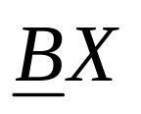
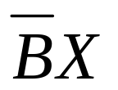
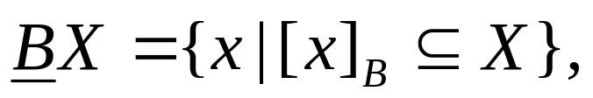
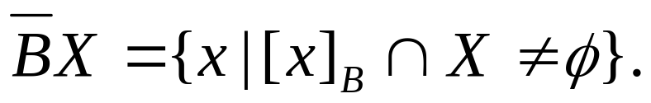
Set Approximation
Let T = (U, A) and let and We can approximate X using only the information contained in B by constructing the B-lower and B-upper approximations of X, denoted and respectively, where

Slide 17
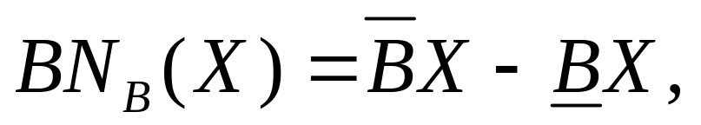
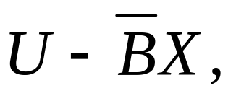
Set Approximation (2)
B-boundary region of X,
consists of those objects that we cannot decisively classify into X in B.
B-outside region of X,
consists of those objects that can be with certainty classified as not belonging to X.
A set is said to be rough if its boundary region is non-empty, otherwise the set is crisp.

Slide 18
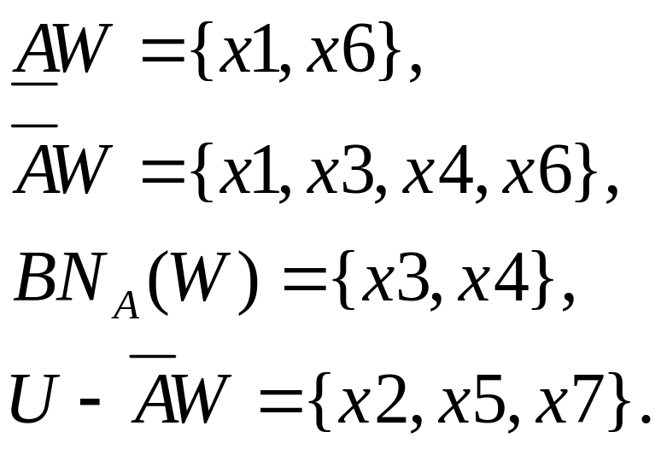
An Example of Set Approximation
Let W = {x | Walk(x) = yes}.
The decision class, Walk, is rough since the boundary region is not empty.
Age LEMS Walk
x１ 16-30 50 yes
x2 16-30 0 no
x3 31-45 1-25 no
x4 31-45 1-25 yes
x5 46-60 26-49 no
x6 16-30 26-49 yes
x7 46-60 26-49 no

Slide 19

An Example of
Set Approximation (2)
{{x2}, {x5,x7}}
{{x3,x4}}
yes
AW
{{x1},{x6}}
yes/no
no

Slide 20

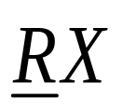
Lower & Upper Approximations
U
U/R
R : subset of
attributes
setＸ

Slide 21
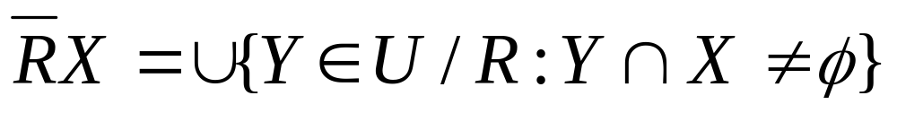
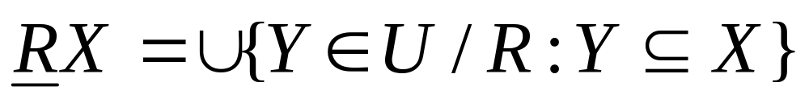
Lower & Upper Approximations (2)
Upper Approximation:
Lower Approximation:

Slide 22
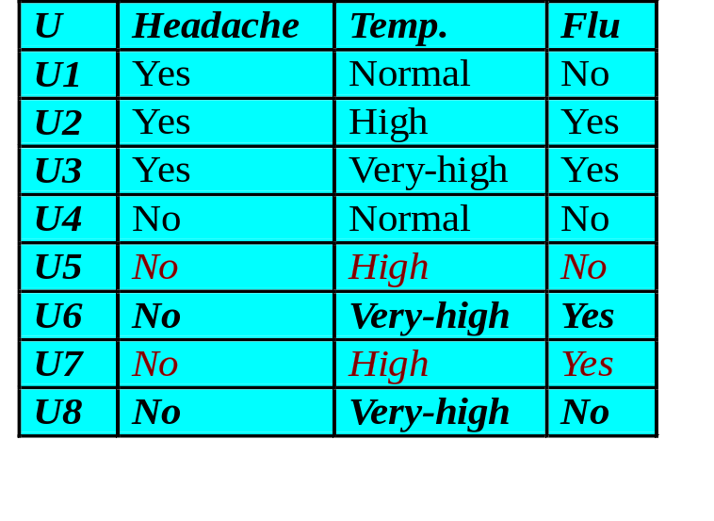


Lower & Upper Approximations
(3)
The indiscernibility classes defined by R = {Headache, Temp.} are {u1}, {u2}, {u3}, {u4}, {u5, u7}, {u6, u8}.
X1 = {u | Flu(u) = yes}
= {u2, u3, u6, u7}
RX1 = {u2, u3}
= {u2, u3, u6, u7, u8, u5}
X2 = {u | Flu(u) = no}
= {u1, u4, u5, u8}
RX2 = {u1, u4}
= {u1, u4, u5, u8, u7, u6}

Slide 23
Lower & Upper Approximations (4)
R = {Headache, Temp.}
U/R = { {u1}, {u2}, {u3}, {u4}, {u5, u7}, {u6, u8}}
X1 = {u | Flu(u) = yes} = {u2,u3,u6,u7}
X2 = {u | Flu(u) = no} = {u1,u4,u5,u8}
X1
X2
RX1 = {u2, u3}
= {u2, u3, u6, u7, u8, u5}
u2
u7
u5
u1
RX2 = {u1, u4}
= {u1, u4, u5, u8, u7, u6}
u3
u6
u8
u4

Slide 24
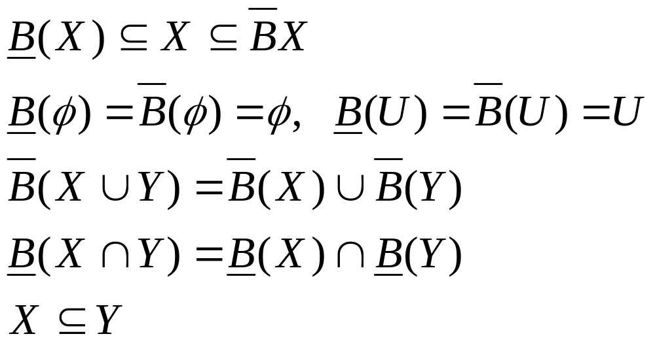
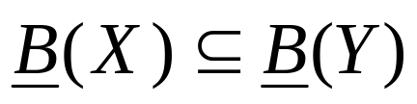
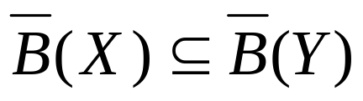
Properties of Approximations
implies
and

Slide 25
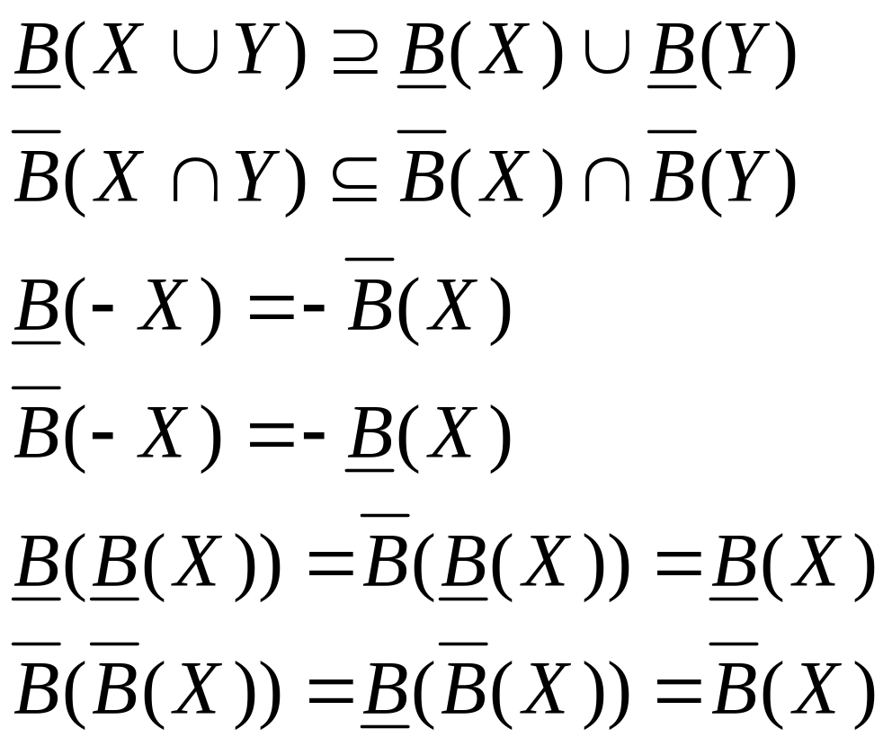
Properties of Approximations (2)
where -X denotes U - X.

Slide 26
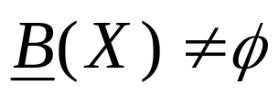
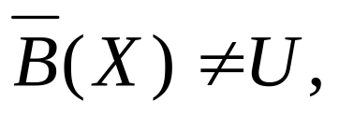
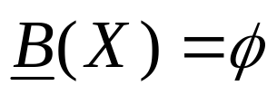
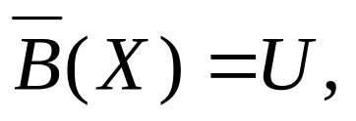
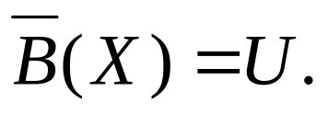
Four Basic Classes of Rough Sets
X is roughly B-definable, iff and
X is internally B-undefinable, iff and
X is externally B-undefinable, iff and
X is totally B-undefinable, iff and

Slide 27
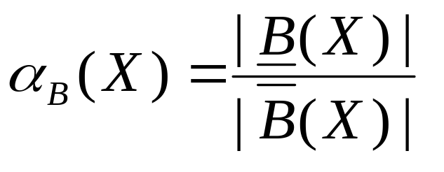
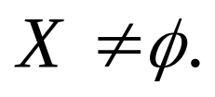
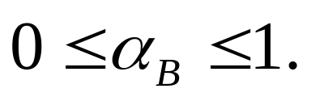
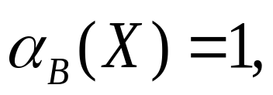
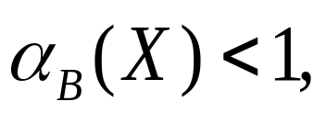
Accuracy of Approximation
where |X| denotes the cardinality of
Obviously
If X is crisp with respect to B.
If X is rough with respect to B.

Slide 28
Issues in the Decision Table
The same or indiscernible objects may be represented several times.
Some of the attributes may be superfluous (redundant).
That is, their removal cannot worsen the classification.

Slide 29
Reducts
Keep only those attributes that preserve the indiscernibility relation and, consequently, set approximation.
There are usually several such subsets of attributes and those which are minimal are called reducts.

Slide 30

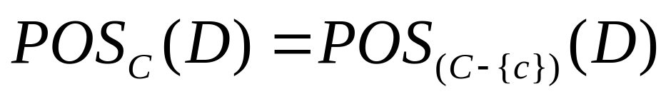

Dispensable & Indispensable Attributes
Let
Attribute c is dispensable in T
if , otherwise
attribute c is indispensable in T.
The C-positive region of D:
Notes:
Dispensable 可省去的，非必要的，可有可无的

Slide 31

Independent
T = (U, C, D) is independent
if all are indispensable in T.

Slide 32
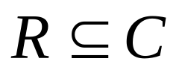


Reduct & Core
The set of attributes is called a reduct of C, if T’ = (U, R, D) is independent and
The set of all the condition attributes indispensable in T is denoted by CORE(C).
where RED(C) is the set of all reducts of C.

Slide 33
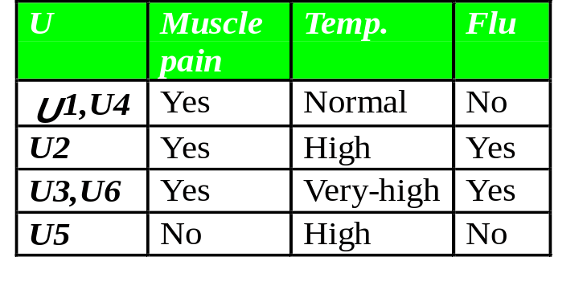
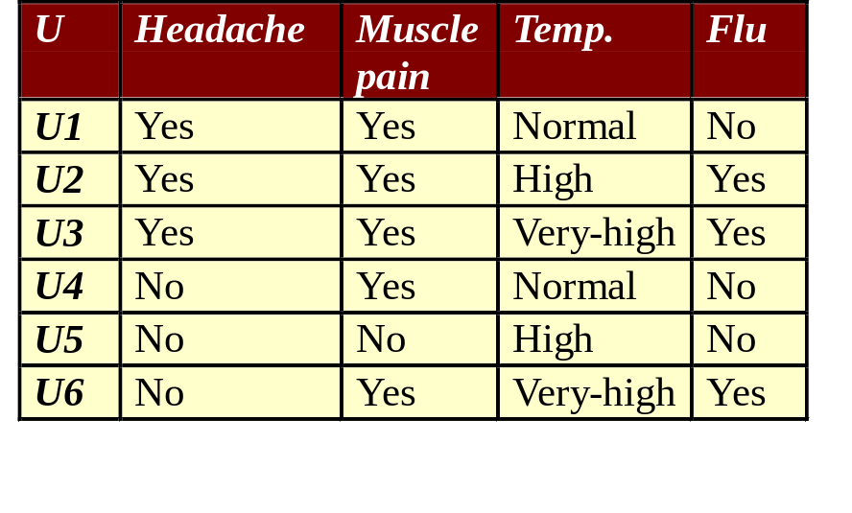
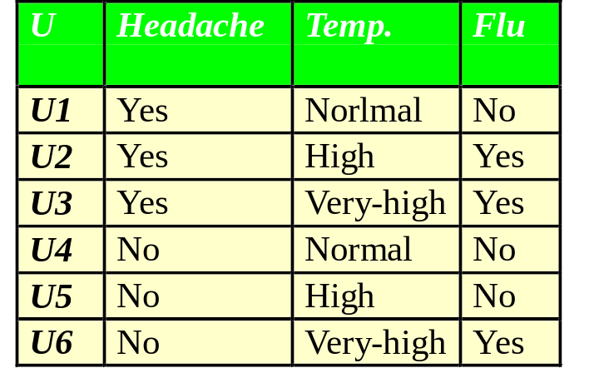

An Example of Reducts & Core
Reduct1 = {Muscle-pain,Temp.}
Reduct2 = {Headache, Temp.}
CORE = {Headache,Temp}
{MusclePain, Temp}
= {Temp}

Slide 34
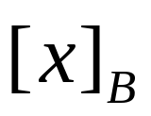
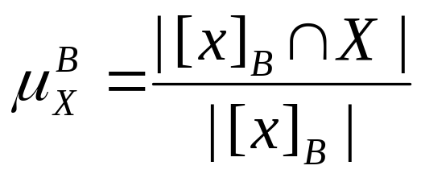
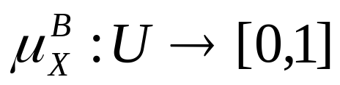

Rough Membership
The rough membership function quantifies the degree of relative overlap between the set X and the equivalence class to which x belongs.
The rough membership function can be interpreted as a frequency-based estimate of
where u is the equivalence class of IND(B).

Slide 35
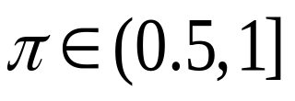
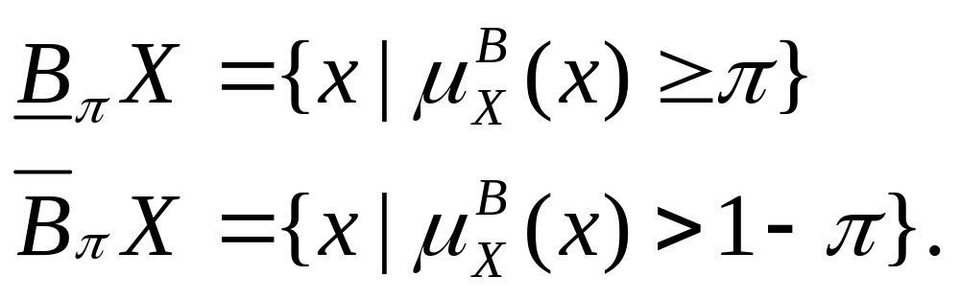

Rough Membership (2)
The formulae for the lower and upper approximations can be generalized to some arbitrary level of precision by means of the rough membership function
Note: the lower and upper approximations as originally formulated are obtained as a special case with

Slide 36
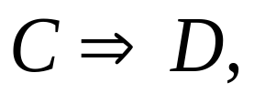
Dependency of Attributes
Discovering dependencies between attributes is an important issue in KDD.
A set of attribute D depends totally on a set of attributes C, denoted if all values of attributes from D are uniquely determined by values of attributes from C.

Slide 37
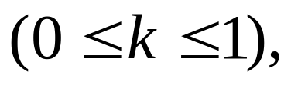
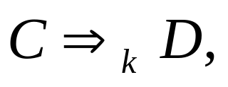
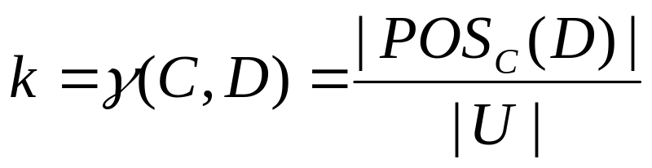
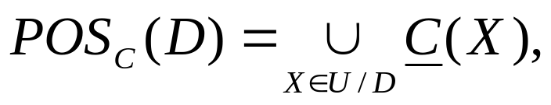
Dependency of Attributes (2)
Let D and C be subsets of A. We will say that D depends on C in a degree k
denoted by if
where called C-positive region of D.

Slide 38
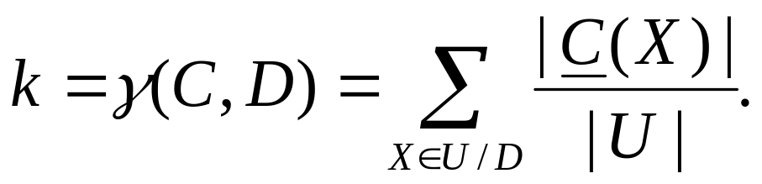
Dependency of Attributes (3)
Obviously
If k = 1 we say that D depends totally on C.
If k < 1 we say that D depends partially (in a degree k) on C.

Slide 39
A Rough Set Based KDD Process
Discretization based on RS and Boolean Reasoning (RSBR).
Attribute selection based RS with Heuristics (RSH).
Rule discovery by GDT-RS.

Slide 40
What Are Issues of Real World ?
Very large data sets
Mixed types of data (continuous valued, symbolic data)
Uncertainty (noisy data)
Incompleteness (missing, incomplete data)
Data change
Use of background knowledge

Slide 41
Methods
ID3 Prism Version BP Dblearn
(C4.5) Space
Real world
issues
very large data set
mixed types of data
noisy data
incomplete instances
data change
use of background knowledge
Okay
possible

Slide 44
Soft Techniques for KDD
Logic
Set
Probability

Slide 45
Soft Techniques for KDD (2)
Deduction
Induction
Abduction
RoughSets
Fuzzy Sets
Stoch. Proc.
Belief Nets
Conn. Nets
GDT

Slide 46
A Hybrid Model
Deduction
GrC
RS&ILP
TM
GDT
RS
Abduction
Induction

Slide 47
GDT : Generalization Distribution Table
RS : Rough Sets
TM: Transition Matrix
ILP : Inductive Logic Programming
GrC : Granular Computing

Slide 48
A Rough Set Based KDD Process
Discretization based on RS and Boolean Reasoning (RSBR).
Attribute selection based RS with Heuristics (RSH).
Rule discovery by GDT-RS.

Slide 49
Observations
A real world data set always contains mixed types of data such as continuous valued, symbolic data, etc.
When it comes to analyze attributes with real values, they must undergo a process called discretization, which divides the attribute’s value into intervals.
There is a lack of the unified approach to discretization problems so far, and the choice of method depends heavily on data considered.

Slide 50
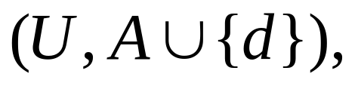
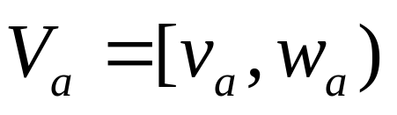

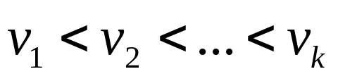
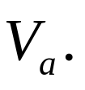
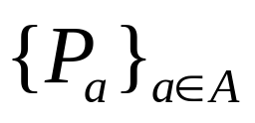
Discretization based on RSBR
In the discretization of a decision table T = where is an interval of real values, we search for a partition of for any
Any partition of is defined by a sequence of the so-called cuts from
Any family of partitions can be identified with a set of cuts.

Slide 51
Discretization Based on RSBR (2)
In the discretization process, we search for a set of cuts satisfying some natural conditions.
U a b d
P
P
U a b d
x1 0.8 2 1
x2 1 0.5 0
x3 1.3 3 0
x4 1.4 1 1
x5 1.4 2 0
x6 1.6 3 1
x7 1.3 1 1
x1 0 2 1
x2 1 0 0
x3 1 2 0
x4 1 1 1
x5 1 2 0
x6 2 2 1
x7 1 1 1
P = {(a, 0.9),
(a, 1.5),
(b, 0.75),
(b, 1.5)}

Slide 52
A Geometrical Representation of Data
b
x3
x6
3
x1
x5
2
1
x7
x4
x2
0.5
0
0.8
1
1.3 1.4 1.6
a

Slide 53
A Geometrical Representation of Data and Cuts
b
x3
x6
3
x1
x5
2
1
x7
x4
0.5
x2
0
0.8
1
1.3 1.4 1.6
a

Slide 54


Discretization Based on RSBR (3)
The sets of possible values of a and b are defined by
The sets of values of a and b on objects from U are given by
a(U) = {0.8, 1, 1.3, 1.4, 1.6};
b(U) = {0.5, 1, 2, 3}.

Slide 55
Discretization Based on RSBR (4)
The discretization process returns a partition of the value sets of condition attributes into intervals.

Slide 56


A Discretization Process
Step 1: define a set of Boolean variables,
where
corresponds to the interval [0.8, 1) of a
corresponds to the interval [1, 1.3) of a
corresponds to the interval [1.3, 1.4) of a
corresponds to the interval [1.4, 1.6) of a
corresponds to the interval [0.5, 1) of b
corresponds to the interval [1, 2) of b
corresponds to the interval [2, 3) of b

Slide 57








The Set of Cuts on Attribute a
0.8
1.0
1.3
1.4
1.6
a

Slide 58





A Discretization Process (2)
Step 2: create a new decision table by using the set of Boolean variables defined in Step 1.
Let be a decision table, be a propositional variable corresponding to the interval for any
and

Slide 59




A Sample Defined in Step 2
U*
1 0 0 0 1 1 0
1 1 0 0 0 0 1
1 1 1 0 0 0 0
0 1 1 0 1 0 0
0 0 1 0 0 1 1
0 0 0 0 0 1 0
0 1 1 1 1 1 1
0 0 1 1 0 0 0
0 0 0 1 0 0 1
0 1 0 0 1 0 0
0 0 0 0 0 1 0
0 0 1 0 0 1 0
(x1,x2)
(x1,x3)
(x1,x5)
(x4,x2)
(x4,x3)
(x4,x5)
(x6,x2)
(x6,x3)
(x6,x5)
(x7,x2)
(x7,x3)
(x7,x5)

Slide 60

The Discernibility Formula
The discernibility formula
means that in order to discern object x1 and x2, at least one of the following cuts must be set,
a cut between a(0.8) and a(1)
a cut between b(0.5) and b(1)
a cut between b(1) and b(2).

Slide 61






The Discernibility Formulae for All Different Pairs

Slide 62






The Discernibility Formulae for All Different Pairs (2)

Slide 63

A Discretization Process (3)
Step 3: find the minimal subset of p that discerns all objects in different decision classes.
The discernibility boolean propositional formula is defined as follows,

Slide 64





The Discernibility Formula in CNF Form

Slide 65

The Discernibility Formula in DNF Form
We obtain four prime implicants,
is the optimal result, because
it is the minimal subset of P.

Slide 66
The Minimal Set Cuts for the Sample DB
b
x3
x6
3
x1
x5
2
1
x7
x4
0.5
x2
0
0.8
1
1.3 1.4 1.6
a

Slide 67
A Result
U a b d
P
P
U a b d
x1 0.8 2 1
x2 1 0.5 0
x3 1.3 3 0
x4 1.4 1 1
x5 1.4 2 0
x6 1.6 3 1
x7 1.3 1 1
x1 0 1 1
x2 0 0 0
x3 1 1 0
x4 1 0 1
x5 1 1 0
x6 2 1 1
x7 1 0 1
P = {(a, 1.2),
(a, 1.5),
(b, 1.5)}

Slide 68
A Rough Set Based KDD Process
Discretization based on RS and Boolean Reasoning (RSBR).
Attribute selection based RS with Heuristics (RSH).
Rule discovery by GDT-RS.

Slide 69
Observations
A database always contains a lot of attributes that are redundant and not necessary for rule discovery.
If these redundant attributes are not removed, not only the time complexity of rule discovery increases, but also the quality of the discovered rules may be significantly depleted.

Slide 70
The Goal of Attribute Selection
Finding an optimal subset of attributes in a database according to some criterion, so that a classifier with the highest possible accuracy can be induced by learning algorithm using information about data available only from the subset of attributes.

Slide 71



Attribute Selection

Slide 72
The Filter Approach
Preprocessing
The main strategies of attribute selection:
  The minimal subset of attributes
  Selection of the attributes with a higher rank
Advantage
  Fast
Disadvantage
  Ignoring the performance effects of the induction algorithm

Slide 73

The Wrapper Approach
Using the induction algorithm as a part of the search evaluation function
Possible attribute subsets (N-number of attributes)
The main search methods:
  Exhaustive/Complete search
  Heuristic search
  Non-deterministic search
Advantage
  Taking into account the performance of the induction algorithm
Disadvantage
  The time complexity is high

Slide 74
Basic Ideas: Attribute Selection using RSH
Take the attributes in CORE as the initial subset.
Select one attribute each time using the rule evaluation criterion in our rule discovery system, GDT-RS.
Stop when the subset of selected attributes is a reduct.

Slide 75

Why Heuristics ?
The number of possible reducts can be
where N is the number of attributes.
Selecting the optimal reduct from all of possible reducts is time-complex and heuristics must be used.

Slide 76
The Rule Selection Criteria in GDT-RS
Selecting the rules that cover as many instances as possible.
Selecting the rules that contain as little attributes as possible, if they cover the same number of instances.
Selecting the rules with larger strengths, if they have same number of condition attributes and cover the same number of instances.

Slide 77
Attribute Evaluation Criteria
Selecting the attributes that cause the number of consistent instances to increase faster
  To obtain the subset of attributes as small as possible
Selecting an attribute that has smaller number of different values
  To guarantee that the number of instances covered by rules is as large as possible.

Slide 78
Main Features of RSH
It can select a better subset of attributes quickly and effectively from a large DB.
The selected attributes do not damage the performance of induction so much.

Slide 79

An Example of Attribute Selection
Condition Attributes:
a: Va = {1, 2}
b: Vb = {0, 1, 2}
c: Vc = {0, 1, 2}
d: Vd = {0, 1}
Decision Attribute:
e: Ve = {0, 1, 2}

Slide 80

Searching for ＣＯＲＥ
Removing attribute a
Removing attribute a does not cause inconsistency.
Hence, a is not used as CORE.

Slide 81


Searching for ＣＯＲＥ (2)
Removing attribute ｂ
Removing attribute b
cause inconsistency.
Hence, b is used as CORE.

Slide 82

Searching for ＣＯＲＥ (3)
Removing attribute c
Removing attribute c
does not cause inconsistency.
Hence, c is not used
as CORE.

Slide 83

Searching for ＣＯＲＥ (4)
Removing attribute d
Removing attribute d
does not cause inconsistency.
Hence, d is not used
as CORE.

Slide 84
Searching for ＣＯＲＥ (5)
Attribute b is the unique indispensable attribute.
CORE(C)={b}
Initial subset R = {b}

Slide 85



R={b}
T
T’
The instances containing b0 will not be considered.

Slide 86
Attribute Evaluation Criteria
Selecting the attributes that cause the number of consistent instances to increase faster
  To obtain the subset of attributes as small as possible
Selecting the attribute that has smaller number of different values
  To guarantee that the number of instances covered by a rule is as large as possible.

Slide 87




Selecting Attribute from {a,c,d}
U/{a,b}
1. Selecting {a}
R = {a,b}
u3
u5
u6
u4
u7
U/{e}
u3,u5,u6
u4
u7

Slide 88



Selecting Attribute from {a,c,d} (2)
2. Selecting {c}
R = {b,c}
U/{e}
u3,u5,u6
u4
u7

Slide 89



Selecting Attribute from {a,c,d} (3)
3. Selecting {d}
R = {b,d}
U/{e}
u3,u5,u6
u4
u7

Slide 90
Selecting Attribute from {a,c,d} (4)
3. Selecting {d}
R = {b,d}
U/{b,d}
U/{e}
u3,
u3,u5,u6
u5,u6
u4
u4
u7
u7
Result: Subset of attributes＝ {b, d}

Slide 91


A Heuristic Algorithm for Attribute Selection
Let R be a set of the selected attributes, P be the set of unselected condition attributes, U be the set of all instances, X be the set of contradictory instances, and EXPECT be the threshold of accuracy.
In the initial state, R = CORE(C),
k = 0.

Slide 92


A Heuristic Algorithm for Attribute Selection (2)
Step 1. If k >= EXPECT, finish, otherwise calculate the dependency degree, k,
Step 2. For each p in P, calculate
where max_size denotes the cardinality of the maximal subset.

Slide 93



A Heuristic Algorithm for Attribute Selection (3)
Step 3. Choose the best attribute p with the largest and let
Step 4. Remove all consistent instances u in
from X.
Step 5. Go back to Step 1.

Slide 94

Experimental Results

Slide 95
A Rough Set Based KDD Process
Discretization based on RS and Boolean Reasoning (RSBR).
Attribute selection based RS with Heuristics (RSH).
Rule discovery by GDT-RS.

Slide 96
Main Features of GDT-RS
Unseen instances are considered in the discovery process, and the uncertainty of a rule, including its ability to predict possible instances, can be explicitly represented in the strength of the rule.
Biases can be flexibly selected for search control, and background knowledge can be used as a bias to control the creation of a GDT and the discovery process.

Slide 97
A Sample DB
U a b c d
u1 a0 b0 c1 y
u2 a0 b1 c1 y
u3 a0 b0 c1 y
u4 a1 b1 c0 n
u5 a0 b0 c1 n
u6 a0 b2 c1 y
u7 a1 b1 c1 y
Condition attributes： a, b, c
Va = {a0, a1} Vb = {b0, b1, b2} Vc = {c0, c1}
Decision attribute： d, Vd = {y，n}

Slide 98
A Sample GDT
F(x)
a0b0c0 a0b0c1 … … a1b0c0 …... a1b2c1
G(x)
*b0c0
*b0c1
*b1c0
*b1c1
*b2c0
*b2c1
a0*c0
…...
a1b1*
a1b2*
**c0
…...
a0**
a1**
1/2 …… 1/2 ……
1/2 ……
……
……
……
…… 1/2
1/3 ……
…… ……
……
…… 1/2
1/6 1/6 ……
…… ……
1/6 1/6 ……
1/6 …… 1/6

Slide 99

Explanation for GDT
F(x): the possible instances (PI)
G(x): the possible generalizations (PG)
the probability relationships
between PI & PG.

Slide 100




Probabilistic Relationship Between PIs and PGs
a0b0c0
p = 1/3
a0b1c0
1/3
a0*c0
1/3
a0b2c0
is the number of PI
satisfying the ith PG.

Slide 101

Unseen Instances
Possible Instances:
yes，no，normal
yes, no, high
yes, no, very-high
no, yes, high
no, no, normal
no, no, very-high
Closed world Open world

Slide 102
Rule Representation
X Y with S
X denotes the conjunction of the conditions that a concept must satisfy
Y denotes a concept that the rule describes
S is a “measure of strength” of which the rule holds

Slide 103


Rule Strength (1)
The strength of the generalization X
(BK is no used),
is the number of the observed
instances satisfying the ith generalization.

Slide 104

Rule Strength (2)
The strength of the generalization X
(BK is used),

Slide 105


Rule Strength (3)
The rate of noises
is the number of instances belonging to the class Y within the instances satisfying the generalization X.

Slide 106

Rule Discovery by GDT-RS
Condition Attrs.： a, b, c
a: Va = {a0, a1}
b: Vb = {b0, b1, b2}
c: Vc = {c0, c1}
Class： d:
  d: Vd = {y，n}

Slide 107





Regarding the Instances
(Noise Rate = 0)

Slide 108



Generating Discernibility Vector for u2

Slide 109


Obtaining Reducts for u2

Slide 110



Generating Rules from u2
{a0,b1}
{b1,c1}
y
a0b1c1(u2)
a0b1c0
y
{b1c1}
{a0b1}
y
a1b1c1(u7)
a0b1c1(u2)
s({a0b1}) = 0.5
s({b1c1}) = 1

Slide 111

Generating Rules from u2 (2)

Slide 112


Generating Discernibility Vector for u4

Slide 113


Obtaining Reducts for u4

Slide 114


Generating Rules from u4
{c0}
a0b0c0
{c0}
n
a1b1c0(u4)
a1b2c0

Slide 115

Generating Rules from u4 (2)

Slide 116

Generating Rules from All Instances
u2: {a0b1} y, S = 0.5
{b1c1} y, S =1
u4: {c0} n, S = 0.167
u6: {b2} n, S=0.25
u7: {a1c1} y, S=0.5
{b1c1} y, S=1

Slide 117
The Rule Selection Criteria in GDT-RS
Selecting the rules that cover as many instances as possible.
Selecting the rules that contain as little attributes as possible, if they cover the same number of instances.
Selecting the rules with larger strengths, if they have same number of condition attributes and cover the same number of instances.

Slide 118

Generalization Belonging to Class y
u2 u7
{b1c1} y with S = 1 u2，u7
{a1c1} y with S = 1/2 u7
{a0b1} y with S = 1/2 u2

Slide 119

Generalization Belonging to
Class n
u4 u6
c0 n with S = 1/6 u4
b2 n with S = 1/4 u6

Slide 120
Results from the Sample DB
（Noise Rate = 0）
Certain Rules: Instances Covered
{c0} n with S = 1/6 u4
{b2} n with S = 1/4 u6
{b1c1} y with S = 1 u2，u7

Slide 121
Results from the Sample DB (2)
(Noise Rate ＞ 0)
Possible Rules:
b0 y with S = (1/4)(1/2)
a0 & b0 y with S = (1/2)(2/3)
a0 & c1 y with S = (1/3)(2/3)
b0 & c1 y with S = (1/2)(2/3)
Instances Covered: u1, u3, u5

Slide 122


Regarding Instances
(Noise Rate > 0)

Slide 123

Rules Obtained from All Instacnes
u1’:{b0} y, S=1/4*2/3=0.167
u2: {a0b1} y, S=0.5
{b1c1} y, S=1
u4: {c0} n, S=0.167
u6: {b2} n, S=0.25
u7: {a1c1} y, S=0.5
{b1c1} y, S=1

Slide 124


Example of Using BK
BK： a0 => c1, 100%

Slide 125
Changing Strength of Generalization by BK
{a0,b1}
{b1,c1}
1/2
a0b1c0
0%
a0b1c0
{a0b1}
{a0b1}
1/2
100%
a0b1c1(u2)
a0 => c1, 100%
a0b1c1(u2)
s({a0b1}) = 0.5
s({a0b1}) = 1

Slide 126
Algorithm 1
Optimal Set of Rules
Step 1. Consider the instances with the same condition attribute values as one instance, called a compound instance.
Step 2. Calculate the rate of noises r for each compound instance.
Step 3. Select one instance u from U and create a discernibility vector for u.
Step 4. Calculate all reducts for the instance u by using the discernibility function.

Slide 127


Algorithm 1
Optimal Set of Rules (2)
Step 5. Acquire the rules from the reducts for the instance u, and revise the strength of generalization of each rule.
Step 6. Select better rules from the rules (for u) acquired in Step 5, by using the heuristics for rule selection.
Step 7. If then go back to Step 3. Otherwise go to Step 8.

Slide 128
Algorithm 1
Optimal Set of Rules (3)
Step 8. Finish if the number of rules selected in Step 6 for each instance is 1. Otherwise find a minimal set of rules, which contains all of the instances in the decision table.

Slide 129
The Issue of Algorithm 1
It is not suitable for the database with a large number of attributes.
Methods to Solve the Issue:
Finding a reduct (subset) of condition attributes in a pre-processing.
Finding a sub-optimal solution using some efficient heuristics.

Slide 130






Algorithm 2
Sub-Optimal Solution
Step1: Set R = {}, COVERED = {}, and SS = {all instances IDs}. For each class , divide the decision table T into two parts: current class and other classes
Step2: From the attribute values of the instances (where means the jth value of attribute i,

Slide 131
Algorithm 2
Sub-Optimal Solution (2)
choose a value v with the maximal number of occurrence within the instances contained in T+，and the minimal number of occurrence within the instances contained in T-.
Step3: Insert v into R.
Step4: Delete the instance ID from SS if the instance does not contain v.

Slide 132

Algorithm 2
Sub-Optimal Solution (3)
Step5: Go back to Step2 until the noise rate is less than the threshold value.
Step6: Find out a minimal sub-set R’ of R according to their strengths. Insert
into RS. Set R = {}, copy the instance IDs
in SS to COVERED，and
set SS = {all instance IDs}- COVERED.

Slide 133
Algorithm 2
Sub-Optimal Solution (4)
Step8: Go back to Step2 until all instances of T+ are in COVERED.
Step9: Go back to Step1 until all classes are handled.

Slide 134




Time Complexity of Alg.1&2
Time Complexity of Algorithm 1:
Time Complexity of Algorithm 2:
Let n be the number of instances in a DB,
m the number of attributes,
the number of generalizations
and is less than

Slide 135
Experiments
DBs that have been tested:
meningitis, bacterial examination, cancer, mushroom,
slope-in-collapse, earth-quack, contents-sell, …...
Experimental methods:
  Comparing GDT-RS with C4.5
  Using background knowledge or not
  Selecting different allowed noise rates as the threshold values
  Auto-discretization or BK-based discretization.

Slide 136

Experiment 1
(meningitis data)
C4.5:
(from a meningitis DB with 140 records, and 38 attributes)

Slide 137

Experiment 1
(meningitis data) (2)
GDT-RS (auto-discretization):

Slide 138

Experiment 1
(meningitis data) (3)
GDT-RS (auto-discretization):

Slide 139


Using Background Knowledge
(meningitis data)
Never occurring together:
EEGwave(normal) EEGfocus(+)
CSFcell(low) Cell_Poly(high)
CSFcell(low) Cell_Mono(high)
Occurring with lower possibility:
WBC(low) CRP(high)
WBC(low) ESR(high)
WBC(low) CSFcell(high)

Slide 140
Using Background Knowledge
(meningitis data) (2)
Occurring with higher possibility:
WBC(high) CRP(high)
WBC(high) ESR(high)
WBC(high) CSF_CELL(high)
EEGfocus(+) FOCAL(+)
EEGwave(+) EEGfocus(+)
CRP(high) CSF_GLU(low)
CRP(high) CSF_PRO(low)

Slide 141
Explanation of BK
If the brain wave (EEGwave) is normal, the focus of brain wave (EEGfocus) is never abnormal.
If the number of white blood cells (WBC) is high, the inflammation protein (CRP) is also high.

Slide 142

Using Background Knowledge
(meningitis data) (3)
rule1 is generated by BK
rule1:

Slide 143



Using Background Knowledge
(meningitis data) (4)
rule2 is replaced by rule2’
rule2:
rule2’:

Slide 144
Experiment 2
(bacterial examination data)
Number of instances: 20,000
Number of condition attributes: 60
Goals:
  analyzing the relationship between the bacterium-detected attribute and other attributes
  analyzing what attribute-values are related to the sensitivity of antibiotics when the value of bacterium-detected is (+).

Slide 145
Attribute Selection
(bacterial examination data)
Class-1： bacterium-detected （＋、－）
condition attributes： 11
Class-2： antibiotic-sensibility
(resistant (R), sensibility(S))
condition attributes： 21

Slide 146



Some Results
(bacterial examination data)
Some of rules discovered by GDT-RS are the same as C4.5, e.g.,
Some of rules can only be discovered by GDT-RS, e.g.,
bacterium-detected(+)
bacterium-detected(-)
bacterium-detected(-).

Slide 147
Experiment 3
(gastric cancer data)
Instances number：7520
Condition Attributes: 38
Classes：
  cause of death (specially, the direct death)
  post-operative complication
Goals：
  analyzing the relationship between the direct death and other attributes
  analyzing the relationship between the post-operative complication and other attributes.

Slide 148
Result of Attribute Selection
（gastric cancer data）
Class： the direct death
  sex, location_lon1, location_lon2, location_cir1,
  location_cir2, serosal_inva, peritoneal_meta,
  lymphnode_diss, reconstruction, pre_oper_comp1,
  post_oper_comp1, histological, structural_atyp,
  growth_pattern, depth, lymphatic_inva,
  vascular_inva, ln_metastasis, chemotherapypos
  (19 attributes are selected)

Slide 149
Result of Attribute Selection (2)
（gastric cancer data）
Class： post-operative complication
multi-lesions, sex, location_lon1, location_cir1,
  location_cir2, lymphnode_diss, maximal_diam,
  reconstruction, pre_oper_comp1, histological,
  stromal_type, cellular_atyp, structural_atyp,
  growth_pattern, depth, lymphatic_inva,
  chemotherapypos
  (17 attributes are selected)

Slide 150
Experiment 4
(slope-collapse data)
Instances number：3436
  (430 places were collapsed, and 3006 were not)
Condition attributes: 32
Continuous attributes in condition attributes: 6
  extension of collapsed steep slope, gradient, altitude, thickness of surface of soil, No. of active fault, distance between slope and active fault.
Goal： find out what is the reason that causes the slope to be collapsed.

Slide 151
Result of Attribute Selection
（slope-collapse data）
9 attributes are selected from 32 condition attributes:
  altitude, slope azimuthal, slope shape, direction of high rank topography, shape of transverse section, position of transition line, thickness of surface of soil, kind of plant, distance between slope and active fault.
  (3 continuous attributes in red color)

Slide 152
The Discovered Rules
(slope-collapse data)
s_azimuthal(2) ∧ s_shape(5) ∧ direction_high(8) ∧ plant_kind(3) S = (4860/E)
altitude[21,25) ∧ s_azimuthal(3) ∧ soil_thick(>=45) S = (486/E)
s_azimuthal(4) ∧ direction_high(4) ∧ t_shape(1) ∧ tl_position(2) ∧ s_f_distance(>=9) S = (6750/E)
altitude[16,17) ∧ s_azimuthal(3) ∧ soil_thick(>=45) ∧ s_f_distance(>=9) S = (1458/E)
altitude[20,21) ∧ t_shape(3) ∧ tl_position(2) ∧ plant_kind(6) ∧ s_f_distance(>=9) S = (12150/E)
altitude[11,12) ∧ s_azimuthal(2) ∧ tl_position(1) S = (1215/E)
altitude[12,13) ∧ direction_high(9) ∧ tl_position(4) ∧ s_f_distance[8,9) S = (4050/E)
altitude[12,13) ∧ s_azimuthal(5) ∧ t_shape(5) ∧ s_f_distance[8,9) S = (3645/E)
…...

Slide 153
Other Methods for Attribute Selection
(download from http://www.iscs/nus.edu.sg/liuh/)
LVW: A stochastic wrapper feature selection algorithm
LVI: An incremental multivariate feature selection
algorithm
WSBG/C4.5: Wrapper of sequential backward
generation
WSFG/C4.5: Wrapper of sequential forward
generation

Slide 154
Results of LVW
Rule induction system: C4.5
Executing times: 10
Class: direct death
Number of selected attributes for each time：
20, 19, 21, 26, 22, 31, 21, 19, 31, 28
Result-2 (19 attributes are selected)：
  multilesions, sex, location_lon3, location_cir4,
  liver_meta, lymphnode_diss, proximal_surg, resection_meth,
  combined_rese2, reconstruction, pre_oper_comp1,
  post_oper_com2, post_oper_com3, spec_histologi, cellular_atyp,
  depth, eval_of_treat, ln_metastasis, othertherapypre

Slide 155
Result of LVW (2)
Result-2 (19 attributes are selected)：
  age, typeofcancer, location_cir3, location_cir4,
  liver_meta, lymphnode_diss, maximal_diam,
  distal_surg, combined_rese1, combined_rese2,
  pre_oper_comp2, post_oper_com1, histological,
  spec_histologi, structural_atyp, depth, lymphatic_inva,
  vascular_inva, ln_metastasis
  (only the attributes in red color are selected by our method)

Slide 156
Result of WSFG
Rule induction system:
C4.5
Results
  the best relevant attribute first

Slide 157
Result of WSFG (2)
(class: direct death）
eval_of_treat, liver_meta, peritoneal_meta, typeofcancer,
chemotherapypos, combined_rese1, ln_metastasis, location_lon2,
depth, pre_oper_comp1, histological, growth_pattern,vascular_inva,
location_cir1,location_lon3, cellular_atyp, maximal_diam,
pre_oper_comp2, location_lon1, location_cir3, sex, post_oper_com3,
age, serosal_inva, spec_histologi, proximal_surg, location_lon4,
chemotherapypre, lymphatic_inva, lymphnode_diss, structural_atyp,
distal_surg,resection_meth, combined_rese3, chemotherapyin,
location_cir4, post_oper_comp1, stromal_type, combined_rese2,
othertherapypre, othertherapyin, othertherapypos, reconstruction,
multilesions, location_cir2, pre_oper_comp3
( the best relevant attribute first)

Slide 158
Result of WSBG
Rule induction system:
C4.5
Result
  the least relevant attribute first

Slide 159
Result of WSBG (2)
(class: direct death）
peritoneal_meta, liver_meta, eval_of_treat, lymphnode_diss,
reconstruction, chemotherapypos, structural_atyp, typeofcancer,
pre_oper_comp1, maximal_diam, location_lon2, combined_rese3,
othertherapypos, post_oper_com3, stromal_type, cellular_atyp,
resection_meth, location_cir3, multilesions, location_cir4,
proximal_surg, location_cir1, sex, lymphatic_inva, location_lon4,
location_lon1, location_cir2, distal_surg, post_oper_com2,
location_lon3, vascular_inva, combined_rese2, age, pre_oper_comp2,
ln_metastasis, serosal_inva, depth, growth_pattern, combined_rese1,
chemotherapyin, spec_histologi, post_oper_com1, chemotherapypre,
pre_oper_comp3, histological, othertherapypre

Slide 160
Result of LVI
(gastric cancer data)
Executing
times
Number of
inconsistent
instances
Number of allowed inconsistent instances
Number of selected attributes
80
20
1
2
3
4
5
1
2
3
4
5
79
68
49
61
66
7
19
19
20
18
19
16
20
18
20
49
26
28
23
26

Slide 161
Some Rules
Related to Direct Death
peritoneal_meta(2) ∧ pre_oper_comp1(.) ∧ post_oper_com1(L) ∧ chemotherapypos(.) S= 3*(7200/E)
location_lon1(M) ∧ post_oper_com1(L) ∧ ln_metastasis(3) ∧ chemotherapypos(.) S= 3*(2880/E)
sex(F) ∧ location_cir2(.) ∧ post_oper_com1(L) ∧ growth_pattern(2) ∧ chemotherapypos(.) S= 3*(7200/E)
location_cir1(L) ∧ location_cir2(.) ∧ post_oper_com1(L) ∧ ln_metastasis(2) ∧ chemotherapypos(.) S= 3*(25920/E)
pre_oper_comp1(.) ∧ post_oper_com1(L) ∧ histological(MUC) ∧ growth_pattern(3) ∧ chemotherapypos(.) S= 3*(64800/E)
sex(M) ∧ location_lon1(M) ∧ reconstruction(B2) ∧ pre_oper_comp1(.) ∧ structural_atyp(3) ∧ lymphatic_inva(3) ∧ vascular_inva(0) ∧ ln_metastasis(2) S=3*(345600/E)
sex(F) ∧ location_lon2(M) ∧ location_cir2(.) ∧ pre_oper_comp1(A) ∧ depth(S2) ∧ chemotherapypos(.) S= 3*(46080/E)

Slide 162
GDT-RS vs. Discriminant Analysis
if -then rules
multi-class, high-dimension, large-scale data can be processed
BK can be used easily
the stability and uncertainty of a rule can be expressed explicitly
continuous data must be discretized.
algebraic expressions
difficult to deal with the data with multi-class.
difficult to use BK
the stability and uncertainty of a rule cannot be explained clearly
symbolic data must be quantized.

Slide 163
GDT-RS vs. ID3 (C4.5)
BK can be used easily
the stability and uncertainty of a rule can be expressed explicitly
unseen instances are considered
the minimal set of rules containing all instances can be discovered
difficult to use BK
the stability and uncertainty of a rule cannot be explained clearly
unseen instances are not considered
not consider whether the discovered rules are the minimal set covered all instances

Slide 164
Rough Sets in ILP and GrC
-- An Advanced Topic --
Background and goal
The normal problem setting for ILP
Issues, observations, and solutions
Rough problem settings
Future work on RS (GrC) in ILP
ILP: Inductive Logic Programming
GrC: Granule Computing

Slide 165
Advantages of ILP
(Compared with Attribute-Value Learning)
It can learn knowledge which is more expressive because it is in predicate logic
It can utilize background knowledge more naturally and effectively because in ILP the examples, the background knowledge, as well as the learned knowledge are all expressed within the same logic framework.

Slide 166
Weak Points of ILP
(Compared with Attribute-Value Learning)
It is more difficult to handle numbers (especially continuous values) prevailing in real-world databases.
The theory, techniques are much less mature for ILP to deal with imperfect data (uncertainty, incompleteness, vagueness, impreciseness, etc. in examples, background knowledge as well as the learned rules).

Slide 167
Goal
Applying Granular Computing (GrC) and a special form of GrC: Rough Sets to ILP to deal with some kinds of imperfect data which occur in large real-world applications.

Slide 168


Normal Problem Setting for ILP
Given:
  The target predicate p
  The positive examples and the negative examples (two sets of ground atoms of p)
  Background knowledge B (a finite set of definite clauses)

Slide 169




Normal Problem Setting for ILP (2)
To find:
  Hypothesis H (the defining clauses of p) which is correct with respect to and , i.e.
  1. is complete with respect to
  (i.e. )
  We also say that covers all positive examples.
  2. is consistent with respect to
  (i.e. )
  We also say that rejects any negative examples.

Slide 170

Normal Problem Setting for ILP (3)
Prior conditions:
  1’. B is not complete with respect to
  (Otherwise there will be no learning task at all)
  2’. is consistent with respect to
  (Otherwise there will be no solution)
Everything is assumed correct and perfect.

Slide 171
Issues
In large, real-world empirical learning, uncertainty, incompleteness, vagueness, impreciseness, etc. are frequently observed in training examples, in background knowledge, as well as in the induced hypothesis.
Too strong bias may miss some useful solutions or have no solution at all.

Slide 172

Imperfect Data in ILP
Imperfect output
  Even the input (Examples and BK) are “perfect”, there are usually several Hs that can be induced.
  If the input is imperfect, we have imperfect hypotheses.
Noisy data
  Erroneous argument values in examples.
  Erroneous classification of examples as belonging to or

Slide 173
Imperfect Data in ILP (2)
Too sparse data
  The training examples are too sparse to induce reliable H.
Missing data
  Missing values: some arguments of some examples have unknown values.
  Missing predicates: BK lacks essential predicates (or essential clauses of some predicates) so that no non-trivial H can be induced.

Slide 174
Imperfect Data in ILP (3)
Indiscernible data
  Some examples belong to both and
This presentation will focus on
(1) Missing predicates
(2) Indiscernible data

Slide 175

Observations
H should be “correct with respect to and ” needs to be relaxed, otherwise there will be no (meaningful) solutions to the ILP problem.
While it is impossible to differentiate distinct objects, we may consider granules: sets of objects drawn together by similarity, indistinguishability, or functionality.

Slide 176
Observations (2)
Even when precise solutions in terms of individual objects can be obtained, we may still prefect to granules in order to have an efficient and practical solution.
When we use granules instead of individual objects, we are actually relaxing the strict requirements in the standard normal problem setting for ILP, so that rough but useful hypotheses can be induced from imperfect data.

Slide 177
Solution
Granular Computing (GrC) can pay an important role in dealing with imperfect data and/or too strong bias in ILP.
GrC is a superset of various theories (such as rough sets, fuzzy sets, interval computation) used to handle incompleteness, uncertainty, vagueness, etc. in information systems
(Zadeh, 1997).

Slide 178
Why GrC?
A Practical Point of View
With incomplete, uncertain, or vague information, it may be difficult to differentiate some elements and one is forced to consider granules.
It may be sufficient to use granules in order to have an efficient and practical solution.
The acquisition of precise information is too costly, and coarse-grained information reduces cost.

Slide 179
Solution (2)
Granular Computing (GrC) may be regarded as a label of theories, methodologies, techniques, and tools that make use of granules, i.e., groups, classes, or clusters of a universe, in the process of problem solving.
We use a special form of GrC: rough sets to provide a “rough” solution.

Slide 180
Rough Sets
Approximation space A = (U, R)
  U is a set (called the universe)
  R is an equivalence relation on U (called an indiscernibility relation).
In fact, U is partitioned by R into equivalence classes, elements within an equivalence class are indistinguishable in A.

Slide 181




Rough Sets (2)
Lower and upper approximations. For an equivalence relation R, the lower and upper approximations of are defined by
where denotes the equivalence class containing x.

Slide 182




Rough Sets (3)
Boundary.
is called the boundary of X in A.
Rough membership.
  elements x surely belongs to X in A if
  elements x possibly belongs to X in A if
  elements x surely does not belong to X in A if

Slide 183
An Illustrating Example
Given:
The target predicate:
customer(Name, Age, Sex, Income)
The positive examples
customer(a, 30, female, 1).
customer(b, 53, female, 100).
customer(d, 50, female, 2).
customer(e, 32, male, 10).
customer(f, 55, male, 10).
The negative examples
customer(c, 50, female, 2).
customer(g, 20, male, 2).
Background knowledge B defining married_to(H, W) by married_to(e, a). married_to(f, d).

Slide 184
An Illustrating Example (2)
To find:
Hypothesis H (customer/4) which is correct with respect to and
The normal problem setting is perfectly suitable for this problem, and an ILP system can induce the following hypothesis H defining customer/4:
customer(N, A, S, I) :- I >= 10.
customer(N, A, S, I) :- married_to(N’, N),
customer(N’, A’, S’, I').

Slide 185




Rough Problem Setting for Insufficient BK
Problem: If married_to/2 is missing in BK, no hypothesis will be induced.
Solution: Rough Problem Setting 1.
Given:
  The target predicate p
  (the set of all ground atoms of p is U).
  An equivalence relation R on U
  (we have the approximation space A= (U, R)).
  and satisfying the prior condition:
  is consistent with respect to .
  BK, B (may lack essential predicates/clauses).

Slide 186






Rough Problem Setting for Insufficient BK (2)
Considering the following rough sets:
containing all positive examples, and those negative examples
containing the “pure” (remaining) negative examples.
containing “pure” positive examples. That is, where

Slide 187






Rough Problem Setting for Insufficient BK (3)
containing all negative examples and “non-pure” positive examples.
To find:
Hypothesis (the defining clauses of p) which is correct with respect to and i.e.
1. covers all examples of
2. rejects any examples of

Slide 188




Rough Problem Setting for Insufficient BK (4)
Hypothesis (the defining clauses of p) which is correct with respect to and i.e.
1. covers all examples of
2. rejects any examples of

Slide 189

Example Revisited
Married_to/2 is missing in B. Let R be defined as “customer(N, A, S, I) R customer(N’, A, S, I)”, with the Rough Problem Setting 1, we may induce as:
customer(N, A, S, I) :- I >= 10.
customer(N, A, S, I) :- S = female.
which covers all positive examples and the negative example “customer(c, 50, female, 2)”, rejecting other negative examples.

Slide 190
Example Revisited (2)
We may also induce as:
customer(N, A, S, I) :- I >= 10.
customer(N, A, S, I) :- S = female, A < 50.
which covers all positive examples except
“customer(d, 50, female, 2)”,
rejecting all negative examples.

Slide 191
Example Revisited (3)
These hypotheses are rough (because the problem itself is rough), but still useful.
On the other hand, if we insist in the normal problem setting for ILP, these hypothese are not considered as “solutions”.

Slide 192

Rough Problem Setting for Indiscernible Examples
Problem: Consider customer(Age, Sex, Income), we have customer(50, female, 2) belonging to
as well as to
Solution: Rough Problem Setting 2.
Given:
  The target predicate p (the set of all ground atoms of p is U).
  and where
  Background knowledge B.

Slide 193
Rough Problem Setting for Indiscernible Examples (2)
Rough sets to consider and the hypotheses to find:
Taking the identity relation I as a special equivalence relation R, the remaining description of Rough Problem Setting 2 is the same as in Rough Problem Setting 1.

Slide 194
Rough Sets (GrC) for Other Imperfect Data in ILP
Noisy data
Too sparse data
Missing values
Discretization of continuous values

Slide 195
Future Work on RS (GrC) in ILP
Trying to find more concrete formalisms and methods to deal with noisy data, too sparse data, missing values, etc. in ILP within the framework of RS (GrC).
Giving quantitative measures associated with hypotheses induced of ILP, either in its normal problem setting or in the new rough setting.
Developing ILP algorithms and systems based on rough problem settings.

Slide 196
Summary
Rough sets offers mathematical tools and constitutes a sound basis for KDD.
We introduced the basic concepts of (classical) rough set theory.
We described a rough set based KDD process.
We discussed the problem of imperfect data handling in ILP using some ideas, concepts and methods of GrC (or a particular form of GrC: Rough Sets).

Slide 197
Advanced Topics
(to deal with real world problems)
Recent extensions of rough set theory (rough mereology: approximate synthesis of objects) have developed new methods for decomposition of large datasets, data mining in distributed and multi-agent systems, and fusion of information granules to induce complex information granule approximation.

Slide 198
Advanced Topics (2)
(to deal with real world problems)
Combining rough set theory with logic (including non-classical logic), ANN, GA, probabilistic and statistical reasoning, fuzzy set theory to construct a hybrid approach.

Slide 199
References and Further Readings
Z. Pawlak, “Rough Sets”, International Journal of Computer and Information Sciences, Vol.11, 341-356 (1982).
Z. Pawlak, Rough Sets - Theoretical Aspect of Reasoning about Data, Kluwer Academic Publishers (1991).
L. Polkowski and A. Skowron (eds.) Rough Sets in Knowledge Discovery, Vol.1 and Vol.2., Studies in Fuzziness and Soft Computing series, Physica-Verlag (1998).
L. Polkowski and A. Skowron (eds.) Rough Sets and Current Trends in Computing, LNAI 1424. Springer (1998).
T.Y. Lin and N. Cercone (eds.), Rough Sets and Data Mining, Kluwer Academic Publishers (1997).
K. Cios, W. Pedrycz, and R. Swiniarski, Data Mining Methods for Knowledge Discovery, Kluwer Academic Publishers (1998).

Slide 200
References and Further Readings
R. Slowinski, Intelligent Decision Support, Handbook of Applications and Advances of the Rough Sets Theory, Kluwer Academic Publishers (1992).
S.K. Pal and S. Skowron (eds.) Rough Fuzzy Hybridization: A New Trend in Decision-Making, Springer (1999).
E. Orlowska (ed.) Incomplete Information: Rough Set Analysis, Physica-Verlag (1997).
S. Tsumolto, et al. (eds.) Proceedings of the 4th International Workshop on Rough Sets, Fuzzy Sets, and Machine Discovery, The University of Tokyo (1996).
J. Komorowski and S. Tsumoto (eds.) Rough Set Data Analysis in Bio-medicine and Public Health, Physica-Verlag (to appear).

Slide 201
References and Further Readings
W. Ziarko, “Discovery through Rough Set Theory”, Knowledge Discovery: viewing wisdom from all perspectives, Communications of the ACM, Vol.42, No. 11 (1999).
W. Ziarko (ed.) Rough Sets, Fuzzy Sets, and Knowledge Discovery, Springer (1993).
J. Grzymala-Busse, Z. Pawlak, R. Slowinski, and W. Ziarko, “Rough Sets”, Communications of the ACM, Vol.38, No. 11 (1999).
Y.Y. Yao, “A Comparative Study of Fuzzy Sets and Rough Sets”, Vol.109, 21-47, Information Sciences (1998).
Y.Y. Yao, “Granular Computing: Basic Issues and Possible Solutions”, Proceedings of JCIS 2000, Invited Session on Granular Computing and Data Mining, Vol.1, 186-189 (2000).

Slide 202
References and Further Readings
N. Zhong, A. Skowron, and S. Ohsuga (eds.), New Directions in Rough Sets, Data Mining, and Granular-Soft Computing, LNAI 1711, Springer (1999).
A. Skowron and C. Rauszer, “The Discernibility Matrices and Functions in Information Systems”, in R. Slowinski (ed) Intelligent Decision Support, Handbook of Applications and Advances of the Rough Sets Theory, 331-362, Kluwer (1992).
A. Skowron and L. Polkowski, “Rough Mereological Foundations for Design, Analysis, Synthesis, and Control in Distributive Systems”, Information Sciences, Vol.104, No.1-2, 129-156, North-Holland (1998).
C. Liu and N. Zhong, “Rough Problem Settings for Inductive Logic Programming”, in N. Zhong, A. Skowron, and S. Ohsuga (eds.), New Directions in Rough Sets, Data Mining, and Granular-Soft Computing, LNAI 1711, 168-177, Springer (1999).

Slide 203
References and Further Readings
J.Z. Dong, N. Zhong, and S. Ohsuga, “Rule Discovery by Probabilistic Rough Induction”, Journal of Japanese Society for Artificial Intelligence, Vol.15, No.2, 276-286 (2000).
N. Zhong, J.Z. Dong, and S. Ohsuga, “GDT-RS: A Probabilistic Rough Induction System”, Bulletin of International Rough Set Society, Vol.3, No.4, 133-146 (1999).
N. Zhong, J.Z. Dong, and S. Ohsuga,“Using Rough Sets with Heuristics for Feature Selection”, Journal of Intelligent Information Systems (to appear).
N. Zhong, J.Z. Dong, and S. Ohsuga, “Soft Techniques for Rule Discovery in Data”, NEUROCOMPUTING, An International Journal, Special Issue on Rough-Neuro Computing (to appear).

Slide 204
References and Further Readings
H.S. Nguyen and S.H. Nguyen, “Discretization Methods in Data Mining”, in L. Polkowski and A. Skowron (eds.) Rough Sets in Knowledge Discovery, Vol.1, 451-482, Physica-Verlag (1998).
T.Y. Lin, (ed.) Journal of Intelligent Automation and Soft Computing, Vol.2, No. 2, Special Issue on Rough Sets (1996).
T.Y. Lin (ed.) International Journal of Approximate Reasoning, Vol.15, No. 4, Special Issue on Rough Sets (1996).
Z. Ziarko (ed.) Computational Intelligence, An International Journal, Vol.11, No. 2, Special Issue on Rough Sets (1995).
Z. Ziarko (ed.) Fundamenta Informaticae, An International Journal, Vol.27, No. 2-3, Special Issue on Rough Sets (1996).

Slide 205
References and Further Readings
A. Skowron et al. (eds.) NEUROCOMPUTING, An International Journal, Special Issue on Rough-Neuro Computing (to appear).
A. Skowron, N. Zhong, and N. Cercone (eds.) Computational Intelligence, An International Journal, Special Issue on Rough Sets, Data Mining, and Granular Computing (to appear).
J. Grzymala-Busse, R. Swiniarski, N. Zhong, and Z. Ziarko (eds.) International Journal of Applied Mathematics and Computer Science, Special Issue on Rough Sets and Its Applications (to appear).

Slide 206
Related Conference and Web Pages
RSCTC’2000 will be held in October 16-19, Banff, Canada
http://www.cs.uregina.ca/~yyao/RSCTC200/
International Rough Set Society
http://www.cs.uregina.ca/~yyao/irss/bulletin.html
BISC/SIG-GrC
http://www.cs.uregina.ca/~yyao/GrC/

Slide 207
Thank You!

